Slide 1
Unit 4: Tourism
Lesson 3.1: Reading
Page 42

Slide 2
Lesson Outline
Warm-up
Vocabulary
Reading
Consolidation
Wrap-up

Slide 3
By the end of this lesson, students will be able to…
- learn vocabulary to describe a country.
- practice reading for details.

Slide 4
WARM-UP

Slide 5
In pairs: Look at the pictures.
1. Which of the places do you recognize?
2. What do you know about them?

Slide 6
Suggested answers:
1. In the picture below are places like Ba Na Hills - Da Nang, Pyramids – Egypt,…
2. Ba Na Hills is located in the Truong Son range in Hoa Ninh commune, Hoa Vang District, about 25km southwest of Da Nang center.

Slide 7
Pre-reading

Slide 9
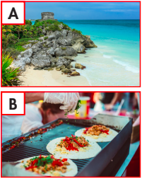
Task a. Read the travel guide for Mexico and match the pictures (A–D) with the paragraphs numbered (1– 4).

Slide 10
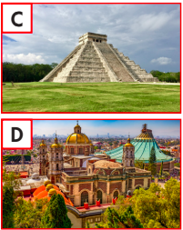
Task a. Read the travel guide for Mexico and match the pictures (A–D) with the paragraphs numbered (1– 4).

Slide 11
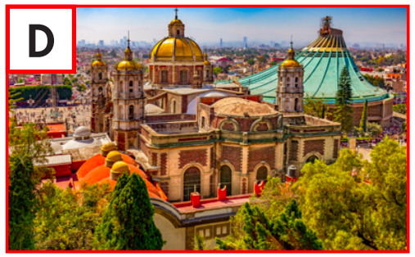
1. Explore Mexico City. This capital city is incredibly rich in history and culture. You can spend days exploring amazing historic sites and museums and admiring the architecture styles from various periods.
D
historic sites
architechture styles
ANSWERS

Slide 12
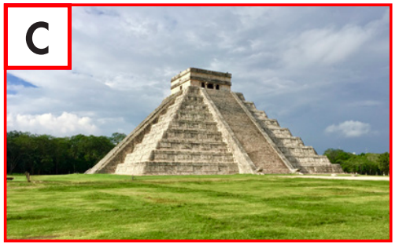
2. Be amazed at the sight of Chichén Itzá. This ancient Maya city is incredible. At the center of it is El Castillo. Scientists believe it's a giant Maya calendar with 365 steps, one for each day of the year.
C
ancient
365 steps
ANSWERS

Slide 13
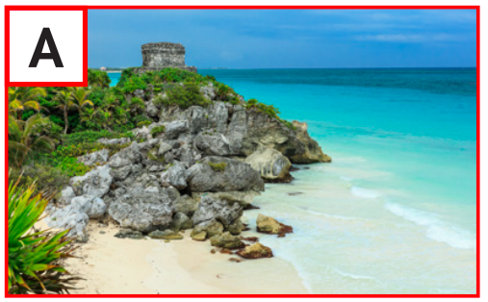
3. Relax on Tulum beaches. This amazing town has it all – lovely white sand, clear waters, and impressive Maya structures. They're part of the only Maya city by the sea.
A
white sand
impressive structure
clear waters
ANSWERS

Slide 14
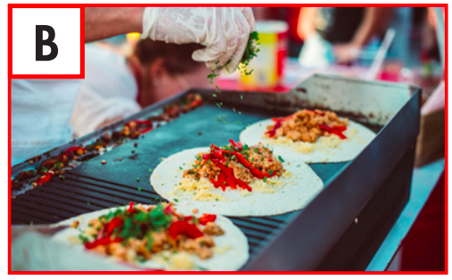
4. Fill yourself with Mexican food. As you walk along the streets of Mexico, take in the incredible smell of food and the sound of cooking all around you. There, you'll find the best tacos, tamales, tostadas, and so much more.
B
smell of food
tacos
sound of cooking
tamales
tostadas
ANSWERS

Slide 15
Listen and repeat. Click on each phrase to hear the sound.
admire (v) /ədˈmaɪər/ chiêm ngưỡng
ancient (adj) /ˈeɪnʃənt/ cổ xưa
fascinating (adj) /ˈfæsəneɪtɪŋ/ hấp dẫn, quyến rũ
impressive (adj) /ɪmˈpresɪv/ ấn tượng
mouth-watering (adj) /ˈmɑʊθˌwɔtərɪŋ/ thơm ngon,
bắt mắt
refreshing (adj) /rɪˈfreʃɪŋ/ sảng khoái
sight (n) /saɪt/ cảnh đẹp, thắng cảnh
Notes:
GV click vào từng cụm nghe âm thanh

Slide 16
Listen and repeat. Click on each phrase to hear the sound.
thrilling (adj) /ˈθrɪlɪŋ/ li kì, kịch tính
various (adj) /ˈveriəs/ khác nhau, đa dạng
Notes:
GV click vào từng cụm nghe âm thanh

Slide 17
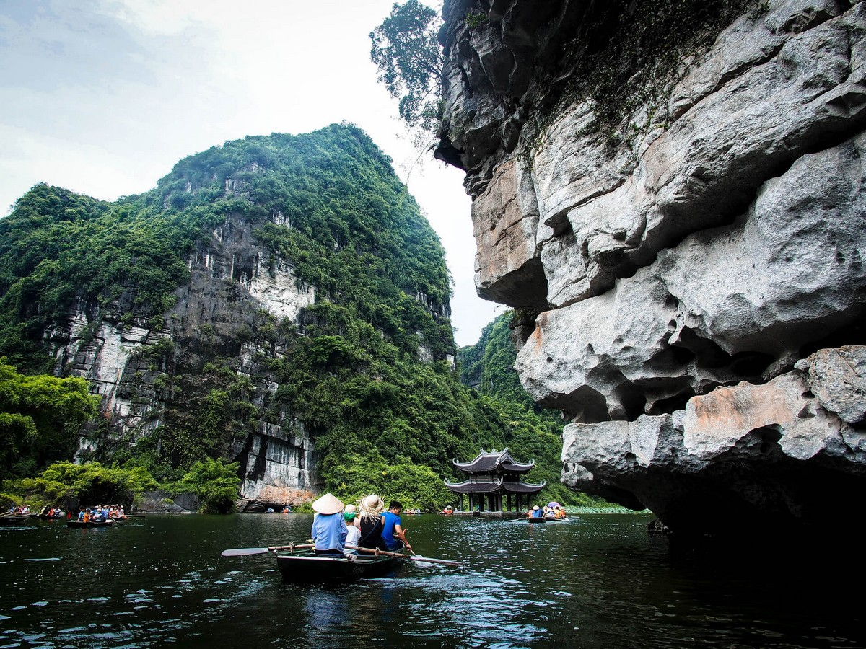
Ninh Binh is a place to admire when coming to Vietnam.

Slide 18
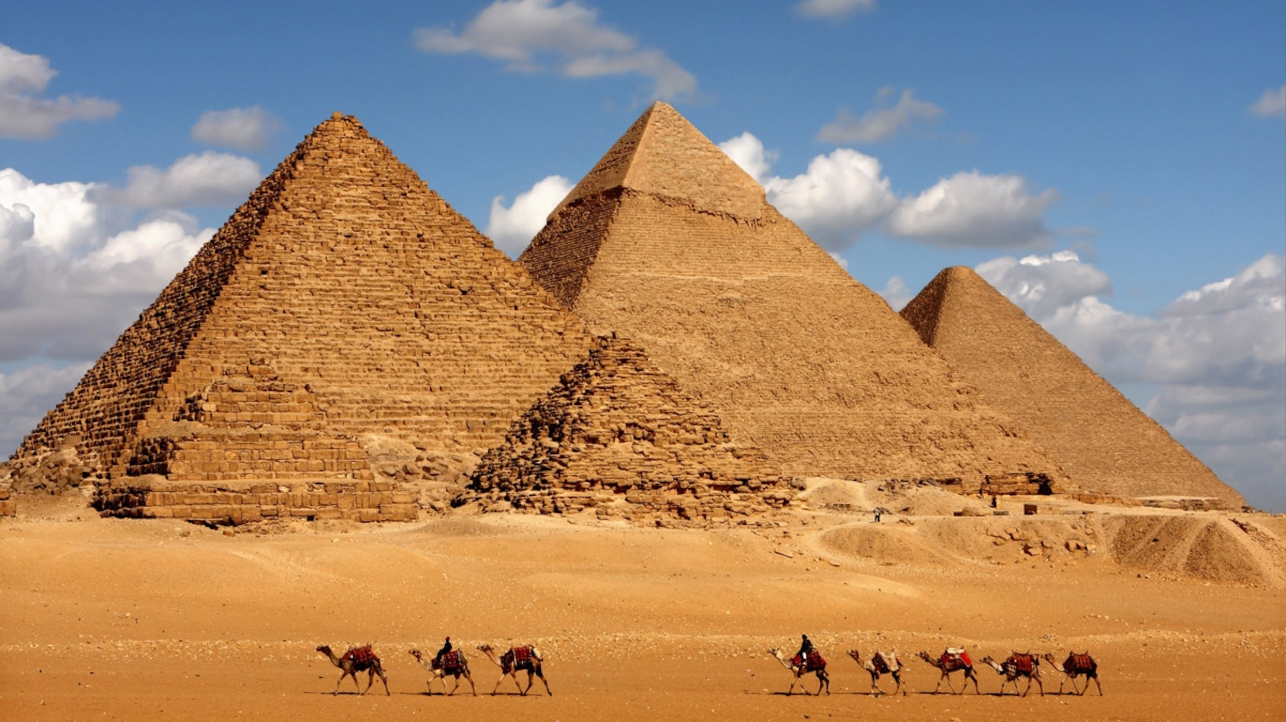
2.The pyramids in Egypt are ancient pyramids that have existed for a long time.

Slide 19
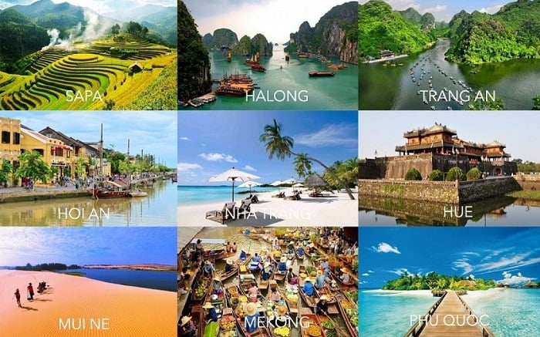
3.Phu Quoc Island is fascinating tourist destination I want to visit.

Slide 20
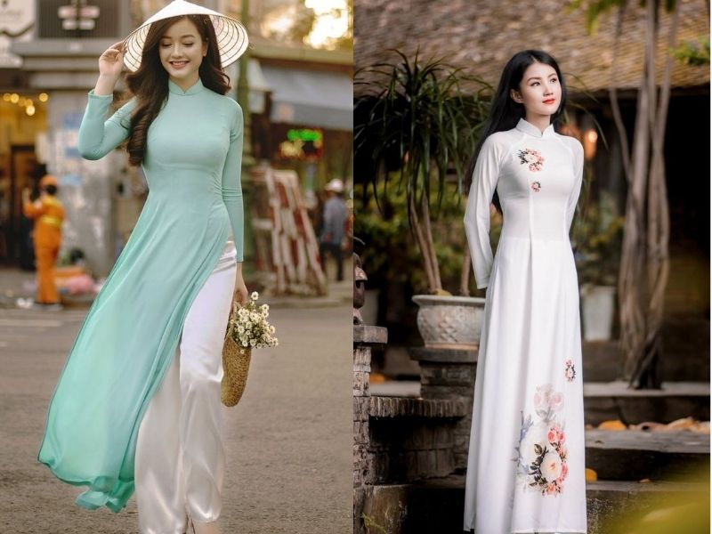
4. Ao dai is a traditional outfit that leaves impressive on international friends.

Slide 21
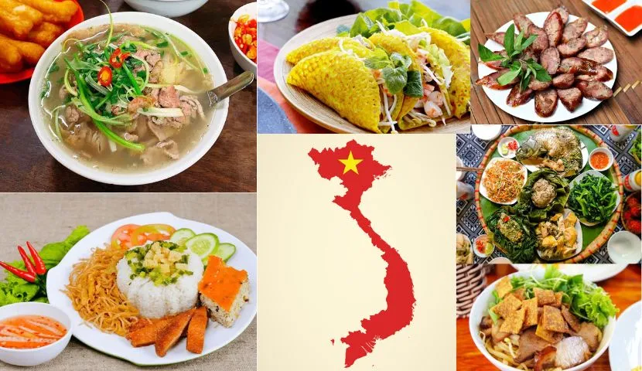
5. Vietnamese food surprises visitors with its mouth-watering.

Slide 22
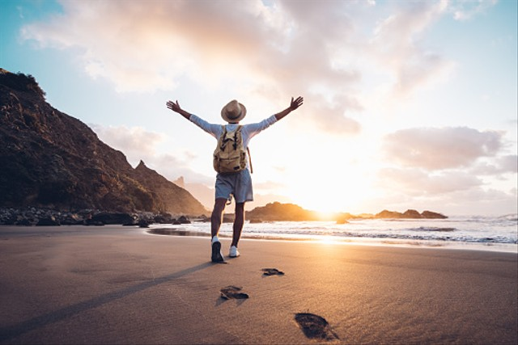
6. Get up early in the morning to watch the sunrise with a refreshing cup of coffee.

Slide 23
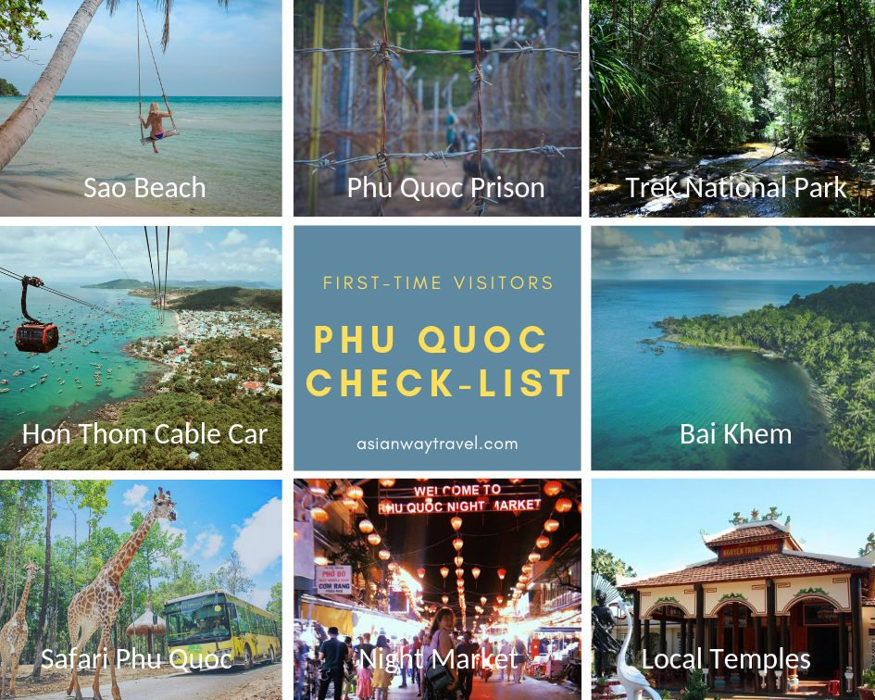
7. Phu Quoc Island is known as a place with many sights.

Slide 24
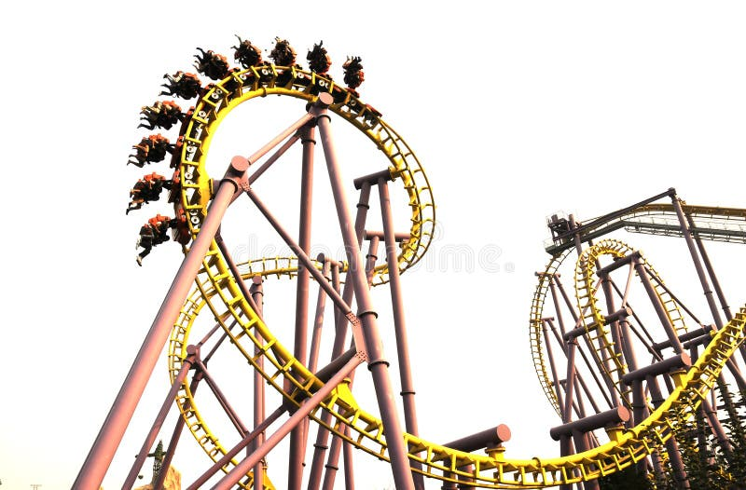
8. Let's go to the lotus pond where there are thrilling and adventurous games.

Slide 25
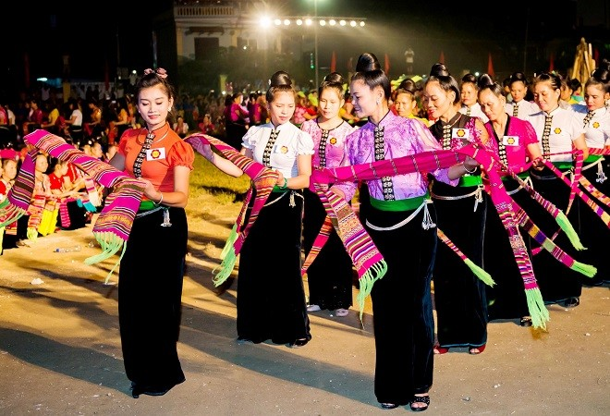
9. Each country has various traditions .

Slide 26
While-reading

Slide 27
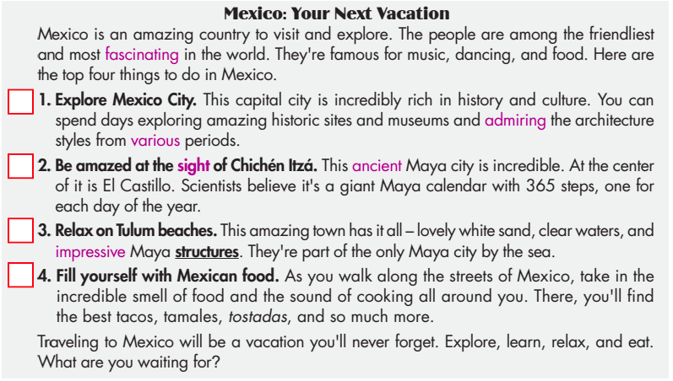

Slide 28
Now, read and choose the correct answers.
Task b

Slide 29
ANSWERS
Now, read and choose the correct answers.
Task b
1. According to the guide, what can you do in Mexico City? A. learn about history B. explore the nature
C. see ancient castles D. watch famous plays
Explore Mexico City. This capital city is incredibly rich in history and culture.

Slide 30
ANSWERS
Now, read and choose the correct answers.
Task b
2. What do experts think El Castillo is?
A. the old capital city B. an ancient calendar
C. Mexico's oldest garden D. a stone palace
At the center of it is El Castillo. Scientists believe it's a giant Maya calendar with 365 steps, one for each day of the year.

Slide 31
ANSWERS
Now, read and choose the correct answers.
Task b
3. Which word is closest in meaning to the word structures in the passage?
A. sentences B. machines
C. buildings D. statues
This amazing town has it all – lovely white sand, clear waters, and impressive Maya structures. They're part of the only Maya city by the sea.

Slide 32
ANSWERS
Now, read and choose the correct answers.
Task b
4. Where can you find the best food in Mexico?
A. in Mexico City B. at El Castillo
C. at small restaurants D. on the streets
As you walk along the streets of Mexico, take in the incredible smell of food and the sound of cooking all around you.

Slide 33
ANSWERS
Now, read and choose the correct answers.
Task b
5. Which of the following is NOT a Mexican food?
A. tulum B. tamales
C. tostadas D. tacos
There, you'll find the best tacos, tamales, tostadas, and so much more.

Slide 34
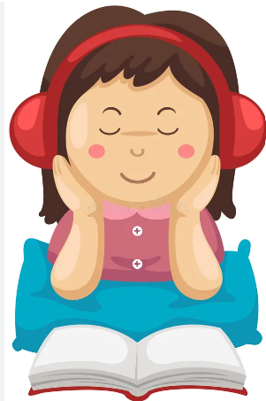
Task c
Listen and read

Slide 35
Post-reading

Slide 36
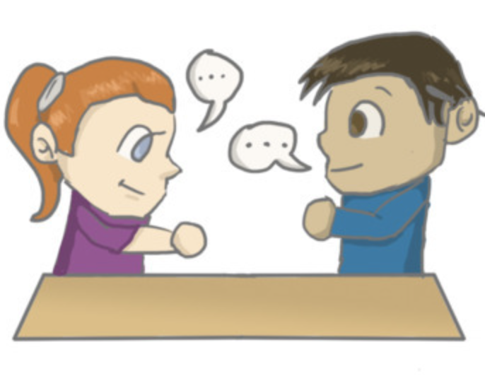
In pairs: Ask and answer:
1. What else do you know about Mexico?
2. What would you like most about visiting it?
Task d

Slide 37
Sample answer
What else do you know about Mexico? What would you like most about visiting it?
Traditional Mexican music includes genres such as mariachi, banda, and ranchera. Dance forms like salsa, cumbia, and the folkloric ballet are also significant cultural expressions.

Slide 38
Extra Practice
Optional

Slide 39
Extra practice - WB
Task a. . Listen to Dung talking to her friend about a trip she went on. What does she mainly discuss?
1. things you should take with you
2. things to do there

Slide 40
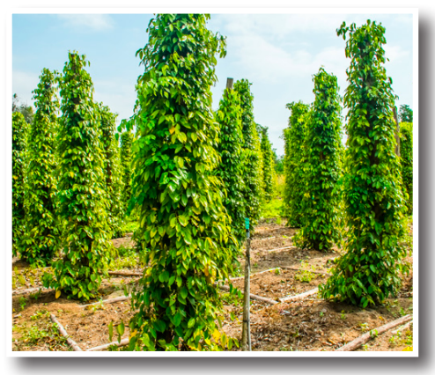
Task b. Now, listen and answer the questions.
1. What food does Dung suggest eating at the night market? ___________________________
2. What does the sand on Sao Beach look like? ___________________________
3. What does Trang like doing on vacation? ___________________________
4. What can visitors to the forests see? ___________________________
5. What is Phú Quốc famous for? ___________________________

Slide 41
Task b. Now, listen and answer the questions.
ANSWERS
1. What food does Dung suggest eating at the night market? ___________________________
seafood
Dung: Oh, wow. Well, you should visit the busy night market at Dương Đông. The seafood is absolutely delicious.

Slide 42
Task b. Now, listen and answer the questions.
ANSWERS
2. What does the sand on Sao Beach look like? ___________________________
ice cream
Dung: If you like relaxing by the sea, then Sao Beach is the best. The sand is so soft and white that it looks like ice cream.

Slide 43
Task b. Now, listen and answer the questions.
ANSWERS
3. What does Trang like doing on vacation? ___________________________
hiking
Trang: That does sound great, but on vacation, I prefer hiking to going to the beach.

Slide 44
Task b. Now, listen and answer the questions.
ANSWERS
4. What can visitors to the forests see? ___________________________
fascinating wildlife
Dung: There are plenty of mountains, too. You can go hiking in the forests with a tour guide and see lots of fascinating wildlife.

Slide 45
Task b. Now, listen and answer the questions.
ANSWERS
5. What is Phú Quốc famous for? ___________________________
pepper
Dung: Well, you could visit one of the impressive pepper gardens. You can walk through the green pepper trees. It's so calming. Phú Quốc is famous for its pepper. It's the best in the world.

Slide 46
Task b. TAPESCRIPT
Trang: Hi, Dung. How was your trip to Phú Quốc?
Dung: Oh, hi, Trang. It was amazing!
Trang: That's great. I'm going there next month. It'll be my first time.
Dung: Oh, wow. Well, you should visit the busy night market at Dương Đông. The seafood is absolutely delicious.
Trang: I love tasty seafood. What else can I do there?
Dung: If you like relaxing by the sea, then Sao Beach is the best. The sand is so soft and white that it looks like ice cream.
Trang: That does sound great, but on vacation, I prefer hiking to going to the beach.

Slide 47
Task b. TAPESCRIPT
Dung: There are plenty of mountains, too. You can go hiking in the forests with a tour guide and see lots of fascinating wildlife.
Trang: Oh, that's awesome. Is there anything else I should do while I'm there?
Dung: Well, you could visit one of the impressive pepper gardens. You can walk through the green pepper trees. It's so calming. Phú Quốc is famous for its pepper. It's the best in the world.
Trang: Thanks, Dung. It sounds like there's lots to do in Phú Quốc.

Slide 48
Task a. Read the travel guide for Malaysia. What is the main idea?
1. Information on the weather and things you shouldn't do
2. Information on the people and what to do, see, and eat

Slide 49
Malaysia is a fascinating country to visit and explore. Malaysians are famous for their mix of different cultures living together: Malay, Chinese, and Indian. The country has delicious food and amazing places to visit. Here are the top four things to do.
1. Explore Kuala Lumpur
This capital city has a rich history and amazing architecture. You can go to the top of the huge Petronas Towers and view the incredible city.
2. Relax on Penang beaches.
This amazing area has the most impressive beaches in Malaysia. There are also lots of historical buildings, so you can spend days sightseeing.

Slide 50
3. Enjoy Malaysian food
You might gain some weight because there are so many tasty Malaysian dishes. Make sure you try nasi lemak and ayam percik on your visit. You won't be disappointed.
4. Be amazed by Batu Caves
You can admire the huge gold Murugan Statue outside the caves first. Then, you can see inside these natural wonders. There are many caves, but the Temple Cave is the most famous.
You will remember your trip to Malaysia forever. In fact, you'll want to visit again to do all the things you didn't have time for!

Slide 51
Answer and clues:
1. Information on the weather and things you shouldn't do
2. Information on the people and what to do, see, and eat
Malaysians are famous for their mix of different cultures living together: Malay, Chinese, and Indian. The country has delicious food and amazing places to visit. Here are the top four things to do.

Slide 52
Task b. Now, read again and write True, False, or Doesn't say.
1. Malaysian people are from the same culture. ______________
2. Kuala Lumpur is the capital city of Malaysia. ______________
3. Penang has impressive temples you can visit. ______________
4. The food in Malaysia is quite disappointing. ______________
5. The Temple Cave is the best known cave at Batu Caves. ______________

Slide 53
ANSWERS
False
1. Malaysian people are from the same culture. ___________
Malaysians are famous for their mix of different cultures living together: Malay, Chinese, and Indian.

Slide 54
ANSWERS
2. Kuala Lumpur is the capital city of Malaysia. ___________
True
Explore Kuala Lumpur This capital city has a rich history and amazing architecture. You can go to the top of the huge Petronas Towers and view the incredible city.

Slide 55
ANSWERS
Doesn't say
3. Penang has impressive temples you can visit. ___________
This amazing area has the most impressive beaches in Malaysia. There are also lots of historical buildings, so you can spend days sightseeing.

Slide 56
ANSWERS
False
4. The food in Malaysia is quite disappointing. ____________
You might gain some weight because there are so many tasty Malaysian dishes. Make sure you try nasi lemak and ayam percik on your visit. You won't be disappointed.

Slide 57
ANSWERS
5. The Temple Cave is the best known cave at Batu Caves. _____________
True
You can admire the huge gold Murugan Statue outside the caves first. Then, you can see inside these natural wonders. There are many caves, but the Temple Cave is the most famous.

Slide 58
CONSOLIDATION

Slide 59
Talk to your partner about a country you know.

Slide 60
Sample answers
Thailand is a country that many people admire for its beauty and culture. It is home to ancient temples that tell the story of its long history. The bustling cities and serene beaches make it a fascinating place to visit. The Grand Palace in Bangkok is especially impressive with its stunning architecture.
One of the best things about Thailand is its food. The mouth-watering dishes like Pad Thai and Tom Yum soup are famous worldwide. After a hot day exploring, a refreshing coconut drink is perfect.
There are many sights to see in Thailand. The beautiful islands and national parks offer thrilling adventures. You can see various animals and plants that are unique to this region.

Slide 61
WRAP-UP

Slide 62
Today’s lesson
Vocabularies
1. admire 2. ancient 3. fascinating 4. impressive 5. mouth-watering 6. refreshing
7. sight
8. thrilling
9. various

Slide 63
Today’s lesson
Vocabulary:
- Learn vocabulary to describe a country.
Reading:
- Practicing reading for details.

Slide 64
Homework
Review vocabulary and use them to make sentences
Prepare for the next lesson (Speaking & Writing - page 43 - SB)
Play the consolidation games on www.eduhome.com.vn

Slide 65
Lesson 3
Stay positive and have a nice day!

