Slide 1
Unit 4: Tourism
Lesson 2.2: Grammar
Pages 39 & 40

Slide 2
Lesson Outline
Warm-up
Presentation
Practice
Production
Consolidation
Wrap-up

Slide 3
By the end of this lesson, students will be able to…
Practice and use Could and wh-words before to-infinitives.
Make conversations about things in your town or city.

Slide 4
WARM-UP

Slide 5
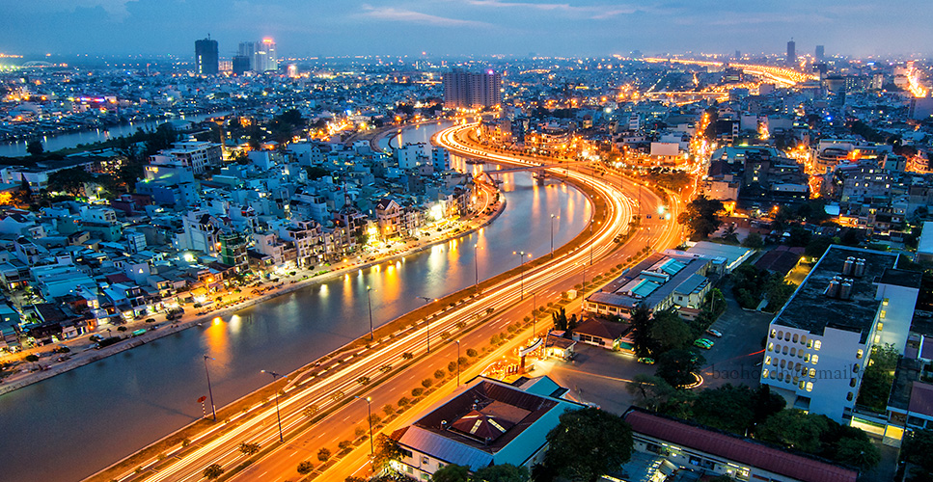
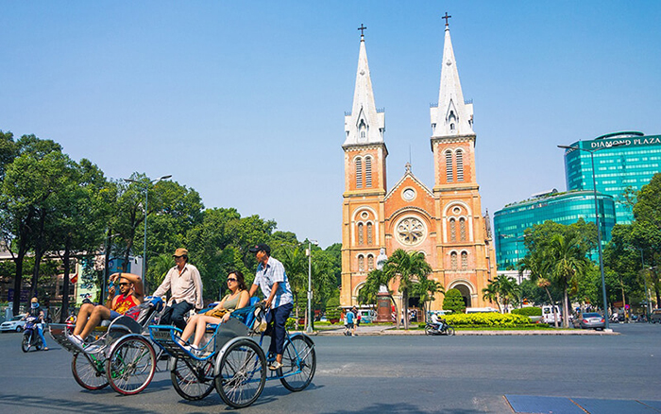
If you could travel, which country would you go to? Why?

Slide 6
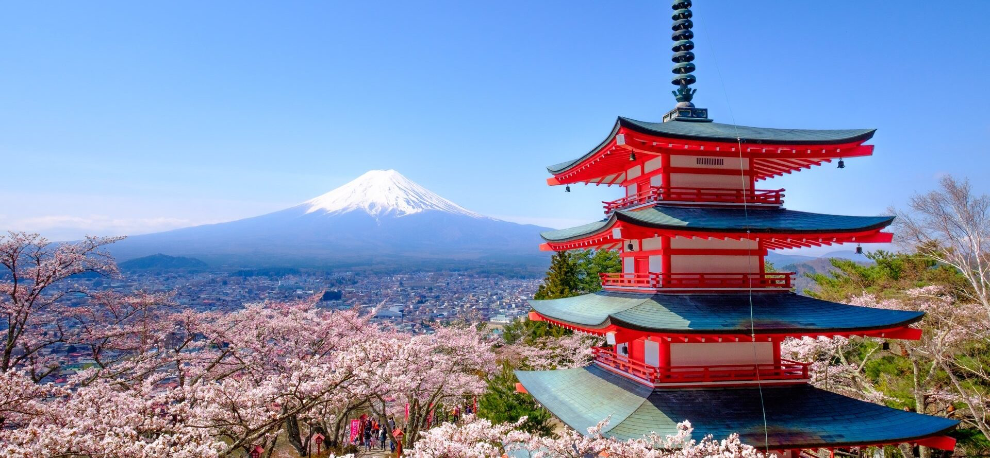
Suggested Answer
If I could travel, I would go to Japan to experience its rich culture, incredible cuisine, and stunning natural beauty.

Slide 7
Presentation

Slide 8
We can use could to make polite requests.
We can use it with Wh-words and with Wh-words + to-infinitives to ask indirect questions.
We use tell for information and show for instructions.
Could + you tell/show me + Wh-word + subject + verb?
Presentation

Slide 9
Could you tell me when the mall opens?
Could you show me what room I'm staying in?
Could you tell me who the manager is?
Could you show me where the swimming pool is?
Could you tell me how much the train costs?
Presentation

Slide 10
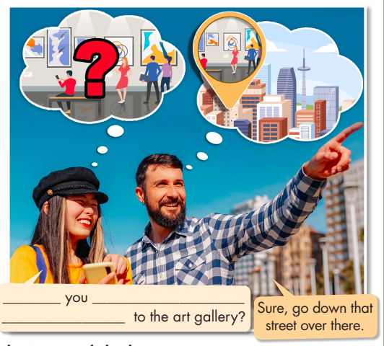
Task a. Read about could and wh-words before to-infinitives, then fill in the blanks.
Presentation

Slide 11
Task b. Listen and check. Listen again and repeat.
Presentation
Could
show me how
to get

Slide 12
Could + you tell/show me + wh-word + to-infinitive?
Could you show me how to get to the museum?
Could you tell me where to buy a SIM card?
Could you tell me what to bring for the trip?
Could you tell me when to leave for the airport?
Could you show me who to talk to about the tour?
Presentation

Slide 13
Practice

Slide 14
Task c. Write questions using the prompts.
1. Could/tell me/where/get/SIM card?
Could you tell me where to get a SIM card?
2. Could/tell me/where/nearest/restaurant is?
3. Could/show me/how/book/spa?
4. Could/tell me/how much/pay/the tour guide?
5. Could/show me/who/ask/about/booking/trip?
6. Could/tell me/when/gallery/open?

Slide 15
Answers
1. Could/tell me/where/get/SIM card? ___________________________________________
2. Could/tell me/where/nearest/restaurant is? ___________________________________________
3. Could/show me/how/book/spa? ___________________________________________
Could you tell me where to get a SIM card?
Could you tell me where the nearest restaurant is?
Could you show me how to book the spa?

Slide 16
Answers
4. Could/tell me/how much/pay/the tour guide? ___________________________________________
5. Could/show me/who/ask/about/booking/trip? ___________________________________________
6. Could/tell me/when/gallery/open? ___________________________________________
Could you tell me how much to pay the tour guide?
Could you show me who to ask about booking a trip?
Could you tell me when the gallery opens/will open?

Slide 17
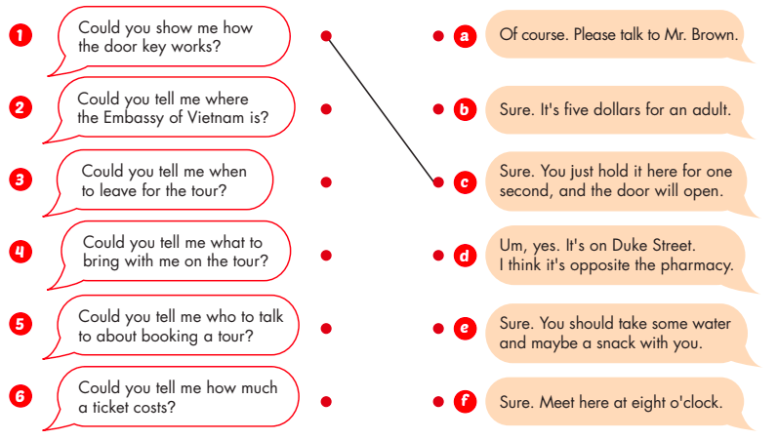
Task d. Match the questions to the responses.

Slide 18
Answers
1. c
2. d
3. f
4. e
5. a
6. b

Slide 19
Extra practice
Presentation

Slide 20
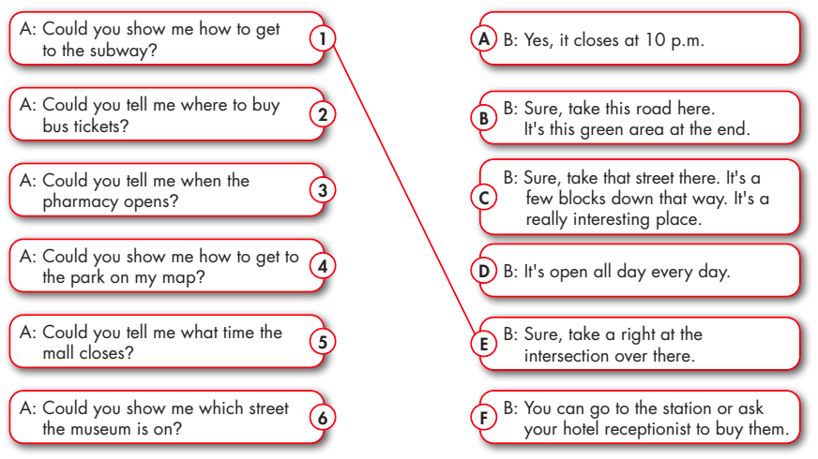
Extra Practice – WB, P 23
Task a. Draw lines to match the questions to the correct answers.
Presentation
Production

Slide 21
Suggested answers
Presentation
Production

Slide 22
Suggested answers
1. E (Speaker B shows Speaker A the intersection to take using "there".)
2. F (Speaker B tells Speaker A how to buy bus tickets.)
3. D (Speaker B tells Speaker A about the opening hours.)
4. B (Speaker B shows Speaker A the way to get to the park on the map.)

Slide 23
Suggested answers
5. A (Speaker B tells Speaker A about the closing hours.)
6. C (Speaker B shows Speaker A the street it's on using "there" and comments that it's an interesting place.)

Slide 24
Production

Slide 25
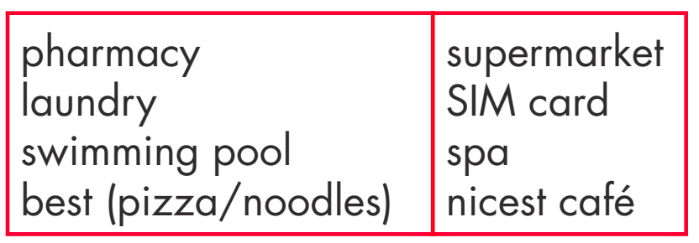
Task e. In pairs: Ask and answer questions about things in your town or city using could with wh-words.

Slide 26
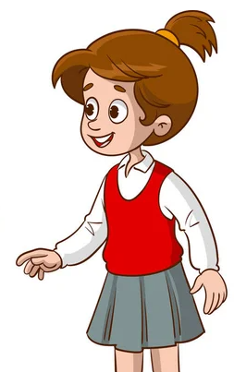
Suggested answers
Could you tell me how to get to the pharmacy?
Sure. Go straight and then turn left on Spring Street.

Slide 27
Suggested answers
Could you tell me how to get my laundry done?
Sure. Leave it outside your door in the morning.

Slide 28
Suggested answers
Could you show me where the swimming pool is?
Sure. Please follow me.

Slide 29
Suggested answers
Could you tell me where the best noodles are?
Sure. Go to Mama's Phở.

Slide 30
CONSOLIDATION

Slide 31
Ask and answer the question about places you could visit and what to see there, using “Could and wh-words before to-infinitives” to give reasons.

Slide 32
Suggested answers
You could go to Paris and see the Eiffel Tower, the Louvre Museum, and Notre-Dame Cathedral.
I will travel to France next month. Could you tell me where to go and what to see there?

Slide 33
WRAP-UP

Slide 34
Today’s lesson
Grammar:
Practice and use Could and wh-words before to-infinitives.
Speaking:
Make conversations about things in your town or city.

Slide 35
Homework
Review Could and wh-words before to-infinitives.
Prepare for the next lesson (Pronunciation & Speaking - pages 40 & 41 - SB).
Play the consolidation games on www.eduhome.com.vn

Slide 36
Lesson 3
Stay positive and have a nice day!

