Slide 1
Unit 4: Tourism
Lesson 1.3: Pronunciation & Speaking
Pages 36 & 37

Slide 2
Lesson Outline
Warm-up
Pronunciation
Speaking
Consolidation
Wrap-up

Slide 3
By the end of this lesson, students will be able to…
Practice stress the last word in proper nouns with two words.
Practice planning a vacation.

Slide 4
WARM-UP

Slide 5
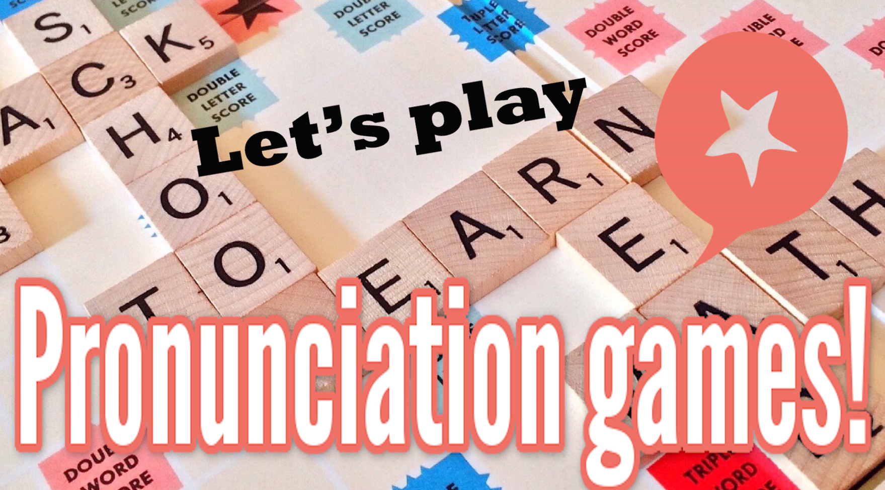
COMPETITION TIME:
Create groups/teams of 5 students.
You will be given some English words with unusual stressed syllables.
You have to underline the stress syllable(s) in these words.
The team(s) with the most correct answers win(s).
Time limit: 5 minutes

Slide 6
Example:
Tourist
Answer: Tourist
/ˈtʊərɪst/

Slide 7
Destination
Passport
Visa
Permit
Customs
Transportation
Accommodation
Itinerary
Etiquette
Currency

Slide 8
Answers
Destination /destiˈneiʃən/
Passport /ˈpaːspoːt/
Visa /ˈviːzə/
Permit /pəˈmit/
Customs /ˈkʌstəmz/
Transportation /ˌtrænspəˈteɪʃən/
Accommodation/əˌkoməˈdeiʃən/
Itinerary/aiˈtinərəri/
Etiquette/ˈetiket/
Currency/ˈkɜ:rənsi/

Slide 9
Pronunciation

Slide 10
Task a
a. Stress the last word in proper nouns with two words.

Slide 11
Task b

Slide 12
Task c

Slide 13
Task c
Answer

Slide 14
Task d
Read the words with the sentence stress noted in Task a. to a partner.
Effel Tower Central Park
Hyde Park National Monument
Opera House

Slide 15
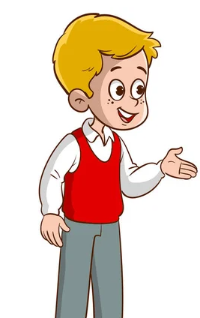
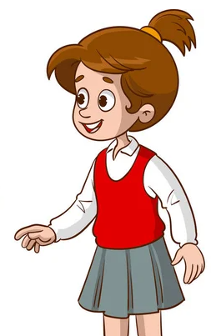
Task a
In pairs: Take turns reporting the suggestions.

Slide 16
Example

Slide 18
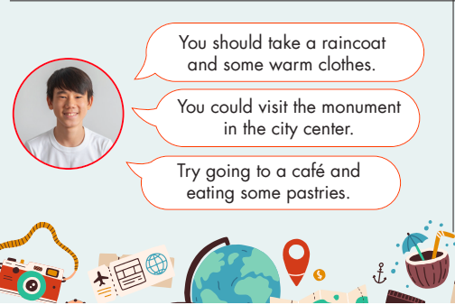

Slide 19
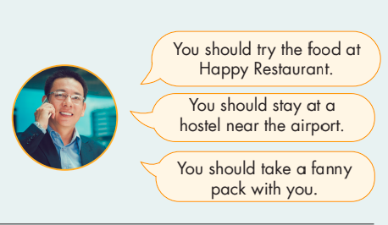

Slide 20
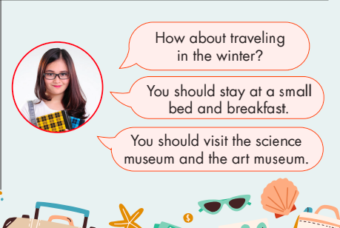

Slide 21
Task a
Now, role-play the conversations in front of the class.

Slide 22
She said that I should travel between May and July.
She suggested that I visit Hyde Park.
She said that I should take a socket adapter.
Suggested answer
That’s a good idea.

Slide 23
He said that I should take a raincoat and some warm clothes.
He suggested that I visit the monument in the city center.
He said that I should try going to a caffe and eating some pastries.
Suggested answer
That’s a good idea.

Slide 24
He said that I should try the food at Happy Restaurant.
He suggested that I stay at a hostel near the airport.
He said that I should take a fanny pack with me.
Suggested answer
That’s a good idea.

Slide 25
She said that I should traveling in the winter.
She suggested that I stay at a small bed and breakfast.
She said that I should visit the science museum and the art museum.
Suggested answer
That’s a good idea.

Slide 26
Task b
Use your own ideas to make similar suggestions to your partner about famous places in your country, then report your partner's suggestions to another student.

Slide 27
Task b
Now role-play your conversations in front of the class.

Slide 28
Task b
Suggested answers
How about traveling to Korea?
You should go to Jeju Island to see the beautiful scenery there.
You should wear Korean traditional costumes.

Slide 29
Task b
Suggested answers
He said that I should travel to Korea.
How about traveling to Korea?
He suggested that I go to Jeju Island to see the beautiful scenery there.
You should go to Jeju Island to see the beautiful scenery there.
He said that I should wear Korean traditional costumes
You should wear Korean traditional costumes.

Slide 30
Presentation
Speaking

Slide 31
Task a
a. You're planning a trip to the UK with a friend and telling them about suggestions someone gave you. Choose who gave you the suggestions and complete the table with your own ideas.

Slide 32
Task a

Slide 33
Task a
my English teacher
Spring or early Autumn for mild weather
visit historical landmarks like Buckingham Palace
try traditional English breakfast with bacon, eggs,…
explore the picturesque villages of the Cotswolds
comfortable walking shoes, umbrella, and a camera
stay in a cozy bed and breakfast in the countryside
Example

Slide 34
Task b
In pairs: Report and discuss the suggestions.

Slide 35
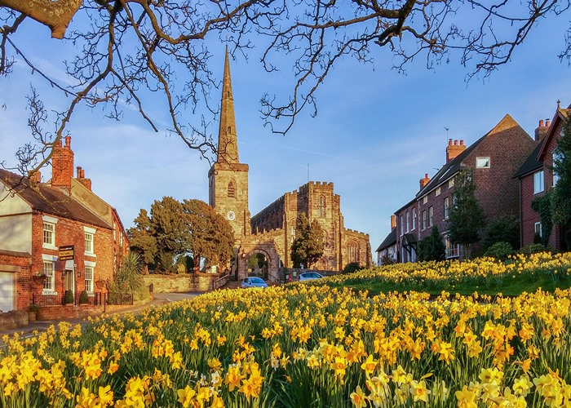
Task b
Suggested answer
My English teacher said we should travel Spring or early Autumn for mild weather.
What month should we travel?

Slide 36
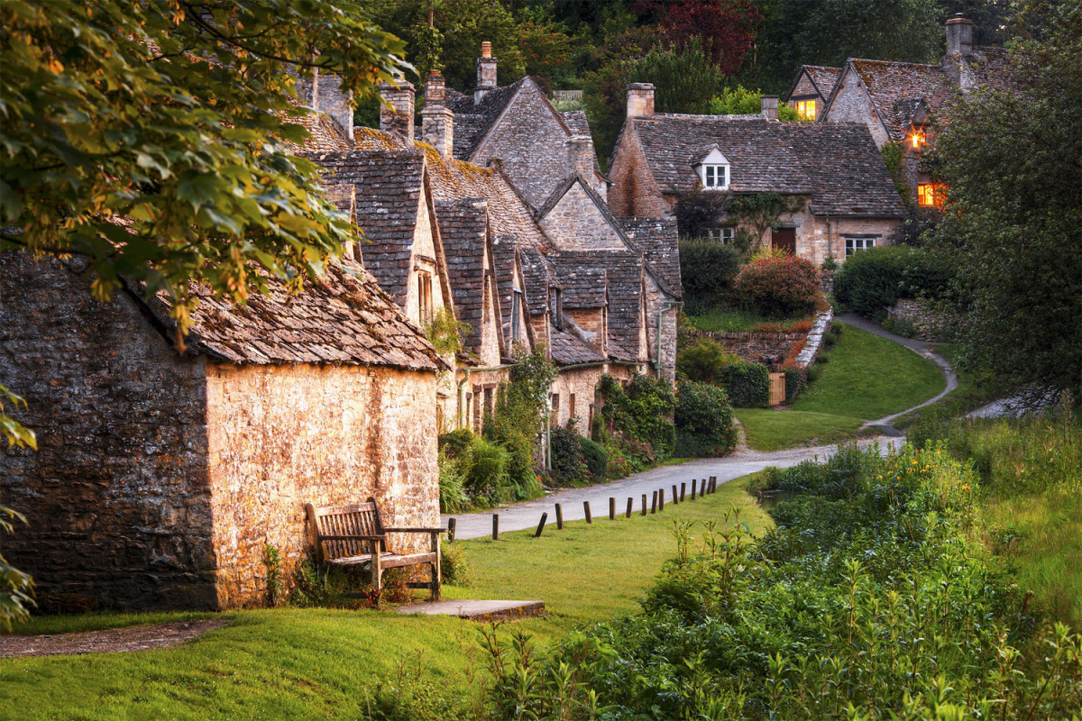
Task b
Suggested answer
He suggested that we explore the picturesque villages of the Cotswolds.
What places should we go to?

Slide 37
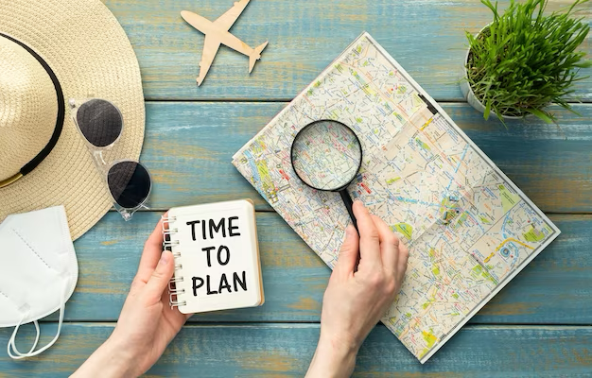
Task c
What do you think is the most important information to learn when planning a trip? Why?

Slide 38
Task c
What do you think is the most important information to learn when planning a trip? Why?
Destination: Know the location and main attractions of the place you want to visit. This helps you plan your activities.
Weather: Check the weather forecast for the time you will be there. This helps you pack the right clothes.
Example

Slide 39
Task c
What do you think is the most important information to learn when planning a trip? Why?
Transport: Learn how to get there and how to move around once you arrive. This includes flights, trains, buses, or other forms of transport.
Accommodation: Find a place to stay, like a hotel or an Airbnb. Make sure it is in a good location and fits your budget.
Example

Slide 40
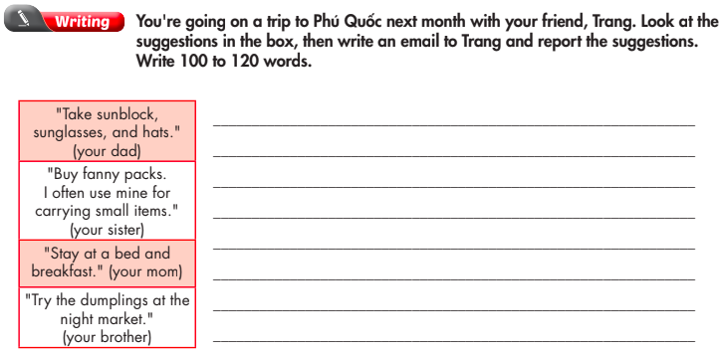
Extra practice - WB - page 21

Slide 41
Suggested answer
Hi Trang,
Are you excited for our trip to Phú Quốc? My family gave me some suggestions for our trip to Phú Quốc next month. My dad suggested we take sunblock, sunglasses, and hats with us because it's very sunny in Phú Quốc. My sister said we should buy fanny packs because they're useful for carrying small items. My mom suggested we stay in a bed and breakfast because it's nice and comfortable.

Slide 42
Suggested answer
My brother said we should try the dumplings at the night market. He said they were delicious.
What do you think about these ideas? Let me know what you think. I can't wait for our trip!
Bình

Slide 43
CONSOLIDATION

Slide 44
Practice stressing the last word in those proper nouns.
Central Park
Golden Gate
Grand Canyon
Eiffel Tower
Great Wall
Bondi Beach
Niagara Falls
Red Square
Mount Everest
Time Square

Slide 45
WRAP-UP

Slide 46
Today’s lesson
Pronunciation:
Practice stress the last word in proper nouns with two words.
Speaking:
Practice planning a vacation.

Slide 47
Homework
Practice sentence stress in the Pronunciation(SB).
Prepare for the next lesson (Vocabulary & Listening - pages 38 & 39 - SB).
Play the consolidation games on www.eduhome.com.vn

Slide 48
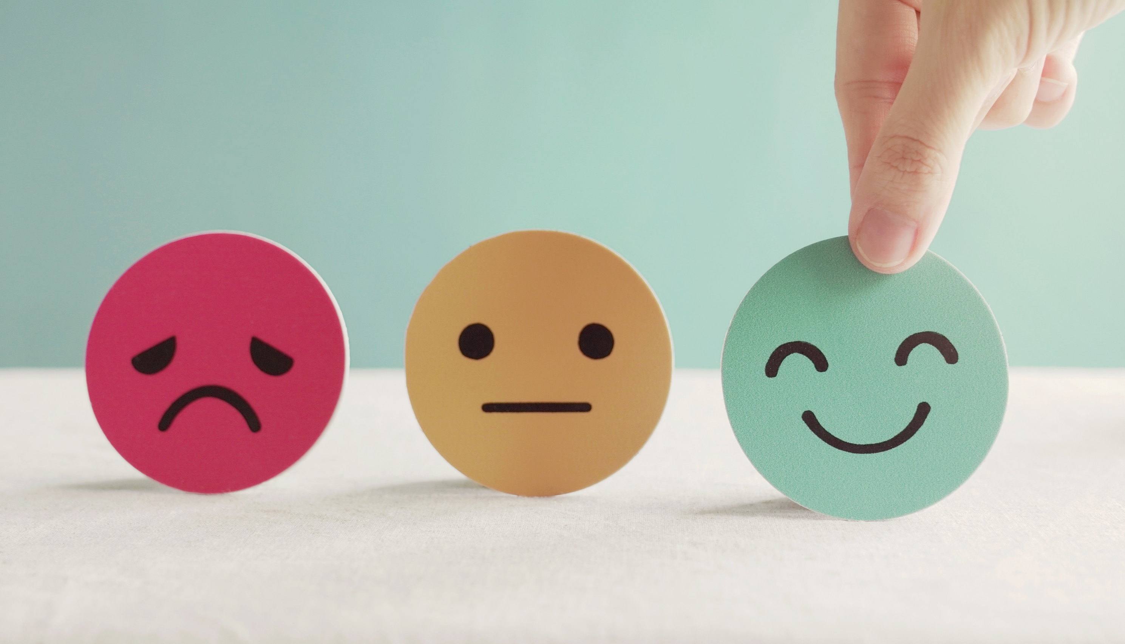
Lesson 3
Stay positive and have a nice day!

