Slide 1
Unit 4: Tourism
Lesson 1.1: Vocab & Reading
Pages 34 & 35

Slide 2
Lesson outline
Warm-up
Vocabulary
Reading
Consolidation
Wrap-up

Slide 3
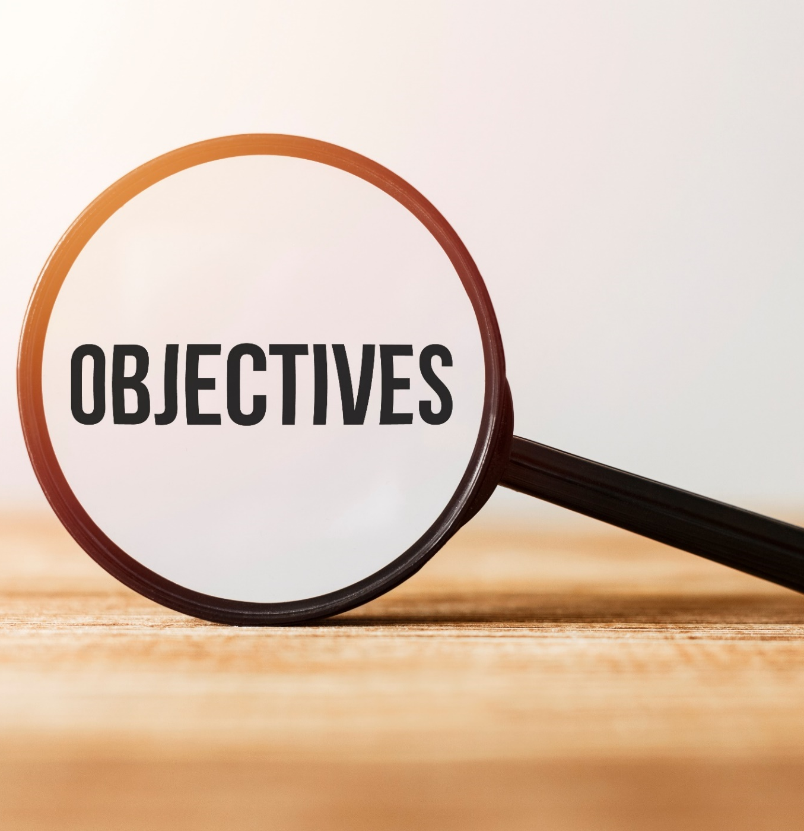
By the end of this lesson, students will be able to…
- learn and use nouns related to traveling.
- practice reading for details.

Slide 4
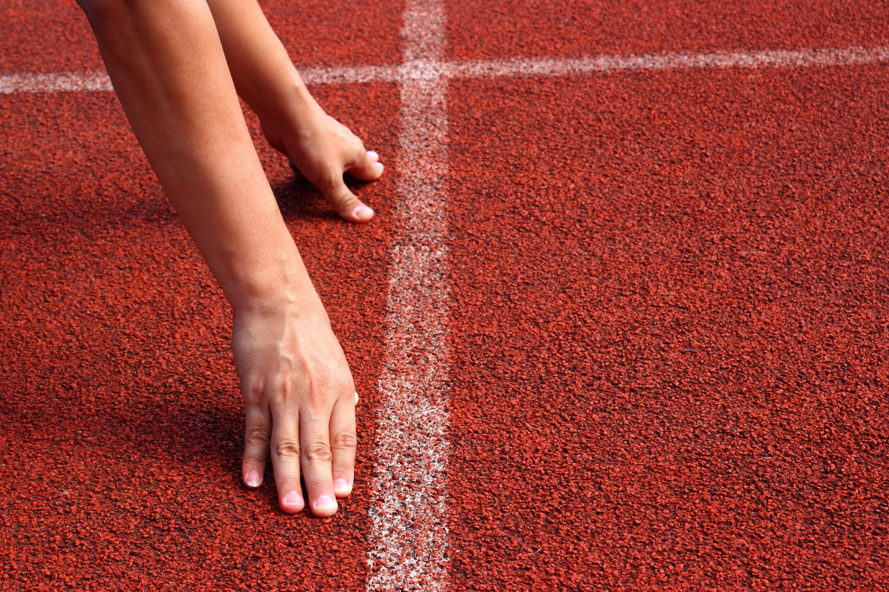
WARM-UP

Slide 5
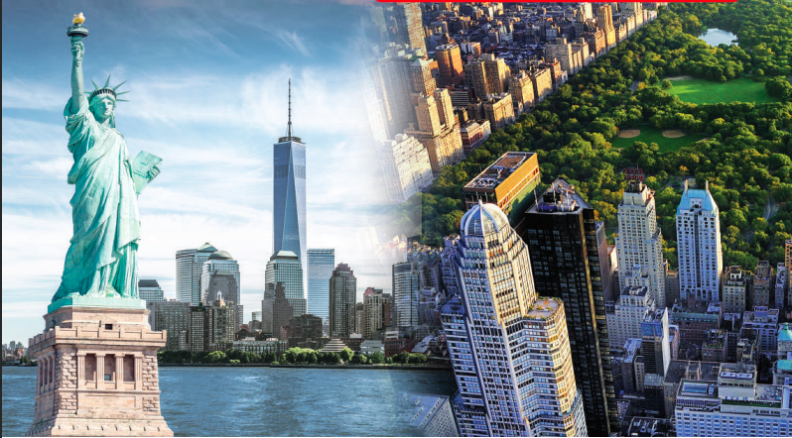
Work in pairs. Look at the pictures:
What famous city can you see?
Where would you most like to travel in the world?
What would you like to see there?

Slide 6
Suggested answers:
I see New York city.
I want to travel in the United States.
I want to see the Statue of Liberty.

Slide 7
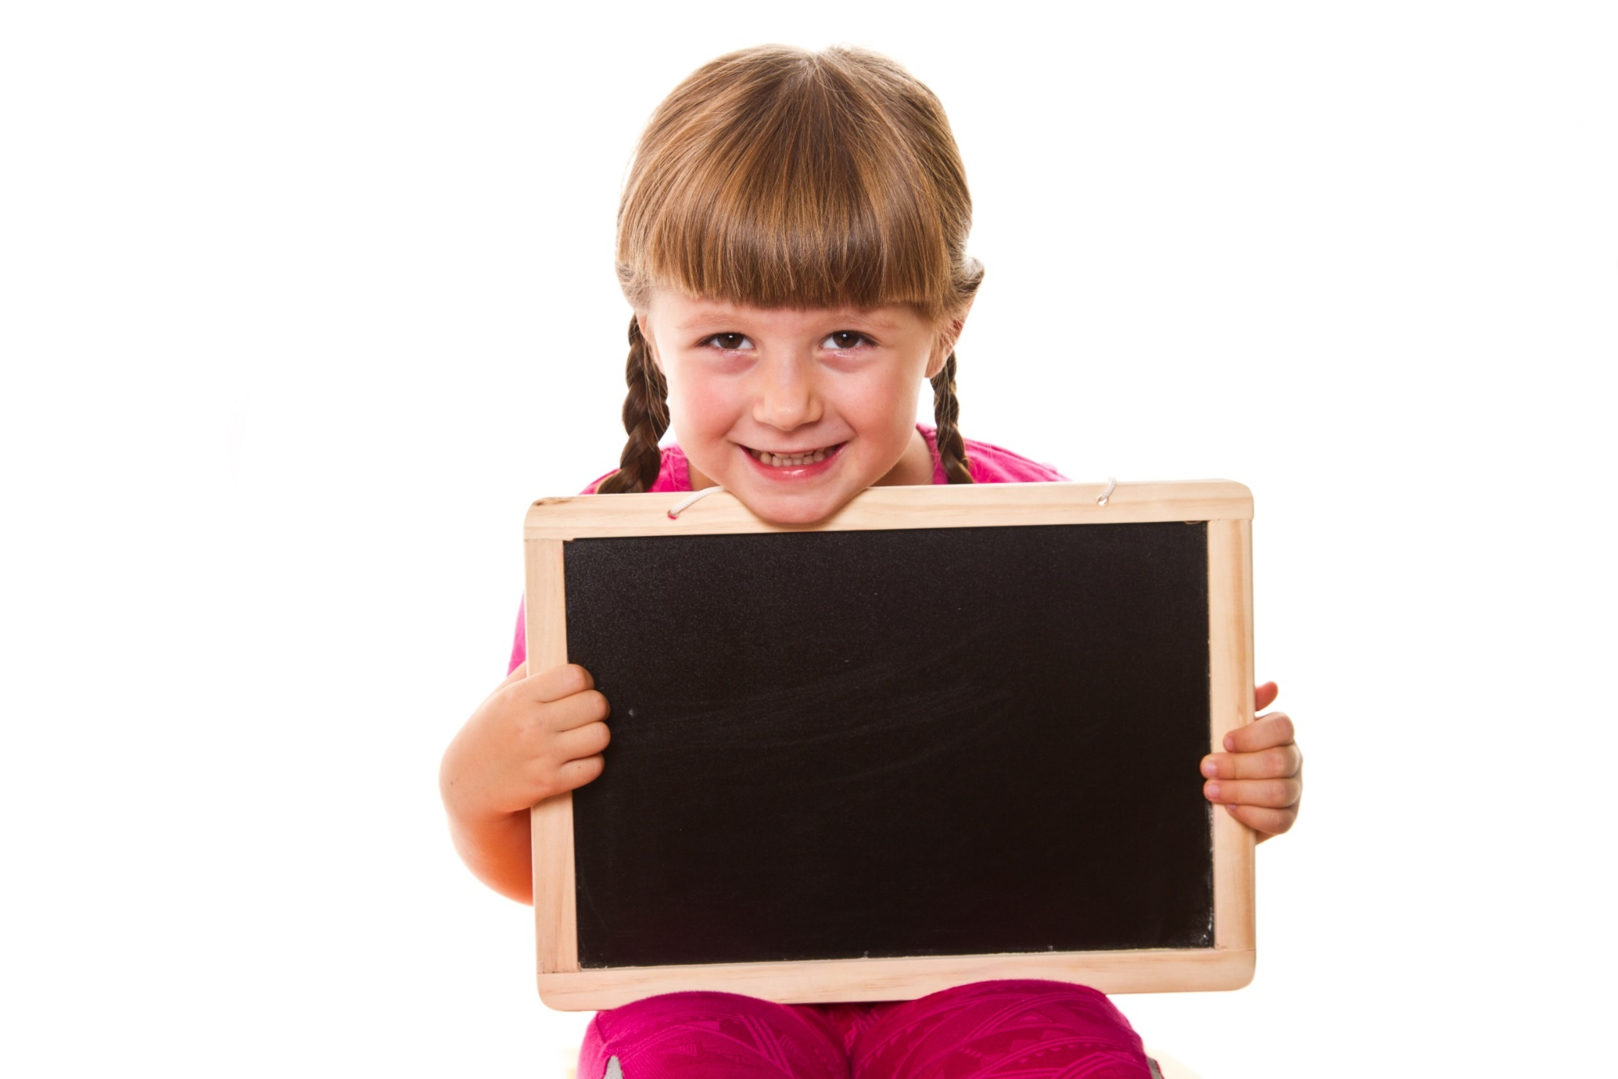
Pre-reading

Slide 9
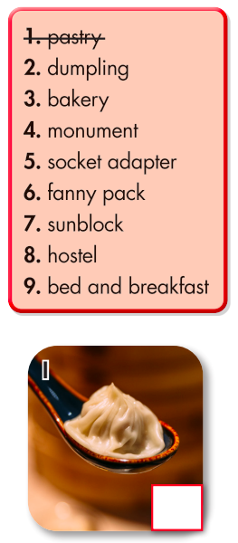
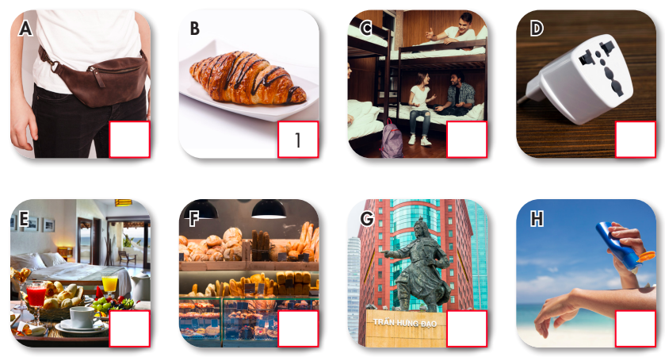
Task a. Number the pictures. Listen and repeat.

Slide 10
Now listen and check
6
8
5
9
3
4
7
2

Slide 11
Listen and repeat. Click on each phrase to hear the sound.
Bakery (n) /ˈbeɪkəri/ tiệm bánh
Bed and breakfast (n phr) /ˌbed ən ˈbrekfəst/ nhà trọ,
khách sạn kèm bữa sáng
Dumpling (n) /ˈdʌmplɪŋ/ sủi cảo, há cảo
Fanny pack(n phr) /ˈfæni ˌpæk/ túi bao tử
Hostel (n) /ˈhɑːstl/ nhà trọ, nhà nghỉ giá rẻ
Monument (n) /ˈmɑːnjəmənt/ tượng đài
Pastry(n) /ˈpeɪstri/ bánh ngọt, bánh bột nhào
Notes:
GV click vào từng cụm nghe âm thanh

Slide 12
Listen and repeat. Click on each phrase to hear the sound.
Socket adapter (n phr) /ˈsɑːkɪt əˈdæptər/ bộ chuyển đổi ổ
cắm điện
Sunblock (n) /ˈsʌnblɑːk/ kem chống nắng
Notes:
GV click vào từng cụm nghe âm thanh

Slide 13
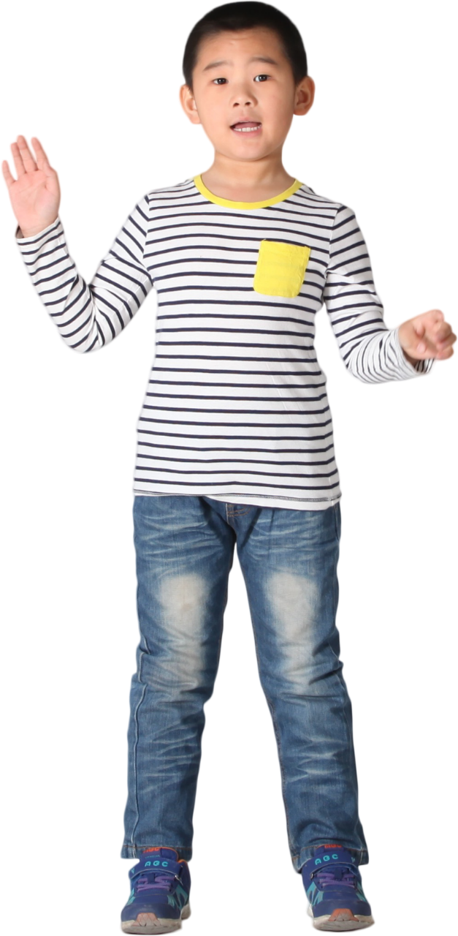
Task b. In pairs: Write the new words in the table and add more words you know. Use the new words to talk about your past vacations.

Slide 14
Task b. In pairs: Write the new words in the table and add more words you know. Use the new words to talk about your past vacations.
socket adapter
fanny pack,
sunblock,
phone charger
hostel, bed and breakfast hotel
pastry,
dumpling,
cake
bakery,
monument,
museum

Slide 15
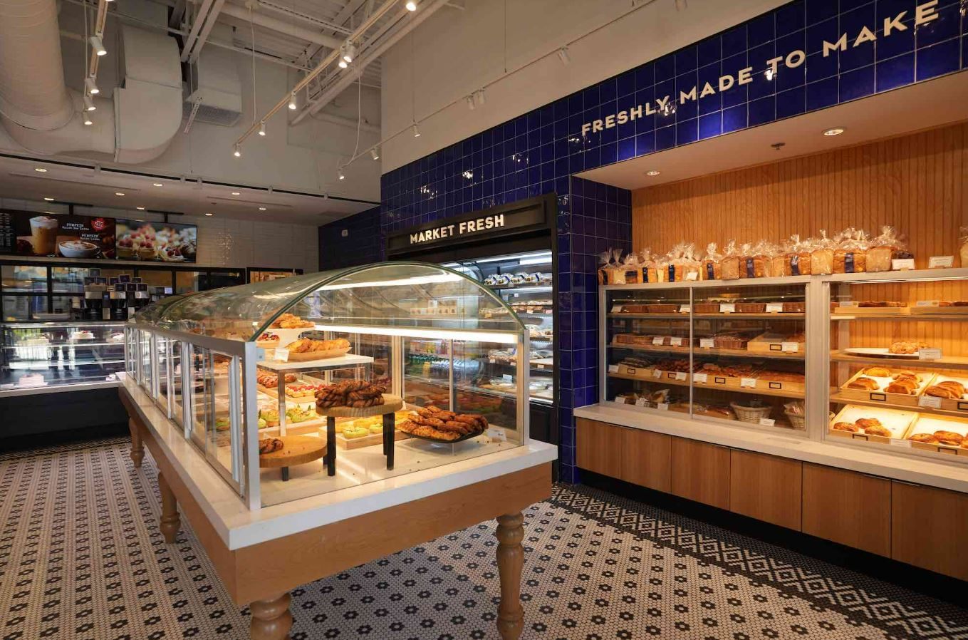
Suggested answer
I went to the bakery to buy some bread.

Slide 16
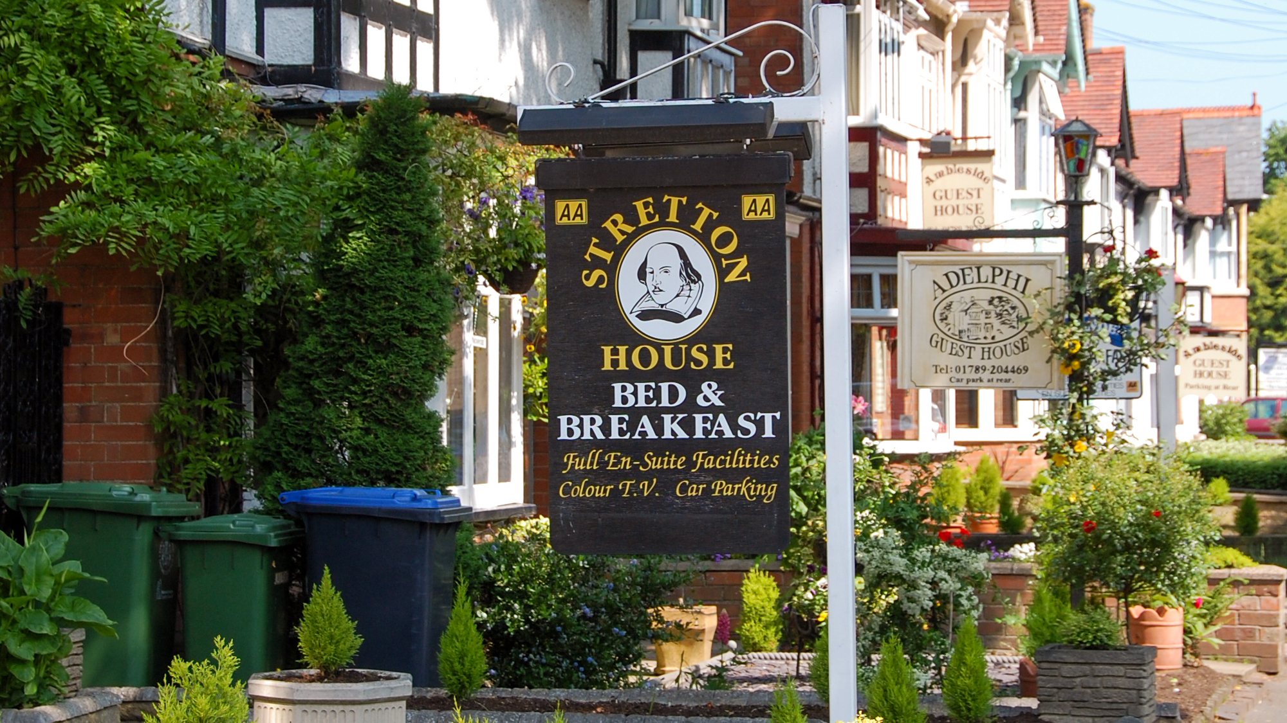
Suggested answer
2. At the bed and breakfast, I tried a homemade cake.

Slide 17
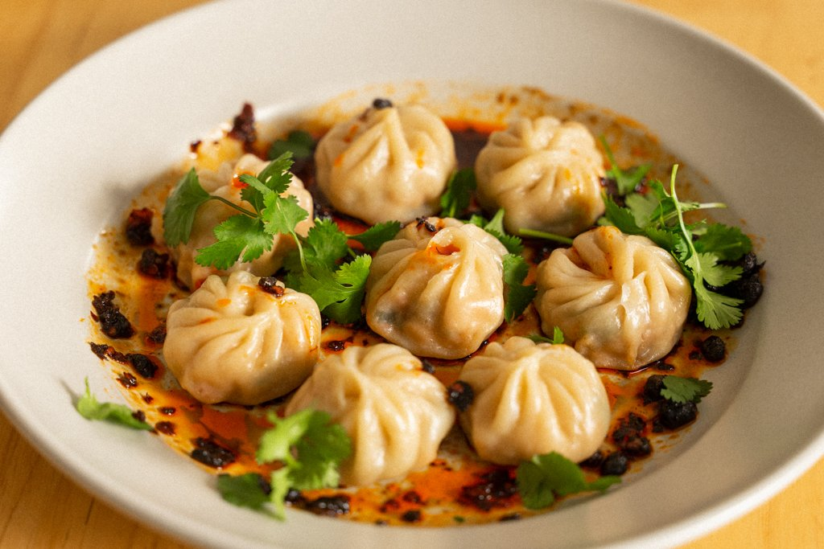
Suggested answer
3. My favorite meal was a dumpling I had at lunch.

Slide 18
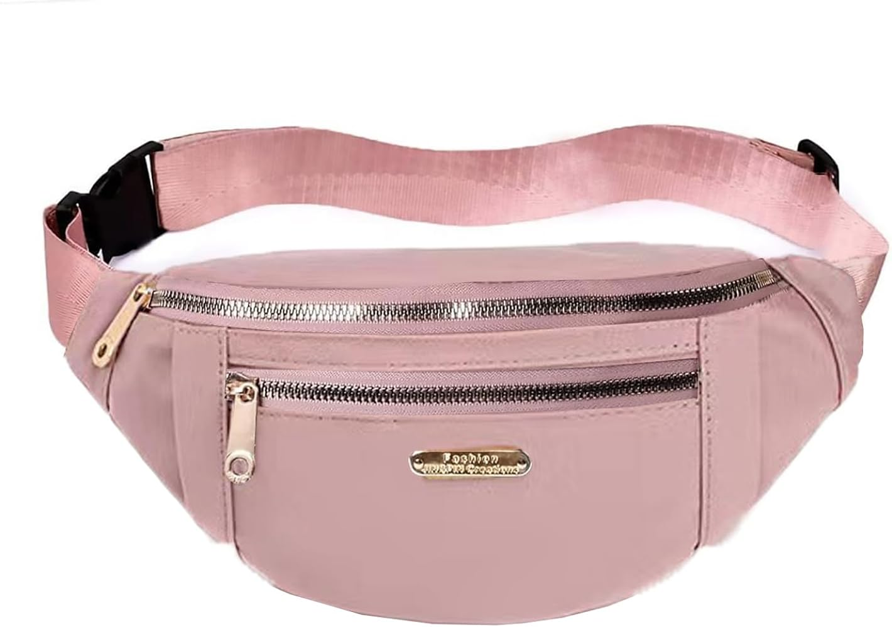
Suggested answer
4. I carried my phone charger in my fanny pack.

Slide 19
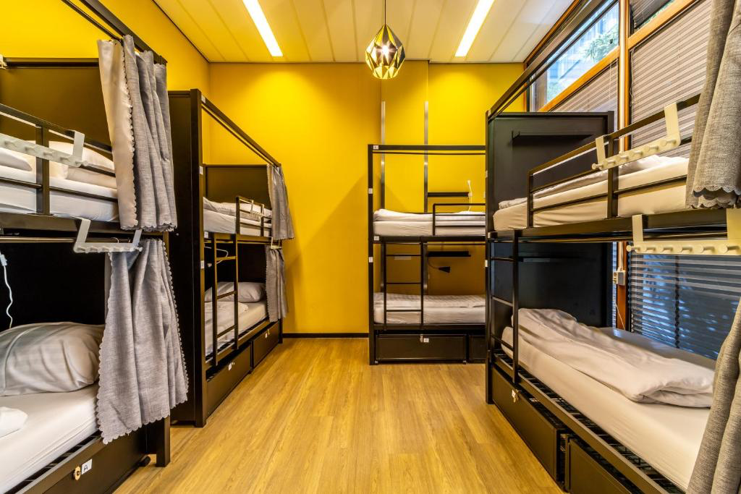
Suggested answer
5. The hostel we stayed was built 5 years ago.

Slide 20
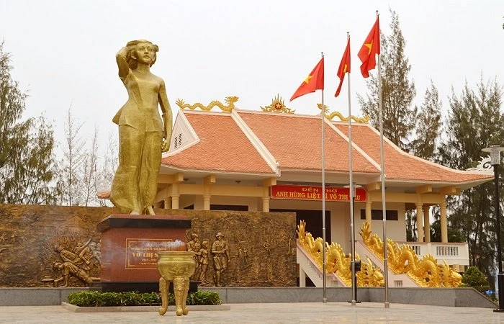
Suggested answer
6. I visited the monument of the hero Vo Thi Sau.

Slide 21
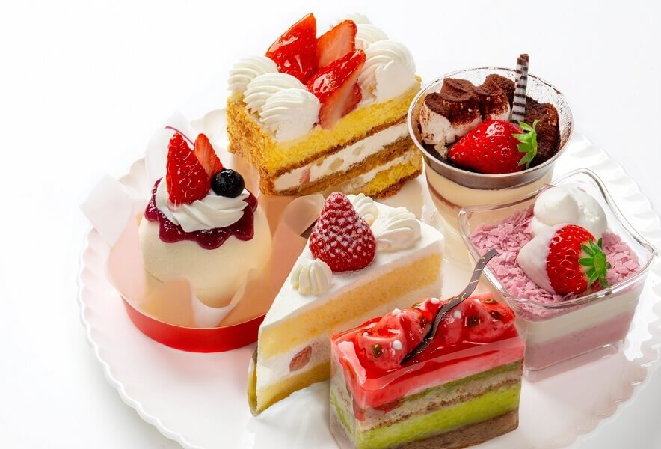
Suggested answer
7. I ate a lot of pastry after dinner.

Slide 22
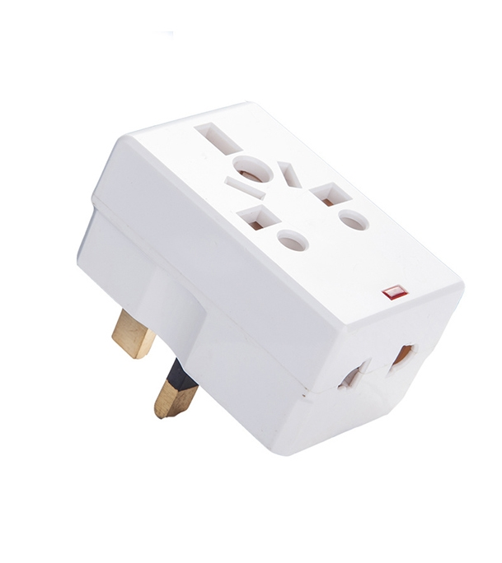
Suggested answer
9. I took a socket adapter to charge my devices.

Slide 23
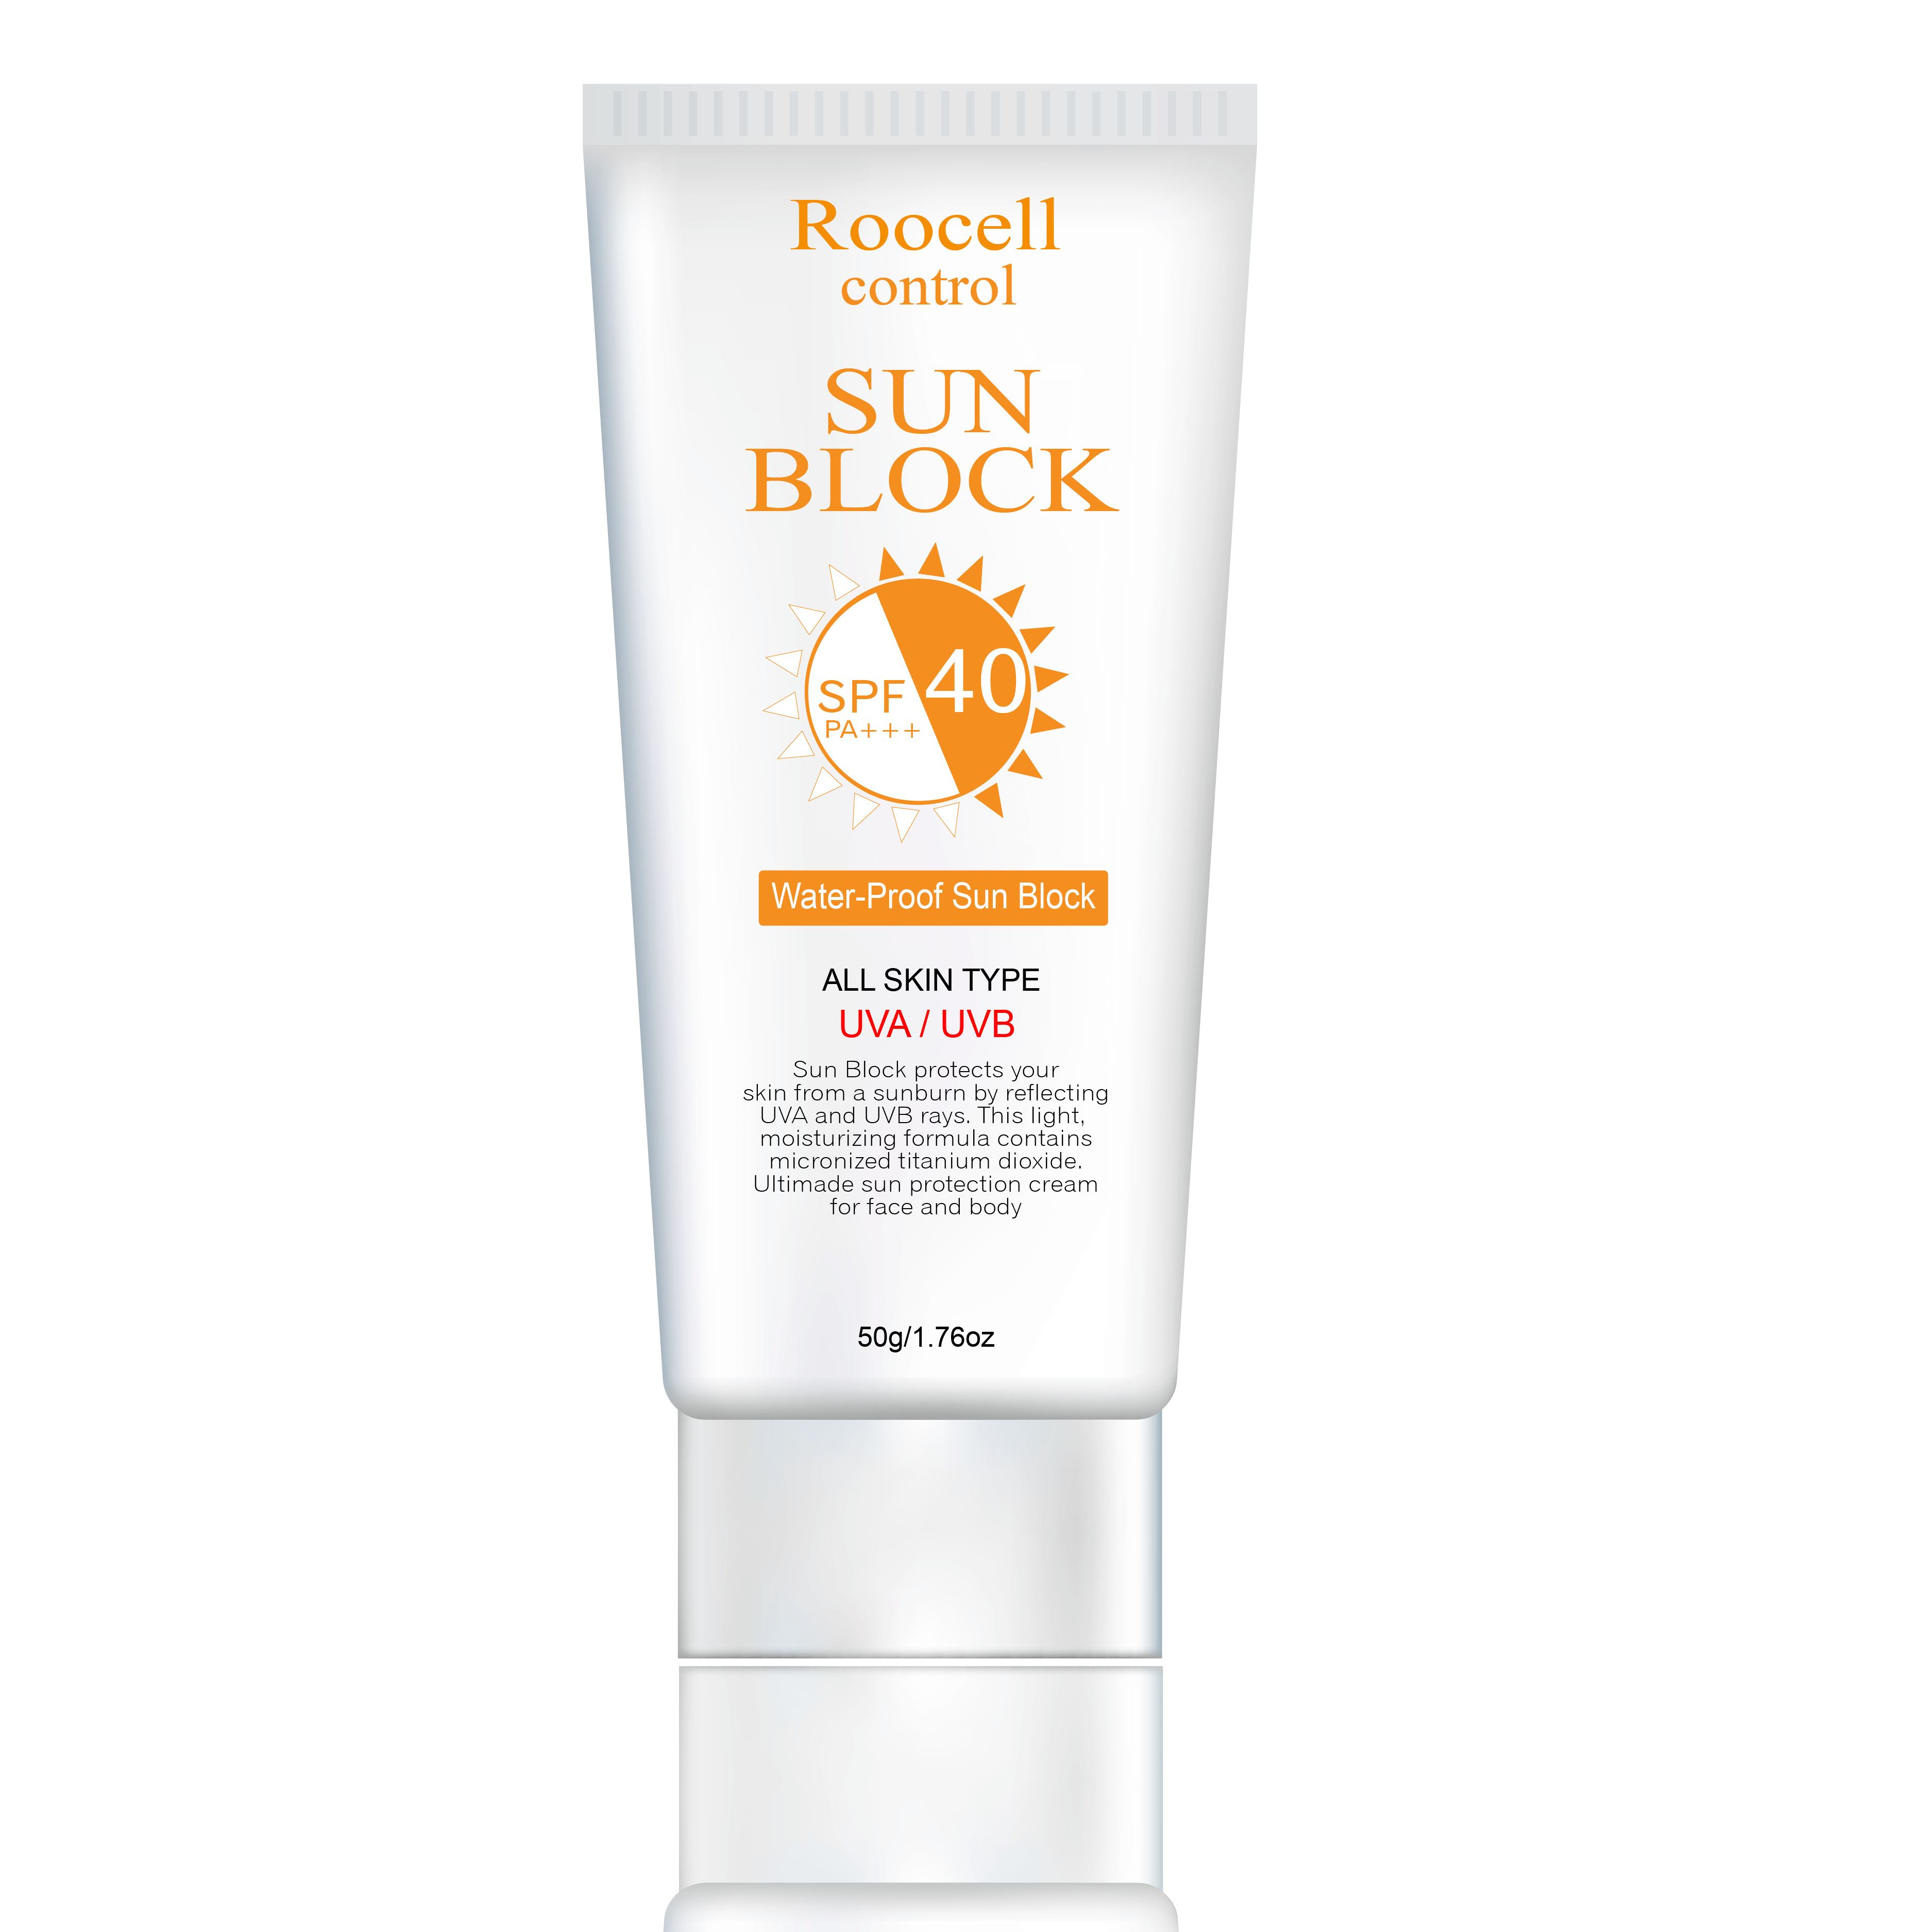
Suggested answer
10. I wore sunblock because it was sunny and hot.

Slide 24
While-reading

Slide 25
Read the email and choose the best subject line. 1. Last week's trip 2. Our trip to Paris! 3. What did you learn?
Task a

Slide 26
To: janegrunt@abcmail.com
Subject: ________________
Hey Jane,
My family gave me some great suggestions for the trip to Paris you and I are taking next year, and I wanted to tell you about them. My dad suggested we travel in October or April. He said it was less crowded at those times.
I think April will be the nicest because it will be sunny and warm. He also said we should visit the Eiffel Tower and the Louvre Museum. I thought that sounded pretty boring, so I asked my mom.

Slide 27
She suggested we visit Disneyland Paris. I think that sounds really fun. I love roller coasters. She also told me about some great places to eat such as Le Petit Paris Restaurant. It's expensive, but I heard it's amazing.
She also suggested we go to a bakery and try some pastries. She said they were really tasty.
Finally, my brother gave me some really useful advice. He suggested we take a socket adapter. They have different sockets in France. He also suggested we take a fanny pack to keep our things safe. I think it might be a good idea to take both.

Slide 28
What do you think? Did you find out anything interesting?
Speak to you soon,
Sabrina

Slide 29
ANSWERS
Read the email and choose the best subject line. 1. Last week's trip 2. Our trip to Paris! 3. What did you learn?
Task a

Slide 30
Clues
To: janegrunt@abcmail.com
Subject:________________________________________
Hey Jane, My family gave me some great suggestions for the trip to Paris you and I are taking next year, and I wanted to tell you about them. He said it was less crowded at those times. I think April will be the nicest because it will be sunny and warm.

Slide 31
Task b
Underline keywords in the following questions
When are they planning to travel to Paris?
What will the weather be like when Sabrina wants to go?
Which two places did Sabrina think were boring?
What restaurant did Sabrina's mom suggest?
What things did Sabrina's brother say they should take?

Slide 32
Task b
Now, read and write short answers.
When are they planning to travel to Paris? __________________________
What will the weather be like when Sabrina wants to go? __________________________
Which two places did Sabrina think were boring? __________________________
What restaurant did Sabrina's mom suggest? __________________________
What things did Sabrina's brother say they should take? __________________________

Slide 33
ANSWERS
Task b
Now, read and fill in the blanks.
1. When are they planning to travel to Paris? __________________________
next year
To: janegrunt@abcmail.com
Subject:________________________________________
Hey Jane, My family gave me some great suggestions for
the trip to Paris you and I are taking next year, and I wanted
to tell you about them.

Slide 34
ANSWERS
2. What will the weather be like when Sabrina wants to go? __________________________
sunny and warm
He said it was less crowded at those times. I think April will be the nicest because it will be sunny and warm.

Slide 35
ANSWERS
3. Which two places did Sabrina think were boring? ____________________________________
the Eiffel Tower and the Louvre Museum
He also said we should visit the Eiffel Tower and the Louvre Museum. I thought that sounded pretty boring, so I asked my mom.

Slide 36
ANSWERS
4. What restaurant did Sabrina's mom suggest? __________________________
Le Petit Paris Restaurant
She suggested we visit Disneyland Paris. I think that sounds really fun. I love roller coasters. She also told me about some great places to eat such as Le Petit Paris Restaurant.

Slide 37
ANSWERS
5. What things did Sabrina's brother say they should take? _________________________________
(a) socket adapter and (a) fanny pack
He suggested we take a socket adapter. They have different sockets in France. He also suggested we take a fanny pack to keep our things safe.

Slide 38
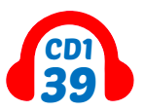
Task c
Listen and read

Slide 39
Post-reading

Slide 40
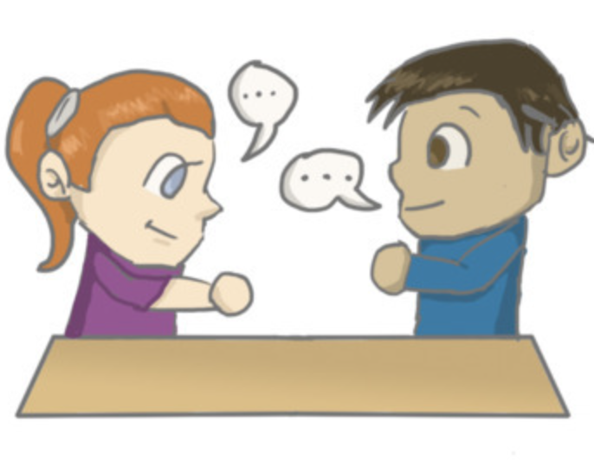
In pairs: Ask and answer:
Which do you think is the best suggestion Sabrina got from her family? Why? What other travel tips do you think they should know about?
Task d

Slide 41
Sample answer
Which do you think is the best suggestion Sabrina got from her family? Why?
The best suggestion she received from her family was to visit Disneyland Paris because that sounds really fun. Besides, Sabrina loves roller coasters.

Slide 42
Extra Practice
Optional

Slide 43
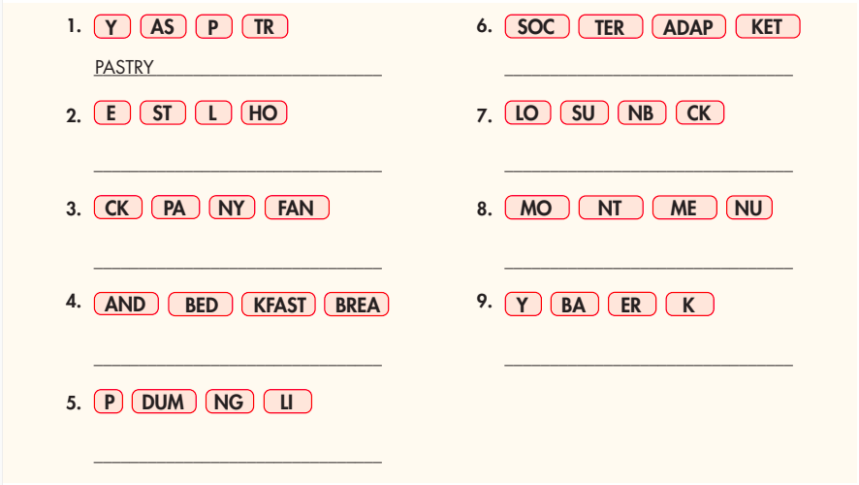
Extra practice - WB
Task a. Unscramble the groups of letters to make words.

Slide 44
SOCKET ADAPTER
HOSTEL
SUNBLOCK
FANNY PACK
MONUMENT
BED AND BREAKFAST
BAKERY
DUMPLING

Slide 45
Task a. . Read the email and tick the best subject line.

Slide 46
To: hoangnguyen@gmail.com
Subject:____________________________________________
Hi Hoàng, My family went to Tokyo a few years ago, and they gave me some suggestions for our trip next month with your aunt's family. My dad suggested we go to Ginza District and see the monuments there. He said he really liked the Hayakawa Noritsugu Statue. My sister loves food, and she said we should try some local dumplings. She also said the pastries in Japan were amazing, and she suggested we eat breakfast at a bakery. Do your aunt and uncle like pastries? Do you think they'd like my sister's idea?
My brother said we should take some important things with us so that

Slide 47
we don't have to buy them when we get there. He suggested we take fanny packs for carrying our valuables during the day. He also suggested taking sunblock with us because it's easier than buying it when we get there. He also said to take a socket adapter with us so that we can charge our phones and other devices as soon as we arrive. What do you think about my family's suggestions? I'm really looking forward to this trip! ☺
Chat soon.
Bình

Slide 48
Answer and clues:
Task a. . Read the email and tick the best subject line.
✔︎

Slide 49
Task b. Now, read and answer the questions.
Who suggested seeing monuments? __________________________________________
Where does Bình's sister think they should eat breakfast? __________________________________________
Who gave Bình advice about things to take on the trip? __________________________________________
What should they take with them instead of buying in Janpan? __________________________________________
What should they take with them for their devices? __________________________________________

Slide 50
ANSWERS
Who suggested seeing monuments?
__________________________________________
Bình's dad
My dad suggested we go to Ginza District and see the monuments there. He said he really liked the Hayakawa Noritsugu Statue.

Slide 51
ANSWERS
2. Where does Bình's sister think they should eat breakfast?
__________________________________________
at a bakery
My sister loves food, and she said we should try some local dumplings. She also said the pastries in Japan were amazing, and she suggested we eat breakfast at a bakery.

Slide 52
ANSWERS
3. Who gave Bình advice about things to take on the trip? __________________________________________
his brother
My brother said we should take some important things with us so that we don't have to buy them when we get there. He suggested we take fanny packs for carrying our valuables during the day.

Slide 53
ANSWERS
4. What should they take with them instead of buying in Janpan?
__________________________________________
sunblock
He suggested we take fanny packs for carrying our valuables during the day. He also suggested taking sunblock with us because it's easier than buying it when we get there.

Slide 54
ANSWERS
5. What should they take with them for their devices? __________________________________________
a socket adapter
He also said to take a socket adapter with us so that we can charge our phones and other devices as soon as we arrive.

Slide 55
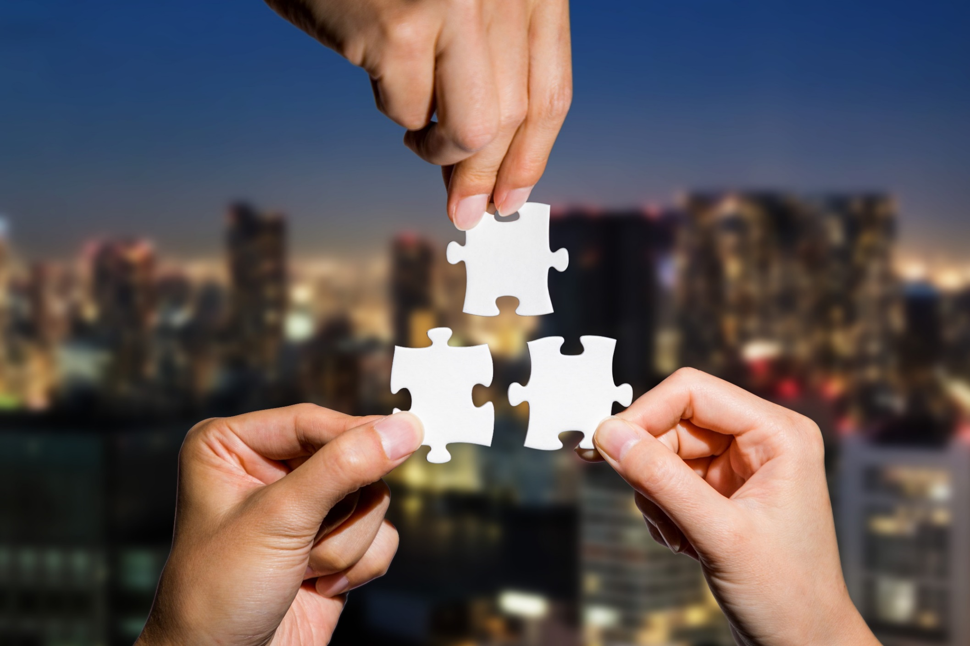
CONSOLIDATION

Slide 56
Talk to your partner about other methods to do when you travel somewhere.

Slide 57
Sample answers
Try local food: Enjoy new flavors and dishes from the area.
Talk to locals: Learn about the culture and get tips.
Learn a few local phrases: Speaking the language can help you connect.
Keep a travel journal: Write down your experiences each day.
Stay open-minded: Embrace new experiences and cultures.

Slide 58
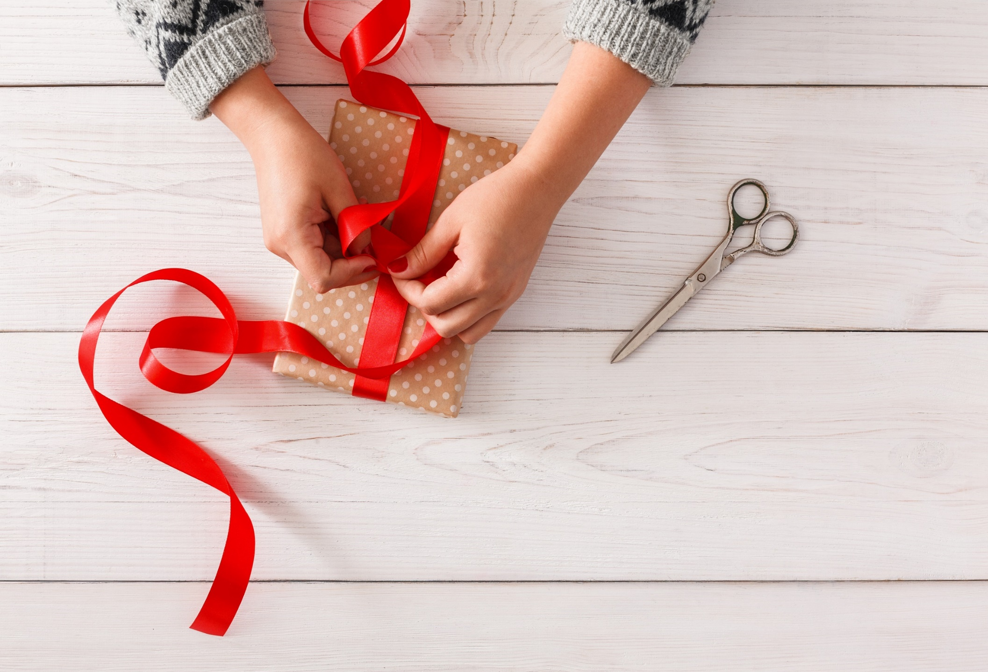
WRAP-UP

Slide 59
Vocabularies
1. bakery 2. bed and breakfast 3. dumpling 4. fanny pack 5. hostel 6. monument 7. pastry
8. socket adapter
9. sunblock
Today’s lesson

Slide 60
Today’s lesson
Vocabulary:
- Using nouns related to traveling.
Reading:
- Understanding an email about traveling.
- Practicing reading for details.

Slide 61
Homework
Review nouns related to traveling.
Make sentences using the nouns in SB
Prepare for the next lesson (Grammar - pages 35 & 36 - SB)
Play the consolidation games on www.eduhome.com.vn

Slide 62
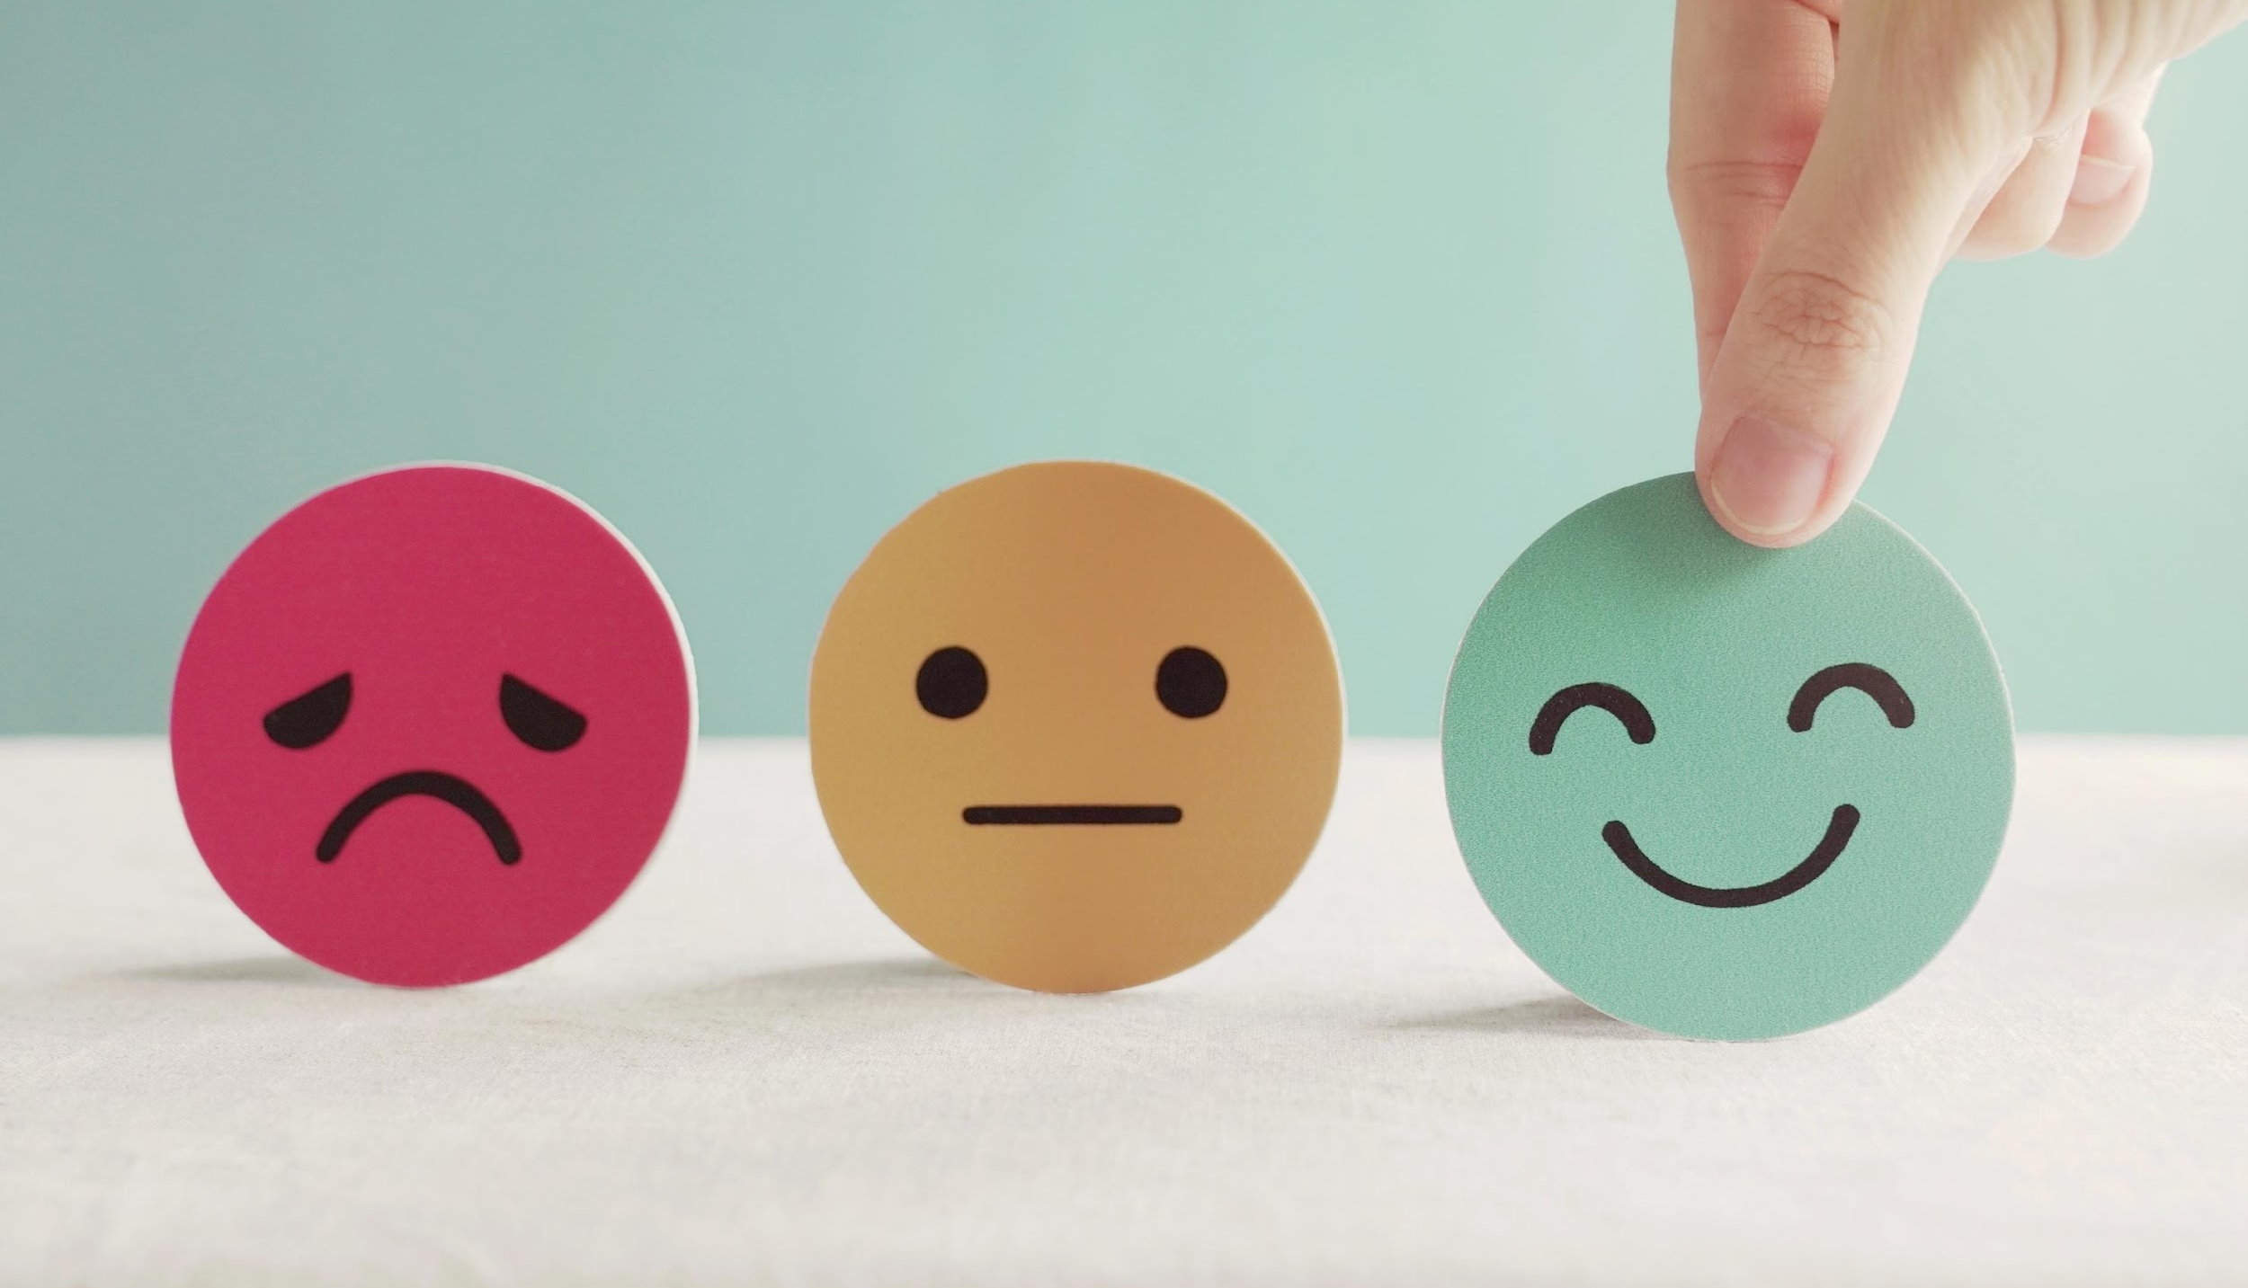
Lesson 3
Stay positive and have a nice day!

