Slide 1
Unit 3: Living Environment
Lesson 3.1: Reading
Page 32

Slide 2
Lesson Outline
Warm-up
Pre-eading
While-reading
Post-reading
Consolidation
Wrap-up

Slide 3
By the end of this lesson, students will be able to…
practice reading for main ideas and specific information

Slide 4
WARM-UP

Slide 5
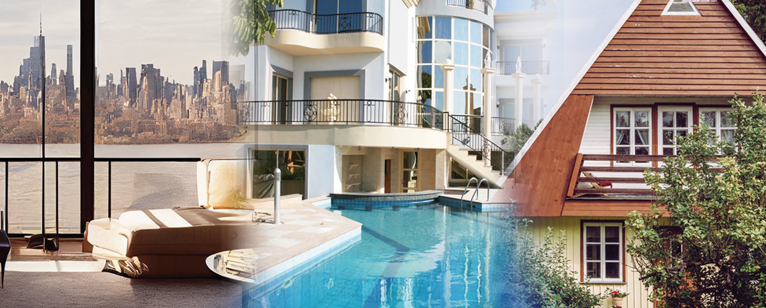
Let’s talk
In pairs: Look at the pictures. Which house would you like to live in? Why? What do you want in your house?

Slide 6
Suggested answers: I would like to live in a palace in the countryside because I want to enjoy the fresh air and the peaceful life there. I want to have a swimming pool and a garden full of flowers and fruit trees.

Slide 7
Pre-reading

Slide 8
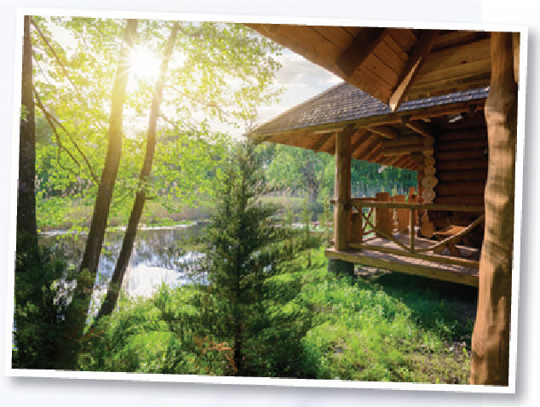
Look at the picture and guess what the blog is mainly about.
1. Things Alex wants in her dream house
2. The way Alex built her dream house

Slide 9
Read Alex's blog below and check the answer.
Let me tell you about my dream house.
My dream house will be in the country. I don't want to live in the city center because it's always noisy there. My house will be a set of three wooden tree houses: one for my living room and kitchen, one for my bedroom, and one for my bathroom. They will have modern equipment to make life comfortable. There will be rope bridges connecting the houses together. I want all the houses to look really nice and cozy with yellow curtains and lots of string lights. When you see them, you'll think of houses in fairy tales.

Slide 10
The house with the living room will have an outdoor area with a view of the forest and a lake. I'll spend lots of time there reading, working, and watching sunsets. My bedroom will have huge windows and a window in the roof so that I can see stars and the moon from my bed. My bathroom will have an outdoor bathtub and shower. There will also be a garden where I can grow vegetables, fruit, and flowers. I'll also decorate my house with lots of photos, paintings, and small souvenirs.
So, that's my dream house. What's yours?

Slide 11
Task a
Read Alex's blog below. What is it mainly about?
1. Things Alex wants in her dream house
2. The way Alex built her dream house

Slide 12
Task b
Read the questions and underline the key words.
1. How does Alex describe the city center?
2. The word They refers to ____.
3. Which of the following is in the bedroom?
4. What decorations won't she have?
5. Which of the following can you infer from the passage?

Slide 13
While-reading

Slide 14
Now, read and choose the correct answers.
1. How does Alex describe the city center?
A. ugly B. noisy
C. busy D. modern
Let me tell you about my dream house. My dream house will be in the country. I don't want to live in the city center because it's always noisy there.

Slide 15
My house will be a set of three wooden tree houses: one for my living room and kitchen, one for my bedroom, and one for my bathroom. They will have modern equipment to make life comfortable.
2. The word They refers to ____.
bedrooms
rope bridges
houses
equipment

Slide 16
3. Which of the following is in the bedroom?
A. TV B. balcony
C. big windows D. shower
My bedroom will have huge windows and a window in
the roof so that I can see stars and the moon from my bed.

Slide 17
4. What decorations won't she have?
A. paintings
B. yellow curtains
C. pillows
D. photos
I want all the houses to look really nice and cozy with yellow curtains and lots of string lights. … I'll also decorate my house with lots of photos, paintings, and small souvenirs.

Slide 18
5. Which of the following can you infer from the passage?
A. Alex wants to have an exciting life. B. Alex loves nature.
C. Alex doesn't like living alone. D. Alex loves city life.
My dream house will be in the country... My house will be a set of three wooden tree houses… There will be rope bridges connecting the houses together… The house with the living room will have an outdoor area with a view of the forest and a lake… My bedroom will have huge windows and a window in the roof so that I can see stars and the moon from my bed. My bathroom will have an outdoor bathtub and shower. There will also be a garden where I can grow vegetables, fruit, and flowers.

Slide 19
Further practice
Read the statement and underline the key words.
1. Alex wants to live in the countryside because it’s not always noisy like in the city.
2. Her house will have three rooms on the trees.
3. There won’t be electricity in her house.
4. She will watch the stars and the moon from her bedroom.
5. She will grow only flowers in the garden.

Slide 20
Read the passage and write True/False after each statement.
1. Alex wants to live in the country because it’s not always noisy like in the city.
My dream house will be in the country. I don't want to live in the city center because it's always noisy there.
True

Slide 21
Read the passage and write True/False after each statement.
2. Her house will have three rooms on the trees.
My house will be a set of three wooden tree houses: one for my living room and kitchen, one for my bedroom, and one for my bathroom.
False

Slide 22
Read the passage and write True/False after each statement.
3. There won’t be electricity in her house.
I want all the houses to look really nice and cozy with yellow curtains and lots of string lights.
False

Slide 23
Read the passage and write True/False after each statement.
4. She will watch the stars and the moon from her bedroom.
My bedroom will have huge windows and a window in the roof so that I can see stars and the moon from my bed.
True

Slide 24
Read the passage and write True/False after each statement.
5. She will grow only flowers in the garden.
There will also be a garden where I can grow vegetables, fruit, and flowers.
False

Slide 25
Task c
Listen and read.
Let me tell you about my dream house.
My dream house will be in the country. I don't want to live in the city center because it's always noisy there. My house will be a set of three wooden tree houses: one for my living room and kitchen, one for my bedroom, and one for my bathroom. They will have modern equipment to make life comfortable. There will be rope bridges connecting the houses together. I want all the houses to look really nice and cozy with yellow curtains and lots of string lights. When you see them, you'll think of houses in fairy tales.

Slide 26
The house with the living room will have an outdoor area with a view of the forest and a lake. I'll spend lots of time there reading, working, and watching sunsets. My bedroom will have huge windows and a window in the roof so that I can see stars and the moon from my bed. My bathroom will have an outdoor bathtub and shower. There will also be a garden where I can grow vegetables, fruit, and flowers. I'll also decorate my house with lots of photos, paintings, and small souvenirs.
So, that's my dream house. What's yours?

Slide 27
Post-reading
Presentation

Slide 28
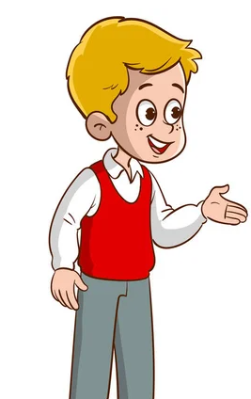
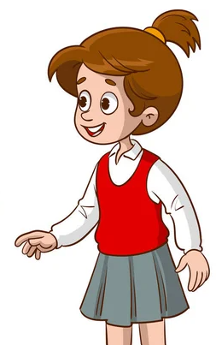
Task d
In pairs: Would you like to live in Alex's dream house? Why (not)?
I wouldn’t like to live in Alex’s dream house because it’s inconvenient when the rooms are separate.
I would like to live in Alex’s dream house because I want to live close to nature like her.

Slide 29
CONSOLIDATION

Slide 30
Write four sentences about things you like/don’t like about Alex’s dream house.
I like the living room will have an outdoor area with a view of the forest and a lake.
I like the idea of a window in the roof which helps see the stars and the moon from the bed.
I don’t like the outdoor bathtub and shower because they will make me feel insecure.
I don’t like the rope bridges because I am not used to walking on them.

Slide 31
WRAP-UP

Slide 32
Today’s lesson
Reading
Reading a passage about a dream house.
Speaking
Saying whether you would like in that house.

Slide 33
Homework
Prepare for the next lesson (Speaking & Writing, page 33).
Play the consolidation games on www.eduhome.com.vn

Slide 34
Lesson 3
Stay positive and have a nice day!

