Slide 1
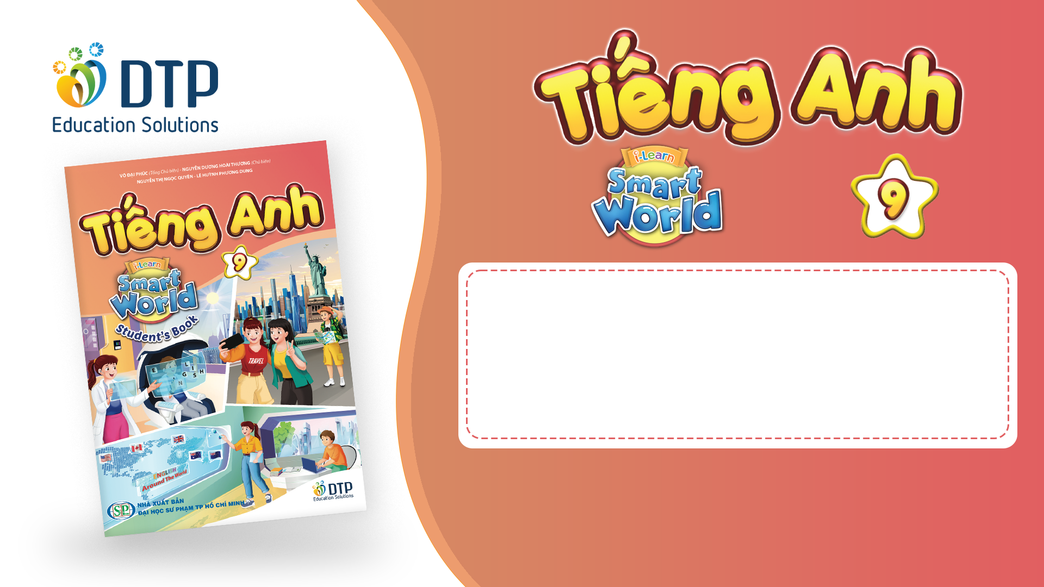
Unit 3: Living Environment
Lesson 2.1: Vocab & Listening
Pages 28 & 29

Slide 2
Lesson Outline
Warm-up
Vocabulary
Listening
Consolidation
Wrap-up

Slide 3

By the end of this lesson, students will be able to…
- To learn and use vocab. related to living environment.
- To practice listening for gist and specific information
- To practice functional English – Asking the same questions

Slide 4

WARM-UP

Slide 5

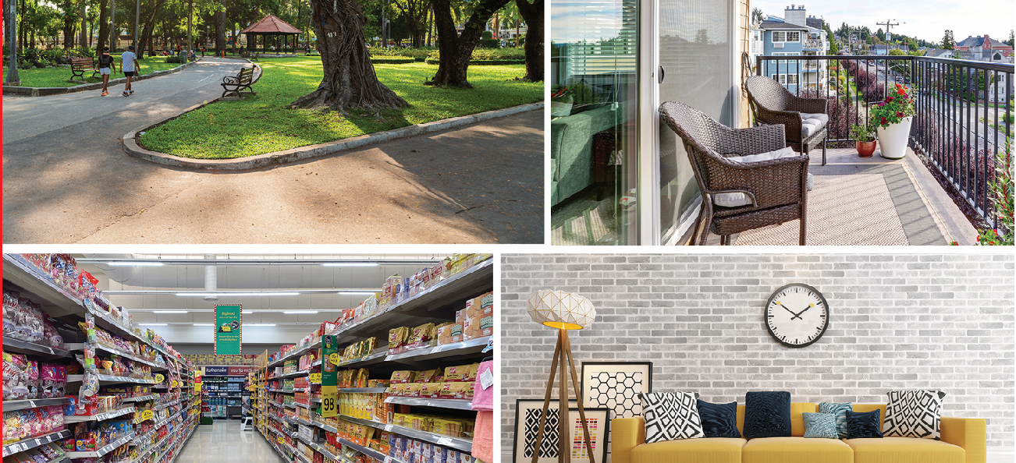
Work in pairs. Look at the pictures:
What can you see?
Do you think they are important things to have in or near your home? Why?

Slide 6
Suggested answers:
1. A park, a balcony, a convenience store and a living room.
2. Yes. Because they help me have a comfortable.

Slide 7

Pre-listening

Slide 8



Slide 9
Task a. Read the definitions, then fill in the blanks with the new words.
bunk beds – two beds that are put together, one above the other
neighborhood – an area or part of a town or city
curtain – a piece of cloth that is put over a window
nearby – not far away
spa – a place where people can go to relax and get healthier
flat screen – television or computer screen that is very thin
air conditioner – a machine that cools and dries the air
game console – a small device for playing video games

Slide 10
1. I'm really tired, so I think I will go to the _____________________.
2. Can you turn on the ___________________________, please? It's getting too hot in here.
3. I love watching movies on my ___________________________ TV.
4. My brother and I share ___________________________. He sleeps on the top, and I sleep on the bottom.
spa
air conditioner
flat screen
bunk beds

Slide 11
5. There isn't a supermarket ___________________________. The closest one is 30 minutes away.
6. My sister has a ___________________________ in her room. She plays video games on it all weekend.
7. My ___________________________s are too thin. The sun wakes me up early in the morning.
8. My ___________________________ is great. There's a huge park, and there are lots of nice houses in the area.
nearby
game console
curtain
neighborhood

Slide 12

Now listen and check
1. I'm really tired, so I think I will go to the _____________________.
2. Can you turn on the ___________________________, please? It's getting too hot in here.
3. I love watching movies on my ___________________________ TV.
4. My brother and I share ___________________________. He sleeps on the top, and I sleep on the bottom.
spa
air conditioner
flat screen
bunk beds

Slide 13
5. There isn't a supermarket ___________________________. The closest one is 30 minutes away.
6. My sister has a ___________________________ in her room. She plays video games on it all weekend.
7. My ___________________________s are too thin. The sun wakes me up early in the morning.
8. My ___________________________ is great. There's a huge park, and there are lots of nice houses in the area.
nearby
game console
curtain
neighborhood

Slide 14
Listen and repeat. Click on each phrase to hear the sound.
spa (n) /spɑː/ nơi thư giãn, chăm sóc sắc đẹp
air conditioner (n phr) /ˈer kənˌdɪʃənər/ điều hòa, máy lạnh
flat screen (n phr) /ˌflæt ˈskriːn/ màn hình phẳng
bunk beds (n phr) /bʌŋk bedz/ giường tầng

Slide 15
nearby (adv) /nɪrˈbaɪ/ gần đây
game console (n phr) /ˈɡeɪm kɑːnsoʊl/ máy điều khiển trò chơi điện tử
curtain (n) /ˈkɜːrtn/ màn cửa, rèm cửa
neighborhood (n) /ˈneɪbərhʊd/ khu phố

Slide 16
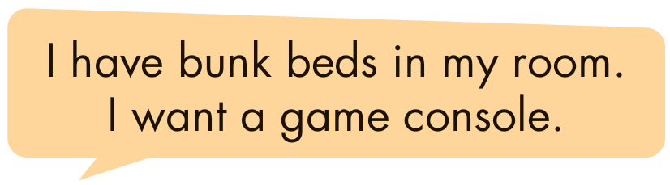
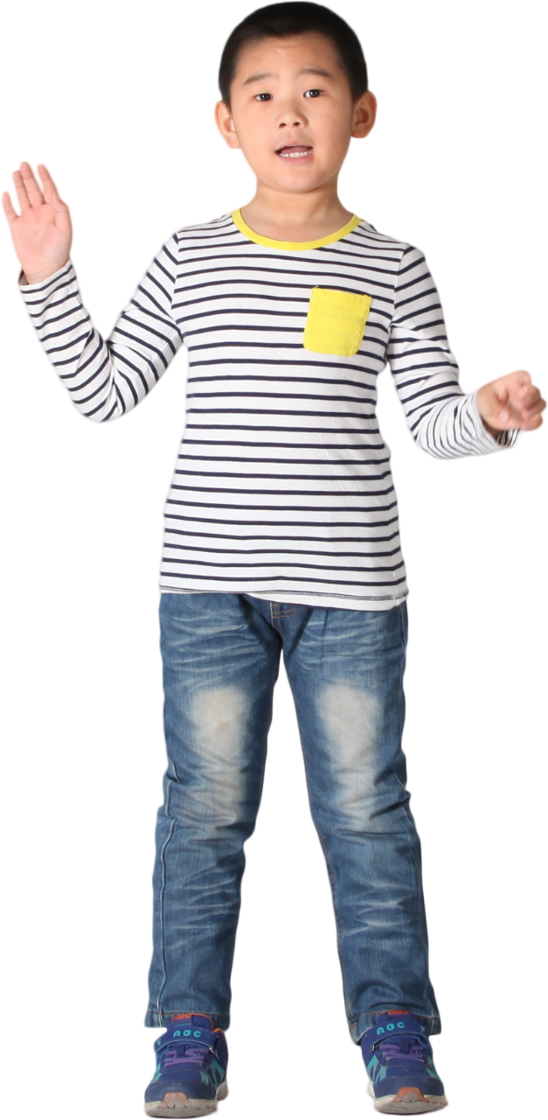
Task b. In pairs: Use the new words to talk about things you already have in your home and what you want your room to have.

Slide 17
Suggested answer
I have thin curtains in my living room. I would love it if I had a flat screen TV in my room.

Slide 18
Suggested answer
I have an air conditioner in most rooms in my apartment. I want bunk beds in my room.

Slide 19
While-listening

Slide 20

Task a

Slide 21
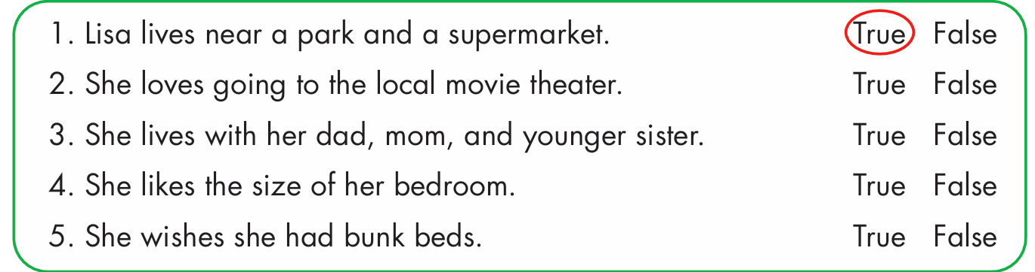
Task b
Now, listen and circle True or False.

Slide 22
Now, listen and circle True or False.

Slide 23
Answer
Now, listen and circle True or False.
1. Lisa lives near a park and a supermarket.
True
Jacob: Hey, Lisa. Where do you live?
Lisa: I live on King's Street.
Jacob: What's your neighborhood like?
Lisa: It's nice. There's a big park and a good supermarket.

Slide 24
2. She loves going to the local movie theater.
True
Jacob: That's good.
Lisa: Yeah, but I wish there was more entertainment.
I love going to the movie theater, but it's so far from my house. I wish I lived closer to it.

Slide 25
3. She lives with her dad, mom, and younger sister.
False
Jacob: I understand. Who do you live with?
Lisa: I live with my mom, dad, and older brother.

Slide 26
4. She likes the size of her bedroom.
False
Jacob: Yeah, maybe. What about your bedroom?
Lisa: It's OK. I wish it was a bit bigger. I don't really have
room for all my clothes and books.

Slide 27
5. She wishes she had bunk beds.
True
Jacob: That's annoying.
Lisa: Yeah. I also wish I had bunk beds. If I did, my friends could sleep over.

Slide 28
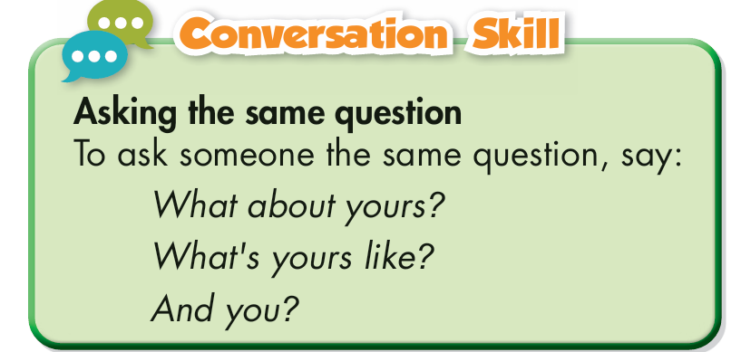
Task c
Read the Conversation Skill box, then listen and repeat.

Slide 29
Task c
Now, listen to the conversation again and circle the phrase that you hear.
What about yours?
What's yours like?
And you?

Slide 30
Post-listening

Slide 31

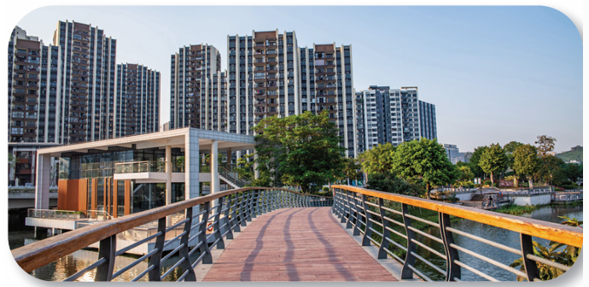
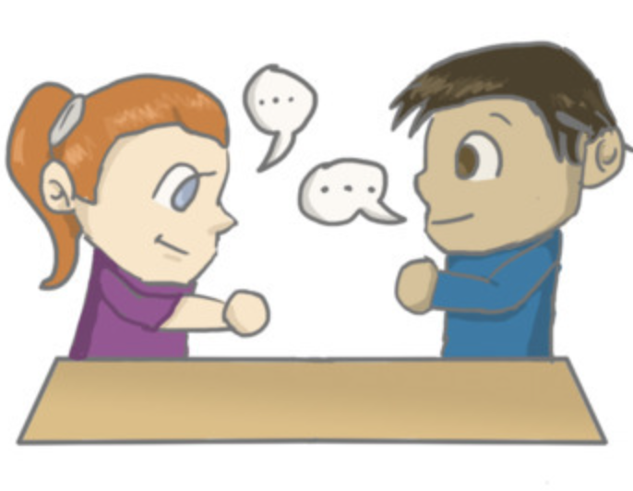
Task e
In pairs: Discuss how similar or different your home to Lisa’s is.

Slide 32

Sample answer
My house is also near a big park and a good supermarket. I wish there was a swimming pool nearby because I really enjoy swimming.
My house is not big. I don’t have my own room. I have to share the bedroom with my sister. I wish there were more bedrooms in my house so that I can have my own place.

Slide 33
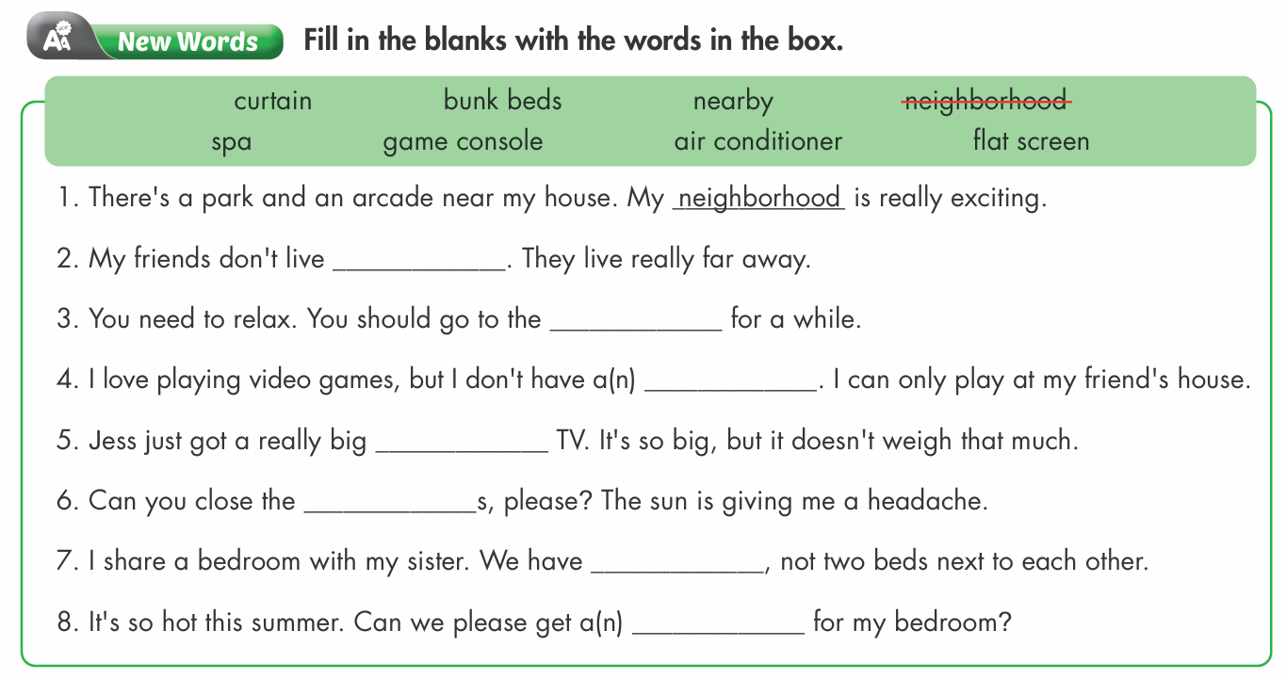
Extra practice - WB

Slide 34
1. There's a park and an arcade near my house. My _____________ is really exciting.
2. My friends don't live _____________. They live really far away.
3. You need to relax. You should go to the _____________ for a while.
neighborhood
nearby
spa

Slide 35
4. I love playing video games, but I don't have a(n) _____________. I can only play at my friend's house.
5. Jess just got a really big _____________ TV. It's so big, but it doesn't weigh that much.
6. Can you close the _____________s, please? The sun is giving me a headache.
game console
flat screen
curtain

Slide 36
7. I share a bedroom with my sister. We have _____________, not two beds next to each other.
8. It's so hot this summer. Can we please get a(n) _____________ for my bedroom?
bunk beds
air conditioner

Slide 37

Task a. Listen to two friends talking about their homes.
Does Chris like his house?
1. Yes 2. No
Katie: What's your new house like? Is it nice?
Chris: Yeah, I like it. It's pretty big, and all the furniture is really nice.

Slide 38
Task b. Now, listen and fill in the blanks.
1. Chris's new house is on ______________________.
2. Chris wishes ______________________ closer to him.
3. Chris says the __________________ in his bedroom are beautiful.
4. Katie wishes she had a flat screen TV and ___________________ in her bedroom.
5. Katie and Chris plan to ______________________ together.
place
subject + verb
noun
noun
verb

Slide 39
Task b. Now, listen and fill in the blanks.
1. Chris's new house is on ______________________.
2. Chris wishes ______________________ closer to him.
3. Chris says the __________________ in his bedroom are beautiful.
4. Katie wishes she had a flat screen TV and ___________________ in her bedroom.
5. Katie and Chris plan to ______________________ together.

Slide 40
Answers
1. Chris's new house is on ______________________.
South Street
Katie: Hey, Chris. How are you?
Chris: I'm OK, but I just moved to a new house with my parents.
Katie: Oh, nice. Where did you move to?
Chris: My new house is on South Street.

Slide 41
2. Chris wishes ______________________ closer to him.
his friends lived
Katie: Cool. What's your neighborhood like?
Chris: It's really nice. There's a nice mall, a supermarket, and
some parks nearby.
Katie: That's great.
Chris: Yeah, but I wish my friends lived close to me. It's too far
to walk to most of their homes.

Slide 42
3. Chris says the _______________ in his bedroom are beautiful.
curtains
Katie: Oh, no. What's your new house like? Is it nice?
Chris: Yeah, I like it. It's pretty big, and all the furniture is really nice.
Katie: Cool. What's your bedroom like?
Chris: It's OK. The curtains are beautiful and thick. But I wish it was bigger. Oh, and I also wish I had a game console in there. I want to relax and play video games in my bedroom and not in the living room.

Slide 43
4. Katie wishes she had a flat screen TV and ________________ in her bedroom.
a game console
Katie: I wish I had a game console, too… and a flat screen TV. Your house sounds really nice.

Slide 44
5. Katie and Chris plan to ______________________ together.
play
Chris: Hey, if you get a game console, then we can play together.
Katie: Sounds great!

Slide 45

CONSOLIDATION

Slide 46
Write a description (5 sentences) of your current house.
Sample answers
My house is near a big park and a convenience store. There is also a bookstore nearby where I usually go on weekends to read books and buy school supplies.
My house is not big, but I have my own bedroom. There is a flat screen TV in my room which helps me relax after studying hard. I want to have an air conditioner to make my room cooler.

Slide 47

WRAP-UP

Slide 48

Today’s lesson
Vocabularies
1. spa
2. air conditioner
3. flat screen
4. bunk beds
5. nearby
6. game console
7. curtain
8. neighborhood

Slide 49
Today’s lesson
Vocabulary:
- use new words to talk about living environment.
Listening:
- practice listening for gist and specific information
Speaking:
- to practice functional English – Asking the same questions.

Slide 50
Homework
Review new words to describe living environment
Make sentences using the new words in SB
Prepare for the next lesson (Grammar - pages 29 & 30 - SB)
Play the consolidation games on www.eduhome.com.vn

Slide 51

Lesson 3
Stay positive and have a nice day!

