Slide 1
Unit 3: Living Environment
Lesson 1.2: Grammar
Pages 25 & 26

Slide 2
Lesson Outline
Warm-up
Presentation
Practice
Production
Consolidation
Wrap-up

Slide 3
By the end of this lesson, students will be able to…
to practice and use the Defining relative clauses with relative pronouns

Slide 4
WARM-UP

Slide 5
COMPETITION TIME:
Create groups/teams of 3 students.
You will be given some clauses, you have to use them to complete the given sentences.
The team(s) with the most correct answers win (s).
Time limit: 5 minutes

Slide 6
a. that want to reduce their impact on the environment
b. which can entertain your kids c. who love nature
d. which generate electricity for
the whole building
e. that connects to a larger garden
Example:
People …………………………will like this place.
Answer: c
People who love nature will like this place.

Slide 7
a. that want to reduce their impact on the environment
b. which can entertain your kids c. who love nature
d. which generate electricity for
the whole building
e. that connects to a larger garden
Complete the sentences with the phrases in the box.
People ………………………………will like this place.
Each house has an outdoor space ……………………………..
The houses also have voice assistants …………………………….
These apartments have solar panels……………………………..
The trash cans will be great for people ……………………………….

Slide 8
a. that want to reduce their impact on the environment
b. which can entertain your kids c. who love nature
d. which generate electricity for
the whole building
e. that connects to a larger garden
2. Each house has an outdoor space ……………………………..
Answer: e
Each house has an outdoor space that connects to a larger garden.

Slide 9
a. that want to reduce their impact on the environment
b. which can entertain your kids c. who love nature
d. which generate electricity for
the whole building
e. that connects to a larger garden
3. The houses also have voice assistants …………………………….
Answer: e
The houses also have voice assistants which can entertain your kids.

Slide 10
a. that want to reduce their impact on the environment
b. which can entertain your kids c. who love nature
d. which generate electricity for
the whole building
e. that connects to a larger garden
4. These apartments have solar panels……………………………..
Answer: d
These apartments have solar panels which generate electricity for
the whole building.

Slide 11
a. that want to reduce their impact on the environment
b. which can entertain your kids c. who love nature
d. which generate electricity for
the whole building
e. that connects to a larger garden
5. The trash cans will be great for people ……………………………….
Answer: a
The trash cans will be great for people that want to reduce their impact on the environment.

Slide 12
Presentation

Slide 13
FORM: relative pronoun (who, whom which, that, whose) + subject + verb
USE: We can use defining relative clause with relative pronouns to give key information about the noun before them.
Presentation
1. These apartments have solar panels which generate electricity for the whole building.
2. People who love nature will like this place.

Slide 14
We use relative pronouns who/that for people.
Ex: This is a great home for families that/who like swimming.
We use relative pronouns which/that for things.
Ex: There is a smart garden that/which helps your plants grow better.
We use relative pronouns whose to show possession with people and things.
Ex: This home is great for people whose children are young.
This house whose yard is big is great for active people.
Presentation

Slide 15
Relative pronouns as subjects:
Noun + that/who/which + verb
Our apartments are great for people that/who have small children.
People that/who care about the environment will love this home.
He wants to live in a building that/which doesn't allow pets.

Slide 16
Relative pronouns as objects:
Noun + that/who/whom/which + subject + verb
This is the house which/that I really like.
The apartment manager who/whom/that you met is here.
Noun + whose + noun + verb
People whose parents are older will love this elevator.
Houses whose roofs have solar panels have lower electricity bills.

Slide 17
Note: We can leave out the pronoun when it is the object of the relative clause.
This is the house that I really like.
This is the house I really like. (that is the object of like)

Slide 18
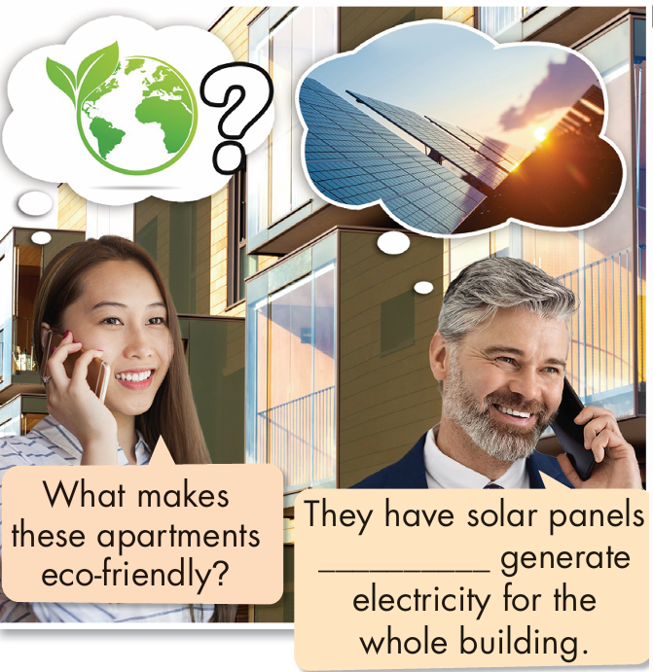
Task a. Read about Defining relative clauses with relative pronouns, then fill in the blanks.
that

Slide 19
Task b. Listen and check. Listen again and repeat.
Presentation
that

Slide 20
Presentation
Practice

Slide 21
Task c. Circle who, whose, or which.
1. I think we should install solar panels who/which can generate electricity for the whole house.
2. People whose/which houses are small will find this smart furniture really useful.
3. Students who/which have busy lifestyles will love these smart appliances.
4. We have a voice assistant who/which can control all of our appliances.
Presentation

Slide 22
5. Parents who/whose have young children will find this safety system very helpful.
6. Our smart mirror has sensors and cameras whose/which monitor your health.
7. Apartments whose/which walls can move to change the size of the rooms are very popular.
8. The smart bathroom is perfect for older people who/which find it difficult to get up and down.

Slide 23
Practice saying the sentences in Task c with a partner. Mind your sentence stress and intonation.
Extra Practice
I think we should install solar panels which can generate electricity for the whole house.
………………………………………..
………………………………………..

Slide 24
Task d. Combine the sentences using relative clauses.
1. We have a sofa. The sofa is also a bed.
We have a sofa that/which is also a bed.
2. Old people would love a house with a smart safety system. Old people live alone.
Old people that/who live alone would love a house with a smart safety system.
Presentation

Slide 25
3. We have a smart elevator. The elevator sends you from your car to your front door.
We have a smart elevator that/which sends you from your car to your front door.
4. People will love these smart apartments. People care about the environment.
People that/who care about the environment will love these smart apartments.

Slide 26
5. Parents will love the smart safety system. Their kids are very active.
Parents whose kids are very active will love the smart safety system.
6. The apartment has a smart garden. The smart garden helps plants grow by watering them and giving them plant food.
The apartment has a smart garden that/which helps plants grow by watering them and giving them plant food.

Slide 27
Work in pairs. One reads the original sentences in Task d. The other reads the revised sentence. Mind your sentence stress and intonation.
Extra Practice
Ex.: 1.
A: We have a sofa. The sofa is also a bed.
B: We have a sofa that/which is also a bed.

Slide 28
Extra Practice – WB, P15
Underline the mistakes and write the correct words on the lines.
_______
_______
_______
_______
_______
1. People which care about animals will love this house.
2. I want to live in a house whose garden are big.
3. There is a safety system who monitors outside the house.
4. The ModHouse has lots of plants which keeps your home cool.
5. People whom have pets will like this house.
who/that
is
whose
Presentation
keep
Production
who/that

Slide 29
Presentation
Production

Slide 30
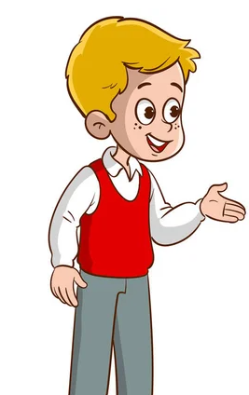
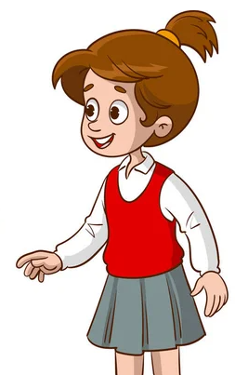
Task e. In pairs: Take turns saying what smart appliances and furniture you think we will have in the future and who the
products would be for using the table below.
Presentation

Slide 31
I think we'll have refrigerators
that can order food and drinks.
I think they'd be for people
who are busy.

Slide 32
I think we'll have television screens that show 3D videos and movies.
I think they'd be for people
who have kids.

Slide 33
CONSOLIDATION

Slide 34
Write 5 sentences, using defining relative clauses with relative pronouns who, whom, which, that, whose :
Lap tops are necessary for students who make projects frequently.
Solar panels which generate electricity from the sun are eco-friendly.
Houses with a voice assistant are suitable for children whose parents are busy.
I want to live in an apartment that is near my school.
My math teacher is the person whom I admire most.

Slide 35
WRAP-UP

Slide 36
Today’s lesson
Grammar:
Defining relative clauses with relative pronouns (who, whom, which, that, whose).

Slide 37
Homework
Review Defining relative clauses with relative pronouns (who, whom, which, that, whose) to give key information about a noun.
Make sentences using Defining relative clauses in SB.
Prepare for the next lesson (Pronunciation & Speaking - pages 26 & 27 - SB).
Play the consolidation games on www.eduhome.com.vn

Slide 38
Lesson 3
Stay positive and have a nice day!

