Slide 1
Unit 3: Living Environment
Lesson 1.1: Vocab & Reading
Pages 24 & 25

Slide 2
Lesson Outline
Warm-up
Vocabulary
Reading
Consolidation
Wrap-up

Slide 3
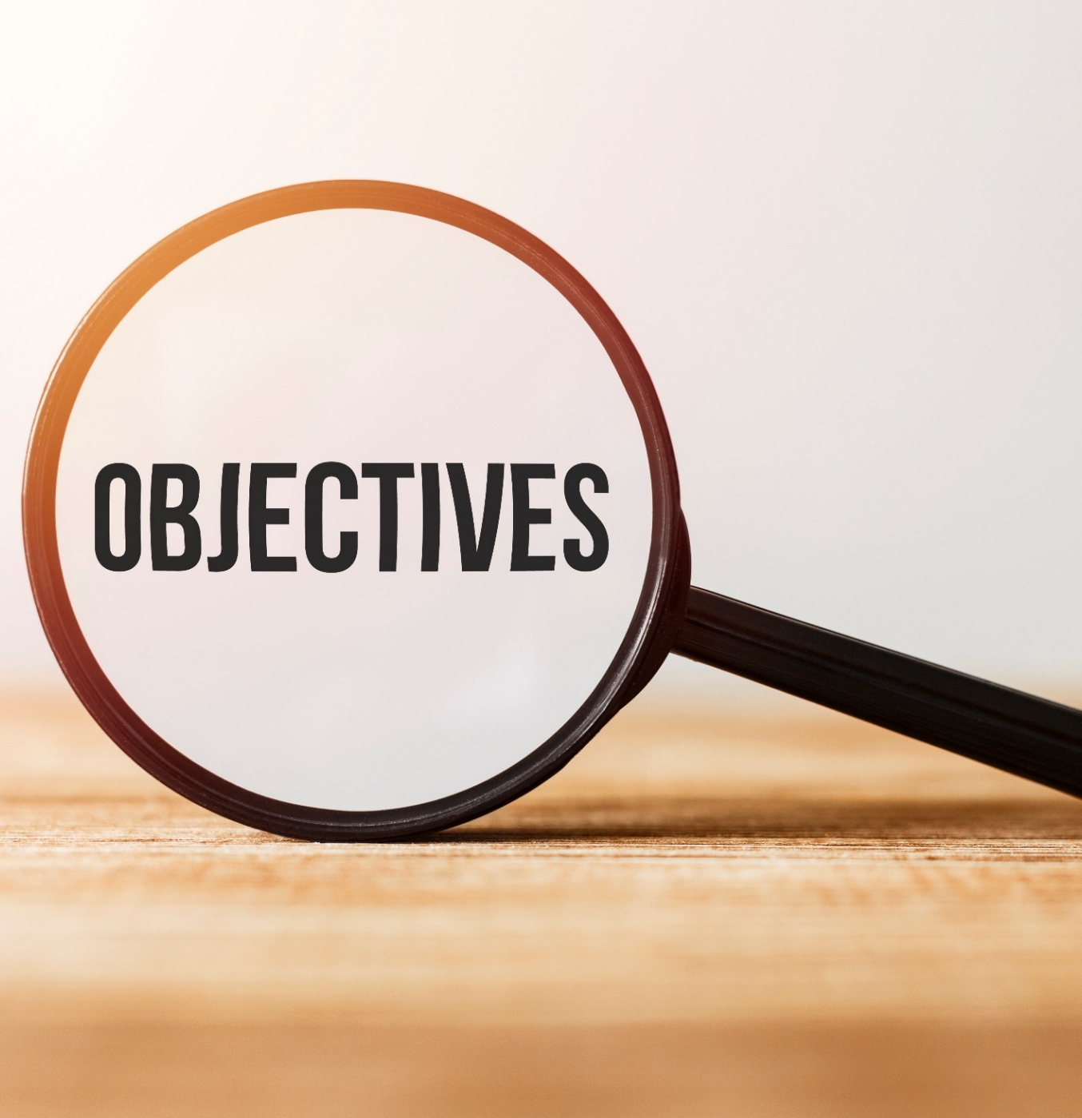
By the end of this lesson, students will be able to…
- To learn and use vocab. related to Living environment.
- To practice reading for gist and specific information
.

Slide 4
WARM-UP

Slide 5
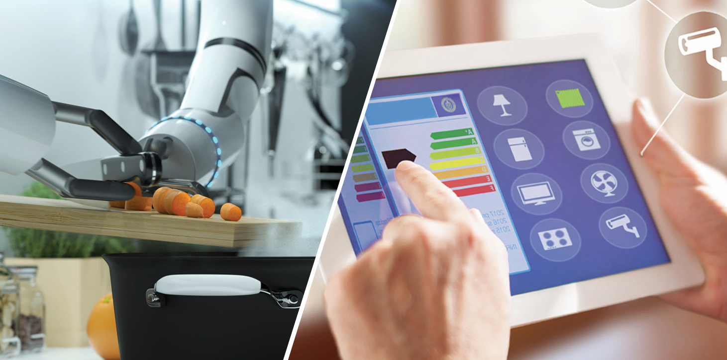
Work in pairs. Look at the pictures:
1. What do you think the devices in the pictures do?
2. Would you like to have similar devices in your home? Why (not)?

Slide 6
Suggested answers:
1. An automatic cutter, a tablet controlling the domestic appliances.
2. Yes. Because they make my life more convenient.

Slide 7
Pre-reading

Slide 9
Task a. Read the sentences, then match the words to the definitions.
a. We need to buy furniture for our new house. It doesn't have a bed or a couch yet.
b. The most expensive appliance in my kitchen is the fridge.
c. The computer system allows you to connect all your devices to your phone and control them with an app.
d. I have to use the elevator to get to my apartment because it's on the 13th floor.

Slide 10
e. Many lights now have sensors. They turn on when there's a person moving in the room.
f. My house has solar panels on the roof. They generate electricity for us to use.
g. This device will monitor your baby and let you know what they're doing.
h. My phone has a voice assistant, so I can talk to it instead of using my hands.

Slide 11
elevator
1. ___________________: a machine for carrying people up and down in a building
2. ___________________: produce energy, especially electricity
3. ___________________: objects such as tables, chairs, and beds
4. ___________________: a machine for doing things in the home, such as cooking or cleaning
generate
furniture
appliance

Slide 12
5. ___________________: a group of connected things (e.g. machines, computers, etc.) working together
6. ___________________: a computer program you can talk to and give instructions to do something
7. ___________________: a device with the ability to find light, heat, sound, etc.
8. ___________________: use technology to watch somebody/something
system
voice assistant
sensor
monitor

Slide 13
Now listen and check
elevator
1. _________: a machine for carrying people up and down in a building
2. _________: produce energy, especially electricity
3. _________: objects such as tables, chairs, and beds
4. _________: a machine for doing things in the home, such as cooking or cleaning
5. _________: a group of connected things (e.g. machines, computers, etc.) working together
6. _________: a computer program you can talk to and give instructions to do something
7. _________: a device with the ability to find light, heat, sound, etc.
8. _________: use technology to watch somebody/something

Slide 14
elevator
ANSWERS
_________: a machine for carrying people up and down
in a building
2. _________: produce energy, especially electricity
3. _________: objects such as tables, chairs, and beds
4. _________: a machine for doing things in the home, such as cooking or cleaning
5. _________: a group of connected things (e.g. machines, computers, etc.) working together
6. ______________: a computer program you can talk to and give instructions to do something
7. _________: a device with the ability to find light, heat, sound, etc.
8. _________: use technology to watch somebody/something
generate
furniture
appliance
system
voice assistant
sensor
monitor

Slide 15
Listen and repeat. Click on each phrase to hear the sound.
elevator (n) /ˈeləveɪtər/ thang máy
generate (v) /ˈdʒenəreɪt/ tạo ra, phát ra
furniture (n) /ˈfɜːrnɪtʃər/ nội thất
appliance (n) /əˈplaɪəns/ thiết bị
system (n) /ˈsɪstəm/ hệ thống
voice assistant (n phr) /ˌvɔɪs əˈsɪstənt/ trợ lý giọng nói
sensor (n) /ˈsensər/ cảm biến
monitor (v) /ˈmɑːnətər/ theo dõi

Slide 16
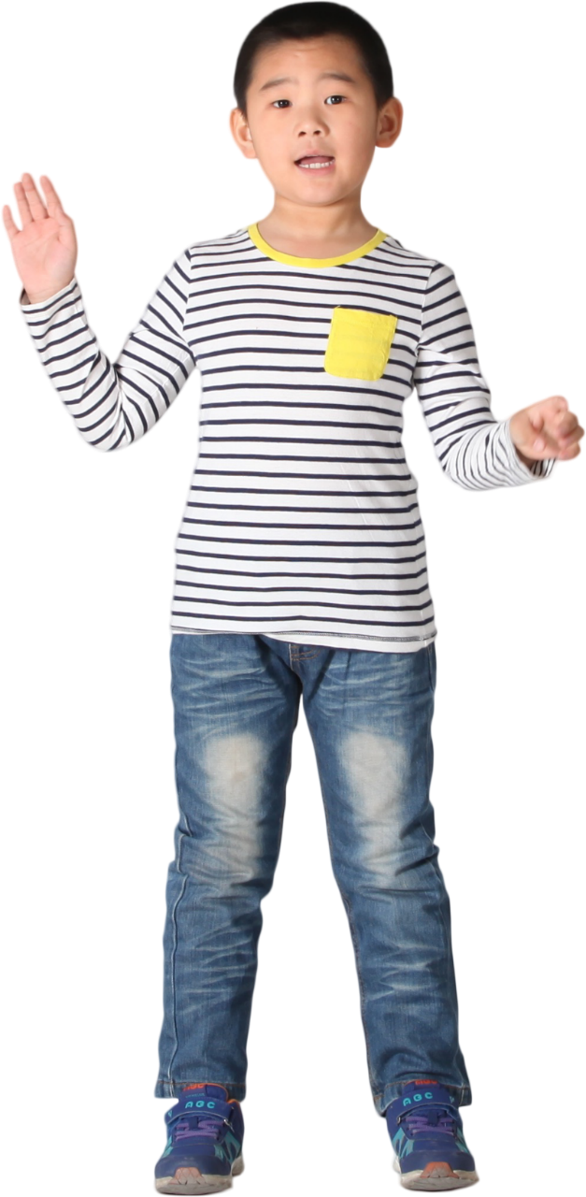
Task b. In pairs: Use the new words to talk about
things you want to have in your house.

Slide 17
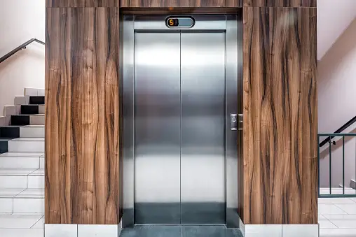
Suggested answer
I'd like to have an elevator to take me from the kitchen to my bedroom.

Slide 18
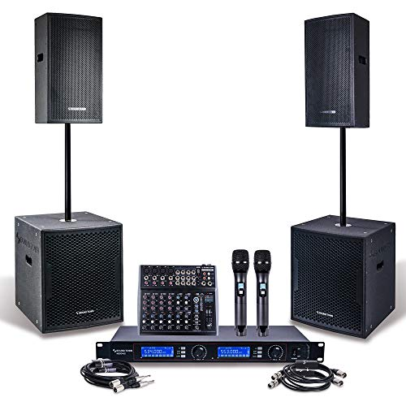
Suggested answer
2. I'd enjoy having a speaker system around my house
so I can listen to music anywhere.

Slide 19
While-reading

Slide 20
Read the article about houses below. Which of the following is the best title for the passage?Reading 1. What Houses Will Be Like in the Future
2. Houses of Tomorrow: They're Here
Task a

Slide 21
If you're looking for a new house, you'll notice that houses are getting smarter. Here are a few examples of houses of the future.
Peace Cube: These apartments have smart appliances and sensors which allow you to control your house remotely. Each apartment has a safety system that reminds you to lock the door or turn off your stove. It will call emergency services if a fire happens or someone tries to get into your house.

Slide 22
Sunshine Place: People who love nature will like this place. Each house has an outdoor space that connects to a larger garden. A smart gardening system will monitor and water your plants, so you don't have to worry about forgetting to water them. The houses also have voice assistants which can entertain your kids.
Smart Nest: These apartments have solar panels which generate electricity for the whole building. The trash can in each apartment sorts your trash and sends it to the recycling center, so you don't have to. The trash cans will be great for people that want to reduce their impact on the environment.
What do you think of these places? What new technology do you want to see in homes?

Slide 23
ANSWERS
Read the article about houses below. Which of the following is the best title for the passage? 1. What Houses Will Be Like in the Future
2. Houses of Tomorrow: They're Here
Task a

Slide 24
Clues
If you're looking for a new house, you'll notice that houses are getting smarter. Here are a few examples of houses of the future.

Slide 25
Task b
Guess the type of missing word(s). Noun? Verb? Adj? etc,?
noun
noun
Peace Cube Apartments | • have (1) _________ and ________ that let you control the house remotely sensors • can (2) _________ if there's a fire
Sunshine Place Houses | • can (3) ________ and _______ your garden • come with (4) _________ which provide children with entertainment
Smart Nest Apartments | • (5) _________ create power for the whole building • have smart (6) _________ which pick out trash to recycle
verb
verb
verb
noun
noun
noun

Slide 26
ANSWERS
Task b
Now, read and fill in the blanks.
smart appliances
sensors
Peace Cube Apartments | • have (1) ___________________ and ________ that let you control the house remotely • can (2) _______________________ if there's a fire
call emergency services
Peace Cube: These apartments have smart appliances and sensors which allow you to control your house remotely. Each apartment has a safety system that reminds you to lock the door or turn off your stove. It will call emergency services if a fire happens or someone tries to get into your house.

Slide 27
ANSWERS
monitor
water
Sunshine Place Houses | • can (3) ________ and _______ your garden • come with (4) ___________________________ which provide children with entertainment
voice assistants
Sunshine Place: People who love nature will like this place. Each house has an outdoor space that connects to a larger garden. A smart gardening system will monitor and water your plants, so you don't have to worry about forgetting to water them. The houses also have voice assistants which can entertain your kids.

Slide 28
ANSWERS
solar panels
Smart Nest Apartments | • (5) ______________ create power for the whole building • have smart (6) ____________ which pick out trash to recycle
trash cans
Smart Nest: These apartments have solar panels which generate electricity for the whole building. The trash can in each apartment sorts your trash and sends it to the recycling center, so you don't have to. The trash cans will be great for people that want to reduce their impact on the environment.

Slide 29
Task c
Listen and read

Slide 30
Post-reading

Slide 31
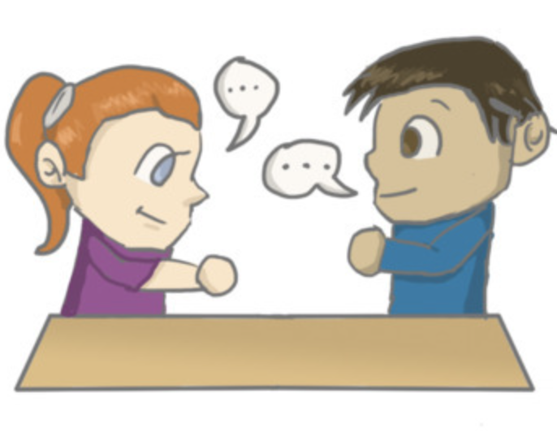
In pairs: Ask and answer:
What kinds of technology or appliances do you think will be most popular in the future? Why?
Task d

Slide 32
Sample answer
What kinds of technology or appliances do you think will be most popular in the future? Why?
I think Smart Nest
Apartments will be the most popular because they help protect the environment with solar panels and smart trash cans.

Slide 33
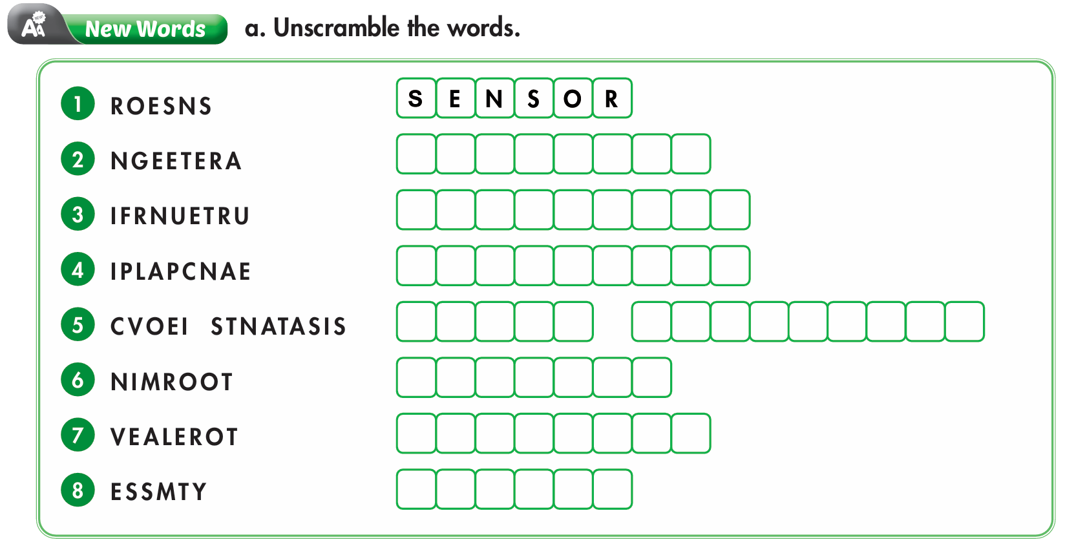
Extra practice - WB
G E N E R A T E
F U R N I T U R E
A P P L I A N C E
V O I C E
A S S I S T A N T
M O N I T O R
E L E V A T O R
S Y S T E M

Slide 34
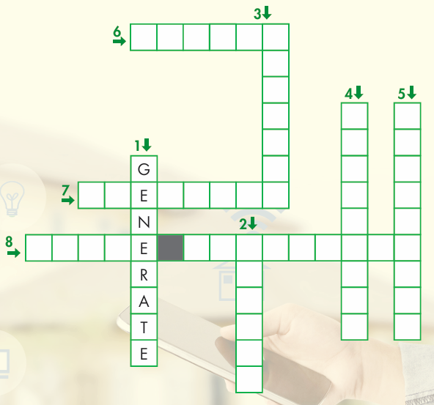
1. make energy
2. a device with the ability to find
and check things like light, heat,
and sound
3. use technology to watch something closely for a period of time
4. a machine for doing certain tasks in a home
M
O
N
I
T
O
R
A
P
P
L
I
A
N
C
E
S
E
N
S
O
R

Slide 35
5. objects in a house or building,
like beds, tables, and chairs
6. connected things working together
7. a machine that helps people to
travel up and down in a building
8. a program on your phone or
computer you can ask questions
or tell to do things
S Y S T E M
F
U
R
N
I
T
U
R
E
E L V A T O R
V O I C A S S I S T A N

Slide 36
Task a. Read the article about houses. What is NOT mentioned?
1. robot cleaners that clean up after you
2. solar panels that create electricity
3. an appliance that cooks for you.

Slide 37
Houses are improving and getting smarter. It feels like we're living in the future. Here are three houses that might make you want to move.
Future Terrace: These houses have a voice assistant that controls everything. Do you want to call the elevator? Just ask. Do you want to turn on the lights? Just ask. These homes are perfect for people who need extra help around the house. You will have much more time for yourself and your family.
Robohomes: These houses have a range of different smart appliances that do lots of different jobs. They have kitchen robots that can make a whole meal, and you only have to press one button. They also have
appliances that clean themselves. You can put your feet up and relax.

Slide 38
Greenhouse Apartments: These apartments use the newest technology and are eco-friendly. The walls have solar panels that produce electricity using energy from the sun. The gardens have outdoor systems that
monitor and water the plants on the balcony. You'll feel like you're living in the country.
Which of these homes would you like to live in? Come and have a look. Your new home is waiting for you. Step into the future!

Slide 39
Answer and clues:
1. robot cleaners that clean up after you
2. solar panels that create electricity
3. an appliance that cooks for you. .
Robohomes: They have kitchen robots that can make a whole meal, and you only have to press one button.
Greenhouse Apartments: The walls have solar panels that produce electricity using energy from the sun.

Slide 40
Task b. Now, read and fill in the blanks.
1. What can call an elevator for you in Future Terrace?
2. How do you use the kitchen robots in Robohomes?
3. What are two things you don't have to do in Robohomes?
4. What do the outdoor systems in Greenhouse Apartments do?
5. Where will you feel like you're living in Greenhouse Apartments?

Slide 41
ANSWERS
1. What can call an elevator for you in Future Terrace?
A voice assistant
Future Terrace: These houses have a voice assistant that controls everything. Do you want to call the elevator? Just ask. Do you want to turn on the lights? Just ask. These homes are perfect for people who need extra help around the house. You will have much more time for yourself and your family.

Slide 42
2. How do you use the kitchen robots in Robohomes?
press one button
Robohomes: These houses have a range of different smart appliances that do lots of different jobs. They have kitchen robots that can make a whole meal, and you only have to press one button. They also have appliances that clean themselves. You can put your feet up and relax.

Slide 43
3. What are two things you don't have to do in Robohomes?
cook and clean
Robohomes: These houses have a range of different smart appliances that do lots of different jobs. They have kitchen robots that can make a whole meal, and you only have to press one button. They also have appliances that clean themselves. You can put your feet up and relax.

Slide 44
4. What do the outdoor systems in Greenhouse Apartments do?
monitor and water the plants
Greenhouse Apartments: These apartments use the newest technology and are eco-friendly. The walls have solar panels that produce electricity using energy from the sun. The gardens have outdoor systems that monitor and water the plants on the balcony. You'll feel like you're living in the country.

Slide 45
5. Where will you feel like you're living in Greenhouse Apartments?
in the country
Greenhouse Apartments: These apartments use the newest technology and are eco-friendly. The walls have solar panels that produce electricity using energy from the sun. The gardens have outdoor systems that monitor and water the plants on the balcony. You'll feel like you're living in the country.

Slide 46
CONSOLIDATION

Slide 47
Talk to your partner about the accommodation you would like to live in.

Slide 48
Sample answers
I would like to live in Robohomes because I don’t have to cook or clean. So, I will have more time to relax.
I would like to live in Greenhouse Apartments because it’s eco-friendly and I enjoy living in the countryside.
I would like to live in Future Terrace because they make my life convenient and comfortable.

Slide 49
WRAP-UP

Slide 50
Today’s lesson
Vocabularies
1. elevator 2. generate 3. furniture 4. appliance 5. system 6. voice assistant 7. sensor 8. monitor

Slide 51
Today’s lesson
Vocabulary:
- use new words to talk about Living environment.
Reading:
- Understanding an article about houses.
- To practice reading for gist and specific information.

Slide 52
Homework
Review new words to describe living environment
Make sentences using the new words in SB
Prepare for the next lesson (Grammar - pages 25 & 26 - SB)
Play the consolidation games on www.eduhome.com.vn

Slide 53
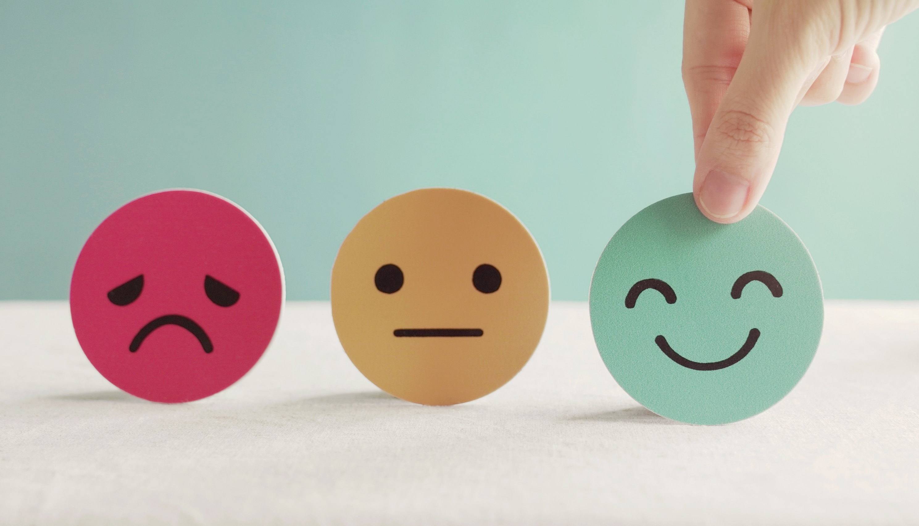
Lesson 3
Stay positive and have a nice day!

