Slide 1
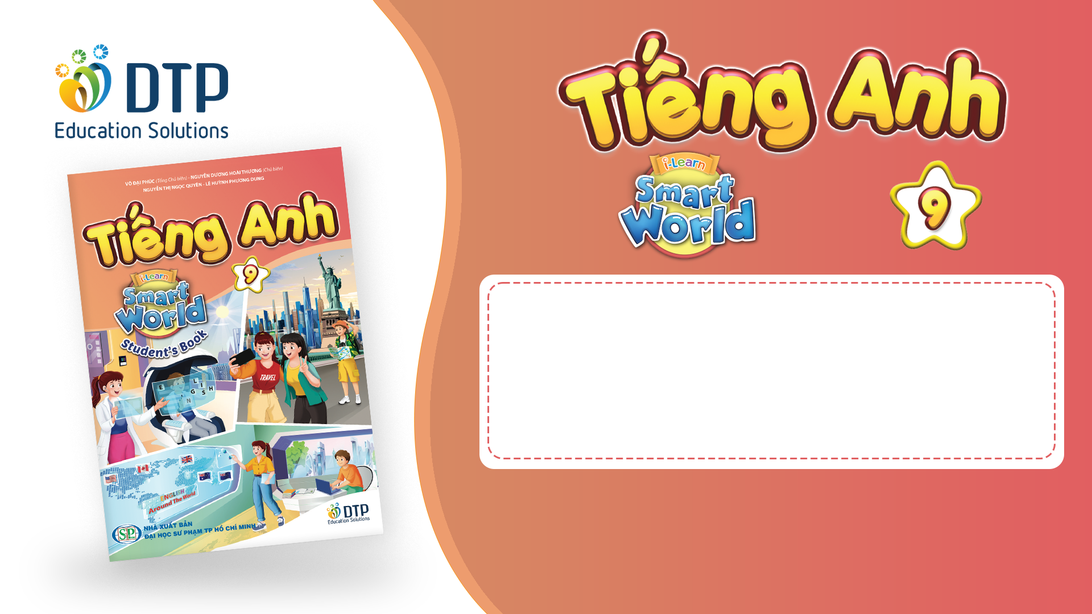
Unit 2: Life in the past
Review 1: Listening, Reading
& Vocab
Pages 87 & 88

Slide 2
Lesson Outline
Warm-up
Listening
Reading
Vocabulary
Consolidation
Wrap-up

Slide 3

By the end of this lesson, students will be able to…
Review the target language learned in the unit
Practice test-taking skills

Slide 4

WARM-UP

Slide 5
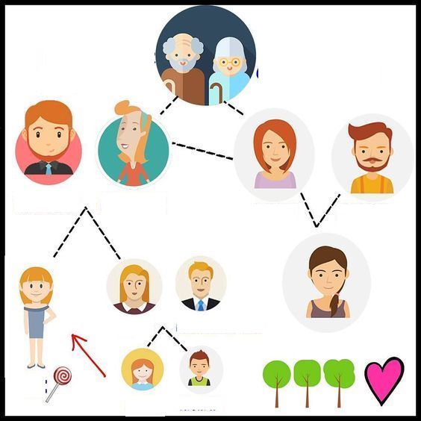
Work in groups.
Fill in the blanks with these words:
niece
uncle
mother
cousin
grandmother
The team(s) with the most correct answers win (s).
Time limit: 5 minutes
grandfather
(1)_______
father
(2)______
aunt
(3)____
sister
Brother-in-law
(4)_____
me
(5)_____
nephew

Slide 6
ANSWERS
Work in groups.
Fill in the blanks with these words:
niece
uncle
mother
cousin
grandmother
The team(s) with the most correct answers win (s).
Time limit: 5 minutes
(1)
__________
grandfather
grandmother
mother
father
(2)______
(3)____
aunt
uncle
sister
Brother-in-law
cousin
(4)_____
me
(5)_____
nephew
niece

Slide 7
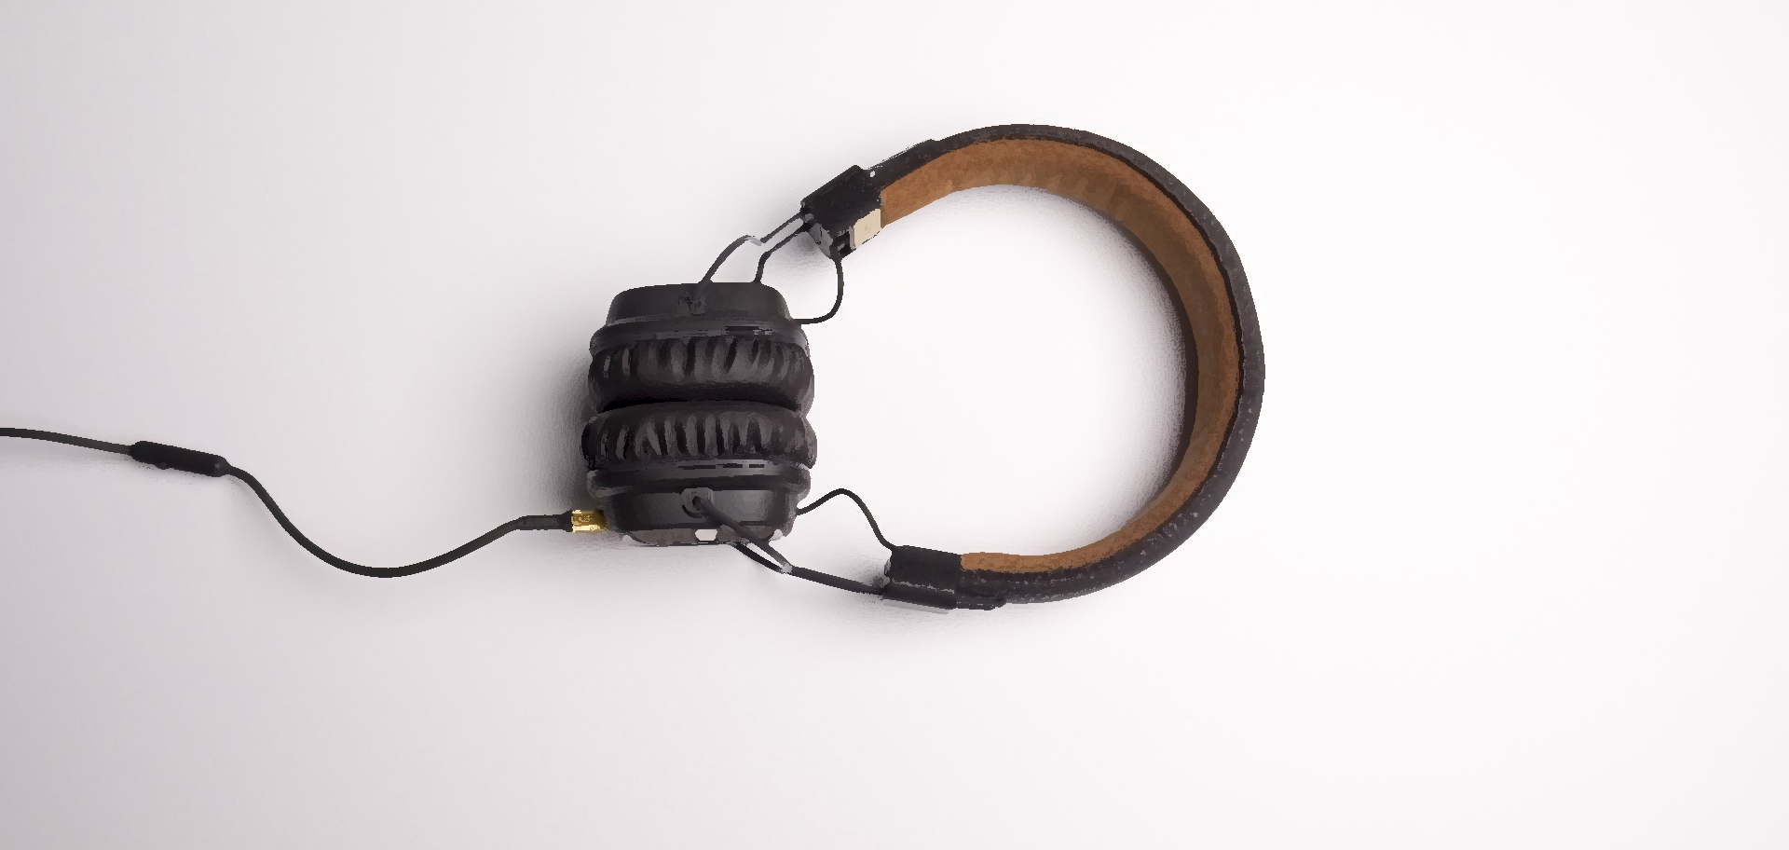
LISTENING

Slide 8


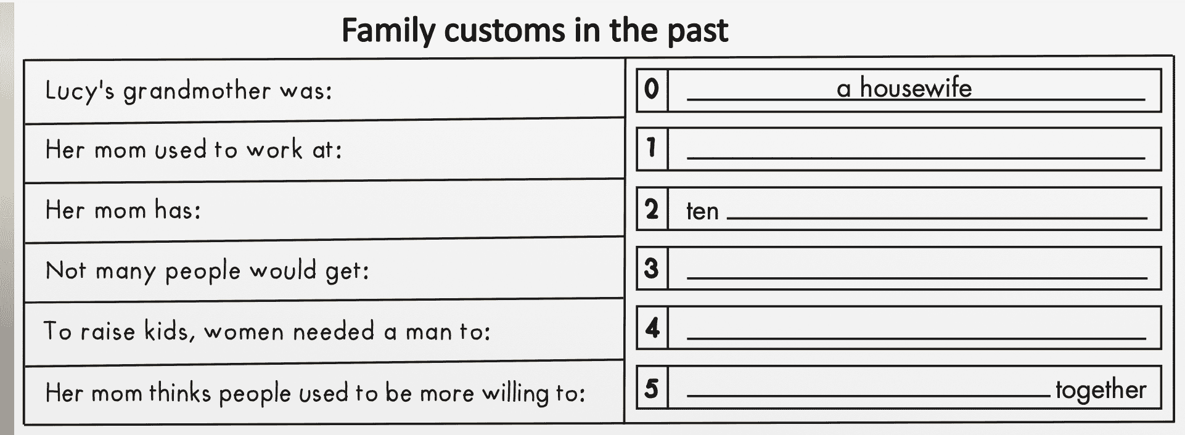
SB p. 87. You will hear a girl, Lucy, and her mom talking about family customs in the past. Listen and fill in the blanks. You will hear the conversation twice

Slide 9
SB p. 87. You will hear a girl, Lucy, and her mom talking about family customs in the past.
Guess the type of missing word(s). Noun? Verb? Adj? etc.?
Noun (a place)
plural noun
Past participle/ noun
Verb (bare infinitive)
Verb (bare infinitive)

Slide 10
SB p. 87. You will hear a girl, Lucy, and her mom talking about family customs in the past.
Underline the key words
Noun (a place)
plural noun
Past participle/ noun
Verb (bare infinitive)
Verb (bare infinitive)

Slide 11
SB p. 87. You will hear a girl, Lucy, and her mom talking about family customs in the past.
ANSWERS
a factory
aunts and uncles
divorced
work
get through difficult times

Slide 12
SB p. 87. You will hear a girl, Lucy, and her mom talking about family customs in the past.
ANSWERS
Lucy: Hey, Mom. I read online that women were only housewives in the past. Is that true?
Mrs. Clark: Well, it depends on when we're talking about. Your grandma's generation, yes, she was a housewife.
Lucy: But you aren't?
Mrs. Clark: No. We can't live with only your dad working. I worked at a factory when we first got married. Now, I work at the bank.
1.Her mom used to work at:
(1)_____________
a factory

Slide 13
SB p. 87. You will hear a girl, Lucy, and her mom talking about family customs in the past.
ANSWERS
Her mom has:
(2) ten_______________
Lucy: OK. What about living with extended family?
Mrs. Clark: Yes. I used to live with my grandparents and my ten aunts and uncles. Back when I was young, many generations would live together.
aunts and uncles

Slide 14
SB p. 87. You will hear a girl, Lucy, and her mom talking about family customs in the past.
ANSWERS
Lucy: I also read that people would rarely get divorced. Is that true?
Mrs. Clark: Yes. Back then, it was rare. For many women, it was because they couldn't work. Men had to go to work so that women could raise the children.
Not many people would get:
(3)_______________
divorced
To raise kids, women
needed a man to
(4)_____
work

Slide 15
SB p. 87. You will hear a girl, Lucy, and her mom talking about family customs in the past.
ANSWERS
Lucy: Life was difficult back then, huh?
Mrs. Clark: Yes. And people didn't get divorced after an argument. People used to work harder to get through difficult times together.
Lucy: I see. That sounds a lot better to me.
Her mom thinks people used to be more willing to:
(5)_____________________together
get through difficult times

Slide 16
SCRIPT
CD2 Track 38
Narrator: You will hear a girl, Lucy, and her mom talking about family customs in the past. Listen and fill in the blanks. You will hear the conversation twice.
Lucy: Hey, Mom. I read online that women were only housewives in the past. Is that true?
Mrs. Clark: Well, it depends on when we're talking about. Your grandma's generation, yes, she was a housewife.
Lucy: But you aren't?
Mrs. Clark: No. We can't live with only your dad working. I worked at a factory when we first got married. Now, I work at the bank.

Slide 17
SCRIPT
Lucy: OK. What about living with extended family?
Mrs. Clark: Yes. I used to live with my grandparents
and my ten aunts and uncles. Back when I was young, many generations would live together.
Lucy: You had ten aunts and uncles?
Mrs. Clark: Family sizes were a lot bigger.
Lucy: I also read that people would rarely get divorced.Is that true?
Mrs. Clark: Yes. Back then, it was rare. For many women, it was because they couldn't work. Men had to go to work so that women could raise the children.

Slide 18
SCRIPT
Lucy: Life was difficult back then, huh?
Mrs. Clark: Yes. And people didn't get divorced after an argument. People used to work harder to get through difficult times together.
Lucy: I see. That sounds a lot better to me.
Narrator: Now, listen again.

Slide 19

Extra practice

Slide 20

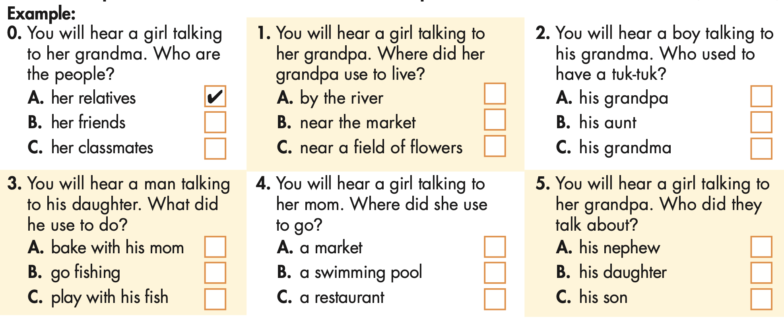
WB p.51: You will hear five short conversations. You will hear each conversation twice. There is one question for each conversation. For each question, choose the correct answer (A, B, or C)

Slide 21

WB p.51: You will hear five short conversations. You will hear each conversation twice. There is one question for each conversation. For each question, choose the correct answer (A, B, or C)
Underline the key words
Example:
0. You will hear a girl talking to her grandma. Who are the people?
A. her relatives
B. her friends
C. her classmates
You will hear a girl talking to her grandpa. Where did her grandpa use to live?
A. by the river
B. near the market
C. near a field of flowers
√

Slide 22
WB p.51: You will hear five short conversations. You will hear each conversation twice. There is one question for each conversation. For each question, choose the correct answer (A, B, or C)
Underline the key words
2. You will hear a boy talking to his grandma. Who used to have a tuk-tuk?
A. his grandpa
B. his aunt
C. his grandma
3. You will hear a man talking to his daughter. What did he use to do?
A. bake with his mom
B. go fishing
C. play with his fish

Slide 23
WB p.51: You will hear five short conversations. You will hear each conversation twice. There is one question for each conversation. For each question, choose the correct answer (A, B, or C)
Underline the key words
4. You will hear a girl talking to her mom. Where did she use to go?
A. a market
B. a swimming pool
C. a restaurant
5. You will hear a girl talking to her grandpa. Who did they talk about?
A. his nephew
B. his daughter
C. his son

Slide 24
WB p.51: You will hear five short conversations. You will hear each conversation twice.
1. Narrator: You will hear a girl talking to her grandpa. Where
did her grandpa use to live?
Jane: Grandpa, what's this picture?
Mr. Smith: That's our first house. We used to live in a cottage by the river.
Jane: It's pretty.
Mr. Smith: Yeah. We had many beautiful memories there. I would catch fish in the river, and your grandma would sell them at her stall.
ANSWERS
You will hear a girl talking to her grandpa. Where did her grandpa use to live?
A. by the river
B. near the market
C. near a field of flowers
√

Slide 25
WB p.51: You will hear five short conversations. You will hear each conversation twice.
2. Narrator: You will hear a boy talking to his grandma. Who used to have a tuk-tuk?
Phong: Where's this, Grandma?
Mrs. Lý: It's your Aunt Lan's house. We used to visit her every
month.
Phong: Oh, yes! When I was little.
Mrs. Lý: You'd usually ask for a ride on her tuk-tuk.
Phong: That's right!
ANSWERS
2. You will hear a boy talking to his grandma. Who used to have a tuk-tuk?
A. his grandpa
B. his aunt
C. his grandma
√

Slide 26
WB p.51: You will hear five short conversations. You will hear each conversation twice.
3. Narrator: You will hear a man talking to his daughter. What did he use to do?
Nancy: Is this you in the photo, Dad?
Mr. Jones: Yes. When I was a little boy, my dad used to take me fishing, then your grandma would bake the fish in a clay pot.
ANSWERS
3. You will hear a man talking to his daughter. What did he use to do?
A. bake with his mom
B. go fishing
C. play with his fish
√

Slide 27
WB p.51: You will hear five short conversations. You will hear each conversation twice.
4. Narrator: You will hear a girl talking to her mom. Where did she use to go?
Linh: What's this photo, Mom?
Mrs. Trần: That's the old market. My parents used to take me there in the evenings.
Linh: What did you use to do there?
Mrs. Trần: We used to get snacks. Sometimes we'd sit by the river and eat.
ANSWERS
4. You will hear a girl talking to her mom. Where did she use to go?
A. a market
B. a swimming pool
C. a restaurant
√

Slide 28
WB p.51: You will hear five short conversations. You will hear each conversation twice.
5. Narrator: You will hear a girl talking to her grandpa. Who did they talk about?
Mr. Davis: I didn't know we still have these photos.
Sarah: Who's this?
Mr. Davis: That's my nephew. He was the first born child in that generation. He used to get all the love until my niece was born.
ANSWERS
5. You will hear a girl talking to her grandpa. Who did they talk about?
A. his nephew
B. his daughter
C. his son
√

Slide 29
SCRIPT
You will hear five short conversations. You will hear each conversation twice. There is one question for each conversation. For each question, choose the correct answer (A, B, or C). Narrator: You will hear five short conversations. You will hear
each conversation twice. There is one question for each conversation. For each question, choose the correct answer (A, B, or C). Here is an example: You will hear a girl talking to her grandma. Who are the people?
Thanh: Oh, who are these people, Grandma?
Mrs. Hồ: That's my family. I used to live in an extended family. Thanh: Wow. I thought they were your friends.
Mrs. Hồ: It wasn't easy to live with so many people, but it was fun. Narrator: The answer is “her relatives,” so there is a tick in Box

Slide 30
SCRIPT
A. Now, we are ready to start. Look at question one.
1. Narrator: You will hear a girl talking to her grandpa. Where
did her grandpa use to live?
Jane: Grandpa, what's this picture?
Mr. Smith: That's our first house. We used to live in a cottage by the river.
Jane: It's pretty.
Mr. Smith: Yeah. We had many beautiful memories there.
I would catch fish in the river, and your grandma
would sell them at her stall. Narrator: Now, listen again.

Slide 31
SCRIPT
2. Narrator: You will hear a boy talking to his grandma. Who used to have a tuk-tuk?
Phong: Where's this, Grandma?
Mrs. Lý: It's your Aunt Lan's house. We used to visit her every
month.
Phong: Oh, yes! When I was little.
Mrs. Lý: You'd usually ask for a ride on her tuk-tuk.
Phong: That's right!
Narrator: Now, listen again.

Slide 32
SCRIPT
3. Narrator: You will hear a man talking to his daughter. What did he use to do?
Nancy: Is this you in the photo, Dad?
Mr. Jones: Yes. When I was a little boy, my dad used to take
me fishing, then your grandma would bake the
fish in a clay pot.
Narrator: Now, listen again.

Slide 33
SCRIPT
4. Narrator: You will hear a girl talking to her mom. Where did she use to go?
Linh: What's this photo, Mom?
Mrs. Trần: That's the old market. My parents used to take me
there in the evenings.
Linh: What did you use to do there?
Mrs. Trần: We used to get snacks. Sometimes we'd sit by the river and eat.
Narrator: Now, listen again.
5. Narrator: You will hear a girl talking to her grandpa. Who did they talk about?
Mr. Davis: I didn't know we still have these photos.
Sarah: Who's this?
Mr. Davis: That's my nephew. He was the first born child in that generation. He used to get all the love until my niece was born.
Narrator: Now, listen again.

Slide 34

READING

Slide 35
SB p. 87. Look and read. Choose the correct answer (A, B, C, or D).
My name's An, and I live in Cần Thơ. I was born in Sóc Trăng, but my family used to live in a cottage in Cà Mau. We used to live near my grandparents, and I'd walk to their house after school with my sister and wait for my parents to come home.

Slide 36
SB p. 87. Look and read. Choose the correct answer (A, B, C, or D).
I always had a good time while I was there. I have many cousins, and we used to play lots of games at my grandparents' house. Sometimes, we'd go fishing, too. After that, we'd bring the fish to my grandma, and she'd fry or grill it. My grandpa used to make pottery. He'd let us play with the clay and try to teach us how to make clay pots. I was really bad at it and couldn't make anything that looked like a pot. My sister was better and made some small pots for us. Sometimes, we'd climb one of the trees around my grandparents' house and sit there looking at the rice fields, the river, and the clouds. Or we'd walk out to the fields and sketch the country.

Slide 37
SB p. 87. Look and read. Choose the correct answer (A, B, C, or D).
Those afternoons at my grandparents' home are some of my favorite memories. My grandparents don't live there anymore, and sometimes I miss their old house in the country.

Slide 38
SB p. 87. Look and read. Choose the correct answer (A, B, C, or D).
Underline the key words
Example:
0. An used to live in
__________.
A. Cần Thơ
B. Cà Mau
C. Sóc Trăng
D. Hanoi
1. She used to wait __________ for her parents.
A. at school
B. at the market
C. at her house
D. at her grandparents' house

Slide 39
SB p. 87. Look and read. Choose the correct answer (A, B, C, or D).
Underline the key words
2. She used to __________ with her cousins.
A. sketch clouds
B. play games and go fishing C. cook
D. make pottery
3. Her __________ taught her how to make clay pots.
A. grandmother
B. cousins
C. grandfather
D. sister

Slide 40
SB p. 87. Look and read. Choose the correct answer (A, B, C, or D).
Underline the key words
5. Which is NOT true about the writer?
A. She loves those memories.
B. Her grandparents still live there.
C. She misses visiting her grandparents.
D. She misses their old cottage.
4. She used to __________ with her sister at the rice fields.
A. do pottery
B. look at the river
C. climb a tree
D. sketch the country

Slide 41
SB p. 87. Look and read. Choose the correct answer (A, B, C, or D).
ANSWERS
My name's An, and I live in Cần Thơ. I was born in Sóc Trăng, but my family used to live in a cottage in Cà Mau. We used to live near my grandparents, and I'd walk to their house after school with my sister and wait for my parents to come home.
1. She used to wait __________ for her parents.
A. at school
B. at the market
C. at her house
D. at her grandparents' house

Slide 42
SB p. 87. Look and read. Choose the correct answer (A, B, C, or D).
ANSWERS
2. She used to __________ with her cousins.
A. sketch clouds
B. play games and go fishing C. cook
D. make pottery
I always had a good time while I was there. I have many cousins, and we used to play lots of games at my grandparents' house. Sometimes, we'd go fishing, too.

Slide 43
SB p. 87. Look and read. Choose the correct answer (A, B, C, or D).
ANSWERS
3. Her __________ taught her how to make clay pots.
A. grandmother
B. cousins
C. grandfather
D. sister
My grandpa used to make pottery. He'd let us play with the clay and try to teach us how to make clay pots.

Slide 44
SB p. 87. Look and read. Choose the correct answer (A, B, C, or D).
ANSWERS
4. She used to __________ with her sister at the rice fields.
A. do pottery
B. look at the river
C. climb a tree
D. sketch the country
Sometimes, we'd climb one of the trees around my grandparents' house and sit there looking at the rice fields, the river, and the clouds. Or we'd walk out to the fields and sketch the country.

Slide 45
SB p. 87. Look and read. Choose the correct answer (A, B, C, or D).
ANSWERS
5. Which is NOT true about the writer?
A. She loves those memories.
B. Her grandparents still live there.
C. She misses visiting her grandparents.
D. She misses their old cottage.
Those afternoons at my grandparents' home are some of my favorite memories. My grandparents don't live there anymore, and sometimes I miss their old house in the country.

Slide 46

Presentation
Vocabulary

Slide 47
SB, p.88 Circle the correct answers.
1. I used to love going to the temple with my mom on her ____________.
A. stall | B. generation | C. tuk-tuk | D. cottage
2. Jane's an aunt now. Her sister just had a baby girl. Jane's __________'s name is Deborah.
A. nephew | B. cousin | C. extended family | D. niece

Slide 48
SB, p.88 Circle the correct answers.
3. My dad used to be the ____________ of his family after my grandfather got sick. He worked three jobs to help send his younger brothers to school.
A. house husband | B. housewife | C. marriage | D. breadwinner
4. My parents used to live in a(n) ___________ together with all their relatives.
A. extended family | B. nuclear family | C. relative | D. marriage

Slide 49
SB, p.88 Circle the correct answers.
5. She didn't become a _____________ after getting married. She continued to work.
A. breadwinner | B. housewife | C. house husband | D. relative
6. He worked at a ____________ selling clothes at night to earn some money.
A. clay pot | B. nuclear family | C. stall | D. sketch

Slide 50
SB, p.88 Circle the correct answers.
7. More than one _____________ would live in the same home. My grandma lived with her parents and grandparents.
A. single | B. bake | C. generation | D. divorce
8. My sister is an artist. She loves to sit in the country and ____________ the trees.
A. bake | B. sketch | C. marriage | D. relative

Slide 51

CONSOLIDATION

Slide 52

Ask and answer the question below with your partner, using “would”
What foods or snacks would you always eat when you were a child?

Slide 53
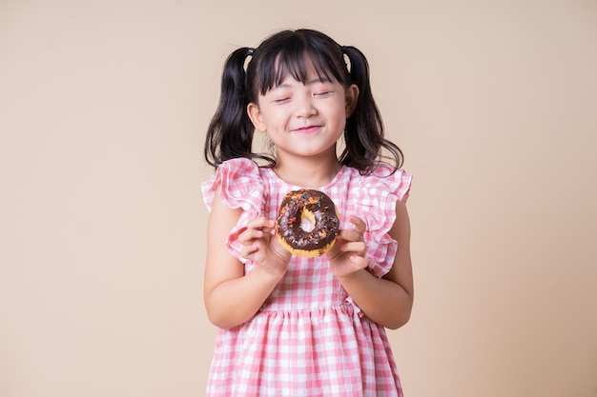
Suggested answer
Presentation
Production
When I was a child, I would always eat chocolate.

Slide 54

WRAP-UP

Slide 55
Today’s lesson
Review:
Review the target language learned in the unit
Practice test-taking skills

Slide 56
Homework
Review the target language learned in the unit
Prepare for the next lesson (Review 2 - Pages 88 & 89 - SB).
Play the consolidation games on www.eduhome.com.vn

Slide 57

Lesson 3
Stay positive and have a nice day!

