Slide 1
Unit 2: Life in the past
Lesson 3.1: Reading
Page 22

Slide 2
Lesson Outline
Warm-up
Pre-Reading
While-Reading
Post-Reading
Consolidation
Wrap-up

Slide 3
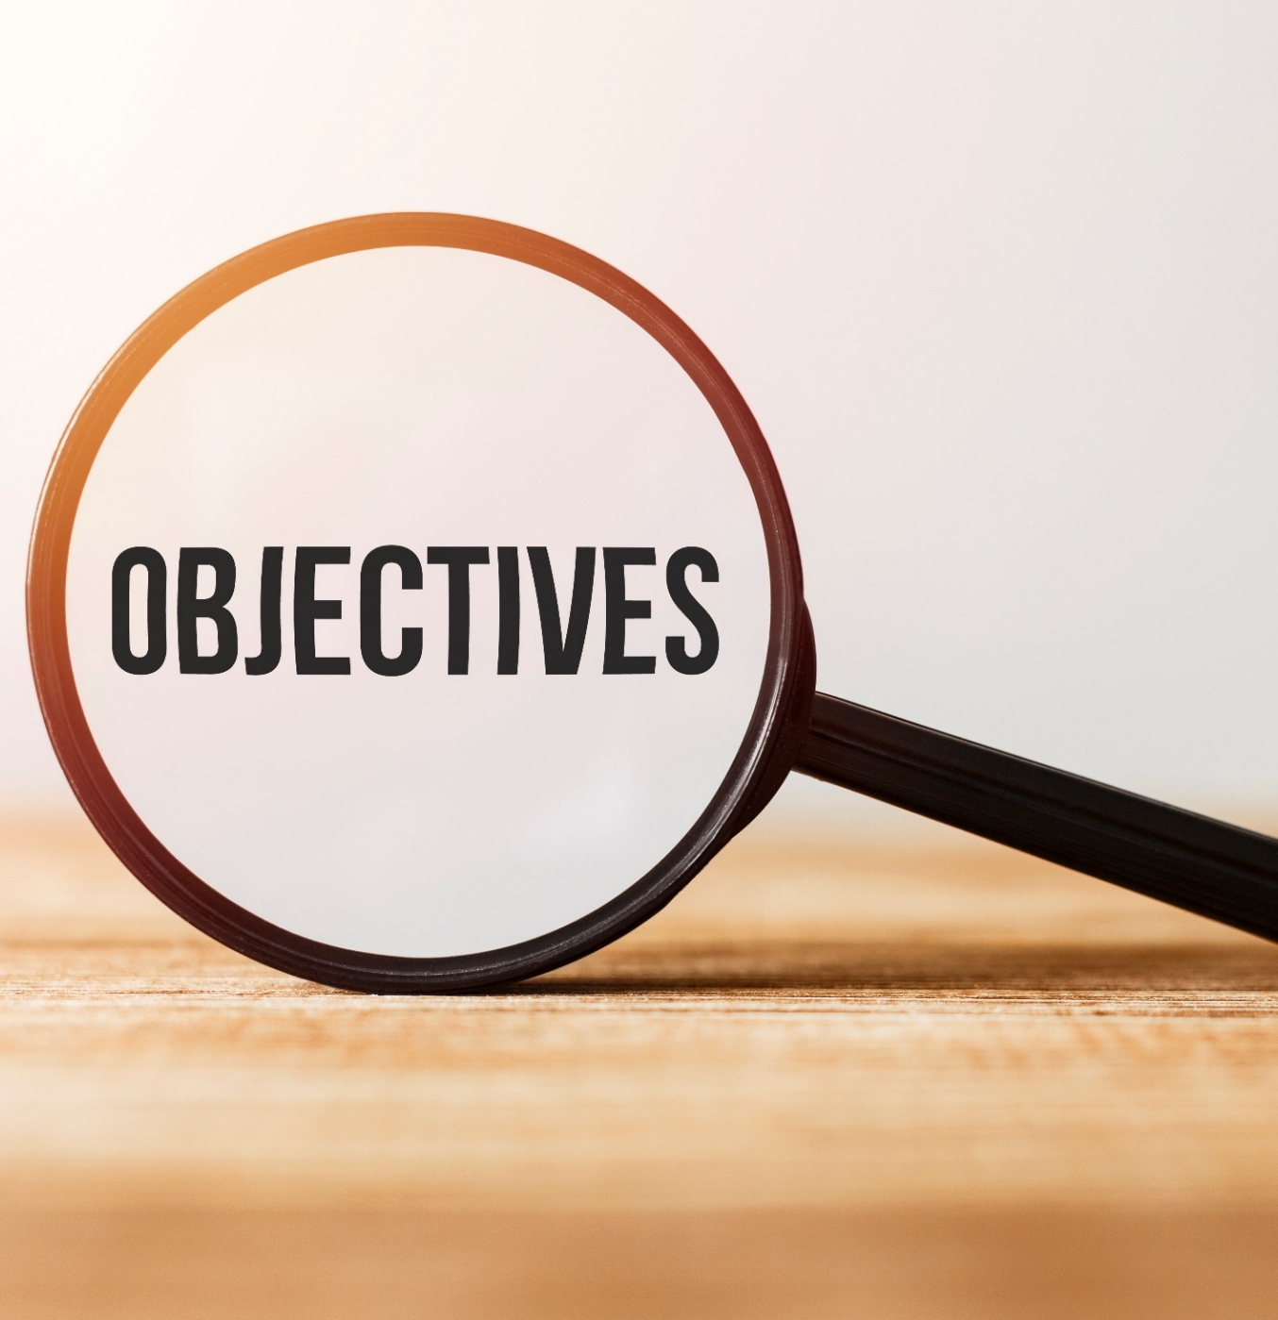
By the end of this lesson, students will be able to…
learn vocabulary related to the life of a family member.
practice reading for main idea and specific information/details.

Slide 4
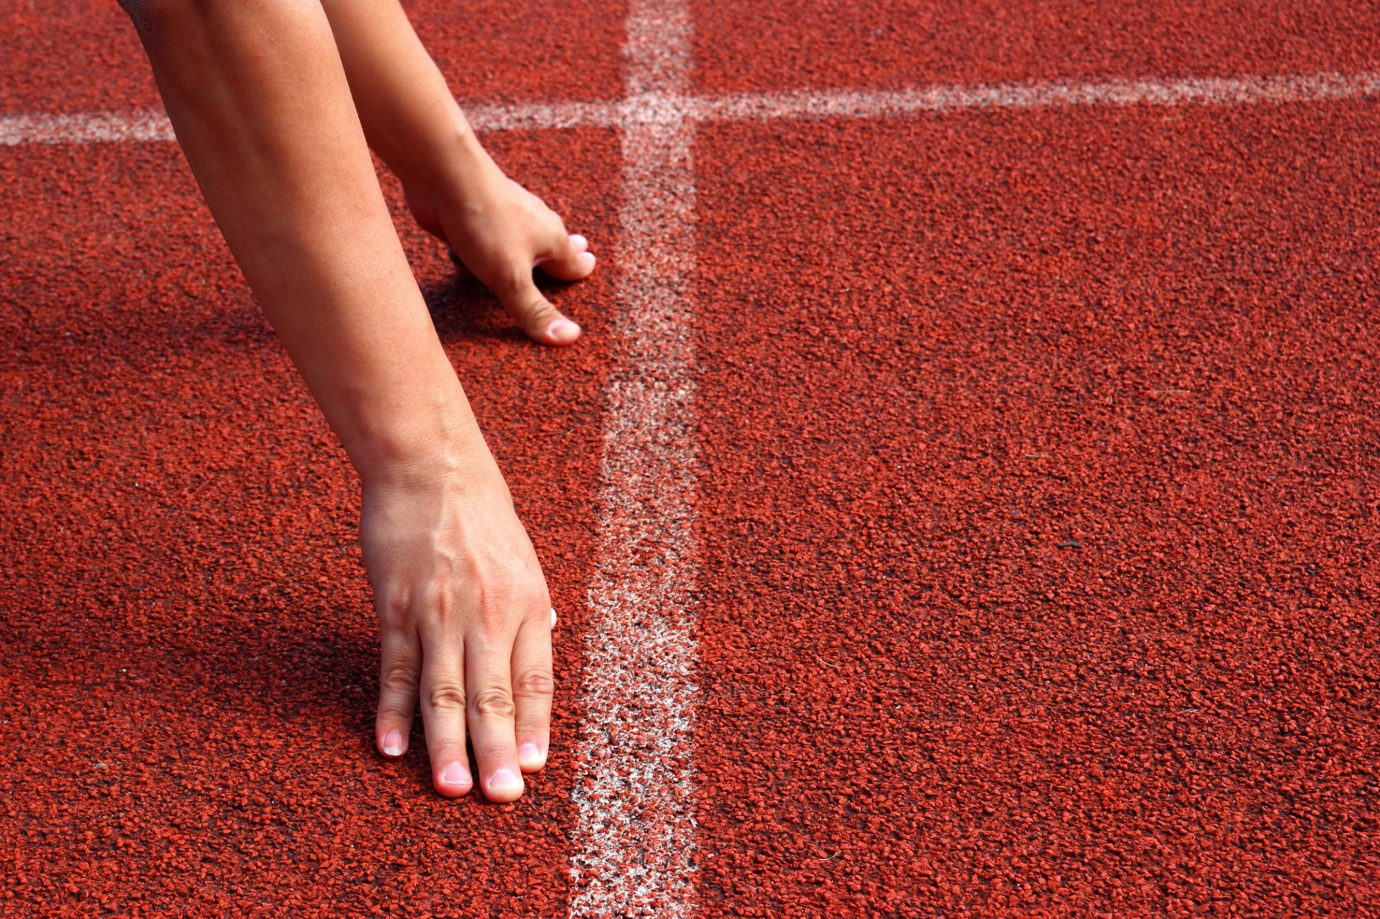
WARM-UP

Slide 5
Work in pairs. Look at the pictures:
What are the people doing?
Do you have any similar childhood memories with your family?

Slide 6
Suggested answers
1.A:What are the people doing?
B: In picture 1, children are building sandcastles with their parents.
In picture 2, a girl is cooking with her father.

Slide 7
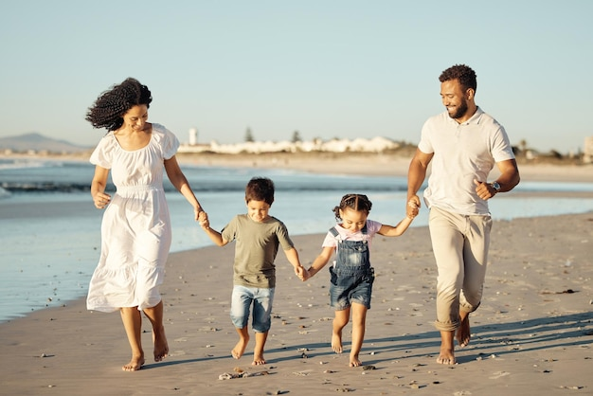
Suggested answers
2.A:Do you have any similar childhood memories with your family?
B: My childhood memories with my family include going to the beach, visiting amusement parks, and having picnics in the park.

Slide 8
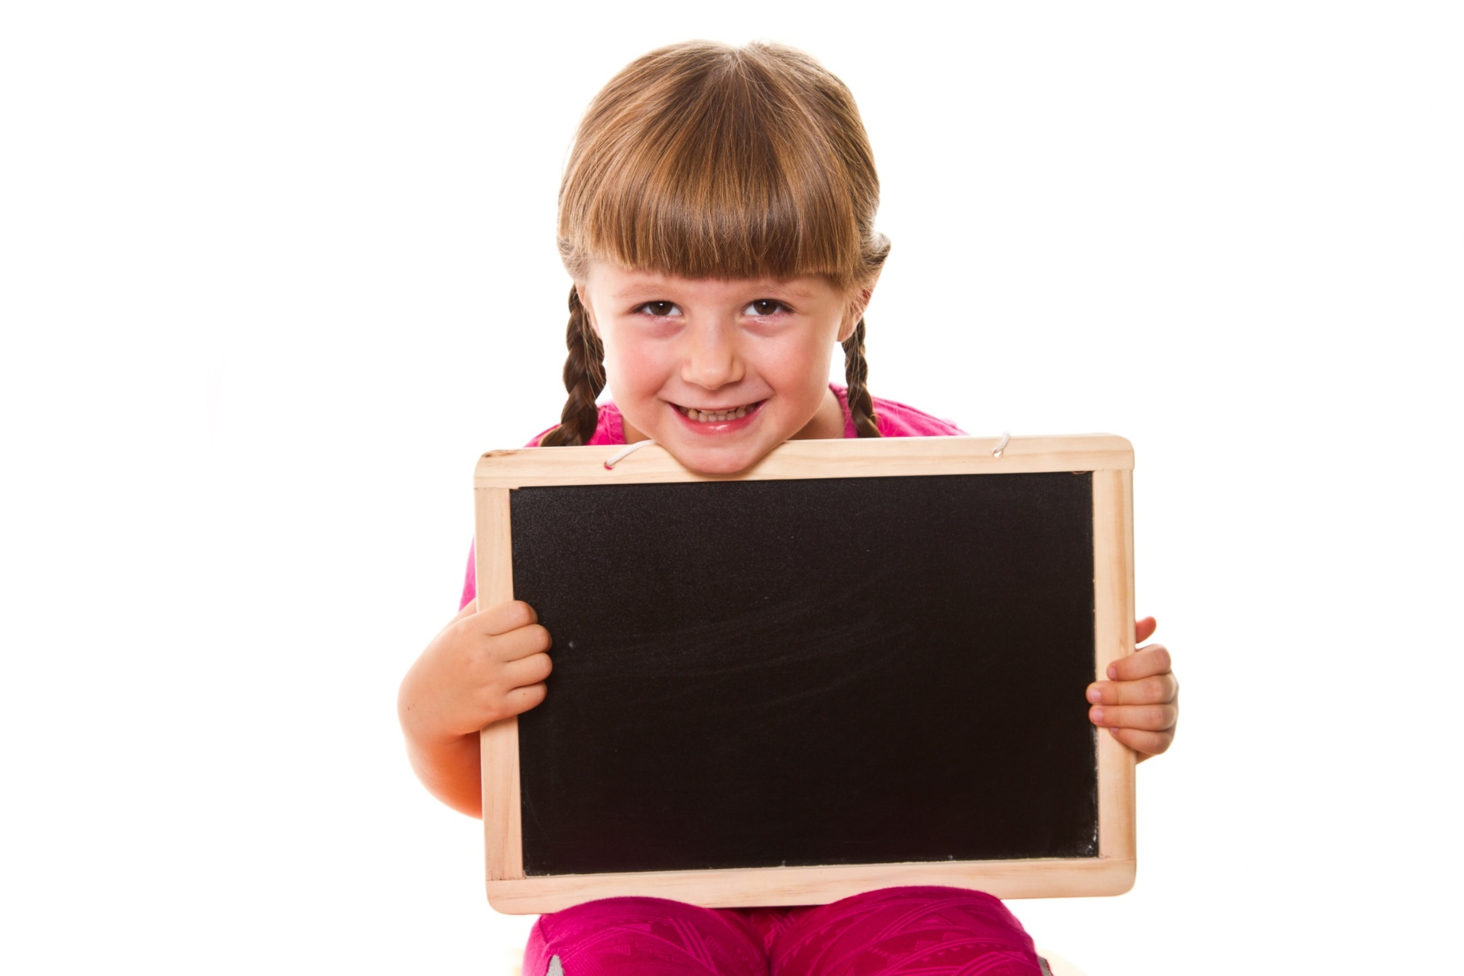
Pre-reading

Slide 9
Vocabularies
afterward (adv)
childhood (n)
fall in love (idm)
meanwhile (adv)
eventually (adv)
overcome (v)
thankful (adj)

Slide 10
Listen and repeat. Practice saying them with a partner.
•
 | 1 | afterward | (adv) | /ˈæftərwərd/ | sau này, sau đó
 | 2 | childhood | (n) | /ˈtʃaɪldhʊd/ | thời thơ ấu
 | 3 | fall in love | (idm) | /fɑːl ɪn lʌv/ | phải lòng, yêu
 | 4 | meanwhile | (adv) | /ˈmiːnwaɪl/ | trong khi đó
•
•

Slide 11
Listen and repeat. Practice saying them with a partner.
 | 5 | eventually | (adv) | /ɪˈventʃuəli/ | sau cùng thì, cuối cùng thì
 | 6 | overcome | (v) | /ˌoʊvərˈkʌm/ | vượt qua
 | 7 | thankful | (adj) | /ˈθæŋkfəl/ | biết ơn
•
•
•

Slide 12
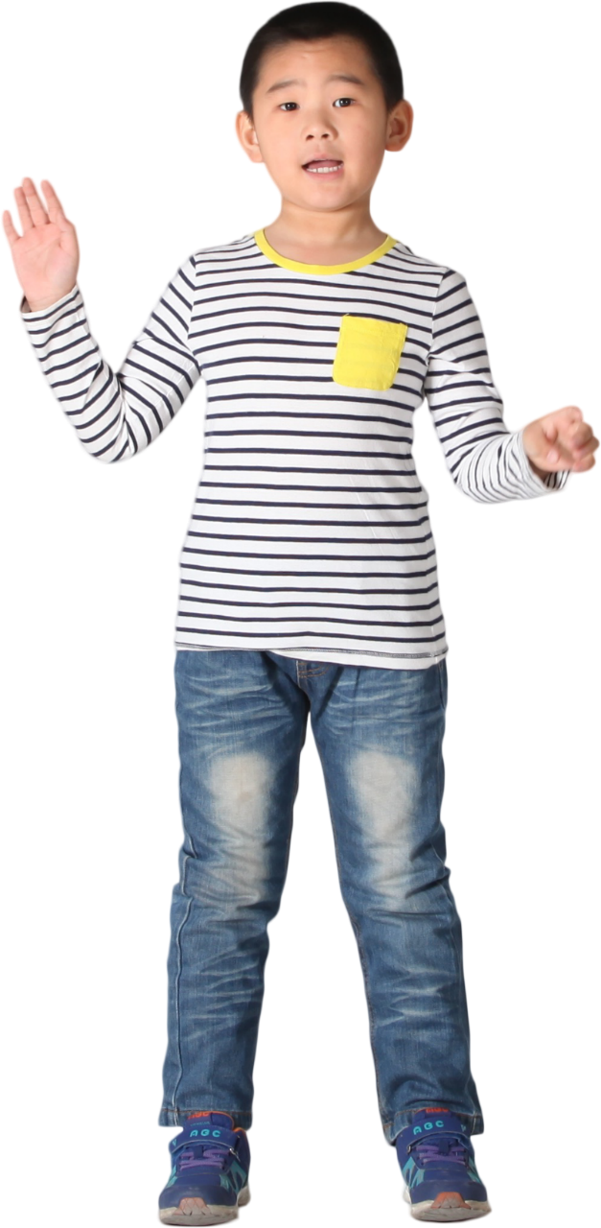
Task b. In pairs: Use the new words to talk about childhood memories you know.
Suggested answer
I am thankful for the love and support my family provided during my childhood.

Slide 13
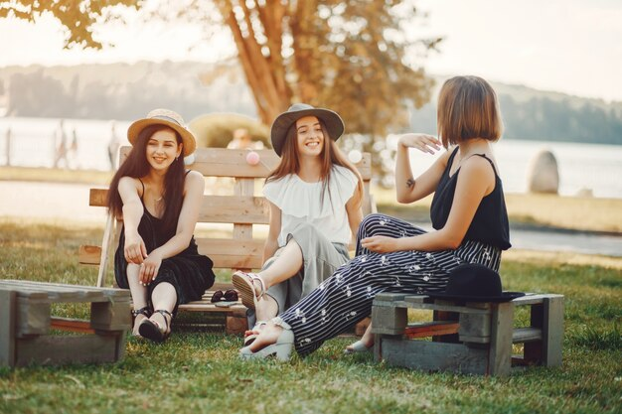
Suggested answer
We had tea. Afterward, we sat in the garden to share stories about our childhood adventures.

Slide 14
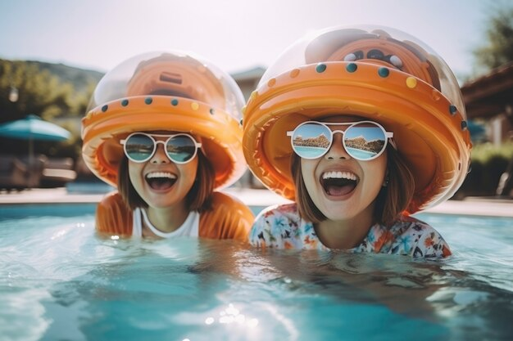
Suggested answer
2. During my childhood, I would often go swimming with my friends.

Slide 15
Suggested answer
3. My parents eventually let me go to the party when I was in high school.

Slide 16
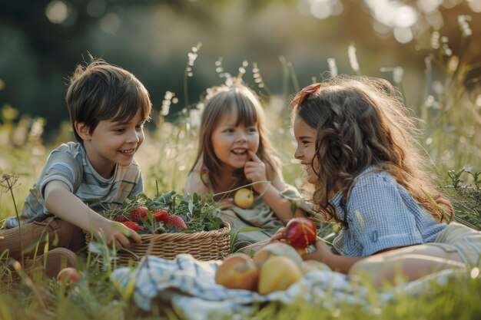
Suggested answer
4. Falling in love with nature was a significant part of my childhood experience.

Slide 17
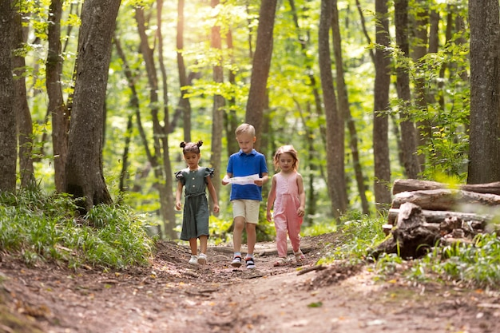
Suggested answer
5. Meanwhile, I would often explore the woods behind our house with my friends during my childhood.

Slide 18
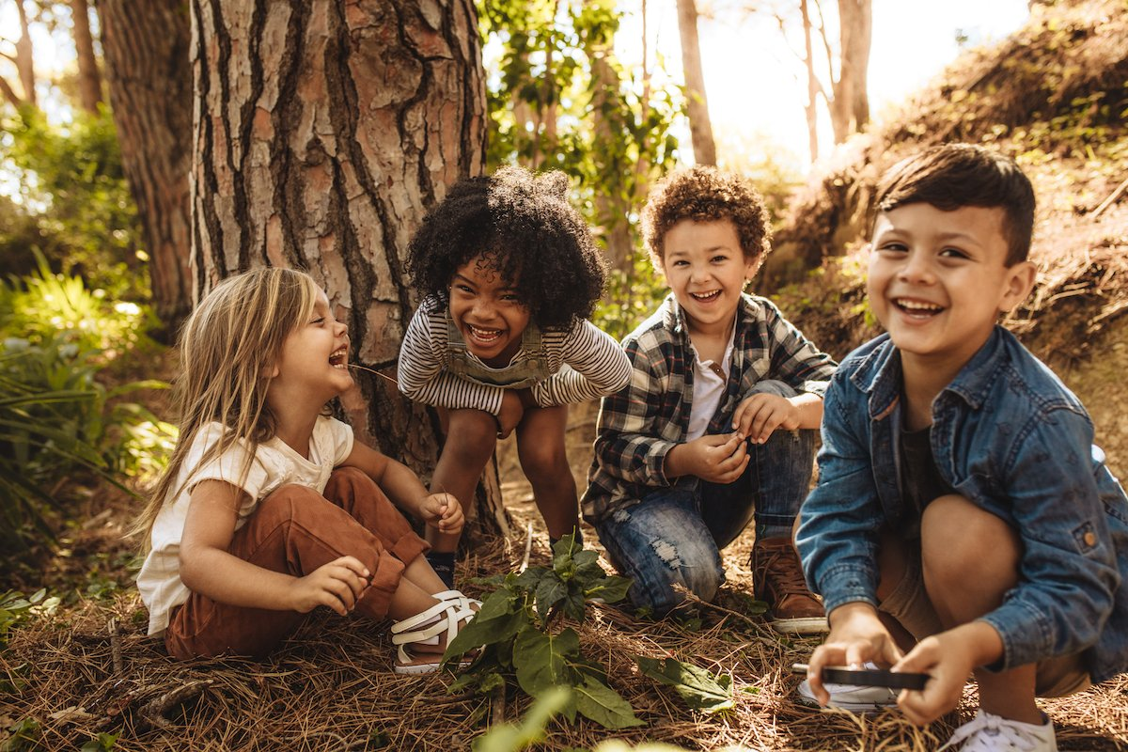
Suggested answer
6. Despite facing challenges, we were able to overcome them together during our childhood years.

Slide 19
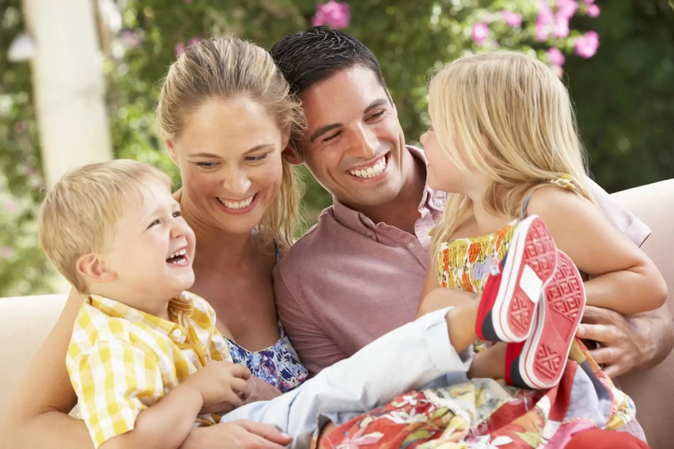
Suggested answer
7. I am thankful for the love and support my family provided during my childhood.

Slide 20
Task a. Read the passage about Lan's grandmother. What lesson does Lan get from her grandmother's stories?
Underline the key words
1. We should work hard to overcome difficulties.
2. We should keep our hope in difficult times.

Slide 21
While-reading

Slide 22
When I was a kid, I used to stay with my grandmother after school. She'd often tell me stories about her life in the past, and I found them very interesting.
Her childhood was different from mine. She grew up in a large, extended family. Her family was poor, and she only finished elementary school. When she was thirteen, she started working. Her uncle cooked for wedding parties, and she'd go with him to those parties to help him.

Slide 23
Afterward, she worked at a pottery place. She was good at making pottery and proud of the things she made. My grandfather also started working there. They fell in love and got married two years later.
My grandparents worked hard to build a family together. After they had their first child, my grandfather continued to work at the pottery place. Meanwhile, my grandmother sold groceries at home. They eventually saved enough money to buy a house of their own and raised three children.
I sometimes think about the stories my grandmother told me and feel thankful for her and my grandfather. Whenever I have a difficult problem, I think about those stories and tell myself to continue to work hard.

Slide 24
Task a. Read the passage about Lan's grandmother. What lesson does Lan get from her grandmother's stories?
ANSWERS
1. We should work hard to overcome difficulties.
2. We should keep our hope in difficult times.
I sometimes think about the stories my grandmother told me and feel thankful for her and my grandfather. Whenever I have a difficult problem, I think about those stories and tell myself to continue to work hard.

Slide 25
Task b. Now, read and choose the correct answers.

Slide 26
Pre-reading

Slide 27
Task b. Now, read and choose the correct answers.
Underline the key words
1. What does the word them in paragraph 1 refer to?
A. Lan's stories
B. Lan's school days
C. Lan's grandmother's stories
D. Lan's family members
2. What was Lan's grandmother's childhood like?
It was difficult.
There were many adventures.
C. It was fun.
D. There were many parties.

Slide 28
Task b. Now, read and choose the correct answers.
Underline the key words
3. What was her grandmother's first job?
A. helping at wedding parties
B. selling groceries
C. making pottery
D. cooking at a restaurant
4. Where did Lan's grandmother meet her grandfather?
A. at a party
B. at school
C. at the market
D. at work

Slide 29
Task b. Now, read and choose the correct answers.
Underline the key words
5. Which of the following is NOT true about Lan's grandmother?
A. She didn't go to high school.
B. She liked making pottery.
C. She went to work after having her first child.
D. She started working from a young age.

Slide 30
While-reading

Slide 31
Task b. Now, read and choose the correct answers.
ANSWERS
1. What does the word them in paragraph 1 refer to?
A. Lan's stories
B. Lan's school days
C. Lan's grandmother's stories
D. Lan's family members
When I was a kid, I used to stay with my grandmother after school. She'd often tell me stories about her life in the past, and I found them very interesting.

Slide 32
Task b. Now, read and choose the correct answers.
ANSWERS
Her childhood was different from mine. She grew up in a large, extended family. Her family was poor, and she only finished elementary school. When she was thirteen, she started working. Her uncle cooked for wedding parties, and she'd go with him to those parties to help him.
2. What was Lan's grandmother's childhood like?
It was difficult.
There were many adventures.
C. It was fun.
D. There were many parties.

Slide 33
Task b. Now, read and choose the correct answers.
ANSWERS
3. What was her grandmother's first job?
A. helping at wedding parties
B. selling groceries
C. making pottery
D. cooking at a restaurant
When she was thirteen, she started working. Her uncle cooked for wedding parties, and she'd go with him to those parties to help him.

Slide 34
Task b. Now, read and choose the correct answers.
ANSWERS
4. Where did Lan's grandmother meet her grandfather?
A. at a party
B. at school
C. at the market
D. at work
Afterward, she worked at a pottery place. She was good at making pottery and proud of the things she made. My grandfather also started working there. They fell in love and got married two years later.

Slide 35
Task b. Now, read and choose the correct answers.
ANSWERS
5. Which of the following is NOT true about Lan's grandmother?
A. She didn't go to high school.
B. She liked making pottery.
C. She went to work after having her first child.
D. She started working from a young age.
My grandparents worked hard to build a family together. After they had their first child, my grandfather continued to work at the pottery place. Meanwhile, my grandmother sold groceries at home. They eventually saved enough money to buy a house of their own and raised three children.

Slide 36
Task b. Now, read and choose the correct answers.
ANSWERS
5. Which of the following is NOT true about Lan's grandmother?
A. She didn't go to high school.
B. She liked making pottery.
C. She went to work after having her first child.
D. She started working from a young age.
Her family was poor, and she only finished elementary school. When she was thirteen, she started working….
…. She was good at making pottery and proud of the things she made ….

Slide 37
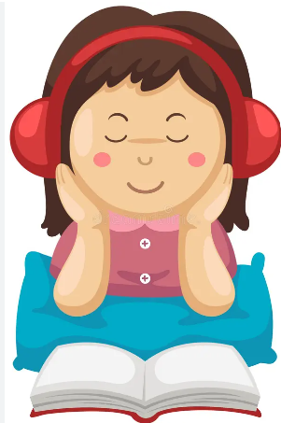
Task c. Listen and read.

Slide 38
Post-reading

Slide 39
Task d. In pairs: : Ask and answer:
What do you know about your grandparents' childhoods? How is your life different or similar?

Slide 40
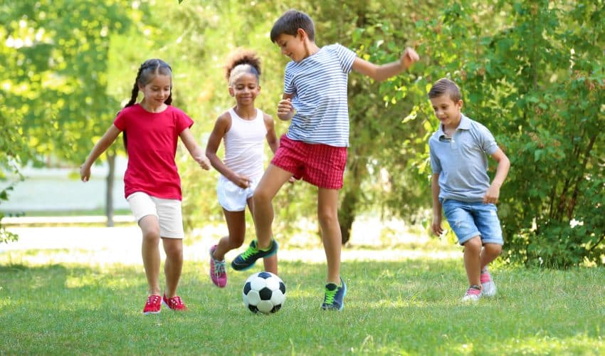
Suggested answer
What do you know about your grandparents' childhoods?
I know that my grandparents had a simpler childhood compared to mine. They would often play outdoors and help their parents with chores.

Slide 41
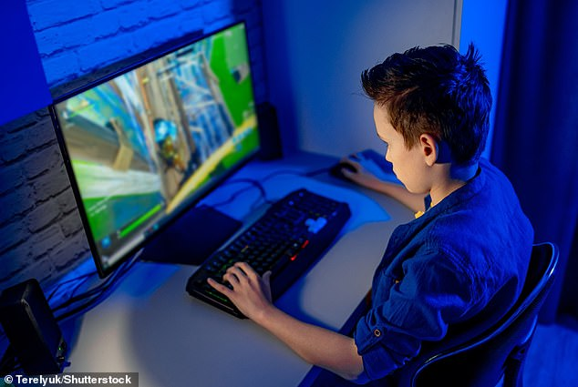
Suggested answer
A: How is your life different or similar?
My life is different from my grandparents' life. I often play video games in my room

Slide 42
Extra
Practice
Presentation

Slide 43
Read the passage about Lan's grandmother again and fill in the blanks.
1.When I was young, I used to spend time with my ________ after school. She told me stories about her life.
2.Her childhood was different from mine. She grew up in a big family and had to start ________ at the age of thirteen.
3.Later, she worked at a ________ place, and my grandfather worked there too. They fell in love and got married.
4.My grandparents worked hard and eventually bought their own house. I'm ________ for their stories.

Slide 44
Underline the key words and guess the type of missing word(s).
1.When I was young, I used to spend time with my ________ after school. She told me stories about her life.
2.Her childhood was different from mine. She grew up in a big family and had to start ________ at the age of thirteen.
3.Later, she worked at a ________ place, and my grandfather worked there too. They fell in love and got married.
4.My grandparents worked hard and eventually bought their own house. I'm ________ for their stories.
noun
V-ing
Adj/ noun
Adj

Slide 45
Read the passage about Lan's grandmother again and fill in the blanks.
ANSWERS
1.When I was young, I used to spend time with my _____________ after school. She told me stories about her life
When I was a kid, I used to stay with my grandmother after school. She'd often tell me stories about her life in the past, and I found them very interesting.
grandmother

Slide 46
Read the passage about Lan's grandmother again and fill in the blanks.
ANSWERS
She grew up in a large, extended family. Her family was poor, and she only finished elementary school. When she was thirteen, she started working. Her uncle cooked for wedding parties, and she'd go with him to those parties to help him.
2.Her childhood was different from mine. She grew up in a big family and had to start ________ at the age of thirteen
working

Slide 47
Read the passage about Lan's grandmother again and fill in the blanks.
ANSWERS
3.Later, she worked at a ________ place, and my grandfather worked there too. They fell in love and got married
Afterward, she worked at a pottery place. She was good at making pottery and proud of the things she made. My grandfather also started working there. They fell in love and got married two years later.
pottery

Slide 48
Read the passage about Lan's grandmother again and fill in the blanks.
ANSWERS
4.My grandparents worked hard and eventually bought their own house. I'm ________ for their stories.
I sometimes think about the stories my grandmother told me and feel thankful for her and my grandfather. Whenever I have a difficult problem, I think about those stories and tell myself to continue to work hard.
thankful

Slide 49
Extra
Practice
WORKBOOK
Presentation

Slide 50
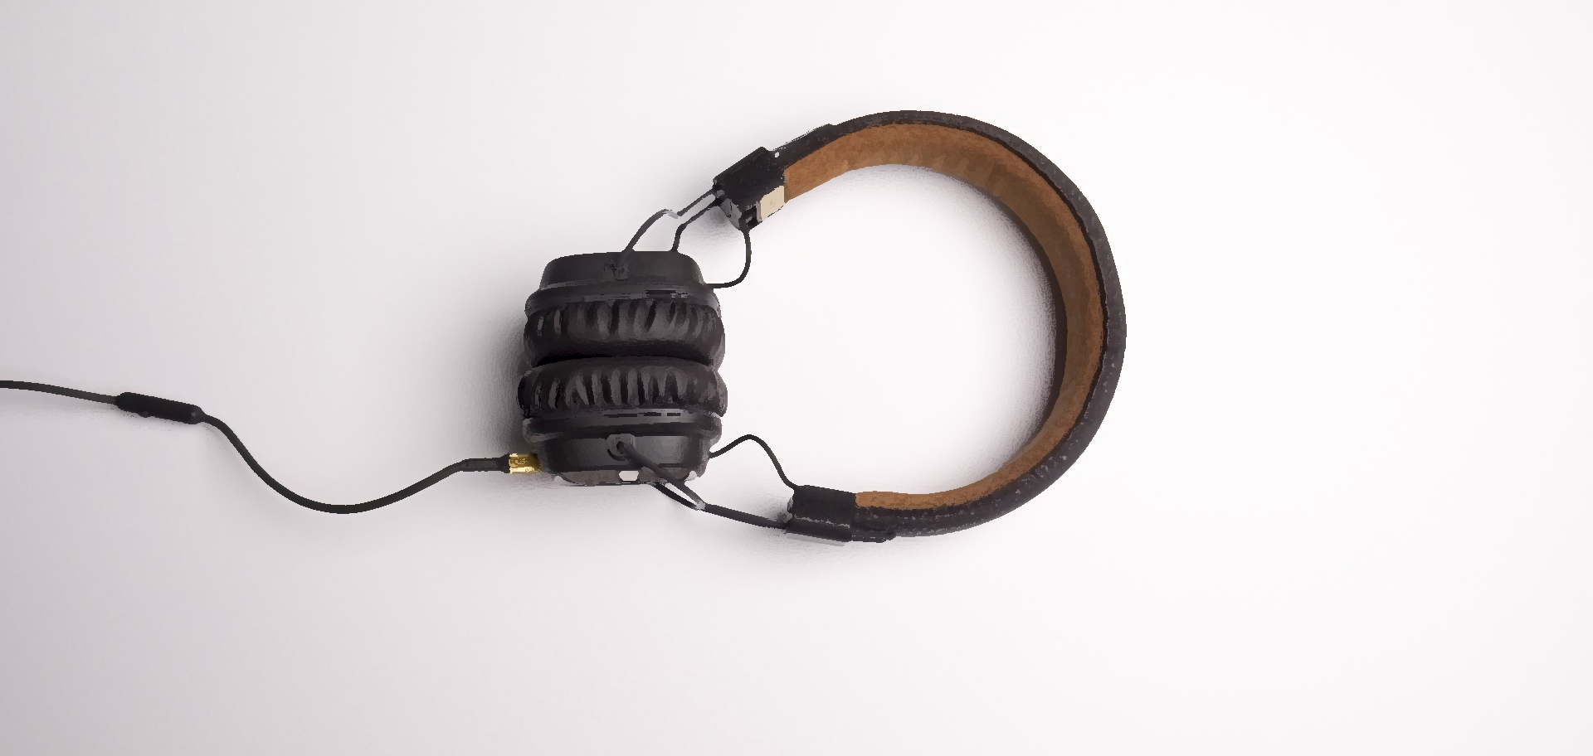
LISTENING

Slide 51
WB - p12 - Task a. Listen to Molly and Freddie talking about Freddie's grandparents. Were they traditional people?
1. yes
2. no

Slide 52
WB - p12 - Task a. Listen to Molly and Freddie talking about Freddie's grandparents. Were they traditional people?
ANSWERS
Freddie: Yeah. He grew up on a farm with his parents. He lived there with my grandma after they got married and he was the breadwinner…………
Freddie: Chickens, cows, and they had some pigs too. Molly: What did your grandma do?
Freddie: She helped on the farm a bit. But she was a traditional housewife. She cooked all the meals and looked after the house.
1. yes
2. no

Slide 53
WB - p12 - Task b. Now, listen and circle True or False.
Underline the key words
1. Freddie's grandpa used to live on a farm with his parents. | True | False
2. He didn't grow vegetables on the farm. | True | False
3. Freddie's grandma was a housewife. | True | False
4. She wasn't a very good cook. | True | False
5. Freddie's grandparents moved into town when they got old. | True | False

Slide 54
WB - p12 - Task b. Now, listen and circle True or False.
1. Freddie's grandpa used to live on a farm with his parents. | True | False
2. He didn't grow vegetables on the farm. | True | False
3. Freddie's grandma was a housewife. | True | False
4. She wasn't a very good cook. | True | False
5. Freddie's grandparents moved into town when they got old. | True | False

Slide 55
WB - p12 - Task b. Now, listen and circle True or False.
ANSWERS
1. Freddie's grandpa used to live on a farm with his parents. | True | False
Molly: It was nice to meet your grandpa last week, Freddie. He was really interesting.
Freddie: Yeah. He's awesome. We used to have such a good time on his farm.
Molly: He lived on a farm?
Freddie: Yeah. He grew up on a farm with his parents. He lived there with my grandma after they got married and he was the breadwinner.

Slide 56
WB - p12 - Task b. Now, listen and circle True or False.
ANSWERS
2. He didn't grow vegetables on the farm. | True | False
Molly: Cool.
Freddie: Yeah. He used to be really busy on the farm. He had a few people that worked on the farm to help him. They would grow so many different vegetables and raise lots of animals.

Slide 57
WB - p12 - Task b. Now, listen and circle True or False.
ANSWERS
3. Freddie's grandma was a housewife. | True | False
Freddie: Chickens, cows, and they had some pigs too. Molly: What did your grandma do?
Freddie: She helped on the farm a bit. But she was a traditional housewife. She cooked all the meals and looked after the house.

Slide 58
WB - p12 - Task b. Now, listen and circle True or False.
ANSWERS
4. She wasn't a very good cook. | True | False
Molly: Cool.
Freddie: She was an amazing cook, Molly. She would make this delicious soup.

Slide 59
WB - p12 - Task b. Now, listen and circle True or False.
ANSWERS
5. Freddie's grandparents moved into town when they got old. | True | False
Freddie: When both my grandparents got too old, they sold the farm and moved into town.
Molly: That's nice.
Freddie: Yeah. They lived closer to me, so I saw them a lot more.

Slide 60
SCRIPT- WB-Track 05
Molly: It was nice to meet your grandpa last week, Freddie. He was really interesting.
Freddie: Yeah. He's awesome. We used to have such a good time on his farm.
Molly: He lived on a farm?
Freddie: Yeah. He grew up on a farm with his parents. He lived there with my grandma after they got married and he was the breadwinner.
Molly: Cool.
Freddie: Yeah. He used to be really busy on the farm. He had a few people that worked on the farm to help him. They would grow so many different vegetables and raise lots of animals.

Slide 61
SCRIPT- WB-Track 05
Molly: What animals did they raise?
Freddie: Chickens, cows, and they had some pigs too.
Molly: What did your grandma do?
Freddie: She helped on the farm a bit. But she was a traditional housewife. She cooked all the meals and looked after the house.
Molly: Cool.
Freddie: She was an amazing cook, Molly. She would make this delicious soup.
Molly: Great.
Freddie: When both my grandparents got too old, they sold the farm and moved into town.
Molly: That's nice.
Freddie: Yeah. They lived closer to me, so I saw them a lot more.

Slide 62
READING

Slide 63
WB - p12 - Task a. Read the passage about a boy's grandma. What information is NOT mentioned?
Underline the key words
1. where she used to live
2. where she went on vacation 3. where she used to work

Slide 64
WB - p12 - Task a. Read the passage about a boy's grandma. What information is NOT mentioned?
ANSWERS
She used to work in a restaurant when she was a teenager. She learned how to cook traditional food. She would practice cooking at home for her whole family. She would make delicious meals, and it gave her mom time to relax.
My grandma used to go on vacation to the beach every summer.
1. where she used to live
2. where she went on vacation 3. where she used to work

Slide 65
My Grandma-by Max Bradford
My grandma used to tell me lots of stories about her life growing up. She had a really interesting life when she was young.
She used to work in a restaurant when she was a teenager. She learned how to cook traditional food. She would practice cooking at home for her whole family. She would make delicious meals, and it gave her mom time to relax.
My grandma used to go on vacation to the beach every summer. She would go surfing in the sea with her brother. She took me and my sister once and eventually taught us how to do it, too. She was a great teacher.

Slide 66
My Grandma-by Max Bradford
She was also the first person in her family to go to university. That was where she met my grandpa. She learned how to be a doctor there. She worked as a doctor for many years, but stopped when she had my mom. Afterward, she was a housewife.
I love hearing stories about my grandma's life. She did so many interesting things, and she made her whole family really proud. I hope I grow up to be like her.

Slide 67
WB - p12 - Task b. Now, read and answer the questions.
Underline the key words and guess the answers.
Suggested answer
1. What did Max's grandma learn to cook?
2. Who did she go surfing with?
3. What did she teach him?
4. Where did she meet her husband?
5. What job did she have before she was a housewife?
(type of food)
(a person)
(skills)
(a place)
(a job)

Slide 68
WB - p12 - Task b. Now, read and answer the questions.
ANSWERS
1. What did Max's grandma learn to cook?
_______________________
She used to work in a restaurant when she was a teenager. She learned how to cook traditional food. She would practice cooking at home for her whole family.
traditional food

Slide 69
WB - p12 - Task b. Now, read and answer the questions.
ANSWERS
2. Who did she go surfing with?
_______________________
_______________________
My grandma used to go on vacation to the beach every summer. She would go surfing in the sea with her brother. She took me and my sister once and eventually taught us how to do it, too. She was a great teacher.
her brother/
Max's grandma's brother

Slide 70
WB - p12 - Task b. Now, read and answer the questions.
ANSWERS
3. What did she teach him?
_______________________
She would go surfing in the sea with her brother. She took me and my sister once and eventually taught us how to do it, too. She was a great teacher.
how to surf

Slide 71
WB - p12 - Task b. Now, read and answer the questions.
ANSWERS
4. Where did she meet her husband?
_______________________
She was also the first person in her family to go to university. That was where she met my grandpa
at university

Slide 72
WB - p12 - Task b. Now, read and answer the questions.
ANSWERS
5. What job did she have before she was a housewife? _______________________
She learned how to be a doctor there. She worked as a doctor for many years, but stopped when she had my mom. Afterward, she was a housewife
a doctor

Slide 73
CONSOLIDATION

Slide 74
Ask and answer the question below with your partner about childhood memories.
Where did you use to go for family vacations when you were a child?

Slide 75
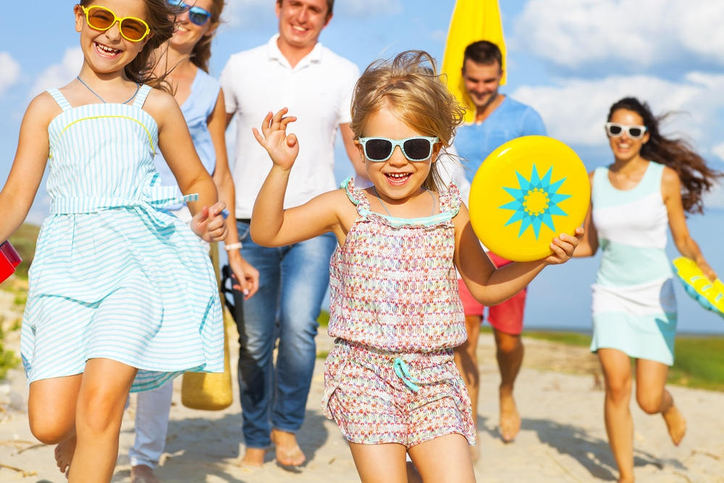
Suggested answer
Presentation
Production
We used to go to the beach for family vacations when I was a child.

Slide 76
WRAP-UP

Slide 77
Vocabularies
afterward (adv)
childhood (n)
eventually (adv)
fall in love (idm)
meanwhile (adv)
overcome (v)
thankful (adj)
Today’s lesson

Slide 78
Today’s lesson
Vocabulary:
- Use vocabularies related to life of a family member.
Reading:
- Practice reading for main idea and specific information/ details.

Slide 79
Homework
Review vocabularies related to life of a family member.
Make sentences using vocabularies in SB
Prepare for the next lesson (Speaking & Writing - Page 23 - SB)
Play the consolidation games on www.eduhome.com.vn

Slide 80
Lesson 3
Stay positive and have a nice day!

