Slide 1
Unit 2: Life in the past
Lesson 1.1: Vocab & Reading
Pages 14 & 15

Slide 2
Lesson Outline
Warm-up
Vocabulary
Reading
Consolidation
Wrap-up

Slide 3
By the end of this lesson, students will be able to…
- learn vocabulary related to life in the past.
- read and understand an interview about family life in the past
- practice reading for gist and details

Slide 4
WARM-UP

Slide 5
Work in pairs. Look at the pictures:
What are the relationships between these people?
What Vietnamese family traditions and customs do you know?

Slide 6
Suggested answers:
-They are family members.
-I know Lunar New Year festivities and customs, family meals and gatherings on special occasions.

Slide 7
Pre-reading

Slide 9
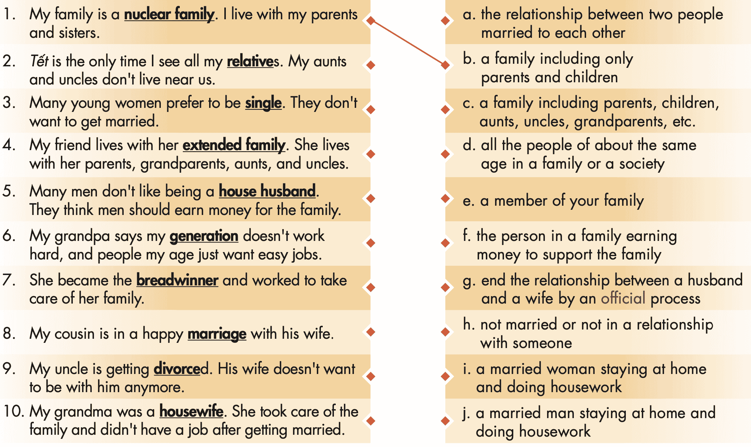
Task a. Match the underlined words with the definitions.

Slide 10
Task a. Match the underlined words with the definitions.
ANSWERS
b. a family including only parents and children
1. My family is a nuclear family. I live with my parents and sisters.
2. Tết is the only time I see all my relatives. My aunts and uncles don't live near us.
3. Many young women prefer to be single. They don't want to get married.
e. a member of your family
h. not married or not in a relationship with someone

Slide 11
Task a. Match the underlined words with the definitions.
ANSWERS
4. My friend lives with her extended family. She lives with her parents, grandparents, aunts, and uncles.
5. Many men don't like being a house husband. They think men should earn money for the family.
c. a family including parents, children, aunts, uncles, grandparents, etc.
j. a married man staying at home and doing housework

Slide 12
Task a. Match the underlined words with the definitions.
ANSWERS
6. My grandpa says my generation doesn't work hard, and people my age just want easy jobs.
7. She became the breadwinner and worked to take care of her family.
8. My cousin is in a happy marriage with his wife.
d. all the people of about the same age in a family or a society
f. the person in a family earning money to support the family
a. the relationship between two people married to each other

Slide 13
Task a. Match the underlined words with the definitions.
ANSWERS
9. My uncle is getting divorced. His wife doesn't want to be with him anymore.
10. My grandma was a housewife. She took care of the family and didn't have a job after getting married.
g. end the relationship between a husband and a wife by an official process
i. a married woman staying at home and doing housework

Slide 14
Task a. Listen and repeat
nuclear family
relatives
single
extended family
house husband
generation
breadwinner
marriage
divorced
housewife

Slide 15
Listen and repeat. Click each phrase to hear the sound.
 | 1 | nuclear family | (n phr) | /ˌnuːkliər ˈfæməli/ | gia đình hạt nhân
 | 2 | relative | (n) | /ˈrelətɪv/ | họ hàng
 | 3 | single | (adj) | /ˈsɪŋɡl/ | độc thân
 | 4 | extended family | (n phr) | /ɪkˌstendɪd ˈfæməli/ | gia đình mở rộng, đại gia đình
 | 5 | house husband | (n) | /ˈhaʊs ˌhʌzbənd/ | người chồng làm nội trợ
•
•
•
•
•
•
•

Slide 16
Listen and repeat. Click each phrase to hear the sound.
•
 | 6 | generation | (n) | /ˌdʒenəˈreɪʃn/ | thế hệ
 | 7 | breadwinner | (n) | /ˈbredˌwɪnər/ | lao động chính
 | 8 | marriage | (n) | /ˈmerɪdʒ/ | hôn nhân
 | 9 | divorce | (v) | /dɪˈvɔːrs/ | ly hôn
 | 10 | housewife | (n) | /ˈhaʊswaɪf/ | người vợ làm nội trợ
•
•
•
•

Slide 17
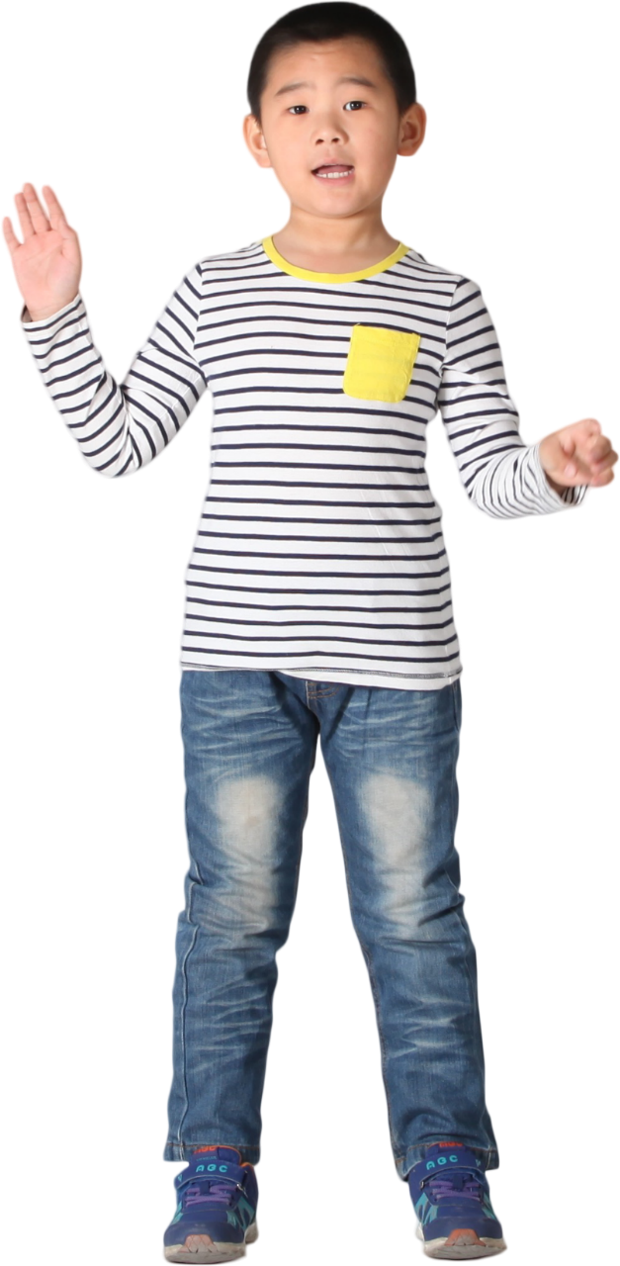
Task b. In pairs: Use the new words to talk about your family or people you know.

Slide 18
Suggested answer
My cousin lives in a nuclear family with his wife and two children.

Slide 19
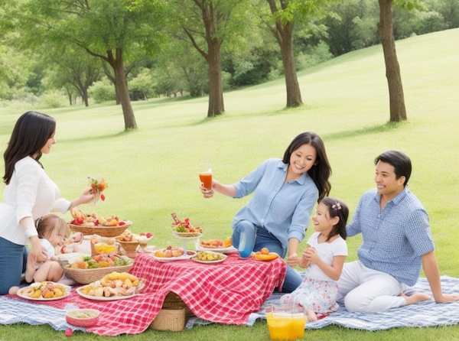
Suggested answer
2. We often have gatherings with our relatives during the holidays.

Slide 20
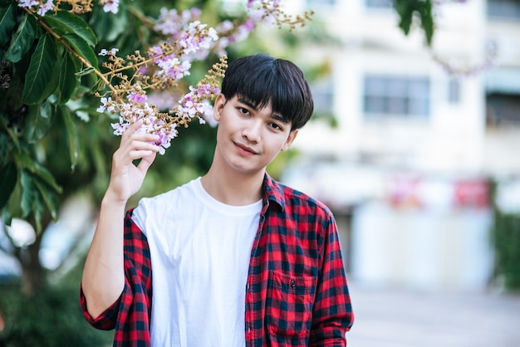
Suggested answer
3. My brother is single.

Slide 21
Suggested
answer
4. My friend lives in an extended family

Slide 22
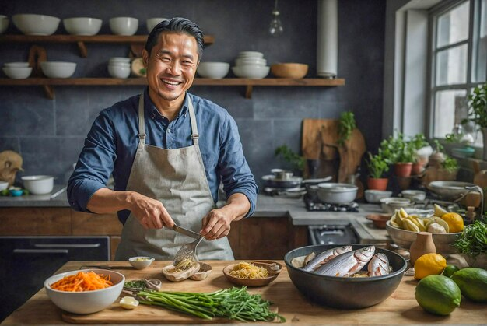
Suggested answer
5. My father is a house husband.

Slide 23
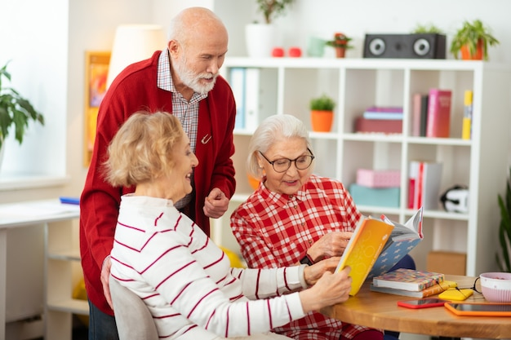
Suggested answer
6. The older generation in our family often shares stories about their childhood.

Slide 24
Suggested answer
7. My uncle is the breadwinner of his family.

Slide 25
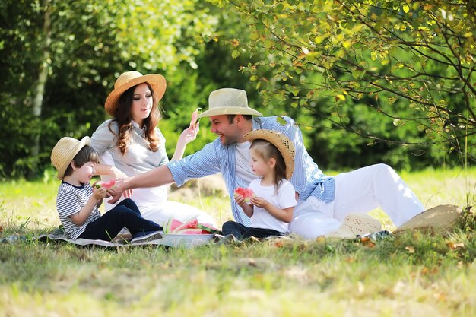
Suggested answer
8. My parents are in a happy marriage.

Slide 26
Suggested answer
9. My sister got divorced last year.

Slide 27
Suggested answer
10. My aunt chose to become a housewife to focus on raising her children.

Slide 28
While-reading

Slide 29
Task a. Read the interview with Mrs. Nguyễn about her memories of family life in the past. What does it mainly discuss?
Underline the key words
1. why families in the past were better
2. the differences between now and then

Slide 30
Interviewer: Mrs. Nguyễn, you have 13 children and 24 grandchildren. That isn't common now. What were families in the past like?
Mrs. Nguyễn: Back then, three or four generations would live together in extended families. Most people have a nuclear family now. Most of my children don't live with me anymore.
Interviewer: What do you think about this change?
Mrs. Nguyễn: Hmm, the smaller family size allows people to be more independent. But sometimes it makes the connections between relatives weaker.

Slide 31
Interviewer: What about marriage in the past?
Mrs. Nguyễn: In the past, married people would live together their whole lives. There weren't many single women, and they often had a difficult life.
Interviewer: Now, some people choose to be single parents or single because they aren't afraid of getting divorced or living alone.
Mrs. Nguyễn: I think that's a positive thing, mostly. Some people just can't live together.

Slide 32
Interviewer: Were the roles of family members different?
Mrs. Nguyễn: Yes. The husband was the breadwinner in the past, and the wife would stay at home. Now, many men help their wives do housework. And I know that in many families, both parents are working because it costs a lot of money to raise a child now.
Interviewer: Thanks for sharing your memories with me.

Slide 33
Task a. Read the interview with Mrs. Nguyễn about her memories of family life in the past. What does it mainly discuss?
ANSWERS
1. why families in the past were better
2. the differences between now and then
Mrs. Nguyễn: Back then, three or four generations would live together in extended families. Most people have a nuclear family now. Most of my children don't live with me anymore.

Slide 34
Task b. Now, read and circle True, False, or Doesn't say.
1. All of Mrs. Nguyễn's children still live with her. | True | False | Doesn't say
2. She says having fewer people living together sometimes affects family connections. | True | False | Doesn't say
3. In the past, most men weren't single. | True | False | Doesn't say
4. Mrs. Nguyễn thinks being a single parent now isn't a good thing. | True | False | Doesn't say
5. She says men went to work, and women did the housework in the past. | True | False | Doesn't say

Slide 35
Task b b.
Underline the key words
1. All of Mrs. Nguyễn's children still live with her. | True | False | Doesn't say
2. She says having fewer people living together sometimes affects family connections. | True | False | Doesn't say
3. In the past, most men weren't single. | True | False | Doesn't say
4. Mrs. Nguyễn thinks being a single parent now isn't a good thing. | True | False | Doesn't say
5. She says men went to work, and women did the housework in the past. | True | False | Doesn't say

Slide 36
Task b. Now, read and circle True, False, or Doesn't say.
ANSWERS
1. All of Mrs. Nguyễn's children still live with her. | True | False | Doesn't say
Mrs. Nguyễn: Back then, three or four generations would live together in extended families. Most people have a nuclear family now. Most of my children don't live with me anymore.

Slide 37
Task b. Now, read and circle True, False, or Doesn't say.
ANSWERS
2. She says having fewer people living together sometimes affects family connections. | True | False | Doesn't say
Mrs. Nguyễn: Hmm, the smaller family size allows people to be more independent. But sometimes it makes the connections between relatives weaker.

Slide 38
Task b. Now, read and circle True, False, or Doesn't say.
ANSWERS
3. In the past, most men weren't single. | True | False | Doesn't say
Mrs. Nguyễn: In the past, married people would live together their whole lives. There weren't many single women, and they often had a difficult life.
=> Doesn't say whether “most men weren't single.”

Slide 39
Task b. Now, read and circle True, False, or Doesn't say.
ANSWERS
4. Mrs. Nguyễn thinks being a single parent now isn't a good thing. | True | False | Doesn't say
Interviewer: Now, some people choose to be single parents or single because they aren't afraid of getting divorced or living alone.
Mrs. Nguyễn: I think that's a positive thing, mostly. Some people just can't live together.

Slide 40
Task b. Now, read and circle True, False, or Doesn't say.
ANSWERS
5. She says men went to work, and women did the housework in the past. | True | False | Doesn't say
Mrs. Nguyễn: Yes. The husband was the breadwinner in the past, and the wife would stay at home. Now, many men help their wives do housework

Slide 41
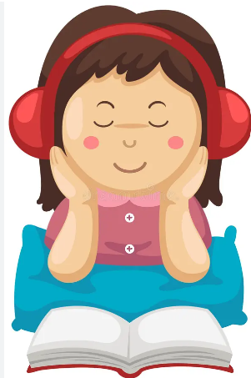
Task c. Listen and read.

Slide 42
Post-reading

Slide 43
Task d. In pairs: Ask and answer:
What changes mentioned in the interview can you see in your family?
What things do you agree or disagree with Mrs. Nguyễn about? Why?

Slide 44
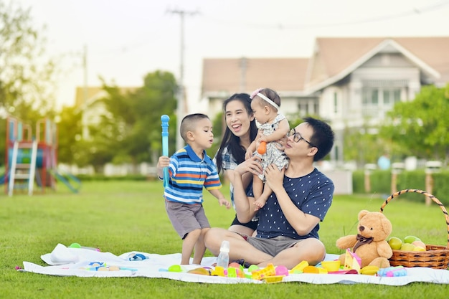
Suggested answer
What changes mentioned in the interview can you see in your family?
In my family, I've noticed a shift towards smaller nuclear families. However, we still prioritize maintaining strong connections with extended relatives through regular communication and gatherings.

Slide 45
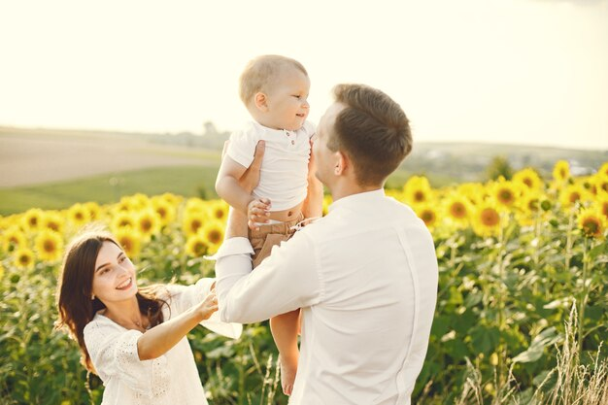
Suggested answer
What things do you agree or disagree with Mrs. Nguyễn about? Why?
I agree with Mrs. Nguyễn that smaller family sizes can foster independence but may weaken connections between relatives because fewer family members mean less frequent interactions and fewer opportunities for shared experiences and support.

Slide 46
Extra
Practice
Presentation

Slide 47
Read the interview with Mrs. Nguyễn about her memories of family life in the past. Answer these questions:
1.How many children does Mrs. Nguyễn have?
2.What is one benefit of smaller family size that Mrs. Nguyễn mentioned?
3.What was the role of the husband in the past?
4.Why do both parents need to work nowadays?

Slide 48
Read the interview with Mrs. Nguyễn about her memories of family life in the past. Answer these questions:
Underline the key words
1.How many children does Mrs. Nguyễn have?
2.What is one benefit of smaller family size that Mrs. Nguyễn mentioned?
3.What was the role of the husband in the past?
4.Why do both parents need to work nowadays?

Slide 49
Read the interview with Mrs. Nguyễn about her memories of family life in the past. Answer these questions:
ANSWERS
1.How many children does Mrs. Nguyễn have?
________________________________________________
Interviewer: Mrs. Nguyễn, you have 13 children and 24 grandchildren.
She has 13 children.

Slide 50
Read the interview with Mrs. Nguyễn about her memories of family life in the past. Answer these questions:
ANSWERS
2.What is one benefit of smaller family size that Mrs. Nguyễn mentioned?
________________________________________________
________________________
Mrs. Nguyễn: Hmm, the smaller family size allows people to be more independent. But sometimes it makes the connections between relatives weaker.
The smaller family size allows people to be more independent.

Slide 51
Read the interview with Mrs. Nguyễn about her memories of family life in the past. Answer these questions:
ANSWERS
3.What was the role of the husband in the past?
________________________________________________
Mrs. Nguyễn: Yes. The husband was the breadwinner in the past, and the wife would stay at home.
The husband was the breadwinner in the past.

Slide 52
Read the interview with Mrs. Nguyễn about her memories of family life in the past. Answer these questions:
ANSWERS
4.Why do both parents need to work nowadays?
________________________________________________
________________________
Mrs. Nguyễn: Now, many men help their wives do housework. And I know that in many families, both parents are working because it costs a lot of money to raise a child now.
Both parents need to work because it costs a lot of money to raise a child now

Slide 53
Extra
Practice
WORKBOOK
Presentation

Slide 54
WB - p8 - Task a. Unscramble the words.

Slide 55
WB - p8 - Task a. Unscramble the words.
ANSWERS
D I V O R C E
M A R R I A G E
N U C L E A R F A M I L Y
R E L A T I V E
H O U S E W I F E
G E N E R A T I O N
B R E A D W I N N E R
H O U S E H U S B A N D
E X T E N D E D F A M I L Y

Slide 56
WB - p8 - Task b. Fill in the blanks using the words from Task a.
1. She's the ______________ and works hard to earn money for the family.
2. After getting married, my mom stopped working and became a ______________.
3. Some husbands and wives have happy __________s, and some don't.
4. Some men choose to be ______________s because they want to stay at home and look after their kids.
breadwinner
housewife
marriage
house husband

Slide 57
WB - p8 - Task b. Fill in the blanks using the words from Task a.
5. There are three ______________s living in my house: my sister and me, my parents, and my grandma.
6. I have a big ______________. There are my four grandparents, six aunts and uncles, ten cousins, my parents, and my sister.
7. These days, many people choose to stay ______________ and not get married.
generation
extended family
single

Slide 58
WB - p8 - Task b. Fill in the blanks using the words from Task a.
8. My ______________ has only me, my mom, and my dad.
9. If a husband and wife are unhappy together, sometimes the best solution is for them to get ______________.
10. My sister got married, and all our _______s came to the wedding to celebrate.
nuclear family
divorced
relative

Slide 59
WB - p9 - Task a. Read the article about families in the past and now. Choose the correct sentence.
Underline the key words
Families are worse now.
2. Families aren't the same now.

Slide 60
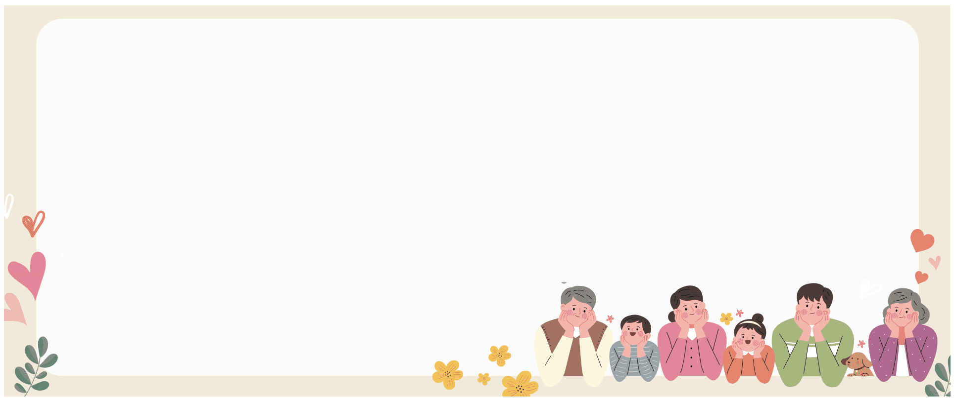
Families in the past looked very different from today. In this article, we'll take a look at some of the differences between now and then.
In the past, three or four generations would live together in one big family. Lots of relatives lived together in one house. Now, most people live in nuclear families with only parents and children.

Slide 61
Back then, people would usually get married and stay together for life. It was the normal thing to do. Now, many people stay single, or become single parents. Marriage is just as important as it was in the past, but some people aren't afraid of getting divorced now.

Slide 62
In the past, the husband was usually the breadwinner, and the wife stayed at home and did the housework. Now, many families have both parents working and doing housework. And more men are house husbands today because they enjoy taking care of their children.
Families will continue to change in the future. Remember that it's normal for things to change like this, but not everyone likes it.

Slide 63
Task a. Read the article about families in the past and now. Choose the correct sentence.
ANSWERS
1. Families are worse now.
2. Families aren't the same now.
Families in the past looked very different from today. In this article, we'll take a look at some of the differences between now and then.

Slide 64
Task b. Now, read and circle True, False, or Doesn't say.
1. In the past, people lived in nuclear families. | True | False | Doesn't say
2. Now, parents usually have more children than before. | True | False | Doesn't say
3. Back then, the husband usually had a job. | True | False | Doesn't say
4. Now, many women are housewives. | True | False | Doesn't say
5. These days, lots of men don't want to be house husbands. | True | False | Doesn't say

Slide 65
Task b.
Underline the key words
1. In the past, people lived in nuclear families. | True | False | Doesn't say
2. Now, parents usually have more children than before. | True | False | Doesn't say
3. Back then, the husband usually had a job. | True | False | Doesn't say
4. Now, many women are housewives. | True | False | Doesn't say
5. These days, lots of men don't want to be house husbands | True | False | Doesn't say

Slide 66
Task b. Now, read and circle True, False, or Doesn't say.
ANSWERS
1. In the past, people lived in nuclear families. | True | False | Doesn't say
In the past, three or four generations would live together in one big family. Lots of relatives lived together in one house.

Slide 67
Task b. Now, read and circle True, False, or Doesn't say.
ANSWERS
2. Now, parents usually have more children than before. | True | False | Doesn't say
The text does not mention whether “Now, parents usually have more children than before.”

Slide 68
Task b. Now, read and circle True, False, or Doesn't say.
ANSWERS
3. Back then, the husband usually had a job. | True | False | Doesn't say
In the past, the husband was usually the breadwinner, and the wife stayed at home and did the housework

Slide 69
Task b. Now, read and circle True, False, or Doesn't say.
ANSWERS
4. Now, many women are housewives. | True | False | Doesn't say
Now, many families have both parents working and doing housework.

Slide 70
Task b. Now, read and circle True, False, or Doesn't say.
ANSWERS
5. These days, lots of men don't want to be house husbands. | True | False | Doesn't say
And more men are house husbands today because they enjoy taking care of their children.

Slide 71
CONSOLIDATION

Slide 72
Ask and answer the question below with your partner about family traditions and customs in the past:
What are your favorite family traditions and customs?

Slide 73
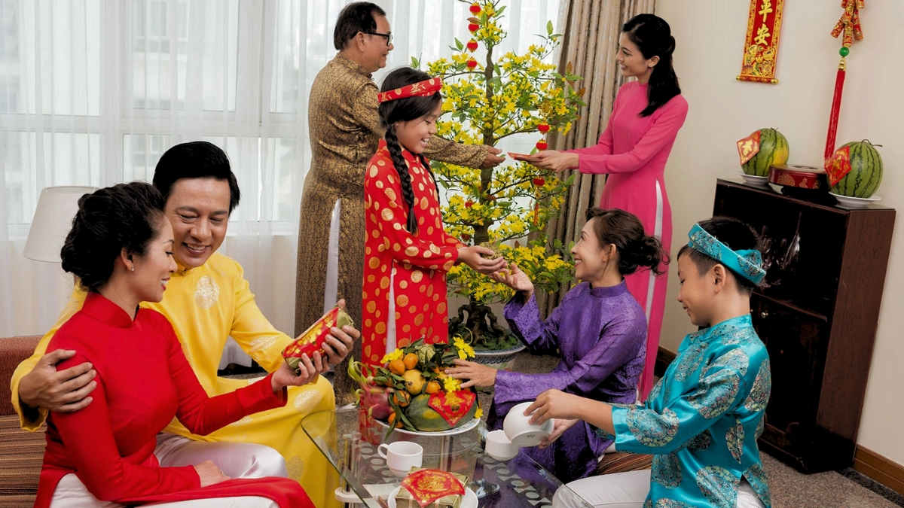
Suggested answer
Presentation
I like the tradition of giving and receiving Lucky Money during Tet holiday.

Slide 74
WRAP-UP

Slide 75
Vocabularies
nuclear family
relatives
single
extended family
house husband
generation
breadwinner
marriage
divorced
housewife
Today’s lesson

Slide 76
Today’s lesson
Vocabulary:
- learn vocabulary related to life in the past.
Reading:
- understand an interview about family life in the past.
- practice reading for gist and details

Slide 77
Homework
Review vocabulary related to life in the past.
Make sentences using vocabularies in SB
Prepare for the next lesson (Grammar - pages 15 & 16 - SB)
Play the consolidation games on www.eduhome.com.vn

Slide 78
Lesson 3
Stay positive and have a nice day!

