Slide 1
Unit 1: English in the World
Review Unit 1.2
Pages 85-86

Slide 2
Lesson Outline
Warm-up
Grammar
Pronunciation
In the real world
Conversation
Speaking
Writing
Consolidation
Wrap-up

Slide 3
By the end of this lesson, students will be able to…
review the use of “to-infinitive” to give purposes.
practice pronouncing words with different stressed syllables.
practice talking and writing about English study methods.
practice test-taking skills: read for details.

Slide 4
WARM-UP

Slide 5
COMPETITION TIME:
Create groups/teams of 5 students.
You will be given 8 words.
You must make 8 sentences using these words.
The team(s) with the most correct sentences win(s).
Time limit: 5 minutes
Sentence Making

Slide 6
LIST OF WORDS:
Note down
Go over
Come across
Opportunities
Look up
Turn on
Because of
Overseas
Sentence Making

Slide 7
Suggested answers
Note down: Remember to note down important things you learn during English lessons.
Go over: You should go over your English notes regularly to make sure you understand everything.
Come across: Sometimes you'll come across new words when reading English books or articles.
Opportunities: Learning English opens up lots of opportunities to communicate with people from different countries.

Slide 8
Suggested answers
Look up: If you don't know the meaning of a word, you can look it up in a dictionary.
Turn on: Turn on English movies or TV shows to practice listening to English.
Because of: Because of good English, you can travel overseas and communicate with people from other countries.
Overseas: English can help you communicate when you travel overseas to places where people speak English.

Slide 9
Grammar

Slide 10
Use the correct form of the given word or phrase in each sentence.
1. I read a lot of books in English ___________ my skills. (improve)
2. My English is getting better because I ___________ a lot. (practice)
to improve
practice

Slide 11
Use the correct form of the given word or phrase in each sentence.
3. I was reading yesterday, and I _____________ lots of new words. (come across)
4. I looked up the lyrics of English songs ___________ what the singer was saying. (know)
came across
to know

Slide 12
Use the correct form of the given word or phrase in each sentence.
to use
5. It's a good idea ____________ subtitles when you watch TV in English. (use)
6. You should study English ____________ yourself more opportunities. (give)
to give

Slide 13
Use the correct form of the given word or phrase in each sentence.
7. I showed my brother some study methods, and now he ____________ new words. (note down)
8. When he finished his homework, he ____________ it to check for mistakes. (go over)
notes down
went over

Slide 14
Pronunciation

Slide 15
Task a. Circle the word that differs from the other three in the position of primary stress in each of the following questions.
1. A. subtitles B. essential C. newspapers D. studying
2. A. career B. method C. lyrics D. content
/ˈsʌbˌtaɪ.t̬əlz/
/ɪˈsen.ʃəl/
/ˈnuːzˌpeɪ.pɚ/
/ˈstʌdiɪŋ/
/kəˈrɪr/
/ˈmeθ.əd/
/ˈlɪrɪks/
/ˈkəntent/

Slide 16
Task b. Circle the word that has the underlined part pronounced differently from the others.
A. note down B. go over C. come across D. overseas
2. A. lyrics B. subtitles C. worldwide D. find
/noʊt/
/ɡoʊ/
/kʌm/
/ˌoʊ.vɚˈsiːz/
/ˈlɪrɪks/
/ˈsʌbˌtaɪ.t̬əlz/
/ˈwɝːld.waɪd/
/faɪnd/

Slide 17
In The Real World

Slide 18
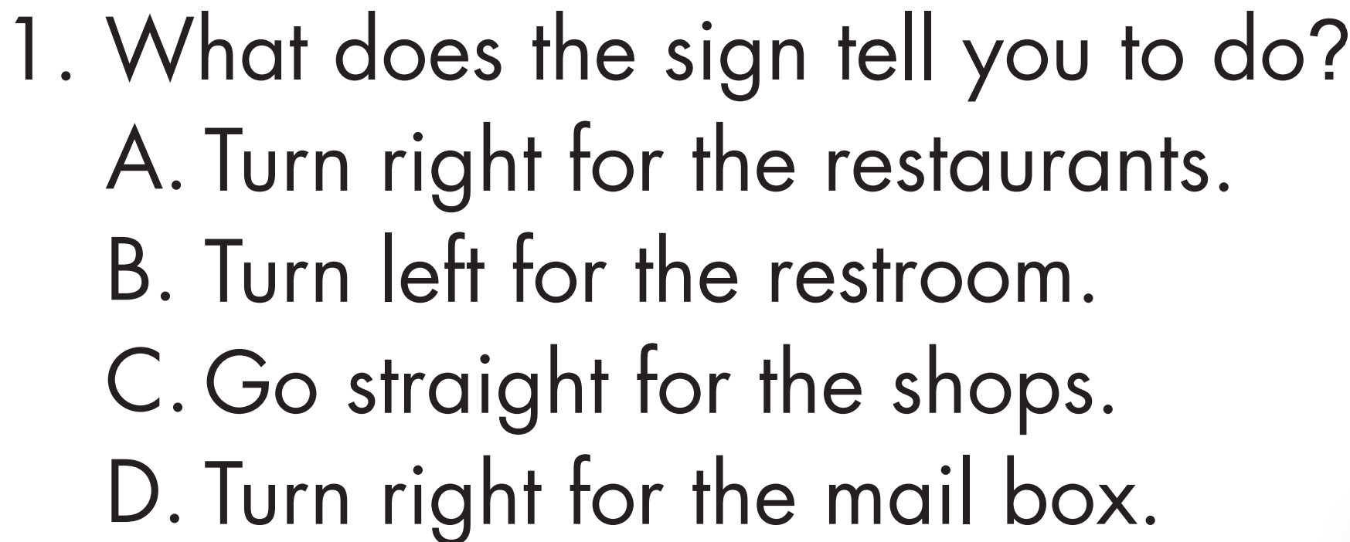
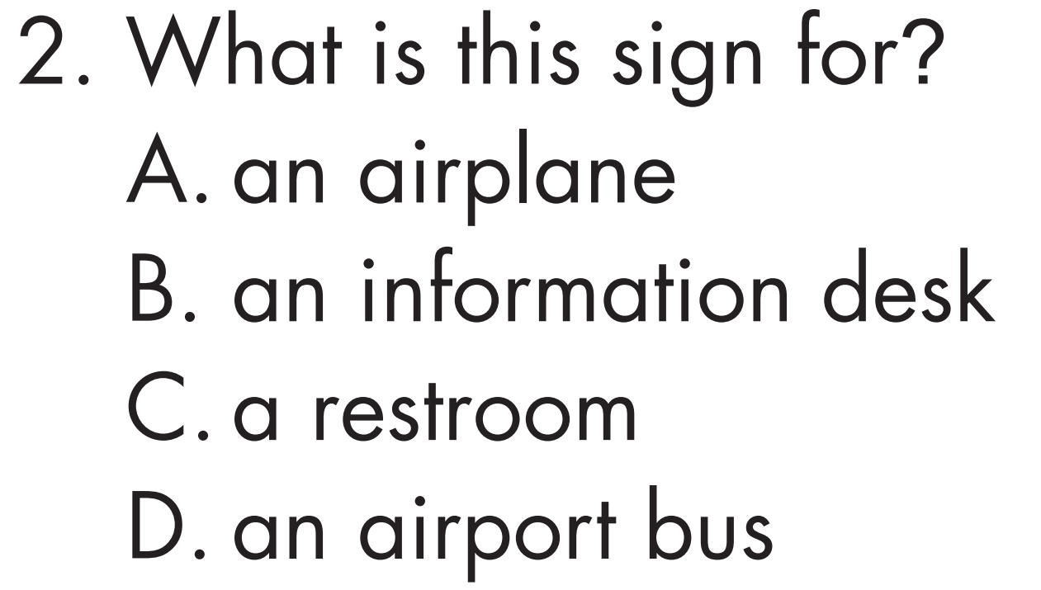
Look at the signs from an airport. Choose the best answers.

Slide 19
Conversation

Slide 20
Choose the correct answer (A, B, C, or D).
1. Khang: "What's your favorite study method, Trang?"
Trang: "When I watch TV in English, I always ______________ the subtitles."
come across B. look up C. turn on D. note down
2. Trang: "Why are you learning English, Khang?"
Khang: "I'm learning English ______________ I want to study overseas in the future."
A. since B. because of C. however D. really
CLAUSE+ SINCE+ CLAUSE (SINCE = BECAUSE)

Slide 21
3. Trang: "Why do you want to study overseas?"
Khang: "I want to have more ______________ for my future career."
essential B. content C. overseas D. opportunities
4. Trang: "What's your favorite study method, Khang?"
Khang: "________________."
A. I note down new words B. I study a lot C. I'm good at English D. It's English

Slide 22
Speaking

Slide 23
In pairs: Talk about study methods you already use and why you use them.

Slide 24
What study methods do you already use and why do you use them?

Slide 25
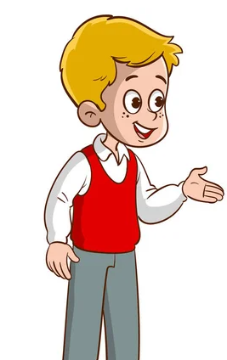
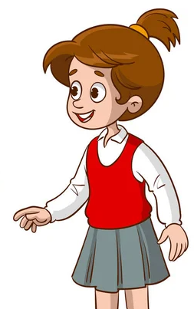
What study methods do you already use and why do you use them?
Suggested answers
I read short stories and articles in English because reading enhances my vocabulary and writing style.

Slide 26
I play vocabulary games and puzzles since they make learning fun and engaging.
Suggested answers
What study methods do you already use and why do you use them?

Slide 27
What study methods do you already use and why do you use them?
Suggested answers
I join group discussions and debates. Debates can help me promote communication skills and confidence.

Slide 28
Writing

Slide 29
Write about your favorite English study method. Write 100 to 120 words.

Slide 30
Suggested answer
My favorite English study method is reading aloud. I choose a book or an article and read it out loud, paying attention to how I pronounce words and use intonation. Reading aloud helps me improve my speaking and pronunciation skills. It also helps me understand the meaning of words better.

Slide 31
Suggested answer
When I read aloud, I feel more confident and comfortable using English. So, whenever I want to study English, I grab a book and start reading out loud. It's simple, but it really works for me!

Slide 32
Presentation
Extra Practice

Slide 33
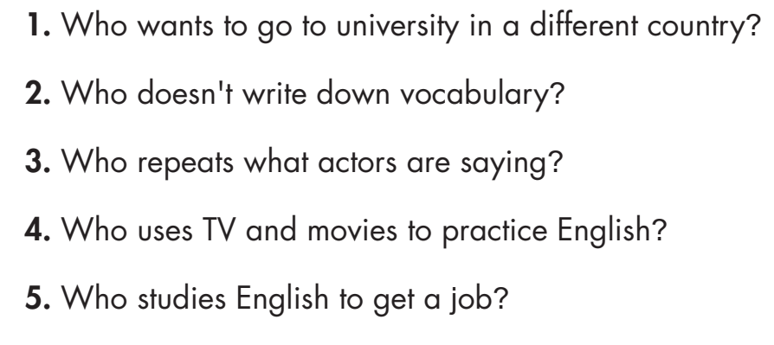
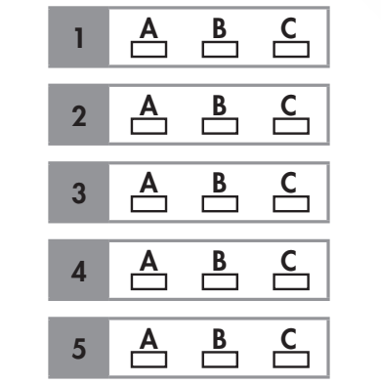
Read the passages about learning English. Choose the correct answer (A, B, or C)

Slide 34
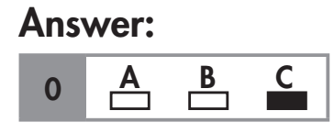
Look at the example below. Now, read the passages and choose the correct answer (A, B, or C)
Example:
0. Who uses songs to learn English?

Slide 35
A. Hi, my name's Bora. I love learning English. I like learning English because I want to be a tour guide. Since I want to be a tour guide, I read English books about famous places to improve my English. I also write to a pen pal. He is from the USA, and he teaches me lots of interesting and useful words.

Slide 36
B. Hello. My name's Lorenzo. I learn English because I want to travel overseas. Since I want to travel, I really need to learn to read menus and signs. I copy what actors say on TV to practice my pronunciation. I also love watching English movies. I often turn on the subtitles and note down useful words.

Slide 37
C. Hi, I'm Ayu. I like learning English because I want to study overseas after high school. I listen to lots of English songs, and I read the lyrics to improve my reading. I also note down any words I don't know and look them up in a dictionary. It's a
really useful way to practice.

Slide 38
Answers
1. Who wants to go to university in a different country?
Hi, I'm Ayu. I like learning English because I want to study overseas after high school.

Slide 39
Answers
2. Who doesn't write down vocabulary?
B: I often turn on the subtitles and note down useful words.
C: I also note down any words I don't know and look them up in a dictionary.

Slide 40
Answers
3. Who repeats what actors are saying?
I copy what actors say on TV to practice my pronunciation.

Slide 41
Answers
4. Who uses TV and movies to practice English?
Since I want to travel, I really need to learn to read menus and signs. I copy what actors say on TV to practice my pronunciation.

Slide 42
Answers
5. Who studies English to get a job?
I like learning English because I want to be a tour guide.

Slide 43
CONSOLIDATION

Slide 44
Fill in the gaps with (a) suitable word(s)/ phrase(s)
note down
Remember to important things you learn during English lessons.
You should your English notes regularly to make sure you understand everything.
Sometimes you’ll new words when reading English books or articles.
Learning English opens up lots of to communicate with people from different countries.
English can help you communicate when you travel to places where people speak English.
go over
come across
opportunities
overseas

Slide 45
WRAP-UP

Slide 46
Today’s lesson
Grammar:
review the use of “to-infinitive” to give purposes.
Pronunciation:
practice pronouncing words with different stressed syllables.
Speaking & Writing:
practice talking and writing about English study methods.
Reading:
practice test-taking skills: read for details.

Slide 47
Homework
Practice making sentences with the words in the Consolidation.
Prepare for the next lesson (Unit 2 – Lesson 1.1 – Vocabulary & Reading – pages 14 & 15 – SB).
Play the consolidation games on www.eduhome.com.vn

Slide 48
Lesson 3
Stay positive and have a nice day!

