Slide 1

Unit 1: English in the World
Review Unit 1.1
Pages 84-85

Slide 2
Lesson Outline
Warm-up
Listening
Reading
Vocabulary
Consolidation
Wrap-up

Slide 3

By the end of this lesson, students will be able to…
review the target language about different ways to learn English.
practice test-taking skills: listen and read for details.

Slide 4

WARM-UP

Slide 5

COMPETITION TIME:
Create groups/teams of 5 students.
You will be given 8 words and 8 definitions.
You must match the words with the correct definitions.
The team(s) with the most correct answers win(s).
Time limit: 5 minutes
Vocabulary Match-Up

Slide 6
WRITE DOWN THESE WORDS:
Words: Subtitles, Content, Essential, Overseas, Note down, Lyrics, Opportunities, Look up.
Vocabulary Match-Up
NOW, READ THE DEFINITIONS IN THE NEXT SLIDE.

Slide 7
Definitions
To write or record information for future reference.
Chances or possibilities for doing something.
The words of a song.
To search for information in a reference source, such as a dictionary or the internet.
Texts displayed at the bottom of a screen that translate the dialogue of a film or TV show into another language.
In or to a foreign country or countries, especially across the sea.
Information such as text, images, videos, etc., that is published or presented online or in other media.
Necessary or extremely important or crucial.

Slide 8
Answers
Note down: To write or record information for future reference.
Lyrics: The words of a song.
Opportunities: Chances or possibilities for doing something.
Look up: To search for information in a reference source, such as a dictionary or the internet.

Slide 9
Answers
Subtitles: Texts displayed at the bottom of a screen that translate the dialogue of a film or TV show into another language.
Overseas: In or to a foreign country or countries, especially across the sea.
Content: Information such as text, images, videos, etc., that is published or presented online or in other media.
Essential: Necessary or extremely important or crucial.

Slide 10

Listening

Slide 11



You will hear Ashley talking to her mom about English study methods. For each question, write a letter (A–H) next to each person. You will hear the conversation twice.

Slide 12
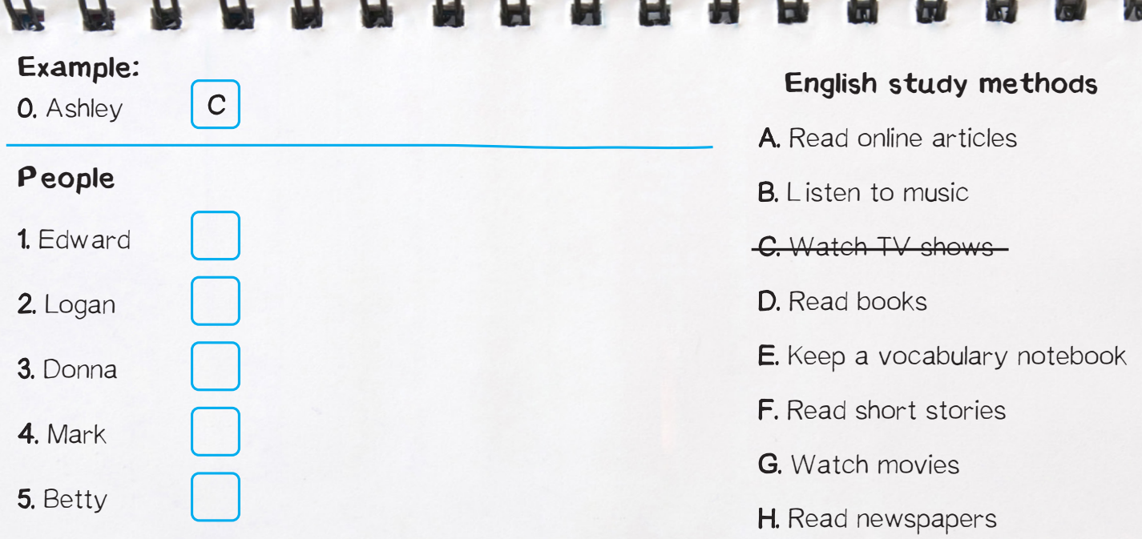

Slide 13

Answers
F
Clues:
Ashley: Everyone has different interests. Edward loves reading but doesn't have much free time. His favorite study method is to read short stories.

Slide 14

Answers
D
Clues:
Ashley's mom: Do any of your other friends read, too?
Ashley: Yes. Logan likes reading books because he can take his time with new words.

Slide 15

Answers
B
Clues:
Ashley: There are other methods, too. My friend Donna listens to music in her free time. She reads the lyrics when she listens.
Ashley's mom: That's fun!

Slide 16

Answers
E
Clues:
Ashley: Yeah. And Mark thinks learning new vocabulary is important. He notes down new words in a notebook.

Slide 17

Answers
G
Clues:
Ashley: Betty is similar to me, but she loves watching movies more than TV shows.
Ashley's mom: With the subtitles on?

Slide 18
Audio Script
Narrator: You will hear Ashley talking to her mom about English study methods. Which study method do Ashley and her friends like? For each question, write a letter (A–H) next to each person. You will hear the conversation twice.
Ashley's mom: Ashley, you should be practicing English, not watching TV!
Ashley: I am practicing English, Mom! This TV show is in English, and I turned the English subtitles on.
Ashley's mom: Do your friends all watch TV?

Slide 19
Ashley: Everyone has different interests. Edward loves reading but doesn't have much free time. His favorite study method is to read short stories.
Ashley's mom: Do any of your other friends read, too?
Ashley: Yes. Logan likes reading books because he can take his time with new words.
Ashley's mom: How does he make sure he always finds new words?
Ashley: He chooses a text a bit above his level.
Ashley's mom: That's a good idea.
Ashley: There are other methods, too. My friend Donna listens to music in her free time. She reads the lyrics when she listens.

Slide 20
Ashley's mom: That's fun!
Ashley: Yeah. And Mark thinks learning new vocabulary is important. He notes down new words in a notebook.
Ashley's mom: What about your friend Betty?
Ashley: Betty is similar to me, but she loves watching movies more than TV shows.
Ashley's mom: With the subtitles on?
Ashley: Of course!
Ashley's mom: Well, OK. Enjoy your study time. Ashley: Thanks, Mom!
Narrator: Now, listen again.

Slide 21
Reading
Presentation

Slide 22

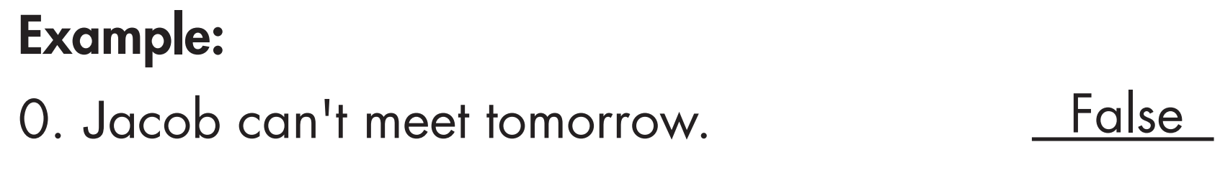
Read the text messages. Decide if the statements are True or False. But let’s underline the key words first.

Slide 23
Underline the key words
1. Tân read a lot last week.
2. He is going to take his books to the meeting tomorrow.
3. Talia is going to take some music for her friends to listen to.
4. She'll be a bit late because she has a meeting with classmates.
5. Himiko tells Tân he should do some more reading practice.

Slide 24
Read the text messages. Decide if the statements are True or False.
1. Tân read a lot last week.
2. He is going to take his books to the meeting tomorrow.
3. Talia is going to take some music for her friends to listen to.
4. She'll be a bit late because she has a meeting with classmates.
5. Himiko tells Tân he should do some more reading practice.

Slide 25
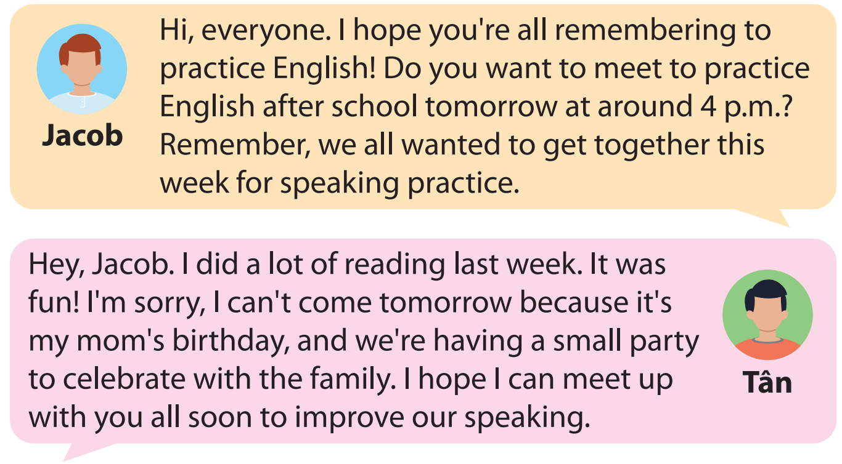

Slide 26
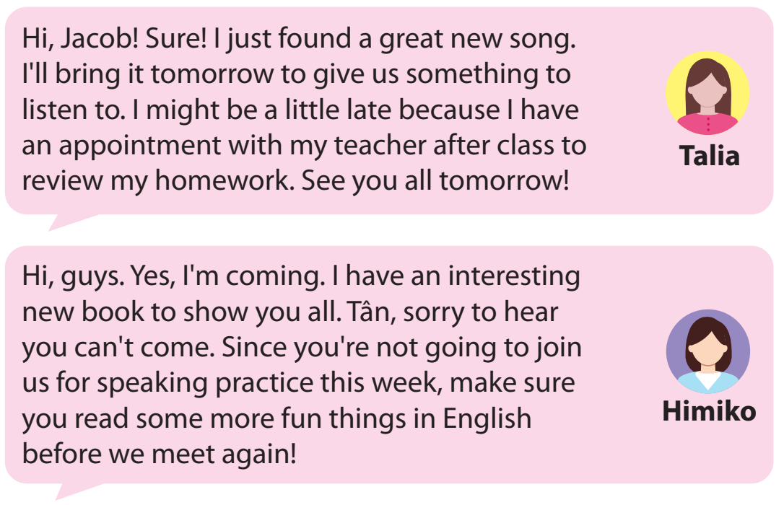

Slide 27

Answers
TRUE
Clues:
Hey, Jacob. I did a lot of reading last week. It was fun!

Slide 28
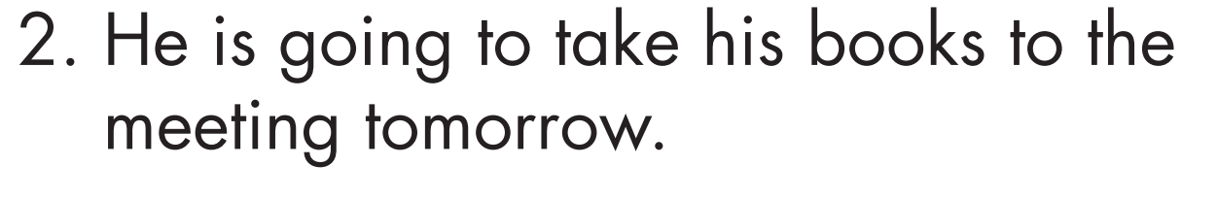
Answers
FALSE
Clues:
I'm sorry, I can't come tomorrow because it's my mom's birthday, and we're having a small party to celebrate with the family.

Slide 29

Answers
TRUE
Clues:
Hi, Jacob! Sure! I just found a great new song. I'll bring it tomorrow to give us something to listen to.

Slide 30
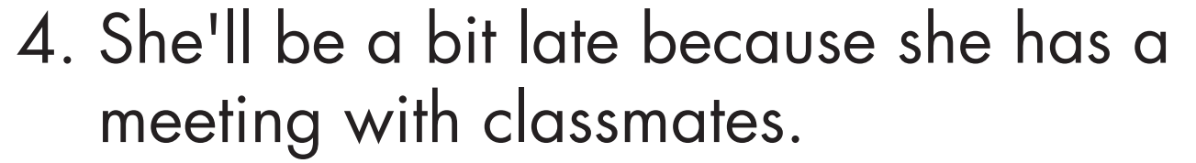
Answers
FALSE
Clues:
I might be a little late because I have an appointment with my teacher after class to review my homework.

Slide 31
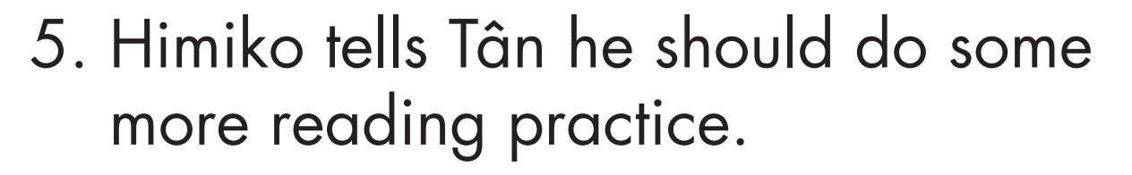
Answers
TRUE
Clues:
Tân, sorry to hear you can't come. Since you're not going to join us for speaking practice this week, make sure you read some more fun things in English before we meet again!

Slide 32
Presentation
Vocabulary

Slide 33

Circle the correct answers.
1. When you read in English, use a dictionary to _____________ any new words you don't know.
A. note down B. come across C. look up D. turn on
2. You can find the _____________ of your favorite songs on the internet.
A. pages B. method C. career D. lyrics
3. It's interesting to travel to _____________ countries.
A. international B. foreign C. essential D. worldwide
4. Learning English will be useful for your future _____________ because many jobs require it.
A. career B. content C. opportunity D. essential

Slide 34
5. I always ______________ new words in a notebook when I read books in English.
A. was noting down B. am noting down C. note down D. will note down
6. When you watch TV in English, remember to use the _______________.
A. subtitles B. songs C. books D. dictionary
7. If you speak English, you can communicate with people when you travel _____________.
A. opportunity B. overseas C. international D. foreign
8. It's _________________ that you speak English if you study in an English-speaking country.
A. method B. content C. career D. essential

Slide 35
Answers
1. When you read in English, use a dictionary to _____________ any new words you don't know.
A. note down B. come across C. look up D. turn on
2. You can find the _____________ of your favorite songs on the internet.
A. pages B. method C. career D. lyrics

Slide 36
Answers
3. It's interesting to travel to _____________ countries.
international B. foreign C. essential D. worldwide
4. Learning English will be useful for your future _____________ because many jobs require it.
career B. content C. opportunity D. essential

Slide 37
Answers
5. I always ______________ new words in a notebook when I read books in English.
was noting down B. am noting down
C. note down D. will note down
6. When you watch TV in English, remember to use the _______________.
A. subtitles B. songs C. books D. dictionary

Slide 38
Answers
7. If you speak English, you can communicate with people when you travel _____________.
opportunity B. overseas C. international D. foreign
8. It's _________________ that you speak English if you study in an English-speaking country.
A. method B. content C. career D. essential

Slide 39
Presentation
Extra Practice

Slide 40

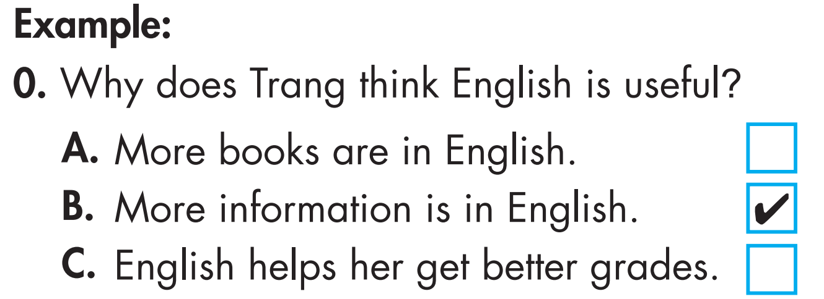
You will hear two friends talking about learning English. For each question, choose the correct answer (A, B, or C). You will hear the conversation twice. But let’s underline the keywords first.

Slide 41
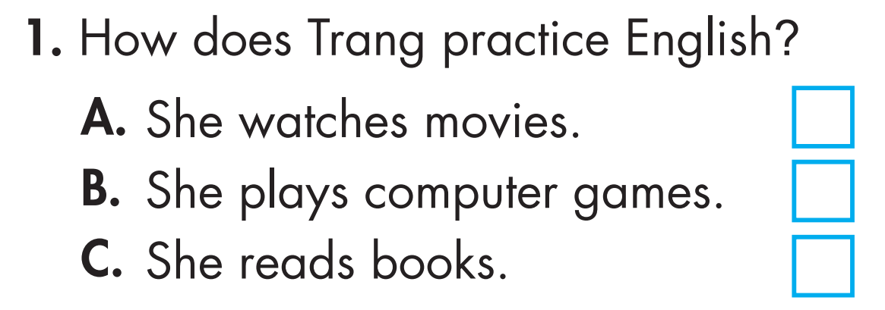
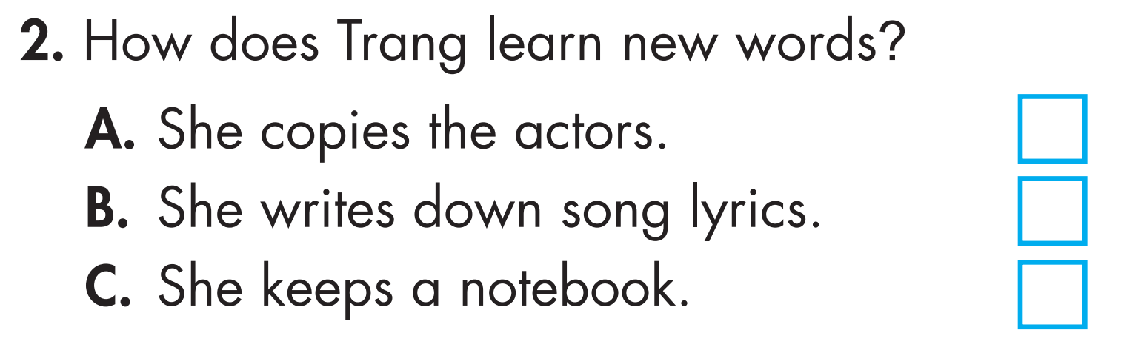
Underline the key words

Slide 42
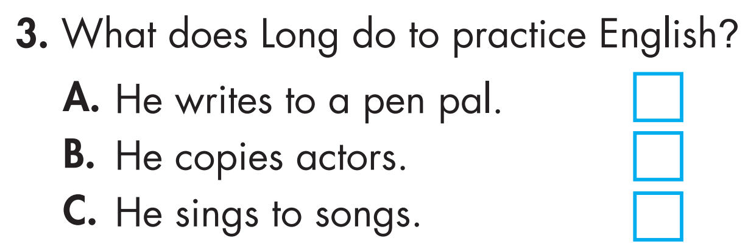
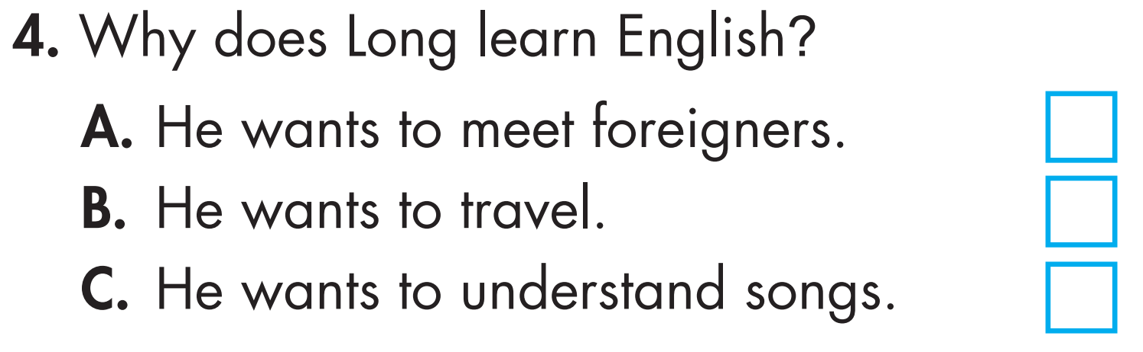

Slide 43
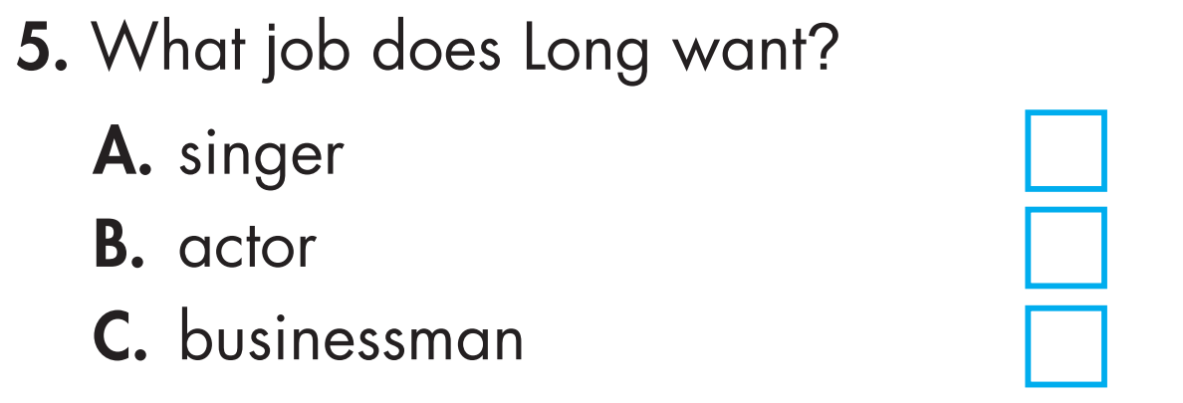

Slide 44
Now listen and choose the correct answer (A, B, or C). You will hear the conversation twice.

Slide 45
Answers

Clues:
Long: Yeah. How do you practice English?
Trang: I watch movies in English with subtitles on.

Slide 46
Answers

Clues:
Long: Does that actually help?
Trang: Yes. The key is focusing on new words. You read them, listen to them, and copy how the actors say them.

Slide 47
Answers

Clues:
Long: That's a great idea. I should do that. I only sing along to practice my pronunciation.

Slide 48
Answers

Clues:
Long: Yeah, it's fun and useful. I want to travel a lot in the future. I also want to work overseas, and English is the language of business.

Slide 49
Answers

Clues:
Long: I think I want to be a businessman.

Slide 50
Audio script
Narrator: You will hear two friends talking about learning English. For each question, choose the correct answer (A, B, or C). You will hear the conversation twice.
Long: Do you like learning English, Trang?
Trang: Yes, it's such a useful thing to learn.
Long: Why do you think that?
Trang: There's a lot more information available in English. When I do class projects, it's easier to find articles and books in English.

Slide 51
Long: Yeah. How do you practice English?
Trang: I watch movies in English with subtitles on.
Long: Does that actually help?
Trang: Yes. The key is focusing on new words. You read them, listen to them, and copy how the actors say them.
Long: Oh, I only care about the story. That's why I can't learn using movies.
Trang: Well, there are other ways. I also listen to English songs. I read the lyrics before I listen to them.

Slide 52
Long: That's a great idea. I should do that. I only sing along to practice my pronunciation.
Trang: So, do you like learning English?
Long: Yeah, it's fun and useful. I want to travel a lot in the future. I also want to work overseas, and English is the language of business.
Trang: Do you know what you want to be?
Long: I think I want to be a businessman.
Trang: Cool.
Narrator: Now, listen again

Slide 53

CONSOLIDATION

Slide 54
Look at the definitions and say the correct words
To write or record information for future reference.
The words of a song.
Chances or possibilities for doing something.
To search for information in a reference source, such as a dictionary or the internet.
Note down
Lyrics
Opportunities
Look up

Slide 55
Texts displayed at the bottom of a screen that translate the dialogue of a film or TV show into another language.
In or to a foreign country or countries, especially across the sea.
Information such as text, images, videos, etc., that is published or presented online or in other media.
Necessary or extremely important or crucial.
Subtitles
Overseas
Content
Essential

Slide 56

WRAP-UP

Slide 57
Today’s lesson
Listening:
Listen to details and practice test-taking skills.
Reading:
Read for details and practice test-taking skills.
Vocabulary
Review vocabulary about different ways to learn English.

Slide 58
Homework
Practice making sentences with the words in the Consolidation.
Prepare for the next lesson (Review Unit 1- pages 85 & 86 - SB).
Play the consolidation games on www.eduhome.com.vn

Slide 59

Lesson 3
Stay positive and have a nice day!

