Slide 1

Unit 1: English in the World
Lesson 3.2: Writing & Speaking
Page 13

Slide 2
Lesson Outline
Warm-up
Writing
Speaking
Consolidation
Wrap-up

Slide 3

By the end of this lesson, students will be able to…
Learn how to use sequence words to organize writing.
Talk about different fun activities to practice English at home.
Write an email to a pen pal to give advice on how to practice English.

Slide 4

WARM-UP

Slide 5
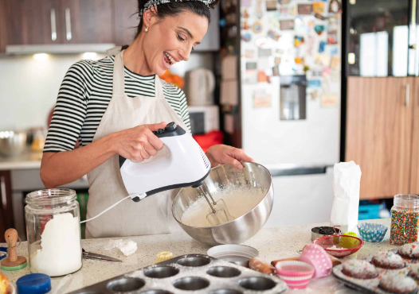
COMPETITION TIME:
Create groups/teams of 5 students.
You will be given 8 sentences but they are in the wrong order.
You must put them in the right order of “cake-making instructions”.
The team(s) with the most correct answers win(s).
Time limit: 5 minutes
Cake-Making Instructions

Slide 6

Cake-Making Instructions
Next, preheat the oven to 350°F to ensure it's ready for baking.
After that, add the wet ingredients and stir well until smooth.
Place the pan in the preheated oven and bake for approximately 25 minutes, or until a toothpick inserted into the center comes out clean.
First, gather all the necessary ingredients.
Then, mix the dry ingredients in a bowl.
Once the mixture is well mixed, carefully pour it into the prepared baking pan.
Finally, slice and serve the cake.
When done, let it cool for 10 minutes.

Slide 7
ANSWERS
First, gather all the necessary ingredients.
Next, preheat the oven to 350°F to ensure it's ready for baking.
Then, mix the dry ingredients in a bowl.
After that, add the wet ingredients and stir well until smooth.
Once the mixture is well mixed, carefully pour it into the prepared baking pan.
Place the pan in the preheated oven and bake for approximately 25 minutes, or until a toothpick inserted into the center comes out clean.
When done, let it cool for 10 minutes.
Finally, slice and serve the cake.

Slide 8

Writing

Slide 9

Task a
Read about using sequence words to organize your writing, then read the email again and circle the sequence words.

Slide 10

Task a
Using sequence words to organize your writing:
To show the order or importance of ideas, you can use the ordinal numbers first, second, third,… and the adverb finally.
      First, learn how to say some new English words.
      Second, practice saying the words to a partner.
      Third, practice listening to your partner saying them.
      Finally, try to use them in a real-life English conversation.

Slide 11
Task a
Using sequence words to organize your writing:
We use sequence words to organize our writing. They make our writing easier to read and our ideas easier to understand. We use them at the beginning of a sentence and write a comma after them.
      First, learn how to say some new English words.
      Second, practice saying the words to a partner.
      Third, practice listening to your partner saying them.
      Finally, try to use them in a real-life English conversation.

Slide 12
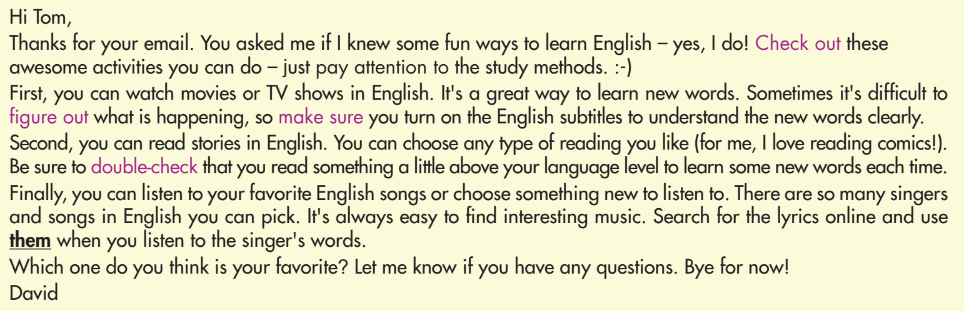
Read the email again and circle the sequence words.

Slide 13
ANSWERS

Slide 14
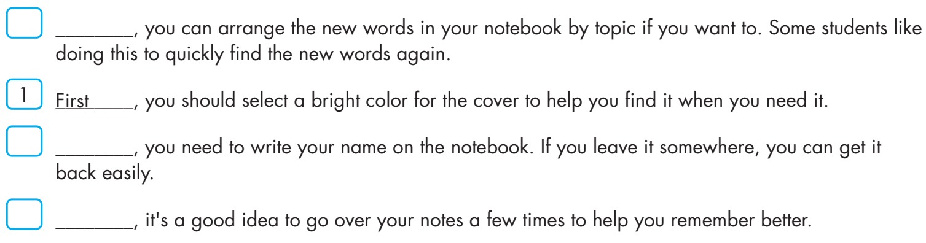
Task b
Read the sentences about keeping a vocabulary notebook. Write numbers in the boxes to put the sentences in order of importance, then write sequence words in the blanks.

Slide 15
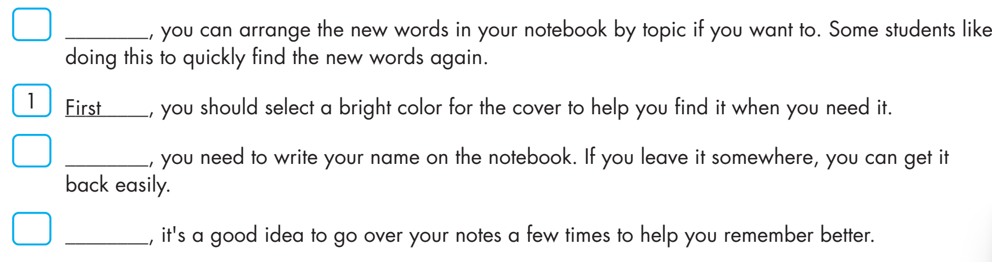
ANSWERS
3
Third
2
Second
4
Finally

Slide 16
Presentation
Speaking

Slide 17



Task a
In pairs: Discuss different fun activities you can do to practice English at home. For each activity, describe a study method you can use to improve your English.

Slide 18
Suggested answers
Fun activities to practice English at home
1. Writing in a Journal or Blog: You can keep a daily journal in English, where you can write about your thoughts, experiences, or daily activities. Additionally, you can start a blog to share your writings with others and receive feedback from readers. Writing regularly helps improve vocabulary, grammar, and overall writing proficiency.

Slide 19
Suggested answers
Fun activities to practice English at home
2. Engaging in Language Exchange Clubs: You can join online language exchange groups where you can interact with native English speakers or other English learners. You can participate in discussions, share your thoughts, and receive feedback on your language skills. Engaging in regular conversations helps improve speaking and listening abilities and builds confidence in using English in real-life situations.

Slide 20
Suggested answers
Fun activities to practice English at home
3. Listening to English Podcasts or Music: You can listen to English podcasts on topics you enjoy or English-language music. You can focus on understanding the content, identifying keywords, and noting down unfamiliar words or phrases. After listening, you can try to summarize the podcast episode or song lyrics in your own words, improving listening comprehension and vocabulary.

Slide 21

Task b
Choose three activities you can do and decide the order of importance, then complete the table.

Slide 22
 | Fun activities | English study methods | Purposes of study methods
1.(most important)
2.(average)
3.(least important)

Slide 23
Suggested answers
 | Fun activities | English study methods | Purposes of study methods
1.(most important) | Listening to English Podcasts | Note down unfamiliar words and summarize the podcast. | Improve listening comprehension and vocabulary.

Slide 24
 | Fun activities | English study methods | Purposes of study methods
2.(average) | Writing in a Journal or Blog | Write about daily activities, share your writings with others, and receive feedback from readers. | Improve vocabulary, grammar, and overall writing proficiency.

Slide 25
 | Fun activities | English study methods | Purposes of study methods
3.(least important) | Engaging in Language Exchange Clubs | join online language exchange groups to share your thoughts, and receive feedback on your language skills. | improve speaking and listening abilities and build confidence.

Slide 26


Now, write an email to your pen pal to give advice on how to practice English. Use the Writing Skill box, the reading model, and your speaking notes to help you. Write 100 to 120 words.
Note: Remember to use sequencing words: First, Second, Finally.

Slide 27
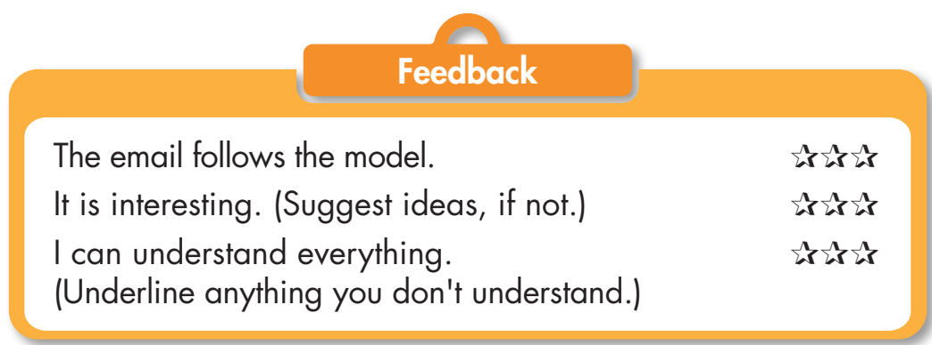
Now, exchange your writing with a partner. Use the feedback box below to help you give your friend some feedback.

Slide 28
Sample answer
To: Tom@English-Speaking-Pen-Pal.com
From: David@English-Speaking-Pen-Pal.com
Subject: _____________________________
Hi Tom,
Thanks for your email. Check out these fun activities you can do in English and the study methods you can use. First, you can watch movies or TV shows in English. It's a great way to learn new words. Don't forget to turn on the English subtitles to understand the new words clearly.

Slide 29
Second, you can read stories in English. You can read anything you like. Remember to choose a text a bit above your language level to learn some new words each time.
Finally, you can listen to your favorite English music. Just make sure you use the lyrics to read the singer's words.
Let me know if you have any questions about anything.
Bye for now.
David

Slide 30
Extra Practice
Presentation

Slide 31
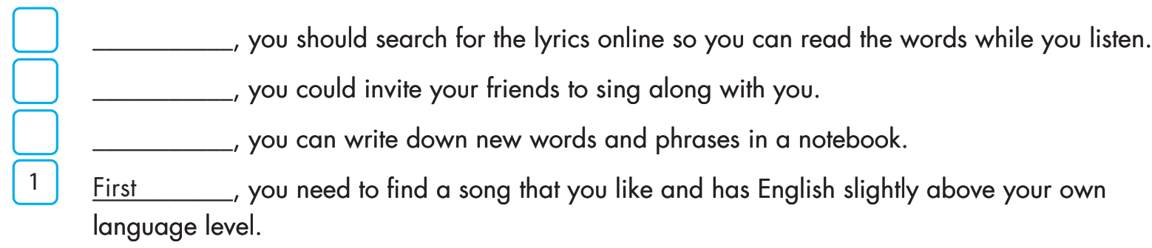
EXTRA PRACTICE- WB- PAGE 7
Read the sentences below. Write numbers in the boxes to put the sentences in order of importance, then write sequence words in the blanks.
2
Second
4
Finally
3
Third

Slide 32

Complete the table with three activities you can do to practice English at home. Order the activities in levels of importance. For each activity, write the study method and its purpose.
 | Fun activities | English study methods | Purposes of study methods
1.(most important)
2.(average)
3.(least important)

Slide 33
Suggested answers
 | Fun activities | English study methods | Purposes of study methods
1.(most important) | Read stories in English | Underline words you don't know and double-check their meaning online | Improve vocabulary

Slide 34
 | Fun activities | English study methods | Purposes of study methods
2.(average) | Speak to your brother in English | Have a normal day but only speak in English | Help practice and remember words and phrases better

Slide 35
 | Fun activities | English study methods | Purposes of study methods
3.(least important) | Listen to English music | Search for the lyrics online and sing along to each song. | Improve listening and pronunciation.

Slide 36
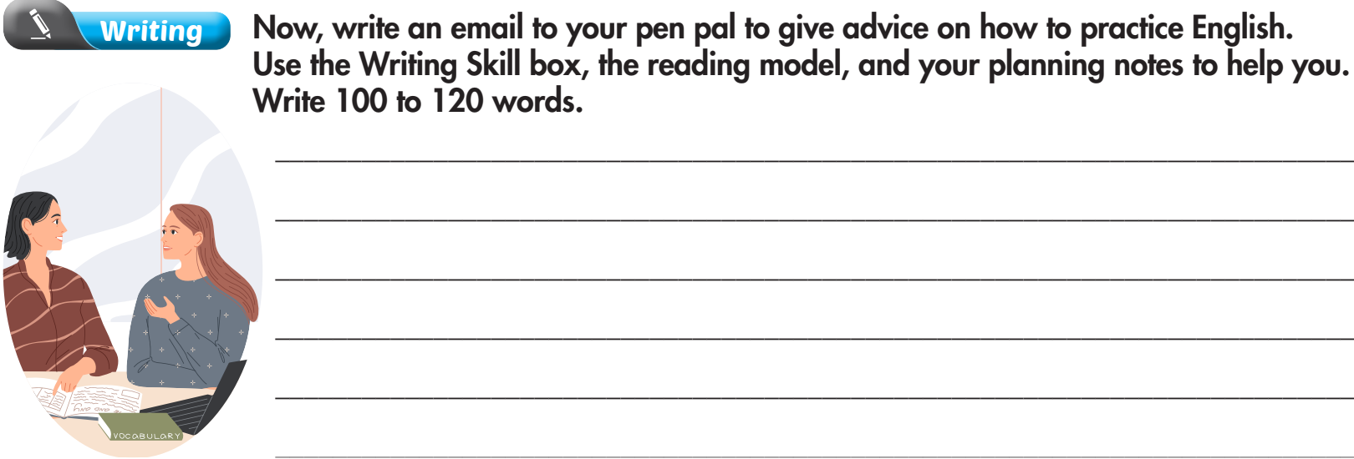

Slide 37
Sample answer:
To: Lisa@English-Speaking-Pen-Pal.com
From: Sarah@English-Speaking-Pen-Pal.com
Subject: Re: Do you have any ideas?
Hey Lisa,
Thanks for your email. I have three great activities you can do at home to practice English.
First, you can listen to English music. You can search for the lyrics online and sing along to each song. It will help you with your pronunciation.

Slide 38
Second, you can speak to your brother in English. You can have a normal day but only speak in English. It will help you practice and remember words and phrases better.
Finally, you should read stories in English. You can underline words you don't know and double-check their meaning online. You will learn lots of new words.
I hope this helps.
All the best,
Sarah

Slide 39

CONSOLIDATION

Slide 40
Make 4 sentences with “first, second, third, and finally” on the topic: fun ways to learn English. Then read these sentences to your partner.

Slide 41
Suggested answers
First, keep yourself fun in learning English by watching entertaining TV shows or movies with subtitles.
Second, engage in interactive language learning apps that offer games and quizzes to make learning enjoyable.

Slide 42
Third, join online conversation clubs or language exchange groups to practice speaking English with native speakers.
Finally, challenge yourself to write in English regularly, whether it's keeping a journal, starting a blog, or participating in creative writing activities.

Slide 43

WRAP-UP

Slide 44
Today’s lesson
Writing:
Learn how to use sequence words to organize writing.
Write an email to a pen pal to give advice on how to practice English.
Speaking:
Talk about different fun activities to practice English at home.

Slide 45
Homework
Practice making sentences with sequence words in the Writing skill - SB.
Prepare for the next lesson (Review Unit 1- pages 84 & 85 - SB).
Play the consolidation games on www.eduhome.com.vn

Slide 46

Lesson 3
Stay positive and have a nice day!

