Slide 1

Unit 1: English in the World
Lesson 2.3: Pronunciation & Speaking
Pages 10 & 11

Slide 2
Lesson Outline
Warm-up
Pronunciation
Speaking
Consolidation
Wrap-up

Slide 3

By the end of this lesson, students will be able to…
Practice Sound changes, pronouncing I’ll.
Discuss Why you are learning English, using adverbial clauses and phrases of reason.

Slide 4

WARM-UP

Slide 5
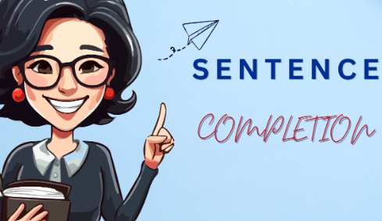
COMPETITION TIME:
Create groups/teams of 5 students.
You will be given incomplete sentences.
You have to complete the sentences with your ideas.
The team(s) with the most correct answers win(s).
Time limit: 5 minutes
Example: Tomorrow, I'll..."
"Tomorrow, I’ll go to school in the morning and then work on the project in the afternoon."

Slide 6
"In the future, I’ll …”
"If I have time, I’ll …”
"When I graduate, I’ll ..."
"After lunch, I’ll …”
"During the holidays, I’ll …”
"Before the end of the month, I’ll …”
"At the party tonight, I’ll …”

Slide 7
"In the future, I’ll focus more on my health and spend more time with my family."
"If I have time, I’ll start learning a new language or maybe pick up a hobby like painting."
"When I graduate, I’ll look for a job in my field and hopefully start my career."
"After lunch, I’ll take a short walk to refresh myself before getting back to work."
Suggested answers

Slide 8
Suggested answers
"During the holidays, I’ll visit my relatives and spend quality time with them."
"Before the end of the month, I’ll finish reading that book I just bought."
"At the party tonight, I’ll try to socialize more and meet new people."

Slide 9

Pronunciation

Slide 10


Task a
Notes:
'...I will...' is often contracted to '...I'll...'.
'...I'll...' sounds like /aɪl/.

Slide 11


Task b
Listen to the words and focus on the underlined letters.
I'll have more career opportunities.
I'll improve quickly.

Slide 12

Task c
Listen and cross out the sentence that doesn’t follow the note in Task a.
I'll earn more money.
I'll study abroad.

Slide 13
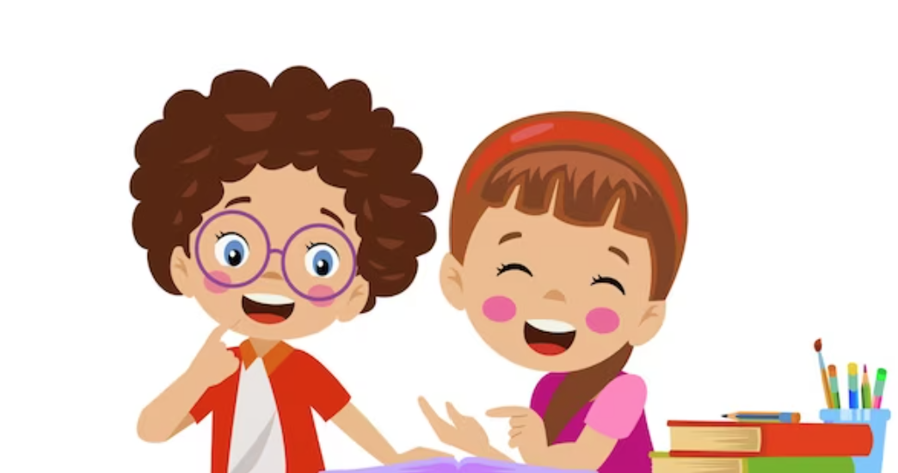
Task d
Read the sentences with the sound changes noted in Task a. to a partner.
I'll earn more money.
I'll study abroad.

Slide 14

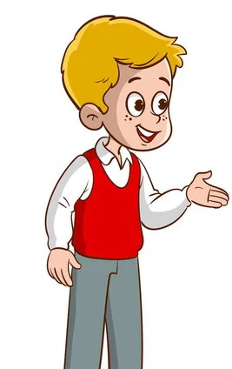
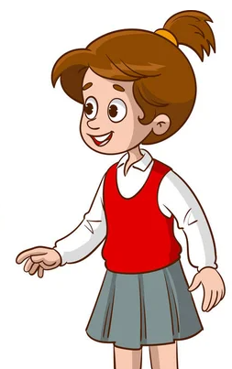
Task a
In pairs: Take turns telling your partner why you are learning English. Look at the example on the next slide.

Slide 15

Example
I'm learning English because of the future career opportunities. Since I'll have more career opportunities, I'll earn more money.
Why are you learning English?

Slide 16

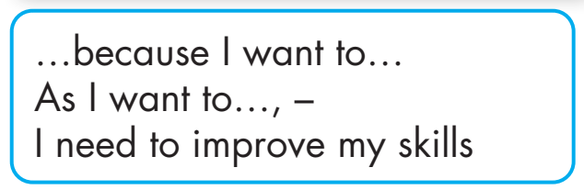

Slide 17
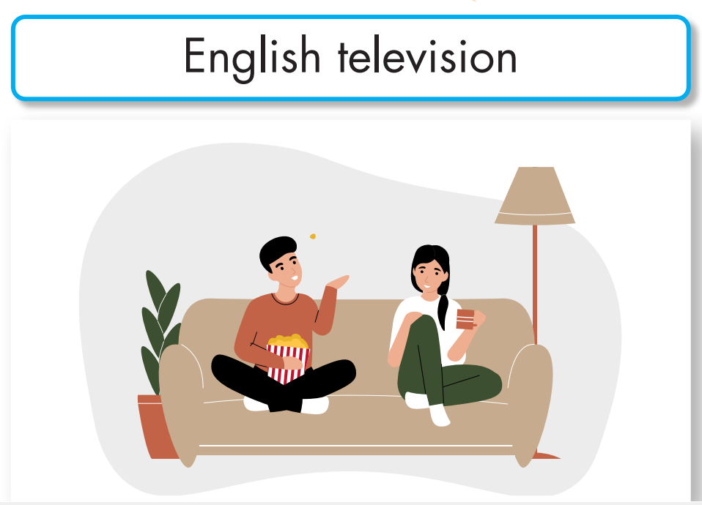
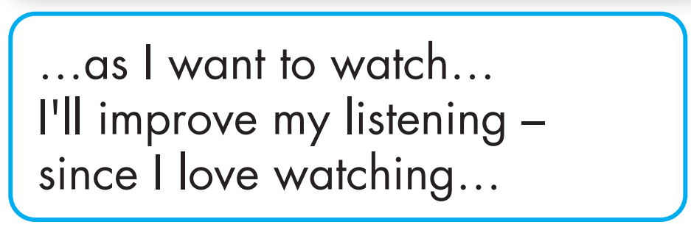

Slide 18
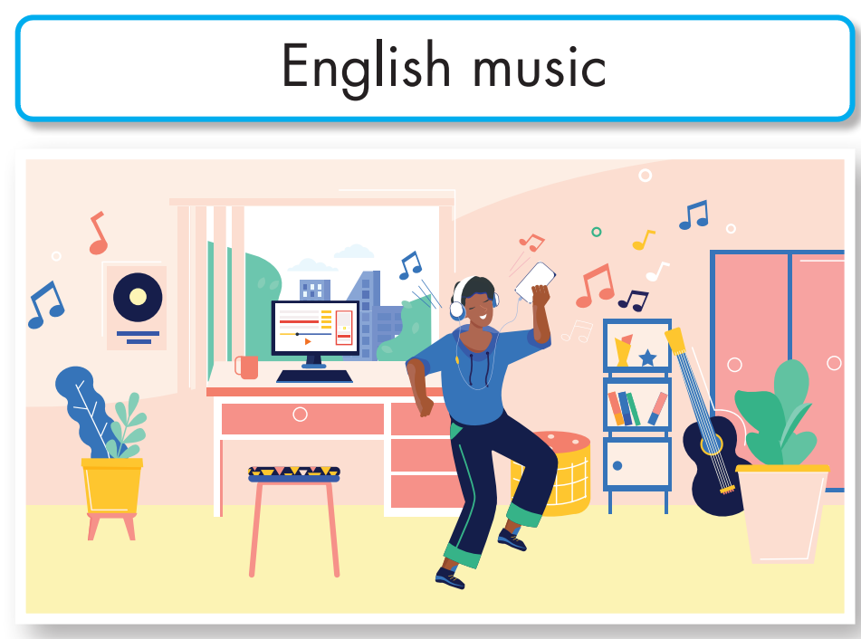
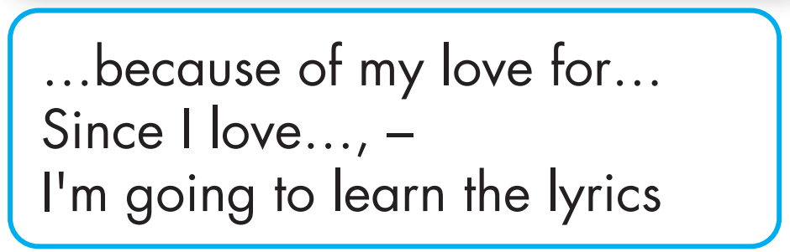

Slide 19

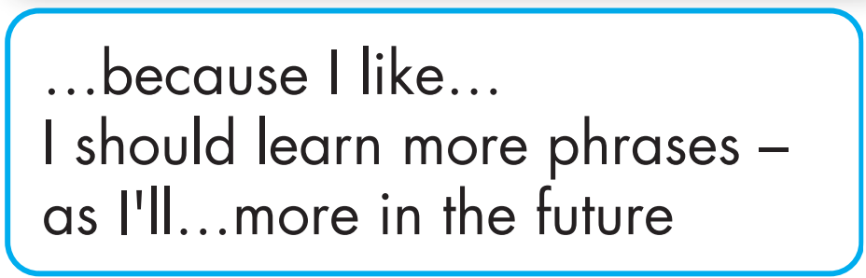

Slide 20
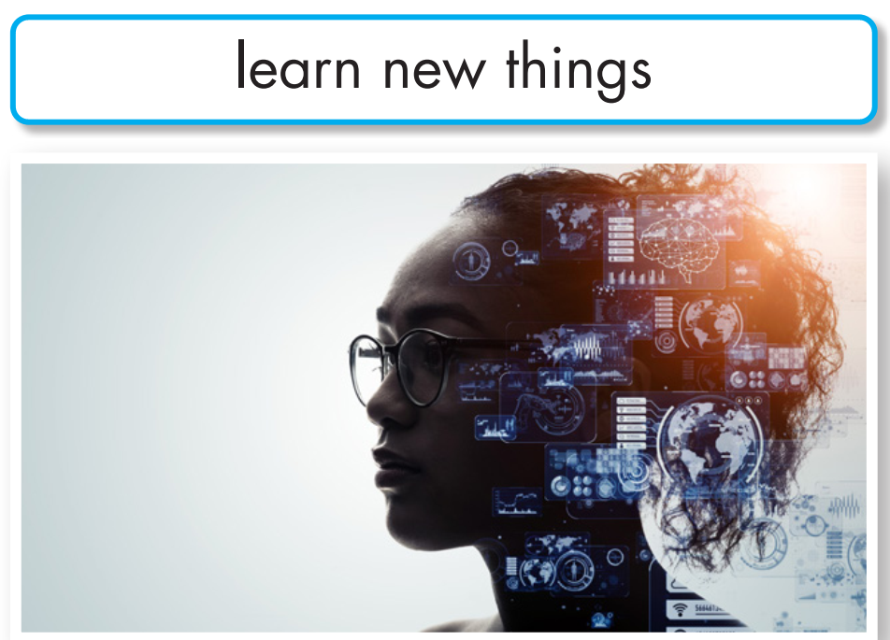
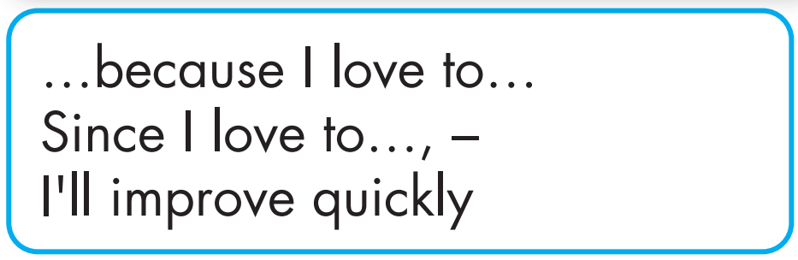

Slide 21
Task a
Now, role-play the conversations in front of the class.

Slide 22

Suggested answer
I'm learning English because I want to study abroad. As I want to study abroad, I need to improve my skills.
Why are you learning English?

Slide 23
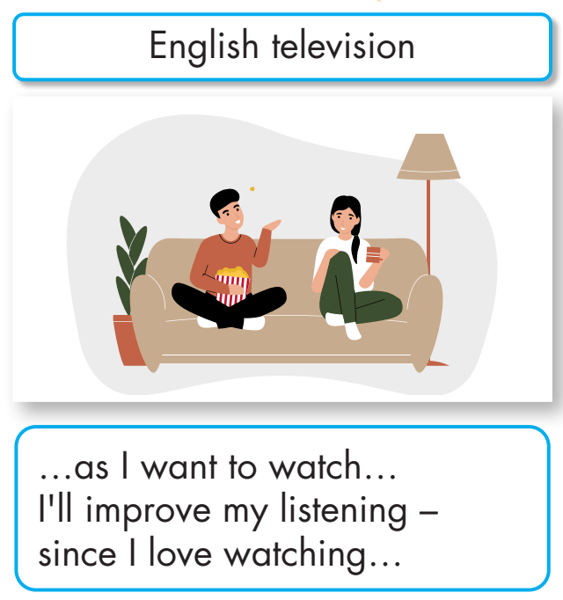
I’m learning English as I want to watch English television. I’ll improve my listening since I love watching English television.
Suggested answer
Why are you learning English?

Slide 24
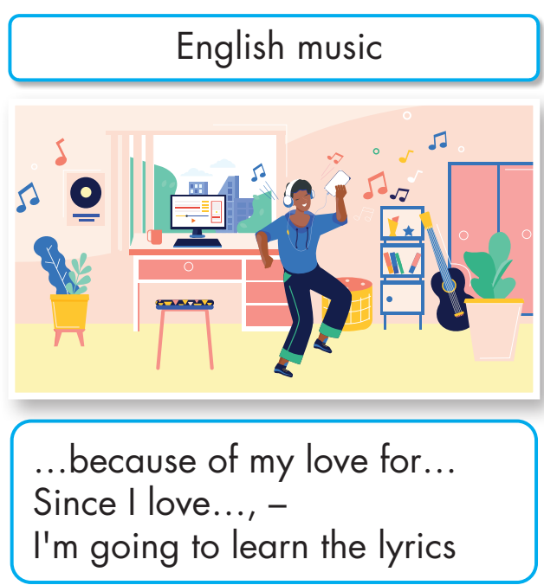
I’m learning English because of my love for English music. Since I love English music, I’m going to learn the lyrics.
Suggested answer
Why are you learning English?

Slide 25
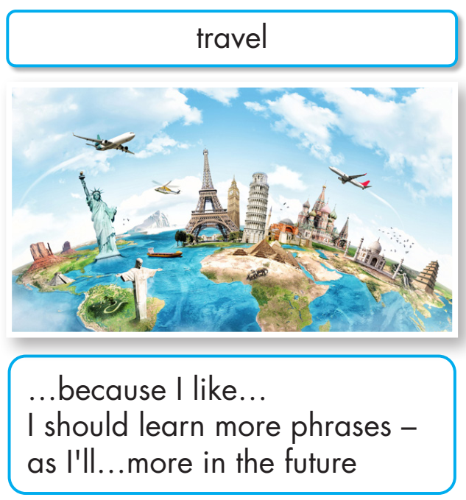
Suggested answer
I'm learning English because I like to travel. I should learn more phrases as I’ll travel more in the future.
Why are you learning English?

Slide 26
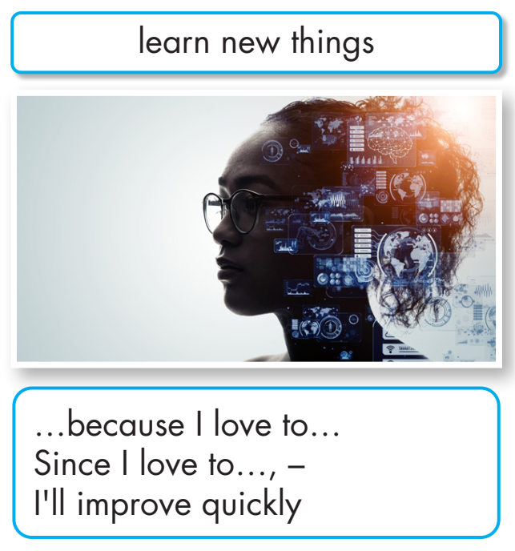
I’m learning English because I love to learn new things. Since I love to learn new things, I’ll improve quickly.
Suggested answer
Why are you learning English?

Slide 27

Task b
Practice with your own ideas.

Slide 28

Suggested answer
I'm learning English because I want to understand international cooking recipes and I’ll try to cook new dishes.
Why are you learning English?

Slide 29

I’m learning English since I’m interested in technology. I’ll use English to access online resources, tutorials, and IT forums.
Suggested answer
Why are you learning English?

Slide 30

Suggested answer
I'm learning English because of my love for English literature. I want to read classic novels and plays in English.
Why are you learning English?

Slide 31
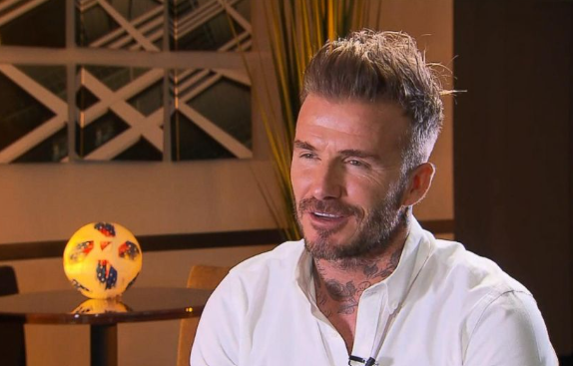
I’m learning English as I have a desire to understand English-speaking celebrities’ interviews.
Suggested answer
Why are you learning English?

Slide 32
Presentation
Speaking

Slide 33
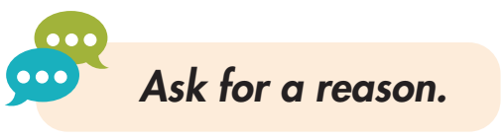
Task a
In pairs: Discuss your top three reasons for learning English. Decide on the two most important reasons and write them in the table.

Slide 34
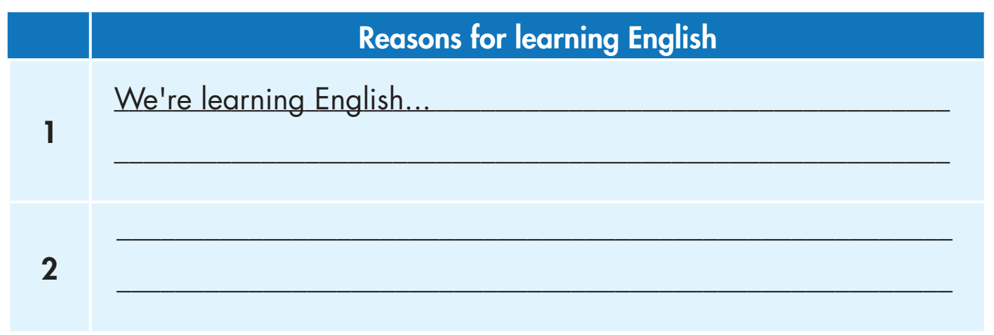

Slide 35
Suggested answers
1. We’re learning English because we want to understand descriptions of products or packaging: English is often used in product packaging, labels, and instructions, especially for global brands.

Slide 36
Suggested answers
2. We’re learning English to take part in fandom groups since English is used in fan communities and forums related to various books, movies, TV shows, and celebrities.

Slide 37
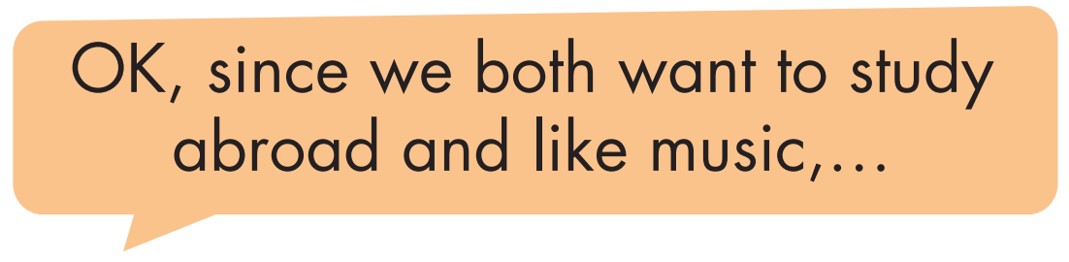
Task b
In pairs: Choose two study methods from Lesson 1 you think
will explain your reasons for studying English. Join another
pair and share your ideas.

Slide 38
Suggested answer
Ok, since we both want to study abroad and like music, we can get better at English by spending time in places where people speak English, listening to English songs, and talking with people who speak English as their first language.

Slide 39

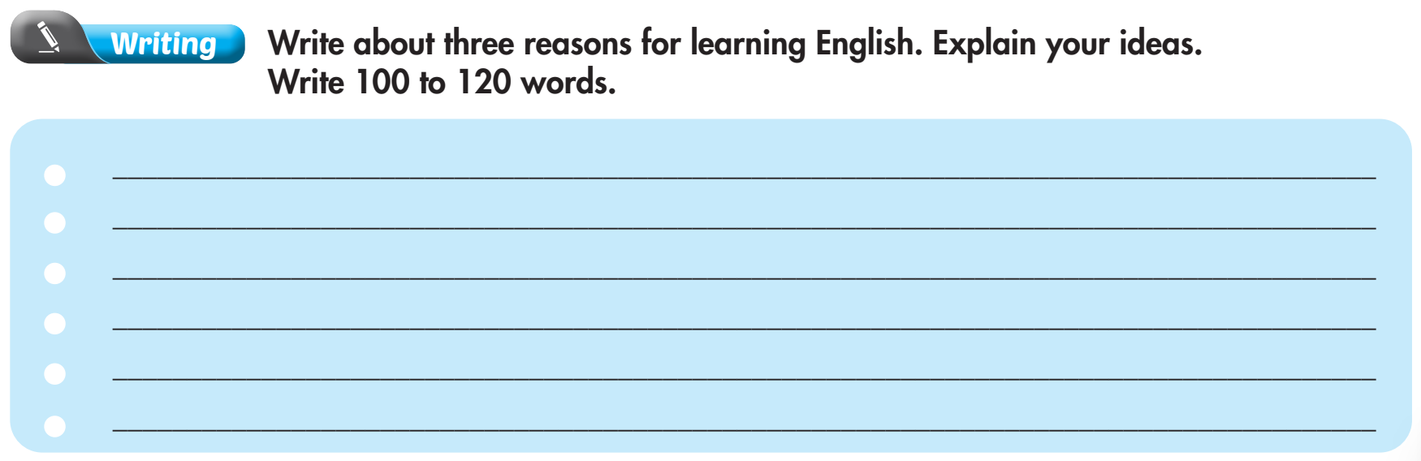
Extra practice - WB - page 3

Slide 40

Suggested answer
I’m learning English because of my love for cooking. English is often the primary language used in international cooking communities and platforms where a lot of recipes, cooking techniques, and culinary trends are shared.

Slide 41

Suggested answer
I’m learning English since I want to stay updated with technological advancements. Many forums, blogs, and technical documentation related to IT topics are in English. I often seek advice from the global IT community so learning English can help me participate in these forums.

Slide 42

Suggested answer
I’m learning English as I want to know more about physics and astronomy. With good English, I can read academic research and specialized knowledge in fields such as astronomy, genetics, and physics.

Slide 43

CONSOLIDATION

Slide 44
Practice saying these sentences by focusing on the highlighted words.
I'll have more career opportunities.
I'll improve quickly.

Slide 45

WRAP-UP

Slide 46
Today’s lesson
Pronunciation:
Sound changes, to practice pronouncing I’ll.
Speaking:
Discuss Why you are learning English, using adverbial clauses and phrases of reason.

Slide 47
Homework
Practice saying sentences in the Pronunciation(SB) with sound changes.
Prepare for the next lesson (Reading & Listening - pages 12 & 13 - SB).
Play the consolidation games on www.eduhome.com.vn

Slide 48

Lesson 3
Stay positive and have a nice day!

