Slide 1

Unit 1: English in the World
Lesson 2.2: Grammar
Pages 9 & 10

Slide 2
Lesson Outline
Warm-up
Presentation
Practice
Production
Consolidation
Wrap-up

Slide 3

By the end of this lesson, students will be able to…
Practice and use adverbial clauses and phrases of reason.
Make conversations about reasons to study English using phrases of reason.

Slide 4

WARM-UP

Slide 5

COMPETITION TIME:
Create groups/teams of 5 students.
You will be given sentence beginnings and sentence endings, you have to match them to make correct sentences.
The team(s) with the most correct answers win(s).
Time limit: 5 minutes

Slide 6
Sentence Beginnings:
I couldn't go to the party
Sarah enjoys outdoor activities
We postponed the meeting
He failed the exam
She left early
We had to cancel the trip
I'll be late
The traffic was heavy
I'll help you
They decided to move
Sentence Endings:
because I have a dentist appointment.
as he didn't study enough.
since she had an early morning flight.
because of the rainy weather.
as we didn't have enough participants.
because of her love for nature.
since we couldn't find a suitable venue.
because of a family emergency.
as the new job opportunity. j. because of the unexpected road closure.

Slide 7
Answers:
I couldn't go to the party h. because of a family emergency.
Sarah enjoys outdoor activities f. because of her love for nature.
We postponed the meeting g. since we couldn't find a suitable venue.
He failed the exam b. as he didn't study enough.
She left early c. since she had an early morning flight.
We had to cancel the trip e. as we didn't have enough participants.
I'll be late a. because I have a dentist appointment.
The traffic was heavy j. because of the unexpected road closure.
I'll help you i. as the new job opportunity.
They decided to move d. because of the rainy weather.

Slide 8

Presentation

Slide 9

FORM: Main clause + as/since/because+ clause.
USE: These clauses and phrases explain why something happens.
Presentation
My English improved because I practiced a lot.
I'm going to study abroad as it will help me get a better job.

Slide 10
As/Since/Because + clause, main clause.
Note: There’s a comma (,) between 2 clauses.
Since your English is better than mine, could you help me?
Because I read lots of English books, my vocabulary improved.
Presentation

Slide 11
Main clause + because of + noun phrase.
I'm studying English because of the opportunities it will give me.
My brother is getting really good at English because of all the English movies he watches.
Presentation

Slide 12
Because of + noun phrase, + main clause.
Note: There’s a comma (,) after the noun phrase.
Because of the cost, I'm not going to study abroad.
Because of the job I want in the future, I need to speak English really well.
Presentation

Slide 13
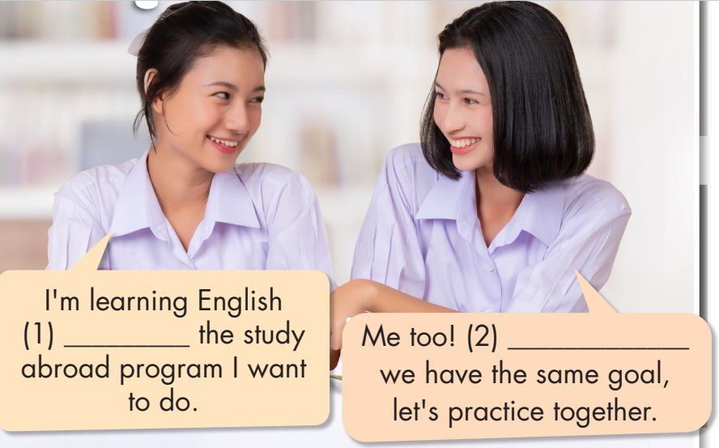
Task a. Read about adverbial clauses/phrases of reason, then fill in the blanks.
Presentation

Slide 14



Task b. Listen and check.
Listen again and repeat.
As/Since/
Because
Presentation
because of

Slide 15
Practice

Slide 16
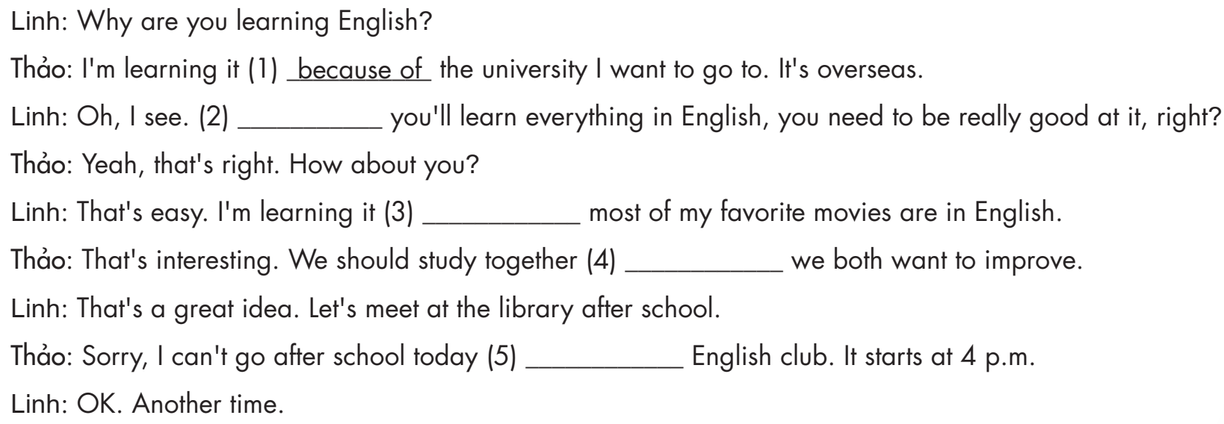
Task c. Fill in the blanks with as/since/because or because of

Slide 17
Linh: Why are you learning English?
Thảo: I'm learning it (1) ___________ the university I want to go to. It's overseas.
Linh: Oh, I see. (2) you'll learn everything in English, you need to be really good at it, right?
Thảo: Yeah, that's right. How about you?
Linh: That's easy. I'm learning it (3) most of my favorite movies are in English.
because of
As/Since/Because
as/since/because

Slide 18
Thảo: That's interesting. We should study together
(4) we both want to improve.
Linh: That's a great idea. Let's meet at the library after school.
Thảo: Sorry, I can't go after school today (5) ____________ English club. It starts at 4 p.m.
Linh: OK. Another time.
as/since/because
because of

Slide 19
Task d. Use the prompts to write replies using as/since/because or because of.
1. Friend: I love English songs.
You: We both like English songs/do you want/sing karaoke?
As/Since/Because we both like English songs, do you want to sing karaoke?

Slide 20
2. New girl in class: How is your class so good at English?
You: We are very good/how much/read and listen/English content every day
__________________________________________________________________
3. Sister: English is spoken all around the world.
You: Yes/English/help you with international travel/people speak it worldwide
_________________________________________________________________
4. Teacher: Why do you want to improve your English?
You: English is/language of overseas study/it/essential to be good/it
__________________________________________________________________
5. Friend: You seem to really like learning English.
You: I/learning English/career opportunities/it will give me/future
__________________________________________________________________

Slide 21
2. New girl in class: How is your class so good at English?
You: We are very good/how much/read and listen/English content every day
3. Sister: English is spoken all around the world.
You: Yes/English/help you with international travel/people speak it worldwide
Answers
We are very good because of how much we read and listen to English content every day.
Yes. English can/will help you with international travel as/since/because people speak it worldwide.

Slide 22
4. Teacher: Why do you want to improve your English?
You: English is/language of overseas study/it/essential to be good/it
5. Friend: You seem to really like learning English.
You: I/learning English/career opportunities/it will give me/future
As/Since/Because English is the language of overseas study, it's essential to be good at it.
I'm learning English because of the career opportunities it will give me in the future.

Slide 23
Extra practice
Presentation

Slide 24

Extra Practice – WB, P 5
Task a. Choose the correct answer.
1. I want to learn English because of/because the overseas study options it will give me.
2. Since/Because of international businesses use English, it's essential to speak it well.
3. I will study English every evening because of/as it will give me more career opportunities.
4. I don't enjoy traveling because/because of I'm not very good at speaking English.
5. Because of/As the benefits to international work, study, and travel, everyone should learn some English phrases.
Presentation
Production

Slide 25
Answers
Task a. Choose the correct answer.
2. Since/Because of international businesses use English, it's essential to speak it well.
3. I will study English every evening because of/as it will give me more career opportunities.
Presentation
Production

Slide 26
Extra Practice - WB
Task a. Choose the correct answer.
4. I don't enjoy traveling because/because of I'm not very good at speaking English.
5. Because of/As the benefits to international work, study, and travel, everyone should learn some English phrases.
Presentation
Production

Slide 27
Task b. Use the prompts and one of the phrases in brackets to write sentences.
Extra Practice – WB
P 5
foreign/universities/use/English,/learn/it/very/important (because of/since)
Since foreign universities use English, learning it is very important.
2. we/learn/new English words/we/watch/TV/with/the/subtitles (as/because of)
3. are/you/learn/English/you/want/live/overseas? (because/because of)
4. you/watch/lot of/English/content,/can/teach/us/any/new/words? (because of/since)
5. she/sings/English/songs/she/wants/practice/pronunciation (since/because of)
Presentation
Production

Slide 28
Answers
Extra Practice - WB
2. we/learn/new English words/we/watch/TV/with/the/subtitles (as/because of)
3. are/you/learn/English/you/want/live/overseas? (because/because of)
We learn new English words as we watch TV with the subtitles.
Presentation
Production
Are you learning English because you want to live overseas?

Slide 29
Answers
Extra Practice - WB
4. you/watch/lot of/English/content,/can/teach/us/any/new/words? (because of/since)
5. she/sings/English/songs/she/wants/practice/pronunciation (since/because of)
Since you watch a lot of English content, can you teach us any new words?
Presentation
Production
She sings English songs because she wants to practice her pronunciation.

Slide 30
Production

Slide 31
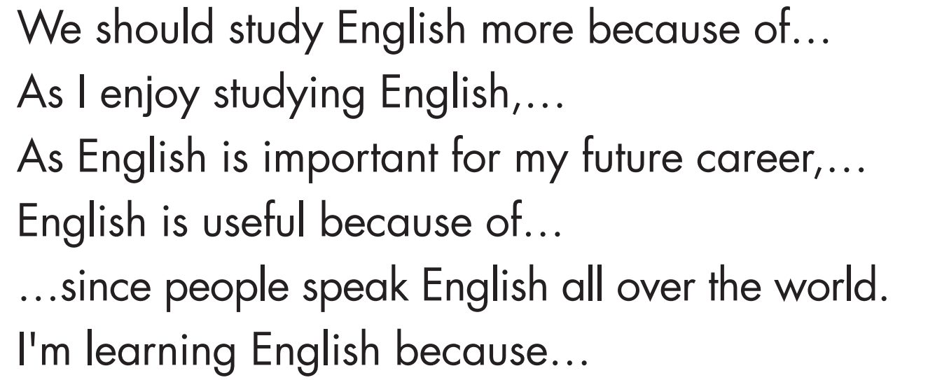

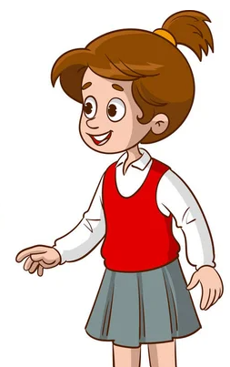
Task e. In pairs: Talk about English using the prompts below.
We should study English more because of all the career opportunities it can give us.

Slide 32

Suggested answers
As I enjoy studying English, I will join the English club at my school.
As English is important for my future career, I will study more in the evenings.

Slide 33

Suggested answers
English is useful because of its popular use at universities abroad.
I want to learn English since people speak English all over the world.

Slide 34

Suggested answers
That’s great.
I'm learning English because I want to be a tour guide.

Slide 35

CONSOLIDATION

Slide 36
Ask and answer the question below with your partner, using “because, as, since, because of” to give reasons:
Why do you learn English?

Slide 37
Suggested answers
I learn English because it is often required for admission to good universities and educational programs.
English is a common language in international travel, so we learn it since it makes traveling easier.
We learn English as we want to enjoy songs in English.
English is a language used in international business, so I learn it because it can enhance my career prospects.

Slide 38

WRAP-UP

Slide 39
Today’s lesson
Grammar:
Practice and use adverbial clauses and phrases of reason.
Speaking:
Make conversations about reasons to study English using phrases of reason.

Slide 40
Homework
Review adverbial clauses and phrases of reason.
Prepare for the next lesson (Pronunciation & Speaking - pages 10 & 11 - SB).
Play the consolidation games on www.eduhome.com.vn

Slide 41

Lesson 3
Stay positive and have a nice day!

