Slide 1
Unit 1: English in the World
Lesson 1.2: Grammar
Pages 5 & 6

Slide 2
Lesson Outline
Warm-up
Presentation
Practice
Production
Consolidation
Wrap-up

Slide 3
By the end of this lesson, students will be able to…
Learn how to use to-infinitives (for purpose) to give the purpose of study methods.
Review and practice how to use phrasal verbs to describe study methods.

Slide 4
WARM-UP

Slide 5
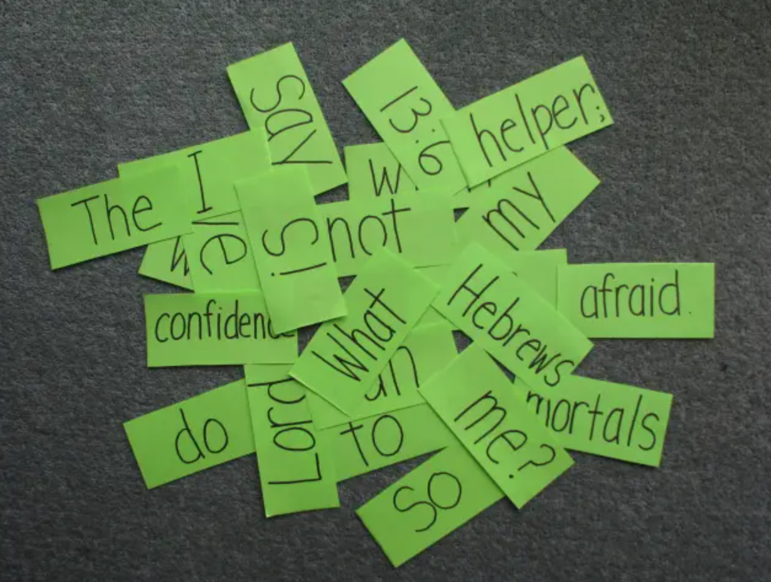
COMPETITION TIME:
Create groups/teams of 5 students.
You will be given some sentences but in the wrong order, you have to unscramble the sentences.
The team(s) with the most correct answers win (s).
Time limit: 5 minutes

Slide 6
Example:
to / She / wants / visit / her / grandparents.
Answer:
She wants to visit her grandparents.

Slide 7
to / clean / We / the / decided / room / together.
to / wants / My / be / astronaut / brother.
to / help / offered / The / us / move / neighbors.
to / like / I / my / guitar / play / every / friend/ day.
to / She / plans / her / complete / studies / abroad.
to / Dad / me / allowed / stay / up / late / on / the / weekends.
to / loves / play / sister / My / with / dolls.
to / need / We / buy / groceries / before / dinner.

Slide 8
to / clean / We / the / decided / room / together.
We decided to clean the room together.
2. to / wants / My / be / astronaut / brother.
→ My brother wants to be an astronaut.
3. to / help / offered / The / us / move / neighbors.
→ The neighbors offered to help us move.

Slide 9
4. to / like / I / my / guitar / play / every / friend / day.
→ I like to play my guitar every day with my friend.
5. to / She / plans / her / complete / studies / abroad.
→ She plans to complete her studies abroad.
6. to / Dad / me / allowed / stay / up / late / on / the / weekends.
→ Dad allowed me to stay up late on the weekends.

Slide 10
7. to / loves / play / sister / My / with / dolls.
→ My sister loves to play with dolls.
8. to / need / We / buy / groceries / before / dinner.
→ We need to buy groceries before dinner.

Slide 11
Presentation

Slide 12
FORM: Main clause + to-infinitive
USE: We can use to-infinitives to express the purpose of something.
Presentation
I read a lot in English to improve my skills.
Do you watch movies to learn new words?

Slide 13
Phrasal verb = A verb + a particle (particle: an adverb or a preposition or both)
The meaning of a phrasal verb is different from each part in it.
Look up the word if you don't know the meaning. (Find the word in a dictionary.)
Look over your homework before you turn it in. (Check it carefully.)
Look for any words you don't understand. (Try to find them.)
Presentation

Slide 14
Task a. Read about to-infinitives and phrasal verbs, then fill in the blanks.
note down
to remember
Presentation

Slide 15
Task b. Listen and check. Listen again and repeat.
Presentation

Slide 16
Some phrasal verbs can be separable. An object can go between the verb and the particle, or after the particle.
Presentation
Can you turn the subtitles on?
2. Can you turn on the subtitles?

Slide 17
If the phrasal verb is separable, and the object is a pronoun, the object must go between the verb and particle.
Presentation
Can you turn them on?

Slide 18
Some phrasal verbs are inseparable. The verb and the particle always go together, and the object follows.
Presentation
I came across a great English website.
I went over my homework and didn't find any mistakes.

Slide 19
Presentation
Practice

Slide 20
Task c. Circle the correct words.
2. I look at/up the lyrics of my favorite songs to know/knowing what the singer is saying.
3. When you learn something new, do you note down/it down to help/helping you remember it?
4. My brother often goes over/up his homework two or three times to finding/find mistakes.
5. You should use subtitles. I turn them on/on to understanding/understand what the actors are saying.
Presentation

Slide 21
Task c. Circle the correct words.
Answers
2. I look at/up the lyrics of my favorite songs to know/knowing what the singer is saying.
3. When you learn something new, do you note down/it down to help/helping you remember it?
Presentation

Slide 22
Task c. Circle the correct words.
Answers
4. My brother often goes over/up his homework two or three times to finding/find mistakes.
5. You should use subtitles. I turn them on/on to understanding/understand what the actors are saying.
Presentation

Slide 23
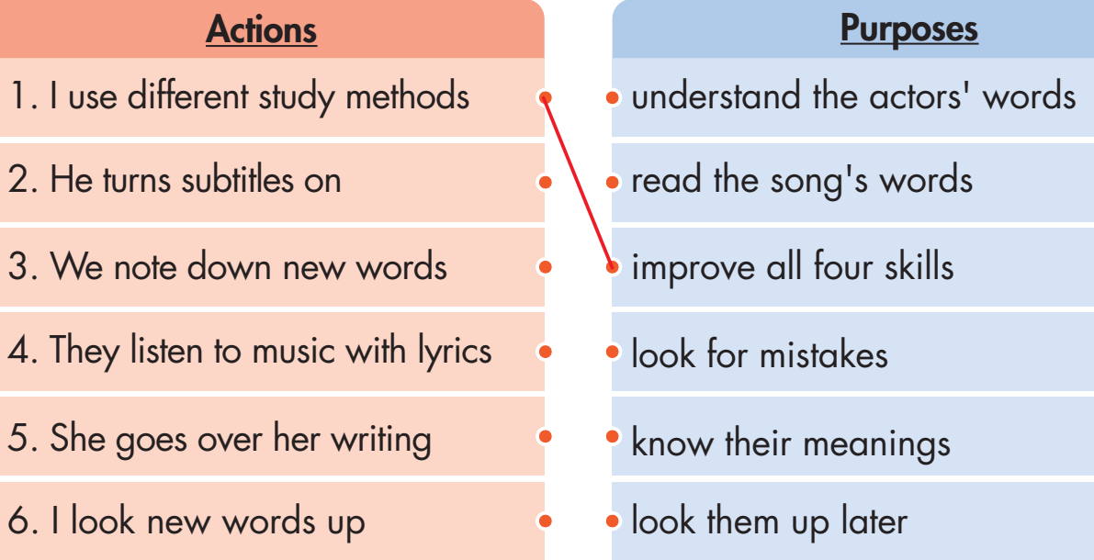
Task d. Match the actions to the purposes, then write complete sentences.
Presentation

Slide 24
Task d. Write complete sentences.
I use different study methods to improve all four skills.
.
.
.
.
.
He turns subtitles on to understand the actors' words.
We note down new words to look them up later.
He turns subtitles on to understand the actors' words.
Presentation
They listen to music with lyrics to read the song's words.
I look new words up to know their meanings.

Slide 25
Extra Practice – WB, P3
Unscramble the sentences.
1. new words/me remember./I note down/to help
2. on./I always turn/useful, and/them/Subtitles are
3. a word you/look it/When you read/up in a dictionary./don’t know,
4. across new/I read texts/words and grammar./above my level/to come
5. on your exam/two times/to get a/Go over/better score./all the questions
Presentation
Production

Slide 26
Extra Practice - WB
ANSWERS:
1. I note down new words to help me remember.
2. Subtitles are useful, and I always turn them on.
3. When you read a word you don't know, look it up in a dictionary.
4. I read texts above my level to come across new words and grammar.
5. Go over all the questions on your exam two times to get a better score.
Presentation
Production

Slide 27
Presentation
Production

Slide 28
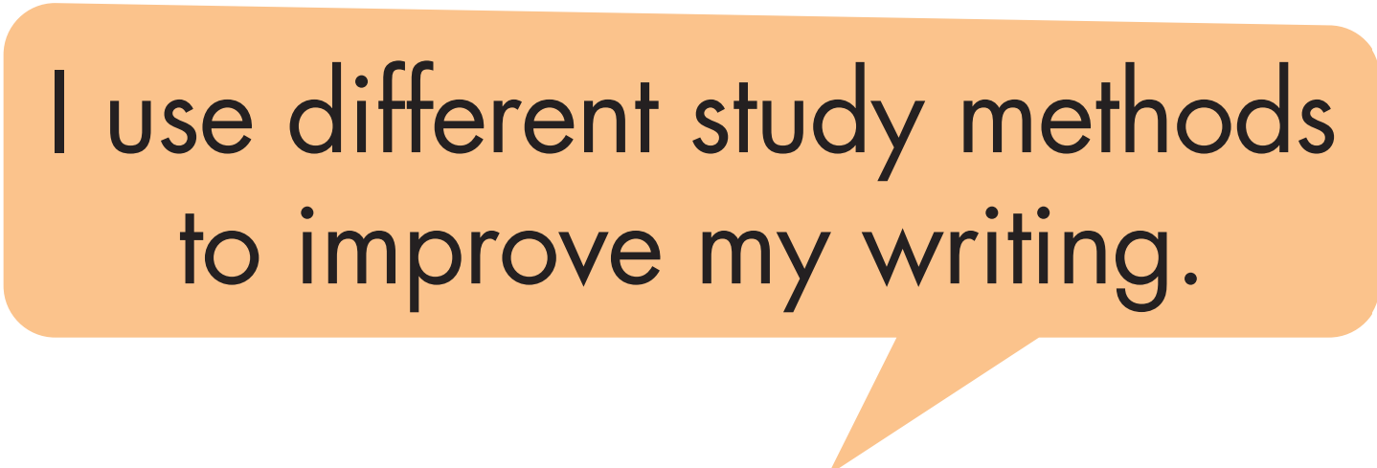
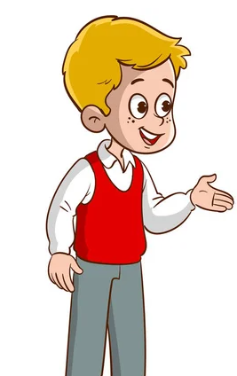
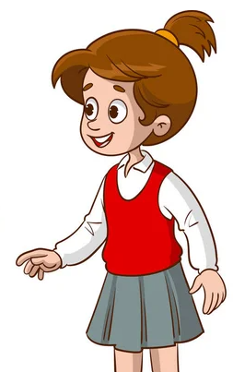
Task e. In pairs: Use the actions from Task d again and make new sentences using your own ideas for the purposes.
Presentation

Slide 29
Suggested answer
Presentation
Production
I use different study methods to pick up information quickly.

Slide 30
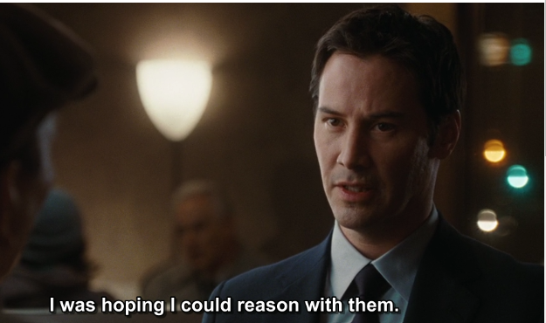
Suggested answer
Presentation
Production
2. He turns subtitles on to understand the movie’s dialogue.

Slide 31
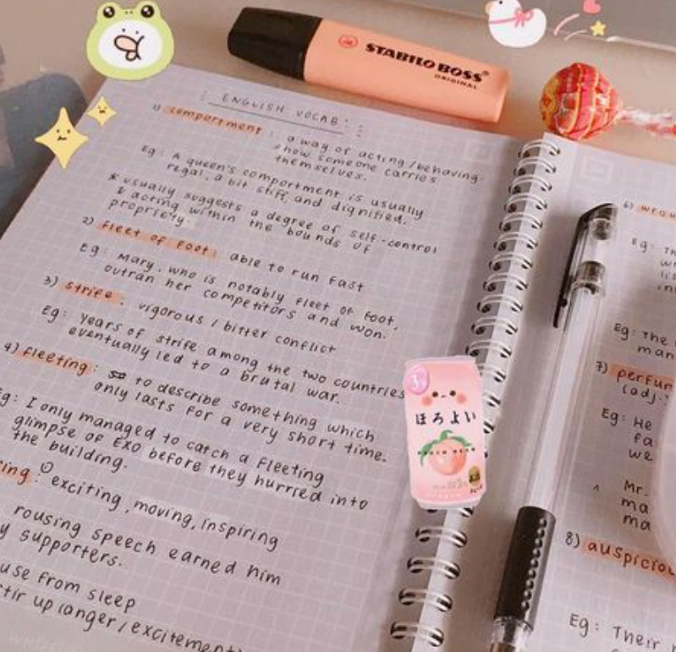
Suggested answer
Presentation
Production
3. We note down new words to make some sentences later.

Slide 32
Suggested answer
Presentation
Production
4. They listen to music with lyrics to get a feel for the language.

Slide 33
Suggested answer
Presentation
Production
5. She goes over her writing to look for mistakes and improvements.

Slide 34
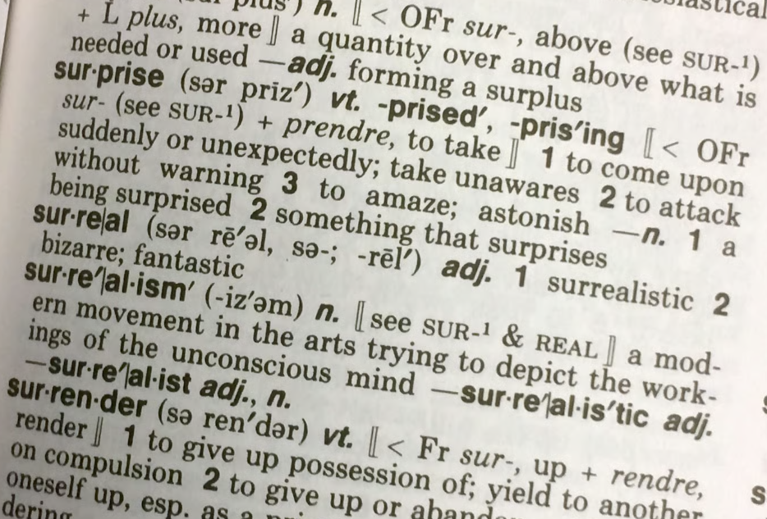
Suggested answer
Presentation
Production
6. I look new words up to understand their meanings.

Slide 35
CONSOLIDATION

Slide 36
Ask and answer the question below with your partner, using “to-infinitives” to give purposes:
What do you do to improve new vocabulary every day?

Slide 37
Suggested answers
Use Flashcards:
I create flashcards with a word on one side and its definition on the other to expand my vocabulary.
Play Word Games:
I Engage in word games like Scrabble, crossword puzzles, or word searches to have some fun learning new words.
Watch Educational Videos:
I watch videos or documentaries that focus on educational topics to make it more exciting to learn new phrases.

Slide 38
Suggested answers
Use Vocabulary Apps:
I explore educational apps that are designed to improve my vocabulary.
Learn a Word Each Day:
I challenge myself to learn a new word every day.

Slide 39
WRAP-UP

Slide 40
Today’s lesson
Grammar:
To-infinitives (for purpose) to give the purpose of study methods.
Separable and inseparable phrasal verbs.

Slide 41
Homework
Review separable and inseparable phrasal verbs to describe study methods.
Make sentences using separable and inseparable phrasal verbs in SB.
Prepare for the next lesson (Pronunciation & Speaking - pages 6 & 7 - SB).
Play the consolidation games on www.eduhome.com.vn

Slide 42
Lesson 3
Stay positive and have a nice day!

