Slide 1

Unit 5: Around Town
Lesson 3.1: Vocabulary & Listening
Page 44

Slide 2
Lesson Outline
Warm-up
Vocabulary
Listening
Consolidation
Wrap-up

Slide 3
Objectives
By the end of this lesson, students will be able to…
- practice and learn vocabularies for cooking: beef, fish sauce, fry, grill, herb, lamb, noodles, pork, seafood.
- practice listening: for main ideas and for details.
- practice functional English (Asking and answering about food).

Slide 4

WARM-UP

Slide 5

Work in pairs.
Choose the right ingredients that go with each dish.
grilled pork | beef | raw fish | egg | onions | herbs
pickled ginger | salmon | noodles | vegetables | rice | cheese
Bún bò Huế
Sushi
Cheeseburger

Slide 6
Answers
grilled pork | beef | raw fish | egg | onions | herbs
pickled ginger | salmon | noodles | vegetables | rice | cheese
Bún bò Huế
Sushi
Cheeseburger
grilled pork
egg
onions
herbs
vegetables
cheese
beef
onions
herbs
noodles
vegetables
raw fish
herbs
pickled ginger
salmon
rice

Slide 7

New words
……..
…….
…….
……..

Slide 8

Listen and repeat. Click each phrase to hear the sound.
noodles (n) /ˈnuːdlz/ mì (ăn liền)
lamb (n) /læm/ thịt cừu
grill (v) /ɡrɪl/ nướng
herbs /ɜːrb/, /hɜːrb/ rau thơm
seafood (n) /ˈsiːfuːd/ hải sản
beef (n) /biːf/ thịt bò
fry (v) /fraɪ/ rán (chiên)
pork (n) /pɔːrk/ thịt lợn (heo)
fish sauce (n) /fɪʃ sɔːs/ nước mắm
Notes:
GV click vào từng cụm nghe âm thanh

Slide 9
Look at the IPA and the meaning of each word to read out the word.
/ˈnuːdlz/ mì (ăn liền)
/læm/ (n) thịt cừu
/ɡrɪl/ nướng
/ɜːrb/, /hɜːrb/ rau thơm
/ˈsiːfuːd/ hải sản
/biːf/ thịt bò
/fraɪ/ rán (chiên)
/pɔːrk/ thịt lợn (heo)
/fɪʃ sɔːs/ nước mắm
Notes:
GV click vào từng cụm nghe âm thanh

Slide 10

Presentation

Slide 11
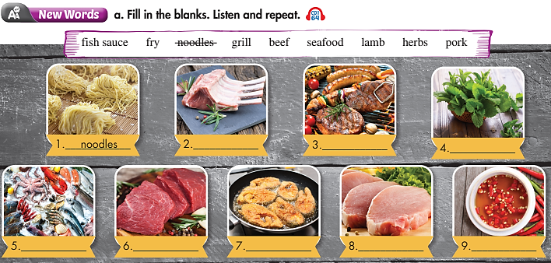
How many pictures are there?
– Nine.
What are they?
– Food.
What are you going to do?
– Fill in the blanks.

Slide 12

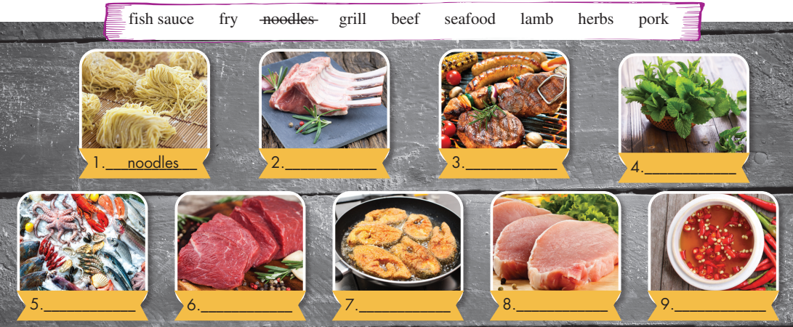
Work in pairs. Fill in the blanks
v
noodles
lamb
grill
herbs
Fill in the table
seafood
beef
fry
pork
fish sauce

Slide 13

Practice

Slide 14


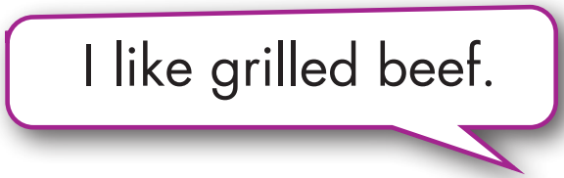
Work in pairs.
Take turns using the words in sentence.

Slide 15

Production

Slide 16
Extra Practice
WB page 26
Fill in the blanks using the words you have learnt.
1. Steak-frites is a kind of meat dish. It's __________ and french fries.
2. We __________ the sausages on the barbecue.
3. You can get good __________ in this restaurant. They serve really good crab and shrimp.
4. I don't like to eat grilled beef or pork, so I had grilled __________ .
5. __________ the steak in a little butter. It's so good.
beef
grill
seafood
lamb
Fry

Slide 17
Extra Practice
WB page 26
Fill in the blanks using the words you have learnt.
6. Pad see ew is a popular dish from Thailand with fried __________ .
7. I really like fried __________. Bacon is my favorite type.
8. I like to put chili in my __________ and pour it on my noodles.
9. My mom uses __________ from the garden to make our food taste amazing.
noodles
pork
fish sauce
herbs

Slide 18

Listening

Slide 19
Pre-Listening
Read the instruction quickly. Underline the key words. Who is the speaker?
a. Listen to a man talking about popular food from around the world. Who is the speaker?
1. A student
2. A customer
3. A chef

Slide 20
While-Listening
Now listen and choose the correct answer.  FIRST TIME
a. Listen to a man talking about popular food from around the world. Who is the speaker?
☞ YOUR ANSWER?
1. A chef
☞ WHY?

Slide 21
While-Listening
Now listen again and check.  SECOND TIME
While you are listening, focus on what the man says.
OK, everyone, quiet, please. Today, I'm going to show you how to make some dishes from around the world. First of all, we have cheeseburgers.
☞ YOUR ANSWER?
A student
A customer
A chef
☞ THE ANSWER IS …

Slide 22
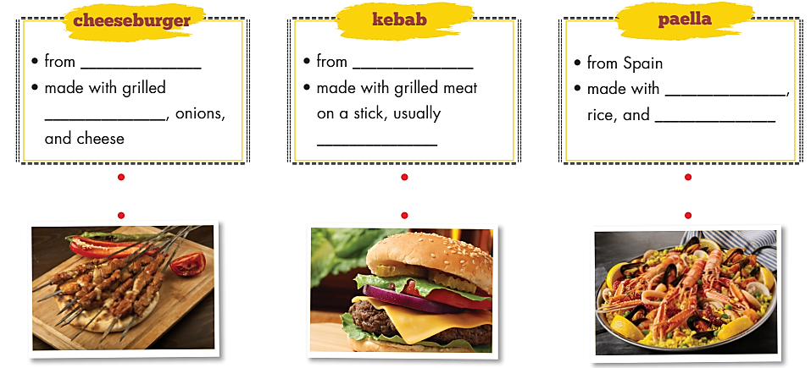
Pre-Listening
b. Now, listen and fill in the blanks, then match with the correct pictures.
☞ SECOND TIME
☞ WHAT ARE YOUR ANSWERS?

Slide 23

While-Listening
b. Now, listen and fill in the blanks, then match with the correct pictures.
☞ FIRST TIME
the USA
Turkey
seafood
beef
some vegetables
lamb
☞ WHAT ARE YOUR ANSWERS?

Slide 24
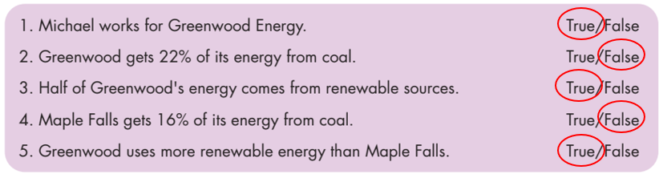
While - listening
While-Listening
Now listen again and check.  THIRD TIME
Cheeseburgers are popular in the USA. People make them with grilled beef, onions, and cheese.
1. Cheeseburger: • from the USA
• made with grilled beef, onions, and cheese
Many people eat kebabs in Turkey. A kebab is grilled meat on a stick, usually lamb.
2. Kebab: • from Turkey
• made with grilled meat on a stick, usually lamb.

Slide 25
While - listening
While-Listening
Now listen again and check.  THIRD TIME
Paella is a seafood-style dish. People in Spain cook and eat this food. They make paella with seafood, rice, and some vegetables.
3. Paella: • from Spain
• made with seafood rice and some vegetables.

Slide 26
Audio Scripts
Practice the conversation with a partner.
Chef: OK, everyone, quiet, please. Today, I'm going to show you how to make some dishes from around the world. First of all, we have cheeseburgers. Cheeseburgers are popular in the USA. People make them with grilled beef, onions, and cheese. Next, we have kebabs. Many people eat kebabs in Turkey. A kebab is grilled meat on a stick, usually lamb. Last but not least, we have paella. Paella is a seafood-style dish. People in Spain cook and eat this food. They make paella with seafood, rice, and some vegetables. Now, wash your hands and get ready to cook.
Students: OK!

Slide 27

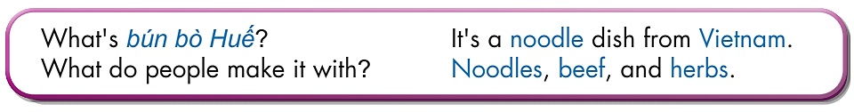
Work in pairs.
Post-Listening
Listen then practice

Slide 28

CONSOLIDATION

Slide 29
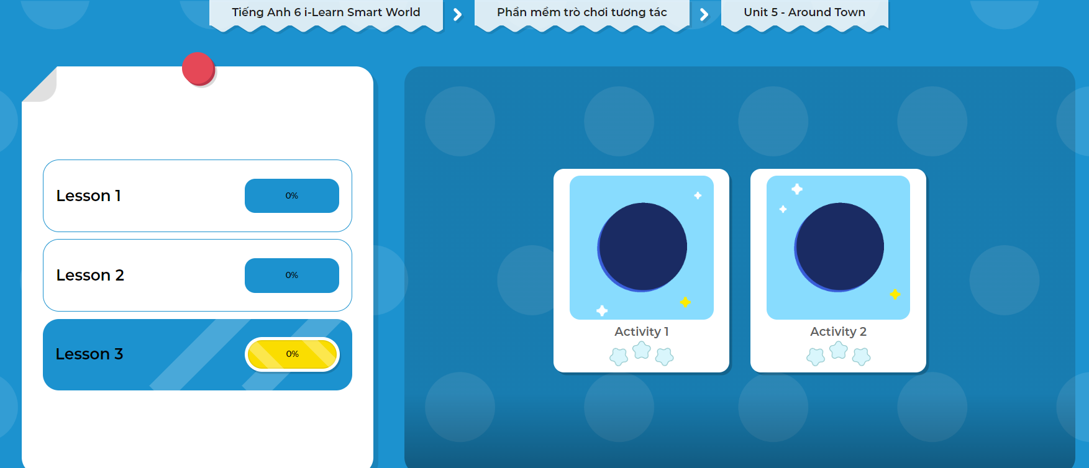
LET’S PLAY!
Click on the picture below to play the games!

Slide 30
Work in pairs.
What is your favorite food?
Can you tell me how you to make that food?

Slide 31

WRAP-UP

Slide 32
Today’s lesson
Vocabularies
beef
fish sauce
fry
grill
herbs
lamb
noodles
pork
seafood
Listening: for main ideas and for details.
Speaking: asking about favorite food and the way to make that dish.

Slide 33
Homework
Learn by hearts vocabularies and make sentences using them.
Do the exercises in Tiếng Anh 6 i-Learn Smart World Workbook (page 30).
Do the exercises in Tiếng Anh 6 i-Learn Smart World Notebook on page 30.
Prepare the next lesson (page 45 - SB).
Play the consolidation games in Tiếng Anh 6 i-Learn Smart World DHA App on www.eduhome.com.vn.

Slide 34

Enjoy your day!

