Slide 1

Unit 5: Around Town
Lesson 2.2: Grammar
Page 42

Slide 2
Lesson Outline
Warm-up
Grammar
Consolidation
Wrap-up

Slide 3
Objectives
By the end of this lesson, students will be able to…
use a, an, some, any correctly.
ask and give directions.

Slide 4

WARM-UP

Slide 5

Work in pairs.
JUMBLED WORDS
Rearrange the letters to make meaningful words.
1. paats
2. haebmurgr
3. jucie
4. cuecapk
5. snadwcih

Slide 6
JUMBLED WORDS
Rearrange the letters to make meaningful words.
1. paats
2. haebmurgr
3. jucie
4. cuecapk
5. snadwcih
1. pasta
2. hamburger
3. juice
4. cupcake
5. sandwich
ANSWER

Slide 7

Presentation
Countable and uncountable nouns

Slide 8
1. I'd like a cookie.
2. I'd like an apple.
3. I'd like some milk.
4. I'm sorry. We don't have any milk left.
5. Do you have any chocolate cake?

Slide 9
Lead in
1. What do we call a/an in sentence 1, 2?
Articles.
2. When do we use a/an?
Use a before singular nouns beginning with consonant sounds and an before vowel sounds.
3. How about some, any in sentence 3, 4, 5?
Indefinite pronouns.
When do we use indefinite pronouns for?
Use some with uncountable nouns and plural countable nouns; any for questions and negative answers.

Slide 10

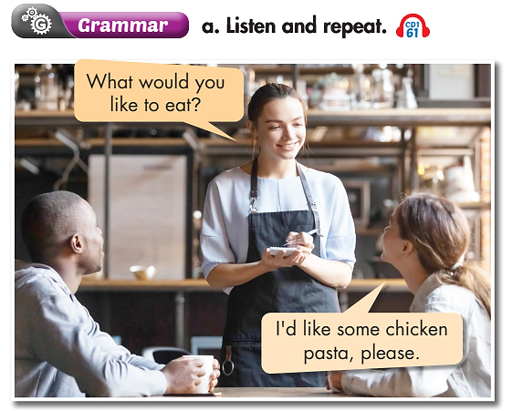
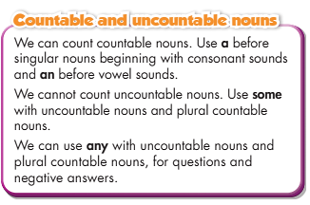

Slide 11

Practice

Slide 12
Practice
Fill in the blanks. Use a, an, some, or any.
How many sentences are there?
1. I'd like __________ chicken pasta.
2. I'd like __________ hamburger.
3. I'd like __________ orange juice.
4. I'd like __________ cheese sandwich.
5. I'd like __________ cola.
6. I'd like __________ egg sandwich.
7. We don't have __________ fries left.
→ There are 7.
What are you going to do?
Fill in the blanks with a, an,
some, any.

Slide 13
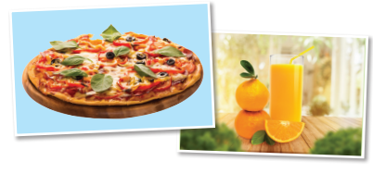
Practice
Fill in the blanks. Use a, an, some, or any.
some
1. I'd like __________ chicken pasta.
2. I'd like __________ hamburger.
3. I'd like __________ orange juice.
4. I'd like __________ cheese sandwich.
5. I'd like __________ cola.
6. I'd like _________ egg sandwich.
7. We don't have __________ fries left.
a
some
a
some
an
any

Slide 14
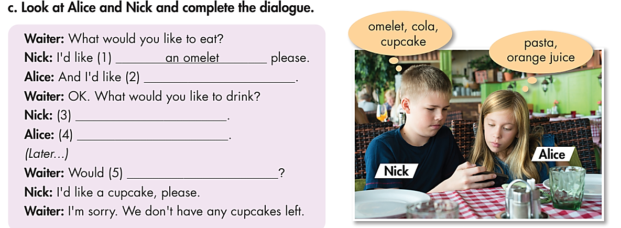
Practice
Who are there in the dialogue?
→ Alice and Nick.
What are you going to do?
Look at them and complete the dialogue.

Slide 15
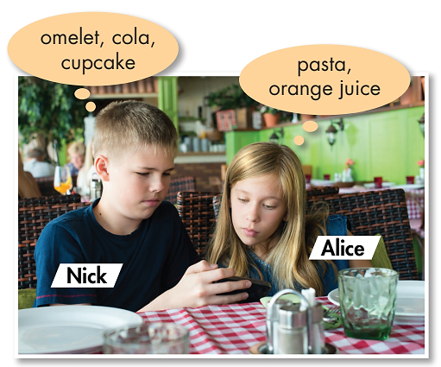
Look at Alice and Nick and complete the dialogue.
Waiter: What would you like to eat?
Nick: I'd like (1) ___________ please.
Alice: And I'd like (2) ___________.
Waiter: OK. What would you like to drink?
Nick: (3) _____________________.
Alice: (4) ____________________________.
(Later...)
Waiter: Would (5) ___________________?
Nick: I'd like a cupcake, please.
Waiter: I'm sorry. We don't have any cupcakes left.
an omelet
some pasta
I’d like some cola, please
I’d like some orange juice, please
you like some dessert

Slide 16
Extra Practice
WB, page 29
1. some/a milk
2. an/some fish soup
3. a/any cheese sandwich
4. some/a fries
5. an/any egg
6. some/a cheesecake
7. a/some hamburger
8. some/a soda
9. a/any salad

Slide 17

Production

Slide 18

Work in pairs.
Now, practice the conversation with your partner.
A: What would you like to eat?
B: I'd like an omelet, please.
C: And I'd like some pasta.
A: OK. What would you like to drink?
B: I’d like some cola, please.
C: I’d like some orange juice, please.
A: Would you like some dessert?
B: I'd like a cupcake, please.
A: I'm sorry. We don't have any cupcakes left.

Slide 19

CONSOLIDATION

Slide 20
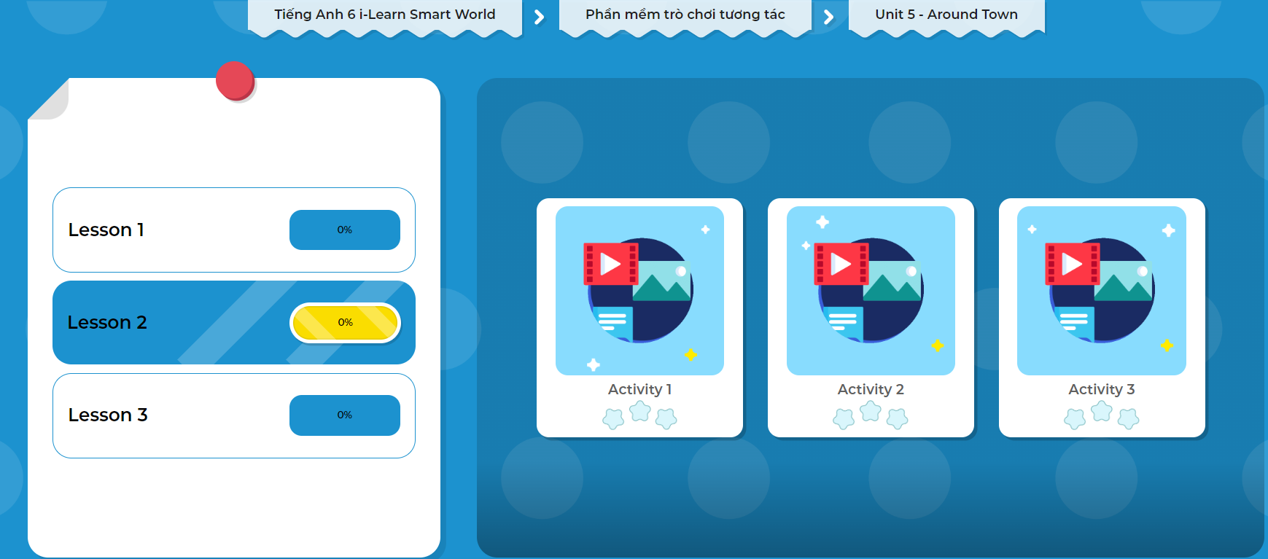
LET’S PLAY!
Click the picture below to play the games.

Slide 21
Work in pairs.
Where do you often eat out?
Who do you go with?
What are your favorite kinds of food? Why?

Slide 22

WRAP-UP

Slide 23
Today’s lesson
Grammar: Practice and use a, an, some, any correctly.
Speaking: Ask and answer when eating out.

Slide 24
Homework
Learn by hearts the use of countable and uncountable nouns and make sentences using them.
Do the exercises in Tiếng Anh 6 i-Learn Smart World Workbook (page 29).
Complete the grammar notes in Tiếng Anh 6 i-Learn Smart World Notebook on page 29.
Prepare the next lesson (page 43 - SB).
Play the consolidation games in Tiếng Anh 6 i-Learn Smart World DHA App on www.eduhome.com.vn.

Slide 25

Enjoy your day!

