Slide 1

Unit 5: Around Town
Lesson 1.2: Grammar
Page 39

Slide 2
Lesson Outline
Warm-up
Grammar
Consolidation
Wrap-up

Slide 3
Objectives
By the end of this lesson, students will be able to…
- use demonstratives and object pronouns.
- ask and answer when going shopping.

Slide 4

WARM-UP

Slide 5

Unit 1
Lesson 1
Work in pairs.
JUMBLED WORDS
Rearrange the letters to make meaningful words.
1. cumtesro
2. emdimu
3. sdesr
4. satwere
5. ubel

Slide 6
Unit 1
Lesson 1
JUMBLED WORDS
Rearrange the letters to make meaningful words.
1. cumtesro
2. emdimu
3. sdesr
4. satwere
5. ubel
1. customer
2. medium
3. dress
4. sweater
5. blue
ANSWER

Slide 7

Presentation
Demonstratives
Object pronouns

Slide 8
1. How much is this T-shirt?
2. I like this jacket. Do you have it in blue?

Slide 9
Lead in
1. What do we call this in sentence 1?
Demontrative.
2. What do we use demontratives for?
To show which things we are talking about.
3. How about it in sentence 2?
Object pronoun.
4. What do we use object pronouns for?
We use Object Pronouns after a verb or a preposition.
We use it for singular nouns and them for plural nouns.

Slide 10

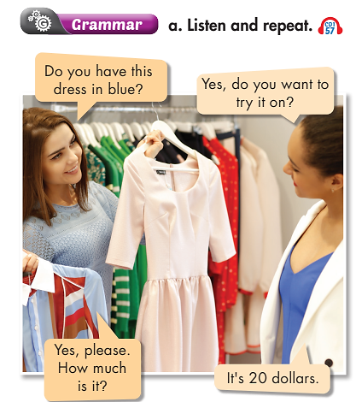
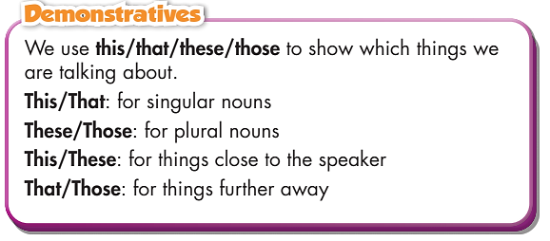
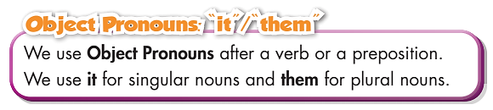

Slide 11
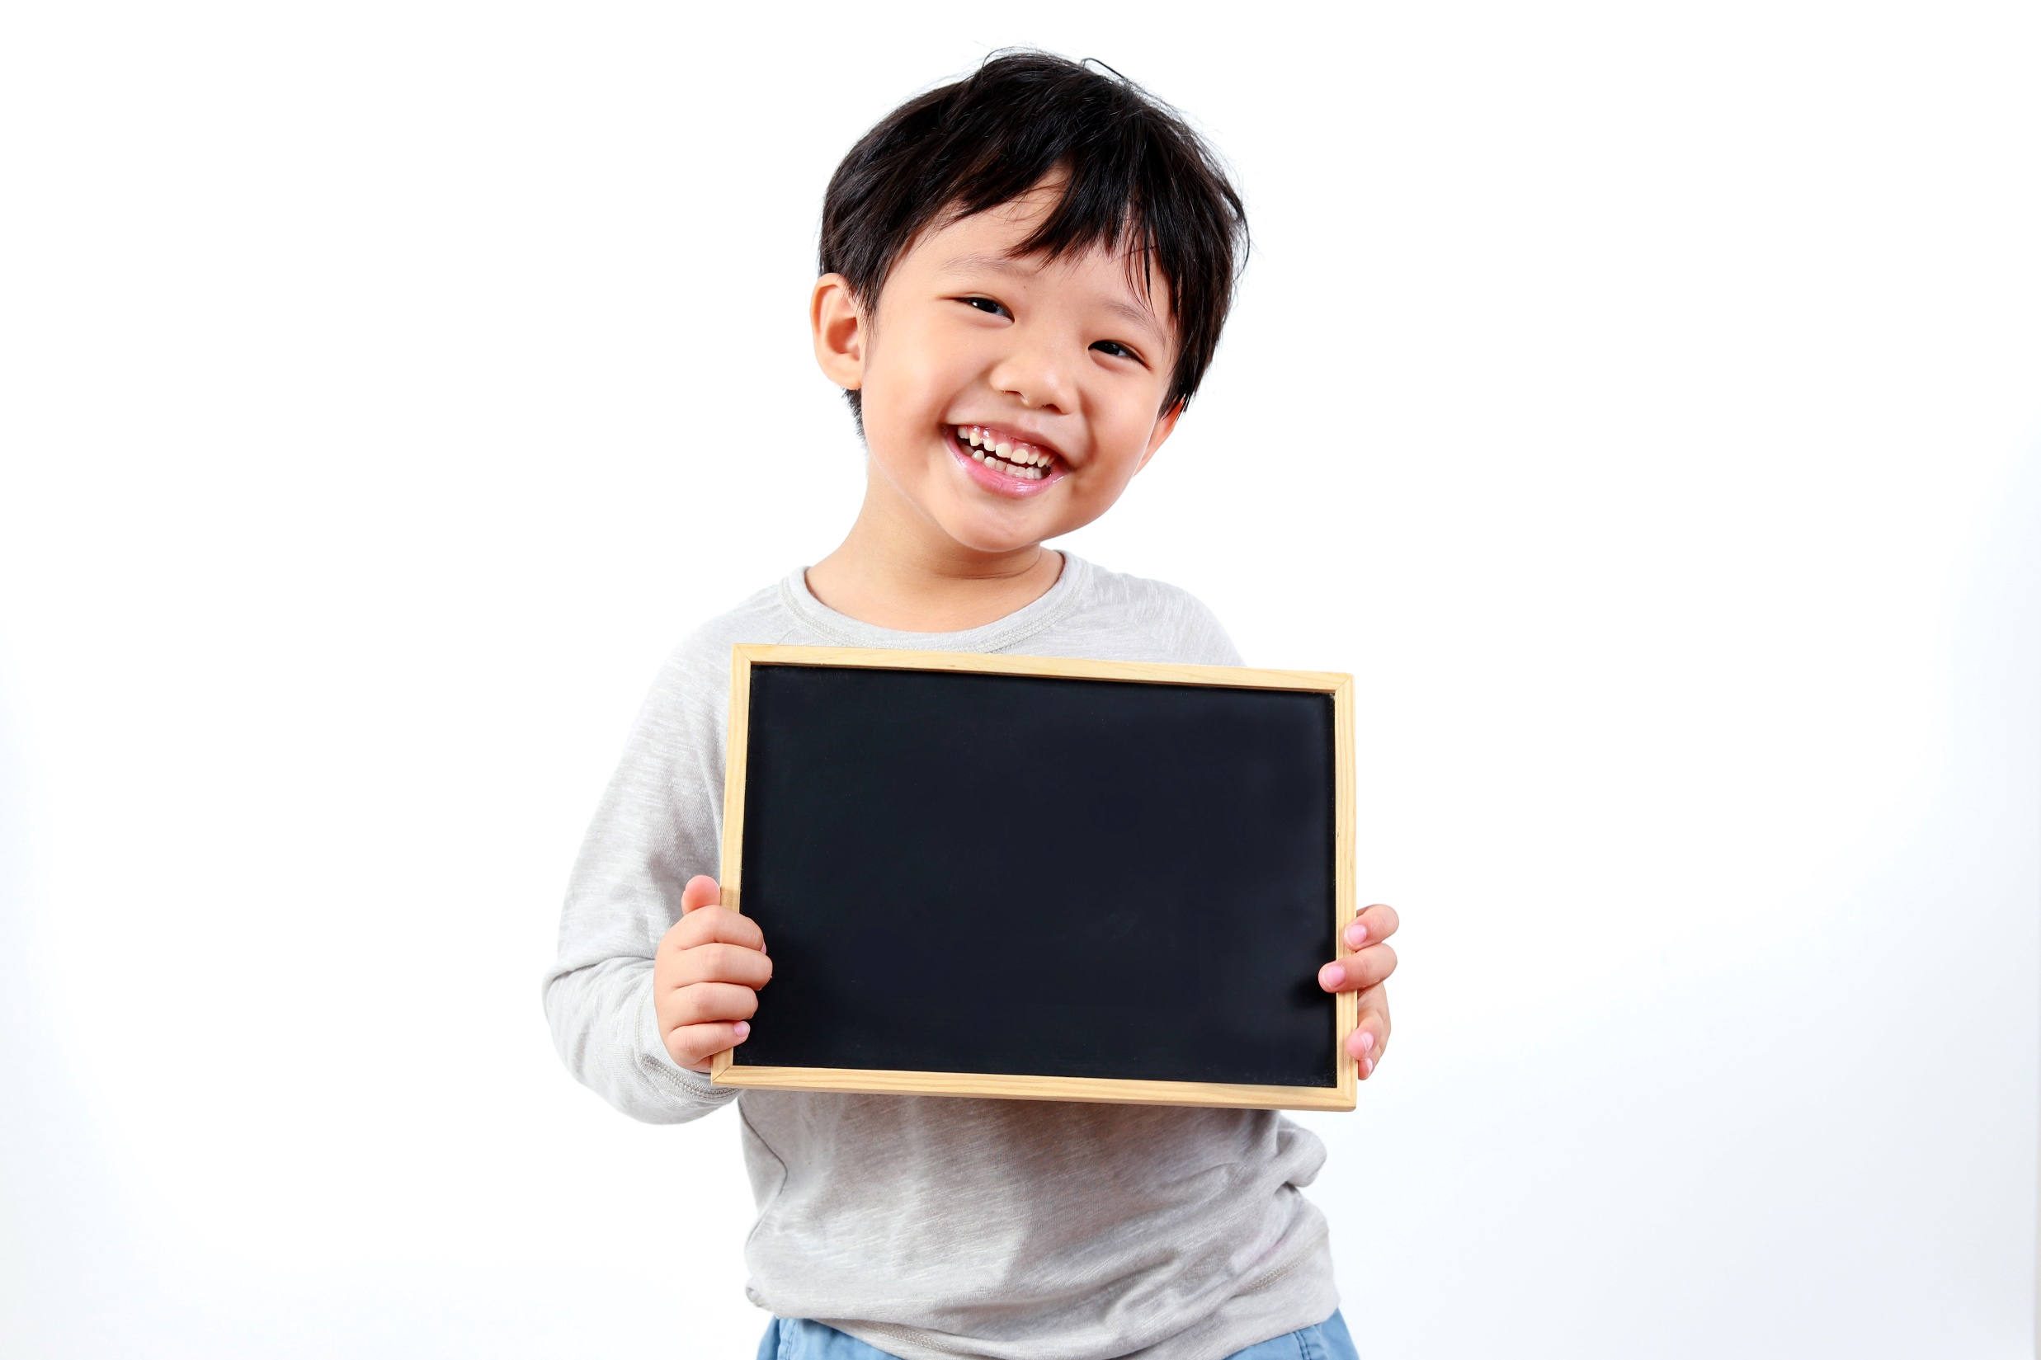
Practice

Slide 12
Practice
Read the sentences. Circle the correct words.
How many sentences are there?
1. How much are that/those shoes?
2. Excuse me, how much is this/these shirt?
3. I like that skirt. Do you have it/them in black?
4. Do you have this/these shoes in black?
5. I like these shorts. Can I try it/them on?
6. What size are those/these pants over there?
7. How much is that/this shirt by the window?
→ There are 7.
What are you going to do?
Read the sentences.
And then?
Circle the correct words.

Slide 13
Practice
Read the sentences. Circle the correct words.
1. How much are that/those shoes?
2. Excuse me, how much is this/these shirt?
3. I like that skirt. Do you have it/them in black?
4. Do you have this/these shoes in black?
5. I like these shorts. Can I try it/them on?
6. What size are those/these pants over there?
7. How much is that/this shirt by the window?

Slide 14
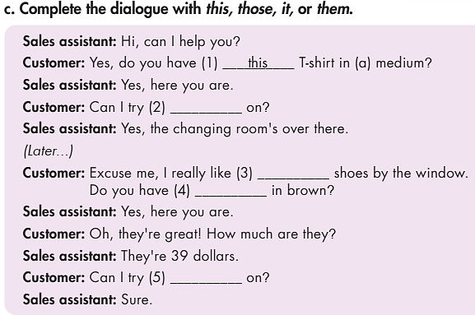
Practice
Who are there in the dialogue?
→ Sales assistant and customer.
What are you going to do?
Complete the dialogue with this, those, it
or them

Slide 15
Complete the dialogue with this, those, it, or them.
Sales assistant: Hi, can I help you?
Customer: Yes, do you have (1) __________ T-shirt in (a) medium?
Sales assistant: Yes, here you are.
Customer: Can I try (2) __________ on?
Sales assistant: Yes, the changing room's over there.
(Later...)
Customer: Excuse me, I really like (3) __________ shoes by the window.
Do you have (4) __________ in brown?
Sales assistant: Yes, here you are.
Customer: Oh, they're great! How much are they?
Sales assistant: They're 39 dollars.
Customer: Can I try (5) __________ on?
Sales assistant: Sure.
this
it
those
them
them

Slide 16
Extra Practice
WB, page 27
1.
A: Do you have this/these shoes in black?
B: Yes, do you want to try it/them on?
A: Yes, please. How much is/are they?
B: It's/They're thirty-five dollars.

Slide 17
Extra Practice
WB, page 27
2.
A: Do you have this/these dress in red?
B: Yes, do you want to try it/them on?
A: Yes, please. How much is/are it?
B: It's/They're forty-three dollars.

Slide 18

Production

Slide 19

Work in pairs.
Now, practice the conversation with your partner
1. A: Do you have these shoes in black?
B: Yes, do you want to try them on?
A: Yes, please. How much are they?
B: They're thirty-five dollars.
2. A: Do you have this dress in red?
B: Yes, do you want to try it on?
A: Yes, please. How much is it?
B: It's forty-three dollars.

Slide 20

CONSOLIDATION

Slide 21
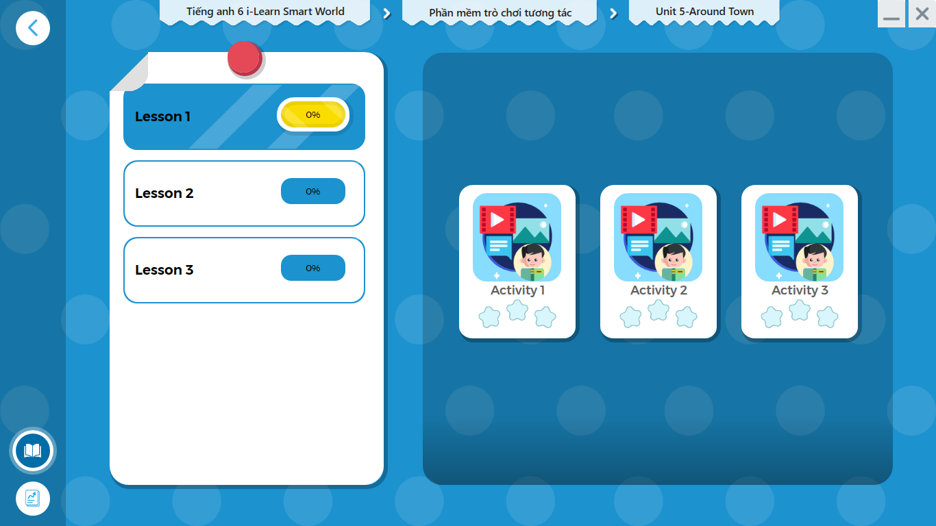
LET’S PLAY!
Click the picture below to play the games.

Slide 22
Extra Practice
WB, page 27
Circle the mistakes. Use this/these, is/are to correct the sentences.
This
1. These T-shirt is very big. Do you have a smaller one?
2. A: Do you have this jeans in dark blue? Can I try
them on?
B: Of course. The changing rooms is over there.
3. A: This pink skirt are so nice. How much is it?
B: It are ten dollars.
these
are
is
is

Slide 23
Extra Practice
WB, page 27
Circle the mistakes. Use this/these, is/are to correct the sentences.
4. These blue jacket is too big. Do you have it in
a medium size?
5. A: How much are this jacket?
B: It are twenty-five dollars.
This
is
is

Slide 24

WRAP-UP

Slide 25
Today’s lesson
Grammar: Practice and use demonstratives and object pronouns correctly.
Speaking: Ask and answer when going shopping.

Slide 26
Homework
Learn by hearts the use of demonstratives and object pronouns and make sentences using them.
Do the exercises in Tiếng Anh 6 i-Learn Smart World Workbook page 27.
Complete the grammar notes in Tiếng Anh 6 i-Learn Smart World Notebook on page 27.
Prepare the next lesson (page 40 - SB).
Play the consolidation games in Tiếng Anh 6 i-Learn Smart World DHA App on www.eduhome.com.vn.

Slide 27
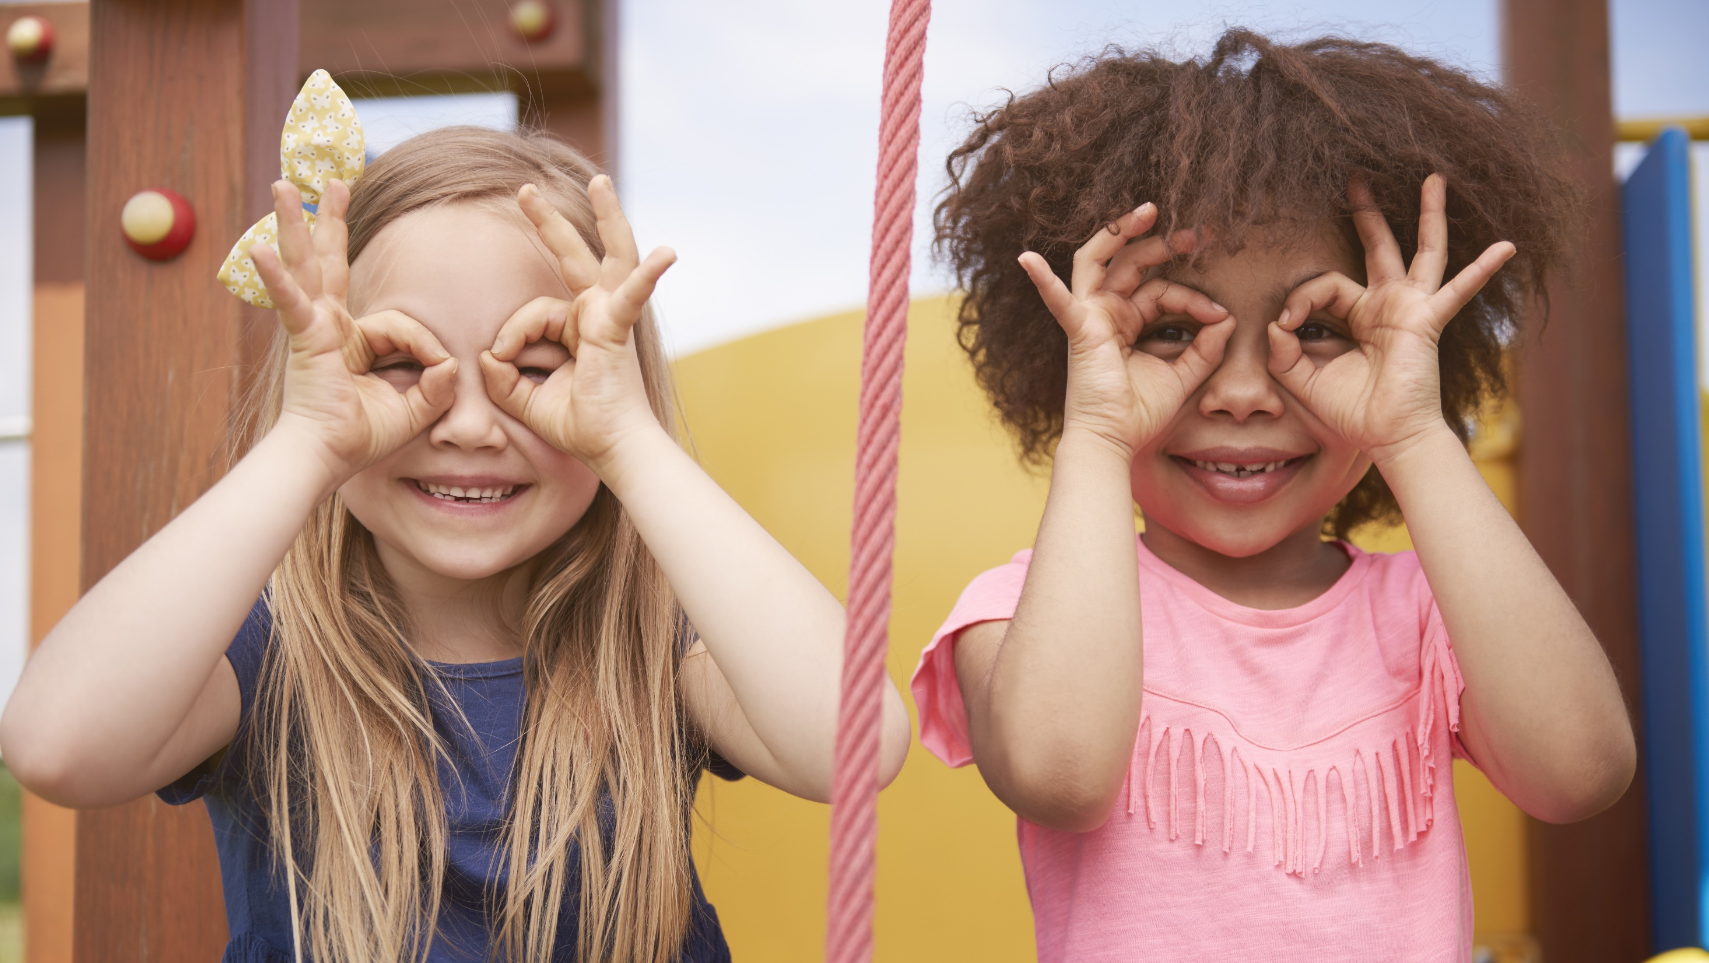
Enjoy your day!

