Slide 1
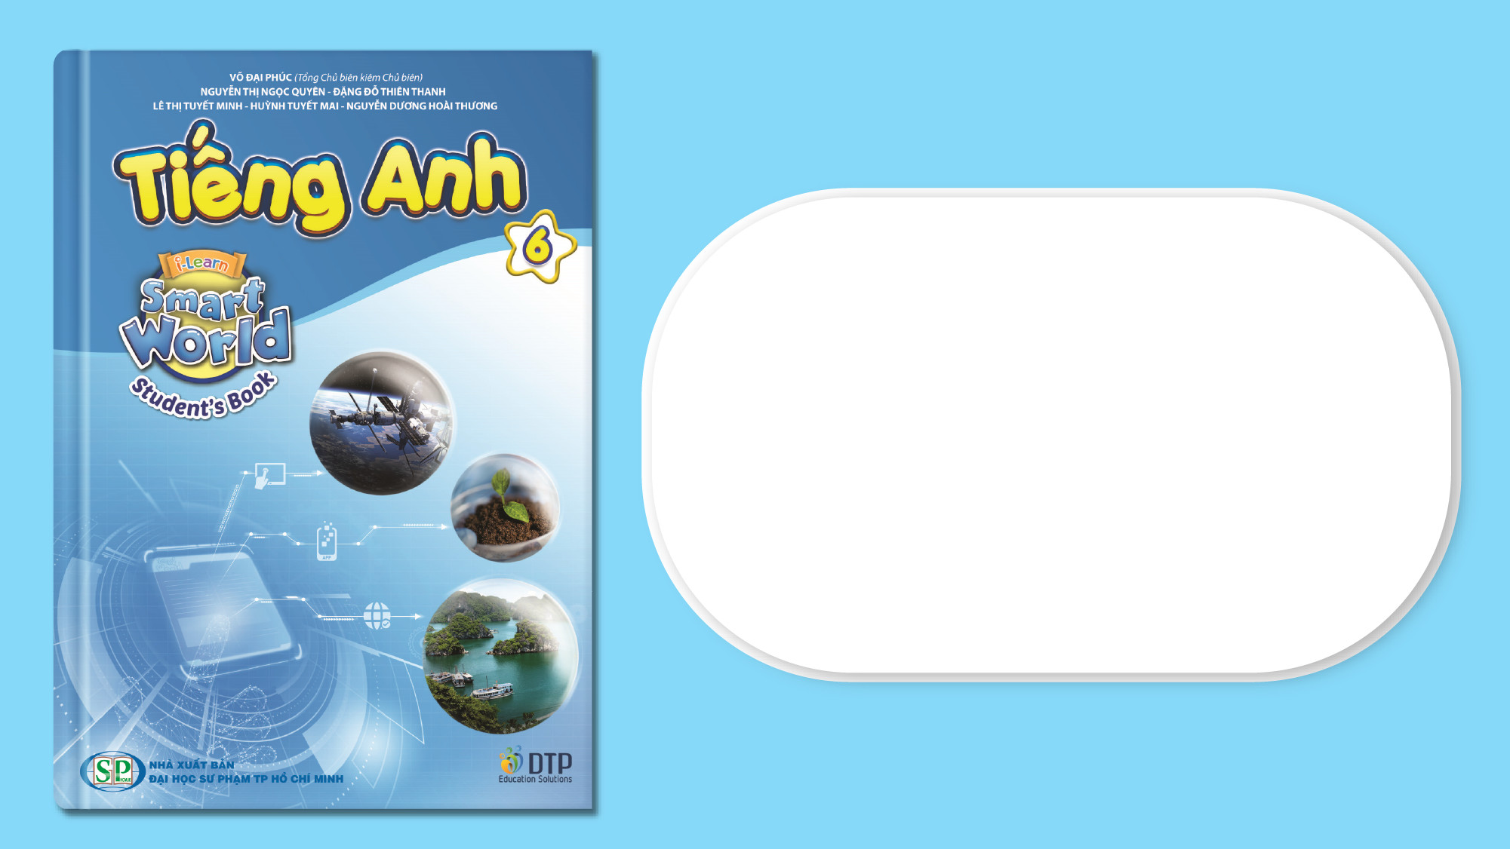
Unit 4: Festivals and Free Time
Lesson 2.2: Grammar
Page 34

Slide 2
Lesson Outline
Warm-up
Grammar
Consolidation
Wrap-up

Slide 3
Objectives
By the end of this lesson, students will be able to…
Use the Present Simple tense for future use.
Use “start / end, open / close” in suitable situations.

Slide 4

WARM-UP

Slide 5
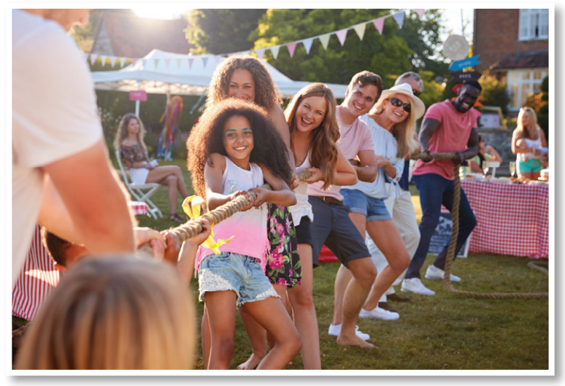
What is it?
Does it start in the morning?
Can you guess what time it starts?

Slide 6

Presentation

Slide 7
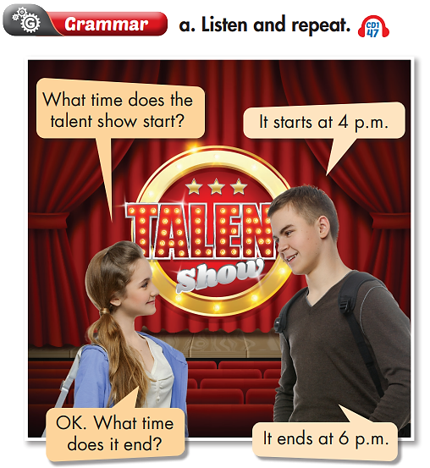

The Present Simple

Slide 8
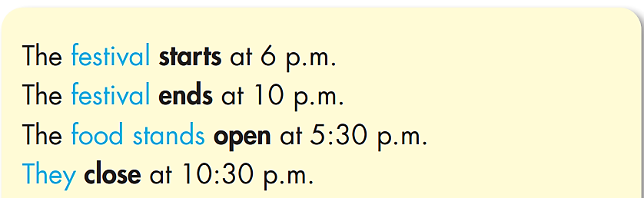
S (He, She, It , N_{singular}) + V_{-s/ -es}
S (I, We, You, They, N_{plural}) + V₁

Slide 9
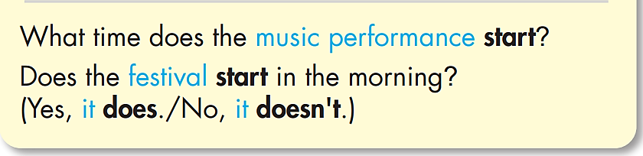
S (He, She, It, N_{singular}) + does not (doesn’t) + V₁
Does + S (He, She, It, N_{singular}) + V₁ ?
S (I, We, You, They, N_{plural}) + do not (don’t) + V₁
Do + S (I, We, You, They, N_{plural}) + V₁ ?

Slide 10
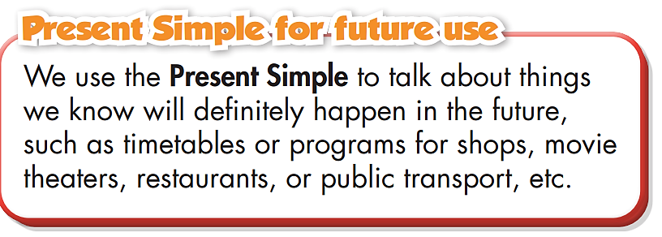

Slide 11
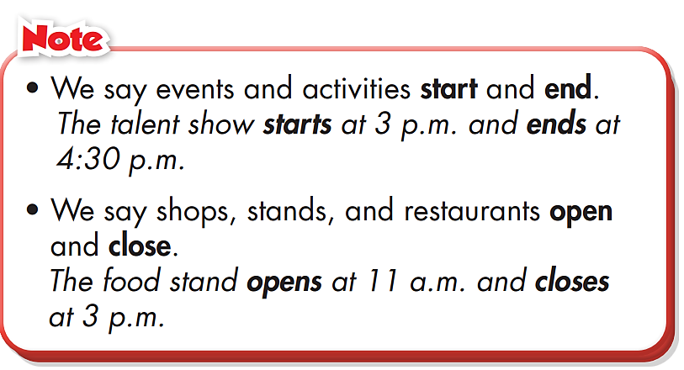

Slide 12

Practice

Slide 13
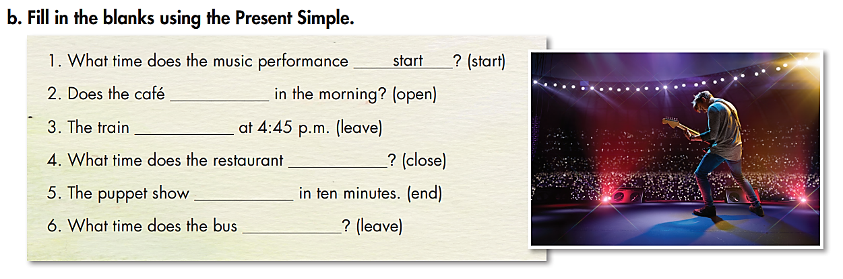
open
leaves
close
ends
leave

Slide 14
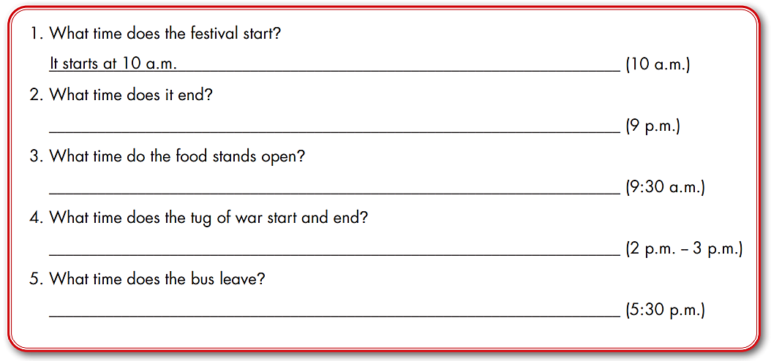
Extra Practice
WB page 23
It ends at 9 p.m.
They open at 9:30 a.m.
It starts at 2 p.m. and ends at 3 p.m.
It leaves at 5:30 p.m.

Slide 15


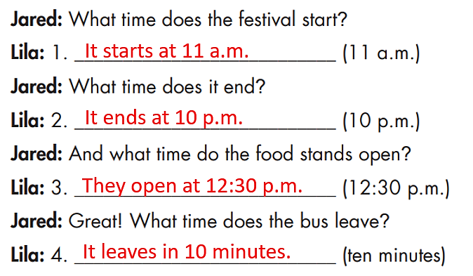
Work in pairs

Slide 16

Production

Slide 17
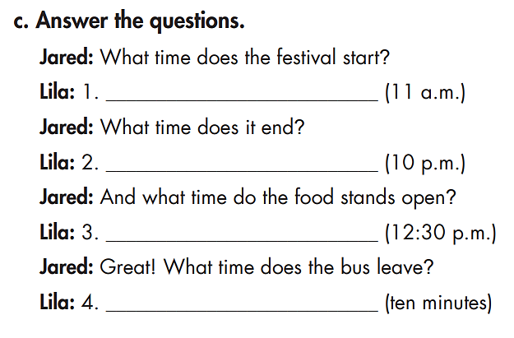
It starts at 11 a.m.
It ends at 10 p.m.
They open at 12:30 p.m.
It leaves in 10 minutes.

Slide 18

CONSOLIDATION

Slide 19
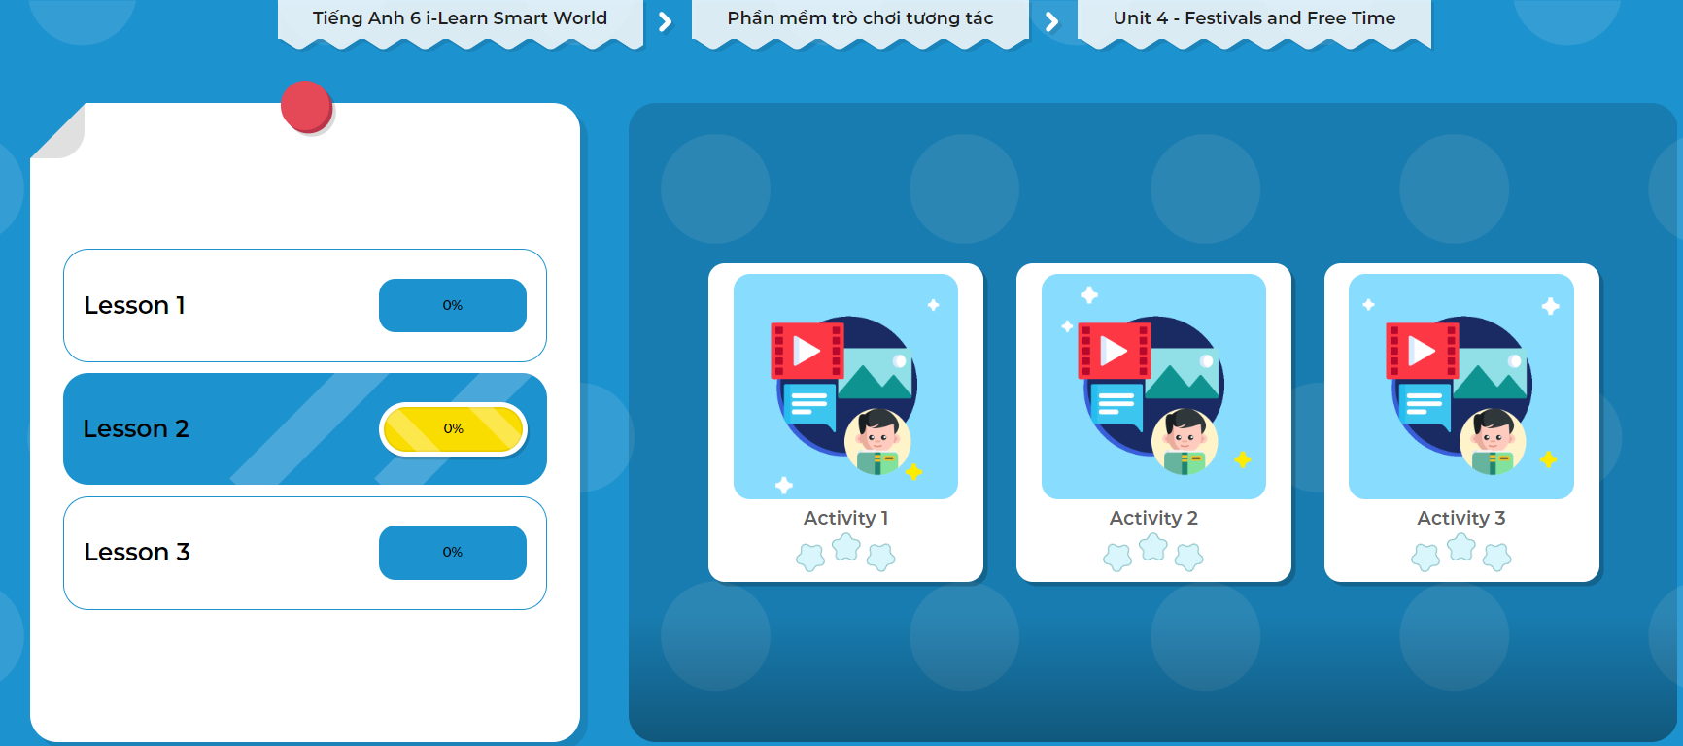
Click on the picture to play the games.

Slide 20

WRAP-UP

Slide 21
Today’s lesson
Structures/ Sentence patterns
Using the Present Simple for future use.
Using “start / end” for events and activities.
Using “open / close” for shops, stands, and restaurants.
Practicing asking and answering about the time of festival activities.

Slide 22
Homework
Practice making sentences using the Present Simple.
Do the exercises in Tiếng Anh 6 i-Learn Smart World Workbook (page 23).
Complete the grammar notes in Tiếng Anh 6 i-Learn Smart World Notebook on page 23.
Prepare the next lesson (page 35 - SB).
Play the consolidation games in Tiếng Anh 6 i-Learn Smart World DHA App on www.eduhome.com.vn.

Slide 23

Lesson 3
Stay positive and have a nice day!

