Slide 1

Unit 4: Festivals and Free Time
Lesson 1.2: Grammar
Page 31

Slide 2
Lesson Outline
Warm-up
Grammar
Consolidation
Wrap-up

Slide 3
Objectives
By the end of this lesson, students will be able to…
Use Adverbs of frequency to talk about how often they do things or how often things happen.
Know the position of the Adverbs of frequency in a sentence.

Slide 4

WARM-UP

Slide 5


Work in pairs
1. What do they usually do in their free time?
2. What do you like doing in your free time?
3. How often do you do it?

Slide 6

Presentation

Slide 7

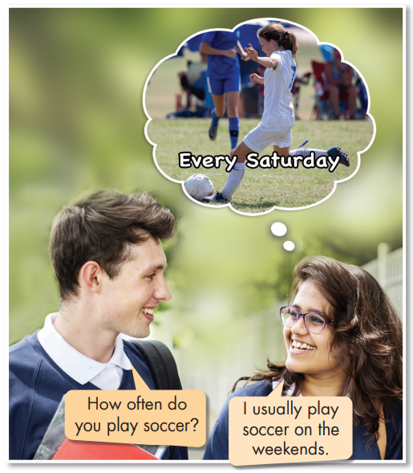

Adverbs of frequency

Slide 8
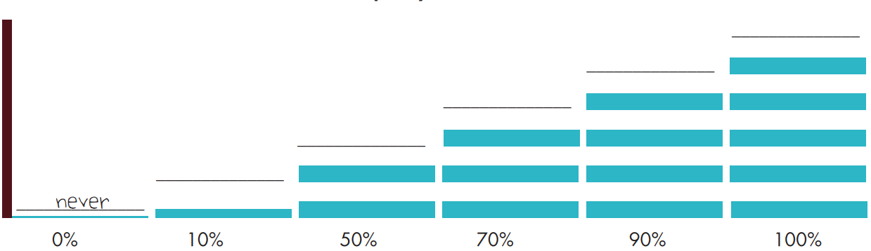
Tense(s):
The Present Simple
Adverbs of frequency
always
usually
often
sometimes
rarely
A: How often do you play soccer?
B: I usually play soccer on the weekends.
A: How often does he/she play soccer?
B: He/She sometimes plays soccer on Saturdays.
They are always friendly.
She is always friendly.

Slide 9
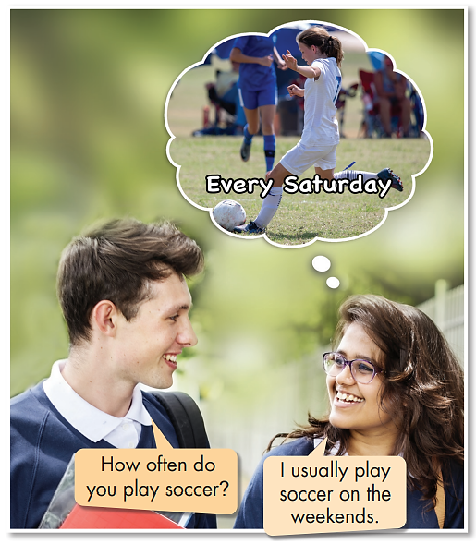
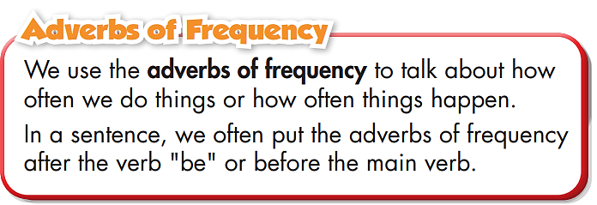
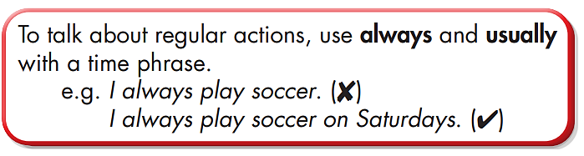
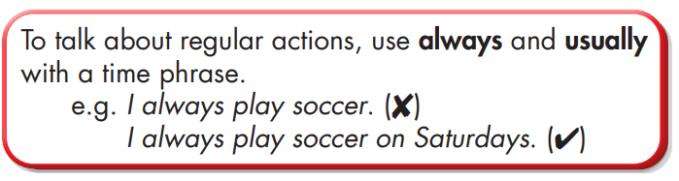
WH – question: How often ……………….?

Slide 10

Practice

Slide 11
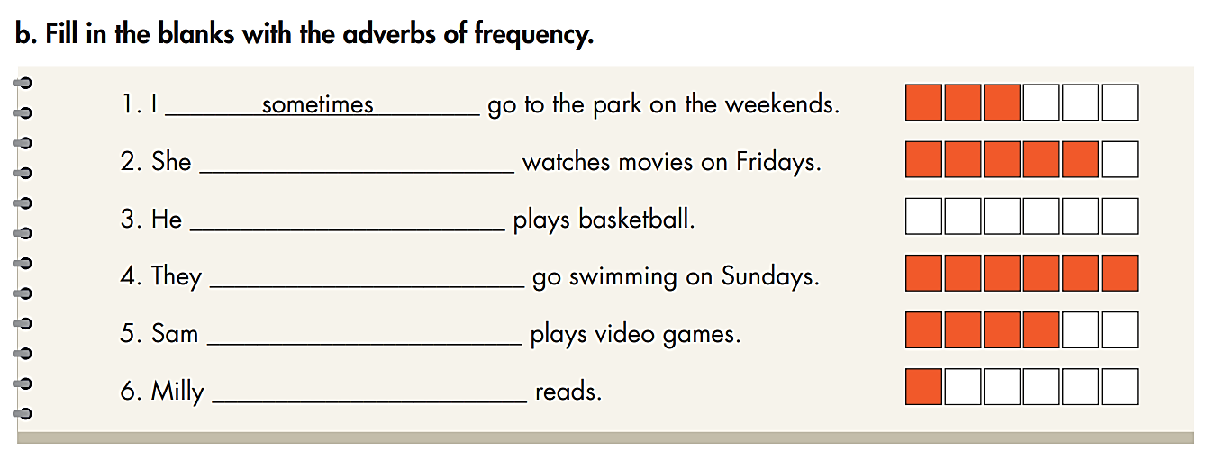
usually
never
always
often
rarely

Slide 12
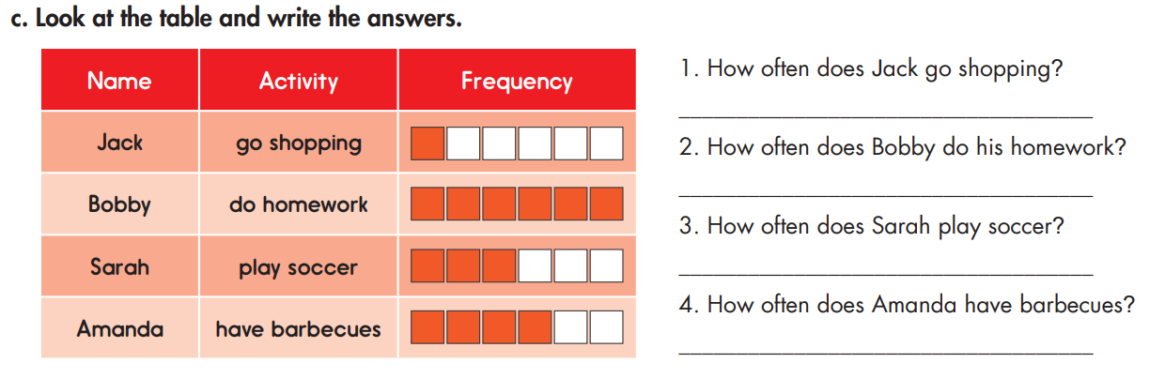
He rarely goes shopping (on the weekends).
He always does homework (after school).
She sometimes plays soccer.
She often has barbecues.

Slide 13
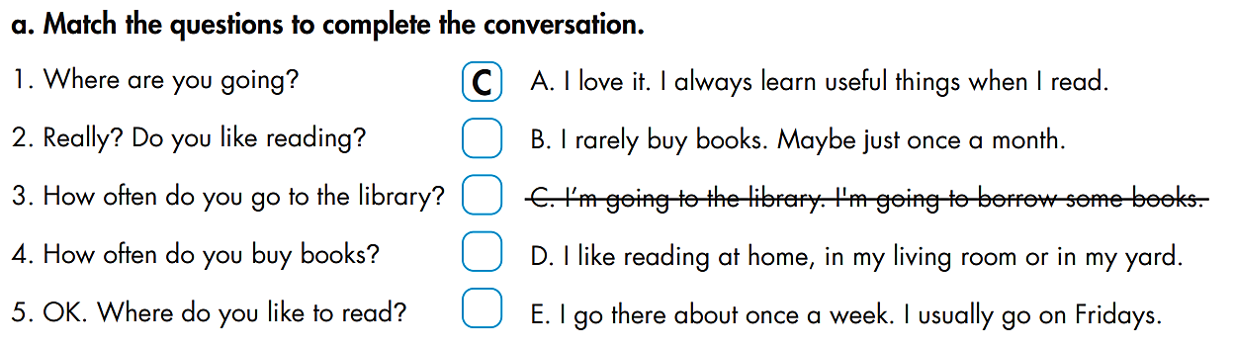
Extra Practice
WB page 21
A
E
B
D

Slide 14
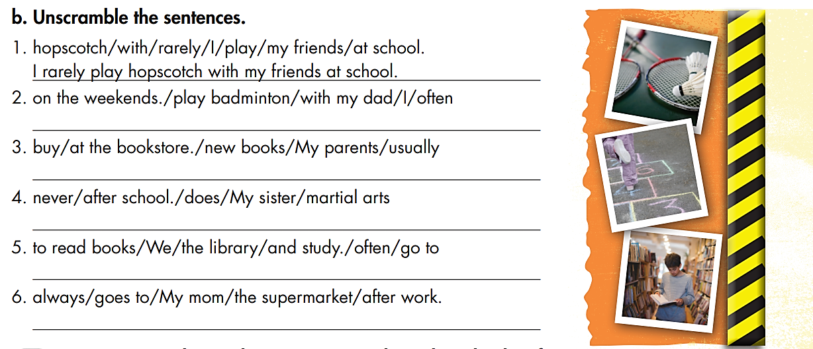
Extra Practice
WB page 21
I often play badminton with my dad on the weekends.
My parents usually buy new books at the bookstore.
My sister never does martial arts after school.
We often go to the library to read books and study.
My mom always goes to the supermarket after work.

Slide 15

Production

Slide 16

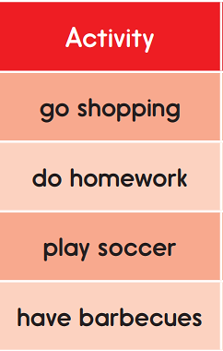

Slide 17
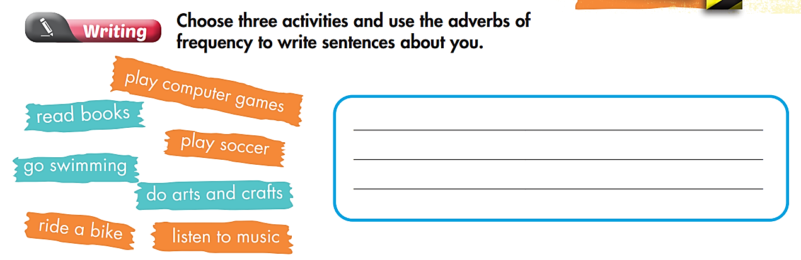
Extra Practice
WB page 21

Slide 18

CONSOLIDATION

Slide 19
Work in groups
- Make a conversation about your activities in your free time.
- Use the grammar point: Adverbs of frequency.

Slide 20
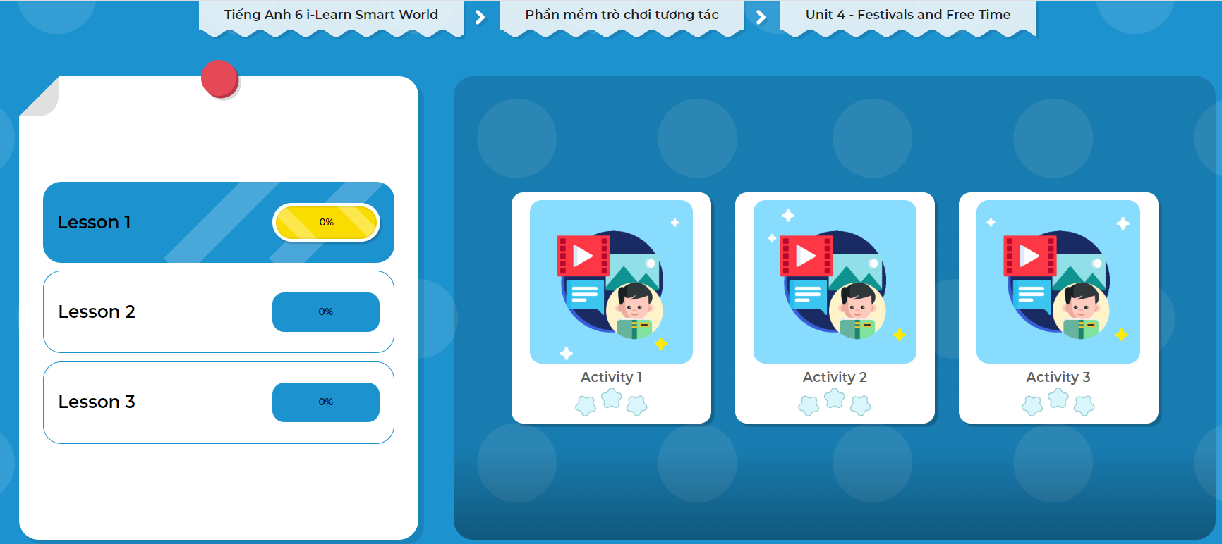
Click on the picture to play the games.

Slide 21

WRAP-UP

Slide 22
Today’s lesson
Structures/ Sentence patterns
Use Adverbs of frequency to talk about how often people do things or how often things happen.
Put Adverbs of frequency after the verb "be" or before the main verb.

Slide 23
Homework
Practice making sentences using “adverbs of frequency”.
Do the exercises in Tiếng Anh 6 i-Learn Smart World Workbook (pages 21).
Complete the grammar notes in Tiếng Anh 6 i-Learn Smart World Notebook on page 21.
Prepare the next lesson (page 32 - SB).
Play the consolidation games in Tiếng Anh 6 i-Learn Smart World DHA App on www.eduhome.com.vn.

Slide 24
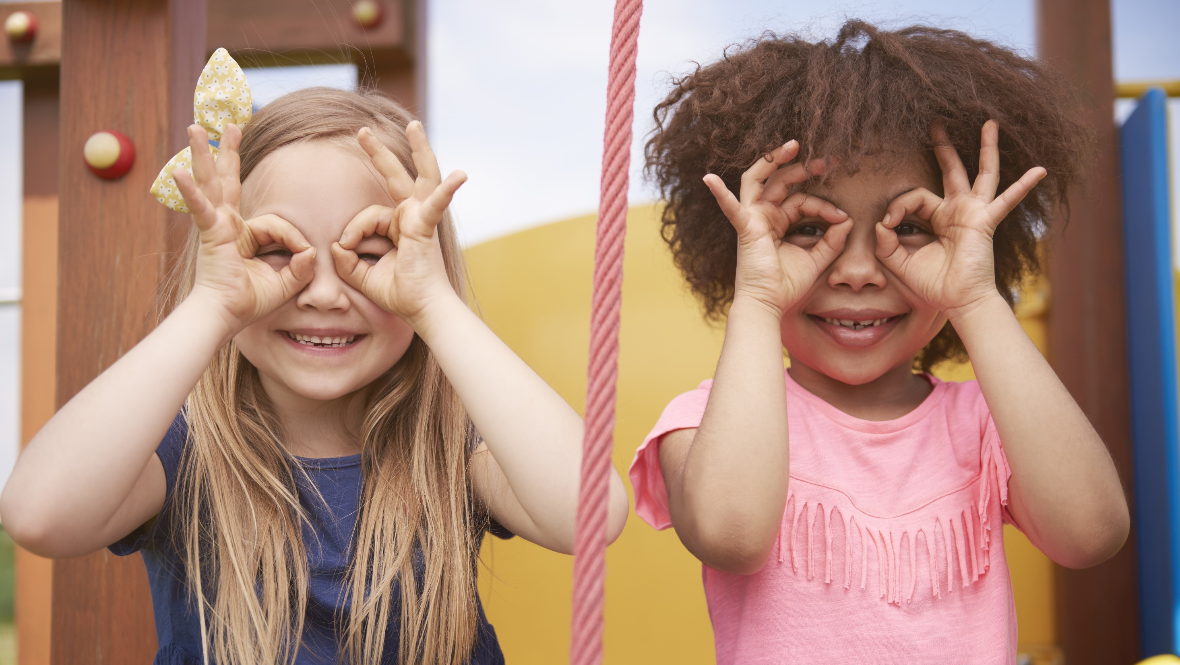
Enjoy your day!

