Slide 1
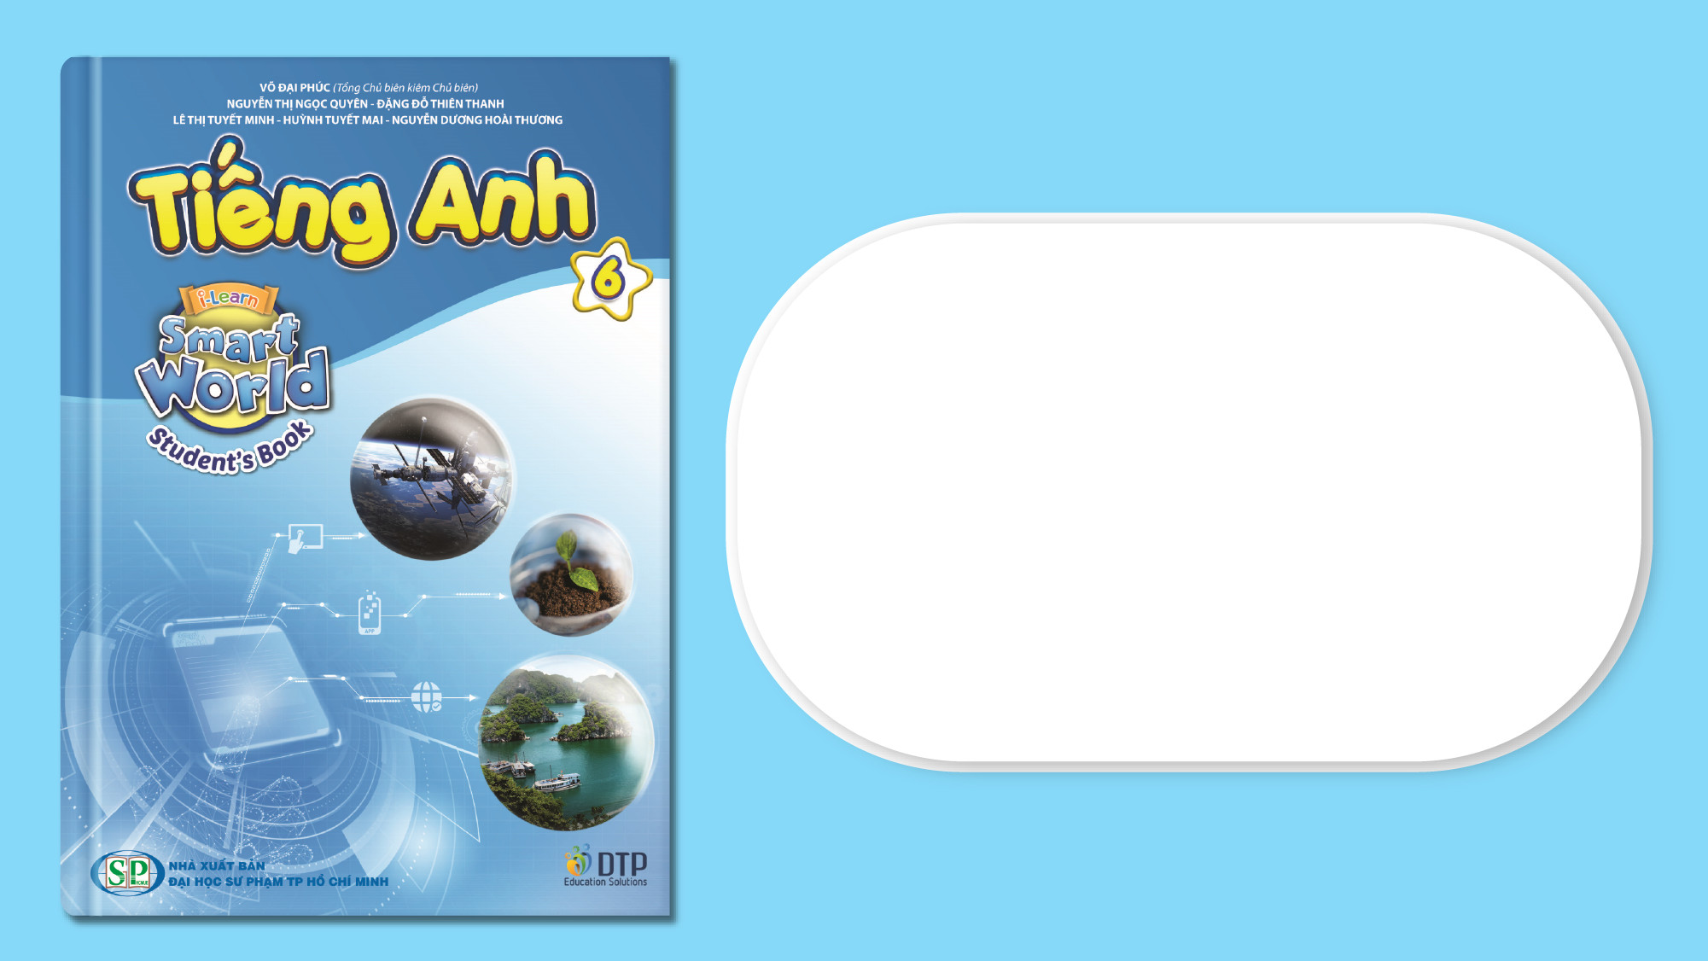
Unit 3: Friends
Lesson 3.2: Reading, Speaking, & Writing
Page 29

Slide 2
Lesson Outline
Warm-up
Reading
Speaking
Writing
Consolidation
Wrap-up

Slide 3
Objectives
By the end of this lesson, students will be able to…
- read an article about 2 sisters from a Vietnamese folklore;
- describe personal characters;
- write an email about their best friend.

Slide 4

WARM-UP

Slide 5
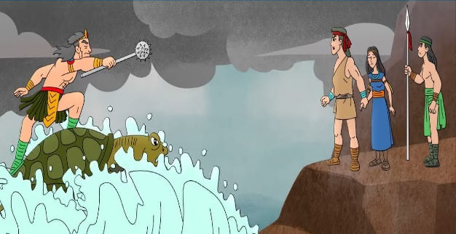
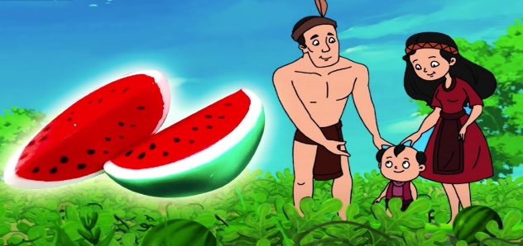
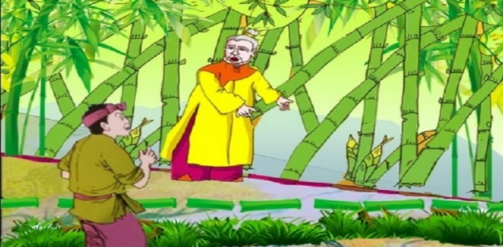
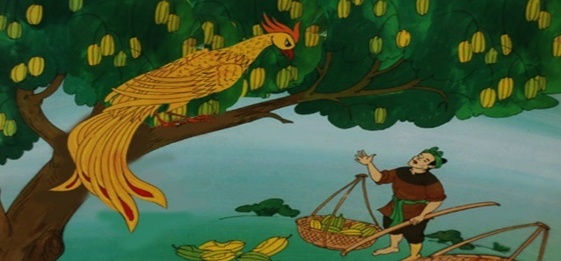
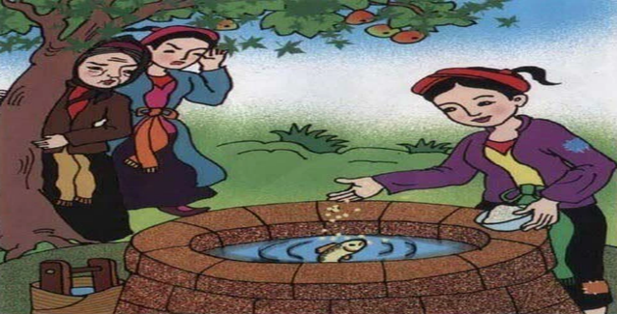
1.
The Two Sisters
Son Tinh, Thuy Tinh
The Golden Star Fruit Tree
The Tale of the Watermelon
The hundred-knot bamboo
Match the pictures with the name of the Fairy tale
2.
3.
4.
5.

Slide 6
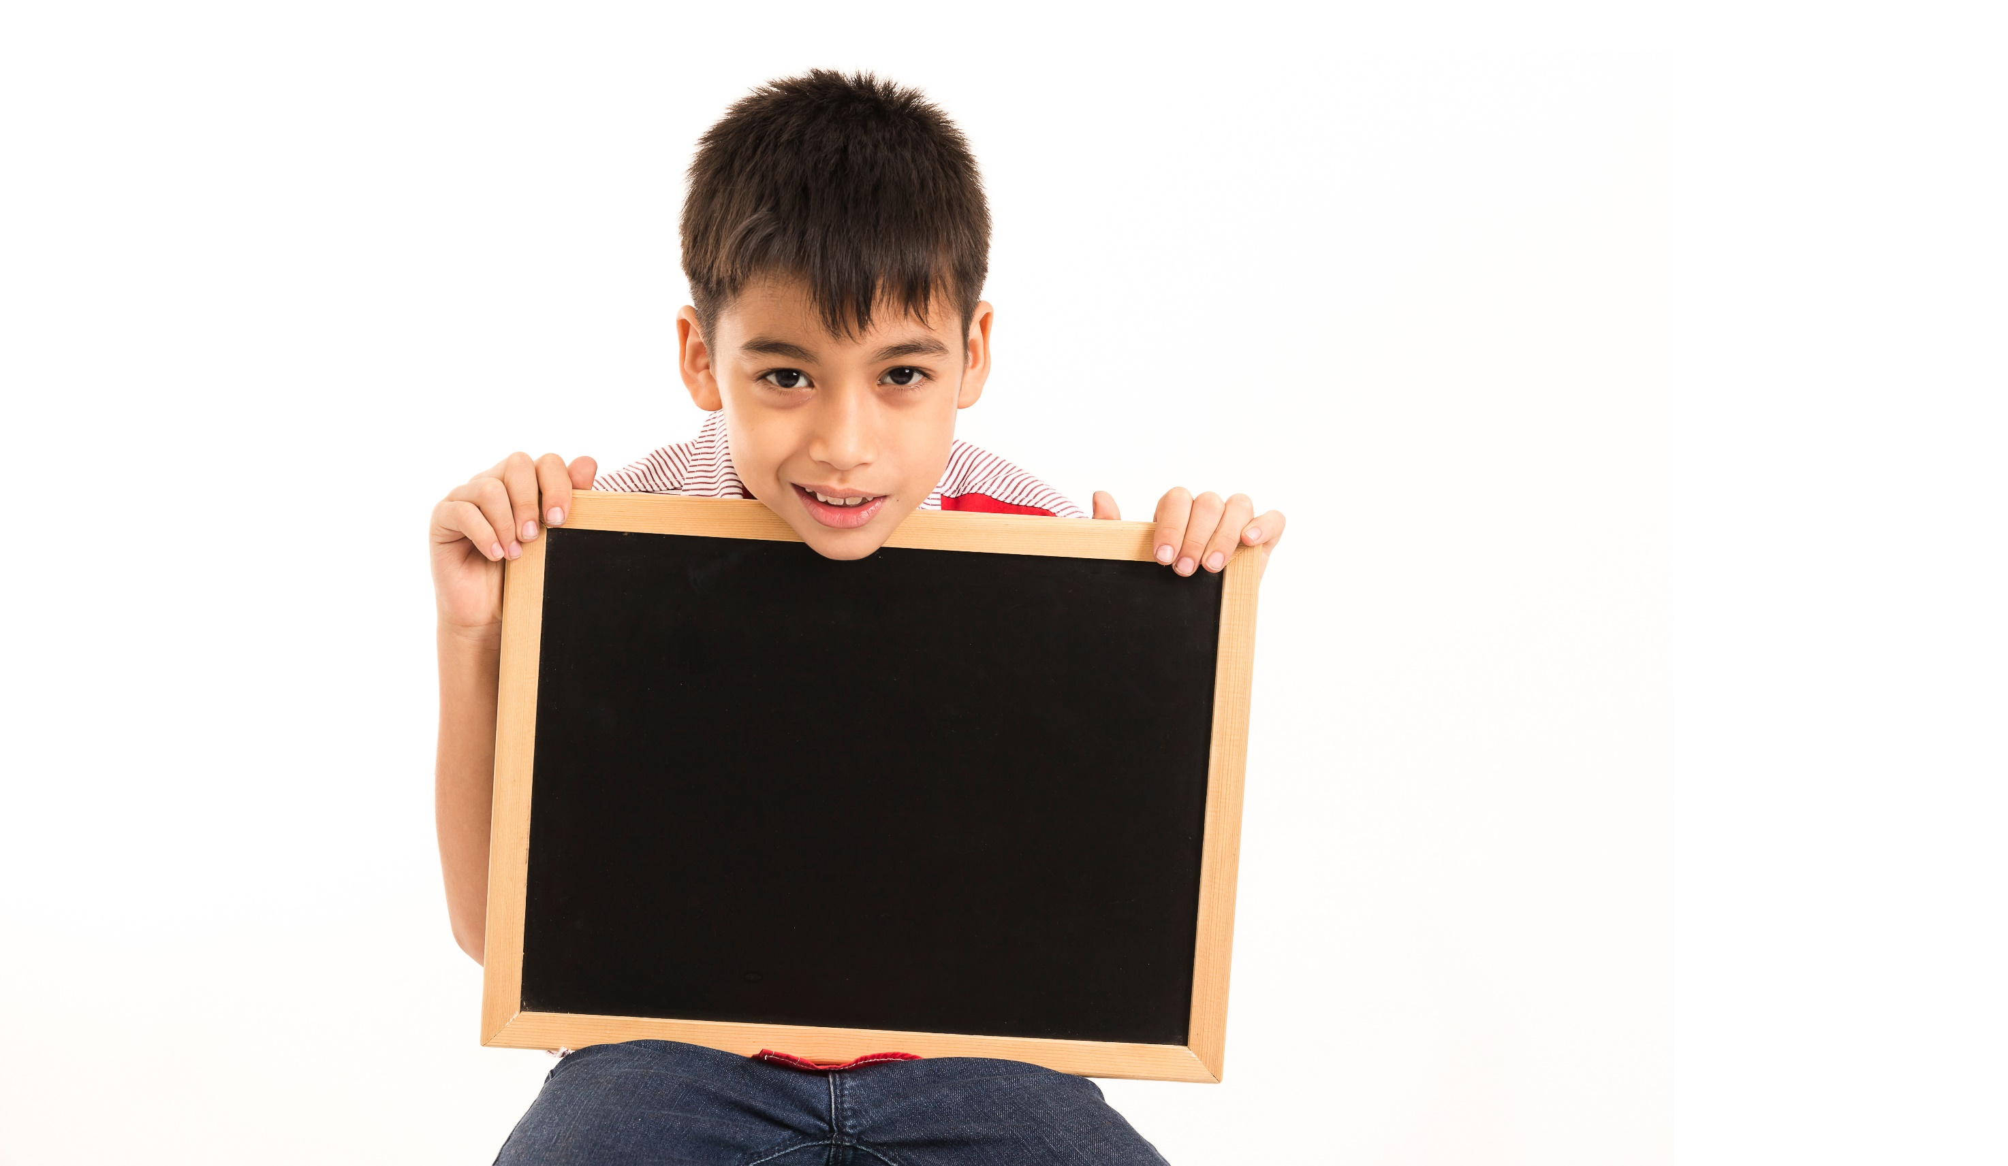
Writing

Slide 7
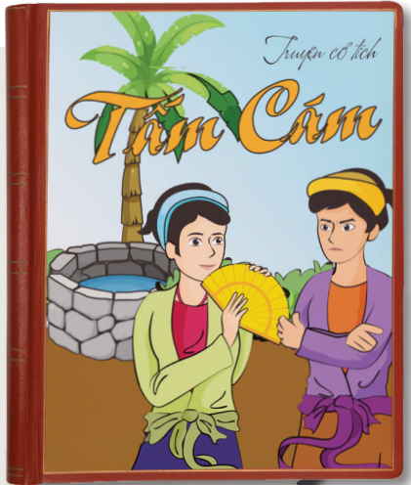
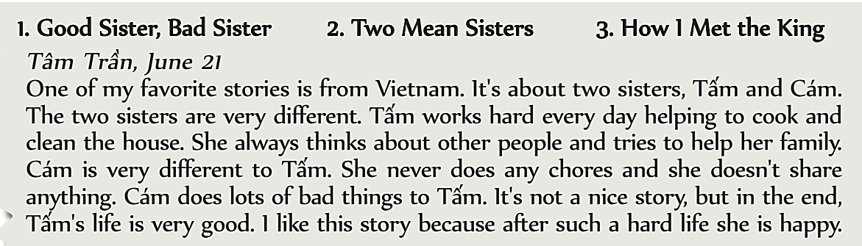
Pre-Writing
a. Read the article and circle the best headline.
1. Good Sister, Bad Sister
2. Two Mean Sisters
3. How I Met the King

Slide 8
Pre-Writing
b. Read and find things that show Tấm and Cám's personalities.
Write an example next to each adjective.
Tấm
1. helpful ________________________________
2. kind ________________________________
Cám
3. lazy ________________________________
4. selfish ________________________
helping to cook and clean the house
think about other people
never does any chore
doesn’t share anything

Slide 9
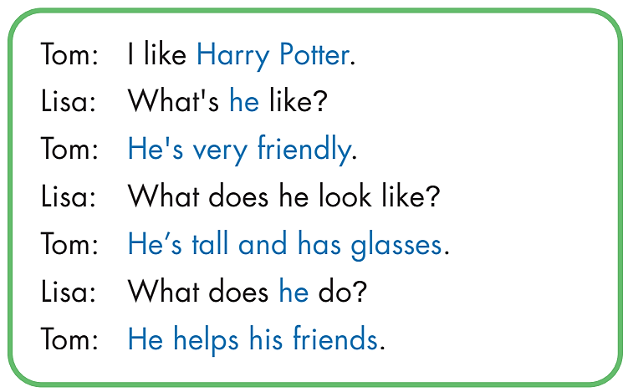
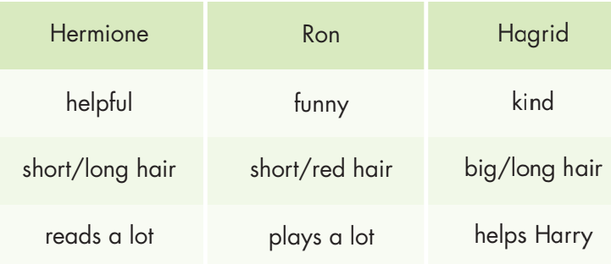
Pre-Writing
Describing Characters
You're in a book club meeting. Work in pairs. Take turns talking about the characters from the Harry Potter books

Slide 10
Pre-Writing
To write about your best friend, you should:
include:
• What his/her name is
• How old he/she is
• What he/she is like
• What he/she looks like
• What he/she does

Slide 11
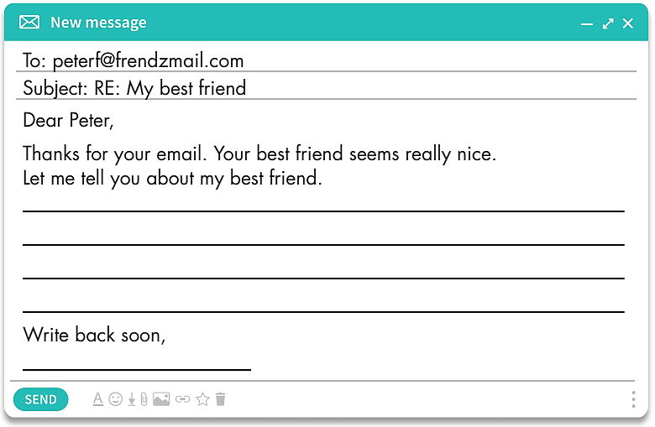
While-Writing
Write an email about your best friend. Write 40 to 50 words.

Slide 12
Post-Writing
Give feedback
Check whether your writing include the following ideas:
What his/her name is
How old he/she is
What he/she is like
What he/she looks like
What he/she does
Check linking words, grammar and spellings.

Slide 13
Post-Writing
Suggested answer
Dear Peter,
Thanks for your email. Your best friend seems really nice.
Let me tell you about my best friend.
My best friend is Quynh. She's 12 years old. She's a student. She's my classmate at school. She's friendly and funny.
She likes making new friends and telling jokes. She's tall and thin. She has brown eyes and short hair.
Write back soon,
Mary.

Slide 14
a. Read the summary of the story Charlotte's Web and circle "True" or "False."
Extra Practice
WB page 19
1. Wilbur is a spider. True/False
2. Mr. Zuckerman is selfish. True/False
3. Charlotte is a helpful spider. True/False
4. Charlotte makes a plan to save Wilbur's life. True/False
5. Mr. Zuckerman thinks Wilbur is very funny. True/False

Slide 15
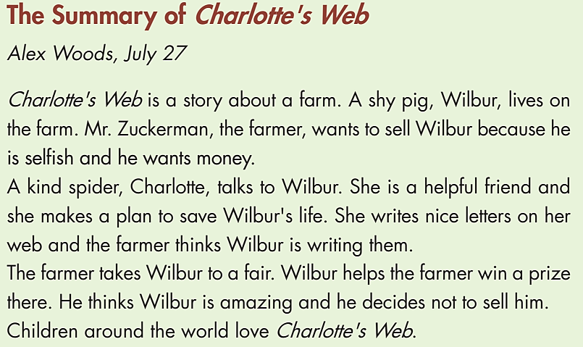

a. Read the summary of the story Charlotte's Web and circle "True" or "False."
Extra Practice
WB page 19

Slide 16
a. Read the summary of the story Charlotte's Web and circle "True" or "False."
Extra Practice
WB page 19
1. Wilbur is a spider. True/False
2. Mr. Zuckerman is selfish. True/False
3. Charlotte is a helpful spider. True/False
4. Charlotte makes a plan to save Wilbur's life. True/False
5. Mr. Zuckerman thinks Wilbur is very funny. True/False

Slide 17

CONSOLIDATION

Slide 18
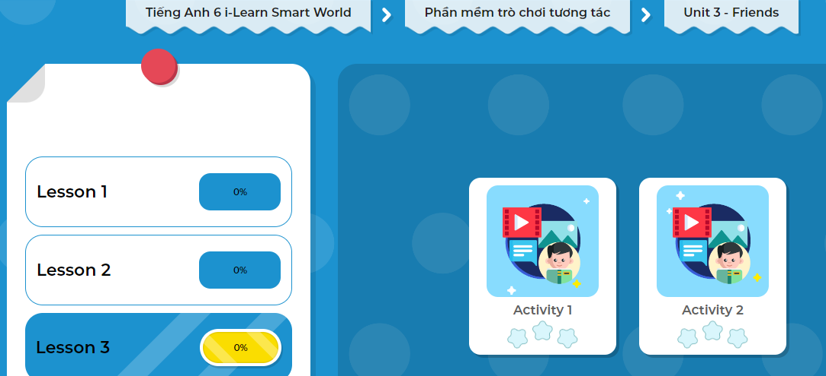
LET’S PLAY!
Click here to play the game!
Notes:
Mở Ứng dụng DHA trên Eduhome. Sách lớp 6, Unit 3 Lesson 3, Activity 2

Slide 19

WRAP-UP

Slide 20
Today’s lesson
To write about your best friend you should include:
What his/her name is
How old he/she is
What he/she is like
What he/she looks like
What he/she does

Slide 21
Homework
Do the exercise(s) in Tiếng Anh 6 i-Learn Smart World Workbook (page 18).
Complete the writing notes in Tiếng Anh 6 i-Learn Smart World Notebook (page 18).
Play consolation games in Tiếng Anh 6 i-Learn Smart World DHA App on www.eduhome.com.vn.
Prepare the next lesson (pages 90 & 91 - SB).

Slide 22
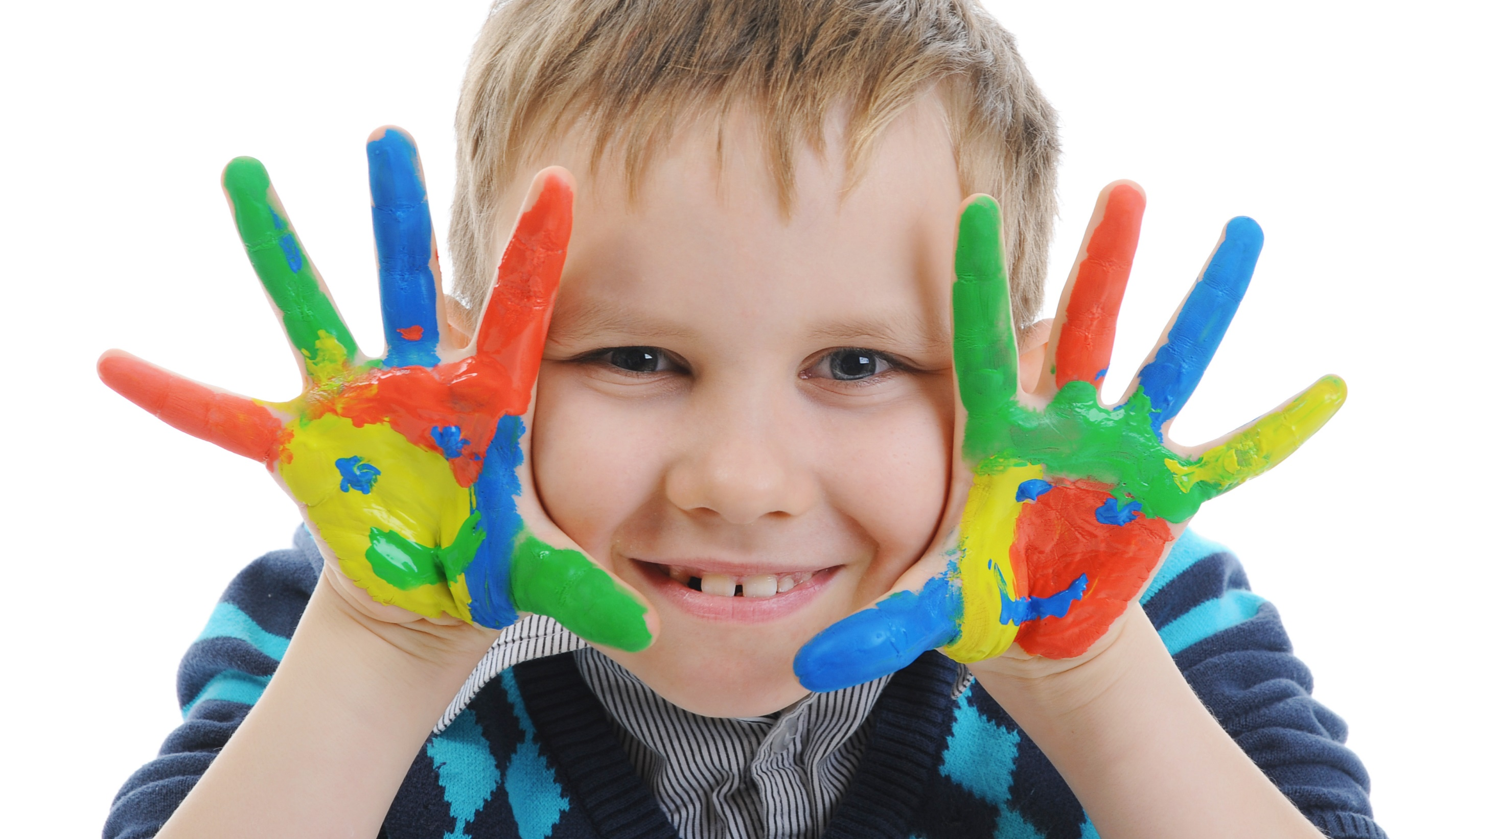
Enjoy your day!

