Slide 1

Unit 3: Friends
Lesson 2.2: Grammar
Page 26

Slide 2
Lesson Outline
Warm-up
Grammar
Consolidation
Wrap-up

Slide 3

Objectives
By the end of this lesson, students will be able to…
use the Present Continuous tense for fixed future plans;
practice using the Present Continuous tense.

Slide 4

WARM-UP

Slide 5

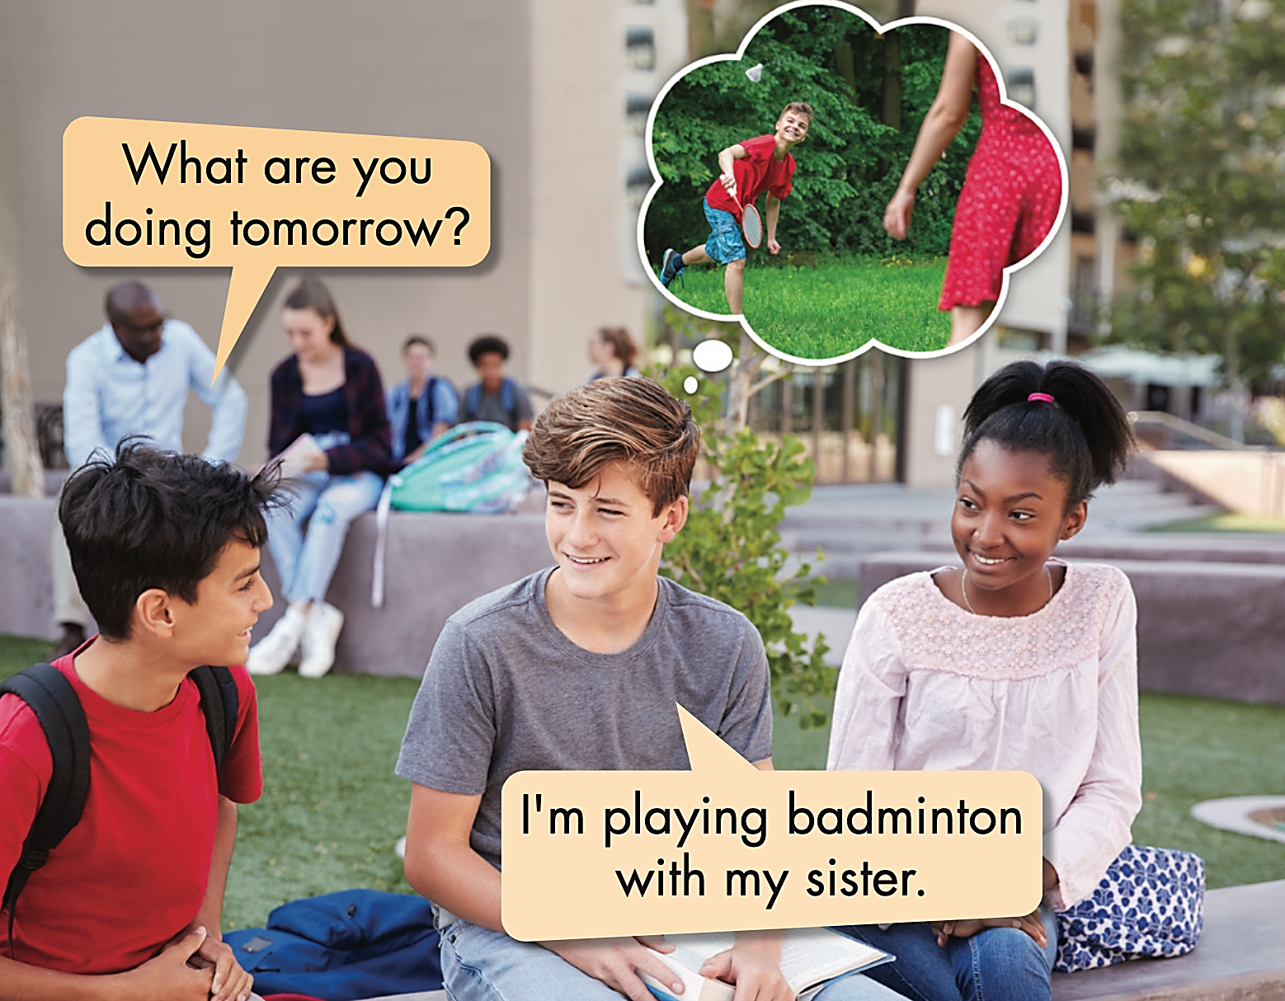


Work in pairs
Fill the blanks with correct words.

Slide 6

a. Listen and repeat.

Slide 7

Presentation

Slide 8
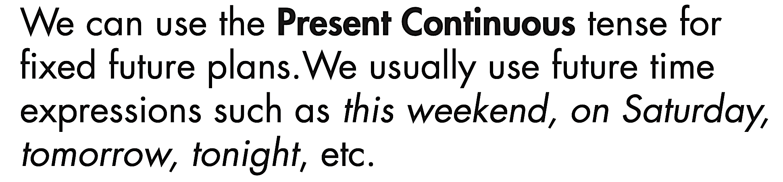
Structure: PRESENT CONTINUOUS

Slide 9
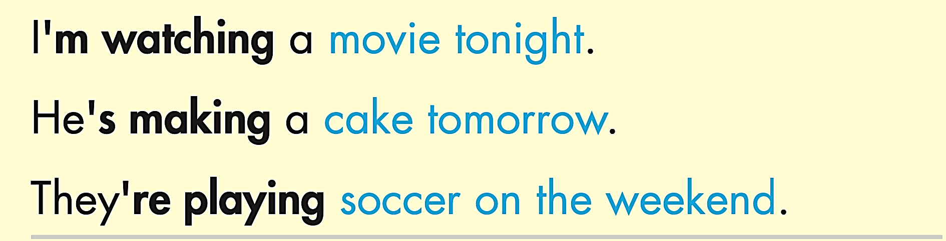



Structure: PRESENT CONTINUOUS
Work in pairs. Underline “V-ing” and circle future time expressions.

Slide 10
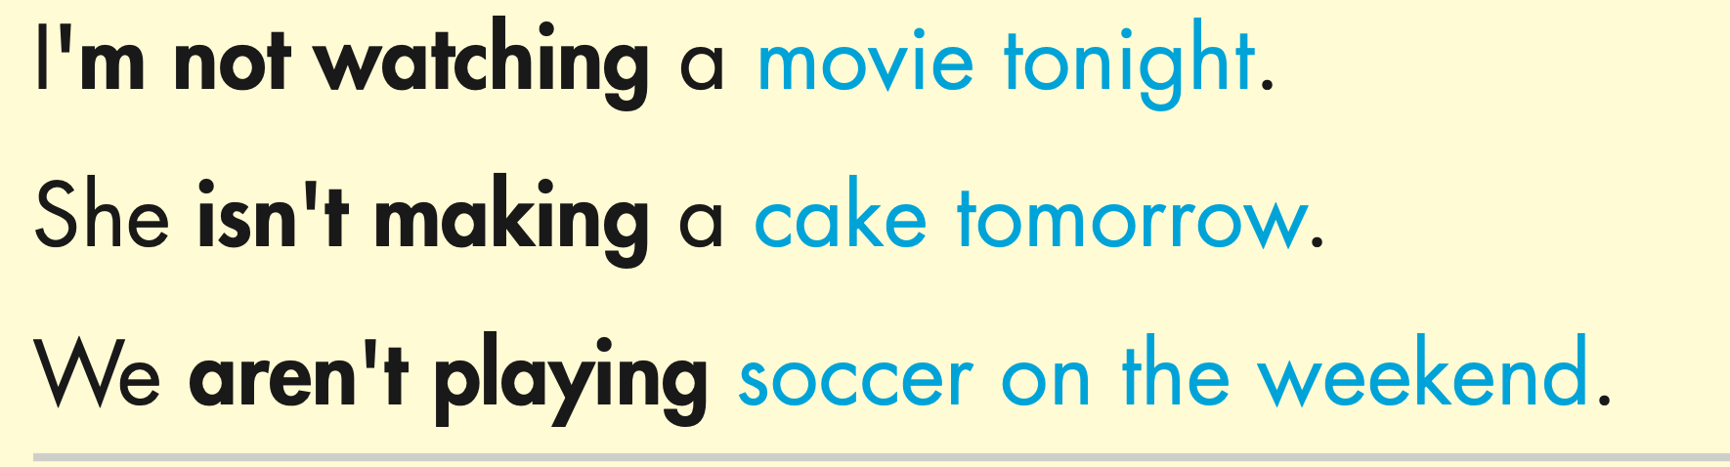
Structure: PRESENT CONTINUOUS
Work in pairs. Underline “V-ing” and circle future time expressions.

Slide 11
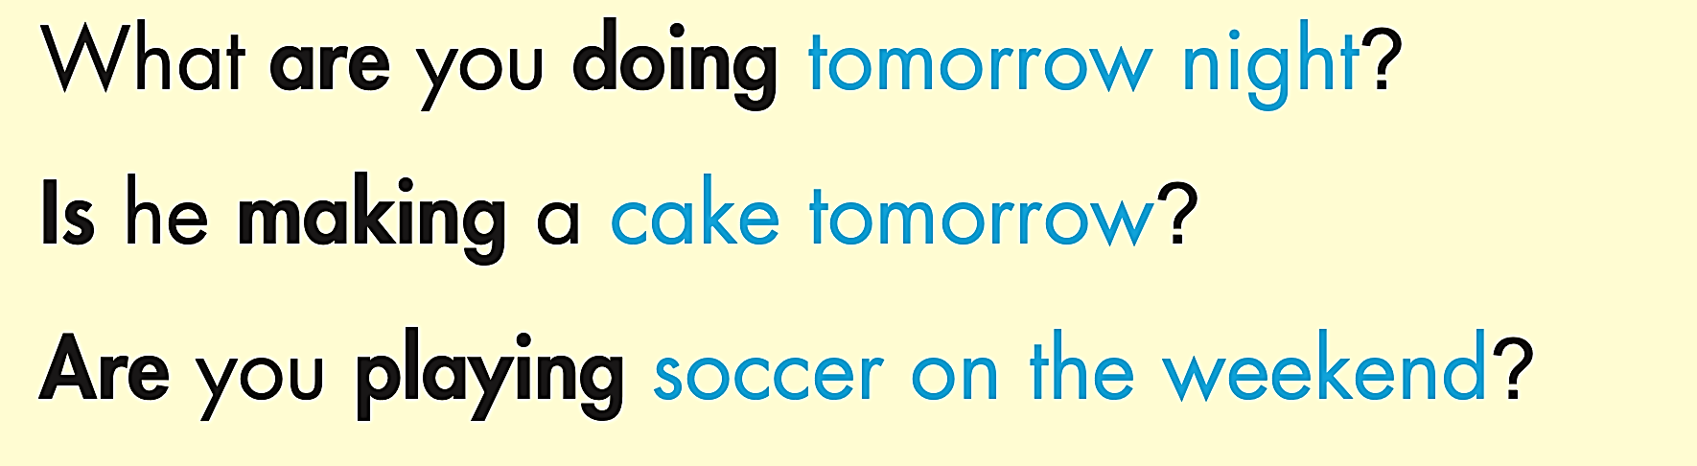
Structure: PRESENT CONTINUOUS
Work in pairs. Underline “V-ing” and circle future time expressions.

Slide 12
Practice

Slide 13
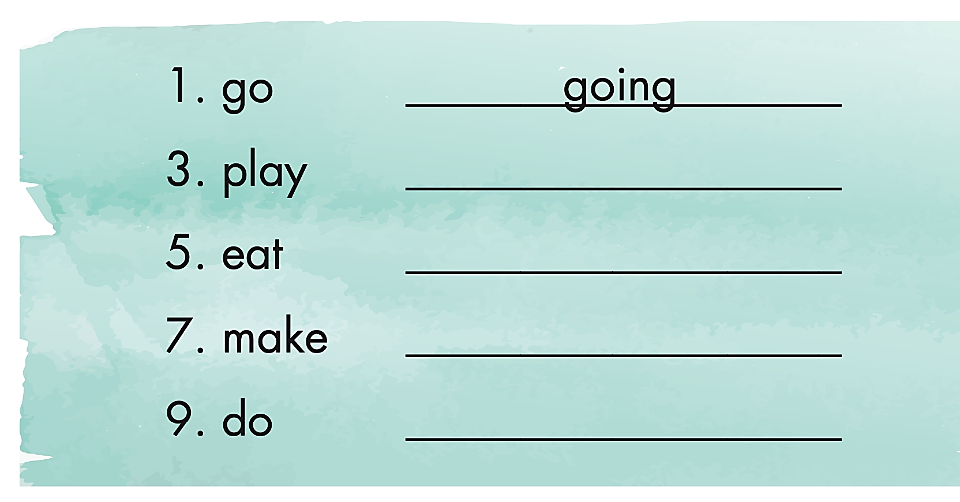
Extra Practice
WB page 17
a. Write the -ing form of the verbs.
playing
eating
making
doing

Slide 14
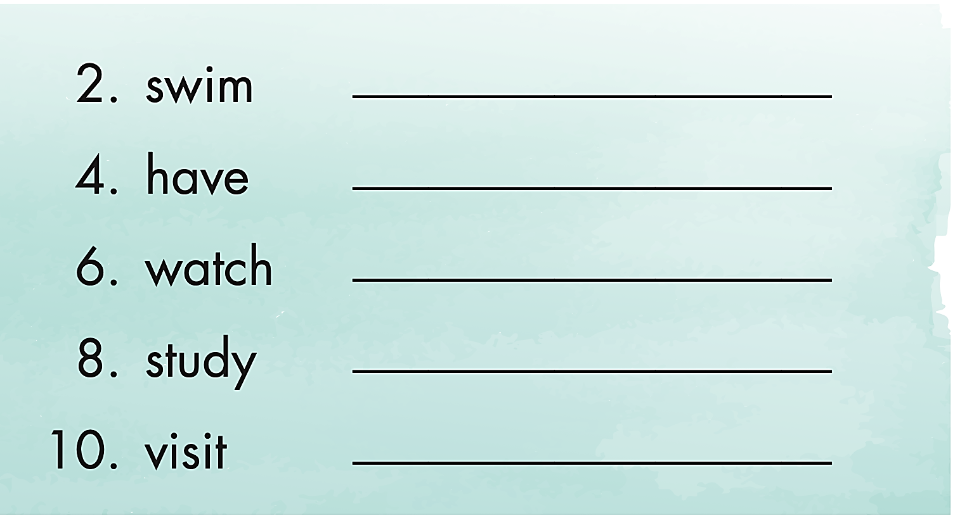
Extra Practice
WB page 17
a. Write the -ing form of the verbs.
swimming
having
watching
studying
visiting

Slide 15
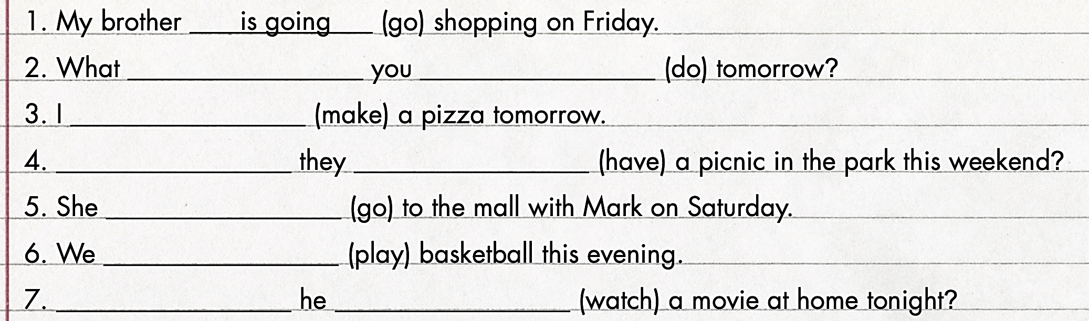
Structure: PRESENT CONTINUOUS
b. Fill in the blanks using the Present Continuous.
are
doing
am
making
Are
having
is
going
are
playing
Is
watching

Slide 16
Structure: PRESENT CONTINUOUS
Work in pairs. Underline the key words.
c. Write full sentences using the given words and the Present Continuous.

Slide 17
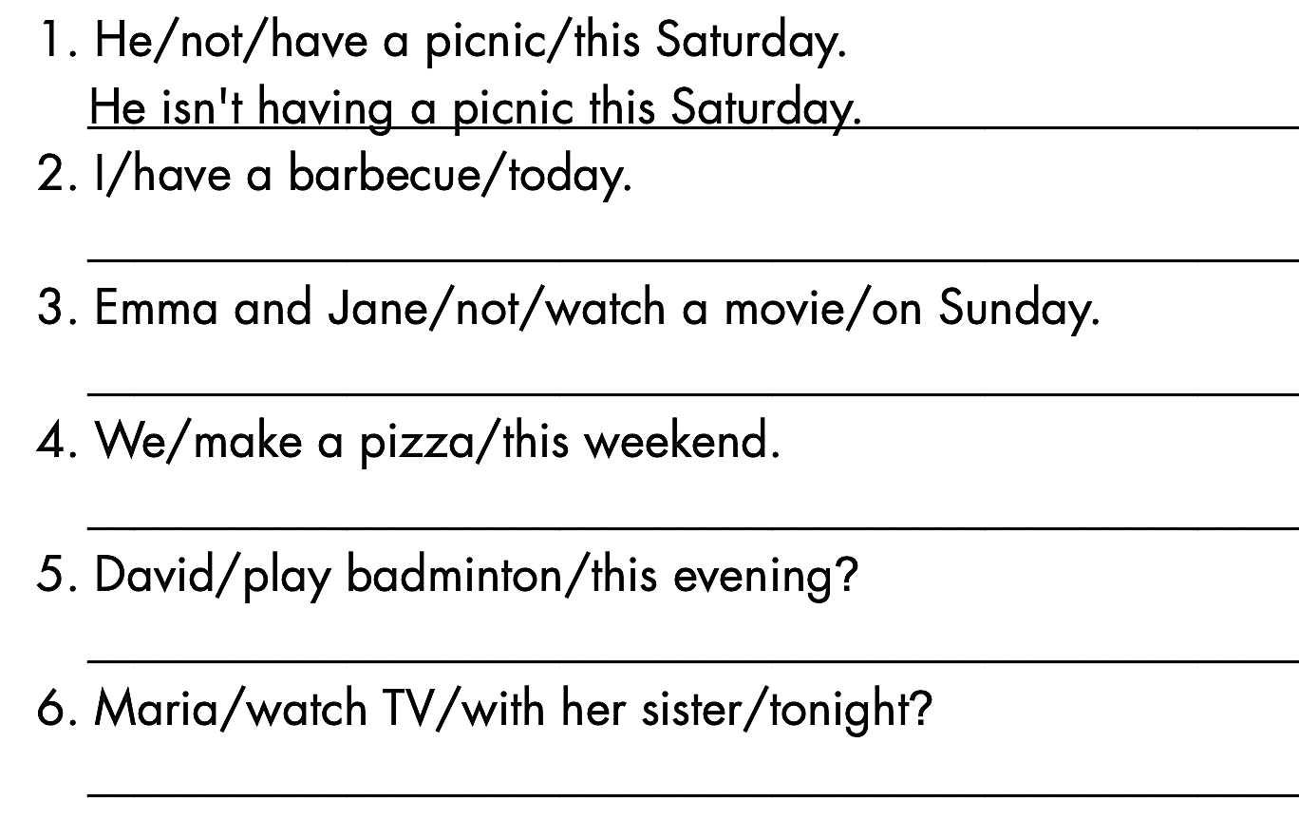
Structure: PRESENT CONTINUOUS
c. Write full sentences using the given words and the Present Continuous.
I’m having a barbecue today.
Emma and Jane aren’t watching a movie on Sunday.
We are making a pizza this weekend.
Is David playing badminton this evening?
Is Maria watching TV with her sister tonight?

Slide 18

Production

Slide 19
Structure: PRESENT CONTINUOUS
Work in pairs. Underline the key words.
d. Now, write true sentences about yourself and then ask your partner.

Slide 20

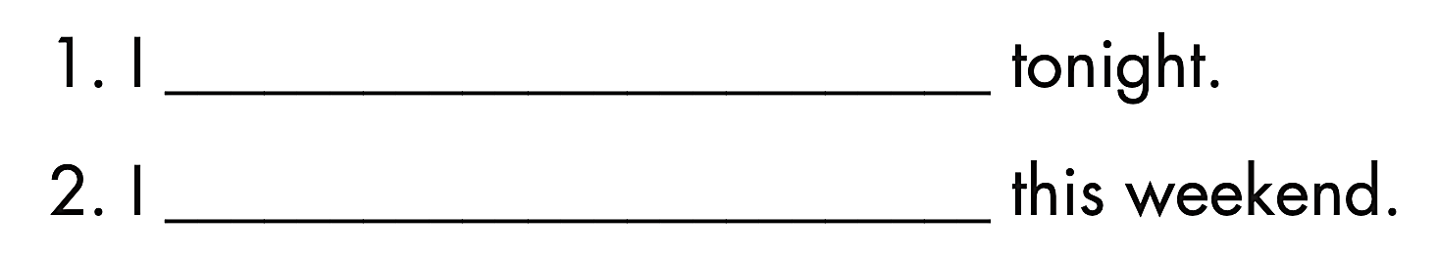
Structure: PRESENT CONTINUOUS
d. Now, write true sentences about yourself, then ask your partner.

Slide 21
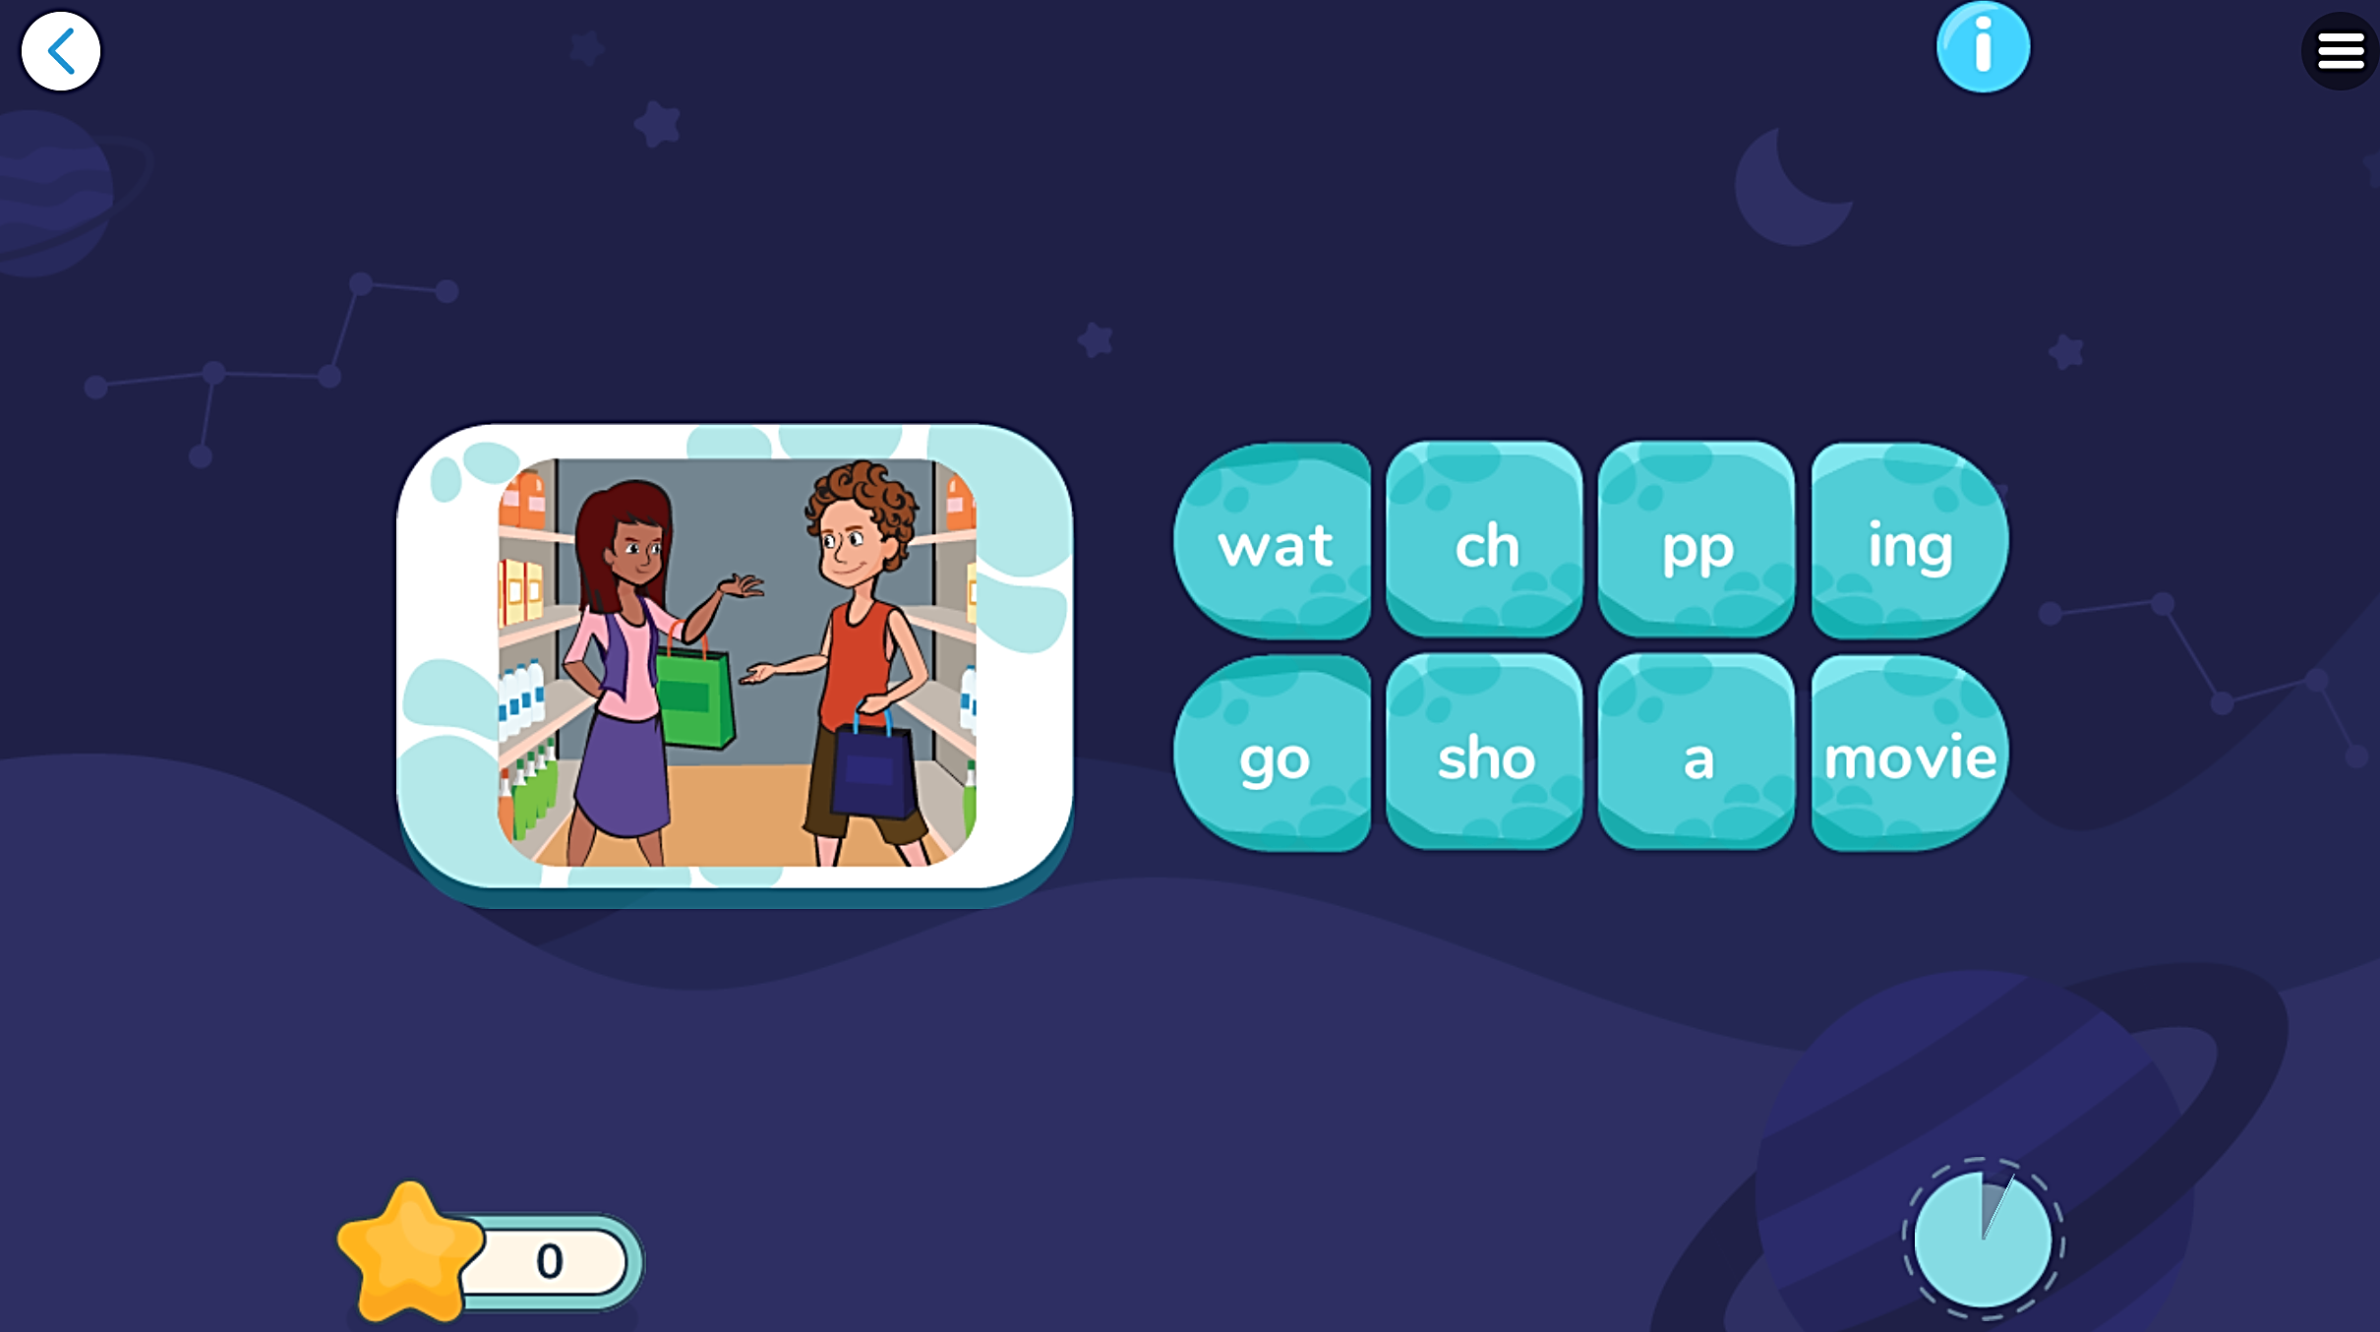
Extra Practice
DHA
Play the games in DHA App. Click the picture below.
Giúp mình add thêm vài trò chơi để HS nhận dạng, nhớ từ và phát âm đúng

Slide 22

CONSOLIDATION

Slide 23
Complete the following sentences using appropriate Present Continuous tense forms.
I _________ (work) over the New Year.
They _________ (fly) to New York tomorrow morning.
So, what _________ we all _________ (do) at Christmas?
I _________ (pop) over to Poland for a few days.
I _________ (go) to bed now.
am working
are flying
are
doing
am popping
am going

Slide 24

WRAP-UP

Slide 25
Today’s lesson
Structures/ Sentence patterns
He's making a cake tomorrow.
They're playing soccer on the weekend.
I'm not watching a movie tonight.
She isn't making a cake tomorrow.
We aren't playing soccer on the weekend. What are you doing tomorrow night?
Is he making a cake tomorrow?
Are you playing soccer on the weekend?

Slide 26
Homework
Review the grammar and practice using them.
Do the exercise(s) in Tiếng Anh 6 i-Learn Smart World Workbook (page 17).
Complete the grammar notes in Tiếng Anh 6 i-Learn Smart World Notebook on page 17.
Prepare the next lesson (page 27 - SB).
Play the consolidation games in Tiếng Anh 6 i-Learn Smart World DHA App on www.eduhome.com.vn.

Slide 27

Enjoy your day!

