Slide 1

Unit 3: Friends
Lesson 1.3: Pronunciation & Speaking
Page 24

Slide 2
Lesson Outline
Warm-up
Vocabulary
Listening
Consolidation
Wrap-up

Slide 3

Objectives
By the end of this lesson, students will be able to…
pronounce precisely /bl/ sound;
describing friends in a conversation.
Notes:
https://www.shutterstock.com/image-photo/hand-writing-inscription-objectives-marker-concept-385430380

Slide 4

WARM-UP

Slide 5

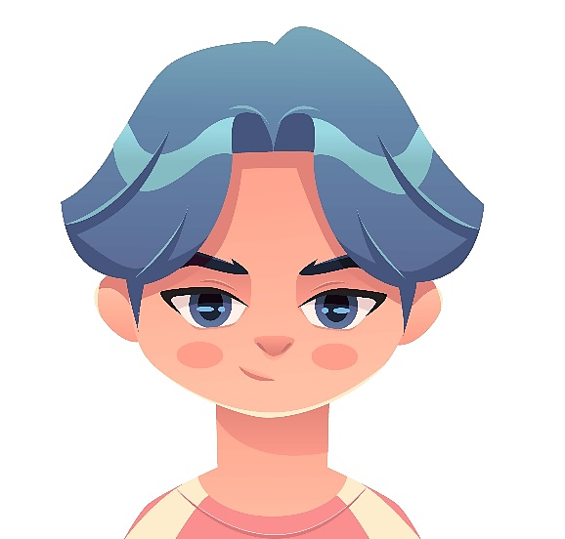
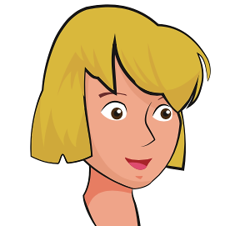
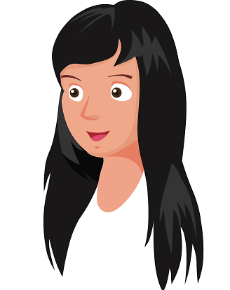
Work in pairs
What color is her/his hair?
BLUE
1.He has ------------ hair.
BLOND
2.She has ------------ hair.
BLACK
3.She has ------------ hair.
Notes:
https://www.shutterstock.com/image-vector/kpop-teen-boy-blue-hair-bts-2131432455

Slide 6

Pronunciation

Slide 7





a. Listen and repeat.
Focus on the /bl/ sound.
Listen to the words and focus on the underlined letters.
Read the words with the correct sound to a partner.
Notes:
https://www.shutterstock.com/image-vector/communication-icon-two-bubbles-information-chat-2116123448

Slide 8

Practice

Slide 9

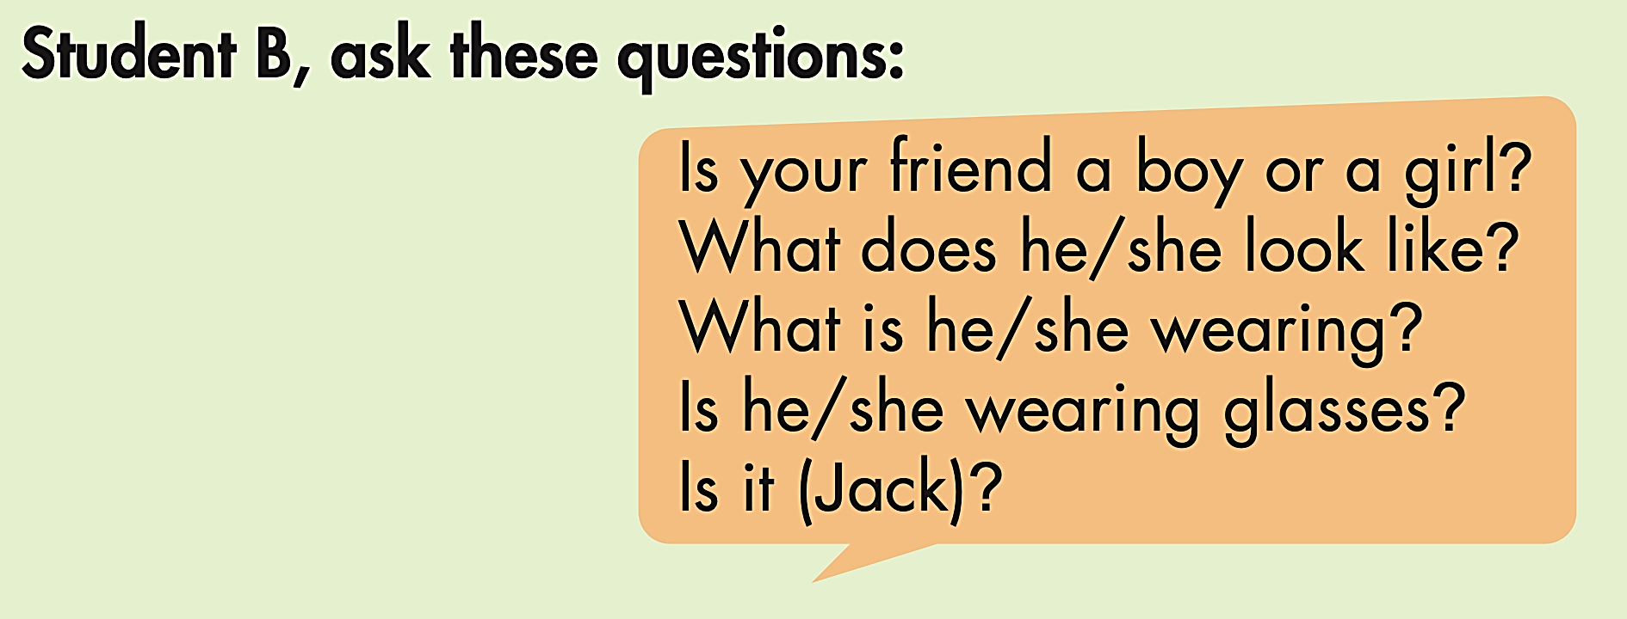
ASK AND ANSWER

Slide 10
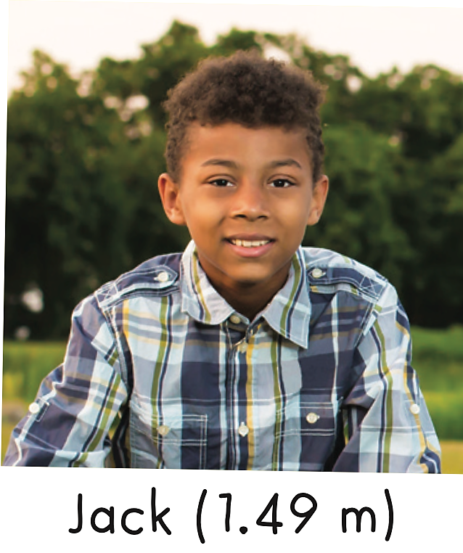
ASK AND ANSWER
Student A:
I'm looking for my friend.
Student B:
Is your friend a boy or a girl?
What does he/she look like?
What is he/she wearing?
Is he/she wearing glasses?
Is it (Jack)?

Slide 11
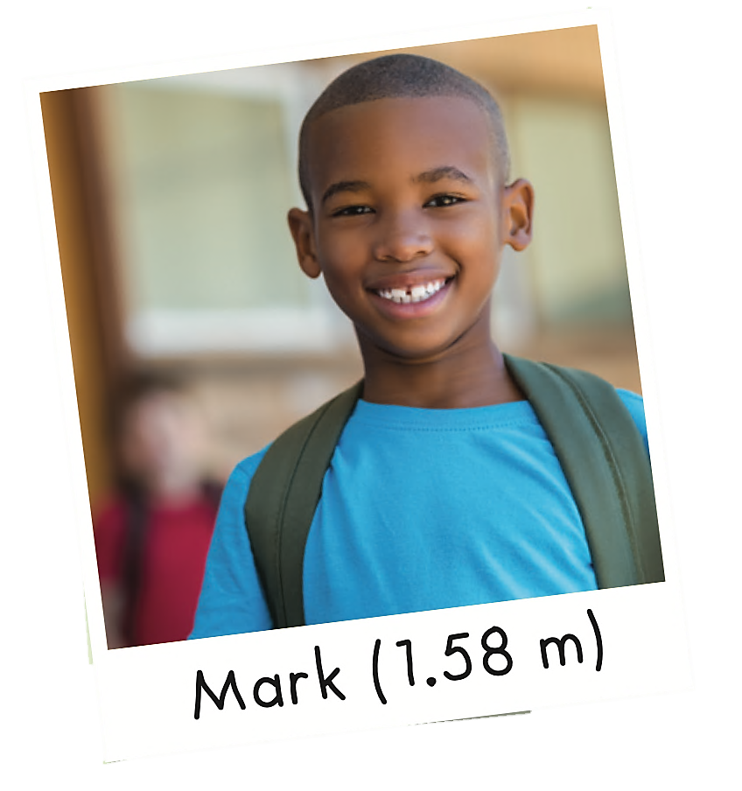
ASK AND ANSWER
Student A:
I'm looking for my friend.
Student B:
Is your friend a boy or a girl?
What does he/she look like?
What is he/she wearing?
Is he/she wearing glasses?
Is it (Jack)?

Slide 12
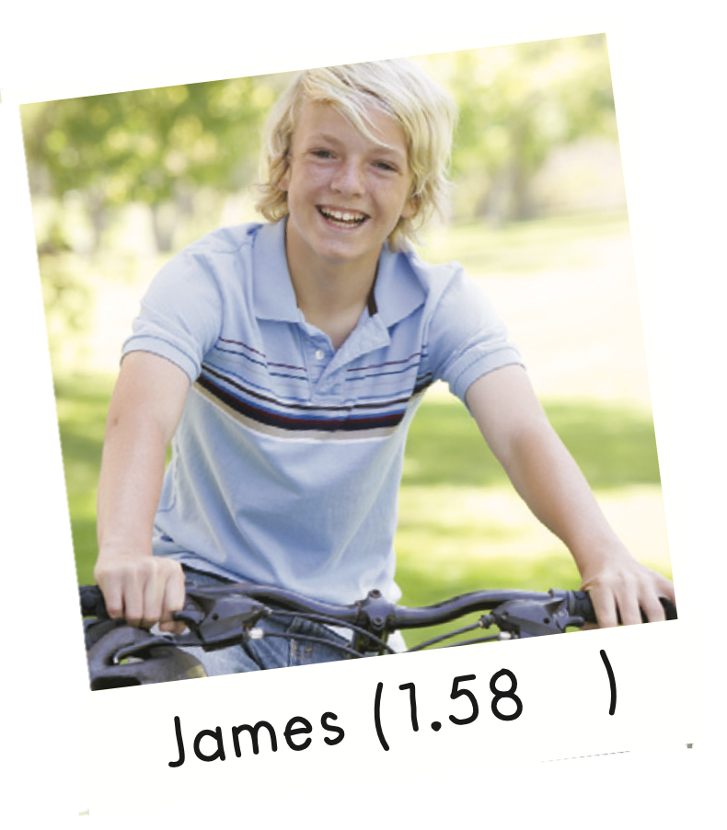
ASK AND ANSWER
Student A:
I'm looking for my friend.
Student B:
Is your friend a boy or a girl?
What does he/she look like?
What is he/she wearing?
Is he/she wearing glasses?
Is it (Jack)?

Slide 13
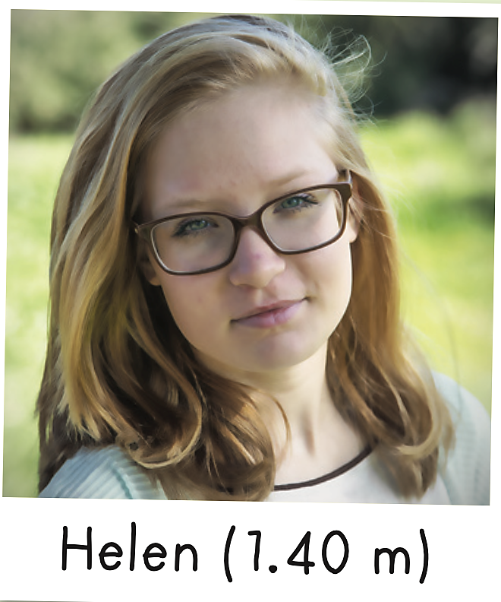
ASK AND ANSWER
Student A:
I'm looking for my friend.
Student B:
Is your friend a boy or a girl?
What does he/she look like?
What is he/she wearing?
Is he/she wearing glasses?
Is it (Jack)?

Slide 14
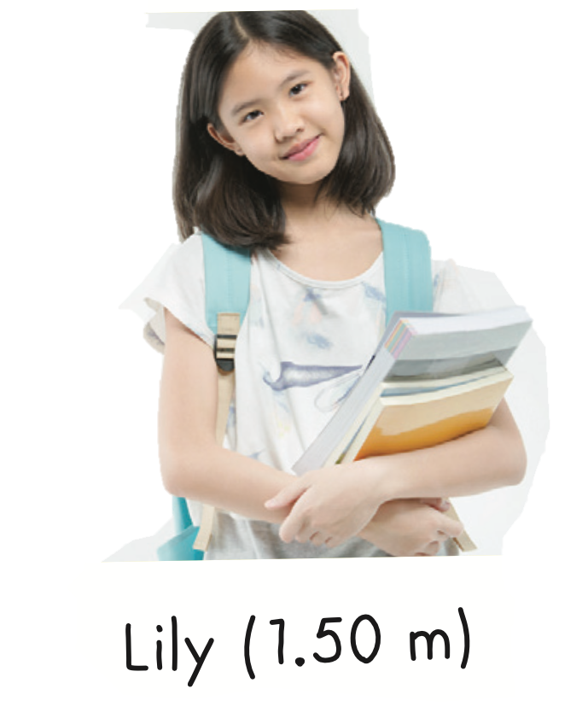
ASK AND ANSWER
Student A:
I'm looking for my friend.
Student B:
Is your friend a boy or a girl?
What does he/she look like?
What is he/she wearing?
Is he/she wearing glasses?
Is it (Jack)?

Slide 15
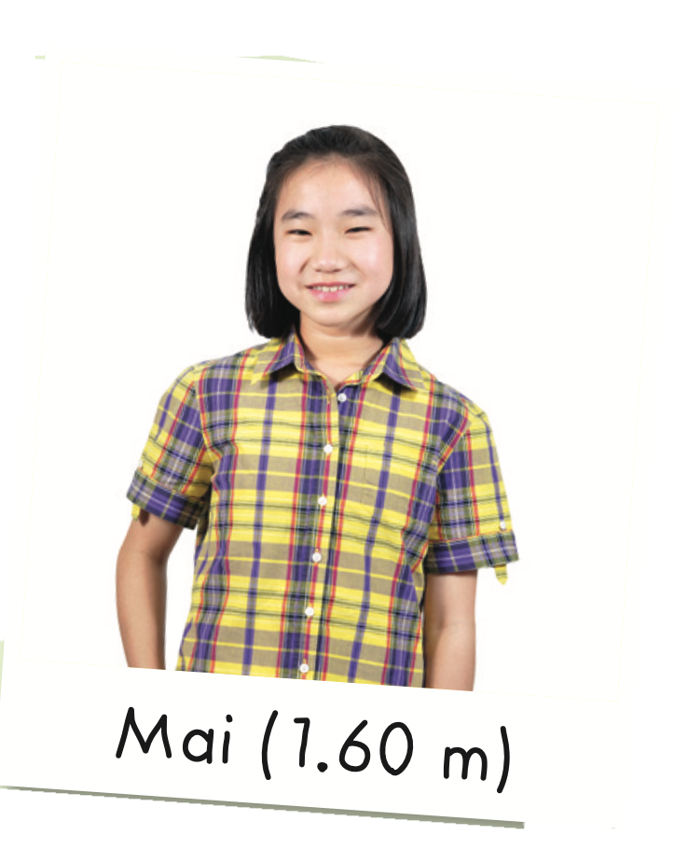
ASK AND ANSWER
Student A:
I'm looking for my friend.
Student B:
Is your friend a boy or a girl?
What does he/she look like?
What is he/she wearing?
Is he/she wearing glasses?
Is it (Jack)?

Slide 16
Speaking

Slide 17
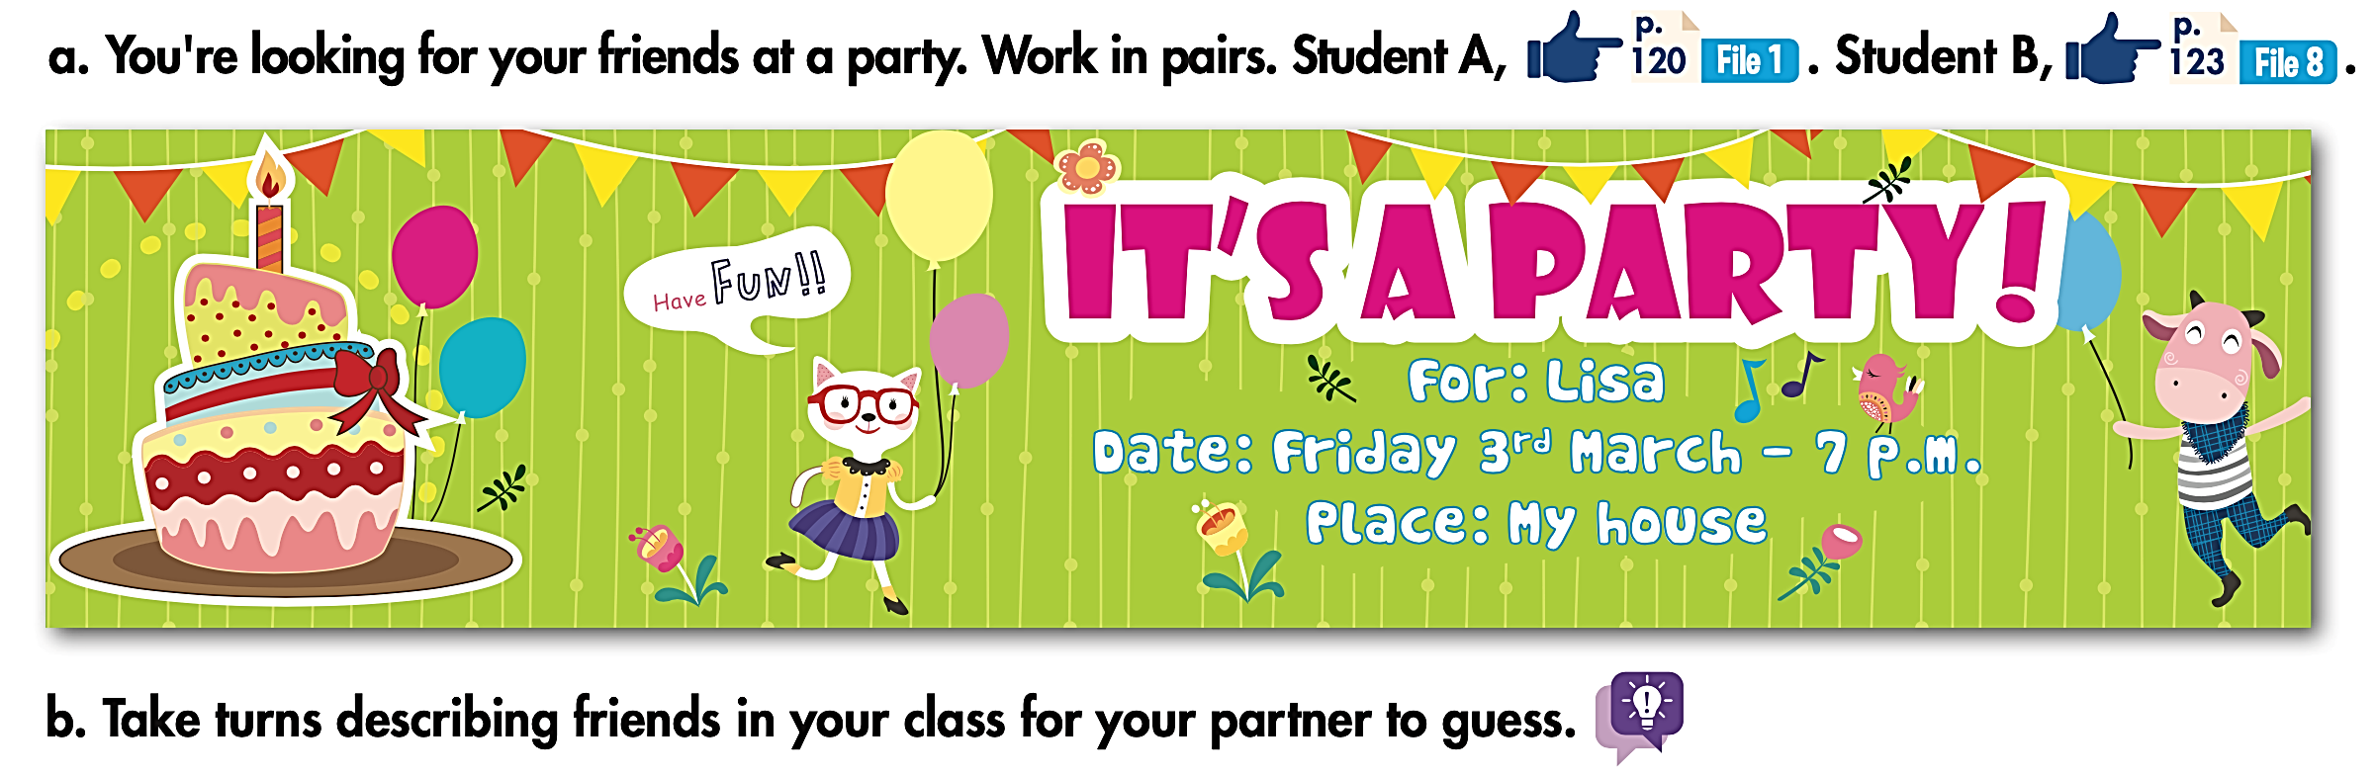
What Do They Look Like?
End the conversation in a friendly way.

Slide 18
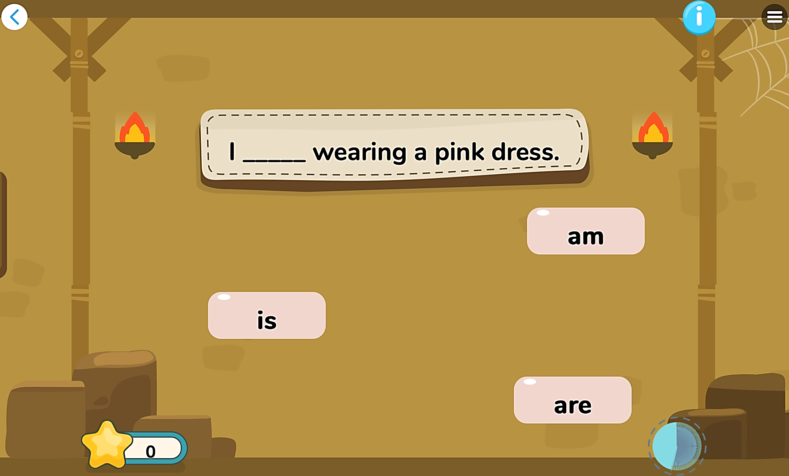
Extra Practice
DHA
Play the games in DHA App. Click the picture below.
Giúp mình add thêm vài trò chơi để HS nhận dạng, nhớ từ và phát âm đúng

Slide 19

WRAP-UP

Slide 20
Today’s lesson
Grammar
I am wearing ….
He/ She is wearing …
Is he/ she/ it wearing …?

Slide 21
Homework
Practice pronouncing /bl/ sound correctly.
Review the vocabulary and grammar notes in Tiếng Anh 6 i-Learn Smart World Notebook (pages 14 & 15).
Prepare the next lesson (page 25 - SB).
Play the consolidation games in Tiếng Anh 6 i-Learn Smart World DHA App on www.eduhome.com.vn.

Slide 22
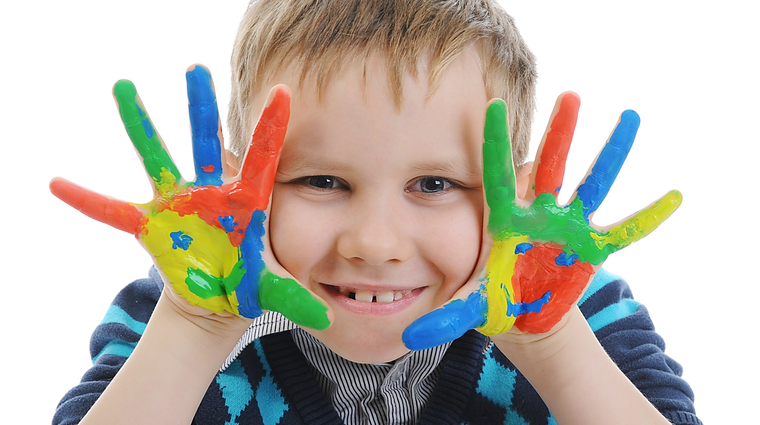
Enjoy your day!

