Slide 1

Unit 2: School
Review Lesson
(Student’s Book - Page 88 & 89; Workbook - Page 63)

Slide 2






LESSSON OUTLINE
Consolidation

Slide 3

In this lesson, they will review…
School subjects and school activities;
Famous books;
Practice test-taking skills.
Notes:
Change information

Slide 4

WARM-UP

Slide 5
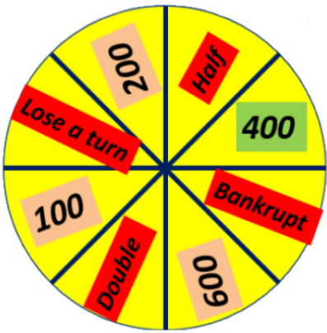
Game. The Wheel of Fortune.
B
I
O
L
O
G
Y
It is a school subject.
Notes:
The class is divided into 4 groups.
Each group in turn spin the WHEEL to get the score.
Then a member from the group guess a letter in answers until he/she has the answer or say answers.
Click the triangle to see the hint.

Slide 6
Game. The Wheel of Fortune.
D
R
A
M
A
C
L
U
B
It is for people who love acting.
Notes:
The class is divided into 4 groups.
Each group in turn spin the WHEEL to get the score.
Then a member from the group guess a letter in answers until he/she has the answer or say answers.
Click the triangle to see the hint.

Slide 7
Game. The Wheel of Fortune.
S
W
I
M
M
I
N
G
It is a kind of sport.
Notes:
The class is divided into 4 groups.
Each group in turn spin the WHEEL to get the score.
Then a member from the group guess a letter in answers until he/she has the answer or say answers.
Click the triangle to see the hint.

Slide 8
Game. The Wheel of Fortune.
F
O
O
T
B
A
L
L
It is an outdoor activity.
Notes:
The class is divided into 4 groups.
Each group in turn spin the WHEEL to get the score.
Then a member from the group guess a letter in answers until he/she has the answer or say answers.
Click the triangle to see the hint.

Slide 9
Game. The Wheel of Fortune.
G
E
O
G
R
A
P
H
Y
It is a school subject.
Notes:
The class is divided into 4 groups.
Each group in turn spin the WHEEL to get the score.
Then a member from the group guess a letter in answers until he/she has the answer or say answers.
Click the triangle to see the hint.

Slide 10
Game. The Wheel of Fortune.
F
A
N
T
A
S
Y
It is a kind of film.
Notes:
The class is divided into 4 groups.
Each group in turn spin the WHEEL to get the score.
Then a member from the group guess a letter in answers until he/she has the answer or say answers.
Click the triangle to see the hint.

Slide 11
Game. The Wheel of Fortune.
A
U
T
H
O
R
It is a job.
Notes:
The class is divided into 4 groups.
Each group in turn spin the WHEEL to get the score.
Then a member from the group guess a letter in answers until he/she has the answer or say answers.
Click the triangle to see the hint.

Slide 12
Game. The Wheel of Fortune.
N
O
V
E
L
It is a book.
Notes:
The class is divided into 4 groups.
Each group in turn spin the WHEEL to get the score.
Then a member from the group guess a letter in answers until he/she has the answer or say answers.
Click the triangle to see the hint.

Slide 13
Game. The Wheel of Fortune.
S
I
G
N
U
P
It is a verb.
Notes:
The class is divided into 4 groups.
Each group in turn spin the WHEEL to get the score.
Then a member from the group guess a letter in answers until he/she has the answer or say answers.
Click the triangle to see the hint.

Slide 14



Slide 15


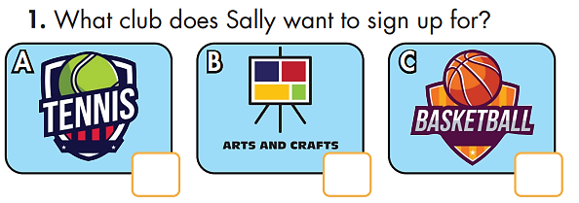

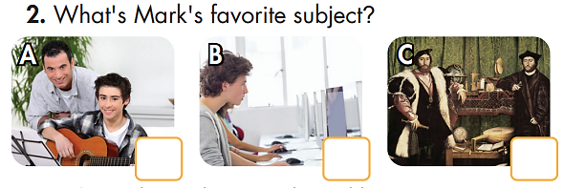
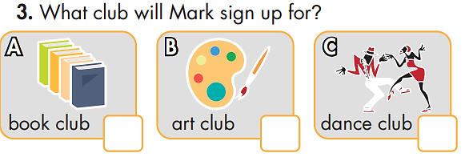
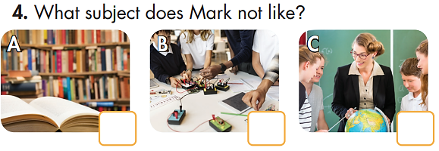
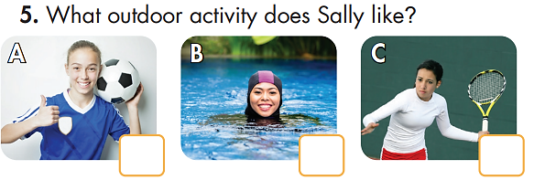
You will hear five short conversations. You will hear each conversation twice. There is one question for each conversation. For each question, choose the correct answer. (A, B, or C).
Click the button to play the audio.
✓
✓
✓
✓
✓

Slide 16



Slide 17
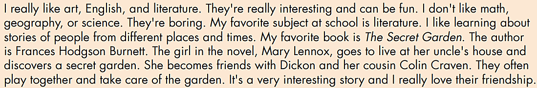
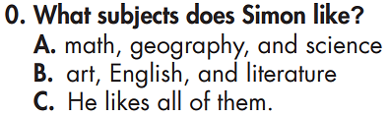


Slide 18
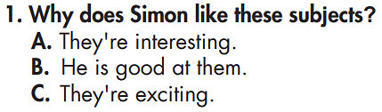


Slide 19
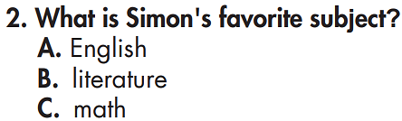


Slide 20
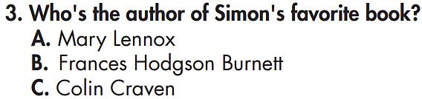

Slide 21
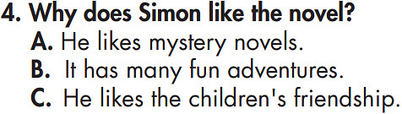

Slide 22

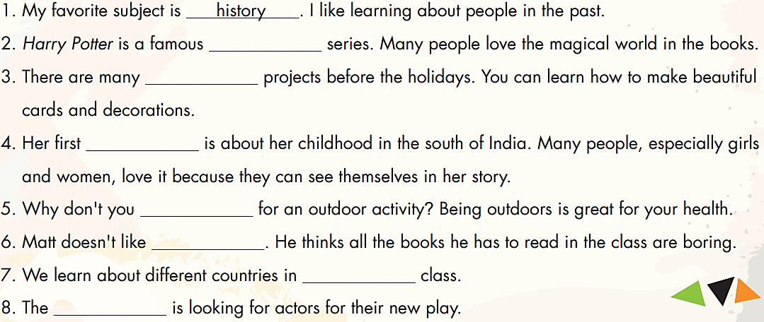
(Verb)
(Noun)
(Noun)
(Noun)
(Noun)
(Noun)
(Noun)
(Noun)
(Noun)
(Noun/
Adjective)
(Noun)
(Verb)
(Noun)
(Noun)
(Noun)

Slide 23

(Verb
(Noun)
(Noun)
(Noun)
(Noun)
(Noun)
(Noun)
(Noun)
fantasy
arts and
crafts
novel
sign up
literature
geography
drama club

Slide 24
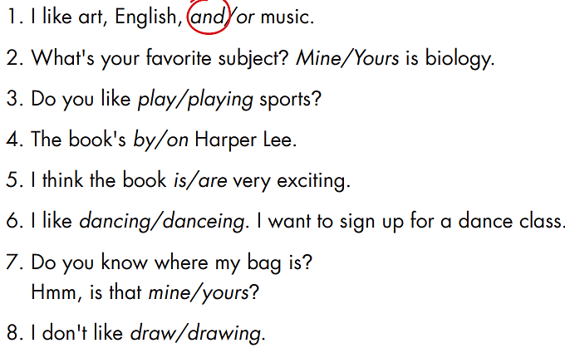

Slide 25

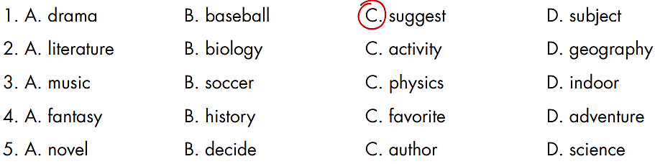
Circle the word that differs from the other three in the position of primary stress in each of the following questions.

Slide 26

CONSOLIDATION

Slide 27

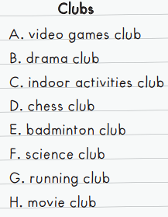
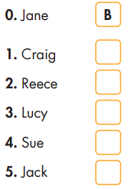
Listen to Jack talking to some friends about school clubs. What club will Jack and his friends sign up for? For questions 1-5, write a letter (A-H) next to each person. You will hear the conversation twice.
Extra Practice
WB, page 63
Click here to play the audio
E
H
F
A
C

Slide 28
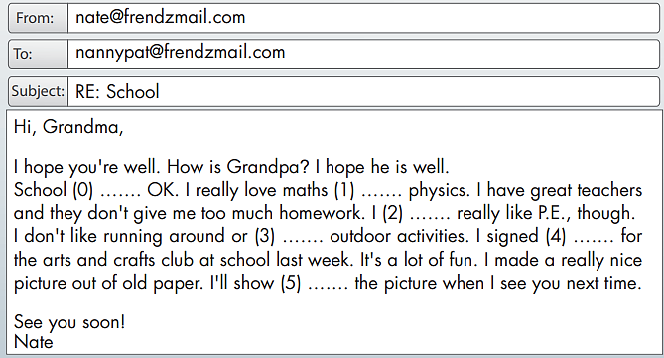
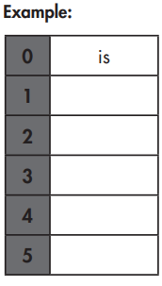
Extra Practice
WB, page 63
Read the email and write one word for each blank.
and
don’t
doing
up
you

Slide 29

WRAP-UP

Slide 30
Today’s lesson
School subjects and school activities;
Famous books.

Slide 31
Homework
Do the exercise(s) in Tiếng Anh 6 i-Learn Smart World Workbook (page 63).
Play the consolation games in Tiếng Anh 6 i-Learn Smart World DHA App on www.eduhome.com.vn.
Prepare the next lesson (page 22 - SB).

Slide 32

Lesson 3
Stay positive and have a nice day!

