Slide 1

Unit 2: School
Lesson 3.1: Vocabulary & Listening
(Student’s Book - Page 20;
Workbook - Page 12)

Slide 2



LESSSON OUTLINE
Consolidation

Slide 3

By the end of this lesson, students will be able to…
talk about different kinds of books;
practice listening for general ideas and filling in the blanks.
Notes:
Change information

Slide 4
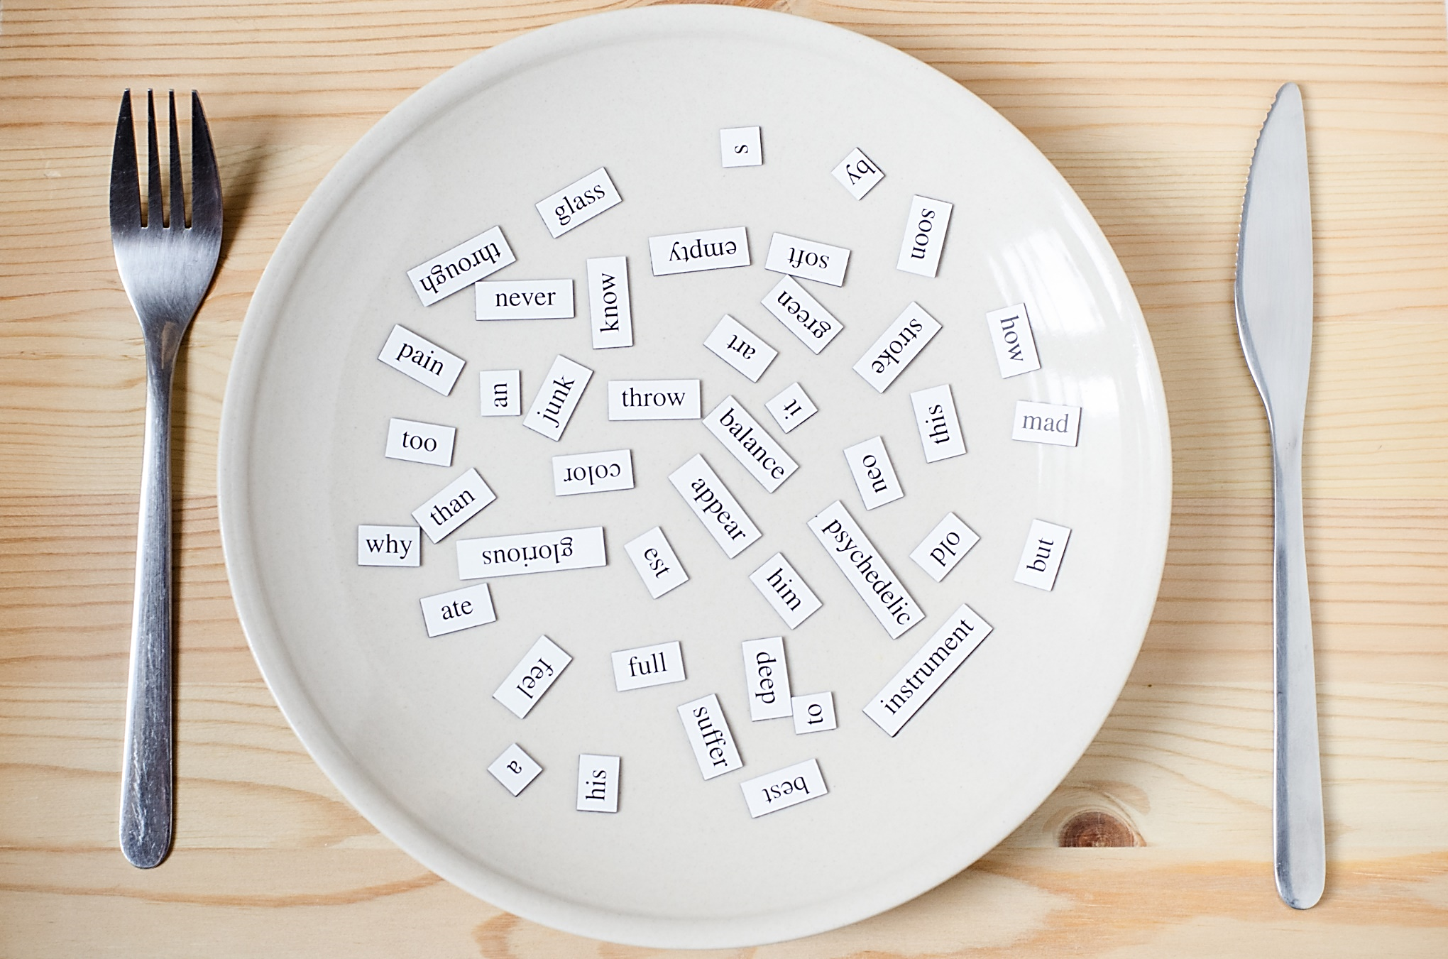
New words:
Fantasy (n)
Author (n)
Novel (n)
Mystery (n)
Adventure (n)
Notes:
Change information

Slide 5

WARM-UP

Slide 6
Speaking. Work in pairs.
Do you like reading books in your free time?
What is your favorite book?
What book are you reading?
Who wrote your favorite book?

Slide 7

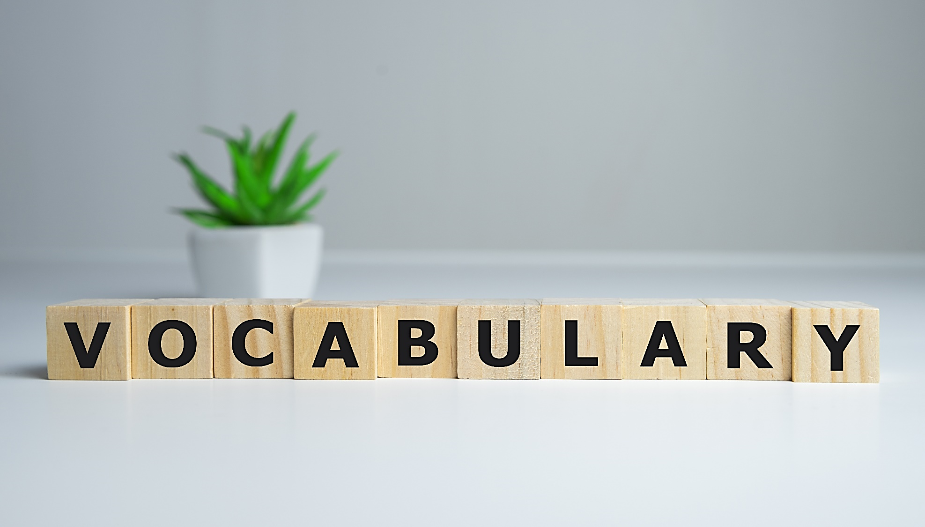

Slide 8

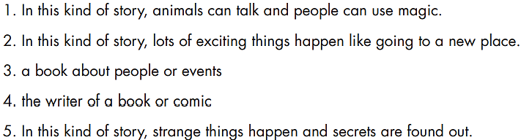
Underline the key words in the sentences.

Slide 9
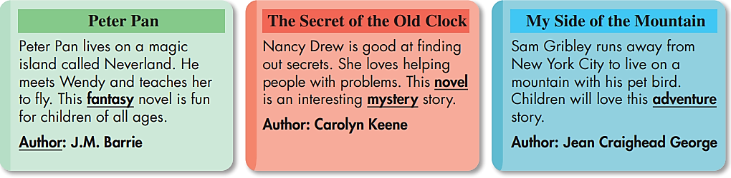
Read the text and match the underlined key words with the definitions.

Slide 10
Read the text and match the underlined key words with the definitions.
adventure

Slide 11
Read the text and match the underlined key words with the definitions.
novel

Slide 12
Read the text and match the underlined key words with the definitions.
author

Slide 13
Read the text and match the underlined key words with the definitions.
mystery

Slide 14

Listen and repeat. (Click each word/phrase to hear the sound)
1. Fantasy (n) /ˈfæntəsi/ truyện hư cấu, kỳ ảo
2. Adventure (n) /ədˈventʃər/ truyện phiêu lưu
3. Novel (n) /ˈnɒvl/ tiểu thuyết
4. Author (n) /ˈɔːθər/ tác giả
5. Mystery (n) /ˈmɪstəri/ truyện bí ẩn
Notes:
GV click vào từng cụm nghe âm thanh

Slide 15
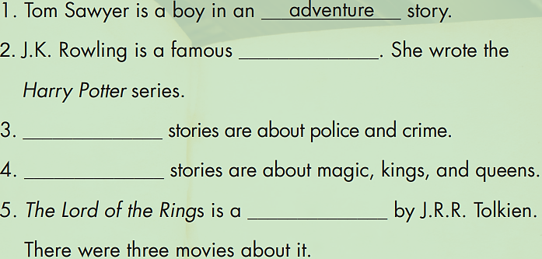
Extra Practice
WB, page 12
Fill in the blanks. Do the crossword puzzle.
1.
A D V E N T U R E
author
2.
A U T H O R
3.
M Y S T E R Y
Mystery
Fantasy
4.
F A N T A S Y
novel
5.
N O V E L

Slide 16

Speaking. Work in pairs. Which story would you like to read?
Which story would you like to read?
I’d like to read Peter Pan. I like fantasy.
Notes:
https://www.shutterstock.com/image-vector/two-young-people-speaking-together-vector-1932277745

Slide 17


Slide 18

Pre-Listening
What are you going to do?
a. Listen to some students talking about books. Circle their favorite kind of book.

Slide 19
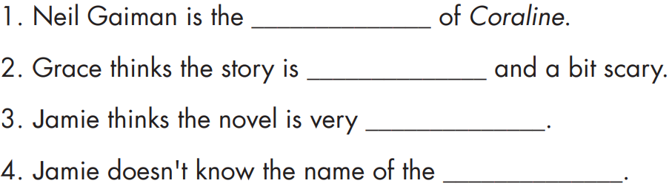
Pre-Listening
Underline the key words.
What are you going to do?
Listen again and fill in the blanks.
Noun
Noun/ Adjective
Adjective
Noun

Slide 20


While-Listening
Click here to play the audio.
a. Listen to some students talking about books. Circle their favorite kind of book.

Slide 21

While-Listening
Listen again and fill in the blanks.
Click here to play the audio.
author
interesting
exciting
author

Slide 22

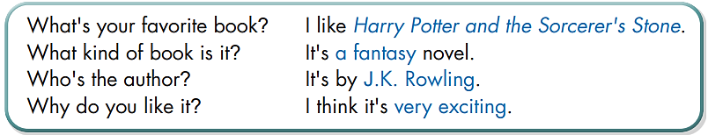
Post-Listening
Click here to play the audio.
Useful language. Listen and repeat.
.
Notes:
https://www.shutterstock.com/image-vector/two-young-people-speaking-together-vector-1932277745

Slide 23
Post - Listening
Speaking. Ask a partner.
.
….
Notes:
https://www.shutterstock.com/image-vector/two-young-people-speaking-together-vector-1932277745

Slide 24

CONSOLIDATION

Slide 25
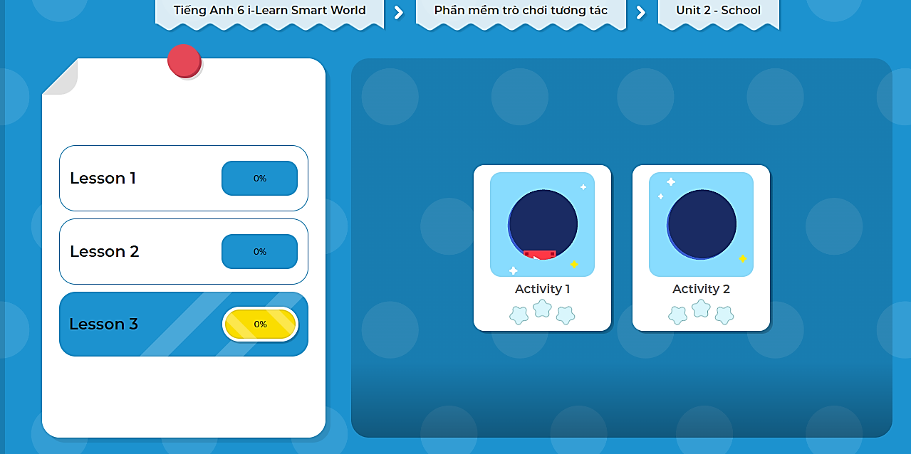
Extra Practice
DHA on EDUHOME
LET’S PLAY!
Click here to play the games.

Slide 26

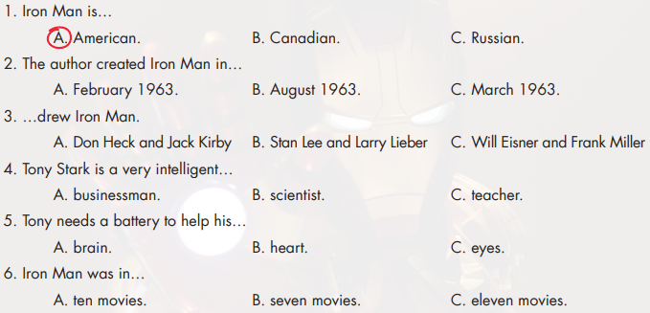
Click here to play the audio.
Extra Practice
WB, page 12
Listen and circle the correct answer.

Slide 27

WRAP-UP

Slide 28
Today’s lesson
Vocabularies
Fantasy (n)
Author (n)
Novel (n)
Mystery (n)
Adventure (n)

Slide 29
Today’s lesson
Listening:
about different kinds of books;
practice listening for general ideas and filling in the blanks.

Slide 30
Homework
Review the vocabularies and practice using them.
Do the exercise(s) in Tiếng Anh 6 i-Learn Smart World Workbook (page 12).
Do the vocabulary exercise in Tiếng Anh 6 i-Learn Smart World Notebook (page 12).
Play the consolation games in Tiếng Anh 6 i-Learn Smart World DHA App on www.eduhome.com.vn.
Prepare the next lesson (page 21 - SB).

Slide 31

Lesson 3
Stay positive and have a nice day!

