Slide 1

Unit 2: School
Lesson 1.1: Vocabulary & Listening
(Student’s Book - Page 14;
Workbook - Page 8)

Slide 2



LESSSON OUTLINE
Consolidation

Slide 3

By the end of this lesson, students will be able to…
talk about school subjects they like or don’t like;
practice listening and passing their turn to someone after finishing speaking.
Notes:
Change information

Slide 4
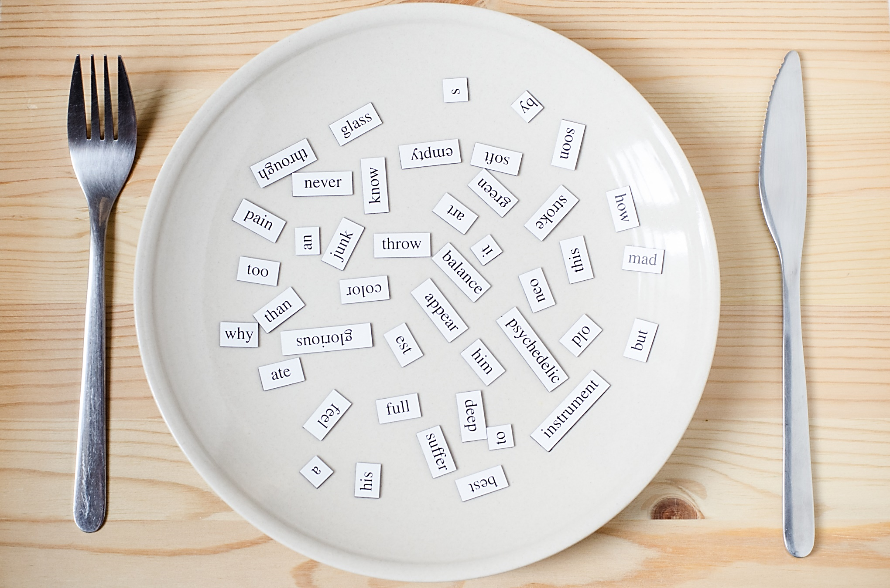
New words:
History
P.E. (Physical Education)
I.T. (Information Technology)
Music
Geography
Literature
Physics
Biology
Notes:
Change information

Slide 5

WARM-UP

Slide 6

Speaking
What is your favorite school subject?
When do you study that subject?

Slide 7


Slide 8
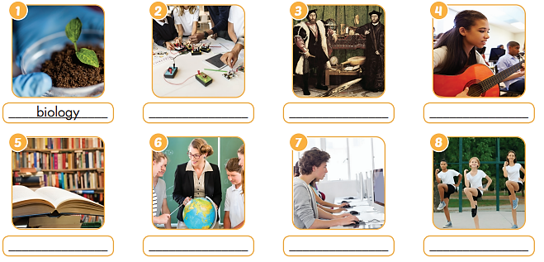
Work in pairs. What can you see in each picture?

Slide 9
Work in pairs. a. Match each phrase to each picture.
History
P.E. (Physical Education)
I.T. (Information Technology
Music
Geography
Literature
Physics
Biology
Physics
History
Music
Literature
Geography
I.T.
P.E.

Slide 10

Listen and repeat. (Click each word/phrase to hear the sound)
1. History (n) /ˈhɪstri/ môn Lịch sử
2. P.E. (Physical Education) (n) /ˈfɪzɪkl ˌedʒuˈkeɪʃn/ môn Thể dục
3. I.T. (Information Technology) (n) /ˌɪnfərˈmeɪʃn tekˈnɒlədʒi/ môn Tin học
4. Music (n) /ˈmjuːzɪk/ môn Âm nhạc
5. Geography (n) /dʒiˈɒɡrəfi/ môn Địa lý
6. Literature (n) /ˈlɪtrətʃər/ môn Văn học
7. Physics (n) /ˈfɪzɪks/
môn Vật lý
8. Biology (n) /baɪˈɑːlədʒi/
môn Sinh học
Notes:
GV click vào từng cụm nghe âm thanh

Slide 11
Extra Practice
WB, page 8
Work in pairs.
Unscramble the words.
L I G B Y O O
G E O R Y H G A P
I M S U C
T.I.
R Y S H I O T
E R T L T I U A R E
P I H C Y S S
E.P.
B I O L O G Y
G E O G R A P H Y
M U S I C
I. T.
H I S T O R Y
L I T E R A T U R E
P H Y S I C S
P. E.

Slide 12
Extra Practice
WB, page 8
Read the sentences. Circle the correct answers.
1. I like ________ because I like reading stories.
A. literature B. math C. physics
2. I like to learn about plants and how they grow. I like _____.
A. I.T B. biology C. history
3. I like computers. That’s why I like _______.
A. I.T B. P.E C. history
4. I love to learn about mountains and rivers. I like _______.
A. I.T B. physics C. geography

Slide 13
Extra Practice
WB, page 8
Read the sentences. Circle the correct answers.
5. I don’t like running and playing sports. I don’t like ______.
A. literature B. P.E C. math
6. Studying _______ helps me learn about countries around the world and famous people in the past.
A. I.T. B. P.E. C. history
7. I love to learn how light, heat, and sound work. I love _____.
A. geography B. biology C. physics

Slide 14

Work in pairs.
b. Note three more subjects you know. Discuss if you like them.
Do you like math?
Yes, I do.
I study math on Monday,…
Notes:
https://www.shutterstock.com/image-vector/happy-cute-little-kids-boy-girl-1631236738

Slide 15

It’s listening time….

Slide 16
Pre-Listening
Read the instruction quickly. Underline the key words. What are we going to do?
Listen and answer the question.
Listen to Adrian and Sarah talking about school subjects?
Who likes more school subjects?

Slide 17


See the underlined key words. Answer the question.
While-Listening
Listen to Adrian and Sarah talking about school subjects?
Who likes more school subjects?
Answer: Sarah
Click the button to play the audio.

Slide 18
Pre-Listening
Read the instruction quickly. What are we going to do?
Listen and fill in the blanks.

Slide 19
Read the statements. Underline the key words.
Pre-Listening
Adrian likes _____________________.
Sarah likes history, physics and __________________.
Sarah doesn’t like ________________.
Adrian’s favorite subject is _____________.

Slide 20
Read the statements. Guess the word type for each answer.
Pre-Listening
Adrian likes _____________________.
Sarah likes history, physics, and __________________.
Sarah doesn’t like __________________.
Adrian’s favorite subject is _____________.
Noun (singular / plural)
Noun (singular / plural)
Noun (singular / plural)
Noun (singular)

Slide 21

While-Listening
Listen and fill in the blanks.
Click the button to play the audio.
Adrian likes _____________________.
Sarah likes history, physics and __________________.
Sarah doesn’t like ________________.
Adrian’s favorite subject is _____________.
art
P.E.
geography
P.E.

Slide 22
Audio Scripts
Sarah: Hello, Adrian.
Adrian: Hi, Sarah.
Sarah: Is that your group's survey about school subjects?
Adrian: Yes, it is.
Sarah: Cool. So, what subjects do you like?
Adrian: I like art. How about you?
Sarah: I like history, physics, and P.E.
Adrian: What subjects don't you like?
Sarah: I don't like geography. What subjects don't you like, Adrian?
Adrian: I don't like history, math, physics, and geography.
Sarah: Wow! You don't like a lot of subjects.
Adrian: Yeah, that's true. What's your favorite subject, Sarah?
Sarah: Mine's physics. What's yours?
Adrian: Mine's P.E.

Slide 23


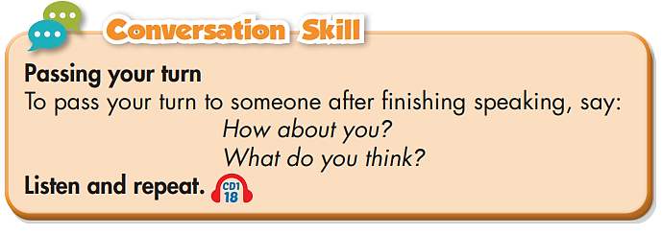
Post-Listening
Conversation skill
Click the button to play the audio.
.

Slide 24

Post-Listening
Work in pairs. Practice passing your turn.
“How about you?
What do you think?”
I like studying biology. How about you?
I love physics.
What do you think?
Notes:
https://www.shutterstock.com/image-vector/two-young-people-speaking-together-vector-1932277745

Slide 25

CONSOLIDATION

Slide 26
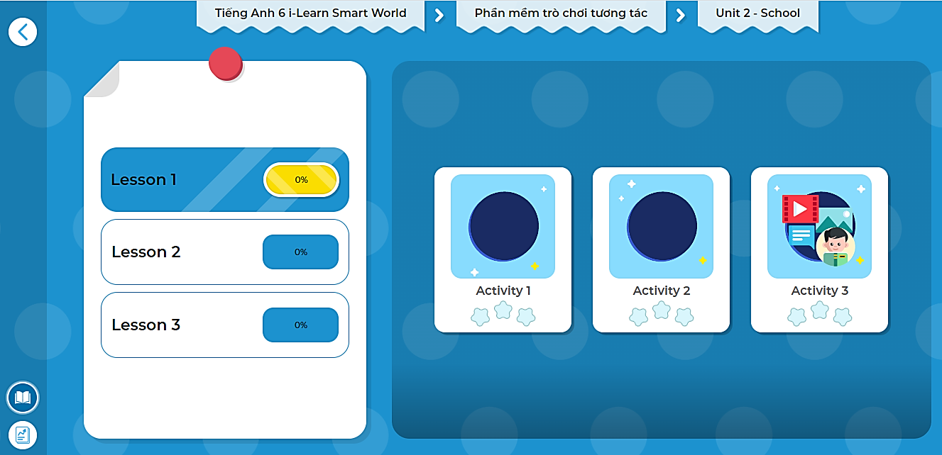
Extra Practice
DHA on EDUHOME
LET’S PLAY!
Click here to play the games.

Slide 27
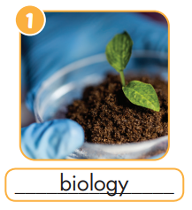
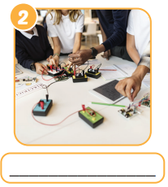
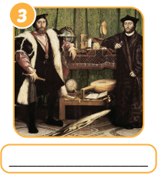
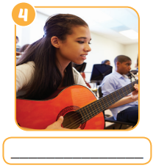



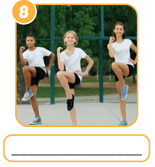
Look at the pictures and write the words.
Physics
History
Music
Literature
Geography
I.T.
P.E.

Slide 28

WRAP-UP

Slide 29
Lesson 3
Vocabularies
History
P.E. (Physical Education)
I.T. (Information Technology)
Music
Geography
Literature
Physics
Biology
Today’s lesson

Slide 30
Today’s lesson
Listening:
About school subjects they like or don’t like;
- Finding the key words.
Speaking:
- Conversation skill.

Slide 31
Homework
Review the vocabularies and practice using them.
Do the exercise(s) in Tiếng Anh 6 i-Learn Smart World Workbook (page 8).
Do the vocabulary exercise in Tiếng Anh 6 i-Learn Smart World Notebook (page 8).
Play the consolation games in Tiếng Anh 6 i-Learn Smart World DHA App on www.eduhome.com.vn.
Prepare the next lesson (page 15 - SB).

Slide 32

Lesson 3
Stay positive and have a nice day!

