Slide 1
Unit 8: Jobs in the future
Review 2: Grammar, Pronunciation, In the Real World, Conversation, Speaking & Writing
Pages 112 & 113

Slide 2
Lesson Outline
Conversation
Warm-up
Speaking
Grammar
Writing
Pronunciation
Consolidation
In the Real World
Wrap-up

Slide 3
By the end of this lesson, students will be able to…
Review the target language learned in the unit
Practice test-taking skills

Slide 4
WARM-UP

Slide 5
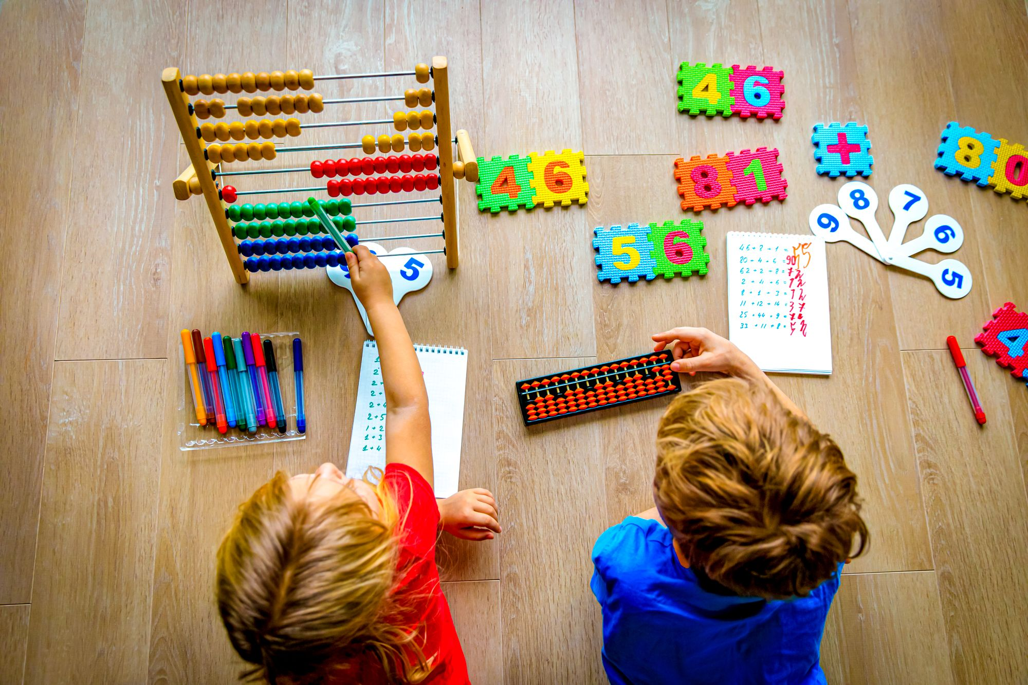
COMPETITION TIME:
Create groups/teams of 5 students.
Work in groups and make six sentences using these verbs with “to infinitives”
The team(s) with the most correct answers win (s).
Time limit: 5 minutes

Slide 6
Make six sentences using these verbs with “to infinitives”
1. aim
2. expect
3. decide
4. hope
5. plan
6. want
Example:
Jack aimed to climb the highest mountain in his country.

Slide 7
Suggested answers
Make six sentences using these verbs with “to infinitives”
1.Lily aimed to finish her novel by the end of the month.
2.She expected to face many distractions but remained determined.
3.After considering her schedule, she decided to write every morning.
4.She hoped to complete a chapter each day.
5.To stay focused, she planned to minimize social activities.
6.Ultimately, she wanted to see her book published.

Slide 8
Grammar

Slide 9
Rearrange the groups of words in the correct order to make complete sentences.
1. content in/I expect/more personalized/the future./to see
2. be a doctor,/If you/you could/want to/get a tutor.
3. virtual worlds./People will/more beautiful/want to see
4. audience likes/what their/Producers will/want to know/the most.

Slide 10
Rearrange the groups of words in the correct order to make complete sentences.
5. skincare specialist,/you could/take a course./to be a/If you want
6. every week if you/design something new/a fashion designer./You should/want to be
7. will want/virtual events./to attend/More people
8. You should/good apprenticeship/want to be/or a mechanic./find a/if you/a plumber

Slide 11
Rearrange the groups of words in the correct order to make complete sentences.
Answers
content in/I expect/more personalized/the future./to see
________________________________________________
2. be a doctor,/If you/you could/want to/get a tutor.
_________________________________________________
3. virtual worlds./People will/more beautiful/want to see
____________________________________________________
I expect to see more personalized content in the future.
If you want to be a doctor, you could get a tutor.
People will want to see more beautiful virtual worlds.

Slide 12
Rearrange the groups of words in the correct order to make complete sentences.
Answers
4. audience likes/what their/Producers will/want to know/the most.
_______________________________________________________
5. skincare specialist,/you could/take a course./to be a/If you want
_______________________________________________________
6. every week if you/design something new/a fashion designer./You should/want to be
_______________________________________________________
_______________________________________________________
Producers will want to know what their audience likes the most.
If you want to be a skincare specialist, you could take a course.
You should design something new every week if you want to be a fashion designer.

Slide 13
Rearrange the groups of words in the correct order to make complete sentences.
Answers
7. will want/virtual events./to attend/More people
_________________________________________________
8. You should/good apprenticeship/want to be/or a mechanic./find a/if you/a plumber
_________________________________________________
_________________________________________________
More people will want to attend virtual events.
You should find a good apprenticeship if you want to be a plumber or a mechanic.

Slide 14
Pronunciation

Slide 15
Task a. Circle the word that differs from the other three in the position of primary stress in each of the following questions.
1.A. mechanic | B. media | C. virtual | D. specialist
2.A. plumber | B. tutor | C. podcast | D. demand

Slide 16
Answers
Task a. Circle the word that differs from the other three in the position of primary stress in each of the following questions.
1.A. mechanic | B. media | C. virtual | D. specialist
/məˈkænɪk/ | /ˈmiːdiə/ | /ˈvɜːrtʃuəl/ | /ˈspeʃəlɪst/
2.A. plumber | B. tutor | C. podcast | D. demand
/ˈplʌmər/ | /ˈtuːtər/ | /ˈpɑːdkæst/ | /dɪˈmænd/

Slide 17
Answers
Task b. Circle the word that has the underlined part pronounced differently from the others.
1. A. media | B. field | C. demand | D. meetings
2. A. producer | B. podcast | C. personalized | D. innovation

Slide 18
Answers
Task b. Circle the word that has the underlined part pronounced differently from the others.
1. A. media | B. field | C. demand | D. meetings
/ˈmiːdiə/ | /fiːld/ | /dɪˈmænd/ | /ˈmiːtɪŋ/
2. A. producer | B. podcast | C. personalized | D. innovation
/prəˈduːsər/ | /ˈpɑːdkæst/ | /ˈpɜːrsənəlaɪzd/ | /ˌɪnəˈveɪʃn/

Slide 19
In the Real World

Slide 20
Look at the signs. Choose the best answers.
1. How can the website help you?
A. find a university
B. meet other people looking for apprenticeships
C. find an apprenticeship
D. fill out application forms

Slide 21
Look at the signs. Choose the best answers.
2. What can you do at the fair?
learn about what audiences want to see
find jobs in media
C. listen to podcasts about the media
D. learn about Fargate

Slide 22
Conversation

Slide 23
Choose the correct answer (A, B, C, or D).
1. Gina: "If you want to be a skincare specialist, you should take a short course in skincare." Harry: "That's a good idea. __________________"
A. Sorry, no thank you. | B. I appreciate it. | C. What do you mean? | D. I should get a tutor.
2. Mike: "I want to be a plumber. Do you have any advice?" Mai: "You could start ____________ apprenticeships in your area."
A. demand | B. researching | C. innovation | D. tutor

Slide 24
Choose the correct answer (A, B, C, or D).
3. Dung: "Why will there be more _____________ designers in the future?" Pete: "Because people will want to see more beautiful virtual worlds."
A. audience | B. skincare | C. virtual reality | D. podcast
4. Sam: "More people will want to ____________ job fairs if they are virtual." Steve: "I think you're right."
A. attend | B. know | C. teach | D. demand

Slide 25
Speaking

Slide 26
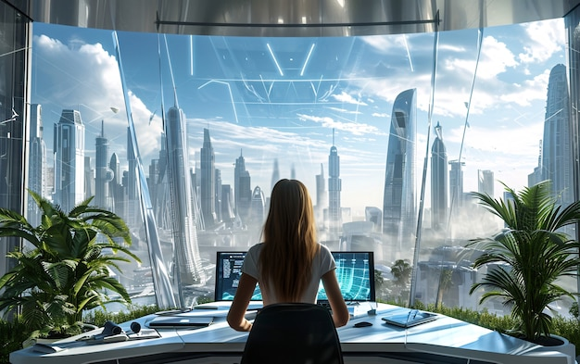
In pairs: Discuss what jobs you want to have in the future. Take turns giving advice about how to get these jobs.

Slide 27
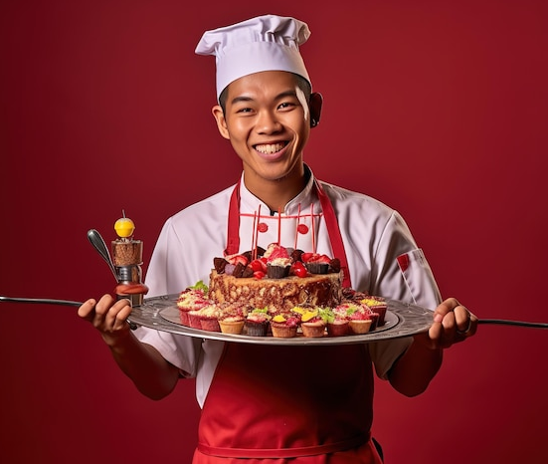
Suggested answer
I want to be a chef.
If you want to be a chef, you should learn to cook a variety of dishes.
What can I do?
You could take cooking classes if you want to learn to cook different dishes.
Thanks.

Slide 28
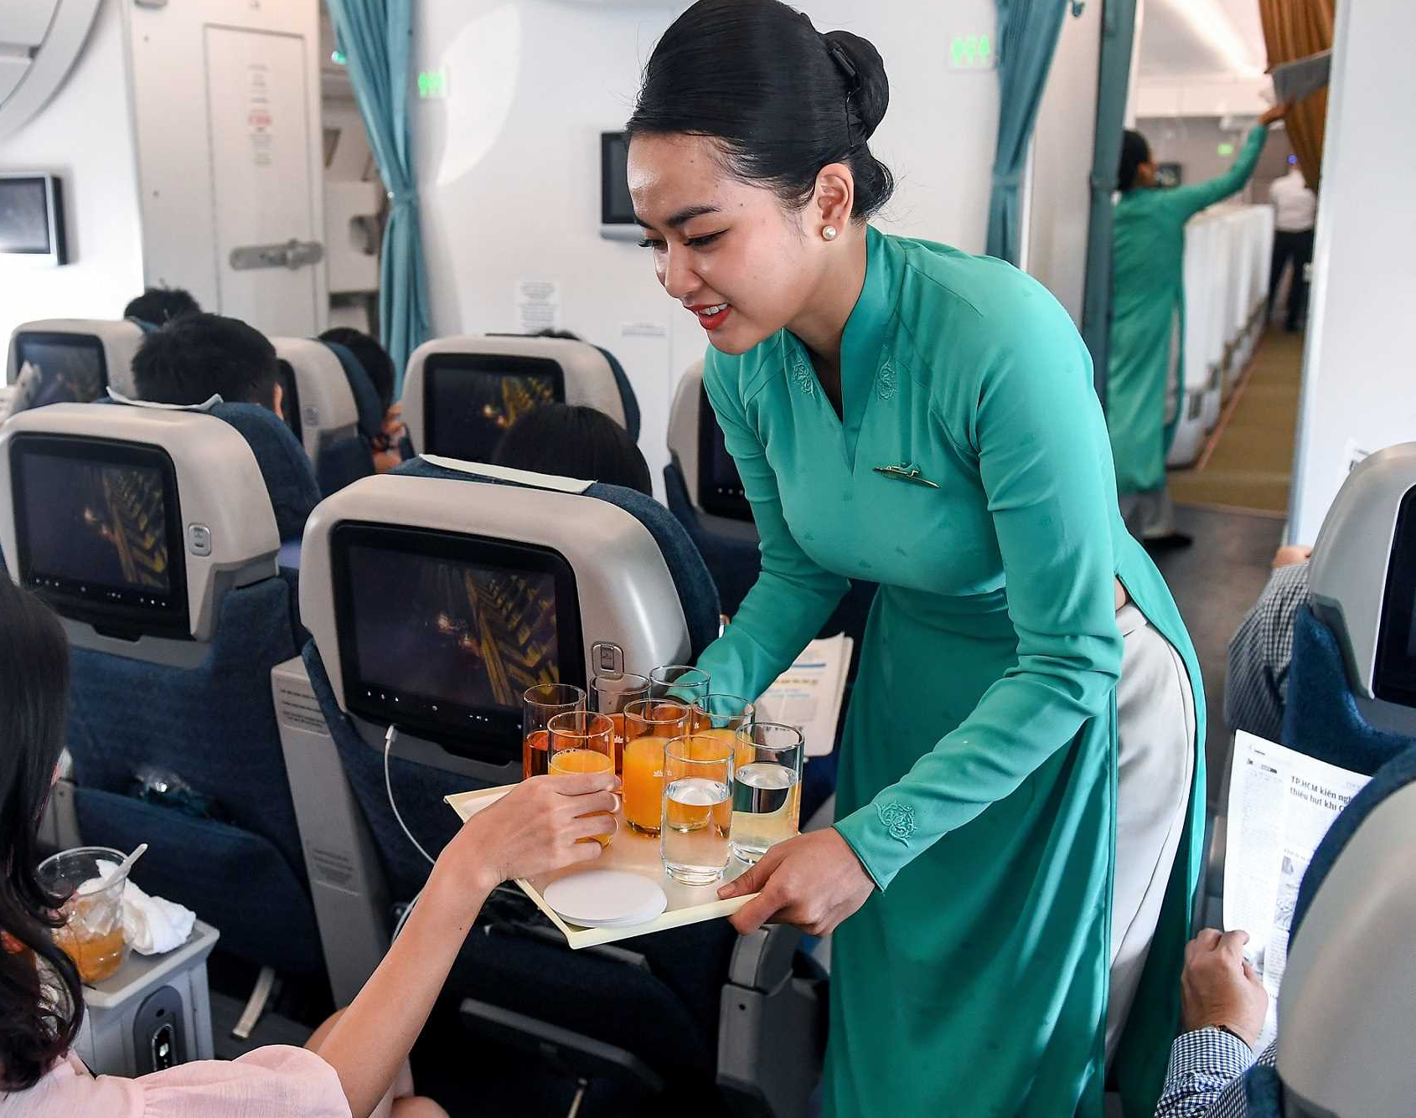
Suggested answer
I want to be a flight attendant.
If you want to be a flight attendant, you should improve your communication skills.
What can I do?
You could take language and communication courses if you want to enhance your skills.
Thanks.

Slide 29
Writing

Slide 30
Write about the things you want and expect to experience from media and entertainment companies in the future. Write 100 to 120 words.

Slide 31
Suggested answer
I hope entertainment and media will be very different in the future. I expect to see more personalized content because I don't want to just watch the same things as everyone else. I also expect to see more virtual reality media. I expect to be able to watch and learn about the world in a virtual reality world. I also expect to play more games and meet with friends in this world. I really want to be able to listen to more podcasts about things I'm interested in, too. I want to listen to podcasts about the natural world and different interesting cultures around the world.
106 words

Slide 32
Extra practice
Workbook

Slide 33
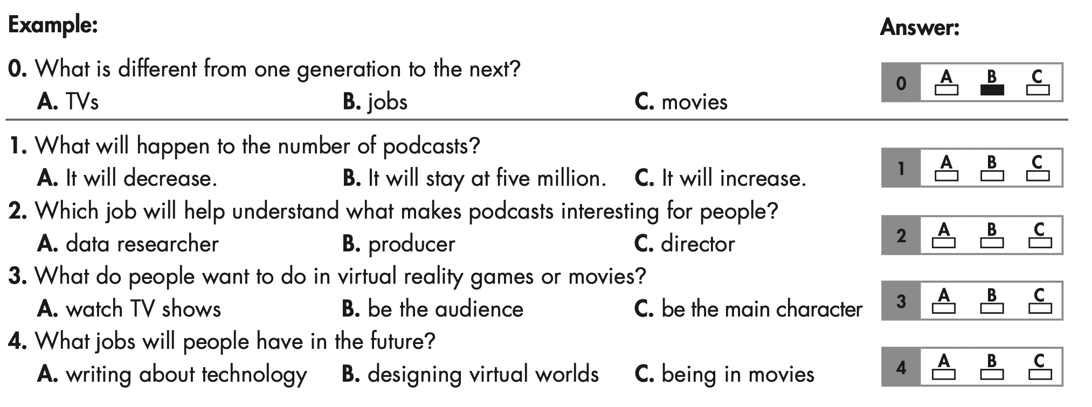
WB p. 57. Read the article about jobs in the future. Choose the correct answer (A, B, or C).
Underline the key words

Slide 34
Reading passage
We know from history that the jobs of one generation may not be the same in the next. Today, many people in entertainment work as actors, writers, or musicians. However, because of the internet, entertainment jobs are likely to be different in the future. Here are a few entertainment jobs we expect to become common.
Jobs making podcasts are going to be more popular. There are over five million different podcasts today, and we expect to see that number keep growing. We will need people to create podcasts and think of interesting and exciting things to talk about. We will also need producers to make these podcasts happen. Podcasts will also need data researchers to find out what people want to hear about.

Slide 35
Reading passage
Jobs related to virtual reality are going to be popular. Other digital media in the future may include virtual reality games or movies. People want to see themselves as the main character, not the audience, in stories on their televisions. So, we can expect to see lots of jobs in creating virtual worlds, writing exciting stories, and using technology to program them.
What do you think? Let us know in the comments below.

Slide 36
WB p. 57. Read the article about jobs in the future. Choose the correct answer (A, B, or C).
ANSWERS
0. What is different from one generation to the next?
A. TVs B. jobs C. movies
We know from history that the jobs of one generation may not be the same in the next.

Slide 37
WB p. 57. Read the article about jobs in the future. Choose the correct answer (A, B, or C).
ANSWERS
1. What will happen to the number of podcasts?
It will decrease.
B. It will stay at five million.
C. It will increase.
Jobs making podcasts are going to be more popular. There are over five million different podcasts today, and we expect to see that number keep growing

Slide 38
WB p. 57. Read the article about jobs in the future. Choose the correct answer (A, B, or C).
ANSWERS
2. Which job will help understand what makes podcasts interesting for people?
data researcher
B. producer
C. director
We will also need producers to make these podcasts happen. Podcasts will also need data researchers to find out what people want to hear about.

Slide 39
WB p. 57. Read the article about jobs in the future. Choose the correct answer (A, B, or C).
ANSWERS
3. What do people want to do in virtual reality games or movies?
watch TV shows
B. be the audience
C. be the main character
Other digital media in the future may include virtual reality games or movies. People want to see themselves as the main character, not the audience, in stories on their televisions.

Slide 40
WB p. 57. Read the article about jobs in the future. Choose the correct answer (A, B, or C).
ANSWERS
4. What jobs will people have in the future?
writing about technology
B. designing virtual worlds
C. being in movies
So, we can expect to see lots of jobs in creating virtual worlds, writing exciting stories, and using technology to program them.

Slide 41
CONSOLIDATION

Slide 42
Ask and answer the question below with your partner
How do you prepare for future jobs?

Slide 43
Suggested answer
Presentation
Production
I can prepare for the future job by staying updated on industry trends, acquiring relevant skills, networking, and being adaptable to change.

Slide 44
Today’s lesson
Review:
Review the target language learned in the unit
Practice test-taking skills

Slide 45
Homework
Review the target language learned in the unit
Prepare for the next lesson (Revision for the final test).
Play the consolidation games on www.eduhome.com.vn

Slide 46
WRAP-UP

Slide 47
Lesson 3
Stay positive and have a nice day!

