Slide 1
Unit 8: Jobs in the future
Lesson 3.2: Speaking & Writing
Page 83

Slide 2
Lesson Outline
Warm-up
Writing
Speaking
Consolidation
Wrap-up

Slide 3
By the end of this lesson, students will be able to…
learn how to highlight important ideas and information.
talk and write about the most popular jobs in the future.

Slide 4
WARM-UP

Slide 5
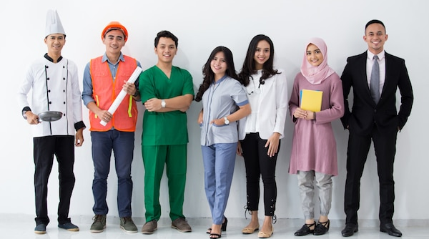
Work in pairs and answer these questions:
1.What jobs do you think will be popular in the future?
2.Do you think technology will affect the types of jobs in the future?
3.What skills will be important for future jobs?
4.Which job will be needed to help people in the future?

Slide 6
Suggested answer
1.What jobs do you think will be popular in the future?
I think jobs in technology like software developers, computer programmers, and cybersecurity experts will be very popular in the future.

Slide 7
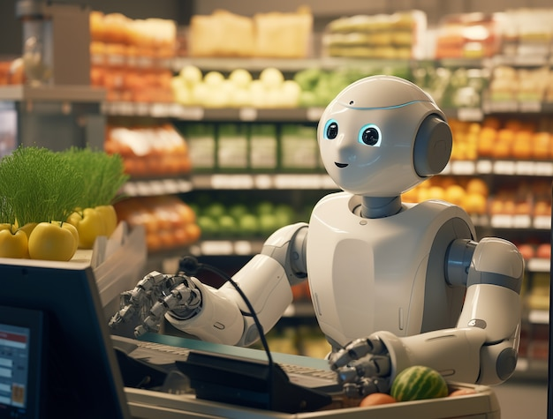
Suggested answer
2.Do you think technology will affect the types of jobs in the future?
Yes, technology will change popular jobs because many jobs will be automated. For example, cashiers and factory workers may be replaced by machines and robots.

Slide 8
Suggested answer
3.What skills will be important for future jobs?
Skills like critical thinking, problem-solving, and communication will be important.

Slide 9
Suggested answer
4.Which job will be needed to help people in the future?
I think healthcare jobs like nurses, doctors, and medical technicians will be in high demand in the future.

Slide 10
WRITING

Slide 11
Pre-writing

Slide 12
Study these examples
He prefers outdoor activities, especially hiking and cycling, on weekends.
She enjoys baking desserts, in particular cakes and cookies.

Slide 13
Work in groups and choose the correct words
She enjoys baking desserts, in particular cakes and cookies.
He prefers outdoor activities, especially hiking and cycling, on weekends.
To highlight important ideas and information from a wider group of information, you should use the following phrases: in particular, especially, and mainly. These phrases come (1)before / after the main group of information they are highlighting. They can also go (2) in the middle of / before / after a sentence. We separate them from the main sentence with (3)full stops / commas.

Slide 14
Task a. Read about highlighting important ideas and information, then read the article again and underline the different phrases used to highlight information.
Highlighting important ideas and information
To highlight important ideas and information from a wider group of information, you should use the following phrases: in particular, especially, and mainly. These phrases come after the main group of information they are highlighting. They can also go in the middle of a sentence. We separate them from the main sentence with commas.

Slide 15
Highlighting important ideas and information
in particular
We will need more video game designers, in particular virtual reality video game designers.
People will have more free time and have creative jobs, in particular musicians and artists, in the future.
especially
I really enjoy studying science, especially biology and chemistry, at school.
I believe some jobs, especially manual jobs, won't be popular someday.

Slide 16
Highlighting important ideas and information
mainly
I believe robots will do a lot of chores for us, mainly the dishes and laundry.
I think sports players, mainly soccer and tennis players, will make more money in the future

Slide 17
Task a. Read about highlighting important ideas and information, then read the article again and underline the different phrases used to highlight information.
Answer
The most popular jobs around the world may not always be so popular. Some jobs will become very important in the future, while others may stop all together. Here are three jobs that I think will be very popular in the future.

Slide 18
Task a. Read about highlighting important ideas and information, then read the article again and underline the different phrases used to highlight information.
Answer
One job that will become more popular is being an astronaut. I think we will want to travel to and explore faraway planets someday, in particular Mars. For this reason, we will need more astronauts.

Slide 19
Task a. Read about highlighting important ideas and information, then read the article again and underline the different phrases used to highlight information.
Answer
Another job that I believe will become more important is being a scientist. In my opinion, we will need new kinds of medicines and vaccines to protect people from new illnesses. Because of this, being a scientist, mainly a medical scientist, will become more popular.

Slide 20
Task a. Read about highlighting important ideas and information, then read the article again and underline the different phrases used to highlight information.
Answer
Virtual reality designers will also be a popular job.I believe we will spend a lot more time in virtual reality. We will do lots of things in it, especially practicing surgery, doing experiments, and having meetings. As a result, we will need more people to design these virtual spaces. The world is changing, and so are the jobs we need people to do. Young people should think about this when they plan their future careers.

Slide 21
Task b. Rewrite the sentences to highlight the important idea and information before the sentence using the prompts.
factory jobs – I think robots will do lots of jobs sooner or later. (especially)
______________________________________________________
______________________________________________________
2. heart surgery – I want to perform surgeries when I grow up. (in particular)
I think robots will do lots of jobs, especially factory jobs, sooner or later.

Slide 22
Task b. Rewrite the sentences to highlight the important idea and information before the sentence using the prompts.
3. young people – People should think about what jobs we need them to do in the future. (mainly)
4. expensive houses – I want to design houses in my future career. (in particular)
5. robots – Technology will become very important in our lives. (especially)

Slide 23
Task b. Rewrite the sentences to highlight the important idea and information before the sentence using the prompts.
Answer
2. heart surgery – I want to perform surgeries when I grow up. (in particular)
______________________________________________________
______________________________________________________
3. young people – People should think about what jobs we need them to do in the future. (mainly)
______________________________________________________
______________________________________________________
I want to perform surgeries, in particular heart surgery, when I grow up.
People, mainly young people, should think about what jobs we need them to do in the future.

Slide 24
Task b. Rewrite the sentences to highlight the important idea and information before the sentence using the prompts.
Answer
4. expensive houses – I want to design houses in my future career. (in particular)
______________________________________________________
______________________________________________________
5. robots – Technology will become very important in our lives. (especially)
______________________________________________________
______________________________________________________
I want to design houses, in particular expensive houses, in my future career.
Technology, especially robots, will become very important in our lives.

Slide 25
SPEAKING

Slide 26
Task a. In pairs: Discuss what jobs will be the most popular in the future and say why. Highlight specific examples for each of the reasons.

Slide 27
Suggested answer
I think being a musician will be very popular in the future.
Really? Why?
Robots will do many jobs, especially manual jobs. People will have more time for fun jobs
Ah, I see. Good idea.

Slide 28
Suggested answer
I think being a chef will be very popular in the future.
Really? Why?
Robots will take over many tasks, especially repetitive ones. People will want unique, creative dining experiences.
Ah, I see. That makes sense.

Slide 29
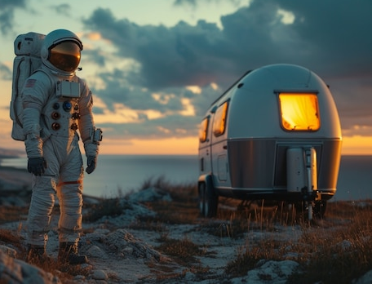
Suggested answer
I think being a space tourism guide will be very popular in the future.
Really? Why?
Space travel will become more accessible, especially for wealthy tourists, and they’ll need guides to help them navigate and enjoy their trips.
Ah, I see. That sounds amazing.

Slide 30
Task b. Choose the two jobs that you think will be most popular and complete the table. Note what point you think you should highlight.

Slide 31
Task b. Choose the two jobs that you think will be most popular and complete the table. Note what point you think you should highlight.
Suggested answer
Jobs | Reasons for being popular in the future | Points to highlight
Video game designer | Robots will do many household tasks, giving people more free time to relax and play video games. | especially around the house

Slide 32
Task b. Choose the two jobs that you think will be most popular and complete the table. Note what point you think you should highlight.
Suggested answer
Jobs | Reasons for being popular in the future | Points to highlight
Engineer | Technology will become increasingly important, requiring many engineers to design and fix new technology and equipment. | especially engineers for designing and fixing

Slide 33
While-writing

Slide 34
Now, write an article about the most popular jobs in the future. Use the Writing Skill box, the reading model, and your speaking notes to help you. Write 100 to 120 words.

Slide 35
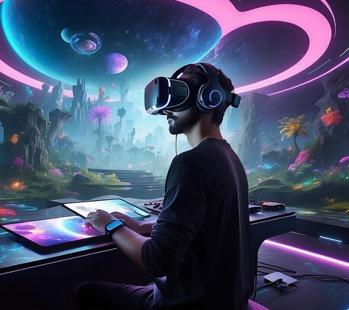
Sample answer
The world is changing, and so are the most popular jobs. Some jobs will be very popular in the future.
A job that will be popular in the future is being a video game designer. I believe that robots will do many things, especially around the house. People will have much more free time to relax and play video games, so designing games will be a popular job.

Slide 36
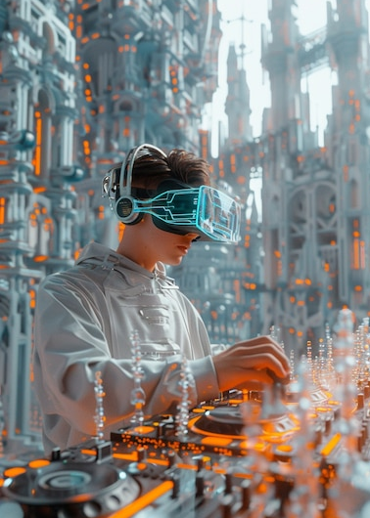
Sample answer
The next job is being an engineer. Technology will become more and more important in our lives. We will need lots of people, especially engineers, to help design and fix new technology and equipment.
The world will be different in the future, and so will the jobs we need people to do.

Slide 37
Extra
Practice-
Workbook
Presentation

Slide 38
Extra practice - WB - p.49. Rewrite the sentences to highlight the important idea and information before the sentence using the prompt.
cars and motorbikes – I want to fix vehicles when I grow up. (in particular).
______________________________________________________
______________________________________________________
2. manual jobs – I think robots will do lots of jobs in the future. (mainly)
I want to fix vehicles, in particular cars and motorbikes, when I grow up.

Slide 39
WB-p.49. Rewrite the sentences to highlight the important idea and information before the sentence using the prompt.
3. rock music – I want to play music for thousands of fans. (especially)
4. cooking and cleaning – I think robots will do chores for us in the future. (in particular)
5. biology – I enjoy studying science at school. (especially)

Slide 40
WB-p.49. Rewrite the sentences to highlight the important idea and information before the sentence using the prompt.
Answer
2. manual jobs – I think robots will do lots of jobs in the future. (mainly)
______________________________________________________
______________________________________________________
3. rock music – I want to play music for thousands of fans. (especially)
______________________________________________________
______________________________________________________
I think robots will do lots of jobs, mainly manual jobs, in the future.
I want to play music, especially rock music, for thousands of fans.

Slide 41
WB-p.49. Rewrite the sentences to highlight the important idea and information before the sentence using the prompt.
Answer
4. cooking and cleaning – I think robots will do chores for us in the future. (in particular)
______________________________________________________
______________________________________________________
5. biology – I enjoy studying science at school. (especially)
______________________________________________________
______________________________________________________
I think robots will do chores, in particular cooking and cleaning, for us in the future.
I enjoy studying science at school, especially biology.

Slide 42
WB-p.49. Choose two jobs you think will be popular in the future and complete the table. Note what point you think you should highlight.
Suggested answer
Jobs | Reasons for being popular in the future | Points to highlight
professional video game player | Because video games will be very popular in the future, more people will be able to do this for their jobs. | especially competitive video games

Slide 43
WB-p.49. Choose two jobs you think will be popular in the future and complete the table. Note what point you think you should highlight.
Suggested answer
Jobs | Reasons for being popular in the future | Points to highlight
astronauts | We will want to explore new planets and possibly live there, so, we'll need more astronauts. | especially Mars

Slide 44
WB - p49. Now, write an article about the most popular jobs in the future. Use the Writing Skill box, the reading model, and your planning notes to help you. Write 100 to 120 words.

Slide 45
WB-p.49. Sample answer
The most popular jobs will be different in the future. The world is changing, so we need people to do different jobs.
One job that I think will be popular is being a professional video game player. Video games, especially competitive video games, are going to be really popular in the future. Because of this, more people will be able to do this for their jobs.

Slide 46
WB-p.49. Sample answer
Another popular job will be astronauts. We will want to visit new planets, in particular Mars, in the future and maybe live on them. For this reason, we will need more astronauts.
We're going to need different jobs in the future, and people should think about that when they plan for their job.

Slide 47
Post writing

Slide 48
Swap the writing texts in pairs and check each other’s work according to the feedback form.

Slide 49
CONSOLIDATION

Slide 50
Ask and answer the question below with your partner about popular jobs in the future
How can people prepare for jobs in the future?

Slide 51
Suggested answer
Presentation
Production
To prepare for future jobs, people should focus on learning new skills, staying updated on industry trends, and being adaptable to changes in technology and work environments.

Slide 52
WRAP-UP

Slide 53
Today’s lesson
Speaking:
Talk about the most popular jobs in the future.
Writing:
Learn how to highlight important ideas and information
Write an article about the most popular jobs in the future.

Slide 54
Homework
Review vocabulary related to jobs.
Make sentences using the vocabulary in SB.
Prepare for the next lesson (Review 1 - Pages 111 & 112 - SB).
Play the consolidation games on www.eduhome.com.vn

Slide 55
Lesson 3
Stay positive and have a nice day!

