Slide 1
Unit 8: Jobs in the future
Lesson 2.3: Pronunciation & Speaking
Pages 80 & 81

Slide 2
Lesson Outline
Warm-up
Pronunciation
Speaking
Consolidation
Wrap-up

Slide 3
By the end of this lesson, students will be able to…
practice sound changes of ‘…can people...’ and ‘...in media...
practice discussing the future of jobs in entertainment and media.

Slide 4
WARM-UP

Slide 5
Work in pairs and answer these questions:
1. What types of movies will people want to see in the future?
2. What new TV shows will people be interested in?
3. How will social media platforms evolve in the coming years?
4. What new gadgets will become popular?

Slide 6
Suggested
answer
1.What types of movies will people want to see in the future?
People will want to see more sci-fi, action, and fantasy movies.

Slide 7
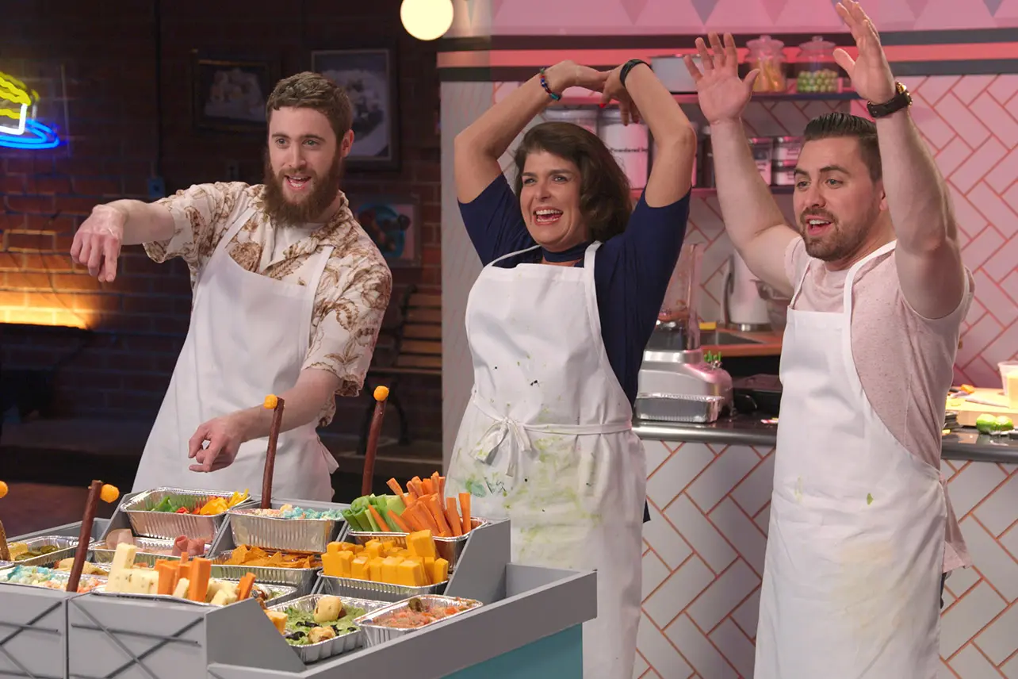
Suggested answer
2.What new TV shows will people be interested in?
People will be interested in reality shows, dramas, and sci-fi series.

Slide 8
Suggested answer
3.How will social media platforms evolve in the coming years?
Social media platforms will become more interactive and personalized.

Slide 9
Suggested answer
4.What new gadgets will become popular?
Smart glasses and advanced VR headsets will become popular.

Slide 10
Presentation
Presentation

Slide 11
Pronunciation

Slide 12
SB - p.80 - Task a.
NOTE

Slide 13
SB - p.80 - Task b:
Listen. Notice the sound changes of the underlined letters

Slide 14
SB - p.80 - Task c.
Listen and cross out the sentence that doesn't follow the note in Task a
1.In the future, what jobs can people expect to have?
2.I want to be a boss so I can make lots of money.

Slide 15
SB - p.80 - Task c.
Listen and cross out the sentence that doesn't follow the note in Task a.
ANSWERS
1.In the future, what jobs can people expect to have?
2.I want to be a boss so I can make lots of money.

Slide 16
SB - p.80 - Task d. Read the sentences with the sound changes noted in Task a. to a partner.
I want to be a boss so I can make lots of money.

Slide 17
Presentation
Practice

Slide 18
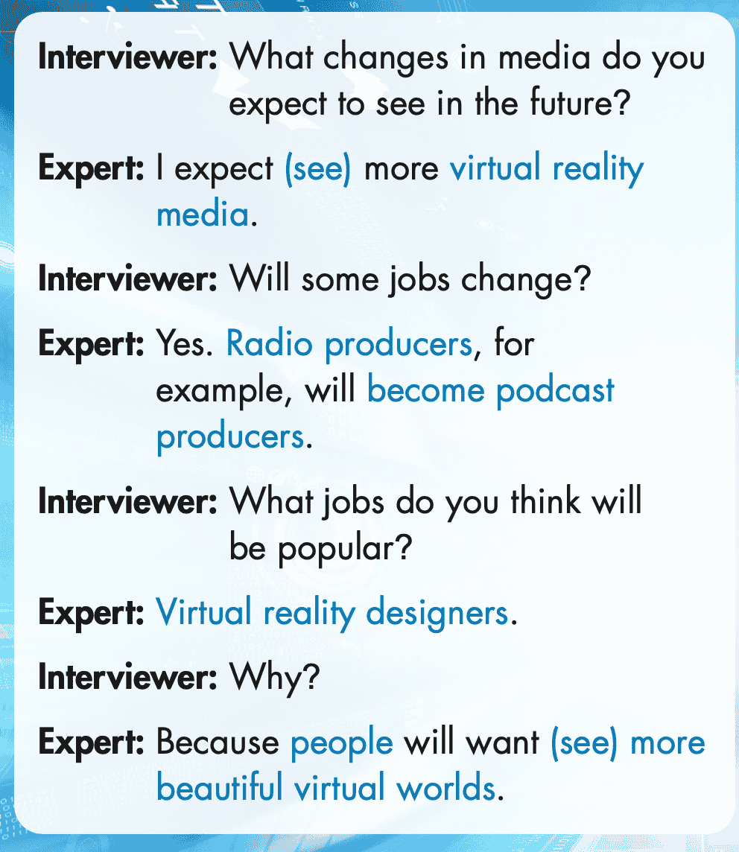
SB - p.81 - Task a. In pairs: Practice the conversation using the correct form of the verbs in brackets. Swap roles and repeat.

Slide 19
SB - p.81 - Task a. In pairs: Practice the conversation using the correct form of the verbs in brackets. Swap roles and repeat.
Expert: Yes. Radio producers, for
example, will become podcast producers.
Interviewer: What jobs do you think will be popular?
Expert: Virtual reality designers.
Interviewer: Why?
Expert: Because people will want to see more beautiful virtual worlds.
Interviewer: What changes in media do you expect to see in the future?
Expert: I expect to see more virtual reality media.
Interviewer: Will some jobs change?

Slide 20
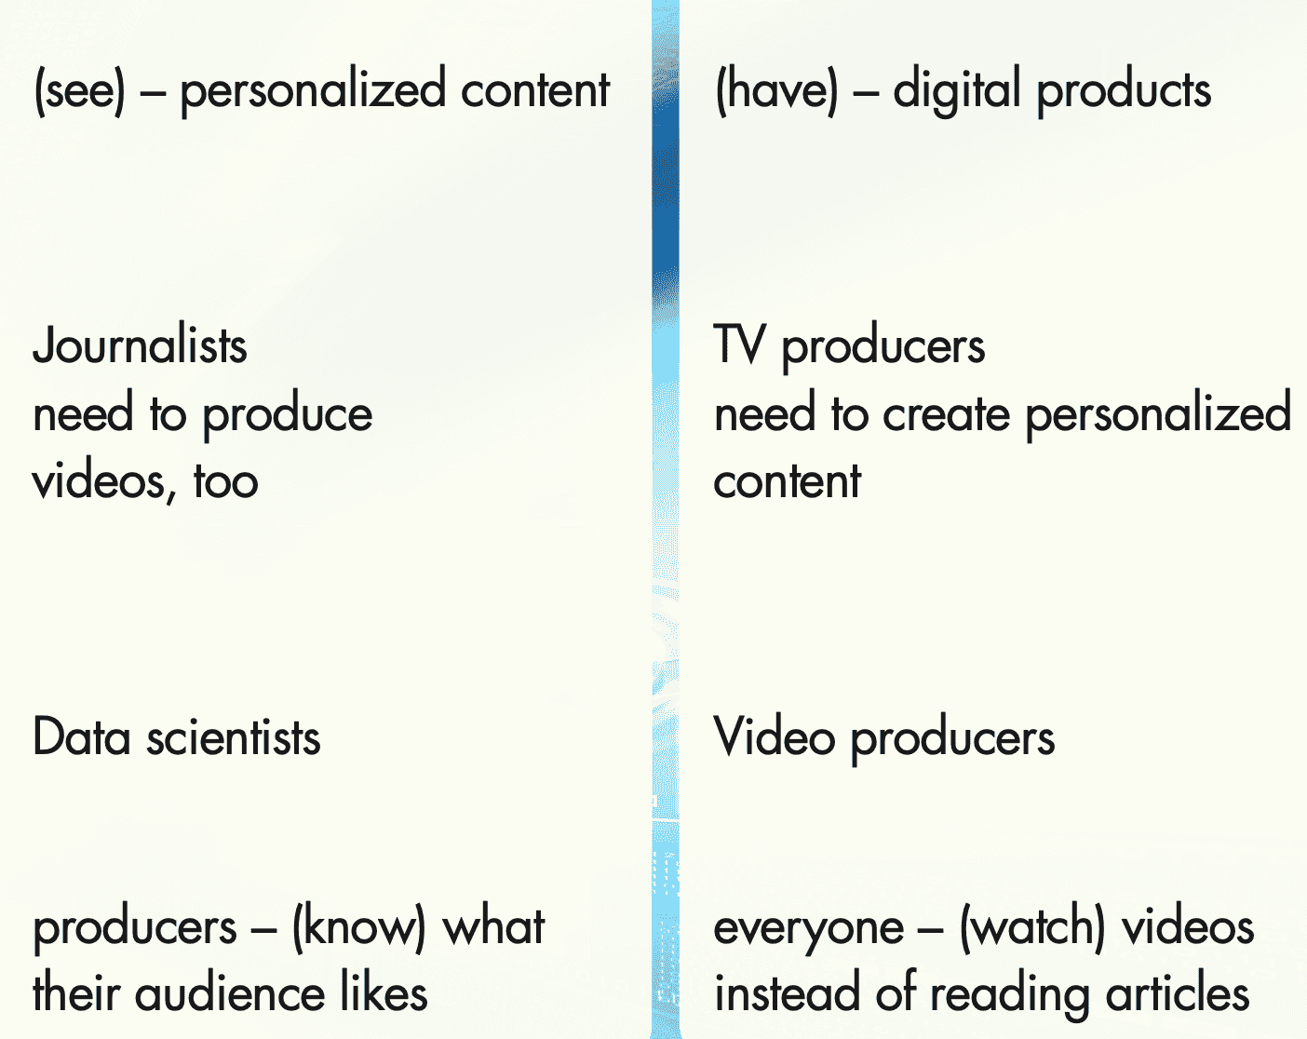
SB-p.81-Task b: Make two more conversations using the ideas on the right.

Slide 21
Task b: Make two more conversations using the ideas on the right.
Suggested answer- Conversation 1
Interviewer: What changes in media do you expect to see in the future?
Expert: I expect to see more personalized content.
Interviewer: Will some jobs change?
Expert: Yes. Journalists, for example, will need to produce videos, too.
Interviewer: What jobs do you think will be popular?
Expert: Data scientists.
Interviewer: Why?
Expert: Because producers will need to know what their audience likes.

Slide 22
Task b: Make two more conversations using the ideas on the right.
Interviewer: What changes in media do you expect to see in the future?
Expert: I expect to see more digital products.
Interviewer: Will some jobs change?
Expert: Yes. TV producers, for example, will need to create personalized content.
Suggested answer
Conversation 2
Interviewer: What jobs do you think will be popular?
Expert: Video producers.
Interviewer: Why?
Expert: Because everyone will be watching videos instead of reading articles.

Slide 23
Presentation
Production

Slide 24
SPEAKING

Slide 25
SB - p.81 - Task a. You're doing a podcast on the future of jobs in entertainment and media. Your listeners sent you a list of questions. In pairs: Discuss and answer the questions. Explain your ideas and give examples.

Slide 26
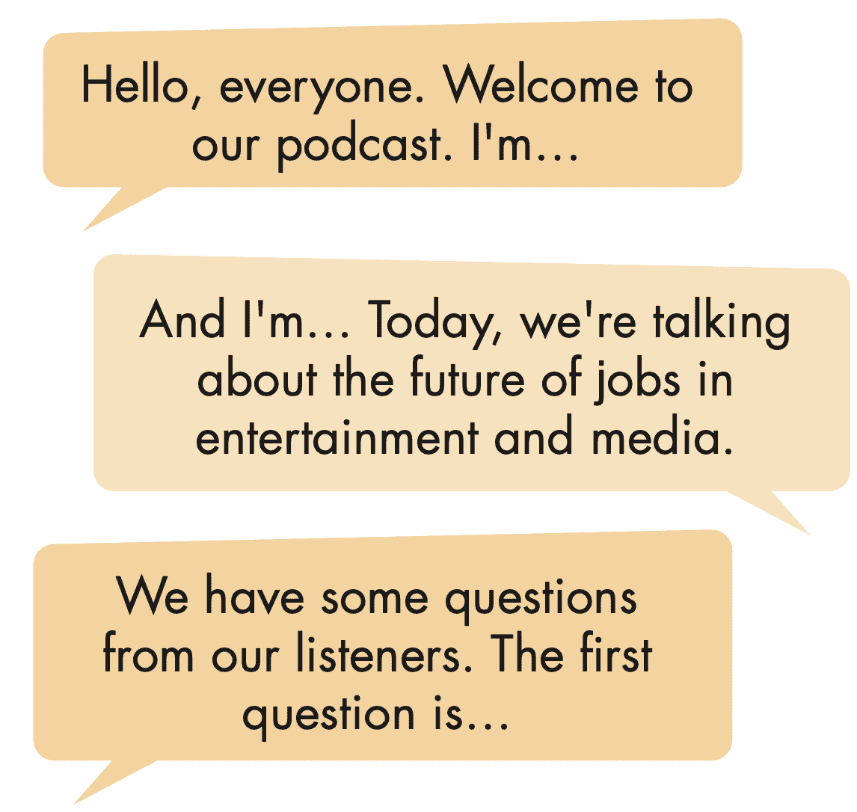
SB - p.81 - Task a. You're doing a podcast on the future of jobs in entertainment and media. Your listeners sent you a list of questions. In pairs: Discuss and answer the questions. Explain your ideas and give examples.

Slide 27
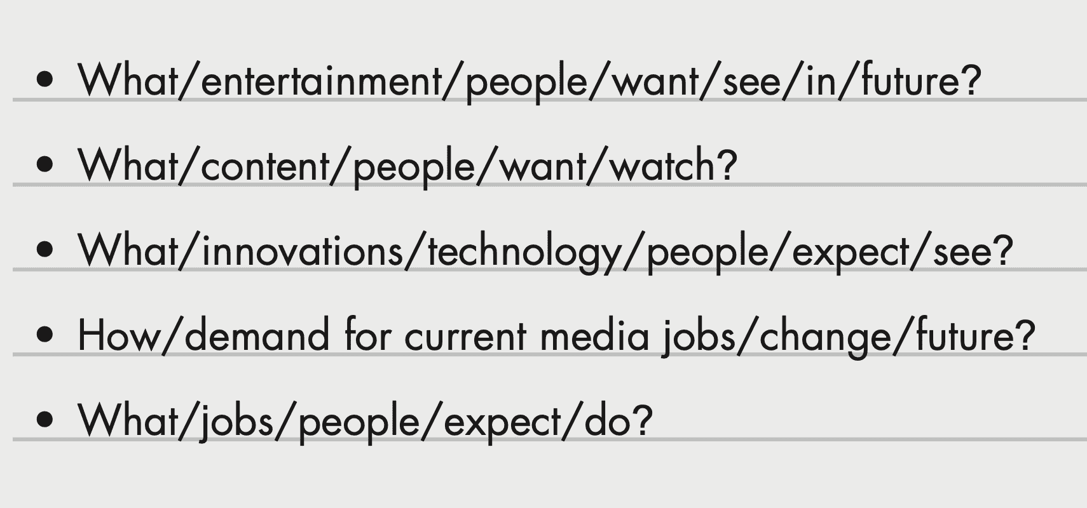
SB - p.81 - Task a. You're doing a podcast on the future of jobs in entertainment and media. Your listeners sent you a list of questions. In pairs: Discuss and answer the questions. Explain your ideas and give examples.

Slide 28
Task a.
Suggested answer
1.What entertainment will people want to see in the future?
People will want to see virtual reality entertainment such as VR movies and games in the future because it feels more real.

Slide 29
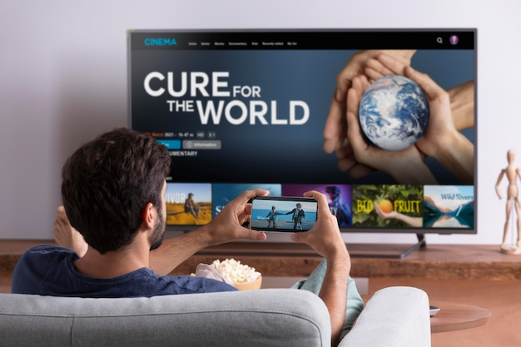
Task a.
Suggested answer
2.What content will people want to watch?
People will want to watch personalized content because it matches their interests. For instance, they may want to watch videos and shows they like.

Slide 30
Task a.
Suggested answer
4.How will the demand for current media jobs change in the future?
The demand for current media jobs will change because new technologies need new skills. For example, radio producers might become podcast producers.

Slide 31
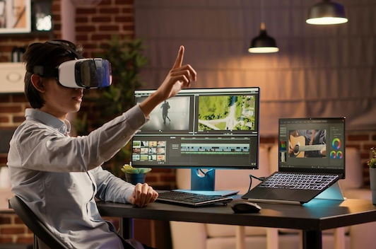
Task a.
Suggested answer
5.What jobs do people expect to do?
People expect to do jobs like data scientists and virtual reality designers because these roles are important for new media. For instance, they may like creating VR worlds or analyzing data for personalized content.

Slide 32
SB - p.81 - Task b. Join another pair. Do you have the same ideas?
Presentation
Production

Slide 33
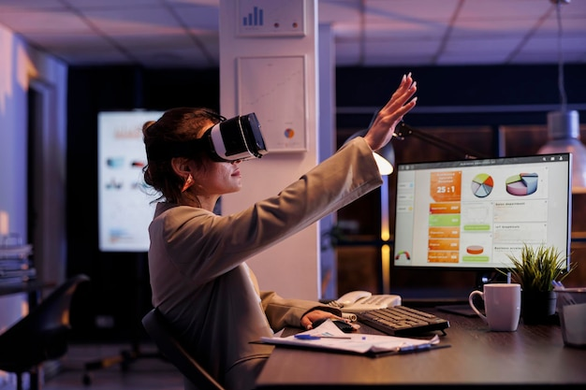
SB - p.81 - Task b. Join another pair. Do you have the same ideas?
Suggested answer
Presentation
Production
1.We think online media and virtual reality jobs will be popular.

Slide 34
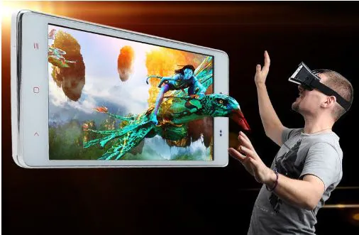
SB - p.81 - Task b. Join another pair. Do you have the same ideas?
Suggested answer
Presentation
Production
2.We think people will want to see more virtual reality entertainment because it feels more real.

Slide 35
SB - p.81 - Task b. Join another pair. Do you have the same ideas?
Suggested answer
Presentation
Production
3.We also think people will want to watch personalized content because it matches their interests.

Slide 36
Extra
Practice
Presentation

Slide 37
WB - p.47. Use verbs + to-infinitive to talk about the future of media. Write six sentences.

Slide 38
Sample answer
Presentation
Production
1. I want to watch virtual reality movies and TV shows.

Slide 39
Sample answer
Presentation
Production
2. I hope to read books that have sounds and videos.

Slide 40
Sample answer
Presentation
Production
3. I want to listen to podcasts that are personalized to me.

Slide 41
Sample answer
Presentation
Production
4. I expect to have more personalized content in everything.

Slide 42
Sample answer
Presentation
Production
5. I will aim to attend virtual events from my couch.

Slide 43
Sample answer
6. I expect to see movies and shows made by computers.

Slide 44
CONSOLIDATION

Slide 45
Ask and answer the question below with your partner
How will education methods change with technology advancements?

Slide 46
Suggested answer
Presentation
Production
I think education methods will become more interactive, personalized, and accessible through technology advancements.

Slide 47
WRAP-UP

Slide 48
Today’s lesson
Pronunciation:
practice sound changes of ‘…can people...’ and ‘...in media...
Speaking:
practice discussing the future of jobs in entertainment and media.

Slide 49
Homework
Practice sound changes of ‘…can people...’ and ‘...in media...
Prepare for the next lesson (Reading - page 82 - SB).
Play the consolidation games on www.eduhome.com.vn

Slide 50
Lesson 3
Stay positive and have a nice day!

