Slide 1
Unit 8: Jobs in the future
Lesson 1.2: Grammar
Pages 75 & 76

Slide 2
Lesson Outline
Warm-up
Presentation
Practice
Production
Consolidation
Wrap-up

Slide 3
By the end of this lesson, students will be able to…
Practice and use the first conditional with modals correctly
Talk about different jobs

Slide 4
WARM-UP

Slide 5
COMPETITION TIME:
Create groups/teams of 5 students.
You will be given incomplete sentences.
You have to complete the sentences with your ideas.
The team(s) with the most correct answers win(s).
Time limit: 5 minutes

Slide 6
Complete the sentences with your ideas
Example: If you feel sick, you should ..…….
Suggested answer : If you feel sick, you should see a doctor

Slide 7
Complete the sentences with your ideas
1.If you study hard, you can ..……
2.If you practice more, you could ..……
3. If it rains tomorrow, we might ……..
4.If you have time, you may ..……
5.If the weather is nice, we can ..……
6.If you save enough money, you might ..…

Slide 8
1.If you study hard, you can achieve your goals.
2.If you practice more, you could become an expert.
3.If it rains tomorrow, we might stay indoors.
4.If you have time, you may want to visit the museum.
5.If the weather is nice, we can go for a walk in the park.
6.If you save enough money, you might go on a vacation.
Suggested answers

Slide 9
Lead-in

Slide 10
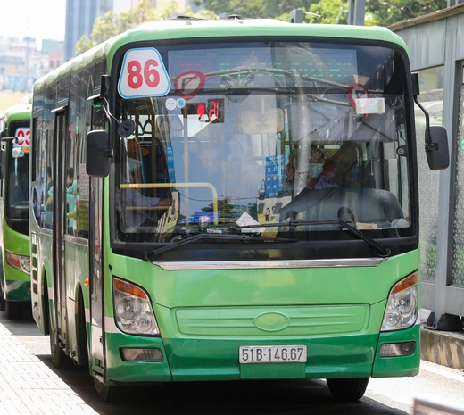
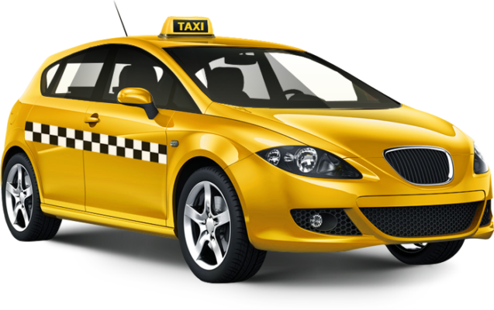
Shall we go by bus or taxi?
Study these examples
If we go by bus, the fare might be cheaper.
If we go by taxi, we can get there more quickly.

Slide 11
Work in groups and fill in the blanks
If we go by bus, the fare might be cheaper.
We can get there more quickly if we go by taxi.
We use the First Conditional to talk about the future situations we believe are real or possible.
Subject + modal + (1)_____________+ if + Present Simple
• When the sentence begins with if, we need to use a (2)_______.
If + Present Simple, subject + modal + (3)_____________
bare infinitive
comma
bare infinitive

Slide 12
Presentation

Slide 13
We use the First Conditional to talk about the future situations we believe are real or possible.
We normally use will in the main clause, but we can also use a modal verb (can, could, should, must, may, or might) for different purposes.
can: possibility or ability
could: suggestion
must: obligation
may/ might: possibility
should: advice
Presentation

Slide 14
Subject + modal + bare infinitive + if + Present Simple
You must study hard if you want to be a psychologist.
We might be able to help you if you need more information.

Slide 15
When the sentence begins with if, we need to use a comma.
If + Present Simple, subject + modal + bare infinitive
If you create an account, you can get a free lesson.
If you like exercise, you could join a sports team.

Slide 16
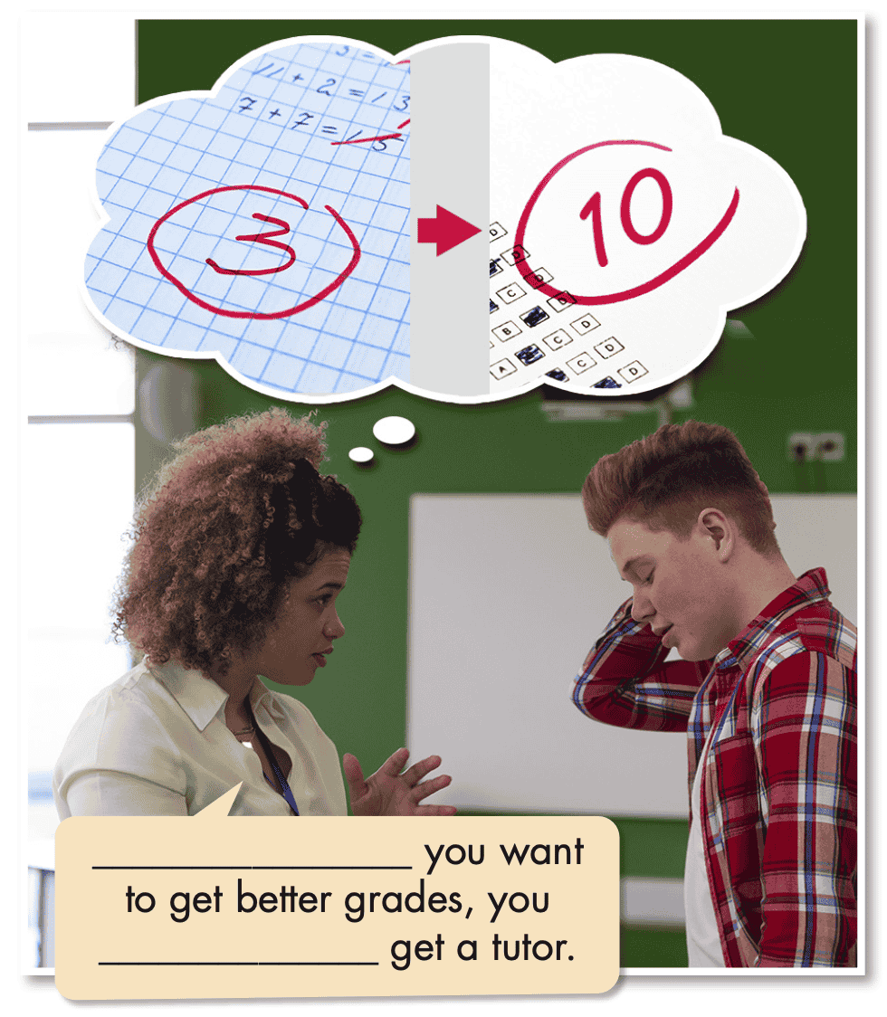
Task a. Read about First Conditional with modals with modals, then fill in the blanks.

Slide 17
Task b. Listen and check. Listen again and repeat.
If
should

Slide 18
Presentation
Practice

Slide 19
Task c. Unscramble the sentences.
1. to the gym/stronger./to get/start going/You could/if/you want ____________________________________________________
2. training/If/be an astronaut,/programs./she should find/she wants to
3. skincare specialists,/want to be/they/If/learn about/they should/face wash.
4. in school./You/video games too much/if/you want/to do well/shouldn't play some/them at
In the past, people would usually be home for family meals.

Slide 20
Task c. Unscramble the sentences.
5. get good grades/want to be/You must/a doctor./if you/in school
6. could find/If/good mechanic,/he wants/he/an apprenticeship./to be a
7. the library./if you/You might/look for/useful books/find some/them at

Slide 21
Task c. Unscramble the sentences.
Answers
2. training/If/be an astronaut,/programs./she should find/she wants to ___________________________________________________
___________________________________________________
3. skincare specialists,/want to be/they/If/learn about/they should/face wash. ___________________________________________________
___________________________________________________
If she wants to be an astronaut, she should find training programs.
If they want to be skincare specialists, they should learn about face wash.

Slide 22
Task c. Unscramble the sentences.
Answers
4. in school./You/video games too much/if/you want/to do well/shouldn't play ___________________________________________________
___________________________________________________
5. get good grades/want to be/You must/a doctor./if you/in school
___________________________________________________
___________________________________________________
You shouldn't play video games too much if you want to do well in school.
You must get good grades in school if you want to be a doctor.

Slide 23
Task c. Unscramble the sentences.
Answers
6. could find/If/good mechanic,/he wants/he/an apprenticeship./to be a
___________________________________________________
___________________________________________________
7. the library./if you/You might/look for/useful books/find some/them at
___________________________________________________
___________________________________________________
If he wants to be a good mechanic, he could find an apprenticeship.
You might find some useful books if you look for them at the library.

Slide 24
Task d. Read the sentences and write the correct modals in the gaps.
1. Suggestion: If you want to be a doctor, you _______read some books about biology.
2. Advice: You __________ stay up late if you want to get good grades.
3. Advice: If you want to be an engineer, you __________ talk to your teacher.
could

Slide 25
Task d. Read the sentences and write the correct modals in the gaps.
4. Possibility: You __________ find some great information in the library if you need to do some research.
5. Obligation: If you want to be a psychologist, you __________ get good grades and try really hard.
6. Possibility: I think you __________ get an apprenticeship in town if you want to be a plumber.

Slide 26
Task d. Read the sentences and write the correct modals in the gaps.
Answers
1. Suggestion: If you want to be a doctor, you _____read some books about biology.
2. Advice: You __________ stay up late if you want to get good grades.
3. Advice: If you want to be an engineer, you __________ talk to your teacher.
could
shouldn't
should

Slide 27
Task d. Read the sentences and write the correct modals in the gaps.
Answers
4. Possibility: You ________________ find some great information in the library if you need to do some research.
5. Obligation: If you want to be a psychologist, you __________ get good grades and try really hard.
6. Possibility: I think you ________________ get an apprenticeship in town if you want to be a plumber.
can/may/might
must
can/may/might

Slide 28
Extra
Practice
Workbook
Presentation

Slide 29
WB - p.45 - Task a. Unscramble the sentences.
1. to get better,/start practicing./If you want/you should
2. to play basketball./if you want/join a team/You could
3. you should/to be a doctor,/If you want/find a/good university
4. you might/If you/a plumbing apprenticeship,/in town./want to look/want to find
5. many video games/well at school./if you want/You shouldn't/play too/to do
Presentation
Production

Slide 30
WB - p.45 - Task a. Unscramble the sentences.
Answers
to get better,/start practicing./If you want/you should
___________________________________________________
2. to play basketball./if you want/join a team/You could ___________________________________________________
3. you should/to be a doctor,/If you want/find a/good university
___________________________________________________
If you want to get better, you should start practicing.
You could join a team if you want to play basketball.
If you want to be a doctor, you should find a good university.

Slide 31
WB - p.45 - Task a. Unscramble the sentences.
Answers
4. you might/If you/a plumbing apprenticeship,/in town./want to look/want to find ___________________________________________________
___________________________________________________
5. many video games/well at school./if you want/You shouldn't/play too/to do
___________________________________________________
___________________________________________________
If you want to find a plumbing apprenticeship, you might want to look in town.
You shouldn't play too many video games if you want
to do well at school.

Slide 32
WB - p.45 - Task b. Write sentences using the prompts.
1. if/doctor – should/get a biology tutor
2. could/watch movies and take notes – if/director
3. if/actor – may/want to take acting lessons
4. shouldn't/skip classes – if/get good grades
5. if/mechanic – could/start researching good apprenticeships
6. must/do a course or go to university – if/psychologist
Presentation
Production

Slide 33
WB - p.45 - Task b. Write sentences using the prompts.
Answers
if/doctor – should/get a biology tutor
___________________________________________________
2. could/watch movies and take notes – if/director ______________________________________________________
3. if/actor – may/want to take acting lessons
___________________________________________________
If you want to be a doctor, you should get a biology tutor.
You could watch movies and take notes if you want to be a director.
If you want to be an actor, you may want to take acting lessons.

Slide 34
WB - p.45 - Task b. Write sentences using the prompts.
Answers
4. shouldn't/skip classes – if/get good grades
___________________________________________________
5. if/mechanic – could/start researching good apprenticeships ___________________________________________________
___________________________________________________
6. must/do a course or go to university – if/psychologist ___________________________________________________
___________________________________________________
You shouldn't skip classes if you want to get good grades.
If you want to be a mechanic, you could start researching good apprenticeships.
You must do a course or go to university if you want to be a psychologist.

Slide 35
Presentation
Production

Slide 36
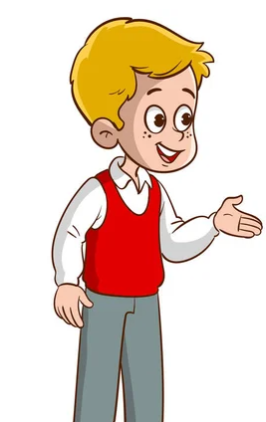
Task e. In pairs: Discuss the different jobs below using modals with if and the prompts
• doctor • director
• singer • fashion designer
• soccer player • veterinarian
• get a science/biology/art tutor
• practice singing/drawing/running
• join a club/start a blog/take part in a contest

Slide 37
Suggested answer
Presentation
Production
1. If you want to be a doctor, you might need a biology tutor.

Slide 38
Suggested answer
Presentation
Production
2. You should practice singing if you want to be a singer.

Slide 39
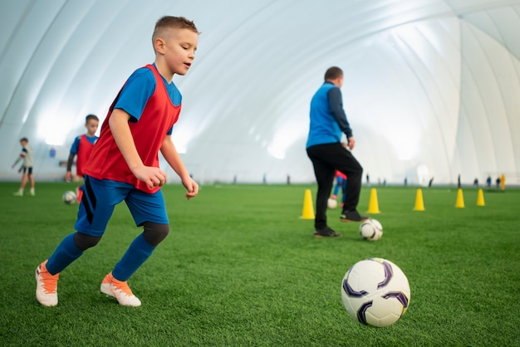
Suggested answer
Presentation
Production
3. If you want to be a soccer player, you could join a club.

Slide 40
Suggested answer
Presentation
Production
4. You could take part in a contest if you want to be a director.

Slide 41
Suggested answer
Presentation
Production
5. If you want to be a fashion designer, you should practice drawing.

Slide 42
Suggested answer
Presentation
Production
6. You could get a science tutor if you look for them at
the library.

Slide 43
CONSOLIDATION

Slide 44
Ask and answer the question below with your partner, using the first conditional with modals.
What should I do if I want to get good grades?

Slide 45
Suggested answer
Presentation
Production
If you want to get good grades, you should study regularly, pay attention in class and complete assignments on time.

Slide 46
WRAP-UP

Slide 47
Today’s lesson
Grammar:
Practice and use the first conditional with modals correctly
Speaking:
Talk about different jobs

Slide 48
Homework
Review the first conditional with modals
Make sentences using the first conditional with modals
Prepare for the next lesson (Pronunciation & Speaking - pages 76 & 77 - SB).
Play the consolidation games on www.eduhome.com.vn

Slide 49
Lesson 3
Stay positive and have a nice day!

