Slide 1
Unit 7: Urban life
Review: Grammar, Conversation, Pronunciation, Speaking, Writing
Pages 109 - 110

Slide 2
Lesson Outline
Warm-up
Grammar
Pronunciation
Speaking
Writing
Wrap-up

Slide 3
By the end of this lesson, students will be able to…
- use adverbial clauses/phrases of reason and result.
- improve word stress and /æ/ &
/dʒ/ sounds.
- talk about problems in a city, future results, and solutions.
- write problem and solution paragraphs.

Slide 4
WARM-UP

Slide 5
Game Time: Pass the ball and say one problem in a city.
- When the teacher plays the music, pass the ball nicely to your classmate.
- When the music stops, who is keeping the ball says one problem in a city.

Slide 6
GRAMMAR

Slide 7
Review: adverbial clauses of result
adverbial clauses/phrases of reason
FORM: S + V + SO + adj/adv + THAT + S + V (+ Object)
S + V + SUCH + noun/noun phrase + THAT + S + V (+ Object)
USE: we can use adverbial clauses of result to show the result of an action or situation.

Slide 8
FORM: Main clause + as/since/because+ clause.
USE: These clauses and phrases explain why something happens.
As/Since/Because + clause, main clause.
Note: There’s a comma (,) between 2 clauses.
Main clause + because of + noun phrase.

Slide 9
Identify clauses of result and clauses/phrases of reason
Example:
1. We’re polluting so many rivers that there won’t be any fish left in ten years.
a clause of reason
a clause of result
any fish left in ten years
There won’t be ________________________ _________________________________________________.
because we’re polluting so many rivers

Slide 10
Identify clauses of result and clauses/phrases of reason
Example:
2. I am not going to study abroad because of high tuition.
a clause of result
a phrase of reason
so high
that I am not going to study abroad
The tuition is ______________________________________________.

Slide 11
Finish each of the sentences so they have the same meaning as the sentence before it.
2. The old bridge was causing so many traffic jams that the government built a new one. The government built _______________________________________ ________________________________________________________. 3. The government banned karaoke singing after 10 p.m. because of the noise. Karaoke singing was ________________________________________ ________________________________________________________.
a new bridge because the old one was
causing so many traffic jams
making so much noise that the
government banned it after 10 p.m.

Slide 12
4. The population is rising so quickly that they'll have to build 50 new apartment buildings by 2030. They'll have to ____________________________________________ ________________________________________________________. 5. There won't be any tourists in ten years because pollution is getting so bad. Pollution is _______________________________________________ ________________________________________________________.
build 50 new apartment buildings by 2023
because the population is rising so quickly
getting so bad that there won’t be any tourists
in ten years

Slide 13
6. The city built lots of new crosswalks because there were so many problems. There were ______________________________________________ ________________________________________________________. 7. People were throwing away so much trash that the government banned plastic bags. The government __________________________________________ ________________________________________________________.
so many problems that the city build lots of
new cross walks
banned plastic bags because people were
throwing away so much trash

Slide 14
8. People had a hard time finding houses because the population increased so quickly. The population increased ___________________________________ ________________________________________________________.
so quickly that people had a hard
time finding houses

Slide 15
Choose the correct answer (A, B, C, or D).
1. Brian: "What problem did the government solve recently?" Susan: "People _________ so much that the government added more trash cans in the streets." A. was littering B. littering C. litters D. were littering
Note: in the questions: simple past tense
in the answer: plural subject

Slide 16
Choose the correct answer (A, B, C, or D).
2. Trang: "We are damaging _________________ that we won't be able to grow crops." Mark: "Yes. We need to do something to stop it." A. so land B. so many land
C. so much land D. much land
Note: adverbial clauses of result: So + noun phrase + that + S + V + O
many + plural noun / much + uncountable noun

Slide 17
Choose the correct answer (A, B, C, or D).
3. Sarah: "Was life hard when you looked for work for a long time, Gary?" Gary: "Yes. _________________." A. It was homeless B. My job banned me
C. I struggled a lot D. I encouraged them

Slide 18
Choose the correct answer (A, B, C, or D).
4. Charlie: "What happened when the population increased?" Lương: "The population increased so __________________ that many people couldn't find houses." A. many B. quickly C. direct D. congested
Note: Adverbial clauses of result: S + V+ so + adv + that + S + V + O

Slide 19
PRONUNCIATION

Slide 20
a. Circle the word that differs from the other three in the position of primary stress in each of the following questions.
1. A. traffic B. struggle C. direct D. homeless
/ˈtræfɪk/ /ˈstrʌɡl/ /daɪˈrekt/ /ˈhoʊmləs/
2. A. criminal B. congested C. accident D. government
/ˈkrɪmənl/ /kənˈdʒestɪd/ /ˈæksədənt/ /ˈgʌvənmənt/

Slide 21
b. Circle the word that has the underlined part pronounced differently from the others.
1. A. pedestrian B. ban C. accident D. traffic jam
/pəˈdæstriən/ / bæn/ /ˈæksədənt/ /ˈtræfɪk dʒæm/
2. A. encourage B. government C. congested D. damage
/ɪnˈkɜːrɪdʒ / /ˈgʌvənmənt/ /kənˈdʒestɪd/ / ˈdæmɪdʒ/

Slide 22
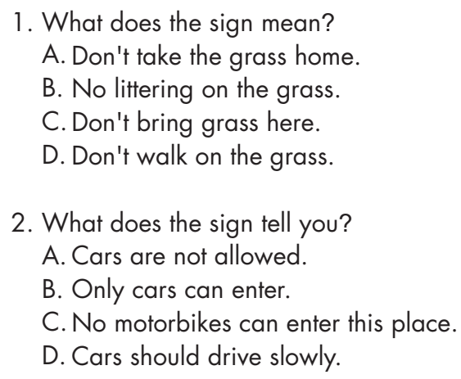
Look at the signs. Choose the best answers.

Slide 23
SPEAKING

Slide 24
In pairs: Talk about some problems in your town/city and the result of each problem. What are some solutions for each problem?
- Work with a partner.
- Discuss problems in your town/city, the result of each problem, and some solutions to each problem.
- Share your discussions with the class.

Slide 25
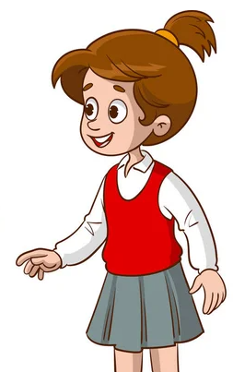
Suggested answer:
Okay, let’s start. One of the biggest problems in our town is traffic jams. It causes delays and accidents.
Definitely. Pollution levels have increased too because of all the vehicles stuck in traffic.
That’s true. So, what do you think could be a solution to this problem?

Slide 26
Well, encouraging people to use public transportation could help. It could reduce the number of cars on the road.
I agree. More people riding bikes could help too. But there should be bike lanes to ensure the safety of cyclists.
That’s right.

Slide 27
Share your ideas with the class.
Okay, let’s start. ……………
………………….

Slide 28
WRITING

Slide 29
Review: How to write a problem and solution paragraph.

Slide 30
Write about two problems your town or city has and suggest potential solutions. Write 100 to 120 words.

Slide 31
CONSOLIDATION

Slide 32
WRAP-UP

Slide 33
Today’s lesson
Grammar: Reviewing
Adverbial clauses of result.
Adverbial clauses/phrases or reason.
Pronunciation: Reviewing
/æ/ and /dʒ/ sounds .
word stress.

Slide 34
Today’s lesson
Speaking: Talking about some problems in your town/city, the results and solutions to each problem.
Writing:
Reviewing how to write a problem and solution paragraph.
Practicing writing about two problems your town or city has and suggest potential solutions.

Slide 35
Homework
Review Grammar points and writing skills.
Prepare for the next lesson (Unit 8: Vocabulary & Listening – pages 74 & 75 - SB)
Play the consolidation games on www.eduhome.com.vn

Slide 36
Lesson 3
Stay positive and have a nice day!

