Slide 1
Unit 7: Urban life
Lesson 3.1: Reading
Page 72

Slide 2
Lesson Outline
Warm-up
Reading
Listening
Consolidation
Wrap-up

Slide 3
By the end of this lesson, students will be able to…
- practice reading for the main idea and details.
- practice listening for the main idea and specific information.

Slide 4
WARM-UP

Slide 6
Suggested answers:
Some of the good things about living in a city:
lots of entertainment and recreational activities such as cinemas, theaters, museums, parks, etc.
Enjoying various food and drinks
Having good healthcare services
Good education: Many universities, colleges, English centers
Easy to find part-time jobs

Slide 7
Suggested answers:
Some of the bad things about living in a city:
Noise pollution, air pollution
Traffic jams
High cost of living
Social concerns: crime, accidents
Stressful, busy lifestyle

Slide 9
Pre-reading

Slide 10
Pre-reading
Read and find the synonym words in the paragraphs.
Par 1: possible
Par 2: offenders
Par 2: fail/fall apart
Par 4: health-related
Par 5: carry out

Slide 11
Pre-reading
Identify the part of speech (noun, verb, adj, adv, etc.)
Par 1: possible
Par 2: offenders
Par 2: fail/fall apart
Par 4: health-related
Par 5: carry out
adj
noun
verb
adj
verb

Slide 12
Pre-reading
Answers:
Par 1: possible
Par 2: offenders
Par 2: fail/fall apart
Par 4: health-related
Par 5: carry out
adj
potential
noun
criminals
verb
break down
adj
medical
verb
implement

Slide 13
While-reading

Slide 14
While-reading
a. Read the passage about the city of Johannesburg and choose the best title.
How the City is Improving
The Perfect City
How Can We Fix the City

Slide 15
Pre-reading
Skim the first paragraph to find the main topic.
I believe all humans have the right to live in a safe and clean place. However, most cities today have many problems that need solutions. Johannesburg, South Africa, is one of these cities. I will explain some of its problems and potential solutions below.
➔ Johannesburg’s problems and solutions

Slide 16
Pre - reading
Skim the other paragraphs to find problems and solutions mentioned in the first paragraph.
A big problem is that crime is high in the city. There are so many criminals that life for normal people is beginning to break down. They may move away from the city. For this reason, the government should provide more police officers on the street.
Another problem is that the population is rising quickly. It might make more people homeless. Having more homeless people can cause many problems. The government should build more apartments around the city.

Slide 17
Pre - reading
Skim the other paragraphs to find problems and solutions mentioned in the first paragraph.
The final problem is that air pollution is getting worse. Because of this, more people will need medical help. This could make hospitals very busy. To improve this, the government should ask people to ride bicycles more and use cars less.
Johannesburg’s problems
its solutions

Slide 18
Pre-reading
Skim the last paragraph which restates the topic in the first paragraph and/or main ideas in other paragraphs.
To conclude, the number of criminals, the population growth, and air pollution are problems in Johannesburg. However, there are solutions the government can implement. They should train more police officers, build more apartments, and ask people to ride bicycles instead of using cars.
Johannesburg’s problems
its solutions

Slide 19
While-reading
a. Read the passage about the city of Johannesburg and choose the best title.
How the City is Improving
The Perfect City
How Can We Fix the City

Slide 20
Pre-reading
Read and underline the key words.
1. The word They in paragraph 2 refers to _______________. A. cities B. people living in Johannesburg
C. criminals D. the government 2. What does the writer say people may not be able to do because of criminals? A. move away B. live normal lives
C. rob people D. raise children safely

Slide 21
3. Which of the following is true about Johannesburg? A. There won't be enough homes for people in the future. B. There aren't enough jobs for people. C. Johannesburg doesn't have any homeless people anymore. D. There aren't many apartment buildings in Johannesburg now. 4. Which of the following is NOT true according to paragraph 4? A. Air pollution isn't so bad in Johannesburg right now. B. Encouraging people to ride bicycles more would help. C. People will get sick if things continue. D. Air pollution is getting worse in Johannesburg.

Slide 22
5. Which of the following can you infer from the passage? A. Johannesburg will improve by itself.
B. Johannesburg is becoming a nice place to live. C. The government are making a lot of improvements.
D. The government has a lot of work to do.

Slide 23
While-reading
b. Now, read and choose the correct answers.
1. The word They in paragraph 2 refers to ___________.
cities B. people living in Johannesburg
C. criminals D. the government
A big problem is that crime is high in the city. There are so many criminals that life for normal people is beginning to break down. They may move away from the city.

Slide 24
While-reading
b. Now, read and choose the correct answers.
2. What does the writer say people may not be able to do because of criminals?
move away B. live normal lives
C. rob people D. raise children safely
A big problem is that crime is high in the city. There are so many criminals that life for normal people is beginning to break down. They may move away from the city.

Slide 25
While - reading
b. Now, read and choose the correct answers.
3. Which of the following is true about Johannesburg? A. There won't be enough homes for people in the future. B. There aren't enough jobs for people. C. Johannesburg doesn't have any homeless people anymore. D. There aren't many apartment buildings in Johannesburg now.
Another problem is that the population is rising quickly. It might make more people homeless. Having more homeless people can cause many problems.

Slide 26
4. Which of the following is NOT true according to paragraph 4? A. Air pollution isn't so bad in Johannesburg right now. B. Encouraging people to ride bicycles more would help. C. People will get sick if things continue. D. Air pollution is getting worse in Johannesburg.
The final problem is that air pollution is getting worse. Because of this, more people will need medical help. This could make hospitals very busy. To improve this, the government should ask people to ride bicycles more and use cars less.

Slide 27
5. Which of the following can you infer from the passage? A. Johannesburg will improve by itself.
B. Johannesburg is becoming a nice place to live. C. The government are making a lot of improvements.
D. The government has a lot of work to do.
Par.5: However, there are solutions the government can implement. They should train more police officers, build more apartments, and ask people to ride bicycles instead of using cars.

Slide 28
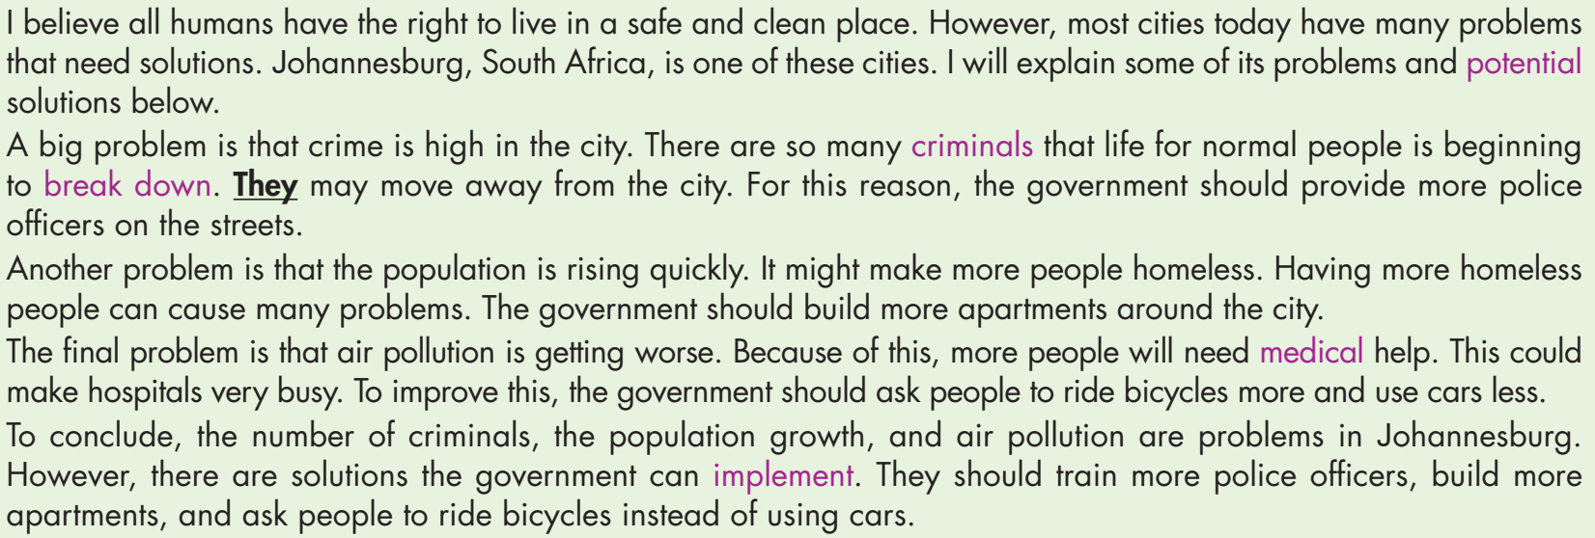
While-reading
c. Listen and read.

Slide 29
Post-reading

Slide 30
Post-reading
d. In pairs: Which problem do you think is the worst? Why? What other solutions to the problem can you think of?
I think air pollution is the worst because more people need medical help. This could overwhelm hospitals and cause a lack of healthcare resources. To improve this, we have to plant trees and create green spaces. Encouraging people to use renewable energy sources or reduce energy consumption could also help.

Slide 32
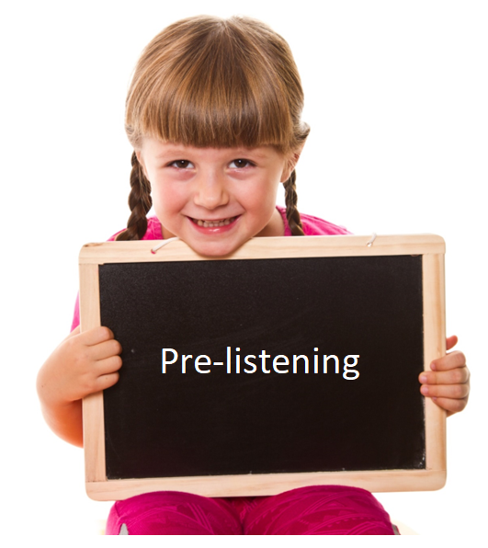
Pre-reading

Slide 33
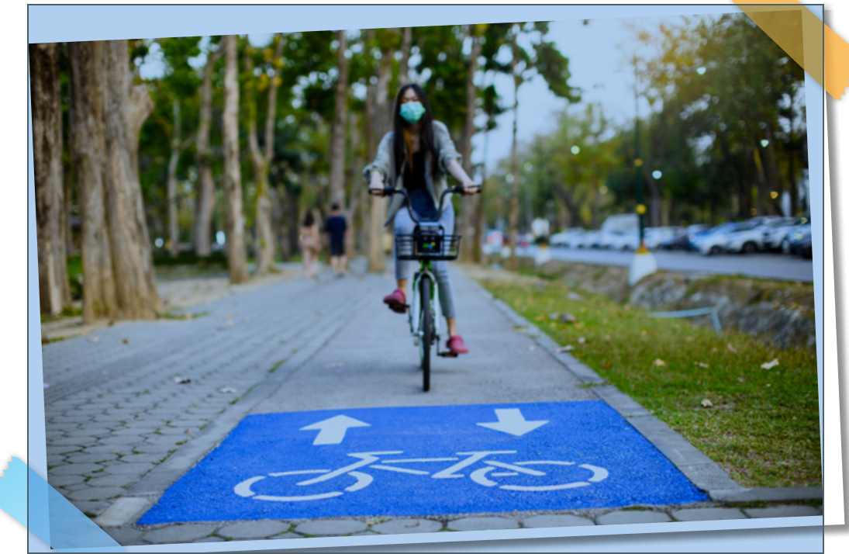
Pre-listening
WB-P42
Look at the picture. Predict how the principal helps Jenny.
1. He buys her a new bicycle.
2. He lets her use his daughter’s bicycle.

Slide 34
Pre-listening
WB-P42
a. Listen to the conversation between Jenny and her school principle. How does the principal help Jenny?
He buys her a new bicycle.
He lets her use his daughter’s bicycle.

Slide 35
While-listening
a. Listen to the conversation between Jenny and her school principle. How does the principal help Jenny?
He buys her a new bicycle.
He lets her use his daughter’s bicycle.
Mr. Lê: Actually, I have an extra bicycle at home because my daughter went to university. Would you like to use hers until you can buy one? Jenny: Yes, please. Thank you! Mr. Lê: No problem. I'll bring it to school tomorrow. Then, you can cycle to school on Monday.

Slide 36
While-listening

Slide 37
Pre-listening
Read the statements and guess what type of words are missing. Are they verbs?/ nouns? / adjectives? etc.?
1. Jenny had to ____________ to school. 2. Jenny was late for school because her mom's car ____________. 3. Mr. Lê says Jenny should think about ____________. 4. The government is going to implement new bike ____________. 5. Jenny can start cycling to school on ____________.

Slide 38
Pre-listening
Read the statements and guess what type of words are missing. Are they verbs?/ nouns? / adjectives? etc.?
1. Jenny had to ____________ to school. 2. Jenny was late for school because her mom's car ____________. 3. Mr. Lê says Jenny should think about ____________. 4. The government is going to implement new bike ____________. 5. Jenny can start cycling to school on ____________.
Verb
Verb
V-ing
Noun
Noun

Slide 39
While-listening
b. Now listen and fill in the blanks.
run
1. Jenny had to ____________ to school
broke down
2. Jenny was late for school because her mom's car ____________.
cycling to school
3. Mr. Lê says Jenny should think about _________________
lanes
4. The government is going to implement new bike ____________.
Monday
5. Jenny can start cycling to school on ____________.

Slide 40
Script:
Mr. Lê: Good morning, Jenny. Jenny: Good morning, Mr. Lê. I'm sorry I'm late. I had to run to school. Mr. Lê: You don't look well. Do you need any help? Jenny: I'm fine, thank you. My mom's car broke down. Mr. Lê: I'm sorry to hear that, but please be on time. Jenny: Yes, Mr. Lê. Mr. Lê: You should think about cycling to school. It's good for you, and you might get to school faster.

Slide 41
Jenny: That's a great idea. However, it's quite dangerous to cycle on the city roads. Mr. Lê: Well, the government is just about to implement new bike lanes around the city. They will open on Monday. Jenny: Oh, really? That's great. But there's another problem. I don't have a bicycle. I'll need to save money to buy one. Mr. Lê: Actually, I have an extra bicycle at home because my daughter went to university. Would you like to use hers until you can buy one?

Slide 42
Jenny: Yes, please. Thank you! Mr. Lê: No problem. I'll bring it to school tomorrow. Then, you can cycle to school on Monday. Jenny: Thanks! Have a great day, Mr. Lê. Mr. Lê: Now, off to class, please!

Slide 43
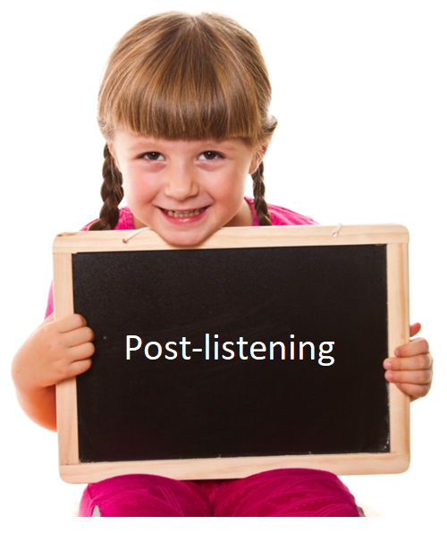
Post-reading

Slide 44
Post-listening
In pairs: Do you cycle to school? Why?/Why not?
I don’t cycle to school because it’s quite dangerous to cycle on the city roads.

Slide 45
CONSOLIDATION

Slide 46
WRAP-UP

Slide 47
Today’s lesson
Reading:
- Reading for the main idea and specific information
Listening:
- Listening for the main idea and specific information.

Slide 48
Homework
Do Reading in WB page 42
Prepare for the next lesson (Writing & Speaking – page 73 - SB)
Play the consolidation games on www.eduhome.com.vn

Slide 49
Lesson 3
Stay positive and have a nice day!

