Slide 1
Unit 7: Urban life
Lesson 2.1: Vocab & Listening
Pages 68 & 69

Slide 2
Lesson Outline
Warm-up
Vocabulary
Listening
Consolidation
Wrap-up

Slide 3
By the end of this lesson, students will be able to…
use new words to describe problems in cities and their future impacts
listen for the main idea and specific information.

Slide 4
WARM-UP

Slide 6
Suggested answers:
1. Buildings or flats are under construction because population in cities is rising.
2. There are many vehicles driving through the crosswalk because there is no traffic light. The police officer is helping a student cross the road at the crosswalk.
3. The river will be polluted with trash such as plastic bottles and face masks, and someone is helping to collect them.

Slide 8
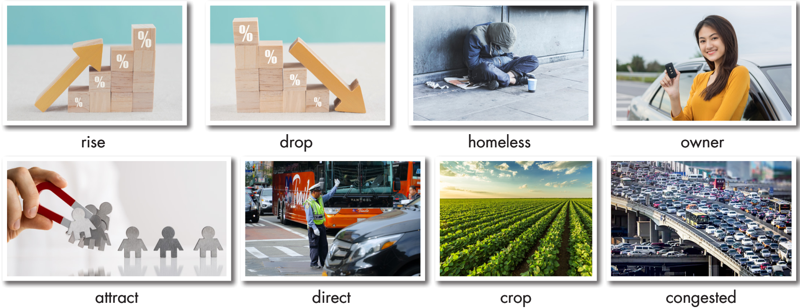
a. Look at the pictures and fill in the blanks.

Slide 9
a. Look at the pictures and fill in the blanks.
Listen and check.
1. ___________: a plant that farmers grow for food 2. ___________: become a lower amount or number 3. ___________: crowded or full of traffic 4. ___________: someone who owns something 5. ___________: having no home and living on the streets
crop
drop
congested
owner
homeless

Slide 10
a. Look at the pictures and fill in the blanks.
Listen and check.
6. _________: make someone come somewhere or take part in something 7. _________: become a higher amount or number 8. _________: control or be in charge of something or somebody
attract
rise
direct

Slide 11
Listen and repeat. Click on each phrase to hear the sound.
crop (n) / krɑːp / vụ mùa
drop (v) / drɑːp / giảm xuống
congested (adj) / kənˈdʒestɪd / tắc nghẽn
owner (n) / ˈoʊnər / người chủ
homeless (adj) / ˈhoʊmləs / vô gia cư
attract (v) / əˈtrækt / thu hút
rise (v) / raɪz / tăng lên
direct (v) / daɪˈrekt / / dɪˈrekt / chỉ huy, điều khiển
Notes:
GV click vào từng cụm nghe âm thanh

Slide 12
b. In pairs: Use the new words to talk about changes in your area.
There are lots of new store owners.
The population here is rising.

Slide 13
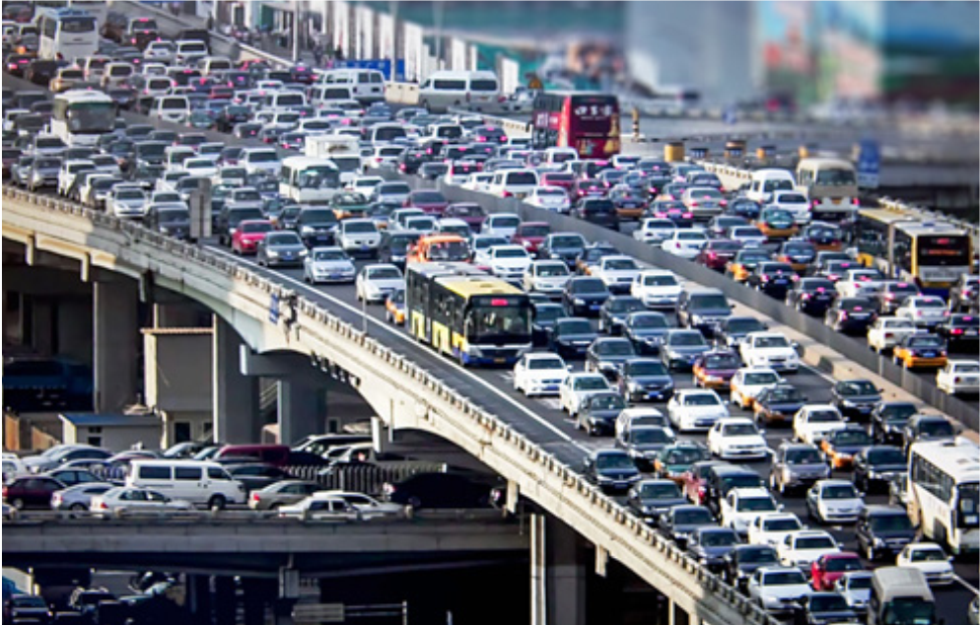
Suggested answer
1. The streets are getting more congested.

Slide 14
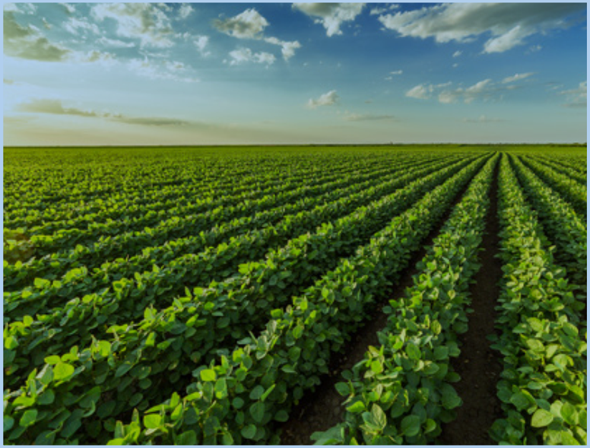
Suggested answer
2. The farmers are trying to grow new crops.

Slide 15
Suggested answer
3. The government is trying to attract people to my district by building more shopping malls and apartments.

Slide 16
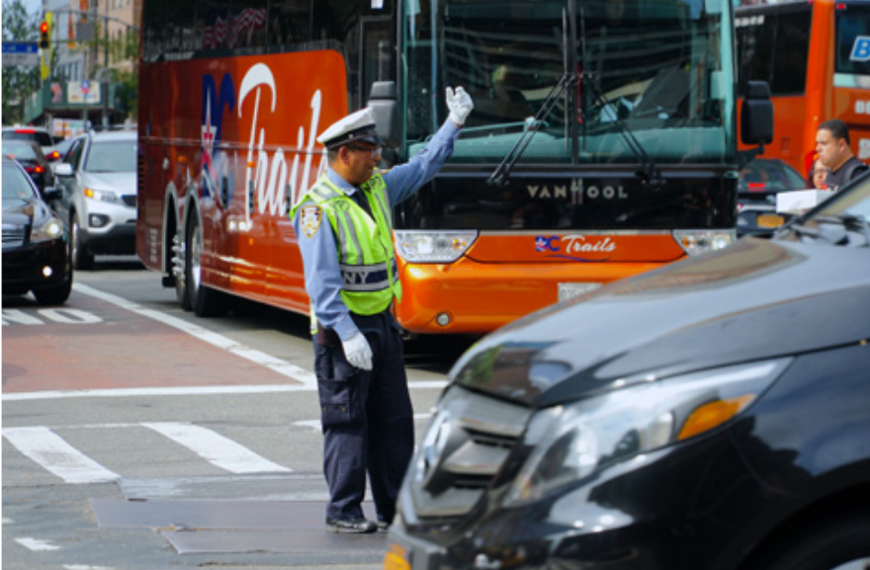
Suggested answer
4. The police officer helps direct vehicles and pedestrians, improving safety on the streets.

Slide 17
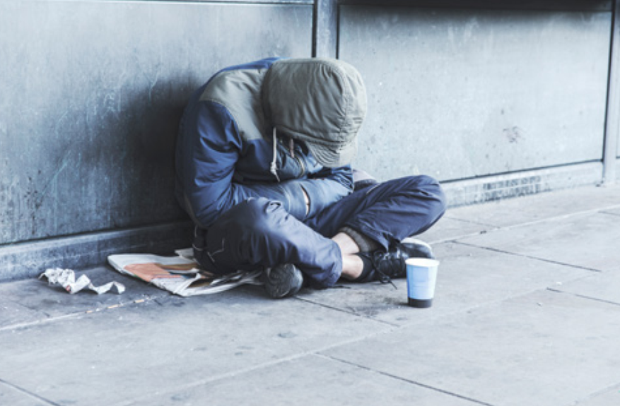
Suggested answer
5. Government should provide affordable housing to reduce the number of homeless people in the city.

Slide 18
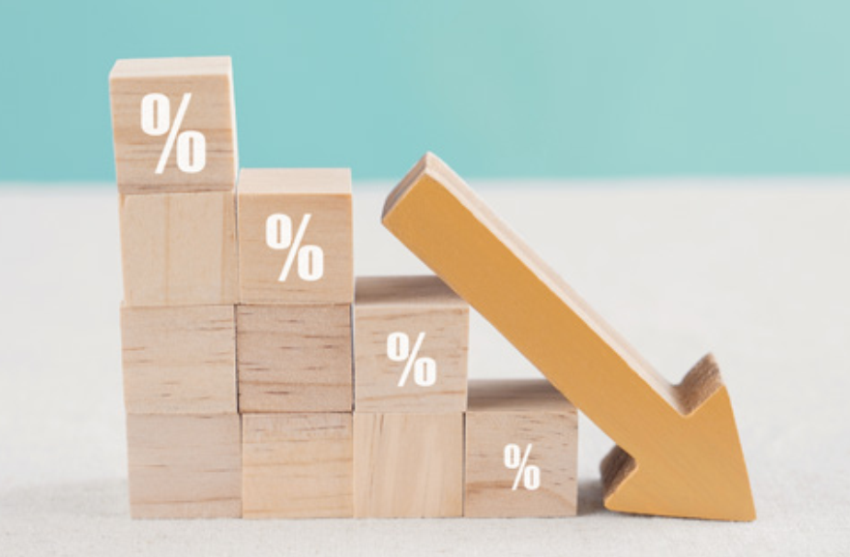
Suggested answer
6. With the use of efficient public transport, traffic congestion dropped significantly in the city center.

Slide 20
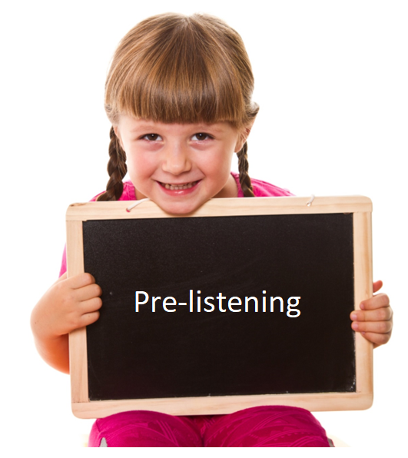
Pre-reading

Slide 21
Pre-listening
Work in groups of 4: Brainstorming
Brainstorm common problems that cities may face in the future. Think about potential solutions or consequences for each problem.
Share your ideas with the class.
Problems in cities | Consequences of problems | Solutions to problems

Slide 22
Suggested answers:
Problems in cities | Consequences of problems | Solutions to problems
Traffic jam/congestion | Late for school/work | Ban cars in the city
Littering | Pollution | More trash cans Volunteering clean-up campaign
Population is rising. | Lack of housing Expensive food | Build more affordable houses 1-2 children in a family
Population is dropping. | Not enough people to work | Encourage families to have more children

Slide 23
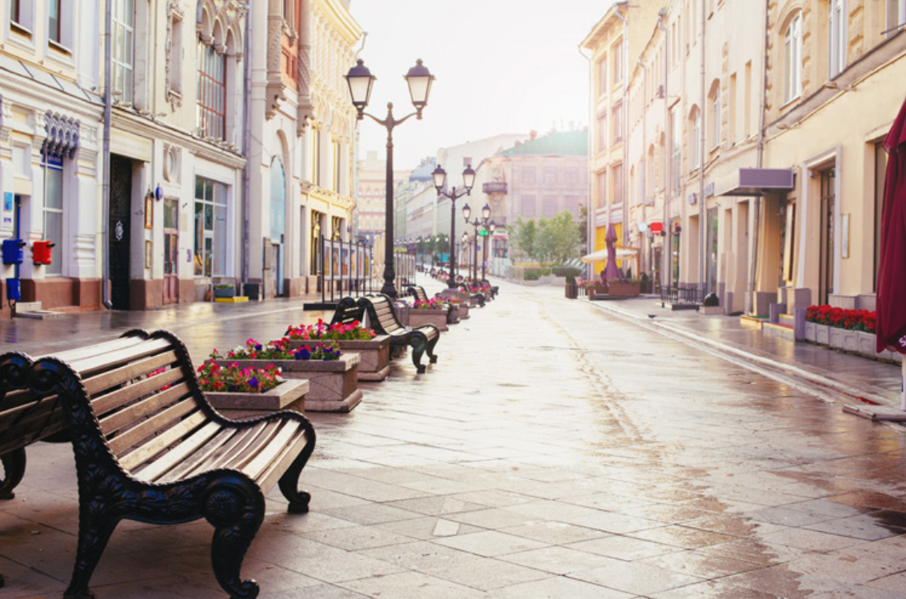
Pre-listening
a. Listen to two students talking about their presentation. What are they mainly talking about?
Solutions to problems
What will happen because of problems
Causes of problems
Consequences of problems

Slide 24
Look at the picture.
1. What is it?
2. What can you see?
3. What problems can you predict?
4. What are two students talking about in their presentation?

Slide 25
Suggested answers:
1. What can you see?
2. What problems can you predict?
3. What are two students talking about in their presentation?
Shopping mall, closed stores, no shoppers, empty seating areas, etc.
Economic decline, increase in online shopping, population decline, development of other shopping centers, aging population
Students’ answers.

Slide 26
While-listening

Slide 27
While-listening
a. Listen to two students talking about their presentation. What are they mainly talking about?
Solutions to problems
What will happen because of problems
Causes of problems
Consequences of problems

Slide 28
Pre-listening
Read the statements and guess what type of words are missing. Are they verbs?/ nouns? / adjectives? etc.?
1. Joe thinks that there won't be enough ____________________. 2. Joe doesn't understand why ____________________________. 3. People are __________________________________ too much. 4. Too many store owners are _____________________________. 5. Lily thinks that the government will need to ________________ to the area.

Slide 29
Pre-listening
Read the statements and guess what type of words are missing. Are they verbs?/ nouns? / adjectives? etc.?
1. Joe thinks that there won't be enough ____________________. 2. Joe doesn't understand why ____________________________. 3. People are __________________________________ too much. 4. Too many store owners are _____________________________. 5. Lily thinks that the government will need to ________________ to the area.
noun / noun phrase
clause (S + V)
V-ing
V-ing
verb

Slide 30
While-listening
b. now, listen and fill in the blanks.
1. Joe thinks that there won't be enough ____________________.
people to work
(some) school will close
2. Joe doesn't understand why ____________________________.
3. People are __________________________________ too much.
littering in the parks

Slide 31
While-listening
b. now, listen and fill in the blanks.
4. Too many store owners are _____________________________.
closing their businesses
5. Lily thinks that the government will need to __________________________ to the area.
attract more businesses

Slide 32
Script:
Joe: We need to plan our class presentation on the future of our city, Lily. Lily: OK. The first problem is that the population is dropping. Joe: Yeah, it's dropping so quickly that there won't be enough people to work at local businesses. Lily: I agree. I also think it's such a big problem that some schools will close. Joe: Sorry, can you explain that? I don't understand.

Slide 33
Lily: Well, if there aren't many people living here, fewer kids will go to schools, and some of them will need to close.
Joe: Oh. Yeah. We should talk about that. Lily: OK, Joe. Next. People are littering in the parks too much.
Joe: Hmm. Yeah, they're littering so much that the government will have to put more bins in the parks. Lily: Yeah, that would help. I think they'll also have to organize a clean-up. Joe: Good idea. Let's talk about that.

Slide 34
Lily: OK.
Joe: Last one. Too many store owners are closing their businesses. Lily: I think there's such a decrease in stores that the government will need to attract more businesses to the area. Joe: Yeah. If they don't, people will have to travel a long way to get food and other things. That will make the streets become more congested. Lily: Exactly!

Slide 35
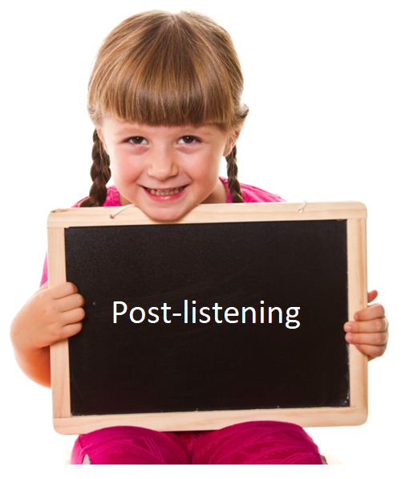
Post-reading

Slide 36
Post-listening
c. Read the Conversation Skill box, then listen and repeat.

Slide 37
Post-listening
d. Listen the conversation again and circle the phrase that you hear.

Slide 38
Post-listening
e. In pairs: Which problem that Lily and Joe discuss do you think is the biggest? Why?
I think the biggest problem may be population decline in their city. It’s dropping so quickly that there won’t be enough people to work and some schools will close.

Slide 39
CONSOLIDATION

Slide 40
WRAP-UP

Slide 41
Today’s lesson
Vocabularies
1. rise 2. drop 3. homeless 4. owner 5. attract 6. direct 7. crop 8. congested

Slide 42
Today’s lesson
Vocabulary:
- Using new words to describe problems in cities and their future impacts.
Reading:
- Listening for the main idea and specific information.

Slide 43
Homework
Do Vocabulary and Listening in WB page 40
Make sentences using the new words in SB
Prepare for the next lesson (Grammar - pages 69 & 70 - SB)
Play the consolidation games on www.eduhome.com.vn

Slide 44
Lesson 3
Stay positive and have a nice day!

