Slide 1
Unit 6: REVIEW 1
Listening, Reading & Vocab. Pages 103 & 104

Slide 2
Lesson Outline
Warm-up
Listening
Reading
Vocabulary
Wrap-up

Slide 3
By the end of this lesson, students will be able to…
- To practice and review the target language learned in the unit
- To practice test-taking skills

Slide 4
WARM UP

Slide 5
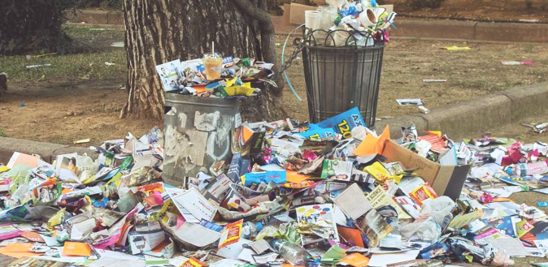
Work in groups of 4. Look at pictures that were covered, and they will be revealed slowly in order. If the group knows and says the answers first wins.
EXAMPLE
1
2
LITTER
4
3

Slide 6
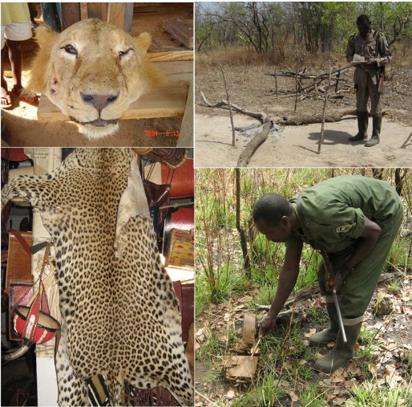
3
4
HUNT
2
1

Slide 7
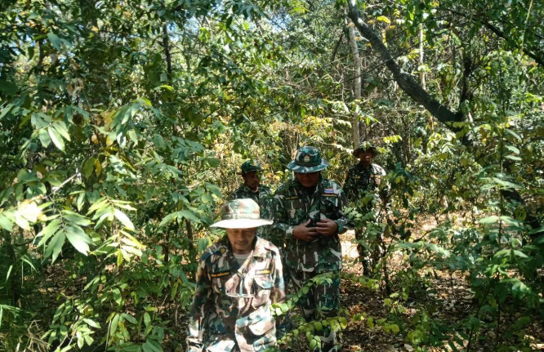
1
2
RANGERS
3
4

Slide 8
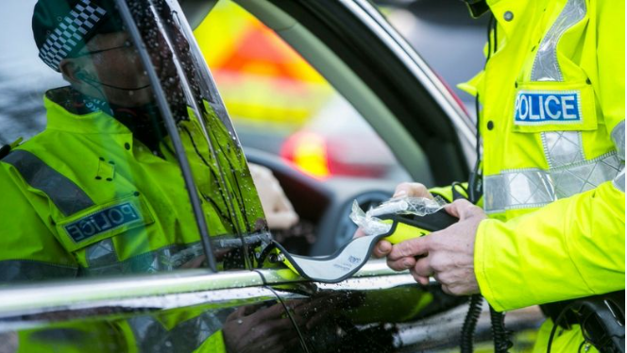
2
4
FINE
3
1

Slide 9
3
1
4
2
GOVERNMENT

Slide 10
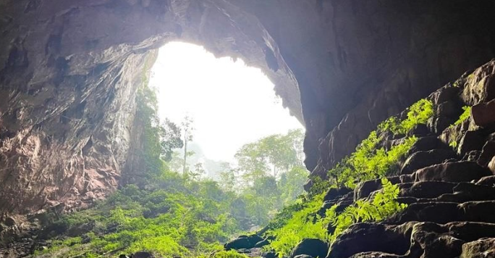
4
1
2
CAVE
3

Slide 11
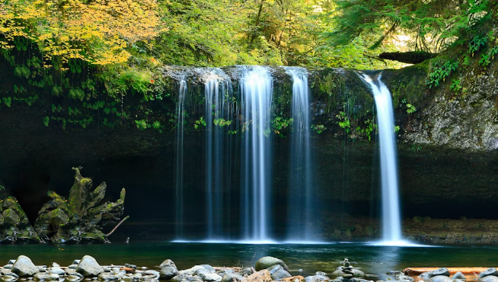
2
3
4
1
WATERFALL

Slide 12
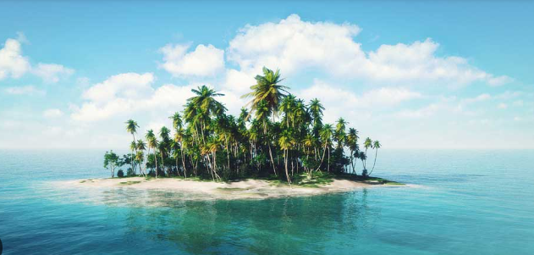
4
3
1
2
ISLAND

Slide 13
LISTENING

Slide 14
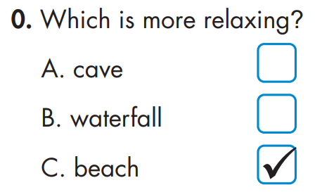
You will hear five short conversations. You will hear each conversation twice. There is one question for each conversation. For each question, choose the correct answer (A, B, or C).
EXAMPLE

Slide 15
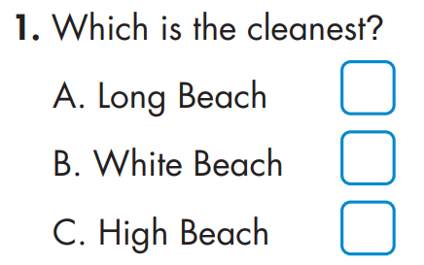
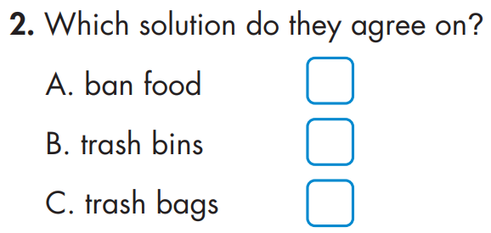

Slide 16
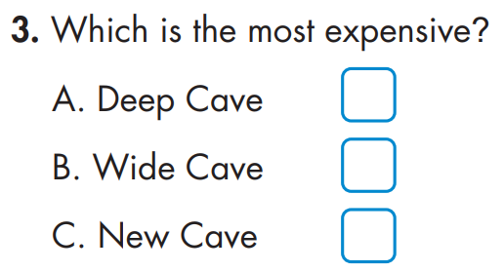
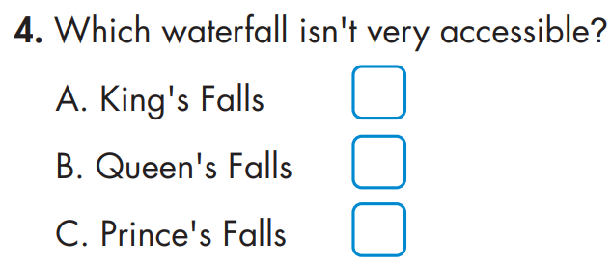
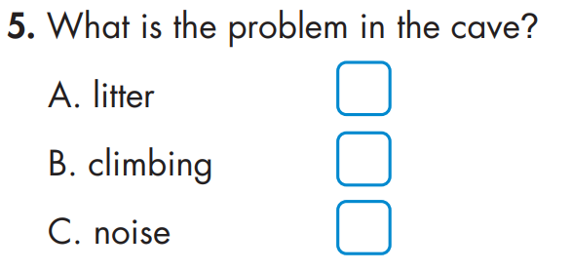

Slide 17
Task a
Underline the key words in the questions
EXAMPLE

Slide 18
Answers
Task a
Underline key words in the questions

Slide 19
Answers
Task a
Underline key words in the questions

Slide 20
Answers and clues
Task b.
EXAMPLE
Tom: Do you prefer the beach or waterfalls?
Jill: I think waterfalls are cool.
Tom: Yes. But I think the beach is more relaxing.
Narrator: The answer is "beach," so there is a tick in Box C. Now, we are ready to start. Look at questions one.

Slide 21
Answers and clues
Narrator: Which is the cleanest?
John: Do you like High Beach?
Mary: No. It's so dirty.
John: Yeah. Long Beach is a bit cleaner.
Mary: Only a little bit, though.
John: White Beach is much cleaner than both.
Narrator: Now, listen again.

Slide 22
Answers and clues
Narrator: Which solution do they agree on?
B: How could we stop littering on High Beach?
G: We could ban food and drinks.
B: Hmm. What about giving visitors trash bags?
G: I think that idea is better.
Narrator: Now, listen again.

Slide 23
Answers and clues
Narrator: Which is the most expensive?
Harry: Do you want to visit New Cave?
Nancy: It's a bit expensive. Maybe Wide Cave?
Harry: I prefer Deep Cave. It's far more expensive, but it's the nicest one.
Nancy: Let's go to New Cave. I don't have much money.
Narrator: Now, listen again.

Slide 24
Answers and clues
4. Mia: Queen's Falls looks beautiful. King's Falls isn't as big, but it's far more scenic.
Steve: I see.
Mia: Oh, it isn't very accessible. Prince's Falls seems really nice.
Steve: Let's go there.
Narrator: Now, listen again.

Slide 25
Answers and clues
5. Narrator: What is the problem in the cave?
Patty: I think we should put up some signs at the cave.
Matt: What's the problem?
Patty: People are climbing on the rocks.
Matt: I see. Signs might help.
Narrator: Now, listen again.

Slide 26
Task c.
In pairs – Listen and practice the conversation
Narrator: You will hear five short conversations. You will hear each conversation twice. There is one question for each conversation. For each question, choose the correct answer (A, B, or C). Here is an example: Which is more relaxing?
Tom: Do you prefer the beach or waterfalls?
Jill: I think waterfalls are cool.
Tom: Yes. But I think the beach is more relaxing.
Narrator: The answer is "beach," so there is a tick in Box C. Now, we are ready to start. Look at questions one.

Slide 27
Task c.
In pairs – Listen and practice the conversation
Narrator: Which is the cleanest?
John: Do you like High Beach?
Mary: No. It's so dirty.
John: Yeah. Long Beach is a bit cleaner.
Mary: Only a little bit, though.
John: White Beach is much cleaner than both.
Narrator: Now, listen again.

Slide 28
Task c.
In pairs – Listen and practice the conversation
Narrator: Which solution do they agree on?
B: How could we stop littering on High Beach?
G: We could ban food and drinks.
B: Hmm. What about giving visitors trash bags?
G: I think that idea is better.
Narrator: Now, listen again.

Slide 29
Task c.
In pairs – Listen and practice the conversation
Narrator: Which is the most expensive?
Harry: Do you want to visit New Cave?
Nancy: It's a bit expensive. Maybe Wide Cave?
Harry: I prefer Deep Cave. It's far more expensive, but it's the nicest one.
Nancy: Let's go to New Cave. I don't have much money.
Narrator: Now, listen again.

Slide 30
Task c.
In pairs – Listen and practice the conversation
4. Narrator: Which waterfall isn't very accessible?
Steve: Let's go to some waterfalls.
Mia: OK. There are three nice waterfalls nearby.
Steve: Yeah?
Mia: Queen's Falls looks beautiful. King's Falls isn't as big, but it's far more scenic.
Steve: I see.
Mia: Oh, it isn't very accessible. Prince's Falls seems really nice.
Steve: Let's go there.
Narrator: Now, listen again.

Slide 31
Task c.
In pairs – Listen and practice the conversation
5. Narrator: What is the problem in the cave?
Patty: I think we should put up some signs at the cave.
Matt: What's the problem?
Patty: People are climbing on the rocks.
Matt: I see. Signs might help.
Narrator: Now, listen again.

Slide 32
Reading

Slide 33
Fakenham is well known for its natural beauty, including several beautiful forests and waterfalls. In this article, we are going to tell you all you need to know about the local waterfalls here in Fakenham. Bless Falls is a very famous waterfall, and many people consider it to be the best of Fakenham's natural wonders. It's much bigger than any other waterfall in the area. However, it isn't as accessible as the others. You can only visit it by helicopter.

Slide 34
Wish Falls is another great waterfall. It isn't as big as Bless Falls, but it's just as nice to visit. It's a bit smaller than the other waterfalls in the area, but it's far more beautiful. It's just a short walk from Fakenham Grand Hotel. Wish Falls is also a great place to have a picnic, and you'll often find locals gathering there on the weekends.

Slide 35
Giving Falls is much more scenic than most waterfalls you will see. High up on Mount Dogi, you can see over all of Fakenham. It's a little more difficult to visit than Wish Falls, but it's worth the hike. You won't forget visiting Giving Falls.

Slide 36
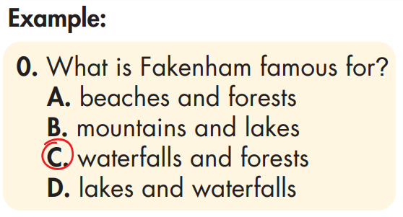
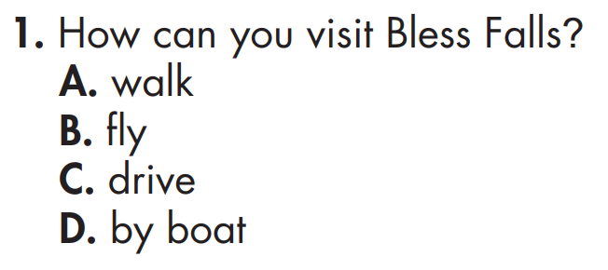
Answers
Task a
Underline the key words in the questions
Pre-reading

Slide 37
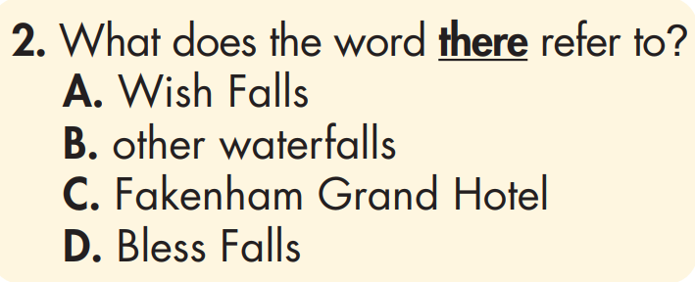
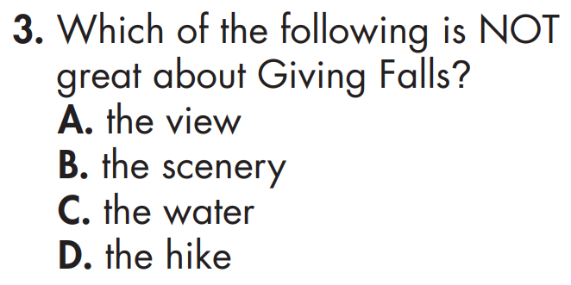
Answers
Task a
Underline key words in the questions

Slide 38
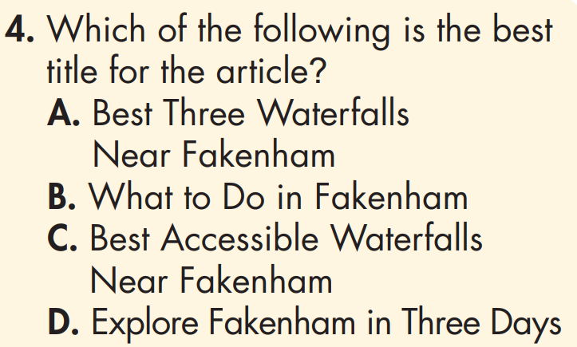
Answers
Underline key words in the questions
5. Which of the following can you infer from the article?
It's easy to visit all three waterfalls in a day.
The writer likes Bless Falls best.
People who live in Fakenham like to visit Wish Falls.
Giving Falls is the least accessible.
Task a

Slide 39
Answers and clues
Task b
Fakenham is well known for its natural beauty, including several beautiful forests and waterfalls. In this article, we are going to tell you all you need to know about the local waterfalls here in Fakenham.
Pre-reading

Slide 40
Answers and clues
Task b
Bless Falls is a very famous waterfall, and many people consider it to be the best of Fakenham's natural wonders. It's much bigger than any other waterfall in the area. However, it isn't as accessible as the others. You can only visit it by helicopter.
Pre-reading

Slide 41
Answers and clues
Task b
Wish Falls is also a great place to have a picnic, and you'll often find locals gathering there on the weekends.

Slide 42
Answers and clues
Task b
Giving Falls is much more scenic than most waterfalls you will see. High up on Mount Dogi, you can see over all of Fakenham. It's a little more difficult to visit than Wish Falls, but it's worth the hike. You won't forget visiting Giving Falls.
Pre-reading

Slide 43
Answers and clues
Task b
Fakenham is well known for its natural beauty, including several beautiful forests and waterfalls. In this article, we are going to tell you all you need to know about the local waterfalls here in Fakenham.

Slide 44
Answers and clues
Task b
5. Which of the following can you infer from the article?
It's easy to visit all three waterfalls in a day.
The writer likes Bless Falls best.
People who live in Fakenham like to visit Wish Falls.
Giving Falls is the least accessible.
Wish Falls is also a great place to have a picnic, and you'll often find locals gathering there on the weekends.

Slide 45
Vocabulary

Slide 46
The water running through the cave created the rocky _________.
outcrops B. summits C. rangers D. government
2. The biggest problem is that people ___________ in the park. There are plastic bottles everywhere.
fine B. spoil C. create D. litter
3. I climbed all the way to the __________ of Mount Snowdon. There was a great view from the top.
A. beach B. formation C. summit D. nature

Slide 47
4. Rangers shouldn't let people ___________ animals in the national park.
fine B. hunt C. consider D. litter
5. The view from the top of the mountain is ____________.
spectacular B. accessible C. tall D. close
6. So many animals live in the ___________.
A. ranger B. Mount C. wildlife D. rainforest

Slide 48
7. If people ___________ the wildlife, it could have a bad effect.
consider B. keep C. float D. disturb
8. I hate littering. Don't people know that it _________ the natural beauty here?
A. explores B. reaches C. spoils D. climbs

Slide 49
Answers
The water running through the cave created the rocky _________.
outcrops B. summits C. rangers D. government
2. The biggest problem is that people ___________ in the park. There are plastic bottles everywhere.
fine B. spoil C. create D. litter
3. I climbed all the way to the __________ of Mount Snowdon. There was a great view from the top.
A. beach B. formation C. summit D. nature

Slide 50
Answers
4. Rangers shouldn't let people ___________ animals in the national park.
fine B. hunt C. consider D. litter
5. The view from the top of the mountain is ____________.
spectacular B. accessible C. tall D. close
6. So many animals live in the ___________.
A. ranger B. Mount C. wildlife D. rainforest

Slide 51
Answers
7. If people ___________ the wildlife, it could have a bad effect.
consider B. keep C. float D. disturb
8. I hate littering. Don't people know that it _________ the natural beauty here?
A. explores B. reaches C. spoils D. climbs

Slide 52
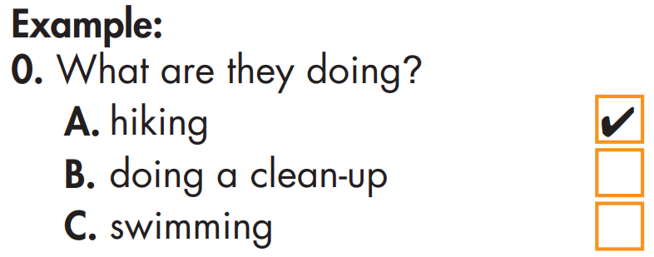
EXTRA PRACTICE – WB page 55
You will hear a conversation between two friends at a national park. For each question, choose the correct answer (A, B, or C). You will hear the conversation twice.

Slide 53
EXTRA PRACTICE – WB page 55

Slide 54
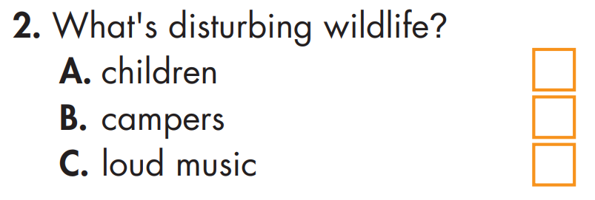
EXTRA PRACTICE – WB page 55

Slide 55
EXTRA PRACTICE – WB page 55

Slide 56
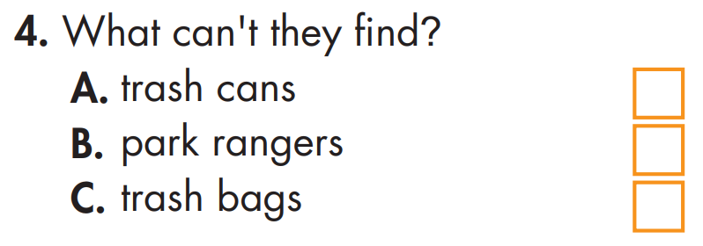
EXTRA PRACTICE – WB page 55

Slide 57
EXTRA PRACTICE – WB page 55

Slide 58
Answers and clues
You will hear a conversation between two friends at a national park. For each question, choose the correct answer (A, B, or C). You will hear the conversation twice.
Bob: The weather's so nice today. It's such a great day for hiking. Mike: Yep! I think we'll get to the waterfall in thirty minutes.

Slide 59
Answers and clues
Bob: Great! Oh, but what's up with all this trash?
Mike: Ugh. Some people didn't clean up after camping. It's so annoying.
Bob: Yeah. Let's pick up their trash. I think the park should consider fining people who litter.
Mike: Definitely! They should make them pay a lot.

Slide 60
Answers and clues
Bob: Ugh! Why do people play such loud music? They're disturbing other people and the wildlife.
Mike: People should stop doing that. The park rangers should make it a rule.
Bob: Yeah!

Slide 61
Answers and clues
Bob: We're here!
Mike: Wow. It's spectacular!
Bob: And yet, there's trash everywhere. I hate it. It spoils the natural beauty and can harm the wildlife.

Slide 62
Answers and clues
Mike: Let's find a trash can.
Bob: Hmm, I don't see a trash can. Mike: Oh. I guess that's the problem. The government should discuss putting more trash cans in the park.

Slide 63
Answers and clues
Bob: Yes. But not having trash cans isn't a reason to litter.
Mike: Maybe we should talk to the park rangers, then we can volunteer or organize a clean-up.
Bob: Great idea.

Slide 64
WRAP-UP

Slide 65
Today’s lesson
Vocabulary:
- To practice and review the target language learned in the unit
Listening:
- To practice test-taking skills for Reading & Listening

Slide 66
Homework
Review vocabulary in Unit 6
Do exercise on pages 55 (WB) – part 1 – Listening
Prepare for the next lesson (Review - pages 104 & 105 - SB)
Play the consolidation games on www.eduhome.com.vn

Slide 67
Lesson 3
Stay positive and have a nice day!

