Slide 1
Unit 6: Natural Wonders
Lesson 2.3: Pronunciation & Speaking
Pages 60 & 61

Slide 2
Lesson Outline
Warm-up
Pronunciation
Speaking
Consolidation
Wrap-up

Slide 3
By the end of this lesson, students will be able to…
Practice intonation for contrasting sentences.
Discuss how to preserve and protect our natural wonders (problem-solving)

Slide 4
WARM-UP

Slide 5
COMPETITION TIME:
Create groups/teams of 5 students.
You will be given incomplete sentences.
You have to complete the sentences with your ideas.
The team(s) with the most similar correct answers win(s).
Time limit: 5 minutes
Example: I love having picnics at
the beach, but ………
"I love having picnics at the beach, but they can cause littering "

Slide 6
I like you a lot, but ……….
People know that plastic bags can harm the environment , but ………..
People know that they shouldn’t disturb animals , but .............
It’s a great idea, but …………

Slide 7
5. Smoking is not good for people’s health, but ……
6. Cheating is not a good thing, but ………
7. The government put more trash cans in national parks, but ………………….
8. It’s a good idea to fine people who litter in public places, but ……..

Slide 8
Suggested answers
I like you a lot, but I don’t love you.
People know that plastic bags can harm the environment , but they still use them daily.
People know that they shouldn’t disturb animals , but they still feed them.

Slide 9
4. It’s a great idea, but not many people like it.
5. Smoking is not good for people’s health, but a lot of people still smoke.
6. Cheating is not a good thing, but many students often do it.
Suggested answers

Slide 10
Suggested answers
7. The government put more trash cans in national parks, but people still litter.
8. It’s a good idea to fine people who litter in national parks, but rangers are too busy to do it.

Slide 11
In pairs – Practice saying these sentences.
I like you a lot, but I don’t love you.
People know that plastic bags can harm the environment, but they still use them daily.
People know that they shouldn’t disturb animals , but they still feed them.
It’s a great idea, but not many people like it.

Slide 12
In pairs – Practice saying these sentences.
5. Smoking is not good for people’s health, but a lot of people still smoke.
6. Cheating is not a good thing, but many students often do it.
7. The government put more trash cans in national parks, but people still litter.
8. It’s a good idea to fine people who litter in national parks, but rangers are too busy to do it.

Slide 13
Look at these sentences and answer some questions.
People know that plastic bags can harm the environment, but they still use them daily.
People know that they shouldn’t disturb animals , but they still feed them.
Look at the second part of these sentences, do they give you the same or contrasting ideas with the first part?

Slide 14
Look at these sentences and answer some questions.
Answer
People know that plastic bags can harm the environment, but they still use them daily.
People know that they shouldn’t disturb animals , but they still feed them.
The second part of these sentences give the contrasting ideas with the first part.

Slide 15
Pronunciation

Slide 16
INTONATION

Slide 17
Task a.
That's not a bad idea, but I think the police are too busy to work in the national park.
I understand what you're saying, but people already litter here.

Slide 18
Task b.

Slide 19
Task b.
Answer

Slide 20
Task c.
Read the sentences with the correct intonation to a partner.

Slide 21
Task d
In pairs – Practice saying these sentences with correct intonation.
I like you a lot, but I don’t love you.
People know that plastic bags can harm the environment, but they still use them daily.
People know that they shouldn’t disturb animals , but they still feed them.
It’s a great idea, but not many people like it.

Slide 22
Task d
In pairs – Practice saying these sentences with correct intonation.
5. Smoking is not good for people’s health, but a lot of people still smoke.
6. Cheating is not a good thing, but many students often do it.
7. The government put more trash cans in national parks, but people still litter.
8. It’s a good idea to fine people who litter in national parks, but rangers are too busy to do it.

Slide 23
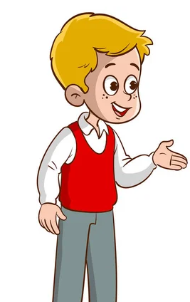
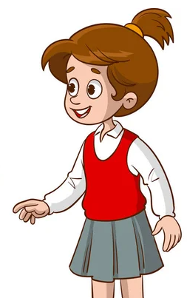
In pairs: Take turns asking and answering about how you feel about the actions and suggesting solutions, then politely disagree and give the next solution.
Task a

Slide 24
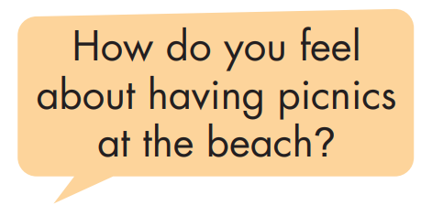
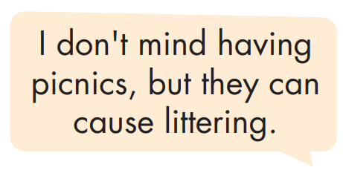
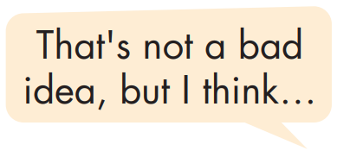
In pairs: Take turns asking and answering about how you feel about the actions and suggesting solutions, then politely disagree and give the next solution.
Task a

Slide 25
Remember using these phrases to disagree politely.

Slide 29
Suggested answer
That's not a bad idea, but I think government should consider adding more trash cans.
I think people should stop bringing food.
That’s right. However, I think rangers shouldn’t keep letting people have picnics in some parts in national parks.
I understand what you’re saying, but we should fine people who litter heavily. That’s a better solution.

Slide 30
Suggested answer
I don’t like having group tours. It damages the rock formations in some caves.
Personally, I think people should stop touching them and they will get a large fine if they do it.
I understand what you’re saying, but I think government should keep building more fences to protect them.
I totally agree with you. And I think government should consider limiting tour sizes.

Slide 31
Suggested answer
For me, I think rangers shouldn’t keep letting people exploring on their own. It’s dangerous sometimes.
I like exploring on my own. It disturbs the nature and wild animal.
That’s not a bad idea, but I think people should stop going off paths which is safer for them.
That’s right. And I think government should consider fining people who disturb wildlife.

Slide 32
Presentation
Speaking

Slide 33
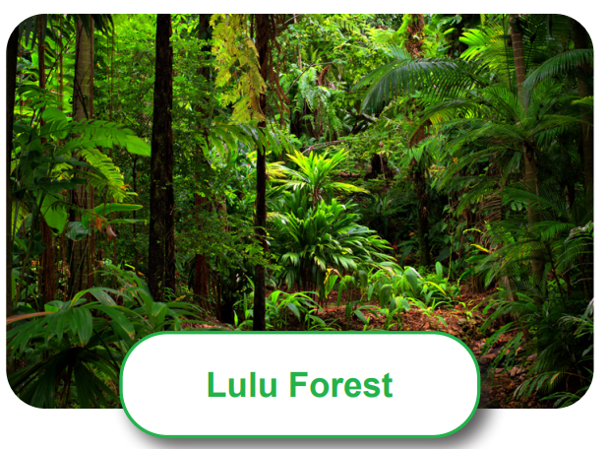
Task a
In pairs: Asking and answering this question
“What problems might these wonders have?

Slide 34
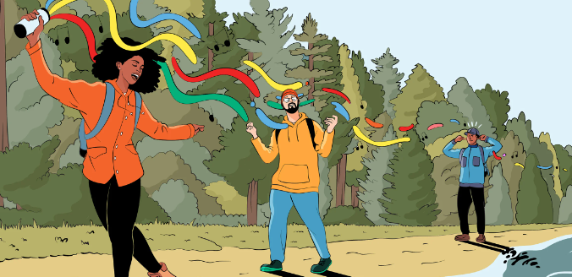
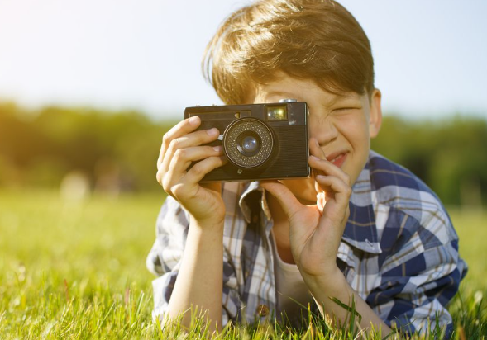
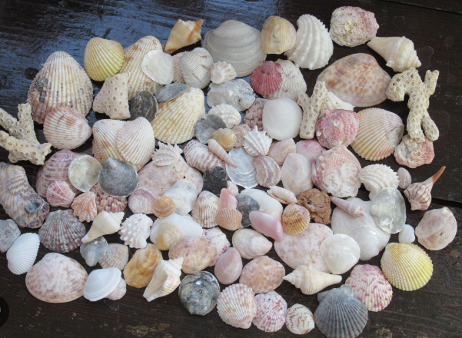
Suggested answer
Task a
In pairs: Asking and answering this question “What problems might these wonders have?
playing loud music
bringing food
disturbing wildlife
collecting shells/rocks
taking photos

Slide 35
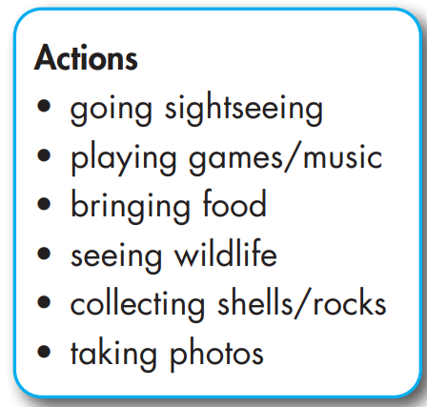
Task b
In pairs: Discuss your feelings about the actions below, any possible problems they could cause, and solutions to them.

Slide 36
Task c
Join another pair. Tell them how you feel about each of the actions, then share the solutions you discussed.

Slide 37
Suggested answer
For me, I think government should consider fining people who play very loud music. People should respect nature and wild animals.
People like playing loud music. It disturbs wild animal.
Moreover, they like bringing food to national parks. It causes littering.
That’s right. And I think government should consider giving more trash cans in these places. People will stop littering.

Slide 38
Suggested answer
I love seeing wildlife and many people love taking photos and collecting shells or rocks. It can disturb and spoil nature.
Yes, I agree with you. I think rangers should put more signs to let people know.
I totally agree with you. But I think government should consider fining people who disturb wildlife.
Exactly. If government does this, no one will not disturb wildlife anymore.

Slide 39
Extra practice - WB - page 35
Write about problems and potential solutions at a natural wonder you know. Write 100 to 120 words.

Slide 40
Suggested answer
Write about problems and potential solutions at a natural wonder you know. Write 100 to 120 words.
The waterfall in my area is beautiful, but people are starting to spoil it. People have picnics by the waterfall quite often. They often leave litter and food waste on the ground. I think the police should consider fining people for littering near the waterfall. People are also jumping into the water from the rocks.

Slide 41
Suggested answer
Write about problems and potential solutions at a natural wonder you know. Write 100 to 120 words.
It damages the rocks and makes it dangerous for other people. I think we should stop people from jumping off the rocks by putting up a sign. The final problem is people feed the animals. They love feeding the monkeys, but it's not good for the animals. The monkeys get too comfortable with people, and it can cause lots of problems.

Slide 42
CONSOLIDATION

Slide 43
INTONATION

Slide 44
WRAP-UP

Slide 45
Today’s lesson
Pronunciation:
Practice intonation for contrasting sentences.
Speaking:
Discuss how to preserve and protect our natural wonders (problem-solving)

Slide 46
Homework
Practice saying contrasting sentences in the Pronunciation (SB).
Prepare for the next lesson (Reading - page 62 - SB).
Do exercise on pages 35 (WB) – Writing.
Play the consolidation games on www.eduhome.com.vn

Slide 47
Lesson 3
Stay positive and have a nice day!

