Slide 1
Unit 5: Healthy Living
Lesson 2.2: Grammar
Pages 49 & 50

Slide 2
Lesson Outline
Warm-up
Presentation
Practice
Production
Consolidation
Wrap-up

Slide 3
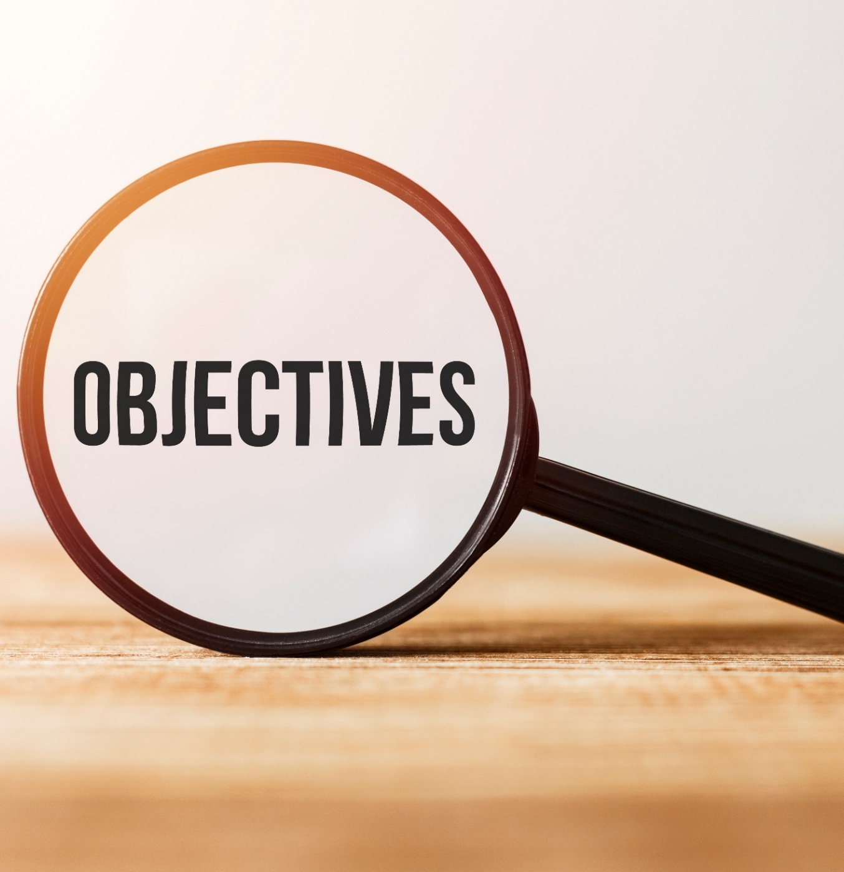
By the end of this lesson, students will be able to…
use adverbial clauses of result in speaking and writing.

Slide 4
WARM-UP

Slide 5
MATCHING GAME:
Create groups of 4-5 students.
Prepare sentence beginnings and sentence endings, and have Ss match them to make correct sentences.
The groups with the most correct answers win.
Time limit: 5 minutes

Slide 6
Sentence Beginnings:
Although he knows it's bad for him, 2. Despite their harm, 3. Many people don't know how to cook a nourishing meal
Sentence Endings:
many people follow detox diets.
he eats a lot of candy.
in spite of knowing the importance of eating healthily.

Slide 7
Sentence Beginnings:
4. Although John has time in the afternoon,
5. He has snacks
6. Peter doesn’t get to play a lot
Sentence Endings:
though he’s in a few sport clubs.
he skips his meal.
in spite of not feeling hungry.

Slide 8
Answers: 1.b 2.a 3.c
Sentence Beginnings:
Although he knows it's bad for him, 2. Despite their harm, 3. Many people don't know how to cook a nourishing meal
Sentence Endings:
many people follow detox diets.
he eats a lot of candy.
in spite of knowing the importance of eating healthily.

Slide 9
Answers: 4.e 5.f 6.d
Sentence Beginnings:
4. Although John has time in the afternoon,
5. He has snacks
6. Peter doesn’t get to play a lot
Sentence Endings:
though he’s in a few sport clubs.
he skips his meal.
in spite of not feeling hungry.

Slide 10
Presentation

Slide 11
Read and look at the highlighted words. Then complete the structures.
Although he knows it's bad for him, he eats a lot of candy.
Students still prefer to eat junk food though they have access to healthy snacks in the school's cafeteria. 3. In spite of their harm, many people follow detox diets.
4. Many people don't know how to cook a nourishing meal despite knowing the importance. of eating healthily

Slide 12
➔ To introduce an idea that contrasts with the main idea.
Although / Though + clause, main clause.
Although he knows it’s bad for him, he eats a lot of junk food.
Main clause + although / though + clause.
Students still prefer to eat junk food though they have access to healthy snacks in the school's cafeteria.

Slide 13
➔ To introduce an idea that contrasts with the main idea.
Despite / In spite of + N/V-ing, main clause.
In spite of their harm, many people follow detox diets.
Main clause + despite / in spite of + N/V-ing.
Many people don't know how to cook a nourishing meal despite knowing the importance of eating healthily.

Slide 14
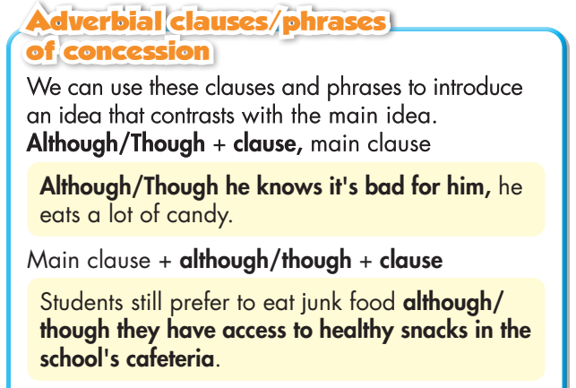
Task a
Read about adverbial clauses/phrases of concession, then fill in the blank.

Slide 15
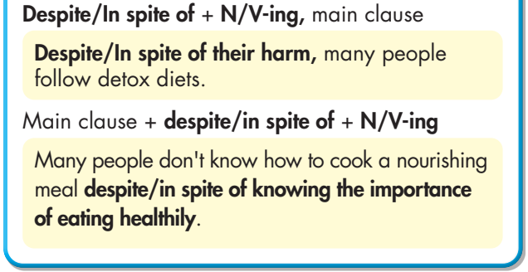
Task a
Read about adverbial clauses/phrases of concession, then fill in the blank.

Slide 16
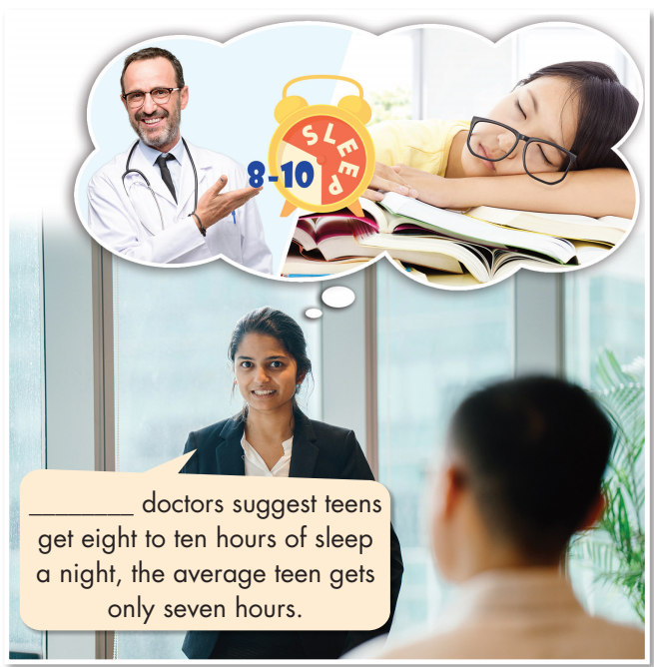
Task b
Listen and check. Listen again and repeat.
Although
________________ doctors suggest teens get eight to ten hours of sleep a night, the average teen gets only seven hours.

Slide 17
Practice

Slide 18
Task c
Fill in the blanks with although / though or despite / in spite of
1. ________________ our school has a cafeteria, students rarely eat there. 2. ________________ too much sugar is bad for our health, most people eat a lot of it. 3. ________________ knowing that smoking is very bad, many people still smoke.
Although / Though
Although / Though
Despite / In spite of

Slide 19
4. Jack never gains weight ________________ all the junk food he eats. 5. ________________ the need for salt to live, too much can be harmful. 6. I don't like eating ice cream ________________ I do like eating candy. 7. Junk food is still very popular ________________ the health advice from experts.
despite / in spite of
Despite / In spite of
although / though
despite / in spite of

Slide 20
Extra practice
WB – page 29
Fill in the blanks with although / though or despite / in spite of
1. _________________ she does a lot of exercise, she isn't healthy because she's addicted to junk food. 2. I don't do exercise _________________ I know the benefits of doing it. 3. Lots of parents let their children eat fast food _________________ knowing it isn't very nourishing.
Although / Though
although / though
despite / In spite of

Slide 21
Extra practice
WB – page 29
Fill in the blanks with although / though or despite / in spite of
4. He doesn't like sweets _________________ he really likes soda and sugary drinks. 5. _________________ trying to promote healthy eating habits, the school cafeteria still serves junk food. 6. They still sit and play video games all day _________________ understanding the harm of being lazy.
although / though
Despite / In spite of
despite / In spite of

Slide 22
Task d
Choose the sentence that is closest in meaning to each of the following sentences.
Although some diets are very dangerous, many people still follow them.
Despite following diets, many people are dangerous.
In spite of being dangerous, many people still follow diets.
Despite the dangers of some diets, many people still follow them.

Slide 23
Task d
2. Despite having access to healthy snacks, students still prefer junk food. A. In spite of junk food, students have healthy snacks.
B. Although students have access to healthy snacks, they still prefer junk food. C. Though students prefer junk food, they also have access to healthy snacks.

Slide 24
Task d
3. I like to eat candy though I know it's bad for me. A. In spite of eating bad candy, I like it. B. Although candy is bad, I don't eat it. C. Despite knowing candy is bad for me, I like to eat it.

Slide 25
Task d
4. Though many people know the dangers of drinking too much soda, they still drink it with every meal. A. Despite knowing the dangers of drinking too much soda, many people still drink it with every meal. B. In spite of drinking soda with every meal, many people don't know it's dangerous. C. Although people drink soda with every meal, they know soda's dangerous.

Slide 26
Task d
5. I eat vegetables every day although I don't like them. A. Though I hate vegetables, I should eat them every day. B. Despite not liking vegetables, I eat them every day. C. In spite of eating vegetables every day, I like them.

Slide 27
Production

Slide 28
Task e
In pairs: Complete the sentences with your own ideas and tell your partner.
Although I don’t like sports, I play badminton twice a week.

Slide 29
Suggested answers:
1. Although I don't like sports, I play badminton twice a week. 2. Though I like having snacks, I try to only have one a day. 3. I eat lots of vegetables although I don’t really like them. 4. I'm trying to wake up at 5 a.m. every day though it’s difficult to do. 5. I like watching horror movies in spite of my fear of
ghosts. 6. I hate exercising despite knowing that it's great for
my health.

Slide 30
CONSOLIDATION

Slide 31
➔ To introduce an idea that contrasts with the main idea.
Although / Though + clause, main clause.
Although he knows it’s bad for him, he eats a lot of junk food.
Main clause + although / though + clause.
Students still prefer to eat junk food though they have access to healthy snacks in the school's cafeteria.

Slide 32
➔ To introduce an idea that contrasts with the main idea.
Despite / In spite of + N/V-ing, main clause.
In spite of their harm, many people follow detox diets.
Main clause + despite / in spite of + N/V-ing.
Many people don't know how to cook a nourishing meal despite knowing the importance of eating healthily.

Slide 33
WRAP-UP

Slide 34
Today’s lesson
Grammar:
Understand, practice and use adverbial clauses/phrases of concession.
Speaking:
Practice speaking with a partner, using adverbial clauses of concession

Slide 35
Homework
Review adverbial clauses of concession
Do homework: Writing on page 29 - WB
Prepare for the next lesson (Pronunciation & Speaking - pages 50 & 51 - SB).
Play the consolidation games on www.eduhome.com.vn

Slide 36
Lesson 3
Stay positive and have a nice day!

