Slide 1
Unit 5: Healthy Living
Lesson 1.2: Grammar
Pages 45 & 46

Slide 2
Lesson Outline
Warm-up
Presentation
Practice
Production
Consolidation
Wrap-up

Slide 3
By the end of this lesson, students will be able to…
- use the suggest + gerund to offer advice.

Slide 4
WARM-UP

Slide 5
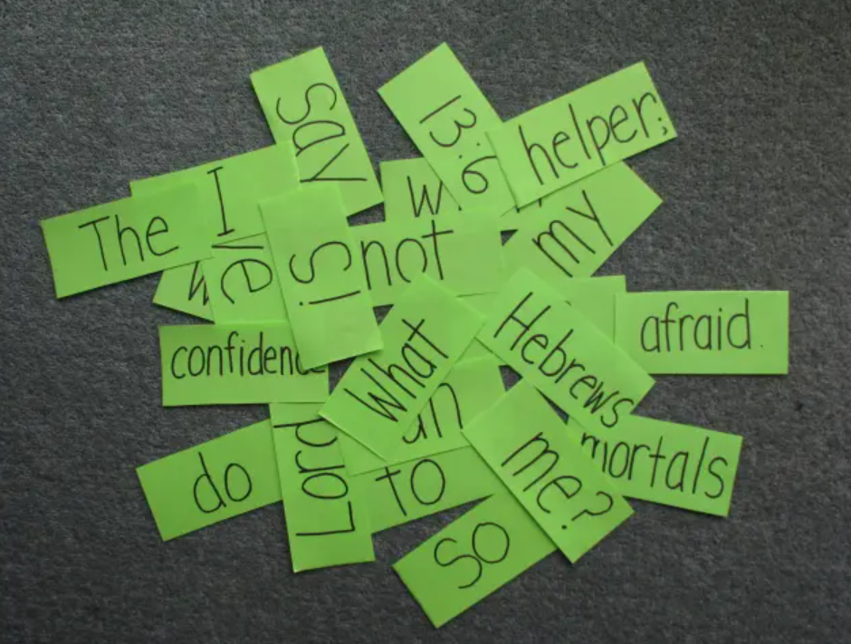
Warm-up
Competition Time
- Work in groups of 5
- Unscramble the words to make sentences.
- Which team has the most correct answers will win.
- Time limit: 5 minutes

Slide 6
Warm-up
Example:
doesn’t / stay / Fat / help / organs / your / healthy.
➔ Fat doesn’t help your organs stay healthy.

Slide 7
Unscramble the words to make the sentences.
The / suggests focusing / on / lose / more / calories than / using / you / eat / to / expert / fat.
What / sick? / doctors / prevent / suggest doing / do / to / getting 3. Doctors / juice. / suggest / drinking / too / not / much
diets. / We / not / any / following / suggest / detox

Slide 8
Answers:
The expert suggests focusing on using more calories than you eat to lose fat.
What do doctors suggest doing to prevent getting sick?
Doctors suggest not drinking too much juice.
We suggest not following any detox diets.

Slide 9
Presentation

Slide 10
Read the sentences again, highlight the suggest + (not) + gerund
The expert suggests focusing on using more calories than you eat to lose fat.
What do doctors suggest doing to prevent getting sick?
Doctors suggest not drinking too much juice.
We suggest not following any detox diets.

Slide 11
1. To offer advice.
Affirmative: suggest + gerund
My teacher suggests doing exercises everyday.
Negative: suggest + not + gerund
Doctors suggests not drinking too much alcohol.

Slide 12
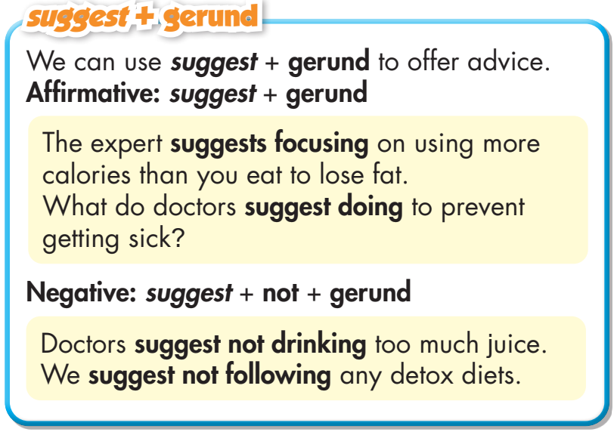
Task a
Read about suggest + gerund, then fill in the blank.

Slide 13
Task b
Listen and check. Listen again and repeat.
Doctors ________________ sunblock 30 minutes before going out in the sun.
suggest using

Slide 14
Presentation
Practice

Slide 15
Task c
Write sentences using the prompts.
1. Doctors/suggest/drink/milk/eat/fish/green vegetables/have/strong bones
➔ Doctors suggest drinking milk and eating fish and green vegetables to have strong bones.
2. The WHO/suggest/eat/healthy diet/get/all nutrients/you/need
➔ The WHO suggests eating a healthy diet to get all the nutrients you need.

Slide 16
Task c
Write sentences using the prompts.
3. Doctors/suggest/remove/soda/from/diet/because/it/have/lots of calories/sugar
➔ Doctors suggest removing soda from your diet because it has lots of calories and sugar.
4. Why/doctors/suggest/wash/hands/regularly?
➔ Why do doctors suggest washing your hands regularly?
5. Health experts/suggest/not/eat/too much salt/every day
➔ Health experts suggest not eating too much salt every day.

Slide 17
Task c
Write sentences using the prompts.
6. What/health experts/suggest/drink/keep/organs strong?
➔ What do health experts suggest drinking to keep your organs strong?
7. Doctors/suggest/find/out/which chemicals/good/and/which/bad
➔ Doctors suggest finding out which chemicals are good and which are bad.

Slide 18
Task d
Complete the passage with suggest and the correct form of the verbs in the box.
only eat drink focus on choose follow not eat
The internet is full of advice to lose weight quickly and easily. People who describe themselves as "experts" (1) ______________ juice for seven days to lose weight. Many (2) ________________ fat-burning foods while some (3) ________________ certain types of food like rice or bread.
suggest drinking
suggest only eating
suggest not eating

Slide 19
Task d
Complete the passage with suggest and the correct form of the verbs in the box.
only eat drink focus on choose follow not eat
Others (4) ________________ a special exercise program to lose the fat on your belly. But real doctors usually only (5) ________________ using more calories than you eat. There isn't an exercise that will help you lose your belly fat. Your body uses energy from the whole body, not just one area. So we (6) ________________ an exercise program you like and doing it regularly.
suggest following
suggest focusing on
suggest choosing

Slide 20
Extra Practice
WB – P27
Fill in the blanks with suggest and the correct form of the verbs in the box.
not sit eat wash not drink reduce get
The WHO _________________ enough sleep to help your organs work properly.
Experts _________________ too much soda or other sugary drinks.
Doctors _________________ your hands regularly to prevent viruses
suggests getting
suggest not drinking
suggest washing

Slide 21
Extra Practice
WB – P27
Fill in the blanks with suggest and the correct form of the verbs in the box.
not sit eat wash not drink reduce get
4. Doctors _________________ a variety of foods to get all the necessary nutrients. 5. The WHO _________________ the amount of fat, sugar, and meat you eat to stay healthy. 6. Experts _________________ all day. They suggest getting up and moving around every 30–60 minutes.
suggest eating
suggests reducing
suggest not sitting

Slide 22
Presentation
Production

Slide 23
Task e
In pairs: Use the prompts to talk about healthy things your parents, teachers, or doctors suggest doing.
My dad suggests waking up early to exercise on the weekends.

Slide 24
Suggested Answers:
My dad suggests waking up early to exercise on the weekends.
My mom suggests going to bed early so I don't get tired the next day.
My doctor suggests washing my hands regularly.
My doctor suggests not eating fast food.
My teacher suggests studying hard before the exam.

Slide 25
CONSOLIDATION

Slide 26
1. To offer advice.
Affirmative: suggest + gerund
My teacher suggests doing exercises everyday.
Negative: suggest + not + gerund
Doctors suggests not drinking too much alcohol.

Slide 27
WRAP-UP

Slide 28
Today’s lesson
Grammar: suggest + gerund : to offer advice.
Affirmative: suggest + gerund
Negative: suggest + (not) + gerund

Slide 29
Homework
Review how to use suggest + gerund to offer advice.
Make sentences using suggest + gerund.
Prepare for the next lesson (Pronunciation & Speaking - pages 46 & 47 - SB)
Play the consolidation games on www.eduhome.com.vn

Slide 30
Lesson 3
Stay positive and have a nice day!

