Slide 1
Unit 8: Traditions of Ethnic Groups in Vietnam
Review:
Vocab., Grammar, Pronun. & Writing
Page 105

Slide 2
Lesson Outline
Warm-up
Vocabulary
Grammar
Pronunciation
Writing
Consolidation
Wrap-up

Slide 3
By the end of this lesson, students will be able to…
- review the target language learned in the unit
- practice test taking skills

Slide 4
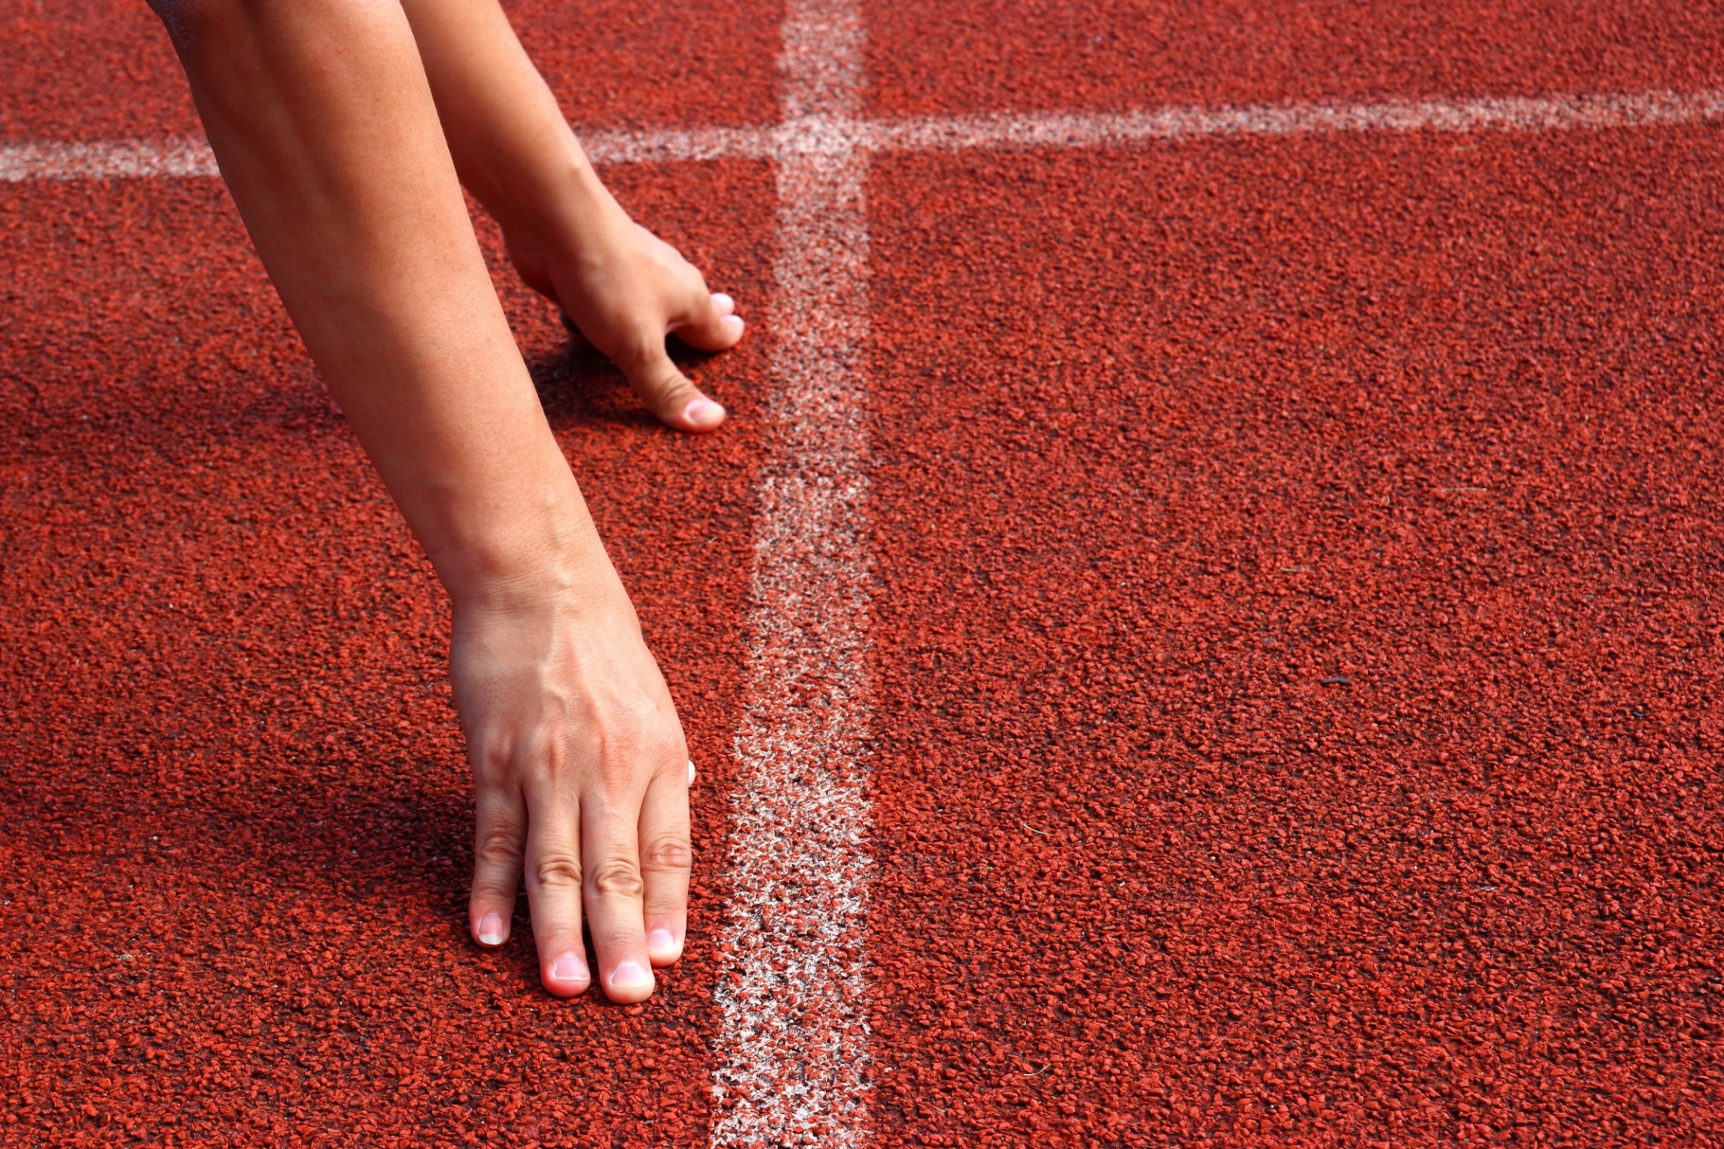
WARM UP

Slide 5
Choose the word whose underlined part is pronounced differently from that of the others.
A. decision B. recipe C. bicycle D. vacation
/dɪˈsɪʒn/ /ˈrɛsəpi/ /ˈbaɪsɪkl/ /veɪˈkeɪʃn/
2. A. phone B. work C. grow D. go
/foʊn/ /wɜːrk/ /ɡroʊ/ /ɡoʊ/
3. A. walked B. played C. joined D. lived
/wɔkt/ /pleɪd/ /dʒɔɪnd/ /lɪvd/

Slide 6
Choose the words whose main stress is placed differently from the others.
A. bamboo B. soccer C. headscarf D. hometown
/bæmˈbuː/ /ˈsɑkər/ /ˈhedskɑːrf/ /ˈhoʊmtaʊn/
2. A. hamburger B. vehicle C. hospital D. computer
/ˈhæmˌbərɡər/ /ˈviːəkəl/ /ˈhɑːspɪtəl/ /kəmˈpjuːtər/
3. A. kilometer B. transportation C. conditioner D. extinguisher
/kɪˈlɒmɪtər/ /ˌtrænspərˈteɪʃn/ /kənˈdɪʃənər/ /ɪkˈstɪŋɡwɪʃər/

Slide 7
Vocabulary

Slide 8
Match the words with the definitions.
1. blouse
2. embroidery
3. steamed
4. cloth
5. pattern
(food) cooked by placing over very hot water
a repeated design we often use to decorate something
a type of shirt for women and girls
a material we often use to make cloth
pictures or designs you sew onto clothes
3
_______
5
_______
1
_______
4
_______
2
_______

Slide 9
Match the words with the definitions.
6. apron
7. utensil
8. basket
9. product
10. corn
a tall plant that people use to make food
you use this to carry thing
a thing that people grow or make, usually to sell
a piece of clothing we wear over other clothes to keep them from getting dirty
a tool you use in the house, especially for cooking and eating
10
_______
8
_______
9
_______
6
_______
7
_______

Slide 10
Grammar

Slide 11
Match the numbers with the letters to complete the rules.
1. We can use the indefinite article a / an when we talk about …
A. things in general or when we use names of people and places.
2. We can use the definite article the when we talk about …
B. one thing or one member of a group of things
C. know a person or thing(s) we’re talking about, or when there is only one of that thing.
3. We use zero article when we talk about …

Slide 12
Task a
Fill in the blanks with a, the, or zero article (Ø).
The
Ø
a
1. _____ Red Dao leave _____ banana flowers at _____ new mother's door. 2. _____ Ê-đê live in _____ Central Highlands. 3. _____ Hmong use _____ corn to make lots of food.
4. Many ethnic groups like to eat _____ sticky rice on _____ important days. 5. Making pottery is _____ traditional craft of many ethnic groups in _____ Northern Vietnam.
6. _____ women of many ethnic groups like to wear _____ silver jewelry.
The
the
The
Ø
Ø
Ø
a
Ø
The
Ø

Slide 13
Match the numbers with the letters.
A. Speaker + asked + listener + Wh-question (in a past statement form)
1. We can use reported speech to say or …
B. yes/no questions, in stead of if in formal situations.
2. We can use whether when reporting ….
3. To report a Wh-question, we use
C. Speaker + asked + listener + if/whether* + Yes/No question (in a past statement form)
4. To report a Yes/No question, we use
D. repeat questions that someone asked before the time of speaking.

Slide 14
Task b
Complete the sentences to report what the people asked.
1. “Do you celebrate Tết?”
→ Peter asked me ____________________________________
2. “When do you wear your traditional clothes?”
→ I asked Ann _______________________________________
3. “What’s your favorite food?”
→ Lucy asked him ____________________________________
if/whether I celebrated Tết.
when she wore her traditional clothes.
what his favorite food was.

Slide 15
Task b
Complete the sentences to report what the people asked.
4. “Do you know how to make any traditional crafts?”
→ I asked them ______________________________________
5. “Is that a Khmer folk dance?”
→ John asked me _____________________________________
if/whether they knew how to make any traditional crafts.
if/whether that was a Khmer folk dance.

Slide 16
Pronunciation

Slide 17
Circle the word that differs from the other three in the position of primary stress in each of the following questions.
A. about B. ethnic C. silver D. boring
/əˈbaʊt/ /ˈeθnɪk/ /ˈsɪlvər/ /ˈbɔː.rɪŋ/
2. A. beautiful B. interesting C. delicious D. colorful
/ˈbjuːtɪfəl/ /ˈɪntrɪstɪŋ/ /dɪˈlɪʃəs/ /ˈkʌləfəl/
3. A. culture B. design C. apron D. custom
/ˈkʌltʃər/ /dɪˈzaɪn/ /ˈeɪprən/ /ˈkʌstəm/

Slide 18
Writing

Slide 19
Write about the customs and traditions of an ethnic group that you know well. Write 80 to 100 words.
Where? (village)
When?
Who?
Where ? (stay)
What? (do, eat)
Your opinion?
Cat Cat Village, Lào Cai Province
last week
aunt and uncle
homestay
see the giant bamboo water wheel, go shopping, try local food (thắng cố, grilled stream fish, steamed meat, watch sunset
amazing trip

Slide 20
Read the sample passage and fill in the blanks.
I ……… a very good trip to Cat Cat Village, where Mong ethnic group lives. It’s in Lào Cai province. I ……… there last week. I went ……… my aunt and uncle. We ……… at a homestay with Mong people. We saw a giant bamboo water wheel, went shopping and ………… sunset over the imposing mountains. We ………… Mong traditional foods like thắng cố, grilled stream fish, special steamed meat. We also learned how to ……… traditional crafts such as knitting, carving silver. The trip was really ………! I think you should visit Cat Cat Village.
had
went
with
stayed
watched
tried
make
amazing

Slide 21
CONSOLIDATION

Slide 22
Work in pairs. Ask your partner about his/her trip to an ethnic village in Vietnam, using the following questions
What did you go?
When did you go there?
Who do did you go with?
Where did you stay?
What activities did you do?
What do you think about the trip?

Slide 23
WRAP-UP

Slide 24
Today’s lesson
Vocabulary
Review traditions of ethnic groups in Vietnam
Pronunciation
Pronunciation of “oʊ”
Stress the first syllable for most two-syllable adjectives
Grammar
Review articles
Review reported speech for questions
Writing
Write about a trip to an ethnic village.

Slide 25
Homework
Review the vocab and grammar in the unit. Practice using them by making sentences.
Do the exercises unit 8 – Part 2 (page 57 WB)
Do review 2 in the notebook i-Learn Smart World 8 (pages 70-71)
Play the consolidation games on www.eduhome.com.vn

Slide 26
Lesson 3
Stay positive and have a nice day!

