Slide 1
Unit 8: Traditions of
Ethnic Groups in Vietnam
Review: Listening & Reading
Page 104

Slide 2
Lesson Outline
Warm-up
Listening
Reading
Consolidation
Wrap-up

Slide 3
By the end of this lesson, students will be able to…
- review the target language learned in the unit
- practice test taking skills

Slide 4
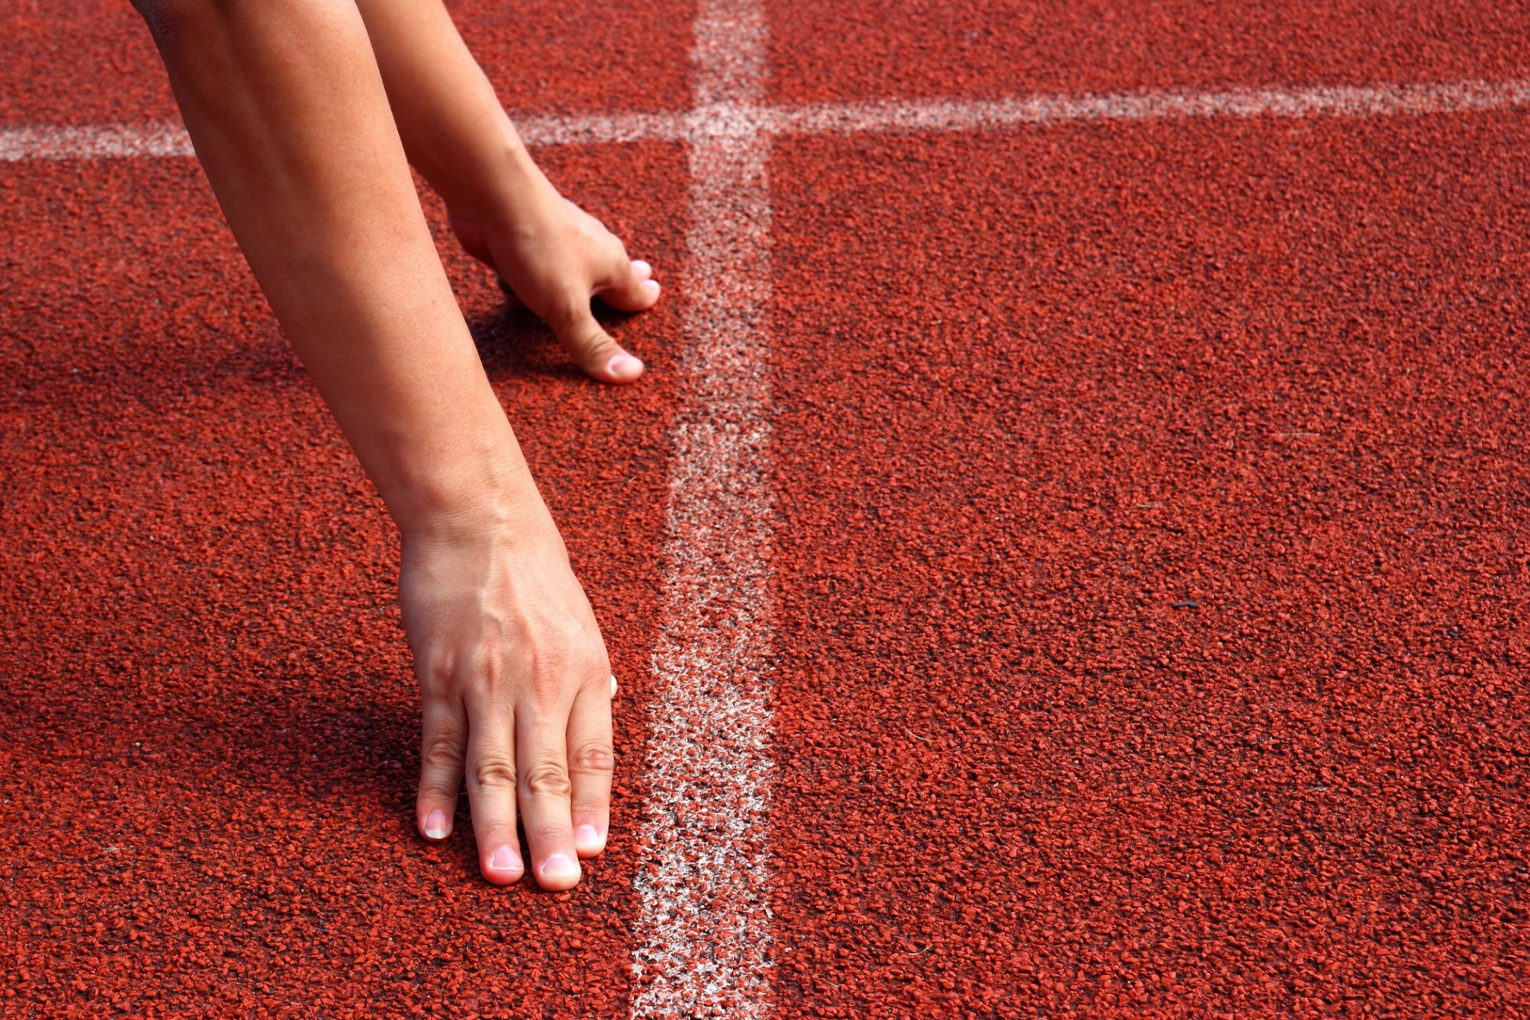
WARM UP

Slide 5
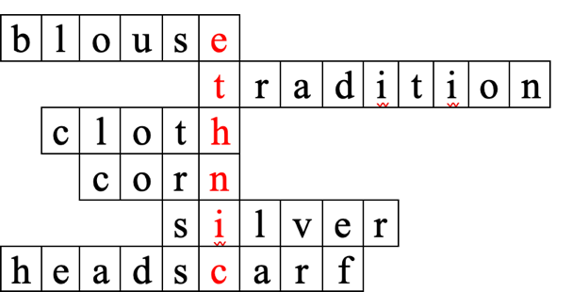
Solve the crossword puzzle
1
1. I think I’ll wear a nice, blue _______ and a pants to the party.
b
l
o
u
s
e
2
t
r
a
d
i
t
i
o
n
2 Many people in my ethnic village celebrate the festival from old village _______.
3
c
l
o
t
h
4
n
5
i
3. My mom uses a _______ to clean the table.
6
c

Slide 6
Solve the crossword puzzle
4. My grandma makes a _______ cake for Tết holiday.
1
b
l
o
u
s
e
2
t
r
a
d
i
t
i
o
n
5. I have a _______ necklace. It’s very beautiful and flashy.
3
c
l
o
t
h
4
c
o
r
n
6. Pu Péo wear a long skirt, two different vests, and a _______ on their head.
5
s
i
l
v
e
r
6
h
e
a
d
s
c
a
r
f

Slide 7
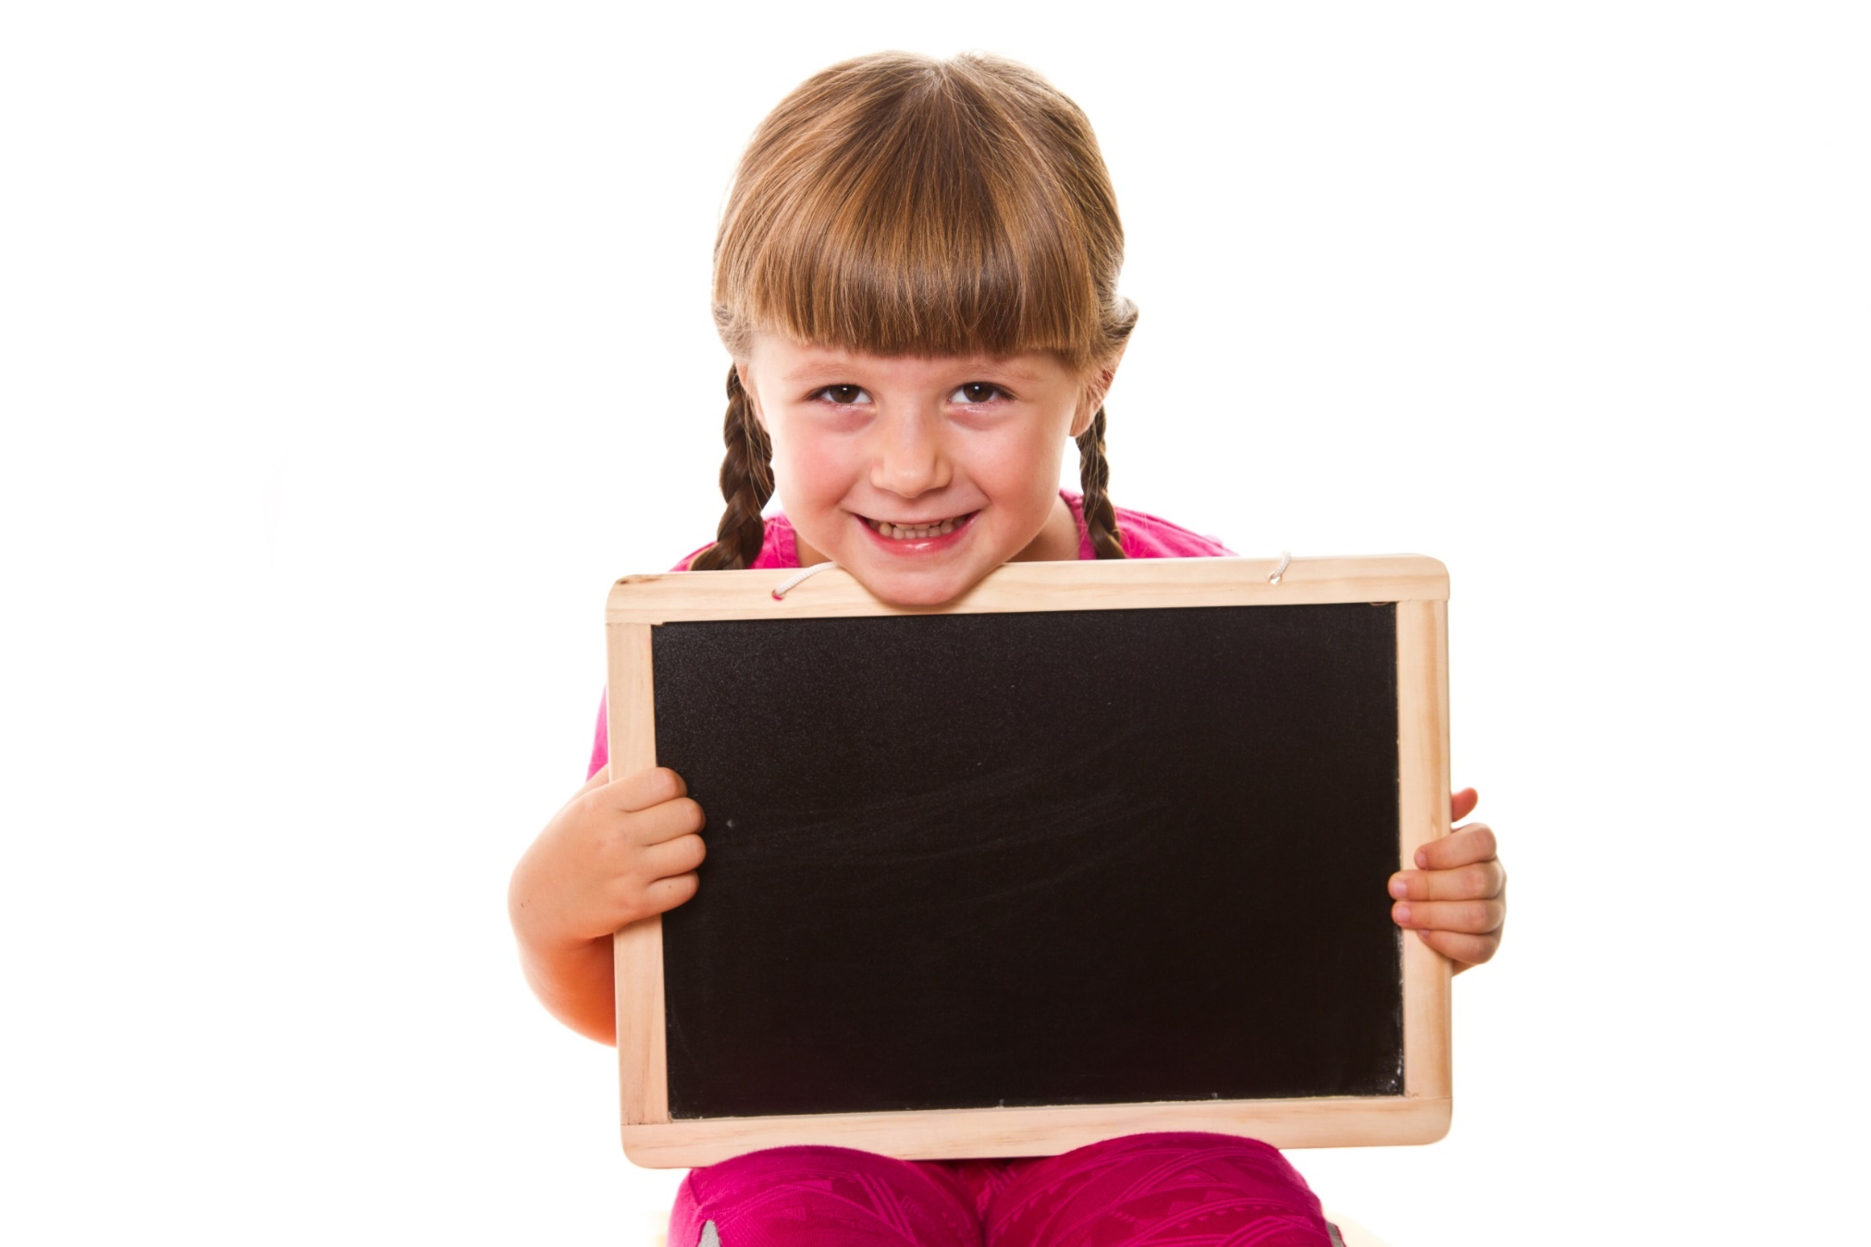
Pre-listening

Slide 8
Pre-listening
Read the instruction and the question quickly:
Underline key words.
Read each option carefully and put a tick (✓).

Slide 9
While-listening

Slide 10
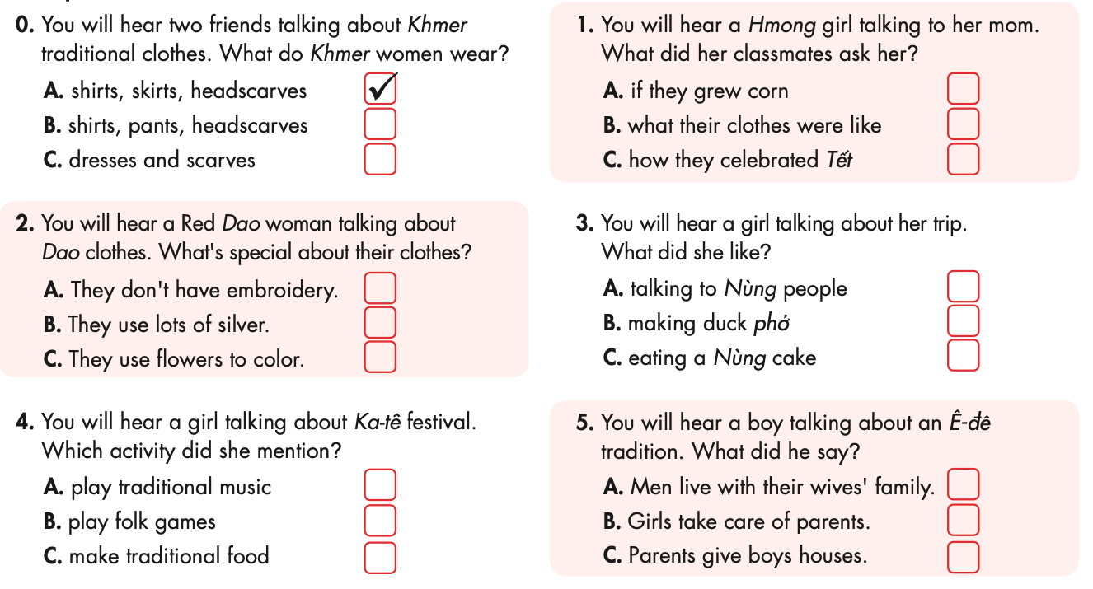
✓
✓
✓
✓
✓

Slide 11
Post-listening

Slide 12
Listen again and fill in the gaps.
Example
Trang: Hey, today I learned about Khmer traditional clothes.
It was _______________.
Nam: Cool. What are their clothes like?
Trang: The women wear a special kind of ___________________, and headscarves. Their clothes are ________. The men's clothes are simpler.
Nam: Yeah, women's clothes are usually prettier.
interesting
skirt with shirts
colorful

Slide 13
Listen again and fill in the gaps.
1
Mrs.Tẩn: How was school today, Phương?
Phương: It was _____, Mom. My classmates asked me so many questions.
Mrs.Tẩn: Yeah?
Phương: Lan asked me if we always _____ traditional clothes. And Phong asked me how we ___________ Tết. They really liked learning about our __________!
Mrs.Tẩn: That's great.
great
wore
celebrate
culture

Slide 14
Listen again and fill in the gaps.
2
Mrs. Phùng: Our clothes have lots of beautiful ___________. But the special thing about our clothes is that we ____________ them with lots of silver. Here are some _____________, and here you can see different __________ such as the sun, the moon, and stars...
embroidery
decorate
silver flowers
patterns

Slide 15
Listen again and fill in the gaps.
3
Jack: How was your trip to Vietnam?
Lucy: It was __________! I met a Nùng family and tried lots of _______.
Jack: Nùng?
Lucy: The Nùng are an ______________ in Vietnam.
Jack: So, what food did you try?
Lucy: Sticky rice, duck phở, and a black cake. I really liked the _______.
amazing
food
ethnic group
cake

Slide 16
Listen again and fill in the gaps.
4
Linh: Hello, I'm Linh. Today I want to talk about one of our festivals, Ka-tê festival. If you visit a Chăm village in ___________, you'll see how we celebrate it. We perform _________________ and play lots of _______________. It's a very fun time.
October
traditional dances
folk games

Slide 17
Listen again and fill in the gaps.
My: How was your trip?
Duy: It was _____. We learned a few things about Ê-đê culture.
My: Yeah?
Duy: I asked them what special tradition they had and they said the men lived with their ______________ after _____________.
My: Oh, I like that!
Duy: Haha, then you'll love this: only girls get _________ and _________ from their parents. Boys don't get anything!
My: I love it!
5
fun
wives’ family
getting married
houses
money

Slide 18
Pre-Reading

Slide 19
Read the instructions, underline the key words and say what you are going to do.

Slide 20
Vocabulary
collection (n) /kəˈlekʃən/ bộ sưu tầm
furniture (n) /ˈfərnɪtʃər/ đồ dùng nội thất trong nhà
crop (n) /krɑp/ vụ mùa

Slide 21
While-Reading

Slide 22
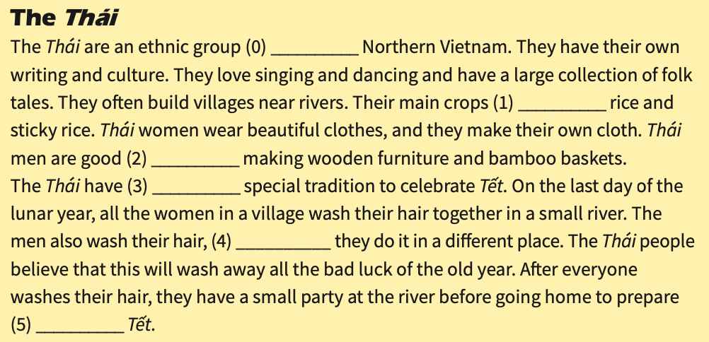
in
are
at
a
but
for

Slide 23
Post-Reading

Slide 24
Quick Quiz
Read the passage again. Answer the questions.
1. Where do the Thái live?
2. Where do the Thái often build their villages?
3. What are their main crops?
4. What are Thái men good at?
5. What do the Thái women do on the last day of lunar year?
6. What do the Thái do after washing their hair on the last day of lunar year?

Slide 25
Quick Quiz
Read the passage again. Answer the questions.
1. Where do the Thái live?
2. Where do the Thái often build their villages?
3. What are their main crops?
4. What are Thái men good at?
5. What do the Thái women do on the last day of lunar year?
6. What do the Thái do after washing their hair on the last day of lunar year?
Northern Vietnam
near rivers
rice and sticky rice
making wooden furniture and bamboo baskets
wash hair together in a small river
have a small party

Slide 26
CONSOLIDATION

Slide 27
Write a short passage about an ethnic group you know. Remember to include:
+ Where do they live?
+ What are their culture?
+ What do their clothes look like?
+ What is their belief?

Slide 28
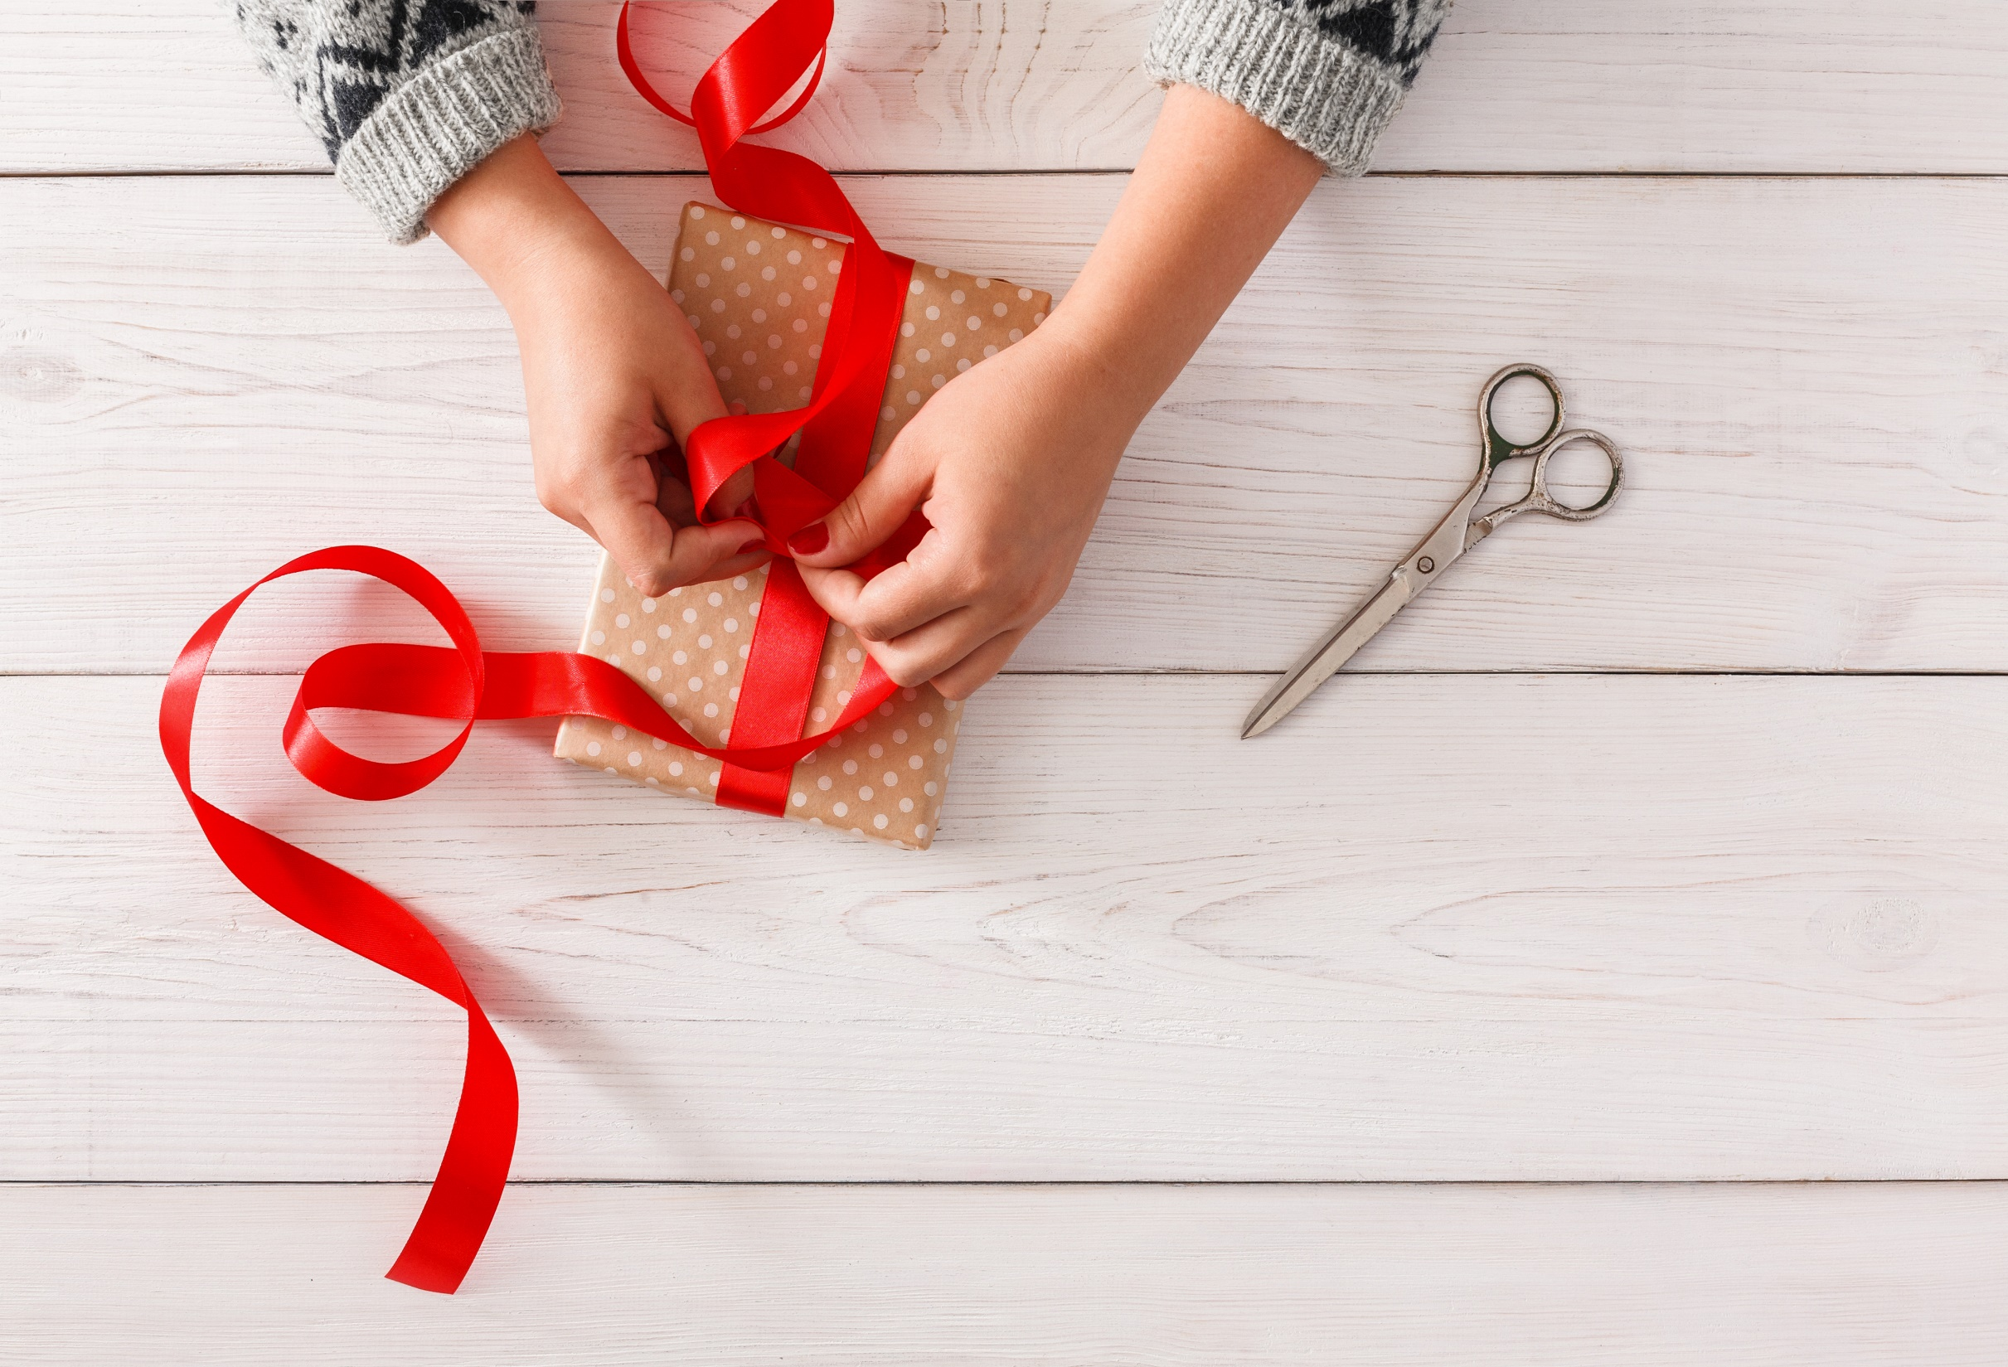
WRAP-UP

Slide 29
Today’s lesson
Listening
Listen to different conversations about ethnic groups.
Reading
Read a passage about the Thái.

Slide 30
Homework
Learn by heart all the new words.
Do the review listening exercise part 1 (page 57 WB)
Prepare the next lesson (page 105 SB)
Play the consolidation games on www.eduhome.com.vn

Slide 31
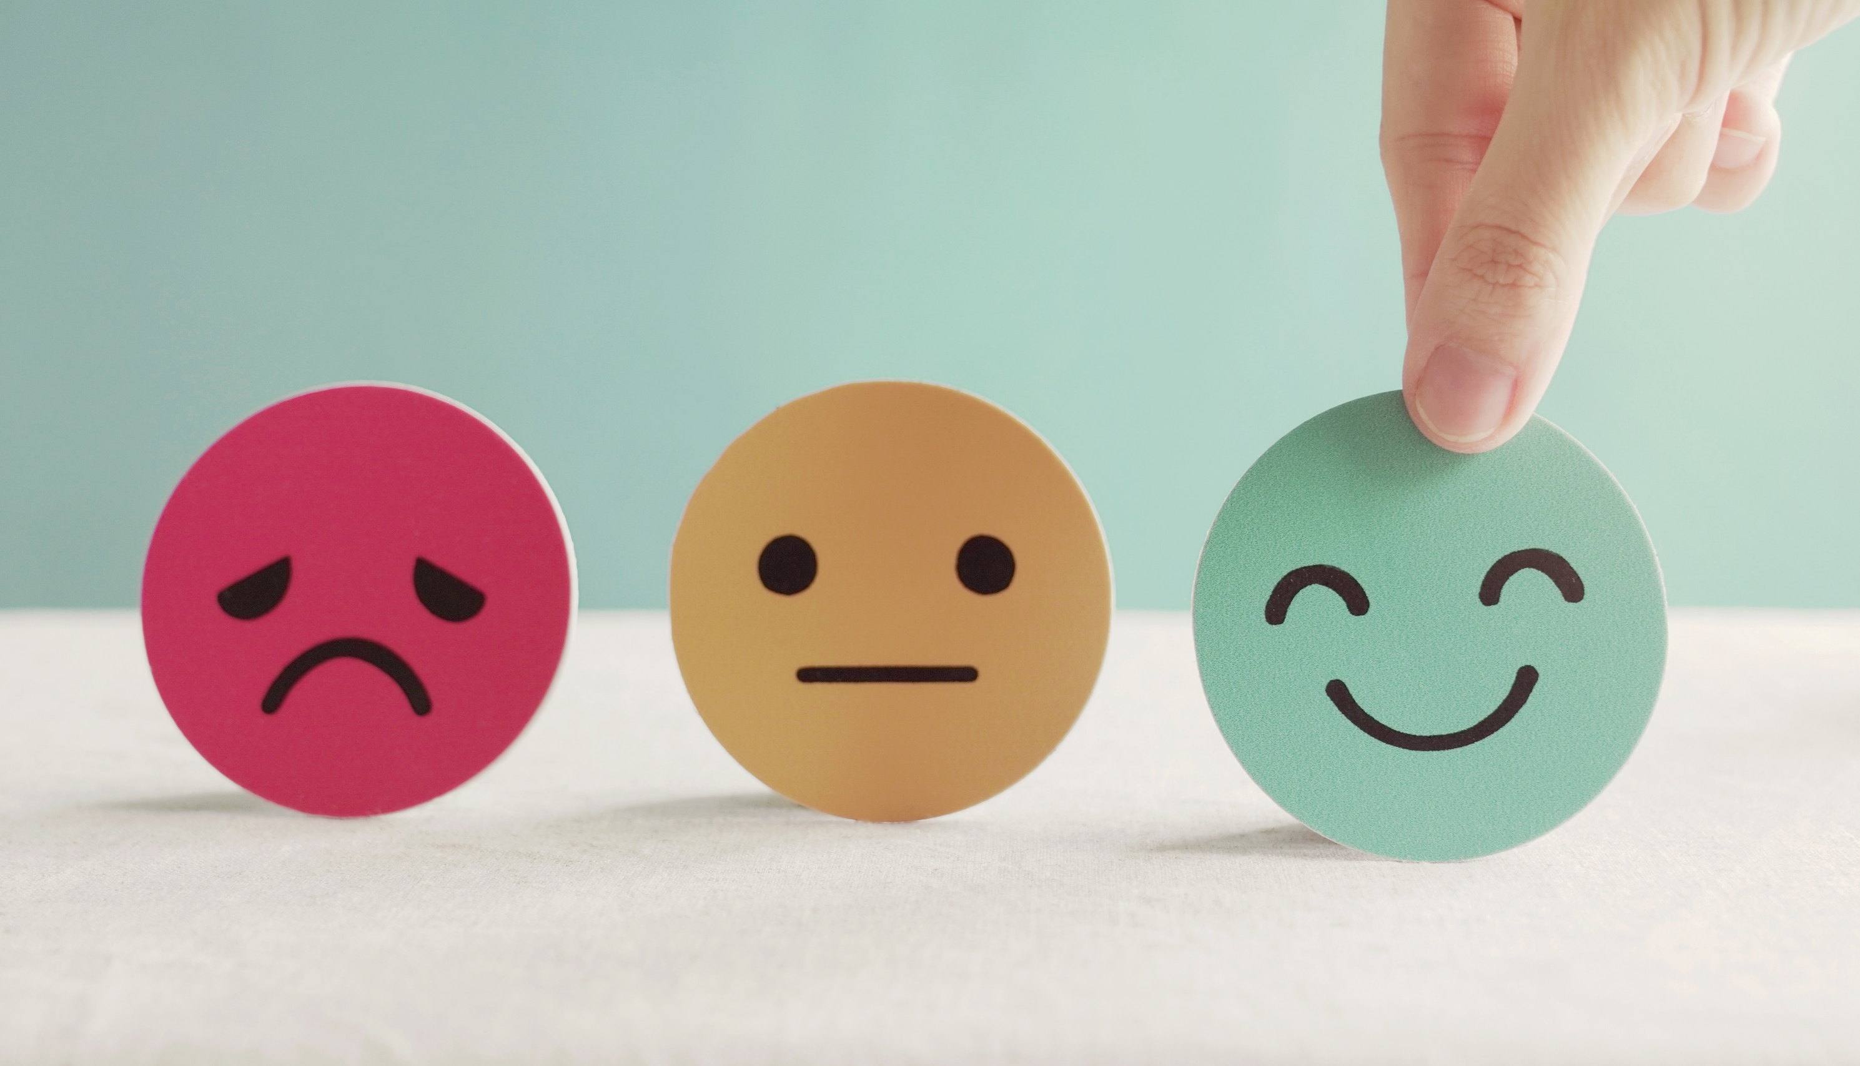
Lesson 3
Stay positive and have a nice day!

