Slide 1
UNIT 7: TEENS
Lesson 2.2 – Grammar
Pages 69 & 70

Slide 2
Lesson Outline
Warm-up
Grammar
Practice
Consolidation
Wrap-up

Slide 3
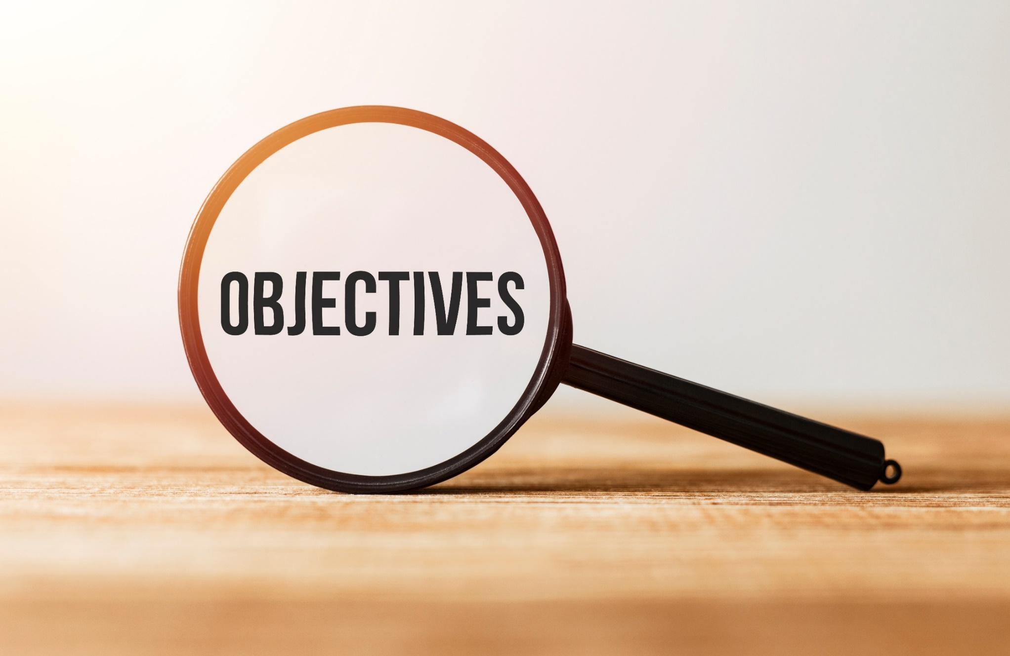
By the end of this lesson, students will be able to…
Practice and use Reported speech for statements correctly

Slide 4
WARM UP

Slide 5
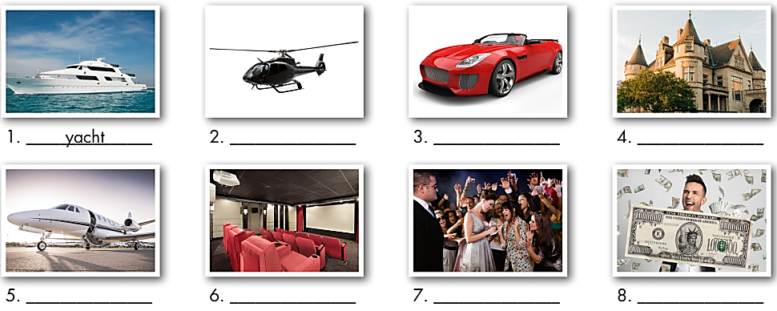
In pairs. Say the correct word for each of the pictures below:
yacht
helicopter
sports car
mansion
jet
celebrity
millionaire
home theatre

Slide 6
Listen and repeat.
______________
celebrity (n) /səˈlebrəti/ người nổi tiếng
helicopter (n) /ˈhelɪkɑːptər/ trực thăng
home theater (n) /ˌhoʊm ˈθiːətər/ rạp chiếu phim tại nhà
jet (n) /dʒet/ máy bay phản lực
mansion (n) /ˈmænʃn/ biệt thự
millionaire (n) /ˌmɪljəˈner/ triệu phú
sports car (n) /ˈspɔːrts kɑːr/ xe ô-tô thể thao
yacht (n) /jɑːt/ du thuyền

Slide 7
Grammar
Presentation

Slide 8
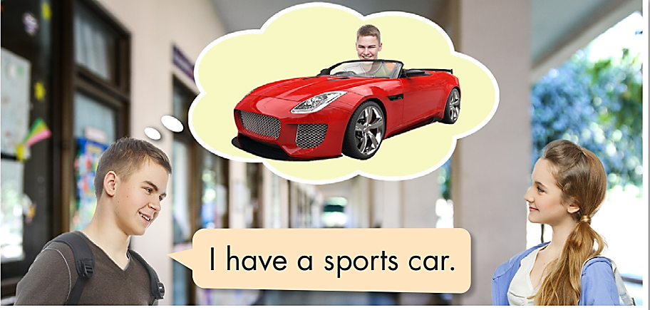
a. Read about reported speech for statements and fill in the blanks.
We can use Reported Speech to repeat what people said in the past in our words.
Jane: I have a helicopter and a mansion.
John: Jane said she had a helicopter and a mansion.

Slide 9

b. Listen and check your answers. Listen again and repeat.

said had


Slide 10
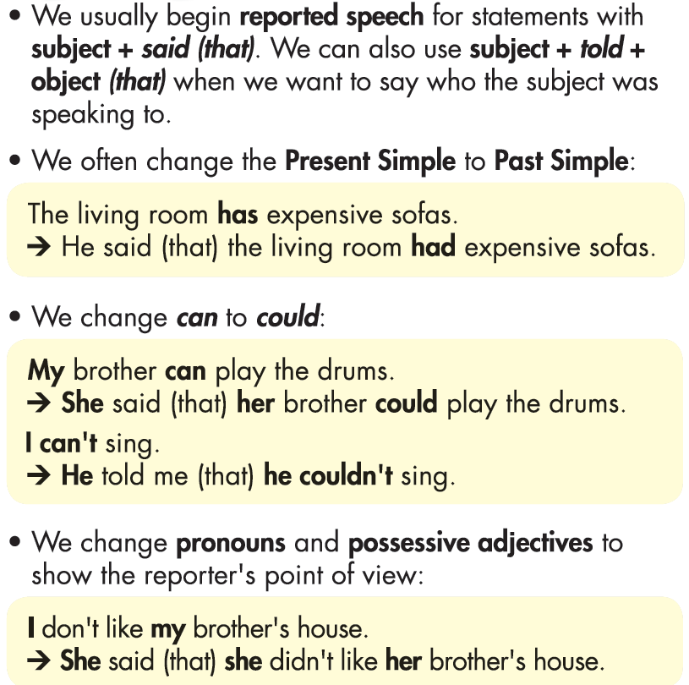
a. Read the notes and examples.

Slide 11
Practice

Slide 12
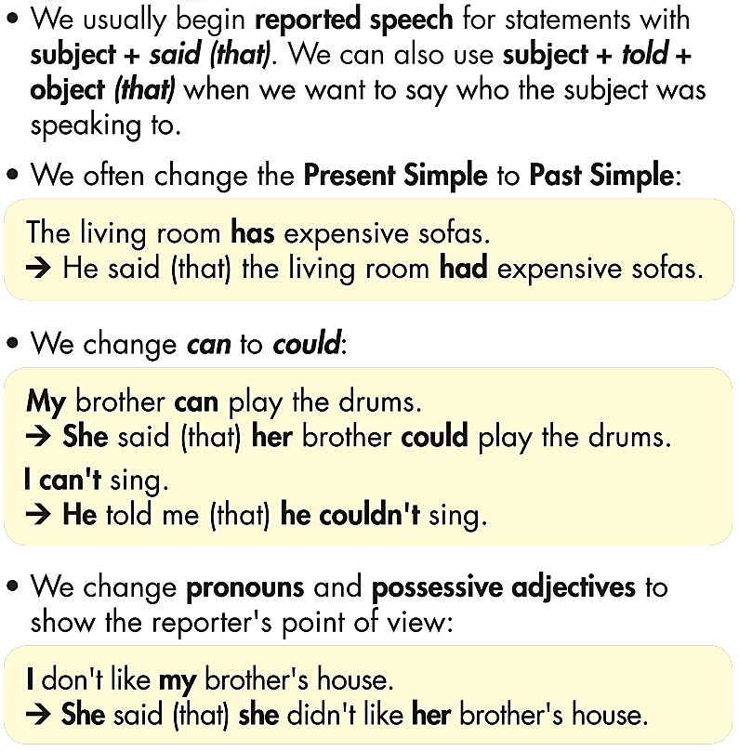
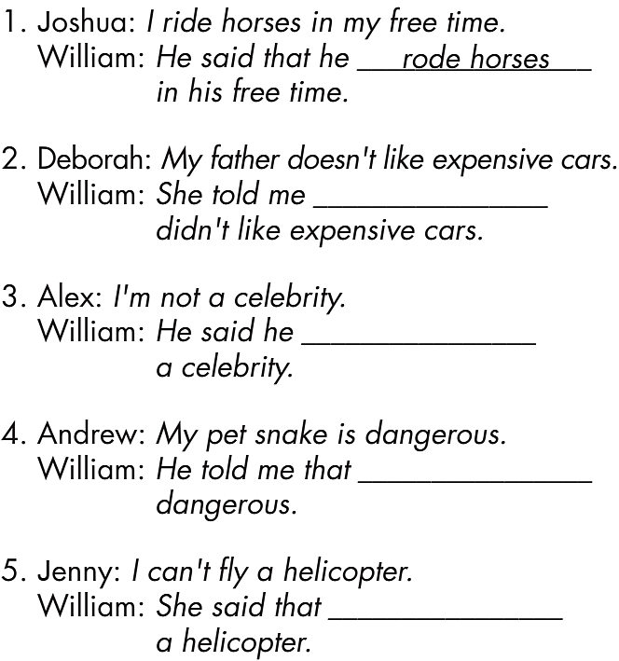
Fill in the blanks.
(that) her father
that he wasn’t
his pet snake was
she couldn’t fly

Slide 13
b. Complete the sentences to report what these people said.
1. Michelle: I have a pet snake. William: She said ________________________________. 2. Robert: My sister is a famous musician. William: He told _________________________________. 3. Amanda: My father doesn't like his new mansion. William: She told _________________________________. 4. Jacob: I can't live without my sports car. William: He said _________________________________. 5. Betty: I don't have an expensive yacht. William: She told _________________________________.
(that) she had a pet snake.
me (that) his sister was a famous musician
me (that) her father didn’t like his new mansion
(that) he couldn’t live without his sports car
me (that) she didn’t have an expensive yacht

Slide 14
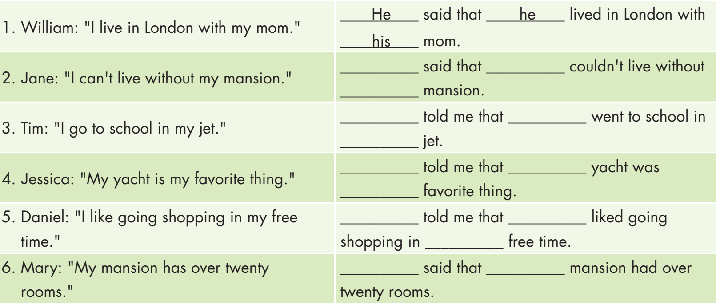
Extra Practice
WB, p.41
Look and write the correct pronouns.
She she
her
He he
his
She her
her
He he
his
She her

Slide 15
Extra Practice
WB, p.41
Look and check the correct answers.







Slide 16
Production

Slide 17
c. In pairs: Take turns reporting what these people said to you.




He said that he was not a millionaire.
She told me that she had a really big jet.
He said that he didn’t like sports cars.
She said that her mansion had a home theater.
Click on the  to see each answer.

Slide 18
CONSOLIDATION

Slide 19
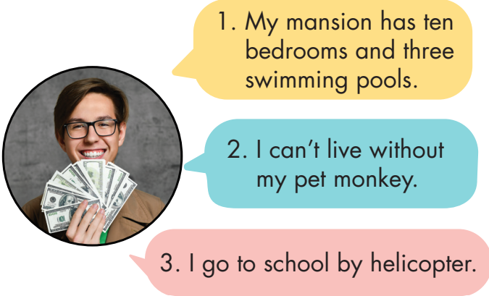
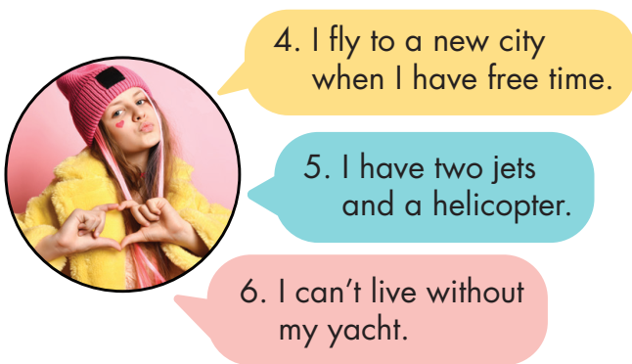
Look at the speech bubbles. Write the sentences using reported speech and the reporting verbs.
(said) _____________________________ 4. (told) ___________________________
(told) _____________________________ 5. (said) ___________________________
(said) _____________________________ 6. (told) ___________________________
He said that his mansion had …
She told me that she flew… when she had…
He told me that he couldn’t live…his…
She said that she had …
He said that he went to …
She told me that she couldn’t live…her…

Slide 20
WRAP-UP

Slide 21
Today’s lesson
Practice and use Reported speech for statements correctly

Slide 22
Homework
Review Reported speech for statements.
Do the exercises on page 41 WB.
Do the exercises in Tiếng Anh 8 i-Learn Smart World Notebook, Page 59.
Prepare the next lesson (Pages 70 & 71, SB)
Play the consolidation games on www.eduhome.com.vn

Slide 23
Lesson 3
Stay positive and have a nice day!

