Slide 1
UNIT 7: TEENS
Lesson 1.3 – Pronunciation & Speaking
Pages 66 & 67

Slide 2
Lesson Outline
Warm-up
Pronunciation
Speaking
Consolidation
Wrap-up

Slide 3
By the end of this lesson, students will be able to…
To practice the /iː/ sound
To talk about dreams and dream jobs, using possessive pronouns and functional English - Responding to ideas

Slide 5
WARM UP

Slide 6
Choose the word whose underlined part is pronounced differently from that of the others.
A. said B. paid C. maid D. laid
2. A. month B. mother C. bother D. brother
3. A. eight B. height C. weight D. freight
/ sed / / peɪd / / meɪd / / leɪd /
/ mʌnθ / / ˈmʌðə / / ˈbɑːðər / / ˈbrʌðər /
/ eɪt / / haɪt / / weɪt / / freɪt /

Slide 7
Choose the words whose main stress is placed differently from the others.
A. vitamin B. apartment C. document D. festival
2. A. computer B. disaster C. elephant D. vanilla
3. A. different B. important C. expensive D. possessive
/ˈvaɪtəmɪn/ /əˈpɑːrtmənt/ /ˈdɑːkjʊmənt/ /ˈfestɪvəl/
/kəmˈpjuːtər/ /dɪˈzæstər/ /ˈeləfənt/ /vəˈnɪlə/
/ ˈdɪfərənt / / ɪmˈpɔːrtənt / / ɪkˈspensɪv / / pəˈzesɪv /

Slide 8
Pronunciation

Slide 9
Listen and repeat.
team / tiːm /
screen / skriːn /
disease / dɪˈziːz /
peace / piːs /
steamed / stiːmd /
recycle / ˌriːˈsaɪkl /







Slide 10


Slide 11

/e/
/iː/
/iː/
/iː/

Slide 13
Practice

Slide 14
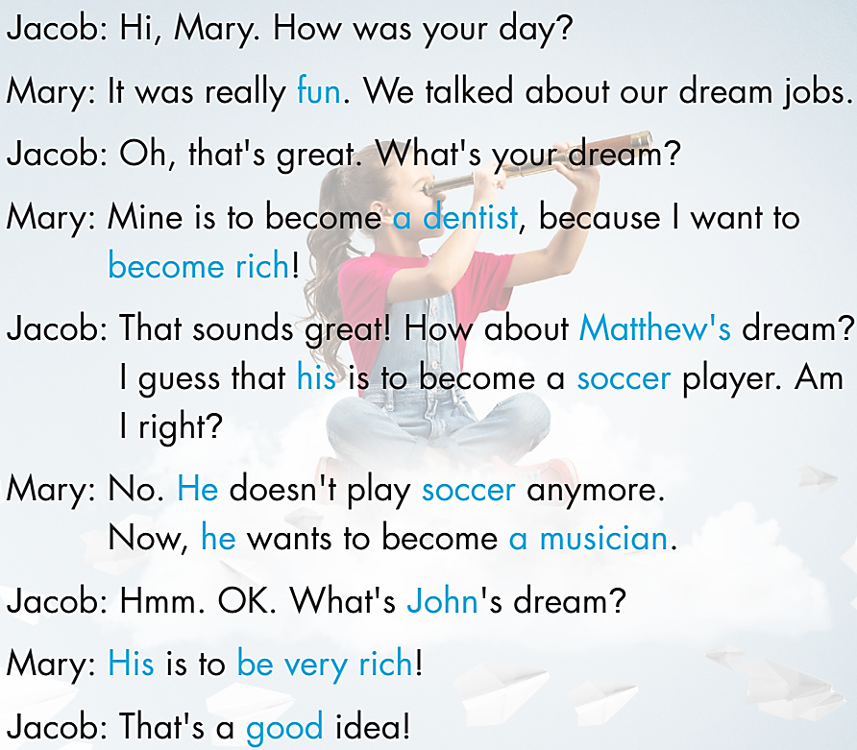
a. Practice the conversation.
Swap roles and repeat.

Slide 15
b. Make two more conversations using the ideas on the right. Remember to use the correct pronouns.

Slide 17
Speaking

Slide 18
a. You're doing a survey about what teens want to do in the future. Fill in the survey for yourself.

Slide 19
In fours: Ask three friends what their dreams are and why. Then, complete the table.

Slide 20
b. Join a student from another group. Ask about their group's dreams.

Slide 21
CLASS DISCUSSION
c. What do you think is the most popular dream for young people? Why?

Slide 22
CONSOLIDATION

Slide 23
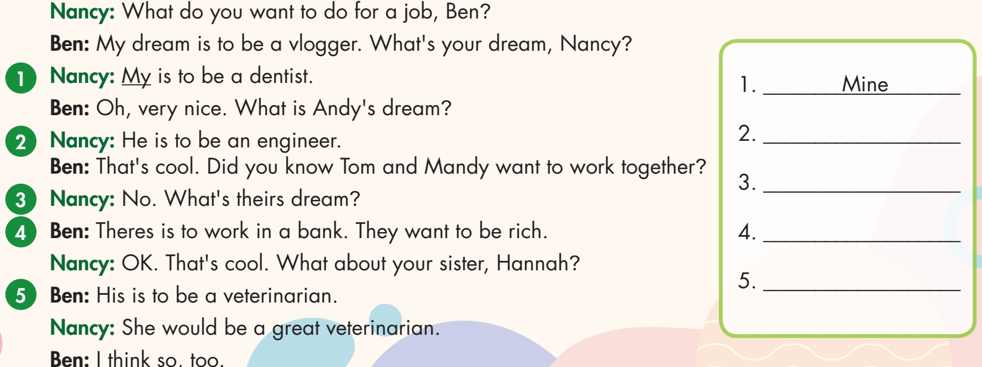
Read the conversation. Underline the mistakes and write the correct words on the lines.
__
His
their
___
____
theirs
Hers
__

Slide 24
WRAP-UP

Slide 25
Today’s lesson
Pronunciation:
- To practice sound /iː/
Speaking:
- To talk about dreams and dream jobs, using possessive pronouns and functional English - Responding to ideas

Slide 26
Homework
Practice the sound /iː/.
Do the exercises on page 39, WB.
Prepare the next lesson (pages 68 & 69, SB)
Play the consolidation games on www.eduhome.com.vn

Slide 27
Lesson 3
Stay positive and have a nice day!

