Slide 1
Unit 6: Life on other planets
REVIEW 2
Page 99

Slide 2
Lesson Outline
Warm-up
Vocabulary
Grammar
Pronunciation
Writing
Consolidation
Wrap-up

Slide 3
By the end of this lesson, students will be able to…
- review vocabularies and grammar points in Unit 6.
- practice listening, reading, and speaking skills.
- practice test-taking skills.

Slide 4
Lesson 1
WARM UP

Slide 5
Read the statements and choose the correct pictures.

Slide 6
Read the statements and choose the correct pictures.

Slide 7
Vocabulary

Slide 8
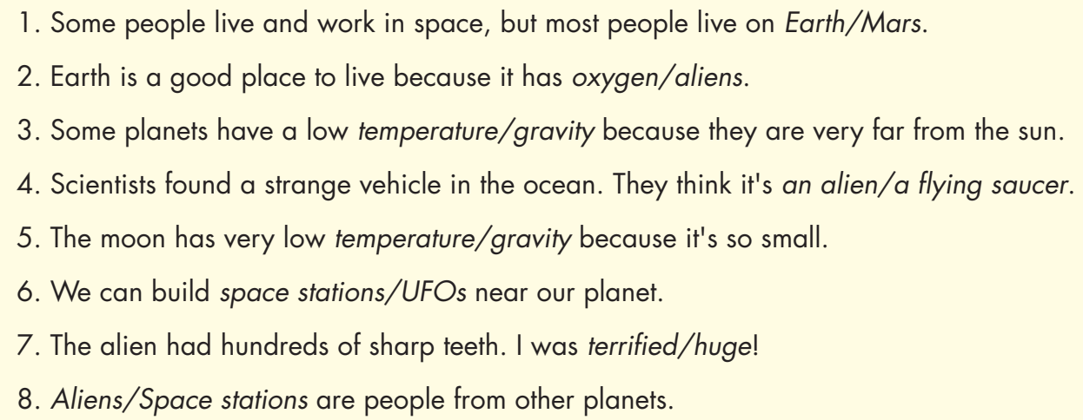

Slide 9
Grammar

Slide 10
were => was
did => will
hearing => heard
year => years
look => looking
Do => Will

Slide 11
Pronunciation

Slide 12
Circle the word that differs from the other three in the position of primary stress in each of the following questions.
1. A. visitor B. popular C. alien D. important 2. A. planet B. station C. affect D. people 3. A. similar B. prediction C. gravity D. scientist

Slide 13
Writing

Slide 14
Can you remember how to write a narrative passage?

Slide 15
Suggested Writing
In a hundred years, I think humans will find a new place to live. I think the Earth will be too hot for humans. We will find a new home on another planet. Some people will live in a space station. They will have a great view of the Earth, but they won't have any gravity. I don't think people will live on Venus. Its temperature is too high. I think people will live on Mars. People will build a city that is warm enough and has gravity and oxygen. I think the future will be exciting.

Slide 16
Write a narrative passage.
Check your answers with a partner, using the feedback form.

Slide 17
CONSOLIDATION

Slide 18
Work in pairs.
Make three predictions of humans’ future home

Slide 19
WRAP-UP

Slide 20
Today’s lesson
Review:
- Grammar of Unit 6: Future Simple, Past Continuous and Past Simple.
- Vocabulary of Unit 6: Words of the topic “life on other planets”.
- Vocabulary, Grammar, Pronunciation and Writing Practice to review the topic “Life on other planets”.

Slide 21
Lesson 3
Homework
- Review vocabulary, grammar and language skills of unit 6.
- Do the exercises in WB: Unit 6 Review - Part 2 (page 55).
- Prepare: Unit 7 – New words and Listening (pages 64 & 65 – SB).

Slide 22
Lesson 3
Stay positive and have a nice day!

