Slide 1

Unit 6: Life on other planets
Lesson 2.2 – Grammar
Pages 59 & 60

Slide 2
Lesson Outline
Warm-up
Grammar
Consolidation
Wrap-up

Slide 3

By the end of this lesson, students will be able to…
- practice and use the Past Continuous and the Past Simple correctly

Slide 4

Lesson 1
WARM UP

Slide 5

Listen to the song by Celine Dion and write down verbs
in the past simple.
Because you loved me

Slide 6
Listen to the song and write down verbs in the past simple.
19 verbs: lifted, believed, loved, carried, blessed, stood, made, brought, found, held, let, saw, were, was, could, gave, lost, said, had.
Because you loved me

Slide 7

Presentation

Slide 8


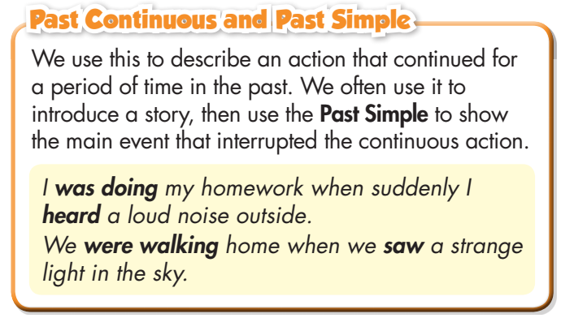
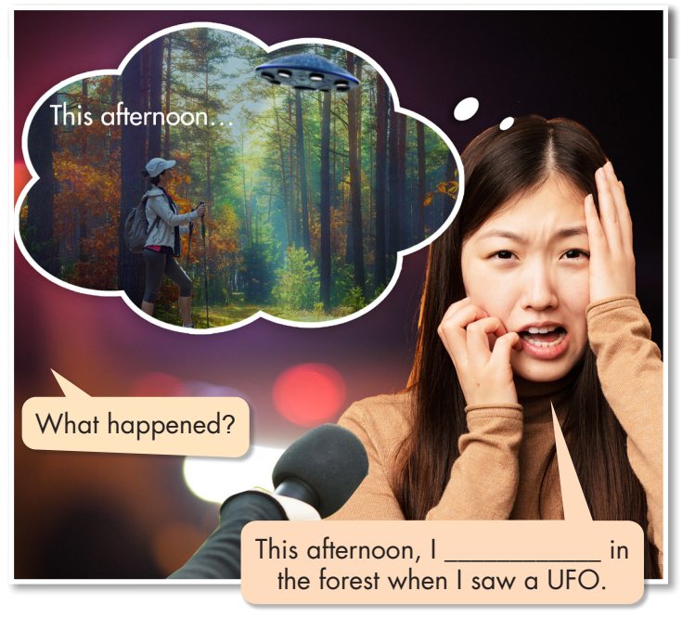

Slide 9
was walking

Slide 10




Slide 11


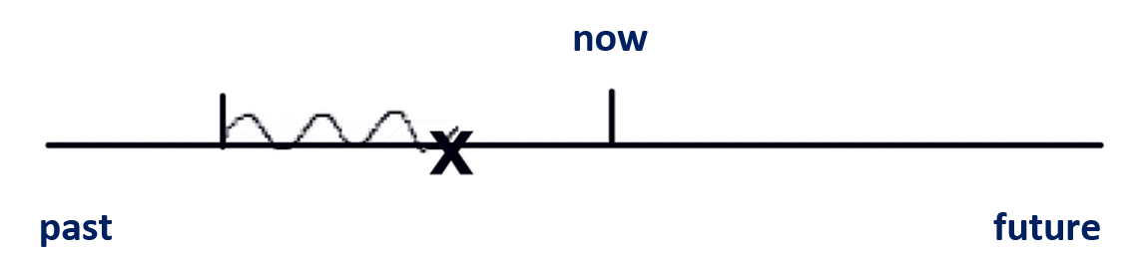
Describe an action that continued for a period of time in the past (Past Continuous).
Introduce a story, then use the Past Simple to show the main event (Past Simple) that interrupted the continuous action (Past Continuous).
Past Continuous
Past Simple
E.g.: I was doing my homework when suddenly I heard a loud noise outside.

Slide 12

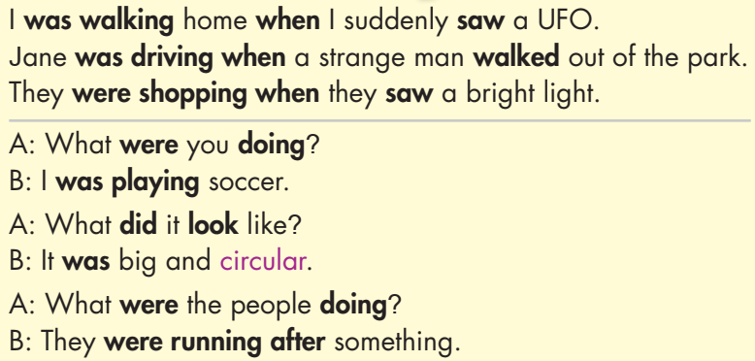

Slide 13
 | PAST SIMPLE | PAST CONTINUOUS
FORM | V2/ -ed | was/were V-ing
USE | Describe a finished past action. | Describe an action that continued for a period of time in the past. Introduce a story, then use the Past Simple to show the main event (Past Simple) that interrupted the continuous action (Past Continuous).
TIME MAKERS | • yesterday • last (last week, last month, last year, etc.) • ago (three days ago, etc.) • when | at 8 p.m last night When While

Slide 14
Subject | was/ were | V_ing
I He She It | was | reading walking swimming learning working running
You We They | were

Slide 15

Practice

Slide 16

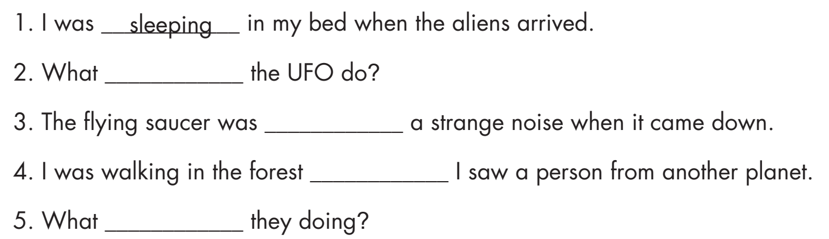
did
making
when
were

Slide 17
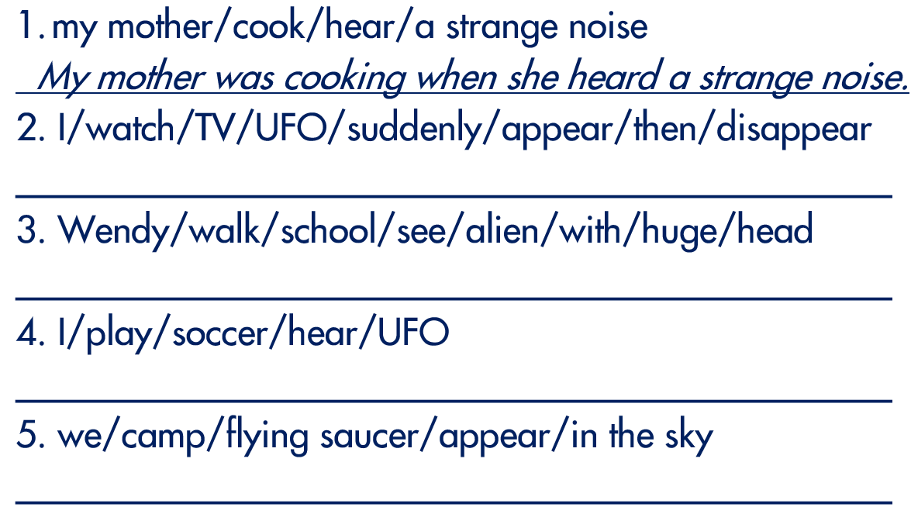
I was watching TV when a UFO suddenly appeared then disappeared.
Wendy was walking to school when she saw an alien with a huge head.
I was watching TV when a UFO suddenly appeared then disappeared.
We were camping when a flying saucer appeared in the sky.

Slide 18

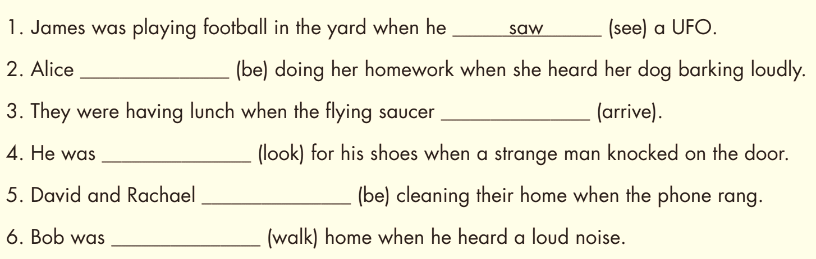
Extra Practice
WB page 35
was
arrived
looking
were
walking

Slide 19

Production:
Speaking

Slide 20

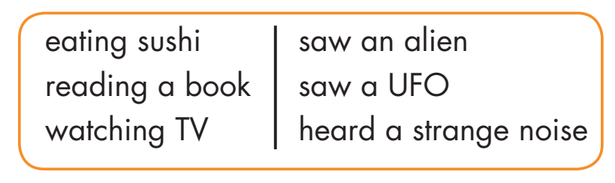
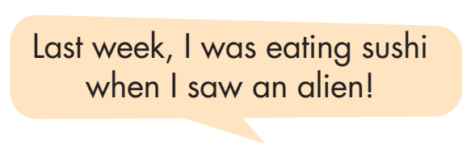

Slide 21
Share with your class!

Slide 22

CONSOLIDATION

Slide 23
WHAT WERE YOU DOING THEN?
Work in pairs.
Talk about what you saw/ felt/ did… when you were doing something yesterday.

Slide 24

WRAP-UP

Slide 25
Today’s lesson
Grammar:
Using the past continuous to describe an action that continued for a period of time in the past.
Using this to introduce a story, then use the Past Simple to show the main event that interrupted the continuous action.
Speaking:
- Making sentences using the prompts.

Slide 26
Lesson 3
Homework
- Make three sentences, using Past Continuous and Past Simple.
- Do the exercises in WB: Grammar (page 35).
- Do the exercises in Tiếng Anh 8 i-Learn Smart World Notebook (page 51).
- Play the consolidation games in Tiếng Anh 8 i-Learn Smart World DHA App on www.eduhome.com.vn
- Prepare: Lesson 2.3 – Pronunciation and Speaking (pages 60 & 61 – SB).

Slide 27

Lesson 3
Stay positive and have a nice day!

