Slide 1

Unit 6: Life on other planets
Lesson 1.3 – Pronun. & Speaking
Pages 56 & 57

Slide 2
Lesson Outline
Warm-up
Pronunciation
Speaking
Consolidation
Wrap-up

Slide 3

By the end of this lesson, students will be able to…
- practice intonation for interest / opinion words.
- practice making predictions about where humans will live in the future, using Future Simple.

Slide 4

Lesson 1
WARM UP

Slide 5
Odd One Out
Choose the word whose underlined part is pronounced differently form that of the others.
A. planet B. packet C. landslide D. storage
/ˈplænɪt/ /ˈpækɪt/ /ˈlændslaɪd/ /ˈstɔːrɪdʒ/
2. A. gravity B. oxygen C. gigabyte D. gallery
/ˈɡrævəti/ /ˈɑːksɪdʒən/ /ˈɡɪɡəbaɪt/ /ˈɡæləri/
3. A. Earth B. dream C. cream D. jeans
/ɜːrθ/ /driːm/ /kriːm/ /dʒiːnz/

Slide 6
Odd One Out
Choose the words whose main stress is placed differently from the others.
A. answer B. complete C. reduce D. protect
/ˈænsər/ /kəmˈpliːt/ /rɪˈduːs/ /prəˈtekt/
2. A. recognize B. navigate C. decorate D. disappear
/ˈrekəɡnaɪz/ /ˈnævəɡeɪt/ /ˈdekəreɪt/ /dɪsəˈpɪr/
3. A. typhoon B. Venus C. saucer D. feature
/taɪˈfuːn/ /ˈviːnəs/ /ˈsɑːsər/ /ˈfiːtʃər/

Slide 7

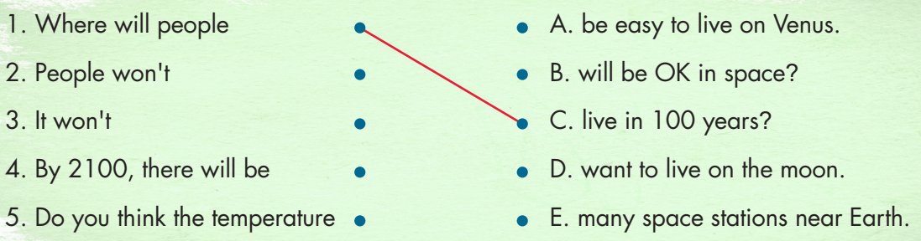

Slide 8

Pronunciation

Slide 9

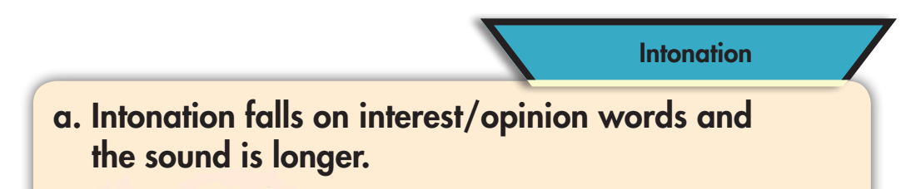


Slide 10




Slide 11
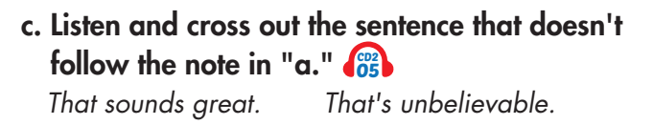
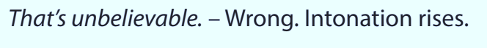

Slide 12

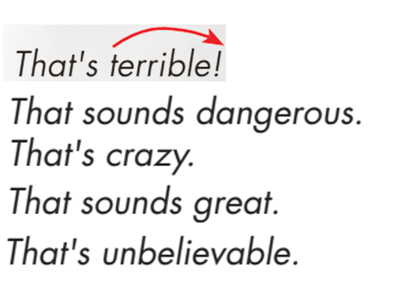

Slide 13
Practice:
Speaking

Slide 14

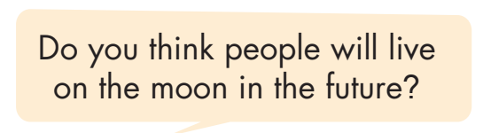
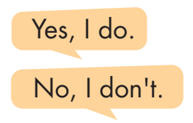

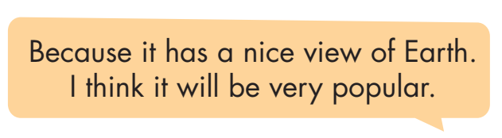
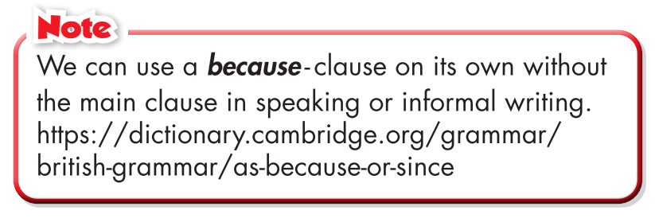
Work in pairs

Slide 15
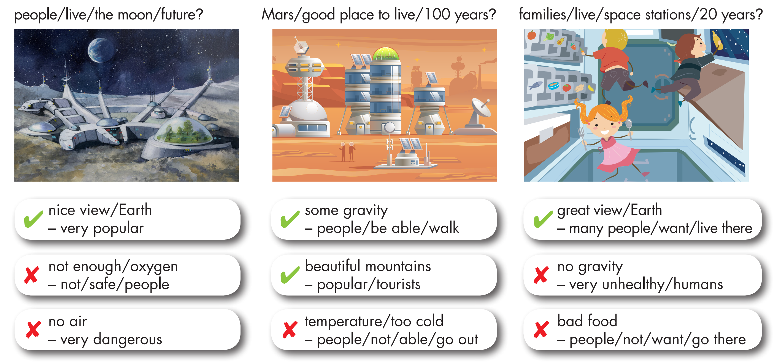
Take turns asking and answering using the prompts.

Slide 16
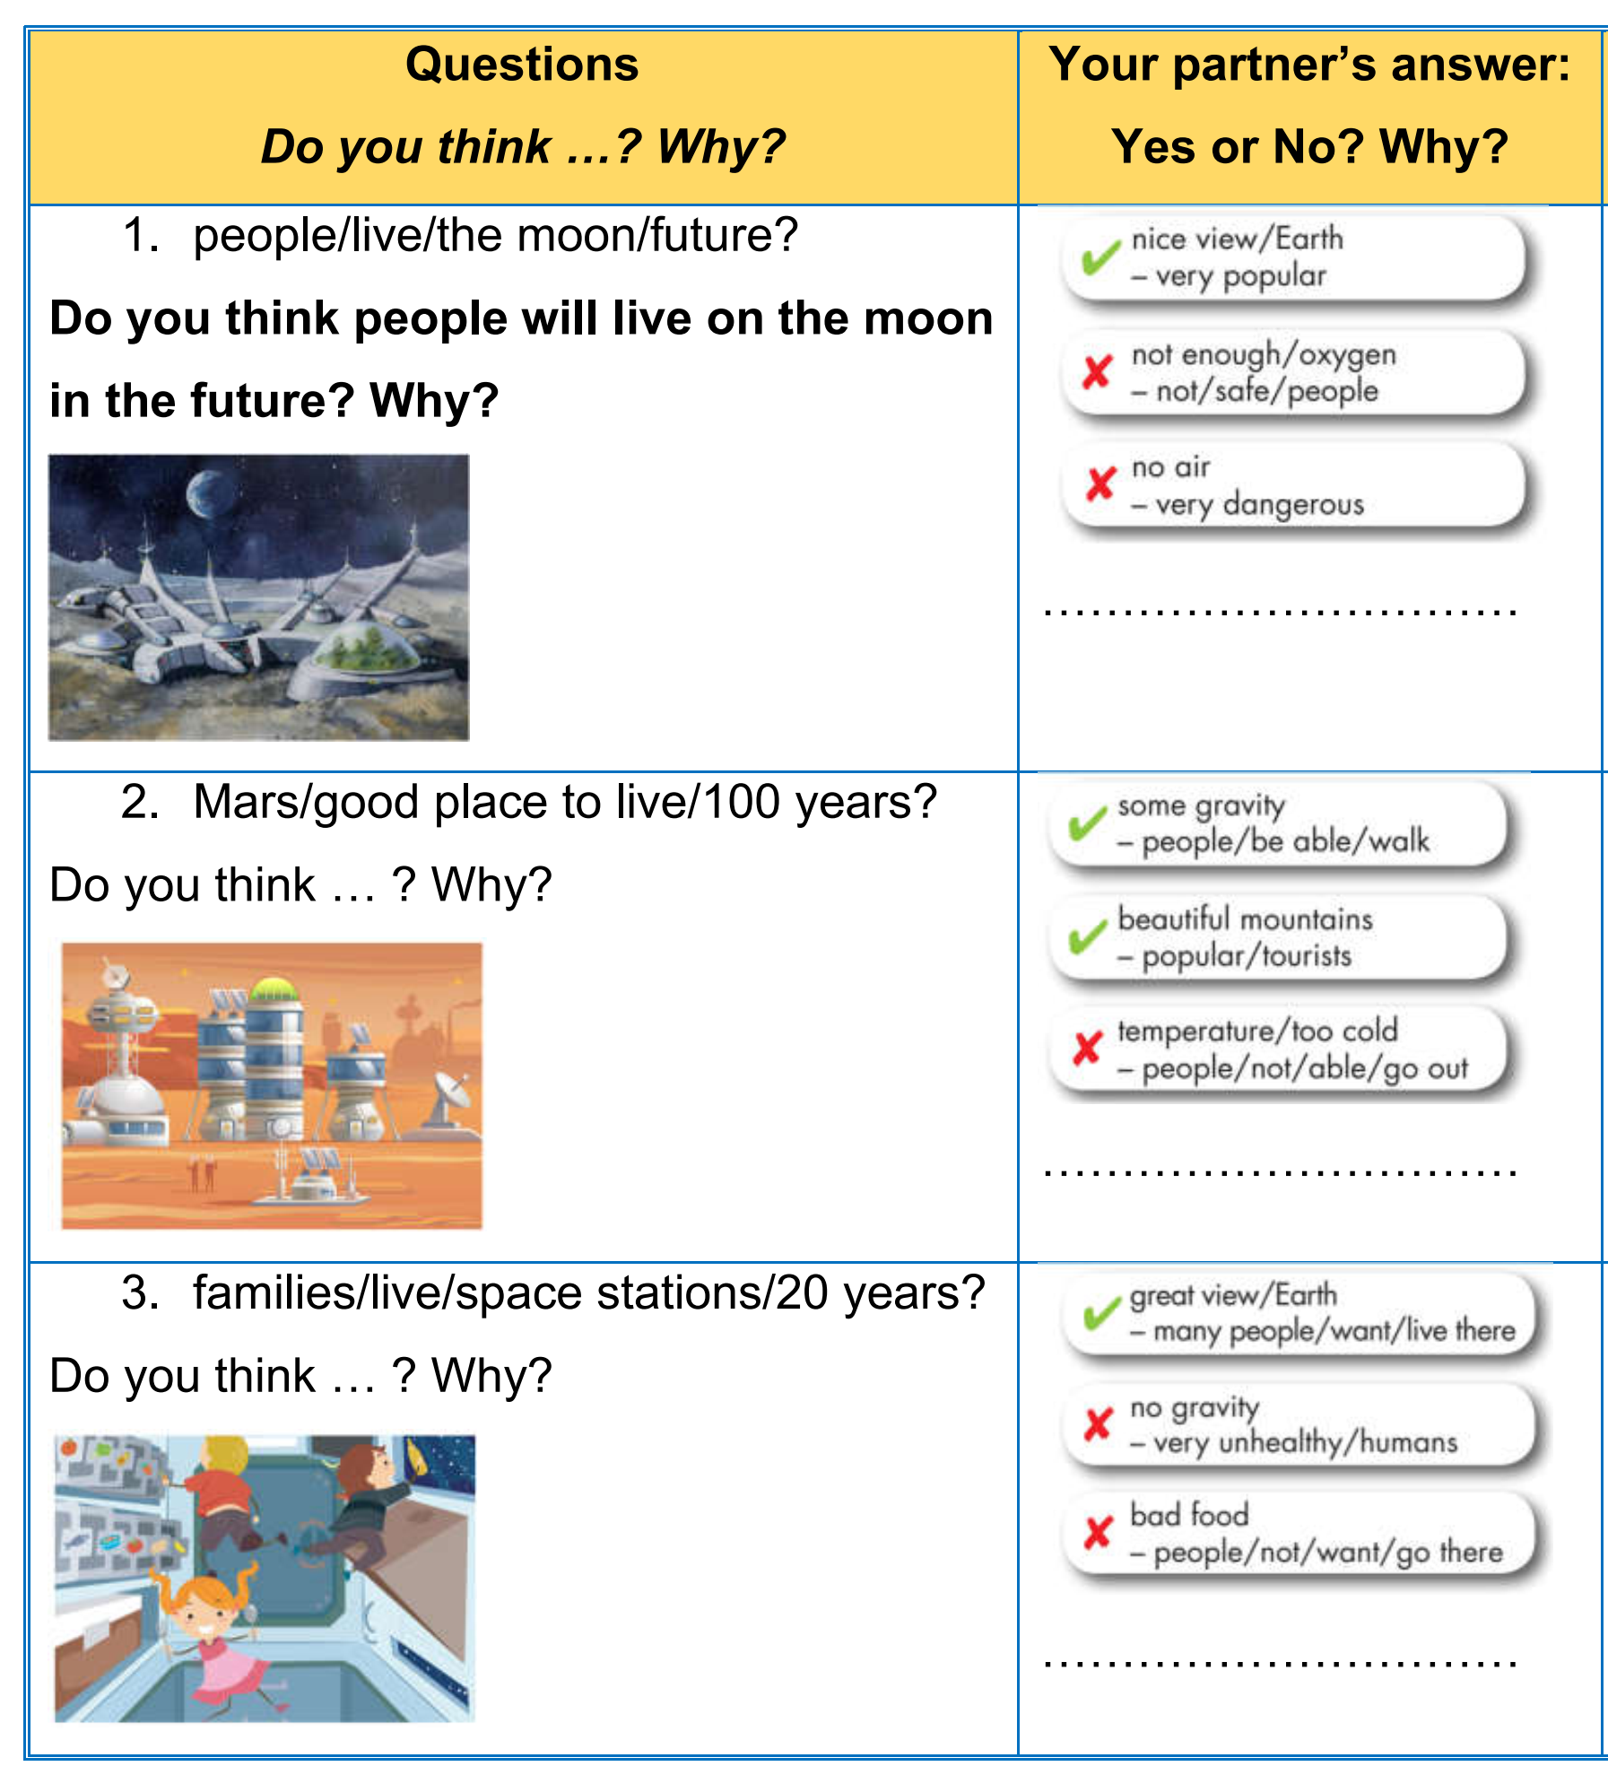
Read the following questions using the prompts. Ask your partner. Write Yes or No and the reason(s).

Slide 17
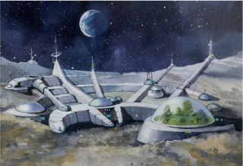
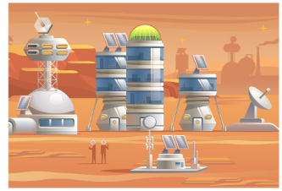
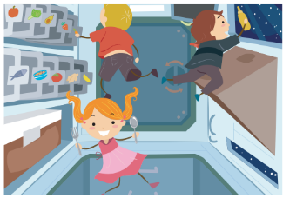

Practice with your own ideas.

Slide 18
Production:
Speaking

Slide 19


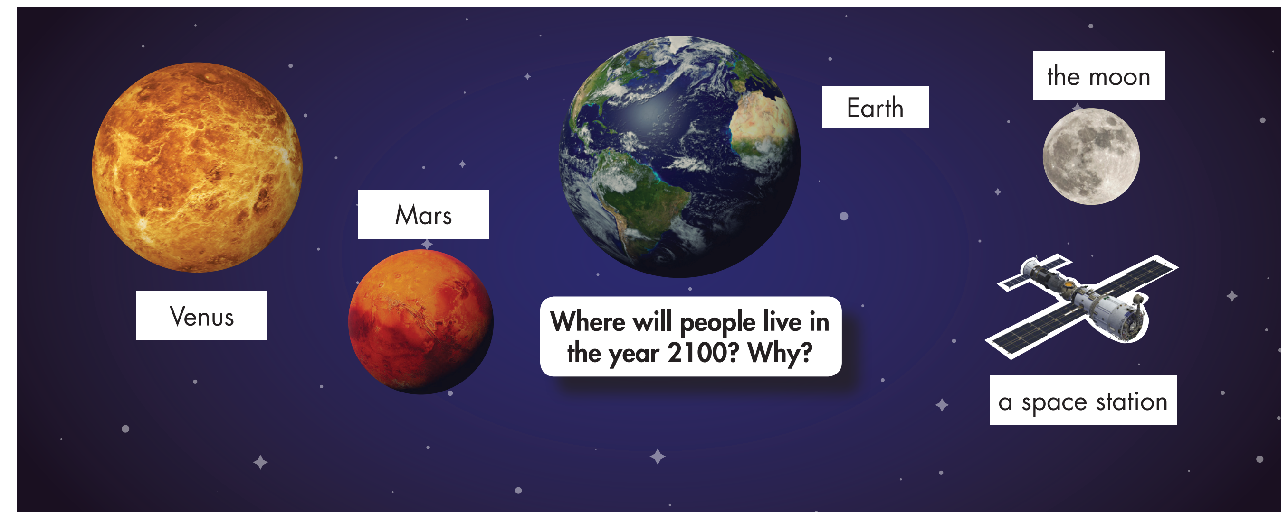
In pairs: Make predictions about where people will and won't live in 2100 and why.

Slide 20

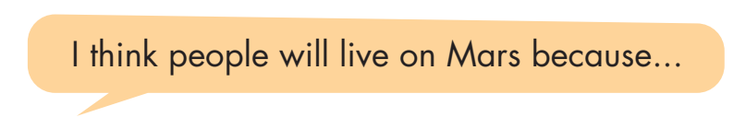
Join another pair. Take turns saying where you think people will/ won't live in the future.
Do you agree with the other pair's choices? Why (not)?

Slide 21

CONSOLIDATION

Slide 22
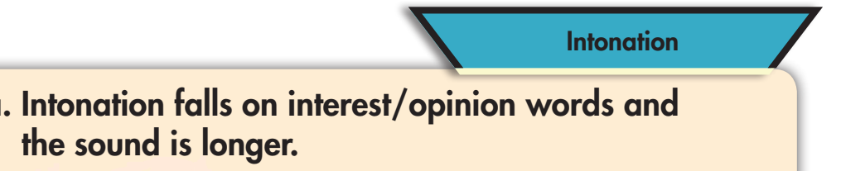

Slide 23

WRAP-UP

Slide 24
Today’s lesson
Using falling intonation for interest/ opinion words
Making predictions about where humans will live in the future, using Future Simple.

Slide 25
Lesson 3
Homework
- Practice: Write five sentences, using will regarding the reasons for where you think people will/ won’t live in the future.
- Do the exercises in WB: Writing (page 33).
- Play the consolidation games in Tiếng Anh 8 i-Learn Smart World DHA App on www.eduhome.com.vn
- Prepare: Unit 6 - Lesson 2.1 – Vocabulary & Listening (pages 58 & 59 – SB).

Slide 26

Lesson 3
Stay positive and have a nice day!

