Slide 1
Unit 6: Life on other planets
Lesson 1.2: Grammar
Pages 55 & 56

Slide 2
Lesson Outline
Warm-up
Grammar
Consolidation
Wrap-up

Slide 3
By the end of this lesson, students will be able to…
- practice and use the Future Simple (will) for future predictions correctly.
- improve writing skill.

Slide 4
Lesson 1
WARM UP

Slide 5
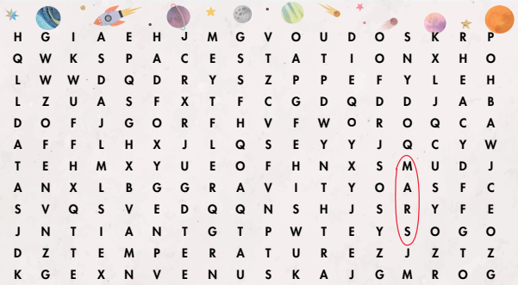
Wordsearch
Can you see any words?

Slide 6
Wordsearch
Can you find six more words?

Slide 7
Presentation

Slide 8
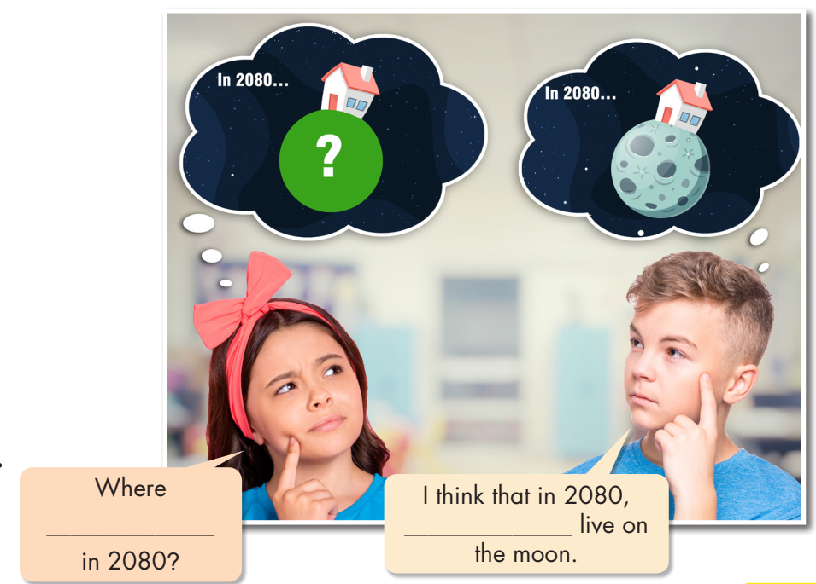
Look at the picture and fill in the blanks.
What are they thinking of?

Slide 10
Read the box and answer the question below.
What can we use will for?

Slide 11
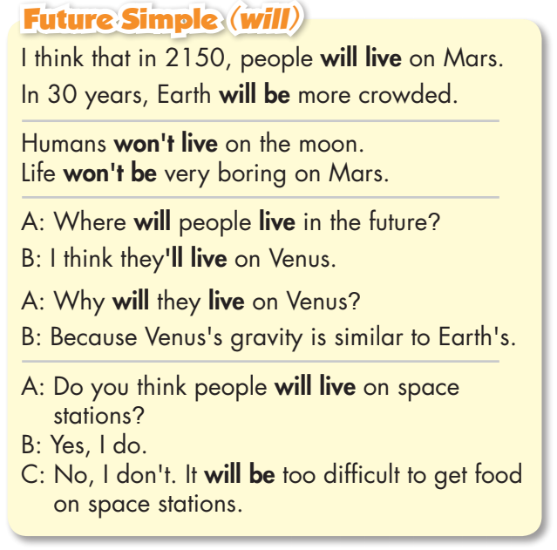
- Read the sentences and circle the bold words.
- Focus on the affirmative, negative and interrogative forms.

Slide 12
THE FUTURE SIMPLE
We use the Future Simple to make predictions based on our opinion.
✔ S + will + verb
✗ S + won't + verb
? Will + S + verb?
KEY WORDS:
I think
I believe
probably …
Can you give more examples using will?

Slide 13
Practice

Slide 14
will have
won’t live
will be
won’t be

Slide 15
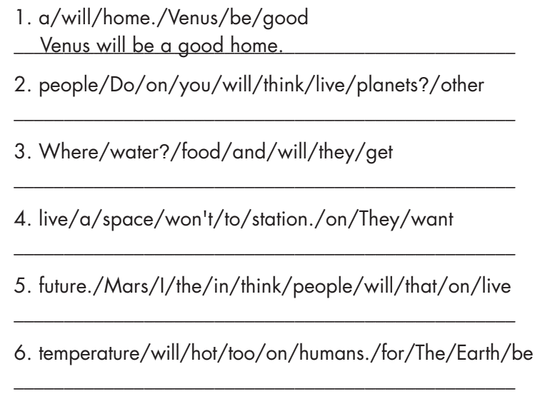
Do you think people will live on other planets?
Where will they get food and water?
They won't want to live on a space station.
I think that people will live on Mars in the future.
The temperature on Earth will be too hot for humans.

Slide 16
Extra Practice
WB page 33
people won’t live on Mars.
people will live on space stations near Earth.
people will not live on Earth.
people will live on all the planets.

Slide 17
Production:
Speaking

Slide 18
Work in pairs
Make predictions about the places. Use the prompts and your own ideas.

Slide 19
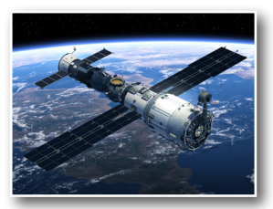
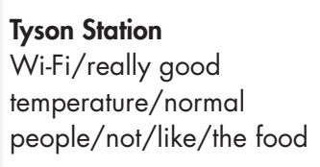
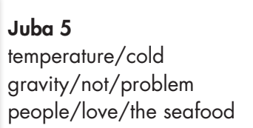

Slide 20
CONSOLIDATION

Slide 21
Find a mistake in each sentence below.

Slide 22
WRAP-UP

Slide 23
Today’s lesson
Grammar:
Using the Future Simple, we may predict the future based on our own beliefs and experiences.
Speaking:
Make predictions about the places.

Slide 24
Lesson 3
Homework
- Make four sentences using will/ won’t.
- Do the exercises in WB: Grammar (page 33).
- Complete the grammar notes in Tiếng Anh 8 i-Learn Smart World Notebook (page 48).
- Play the consolidation games in Tiếng Anh 8 i-Learn Smart World DHA App on www.eduhome.com.vn
- Prepare: Lesson 1 – Pronunciation and Speaking (pages 56 & 57 – SB).

Slide 25
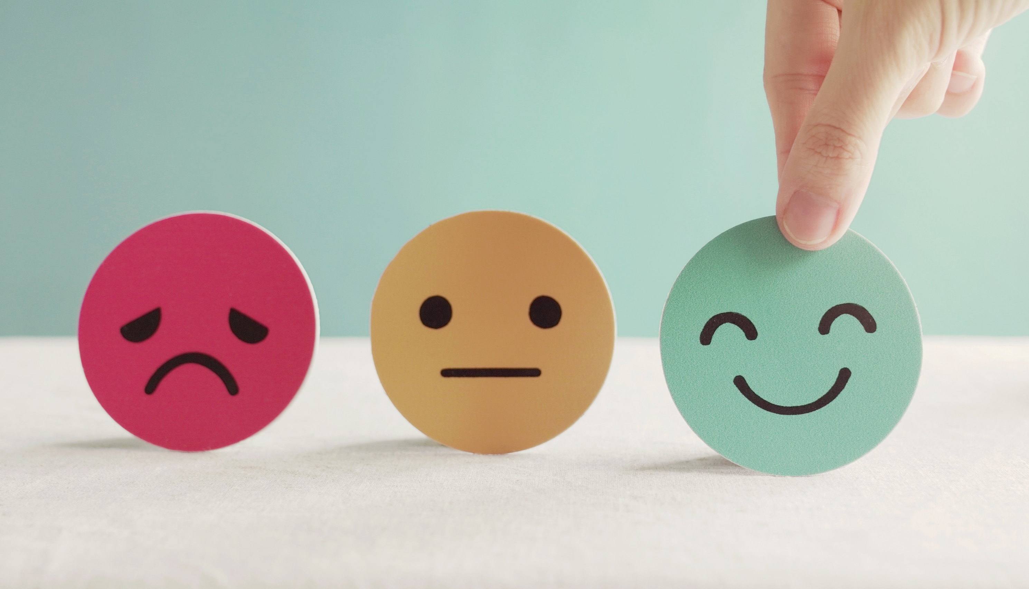
Lesson 3
Stay positive and have a nice day!

