Slide 1
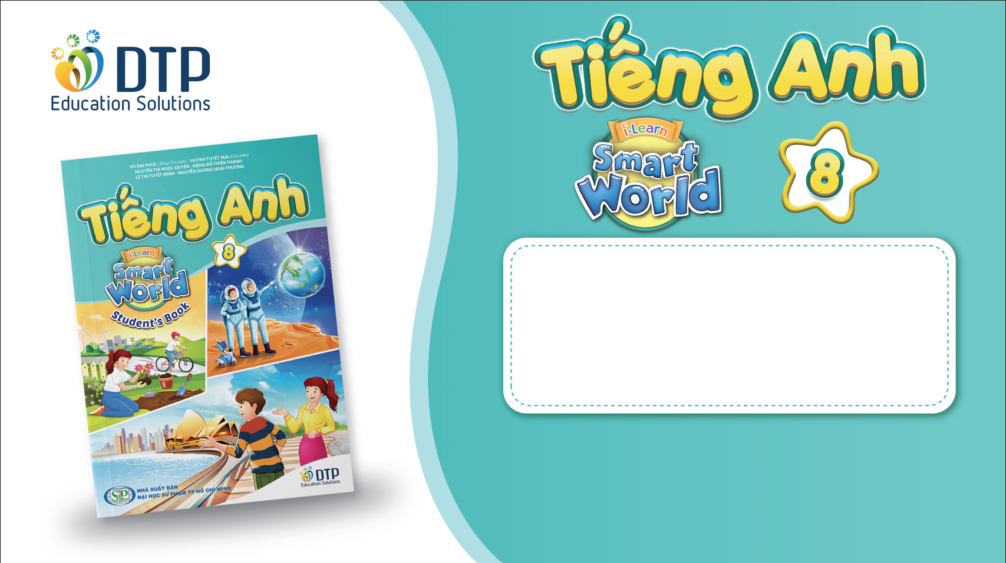
Unit 5: Science and technology
REVIEW 2
Page 97

Slide 2
Lesson Outline
Warm-up
Vocabulary
Grammar
Pronunciation
Writing
Consolidation
Wrap-up

Slide 3

By the end of this lesson, students will be able to…
-review vocabularies and grammar points in Unit 5.
- practice listening, reading, and speaking skills.
- practice test-taking skills.

Slide 4

WARM UP

Slide 5

Quiz Game
in Science and Technology
Start Quiz

Slide 6
WRONG ANSWER
Retry

Slide 7
1. What is the space you can use on a computer for holding data?
Storage
Battery life
Screen size
Price

Slide 8
CORRECT ANSWER
Next

Slide 9
2. What's the screen size?
6 hours
15.6 inches
256 GB
1.5 kg

Slide 10
CORRECT ANSWER
Next

Slide 11
3. What can robots do with people's voice to do
what they say?
They can navigate it.
They can lift it.
They can recognize it.
They can control it.

Slide 12
CORRECT ANSWER
Next

Slide 13
4. Which sentence is correct?
Ziggy drives more safe than Buster.
Ziggy drives safely than Buster.
Ziggy drives safelier than Buster.
Ziggy drives more safely than Buster.

Slide 14
CORRECT ANSWER
End Show

Slide 15

Vocabulary

Slide 16
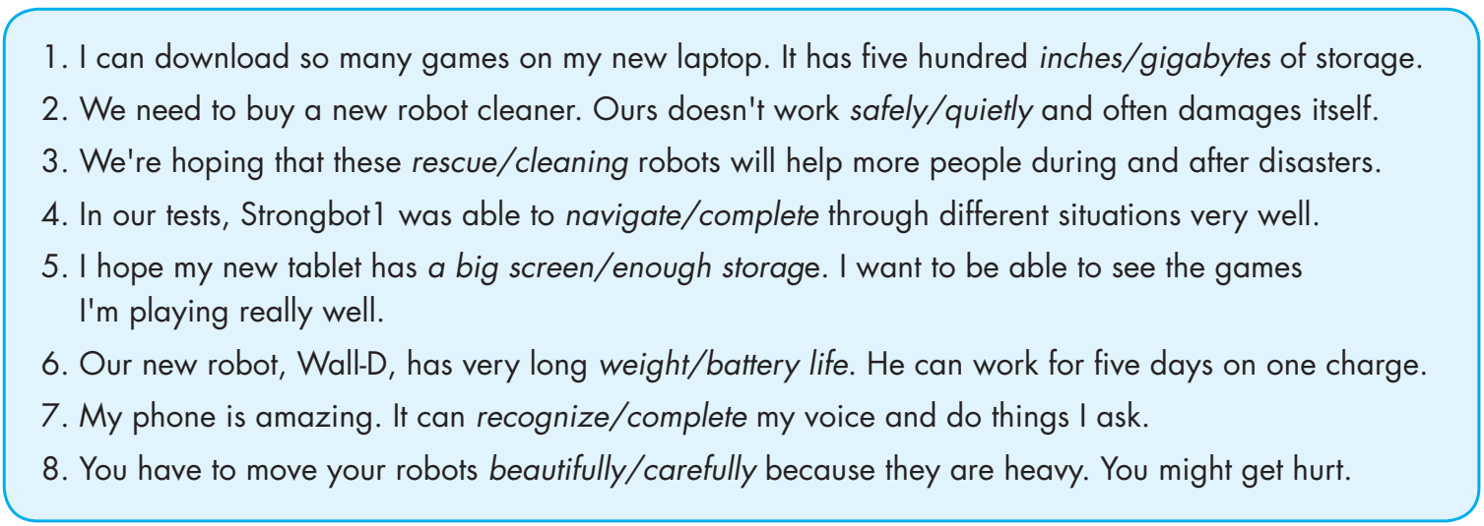
v
v

Slide 17
Grammar

Slide 18
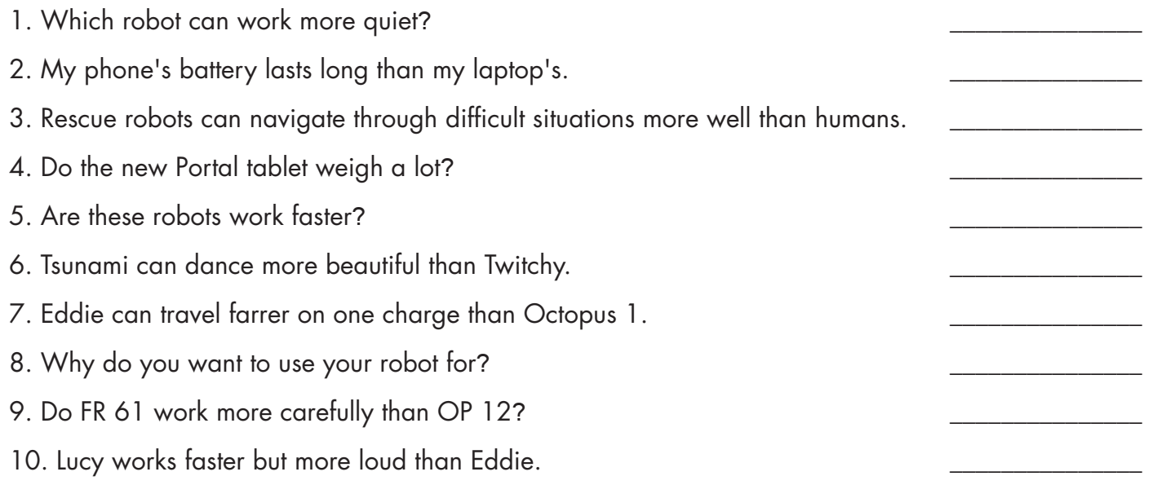
quiet -> quietly
long -> longer
more well -> better
Do -> Does
Are -> Do
beautiful -> beautifully
farrer -> farther
Why -> What
Do -> Does
loud -> loudly

Slide 19
Pronunciation

Slide 20
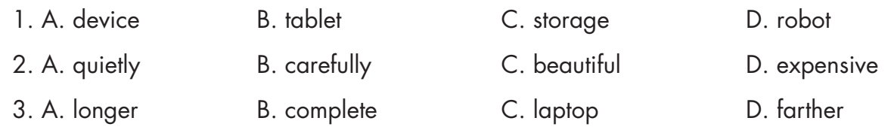

Circle the word that differs from the other three in the position of primary stress in each of the following questions.

Slide 21

Writing

Slide 22
Write a descriptive passage to describe your phone, laptop, or tablet, and say what it can do.
Check your answers with a partner.
What do you write in the topic sentence?
How do you describe your device?
Do you give explanations and examples to describe it?
Do you only write about its good features?

Slide 23
Suggested Writing
My parents got a new laptop for me for my birthday. It has a big screen, so I can watch movies and TV shows on it. The screen is seventeen inches. My laptop has 256 GB of storage so I can download lots of music and movies.
I can also save lots of games and homework. One thing I don't like is the weight. It's a little bit heavy to carry in my backpack with my school books. I really like my laptop.

Slide 24

CONSOLIDATION

Slide 25

Work in pairs.
Make three sentences to describe your electronic device.

Slide 26

WRAP-UP

Slide 27
Today’s lesson
Review:
- Grammar of Unit 5: Wh-questions and Yes/No questions and comparative adverbs.
- Vocabulary of Unit 5: Words of the topic “science and technology” (tablet, screen, inch, weight, gigabyte, storage, rescue, lift, complete, navigate, recognize, carefully, quietly, safely).

Slide 28
Homework
- Review vocabulary, grammar and language skills of unit 5.
- Do the exercises in WB: Unit 5 Review - Part 2 (page 54).
- Prepare: Unit 6 – Vocabulary and Reading (pages 54 & 55 – SB).

Slide 29

Lesson 3
Stay positive and have a nice day!

