Slide 1
Unit 5: Science and technology
Lesson 2.2 – Grammar
Pages 49 & 50

Slide 2
Lesson Outline
Warm-up
Grammar
Consolidation
Wrap-up

Slide 3
By the end of this lesson, students will be able to…
- practice and use comparative adverbs correctly.

Slide 4
WARM UP

Slide 5
Listen to the song Stronger (What Doesn't Kill You) by Kelly Clarkson.
Fill in the gaps.
warmer
You know the bed feels _________ (warm)
Sleeping here alone
You know I dream in colour
And do the things I want
You think you got the best of me
Think you've had the last laugh
Bet you think that everything good is gone
Think you left me broken down
Think that I'll come running back
Baby, you don't know me, 'cause you're dead wrong
What doesn't kill you makes you ________ (strong)
Stand a little _____(tall)
Doesn't mean I'm lonely when I'm alone
What doesn't kill you makes a fighter
Footsteps even _______ (light)
Doesn't mean I'm over cause you're gone
stronger
taller
lighter

Slide 6
Presentation

Slide 7
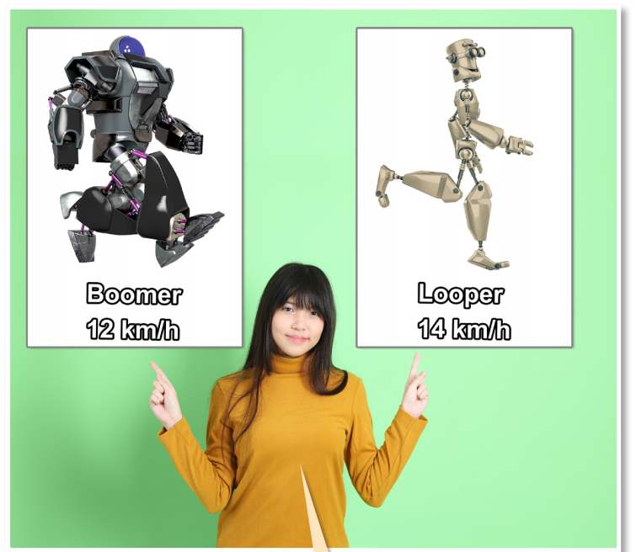

Slide 8
faster

Slide 9
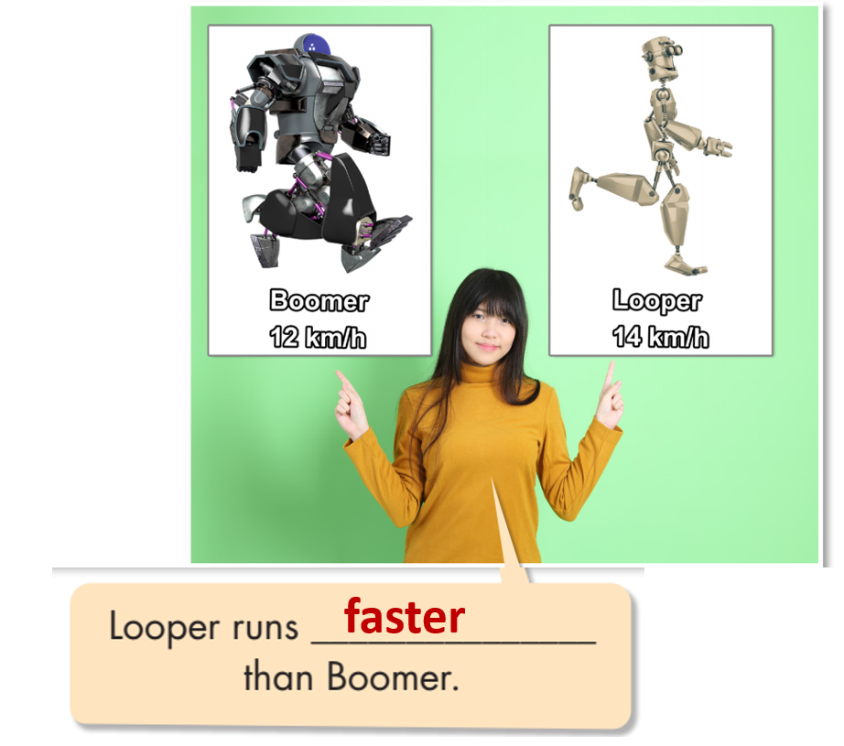

Slide 10
S1 + V + comparative adverb + than + S2
* Adverbs show ‘how.’
* Comparative adverbs compare ‘how.’

Slide 11
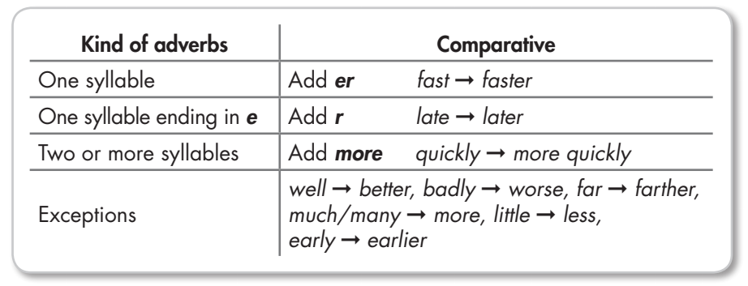
* Some adverbs look like adjectives:
FAST, LONG, HIGH, HARD, FAR, CLOSE, EARLY, LATE.
Ex: Stumpy's battery lasts longer than Flying Chicken’s.

Slide 12
Practice

Slide 13
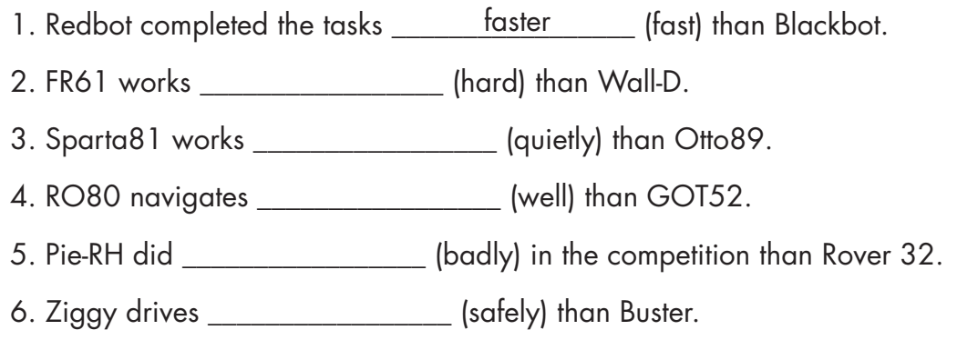
harder
more quietly
better
worse
more safely

Slide 14
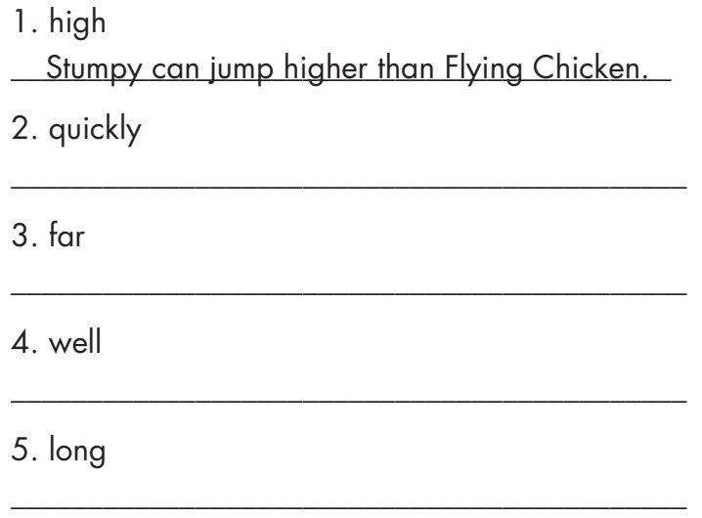
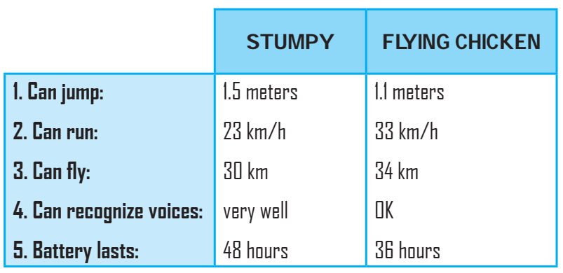
Stumpy can run more quickly than Flying Chicken.
Flying Chicken can fly farther than Stumpy.
Stumpy can recognize voices better than Flying Chicken.
Stumpy's battery lasts longer than Flying Chicken’s.

Slide 15
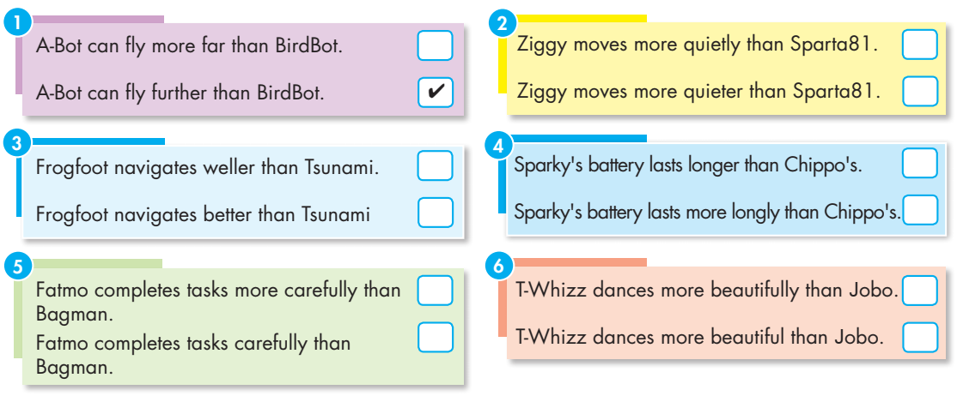
Extra Practice
WB page 29
✓
✓
✓
✓
✓

Slide 16
Production:
Speaking

Slide 18
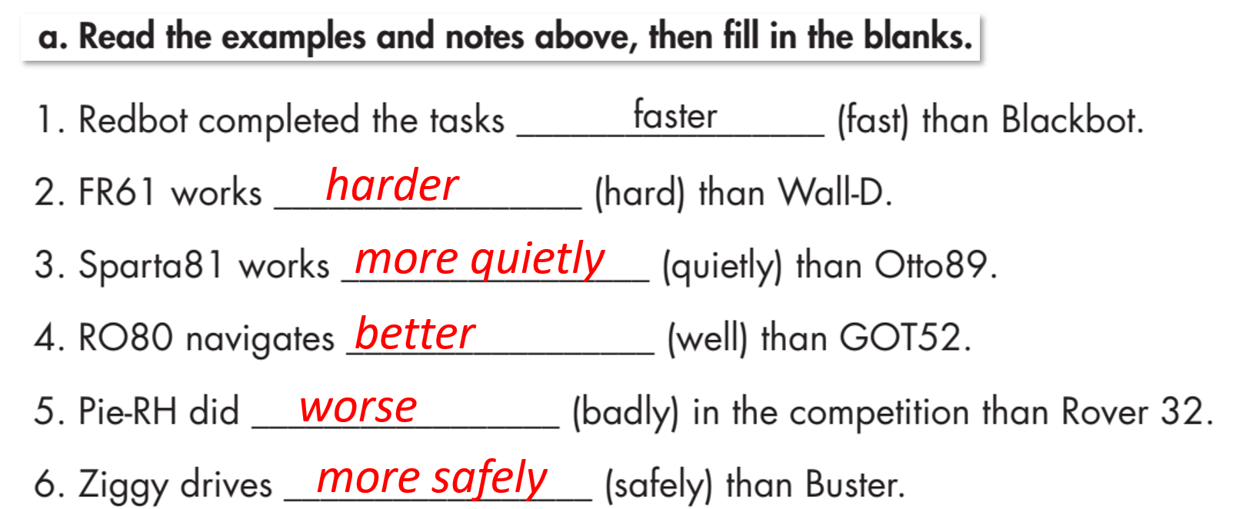
Task a

Slide 19
Task b

Slide 20
Close your book and test your memory with your partner.

Slide 21
CONSOLIDATION

Slide 22
WHICH ROBOT IS BETTER?
Read the sentences about two robots. Give the correct forms of comparative adverbs.
D-19 moves much ( quick) ________ than Apex1.
D-19 works (quiet) ________ than Apex1
Apex1's battery lasts (long) ________ than D-19's
D-19 can dance (beautiful) ________ than Apex1.
Key
1. more quickly 2. more quietly 3. longer 4. more beautifully

Slide 23
WRAP-UP

Slide 24
Today’s lesson
Grammar:
Using comparative adverbs to compare two actions. They modify verbs and indicate that one action is more or less than another.
Speaking:
- Making sentences comparing two robots.

Slide 25
Homework
- Make three sentences, using comparative adverbs.
- Do the exercises in WB: Grammar (page 29).
- Complete the grammar notes in Tiếng Anh 8 i-Learn Smart World Notebook (page 43).
- Play the consolidation games in Tiếng Anh 8 i-Learn Smart World DHA App on www.eduhome.com.vn
- Prepare: Lesson 2.3 – Pronunciation and Speaking (pages 50 & 51 – SB).

Slide 26
Lesson 3
Stay positive and have a nice day!

