Slide 1

Unit 5: Science and Technology
Lesson 1.3 – Pronun. & Speaking
Pages 46 & 47

Slide 2
Lesson Outline
Warm-up
Pronunciation
Speaking
Consolidation
Wrap-up

Slide 3

By the end of this lesson, students will be able to…
- practice the /eɪ/ sound
- practice asking and answering about devices, using Wh-questions and Yes/No questions

Slide 4

WARM UP

Slide 5
Odd One Out
Choose the word whose underlined part is pronounced differently form that of the others.
A. chip B. chat C. inch D. Christ
/tʃɪp/ /tʃæt/ /ɪntʃ/ /kraɪst/
2. A. tablet B. laptop C. smartwatch D. gallery
/ˈtæblət/ /ˈlæptɑːp/ /ˈsmɑːrtwɑːtʃ/ /ˈɡæləri/
3. A. share B. space C. lake D. game
/ʃer/ /speɪs/ /leɪk/ /ɡeɪm/

Slide 6
Odd One Out
Choose the words whose main stress is placed differently from the others.
A. battery B. tsunami C. disaster D. performance
/ˈbæt̬ɚi/ /tsuːˈnɑːmi/ /dɪˈzæstɚ/ /pɚˈfɔːrməns/
2. A. flashlight B. storage C. tablet D. typhoon
/ˈflæʃlaɪt/ /ˈstɔːrɪdʒ/ /ˈtæblət/ /taɪˈfuːn/
3. A. reuse B. reduce C. inform D. follow
/riːˈjuːz/ /rɪˈduːs/ /ɪnˈfɔːrm/ /ˈfɑːloʊ/

Slide 7

Pronunciation

Slide 8

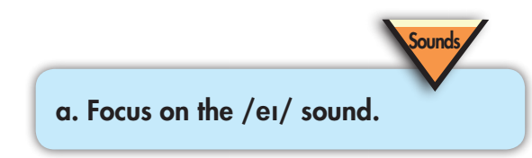



/weɪt/
/pleɪ/
/speɪs/
=> Focus on the /ei/ sound

Slide 9
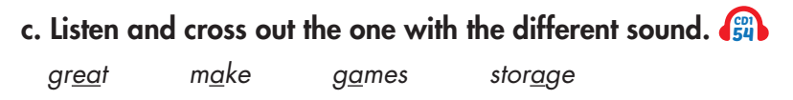


/meɪk/
/ˈstɔːr.ɪdʒ/
/greɪt/
/geɪmz/

Slide 10
Practice:
Speaking

Slide 11
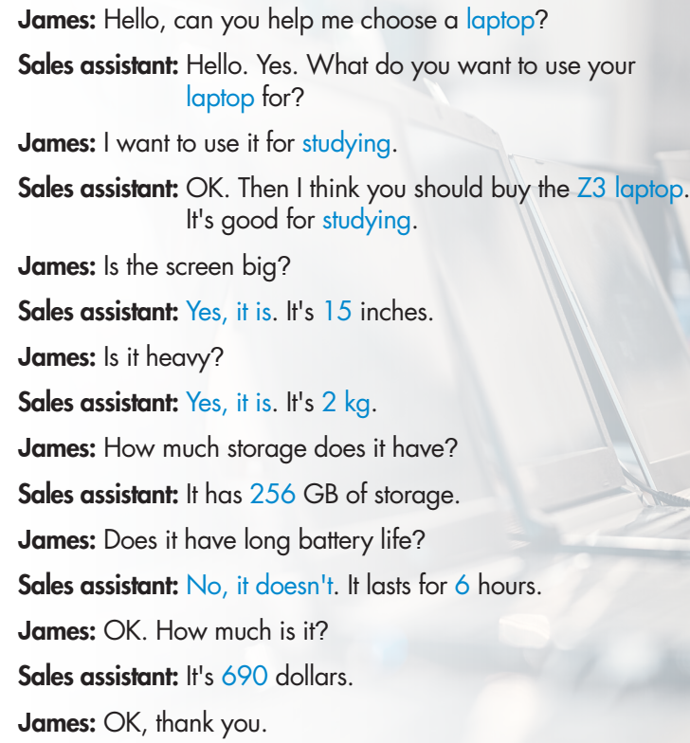

Focus on yes/no and wh- questions.

Slide 12
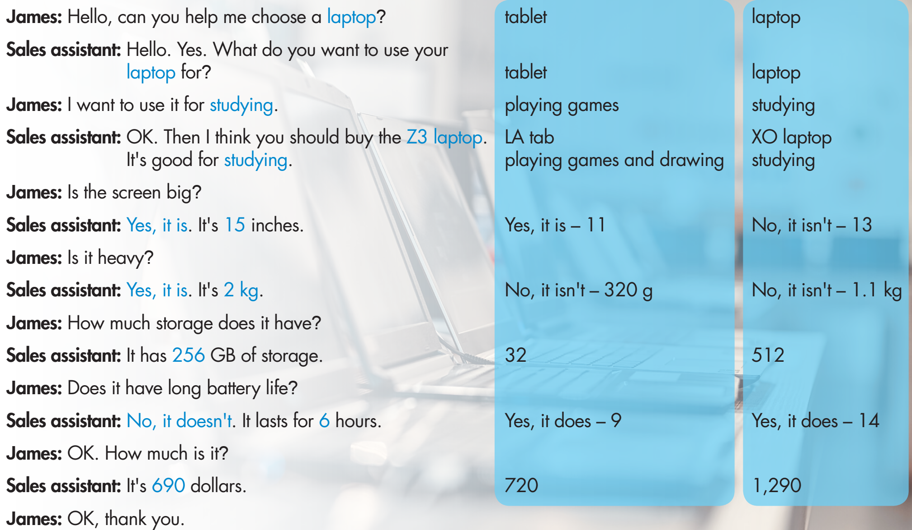

Slide 13
Production:
Speaking

Slide 14


Slide 15
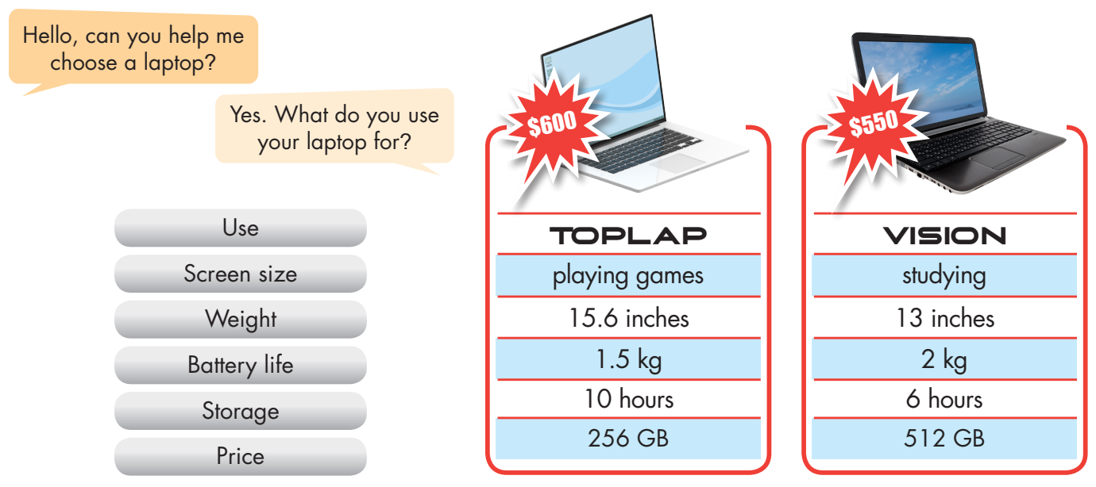
Student A
Student A ask about the points in the box and Student B helps Student A choose a tablet.

Slide 16
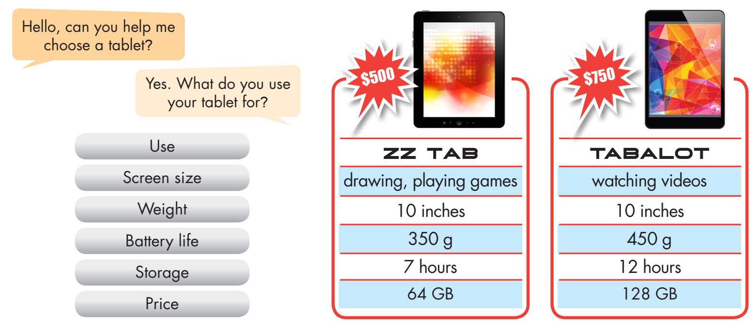
Student B
Student B ask about the points in the box and Student A helps Student B choose a tablet.

Slide 17
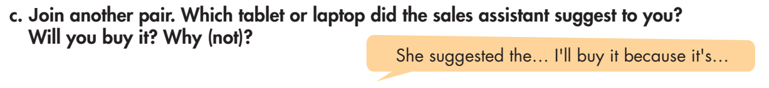

Slide 18

CONSOLIDATION

Slide 19
b. Retell some yes/no questions and wh-questions regarding buying and selling an electronic device at a store.
Can you help me choose a smart phone?
What do you want to use your laptop for?
Is the screen big?
Is it heavy?
How much storage does it have?
Does it have long battery life?

Slide 20

WRAP-UP

Slide 21
Today’s lesson
- practicing the /eɪ/ sound
- practicing asking and answering about devices, using Wh-questions and Yes/No questions

Slide 22
Homework
- Practice: Write five sentences, using will regarding the reasons for where you think people will/ won’t live in the future.
- Do the exercises in WB: Writing (page 33).
- Play the consolidation games in Tiếng Anh 8 i-Learn Smart World DHA App on www.eduhome.com.vn
- Prepare: Unit 6 - Lesson 2.1 – Vocabulary & Listening (pages 58 & 59 – SB).

Slide 23

Lesson 3
Stay positive and have a nice day!

